Slide 1






ALM216 · SOCIAL MEDIA STRATEGY
Social Media Audit
Nature Advocates Collective (NAC)
Presented by [ Ben Nguyen ]
Student ID [ 225443664 ]
Assessment Task 1
Notes:
Replace this cover with your own title, name and student ID. Remember to Save As before editing.
1

Slide 2


AGENDA
Contents
01
Organisational Overview
02
Social Media Platform Audit
Profiles · Audience · Content · Engagement · Posting · Hashtags · Competitors
03
Recommendations & Conclusion
References
Notes:
Optional agenda slide. Keep it if it helps your client follow the flow.
3

Slide 3



SECTION
01
Organisational Overview
Notes:
Section 1 — set the context for everything that follows.
4

Slide 4




01 · ORGANISATIONAL OVERVIEW
Who is Nature Advocates Collective?
30,000+
50,000
8,200+
486
Social media followers
Petition signatures
Media mentions
New members & sign-ups
Vision and mission
Objectives
Save Our Big Backyard
  Protect and regenerate nature
  End extinction
Renewable Powered Australia
  Transition to renewable energy
  Reduce climate pollution
Vision: An Australia where nature and people thrive
Mission: To empower people to stand up for nature
Products / services
Target audience
  Advocacy campaigns
  Research & policy reports
  Land Clearing Tracker
  Petitions, webinars & memberships
  Community supporters
  Volunteers and donors.
  Government & decision-makers
  Businesses & investors
  Journalists
Source: Nature Advocates Collective (2026)
Notes:
Sources: Annual Report and Website Visual. A logo, mission statement and key facts work well here.
5

Slide 5
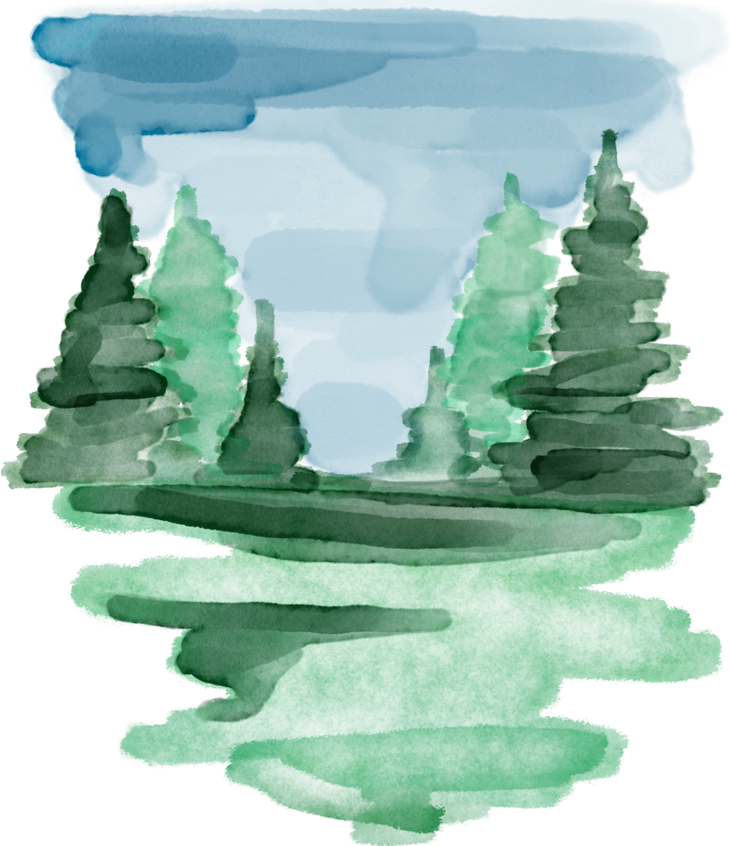



SECTION
02
Social Media Platform Audit
Evaluate what's working, what isn't, and what could improve — across seven areas for each platform NAC uses.
Notes:
Section 2 — the core audit. Work through the seven areas for each platform.
6

Slide 6









02 · PLATFORM AUDIT
Platforms in use
X/Twitter
1
Profile completeness & consistency
2
Audience
3
Content quality & relevance
4
Engagement
5
Posting frequency & scheduling
6
Hashtags & keywords
7
Competitor analysis
Notes:
List every platform NAC uses, then audit each across the seven areas that follow.
7

Slide 7


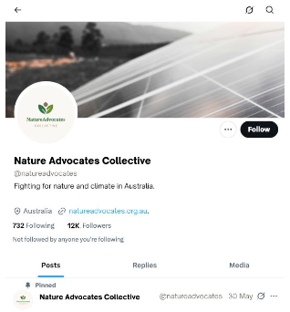
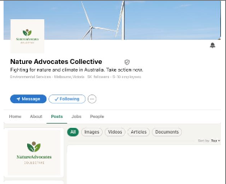
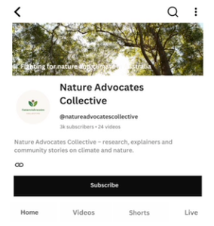
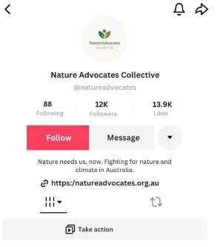
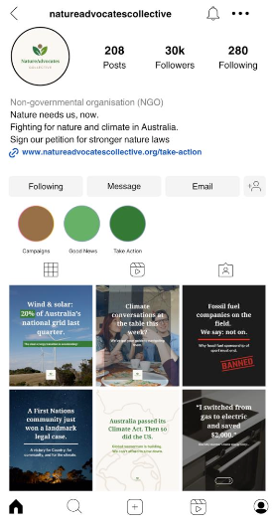
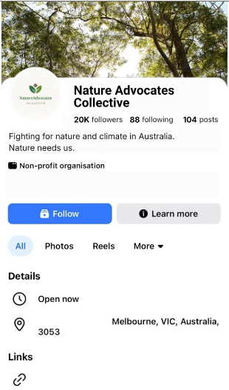
02 · PLATFORM AUDIT
Profile completeness & consistency
X/Twitter
LinkedIn
YouTube
Audit Criteria
Logo Consistency
Account name
Profile bio
Call to action (CTA)
Profile link
Perfect
Needs improvement
Missing/Poor
TikTok
Instagram
Facebook
Key Findings
Based on NAC Social Media Profiles
  According to the Profile Completeness audit Instagram uses a campaign-specific landing page, while TikTok and X direct users to the NAC homepage. Facebook, LinkedIn and YouTube do not display an external profile link.
  Facebook, X, LinkedIn and YouTube present less consistent profile messaging, weakening NAC’s brand message.
  TikTok, Facebook, and LinkedIn use less compelling CTAs, while YouTube and X do not include a clear CTA.
Source: NAC Social Media Profiles (2026). Profile Completeness audit.
Notes:
Tip: a comparison table or side-by-side screenshots across platforms works well here.
8

Slide 8
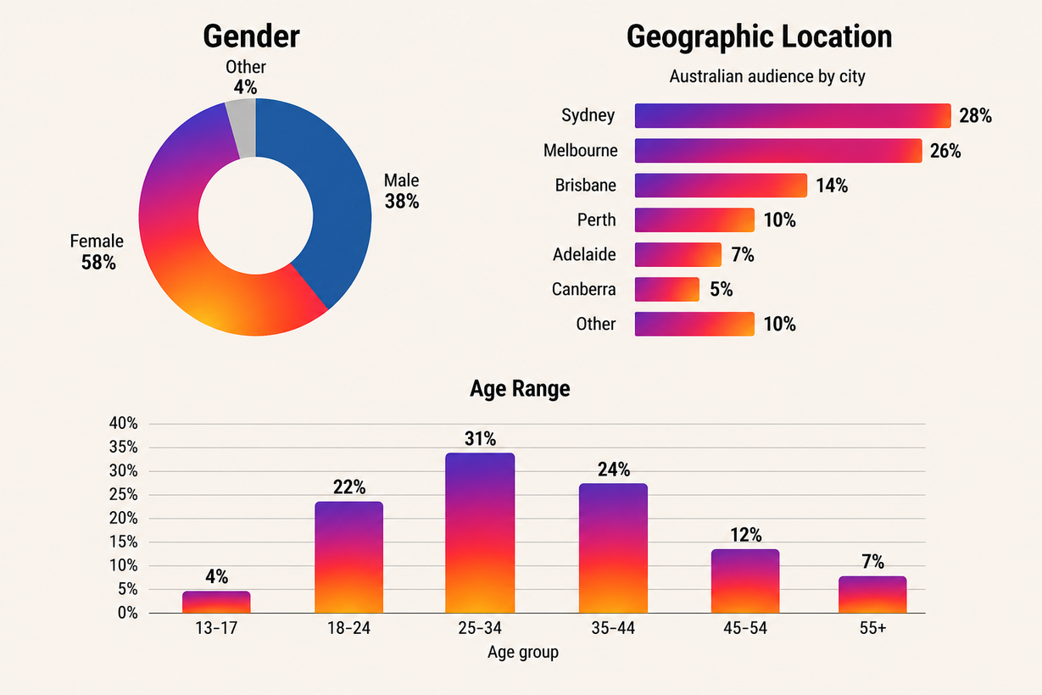

02 · PLATFORM AUDIT
Instagram Audience
30K Followers
Gender
Gender
Gender data from the Instagram Audience dashboard show that 58% of Instagram followers are female, indicating stronger engagement among women interested in environmental advocacy.
Locations
Geographic location
Location data from the Instagram dashboard indicate that followers are concentrated in Sydney (28%) and Melbourne (26%), highlighting strong reach in Australia’s largest metropolitan markets.
Age range
Age demographic data from the Instagram Audience dashboard show that the majority of followers are aged 25–44 (56%), aligning with NAC’s primary target audience.
Audience Segments
  Based on insights from the Instagram Audience dashboard, the core audience comprises university-educated professionals aged 25–44 with a strong interest in environmental and climate issues.
Age range
Source: NAC Social Media Profiles (2026). Audience dashboard.
Notes:
Build your OWN charts from the dashboard data — do not screenshot the dashboard graphs.
9

Slide 9
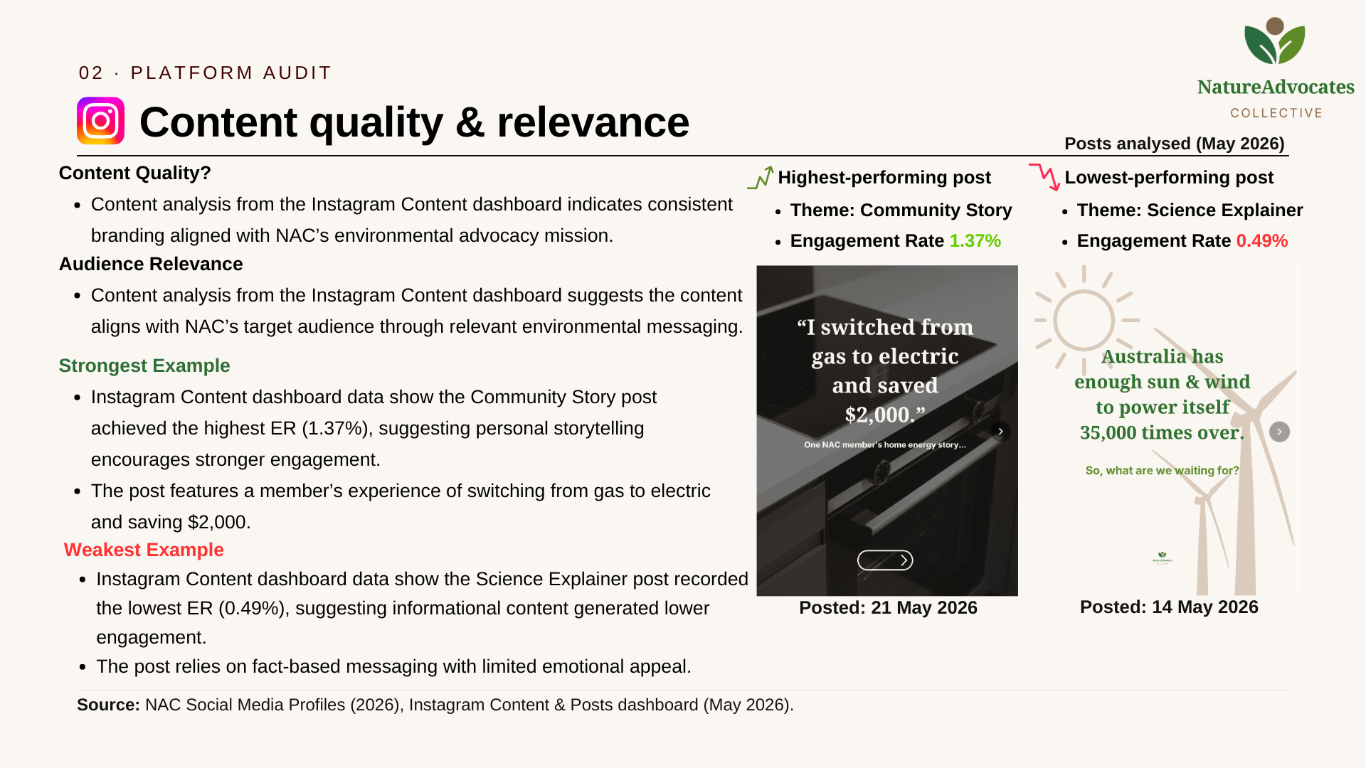
Notes:
Bar or line charts comparing engagement across platforms or over time are effective. Replying to comments isn't visible in this dashboard — keep that for AT3.
11

Slide 10
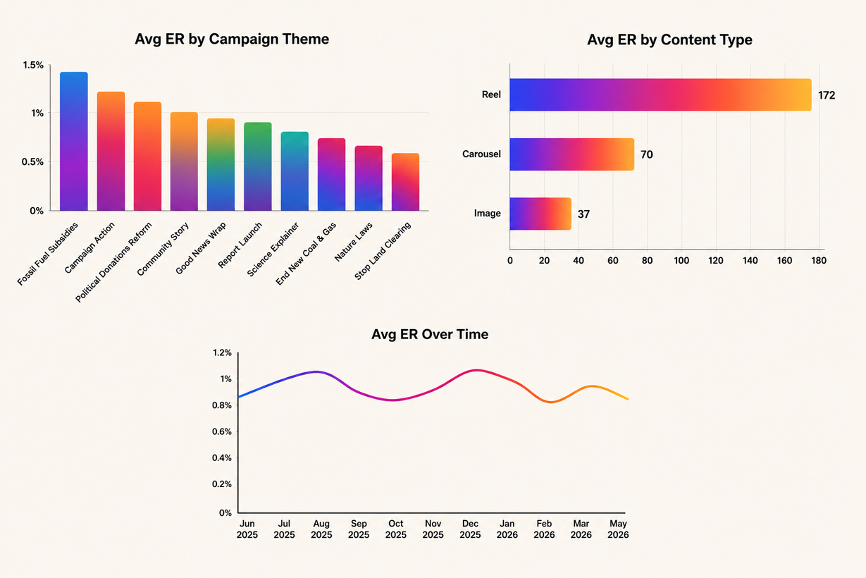


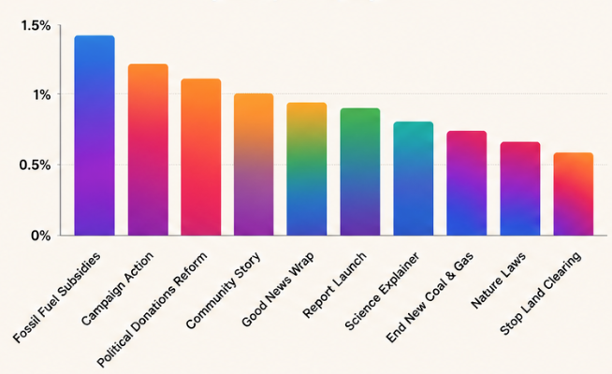
02 · PLATFORM AUDIT
Engagement
Engagement Performance
  Engagement data from the Instagram Engagement dashboard show 6.8K likes, 1.5K saves and 1.4K shares, reflecting strong audience interaction.
  The average engagement rate (0.98%) exceeded the industry benchmark (0.48%).
  Engagement remained consistently high, peaking in December 2025.
Engagement Rate Over Time
Total Likes
6.8K
Total Comments
556
Shares
1.4K
Saves
1.5K
Avg Engagement by Content Type
Avg ER by Campaign Theme
Campaign Themes
  Campaign theme data from the Instagram Engagement dashboard show Fossil Fuel Subsidies and Campaign Action achieved the highest average engagement, suggesting audiences respond well to action-oriented content.
Content Formats
  The Average Engagement by Content Type graph shows Reels generated the highest average engagement (172), highlighting short-form video as Instagram’s strongest-performing format.
Source: NAC Social Media Profiles (2026). Engagement dashboard.
Notes:
Bar or line charts comparing engagement across platforms or over time are effective. Replying to comments isn't visible in this dashboard — keep that for AT3.
11

Slide 11
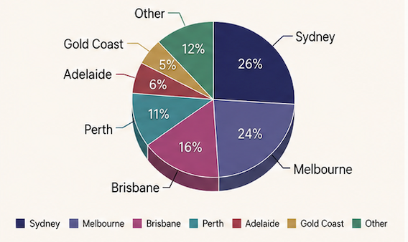
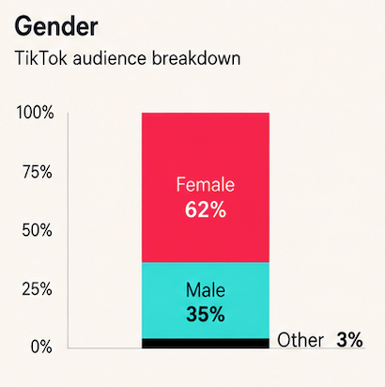
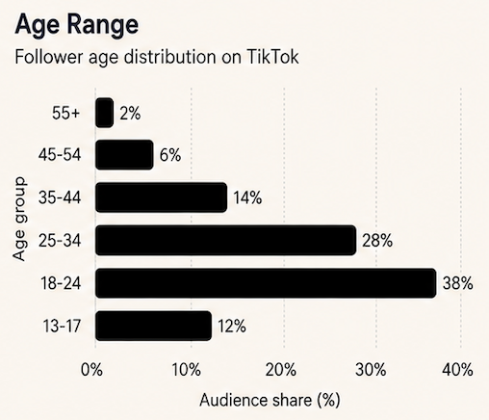
02 · PLATFORM AUDIT
TikTok Audience
12.0K Followers
Top Locations
Geographic location
The location graph shows that NAC’s TikTok audience is concentrated in Sydney (26%) and Melbourne (24%), while also maintaining a broad geographic reach across Australia.
Gender
Gender
Gender data from the TikTok Audience dashboard show that women account for 62% of followers, indicating environmental content resonates more strongly with female audiences.
Age Range
Age range
Age demographic data from the TikTok Audience dashboard show the largest audience is aged 18–24 (38%), followed by 25–34 (28%), indicating TikTok is most effective for reaching younger climate-conscious audiences.
Audience Segments
The Audience Segments section identifies climate-conscious adults aged 18–24 as TikTok’s core audience, supporting the platform’s role in engaging younger audiences through short-form video.
Source: NAC Social Media Profiles (2026). Audience dashboard.
Notes:
Build your OWN charts from the dashboard data — do not screenshot the dashboard graphs.
9

Slide 12
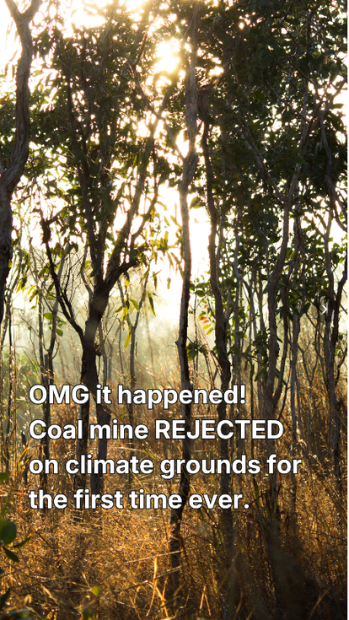

02 · PLATFORM AUDIT
Content quality & relevance
Posts analysed (May 2026)
Content Quality
Both videos maintain consistent branding, high production quality and messaging aligned with NAC’s environmental advocacy mission.
Highest-performing post
Lowest-performing post
  Theme: Nature Laws
  Engagement Rate: 4.32%
  Theme: Science Explainer
  Engagement Rate 3.44%
Audience Relevance
  Short, news-driven content with immediate real-world impact is more relevant to TikTok’s younger audience and encourages higher engagement (Owens, 2024).
Strong Example
  TikTok Content dashboard data show the Nature Laws post achieved the highest engagement rate (4.32%), suggesting timely environmental news drives stronger audience engagement.
  The headline “OMG it happened?” immediately communicates a significant outcome.
Weak Example
  TikTok Content dashboard data show the Science Explainer post recorded the lowest engagement rate (3.44%), suggesting educational content generated lower engagement.
  The post focuses on explaining a topic rather than telling a story or celebrating an achievement.
Posted: 7 May 2026
Posted: 19 May 2026
Source: NAC Social Media Profiles (2026), TikTok Content & Posts (May 2026).
Notes:
Annotated screenshots of strong or weak content examples illustrate this well.
10

Slide 13
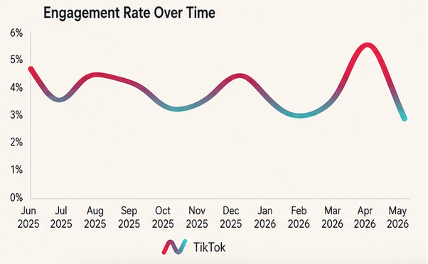
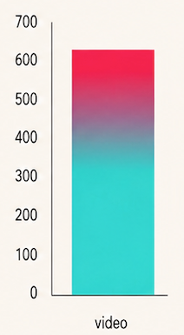
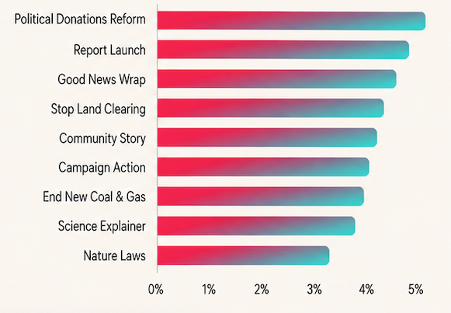
02 · PLATFORM AUDIT
Engagement
Engagement Rate Over Time
Engagement Performance
  The Engagement Rate Over Time graph and TikTok Engagement dashboard show 13.9K likes, 5.6K comments, 12K shares and 12.4K saves, reflecting strong audience engagement.
  Engagement remained stable throughout the year, peaking at 5.58% in March 2026.
  TikTok maintained consistently high engagement throughout the year.
Total Likes
13.9K
Total Comments
5.6K
Shares
12.0K
Saves
12.4K
Avg Engagement by Content Type
Avg ER by Campaign Theme
Campaign Themes
Political Donations Reform and Report Launch recorded the highest ER, while all campaign themes exceeded 3%, indicating consistently strong audience engagement.
Content Format
The Average Engagement by Content Type graph shows video averaged 606 engagements per post, highlighting its effectiveness on TikTok.
Source: NAC Social Media Profiles (2026). Engagement dashboard.
Notes:
Bar or line charts comparing engagement across platforms or over time are effective. Replying to comments isn't visible in this dashboard — keep that for AT3.
11

Slide 14

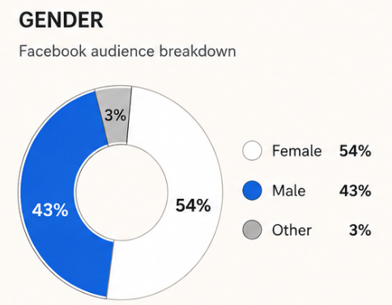
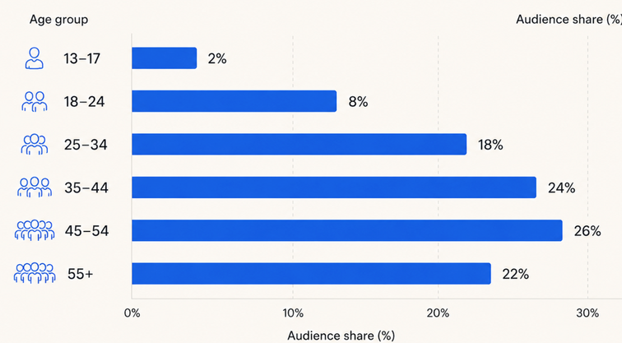
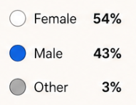
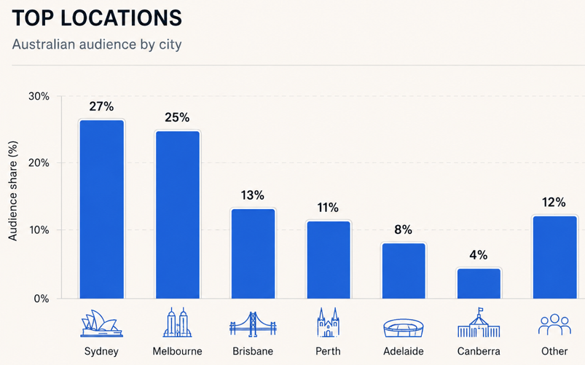
02 · PLATFORM AUDIT
Audience
20.0K Followers
Gender
Age Range
Gender
Gender data from the Facebook Audience dashboard show a relatively balanced audience, with 54% female and 43% male followers.
Age range
Age range data from the Facebook Audience dashboard show most followers are aged 45–54 (26%), followed by 35–44 (24%), indicating Facebook is effective for reaching older supporters.
.
Top Locations
Geographic location
Location data from the Facebook Audience dashboard show Sydney (27%) and Melbourne (25%) have the largest audiences, indicating broad national reach.
Audience Segments
  Insights from the audience segments dashboard suggest the core audience comprises professionals and retirees (45–65) with strong membership and donation potential.
Source: NAC Social Media Profiles (2026). Audience dashboard.
Notes:
Build your OWN charts from the dashboard data — do not screenshot the dashboard graphs.
9

Slide 15
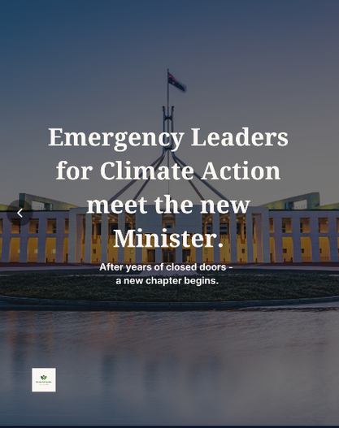
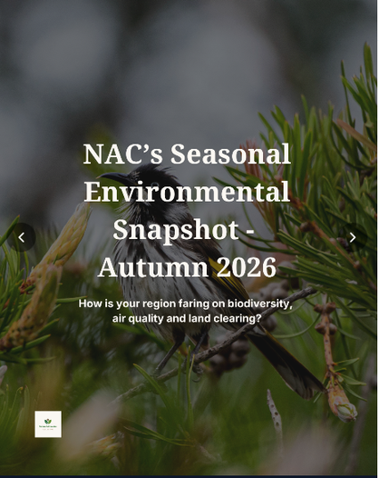
02 · PLATFORM AUDIT
Content quality & relevance
Posts analysed (May 2026)
Content Quality
Both posts present clear visuals and consistent messaging that reinforce NAC’s advocacy identity.
Highest-performing post
Lowest-performing post
  Theme: Nature Laws
  Engagement Rate: 0.71%
  Theme: Report Launch
  Engagement Rate 0.08%
Audience relevance
Content analysis from the Facebook Content dashboard indicates audiences responded more positively to leadership and policy updates than report-based content.
Strong Example
Facebook content dashboard data show the Nature Laws post generated the highest engagement rate (0.71%) by highlighting a change in climate action and its real-world impact.
Weak Example
Facebook content analysis shows the Report Launch post recorded the lowest engagement rate (0.08%), suggesting informational updates alone attracted limited audience interaction.
Posted: 8 May 2026
Posted: 27 May 2026
Source: NAC Social Media Profiles (2026), Facebook Content & Posts (May 2026).
Notes:
Annotated screenshots of strong or weak content examples illustrate this well.
10

Slide 16
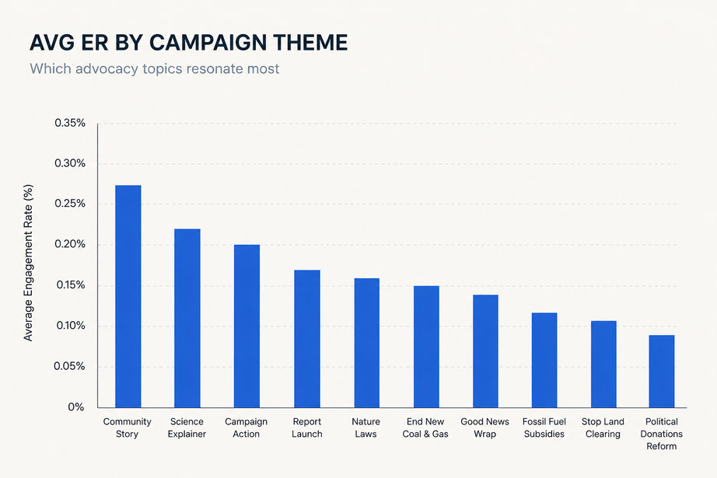
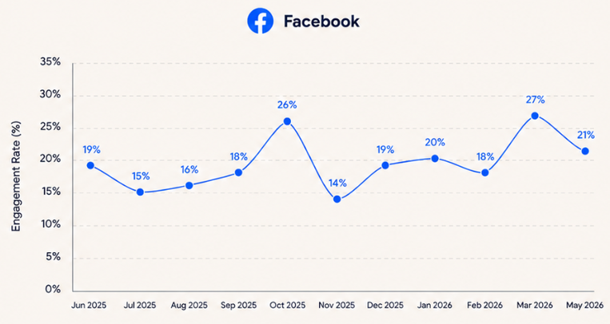
02 · PLATFORM AUDIT
Engagement
Engagement Performance
  The Engagement Rate Over Time graph and Facebook Engagement dashboard show 152 reactions, 40 comments and 29 shares, reflecting modest audience interaction.
  Engagement remained relatively stable throughout the year, averaging around 0.2–0.3% ER.
Avg ER by Campaign Theme
Campaign Themes
  The Average ER by Campaign Theme graph shows Community Story and Science Explainer achieved the highest engagement rates, indicating Facebook users responded well to community-focused and educational content.
Engagement Rate Over Time
Content Format
  Avg Engagement by Content Type
Link: 2 avg engagement
Video: 1 avg engagement
Photo: 0 avg engagement
  The Average Engagement by Content Type graph shows link posts generated the highest average engagement, suggesting Facebook users preferred content directing them to additional information.
Total reactions
152
Total Comments
40
Shares
29
Saves
0
Source: NAC Social Media Profiles (2026). Engagement dashboard.
Notes:
Bar or line charts comparing engagement across platforms or over time are effective. Replying to comments isn't visible in this dashboard — keep that for AT3.
11

Slide 17

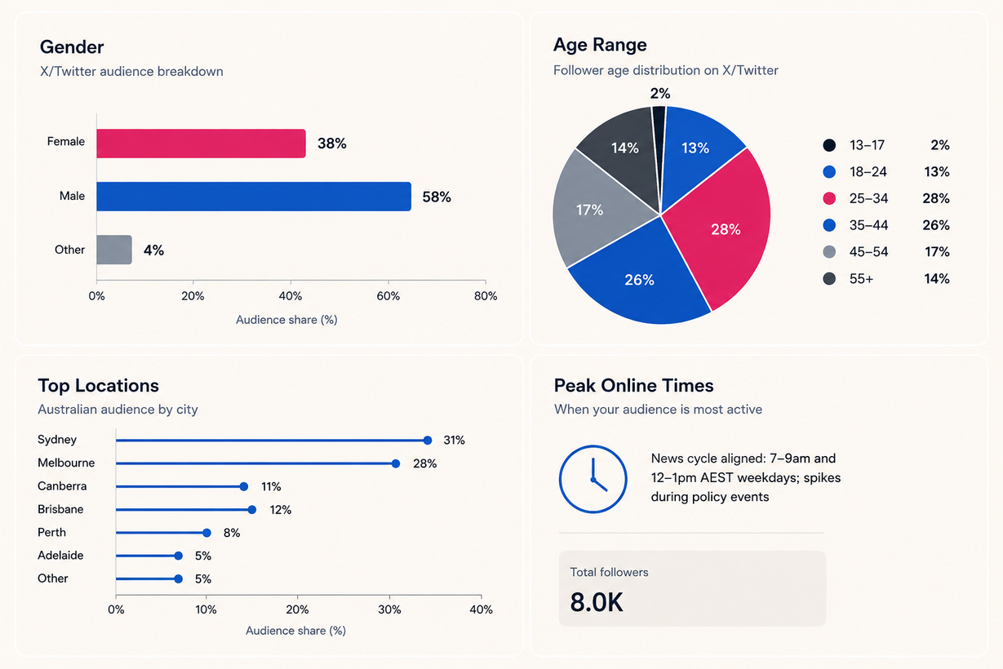
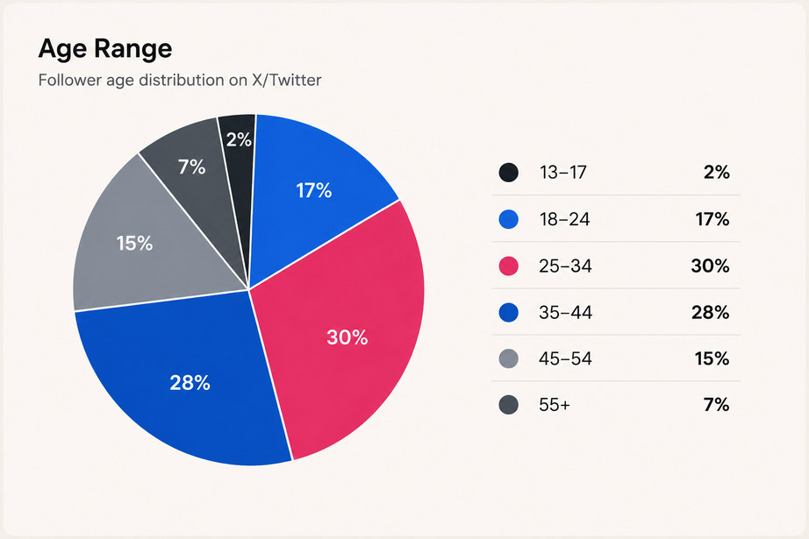
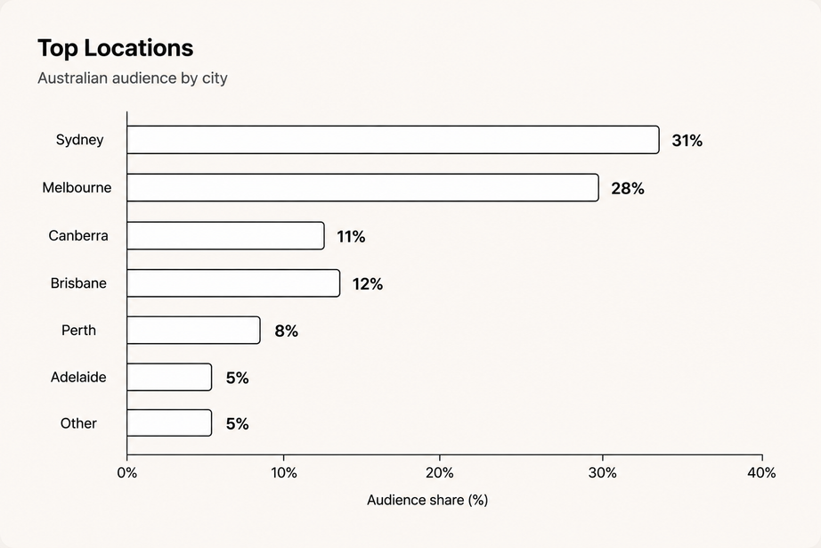
02 · PLATFORM AUDIT
Audience
8.0K Followers
Gender
Gender
Gender data from the X Audience dashboard show male followers account for 58% of the audience, indicating stronger engagement among policy- and news-oriented users.
Age range
Top Locations
Geographic Location
Location data from the X Audience dashboard show followers are distributed across Australia’s major cities, led by Sydney (31%) and Melbourne (28%), indicating broad national reach.
Age Range
Age demographic data from the X Audience dashboard show most followers are aged 25–34 (30%), followed by 35–44 (28%), indicating X is effective for reaching working-age professionals.
Audience Segments
Insights from the X Audience dashboard suggest the core audience comprises university-educated professionals aged 25–44 interested in science, policy and collective action.
Source: NAC Social Media Profiles (2026). Audience dashboard.
Notes:
Build your OWN charts from the dashboard data — do not screenshot the dashboard graphs.
9

Slide 18
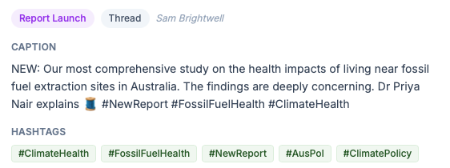
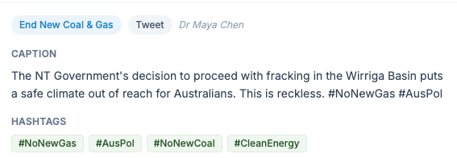
02 · PLATFORM AUDIT
Content quality & relevance
Posts analysed (May 2026)
Content Quality
Both posts deliver concise environmental news, policy updates aligned with NAC’s X audience.
  Theme: Report Launch
  Engagement Rate: 0.37%
Highest-performing post
Audience Relevance
Research findings and policy updates are well suited to X’s professional audience, which actively follows environmental and public affairs.
Strong Example
X Content dashboard data show the Report Launch post achieved the highest engagement rate (0.37%), suggesting evidence-based research content encouraged stronger audience engagement.
  Theme: End New Coal & Gas
  Engagement Rate 0.18%
Lowest-performing post
Weak Example
X Content dashboard data indicate the End New Coal & Gas tweet recorded the lowest engagement rate (0.18%), suggesting posts presenting original research findings resonated more strongly than policy commentary alone.
Source: NAC Social Media Profiles (2026), X Content & Posts (May 2026).
Notes:
Annotated screenshots of strong or weak content examples illustrate this well.
10

Slide 19
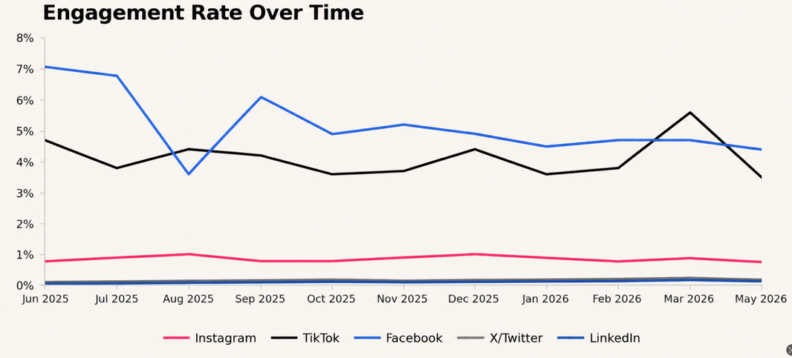
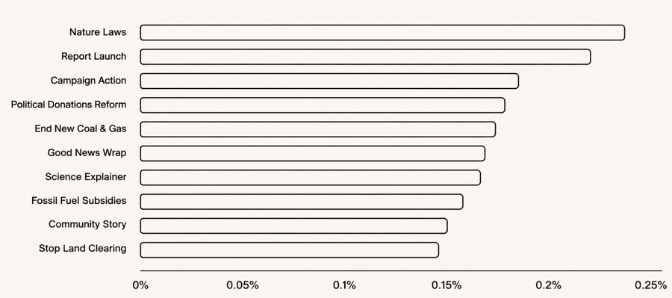
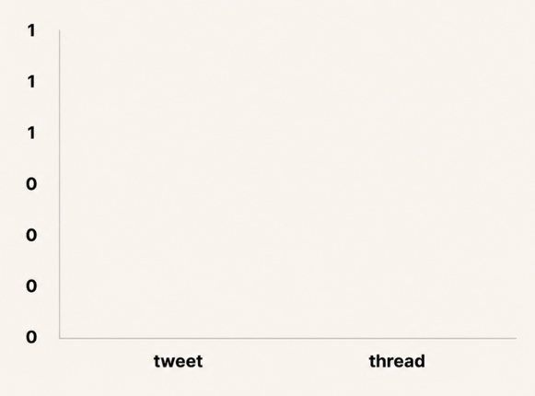
02 · PLATFORM AUDIT
Engagement
Engagement Performance
  X generated 100 likes, 35 retweets, 2 bookmarks and no comments, reflecting limited audience interaction.
  The Engagement Rate Over Time graph indicates stable engagement (0.16%–0.20% ER).
  X recorded the lowest engagement among NAC’s platforms.
Engagement Rate Over Time
Total Likes
100
Total Comments
0
Retweets
35
Saves
2
Content Format
The Avg Engagement by Content Type chart indicates Content format had little impact on engagement, with similar performance across tweets and threads.
Avg ER by Campaign Theme
Campaign Themes
The AVG ER by Campaign Theme chart indicates Nature Laws achieved the highest ER, while all campaign themes recorded similar engagement rates, suggesting consistent audience interest.
Avg Engagement by Content Type
Source: NAC Social Media Profiles (2026). Engagement dashboard.
Notes:
Bar or line charts comparing engagement across platforms or over time are effective. Replying to comments isn't visible in this dashboard — keep that for AT3.
11

Slide 20
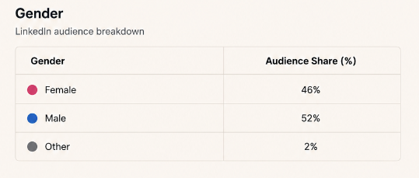
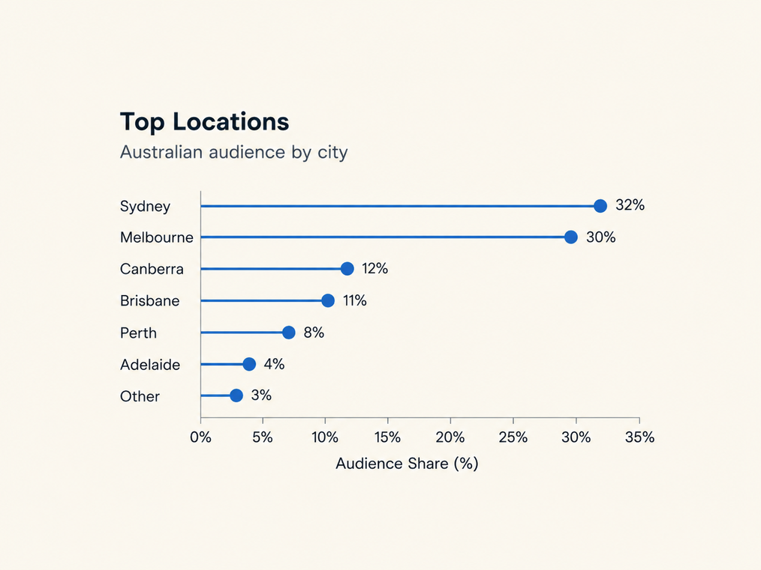
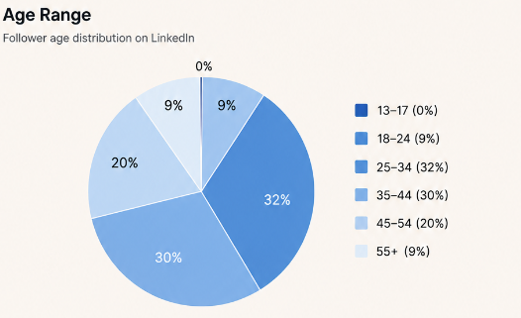

02 · PLATFORM AUDIT
Audience
5.0K Followers
Top Locations
Gender
Gender data from the LinkedIn Audience dashboard indicate a relatively balanced audience, with male followers accounting for 52%.
Age Range
Age range
Age demographic data from the LinkedIn Audience dashboard indicate most followers are aged 25–34 (32%), followed by 35–44 (30%), suggesting LinkedIn primarily reaches working professionals.
Geographic location
Location data from the LinkedIn Audience dashboard indicate followers are concentrated in Sydney (32%) and Melbourne (30%), with the remaining audience distributed across Australia’s major cities.
Audience Profile
Audience segment insights from the LinkedIn Audience dashboard indicate LinkedIn primarily reaches university-educated professionals aged 25–44 interested in environmental and policy issues.
Source: NAC Social Media Profiles (2026). Audience dashboard.
Notes:
Build your OWN charts from the dashboard data — do not screenshot the dashboard graphs.
9

Slide 21
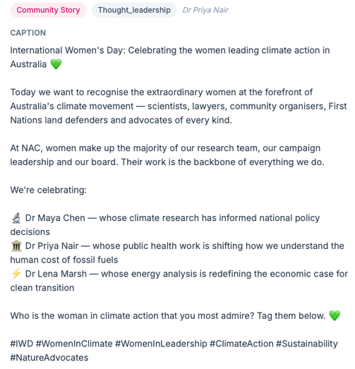
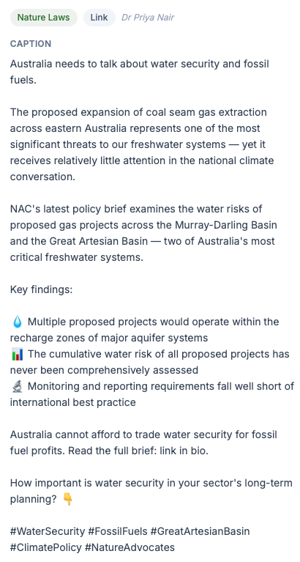
Content quality & relevance
Posts analysed (June 2025- June 2026)
Content Quality
Both posts present high-quality content with clear messaging.
Highest-performing post
Lowest-performing post
  Theme: Community Story
  Engagement Rate: 12.00%
  Theme: Nature Laws
  Engagement Rate 3.30%
Audience Relevance
Professional storytelling and evidence-based insights are well suited to LinkedIn’s audience of working professionals.
Strong Example
LinkedIn Content & Posts dashboard data indicate the Community Story post achieved the highest engagement rate (12.00%), suggesting timely professional storytelling generated stronger audience engagement.
Weak Example
LinkedIn Content & Posts dashboard data indicate the Nature Laws post recorded a lower engagement rate (3.30%), suggesting information heavy generated less interaction than community focused professional stories.
Source: NAC Social Media Profiles (2026), LinkedIn posts (Jun 2025-Jun 2026).
Notes:
Annotated screenshots of strong or weak content examples illustrate this well.
10

Slide 22
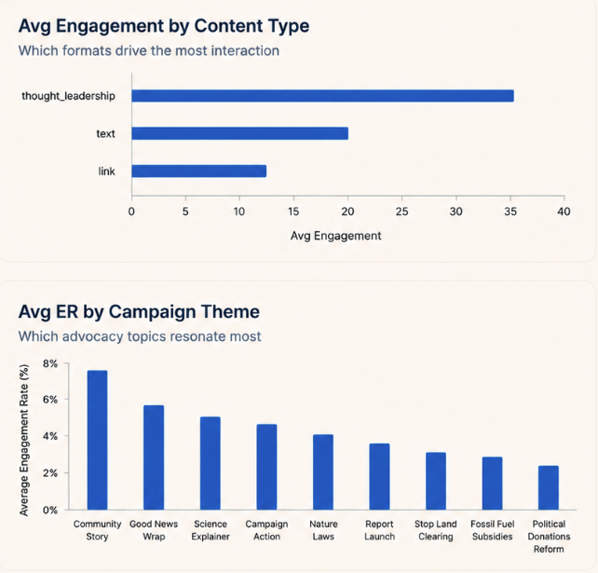
02 · PLATFORM AUDIT
Engagement
Engagement Performance
  LinkedIn generated 855 likes, 262 comments and 196 shares, demonstrating strong professional engagement.
  The Engagement Rate Over Time graph indicates engagement remained consistently high throughout the year, peaking at 12.00% ER.
  LinkedIn recorded one of NAC’s highest engagement rates, despite having only 5K followers.
Engagement Rate Over Time
Total Likes
855
Total Comments
262
Shares
196
Saves
2
Avg Engagement by Content Type
Avg ER by Campaign Theme
Campaign Themes
The Avg ER by Campaign Theme chart reflects Community Story achieved the highest engagement rate (7.47%), while all campaign themes exceeded 3%, indicating broad audience interest across environmental topics.
Content Format
The Avg Engagement by Content Type chart indicates thought leadership generated the highest average engagement, highlighting LinkedIn users’ preference for expert insights and professional discussion.
Source: NAC Social Media Profiles (2026). Engagement dashboard.
Notes:
Bar or line charts comparing engagement across platforms or over time are effective. Replying to comments isn't visible in this dashboard — keep that for AT3.
11

Slide 23

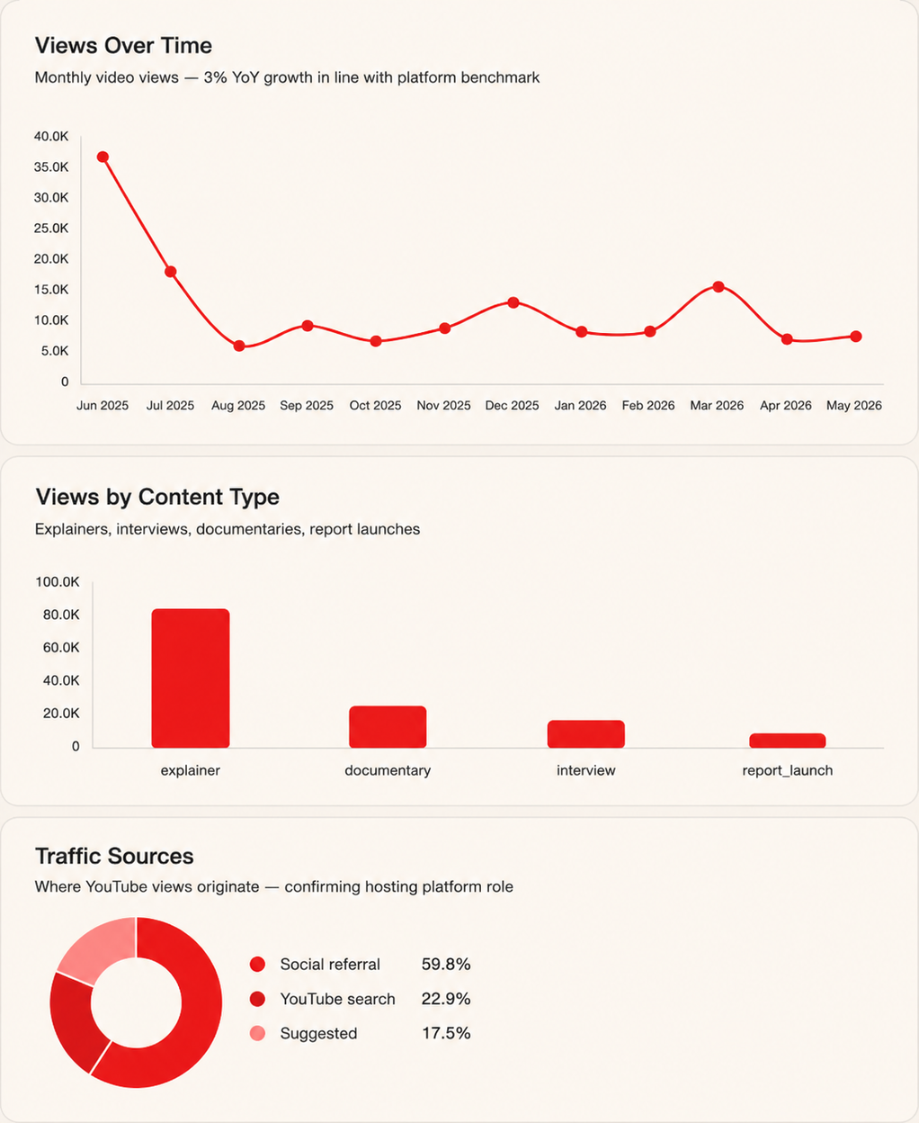
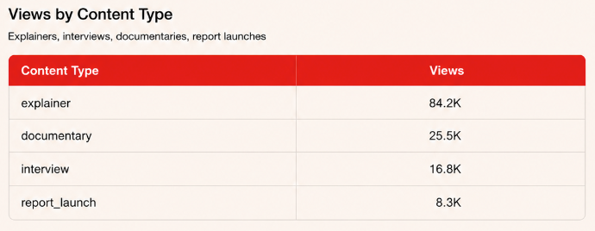
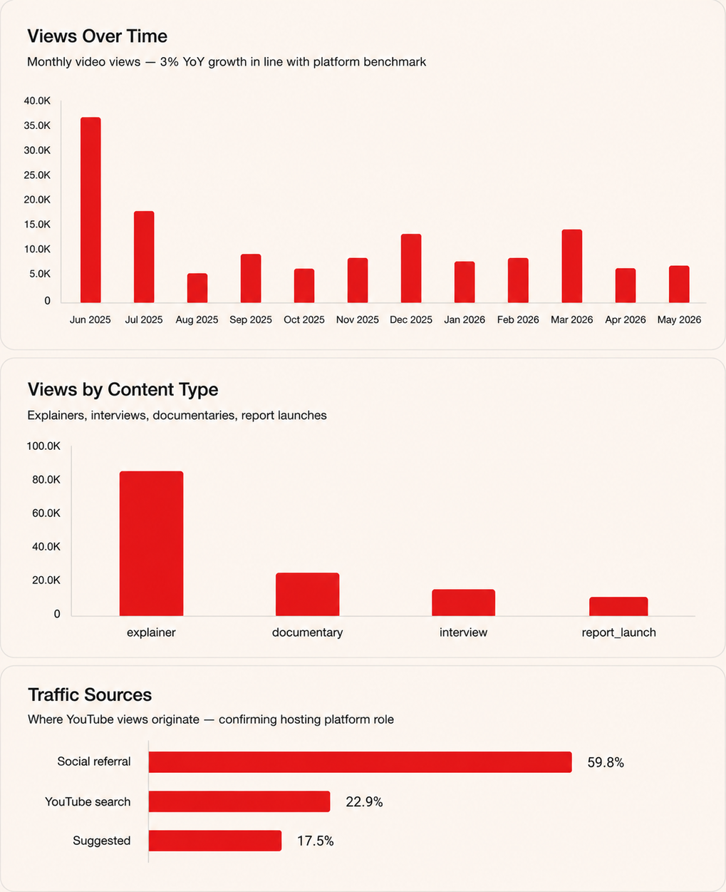
02 · PLATFORM AUDIT
YouTube Performance
Engagement & Performance
  YouTube generated 134.8K views, 9.5K watch hours and 911 new subscribers demonstrating strong audience engagement.
  Average engagement rate reached 4.90%, exceeding the 3.87% benchmark.
  The Views Over Time graph indicates views fluctuated throughout the year, peaking at 37.3K in June 2025.
Views Over Time
Traffic Sources
Traffic Sources
The Traffic Sources chart indicates 59.8% of views came from social referrals, confirming YouTube primarily supports traffic from other social platforms.
Content Format
The Content Type table indicates explainer videos generated the highest views (84.2K), reinforcing educational content as YouTube’s strongest format.
Total views
134.8K
Watch time
9.5K
Avg engagement rate
4.90%
Subscribers gained
911
Source: NAC Social Media Profiles (2026). YouTube dashboard.
Notes:
A frequency graph or calendar-style visualisation shows posting patterns compellingly.
12

Slide 24
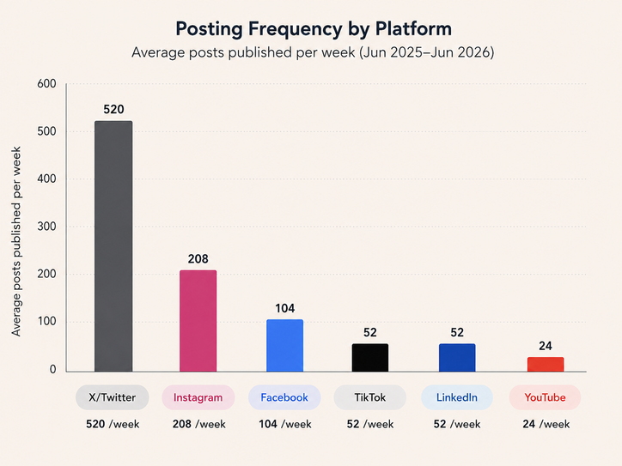
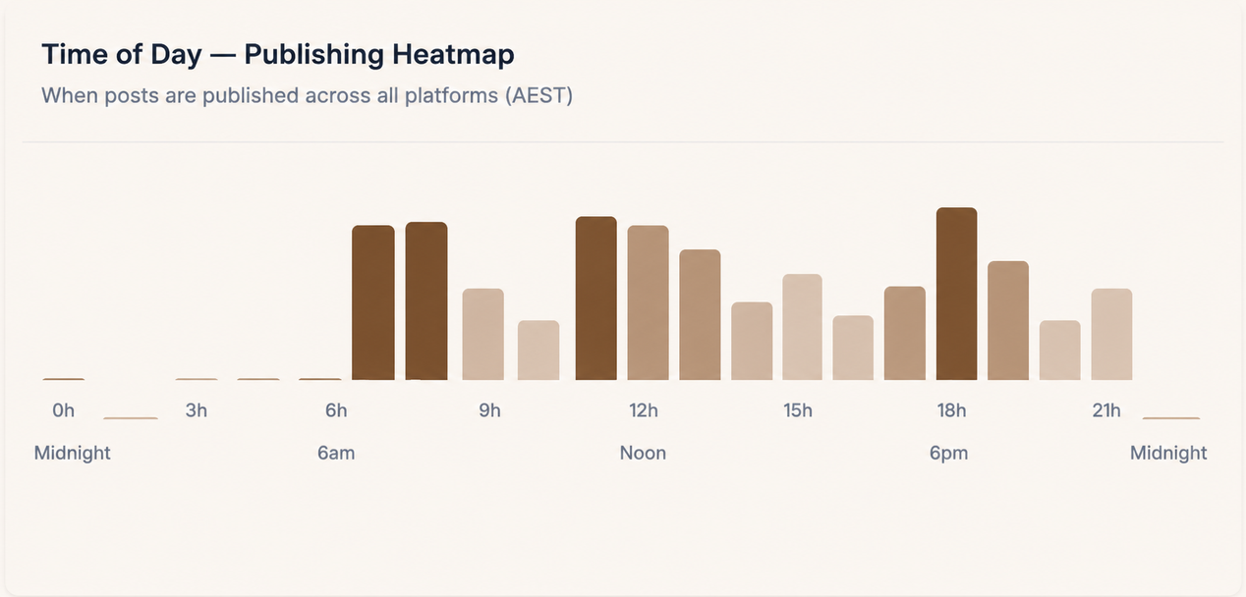
02 · PLATFORM AUDIT
Posting frequency & scheduling (June 2025 - June 2026)
Posting Frequency
  The Posting Frequency by Platform chart indicates NAC maintained recommended publishing frequencies across all major platforms.
  X/Twitter was the most active platform (520 posts), supporting real-time advocacy and policy updates.
  YouTube published 24 videos annually (≈2 videos/month), slightly exceeding the recommended schedule.
Weekly Publishing Pattern
 | MON | TUE | WED | SAT | THU | FRI | SUN
High posting frequency
Low
Posting Timing
The Posting Timing chart indicates most posts were published between 7 AM and 9 PM (AEST), with activity peaking during the morning (7–8 AM), midday (11 AM–12 PM) and evening (6–7 PM).
Moderate
None
  The Weekly Publishing Pattern heatmap indicates posting activity was concentrated on Wednesday and Thursday, while weekend publishing remained limited.
Source: NAC Social Media Profiles (2026). Publishing dashboard.
Notes:
A frequency graph or calendar-style visualisation shows posting patterns compellingly.
12

Slide 25
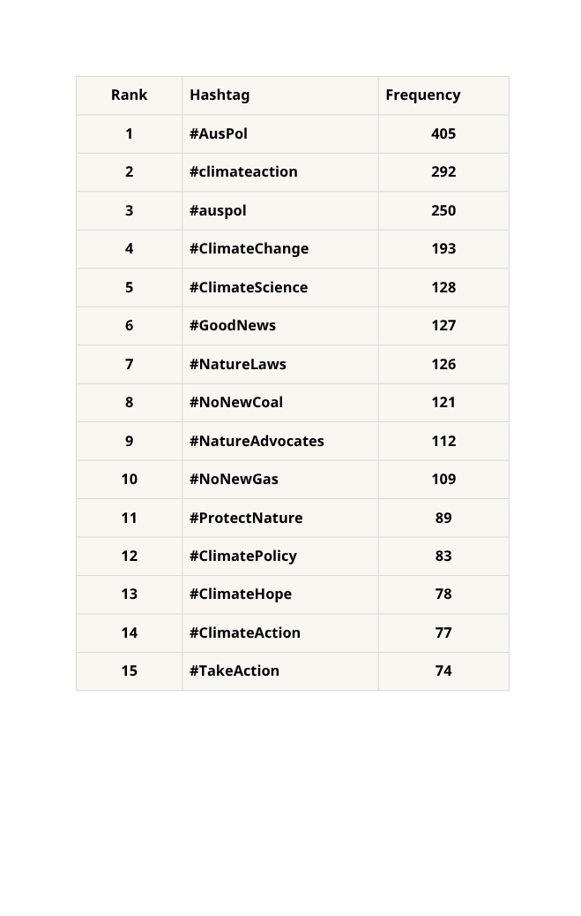
02 · PLATFORM AUDIT
Hashtags & keywords
Top Hashtags
The Top Hashtags table in the Content & Posts dashboard reveals NAC consistently used policy, environmental and branded hashtags, with #AusPol, #ClimateAction, #ClimateChange and #NatureAdvocates being the most frequently used.
Hashtags Ranking
Reach & Relevance
  The hashtags are highly relevant to environmental advocacy, policy and climate issues, improving discoverability among NAC’s target audience.
  Branded hashtags strengthen campaign recognition and reinforce NAC’s brand identity across platforms.
Improvement Opportunities
  The ranking shows duplicate hashtags variations caused by inconsistent capitalisation such as #AusPol/#auspol and #ClimateAction/#climateaction, indicating opportunities to standardise hashtag usage, improving campaign tracking, brand identity and search consistency.
Source: NAC Social Media Profiles (2026). Content & Posts dashboard.
Notes:
A word cloud or table of top hashtags/keywords is an effective visual here.
13

Slide 26
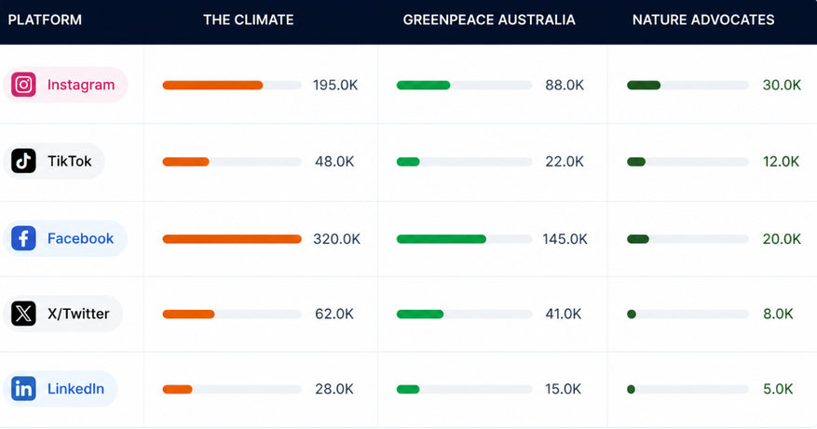

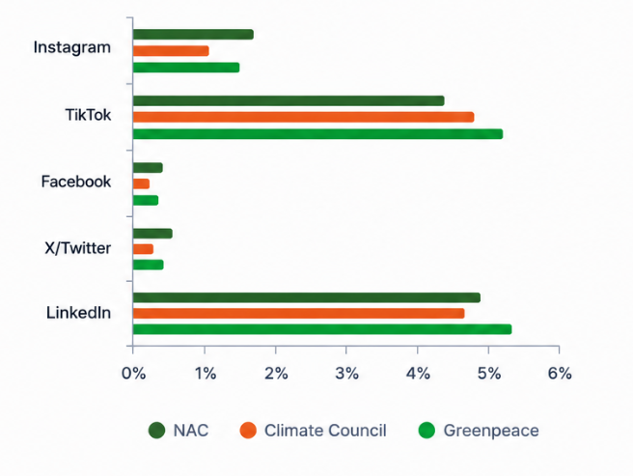
02 · PLATFORM AUDIT
Competitor analysis
Strengths (compared to NAC)
  Competitor Followers Comparison table indicates a larger audience across all major platforms.
  Broader environmental focus, including biodiversity, oceans and direct action.
Strengths (compared to NAC)
  Competitor Followers Comparison table indicates the largest audience (653K followers).
  Strong focus on evidence-based policy communication.
Engagement Rate Comparison
Weakness (compared to NAC)
  Lower engagement than NAC on Instagram, Facebook and X.
  Greater focus on activism, while NAC emphasises policy and community storytelling.
Weaknesses (compared to NAC)
  Engagement Rate Comparison chart indicates NAC achieved higher engagement on Instagram, Facebook and X.
  Less community storytelling than NAC.
Source: NAC Social Media Profiles (2026). Competitors dashboard.
Notes:
The two competitors are real organisations but the dashboard data is dummy data. Use a structured comparison.
14

Slide 27
SECTION
03
Recommendations & Conclusion
Notes:
Section 3 — turn the audit into evidence-based advice.
15

Slide 28

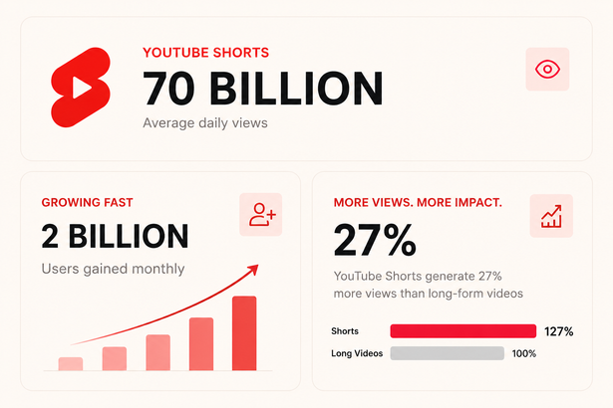

Recommendation 1 - YouTube Shorts
Recommendation
Expand YouTube Shorts by publishing the same short-form video content simultaneously across YouTube, Instagram Reels and TikTok.
Justification
  YouTube achieved 134.8K views and 4.90% average engagement rate, but NAC does not currently publish YouTube Shorts.
  Short-form video generated the highest engagement on Instagram and TikTok.
  Existing short-form videos can be reposted across platforms, making this a low-cost and efficient content strategy.
  According to Adobe Express (2023) YouTube short video generated 27% more views than long video.
  YouTube Shorts records an average of 70 billion daily views and reaches over 2 billion monthly users (Henke, 2025).
Implementation
  Publish 2-3 shorts per week, simultaneously on YouTube Shorts, Instagram Reels and TikTok
  Optimise captions, hashtags and thumbnails for each platform.
  Include links to relevant campaign pages and full-length YouTube videos.
  Monitor monthly views, watch time, and click-through rates to optimise future content.
Source: NAC Social Media Profiles (2026). YouTube dashboard.
Notes:
Prioritise 3–5 key recommendations with clear rationale rather than a long list. Link each back to your audit findings and support with sources.
16

Slide 29
Recommendation 2 - Strengthen Platform Linking
Recommendation
Standardise website links by directing all social media platforms to the NAC homepage.
Insights
  According to the Profile Completeness audit, Instagram links users to the Take Action campaign page, while Facebook and TikTok direct users to the NAC homepage.
  LinkedIn, X and YouTube do not include a website link in their profiles.
Justification
  Standardising website links strengthens brand consistency and provides a consistent user experience across all platforms.
  Directing users to the NAC homepage enables easy access to campaigns, petitions, donations and other key information from a single destination.
  Seamless cross-channel integration strengthens the customer experience (Lemon & Verhoef, 2016).
Implementation
  Update all social media profile links to the NAC home page.
  Ensure the homepage prominently features current campaigns, petitions and donation opportunities.
  Use UTM links to track website traffic and user behavior from each social media platform.
  Review and update profile links monthly to maintain consistency across all platforms.
Source: Nature Advocates Collective (2026).
Notes:
Prioritise 3–5 key recommendations with clear rationale rather than a long list. Link each back to your audit findings and support with sources.
16

Slide 30
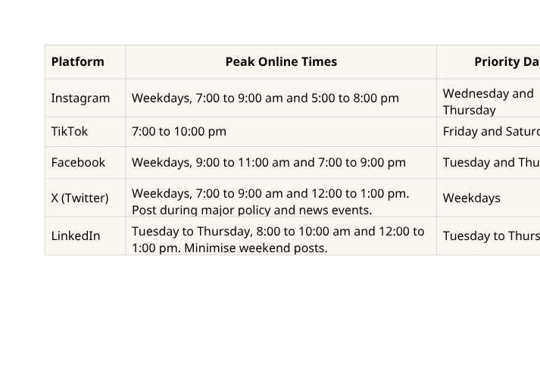

Recommendation 3 - Expand Posting Schedule
Recommendation
Optimise posting times to align with platform-specific audience activity.
Insights
  The Weekly Publishing Pattern heatmap shows NAC mainly posts on Wednesday and Thursday, with limited weekend activity.
  The Publishing Heatmap indicates posting peaks at 7–8am, 11am–12pm and 6–7pm.
  Industry benchmarks indicate different peak engagement periods across platforms.
Justification
  The Weekly Publishing Pattern and Publishing Heatmap suggest NAC’s current posting schedule does not fully align with platform-specific peak audience activity.
  Aligning publishing schedules with peak audience times can improve reach and engagement.
Posts by Day of Week
Implementation
  Instagram: 7–9am and 5–8pm (Wed–Thu)
  TikTok: 7–10pm (Fri–Sat)
  Facebook: 9–11am and 7–9pm (Tue & Thu)
  X: 7–9am and 12–1pm; increase posting during policy/news events.
  LinkedIn: Tue–Thu, 8–10am and 12–1pm; reduce weekend posts.
Implement the revised schedule for two months and evaluate engagement performance.
Publishing Heatmap
Notes:
Prioritise 3–5 key recommendations with clear rationale rather than a long list. Link each back to your audit findings and support with sources.
16

Slide 31
Conclusion
Key Findings
  NAC maintains a consistent brand identity across major social media platforms.
  Despite having a smaller audience than competitors, NAC achieved strong engagement on Instagram, TikTok and LinkedIn.
  Short-form video, community storytelling generated the strongest audience engagement.
Recommendations
My recommendations will:
  Improve profile consistency and customer experience.
  Increase engagement by optimising content formats and posting schedules.
  Strengthen long-term audience growth and campaign performance.
Closing Statement
By implementing these recommendations, Nature Advocates Collective can strengthen its digital presence, build deeper audience engagement and enhance the impact of its environmental advocacy campaigns.
Notes:
Briefly tie your recommendations back to NAC's objectives and leave the client with a clear next step.
17

Slide 32
References
Adobe Express. (2023). The Marketing Potential of YouTube Shorts - Adobe. In Adobe.com. https://www.adobe.com/express/learn/blog/marketing-potential-of-youtube-shorts
Greenpeace Australia Pacific. (n.d.). Greenpeace Australia logo [Logo]. Greenpeace Australia Pacific. https://www.greenpeace.org.au/
Climate Council. (n.d.). Climate Council logo [Logo]. Retrieved July 29, 2026, from https://www.climatecouncil.org.au/
Henke, C. (2025). How to use YouTube Shorts to drive sustained growth, engagement. In Search Engine Land. https://searchengineland.com/youtube-shorts-growth-engagement-454423
Lemon, K. N., & Verhoef, P. C. (2016). Understanding Customer Experience Throughout the Customer Journey. Journal of Marketing, 80(6), 69–96.
Owens, E. (2024). Teens on TikTok: Understanding Young People’s Digital Agency as Practice. International Research in Children’s Literature, 17(2), 174–188. https://doi.org/10.3366/ircl.2024.0562
Social Media Strategy Unit Materials (2026). Nature Advocates Collective Annual Report 2025-2026. School of Communication and Creative Arts, Deakin University. https://d2l.deakin.edu.au/d2l/le/content/1691429/viewContent/8789437/View
Social Media Strategy Unit Materials (2026). Nature Advocates Collective Social Media Profiles. School of Communication and Creative Arts, Deakin University. https://d2l.deakin.edu.au/d2l/le/content/1691429/viewContent/8800749/View
Social Media Strategy Unit Materials (2026). NAC Social Media Profiles Dashboard. School of Communication and Creative Arts, Deakin University. https://d2l.deakin.edu.au/d2l/le/content/1691429/viewContent/8800749/View
Notes:
Deakin APA. 5–10 references in total, some from the unit's readings. Cite all visuals and graphics used in the deck.
18

