Slide 1
Timed Remote Data Mirroring Simulator to Assess Runtime Model Fidelity
Dr.-Ing. Sebastian Götz
May 2023

Slide 2
Motivation
There is an RDMSim exemplar at SEAMS
This exemplar allows for stepwise simulation or a remote data mirroring system
At each time step, the metrics of the system are are computed as if the system is running
But, there is no running system simulating mirrors and their links
To measure the time required for an adapation action to be realized, we need a time-aware simulation (runtime model → managed system)
This is where the TimedRDMSim helps
We also need special means to identify how long it takes for the runtime model to notice a change in the running system (managed system → runtime model)
Becomes interesting, when updating the runtime model every time step in a simulation is too resource consuming

Slide 3
Principle Idea
Create a network of mirrors
Connect the mirrors according to a strategy
Each mirror requires some time to to start and to be ready for communication
Mirror states: down → starting → up → ready → stopping → stopped
Links between mirrors are established
Link states: inactive → active → closed
Links can only get active if their source and target mirror are ready
At runtime we can change the number of mirrors
Future work: change the TopologyStrategy

Slide 4
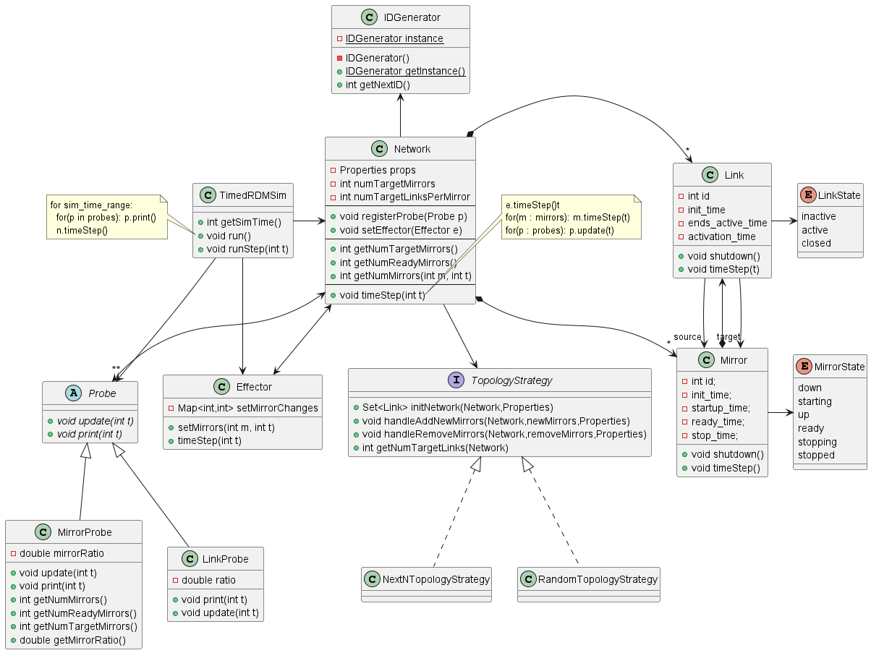
Framework Overview
Probes to observe network
Effectors to send changes
TopologyStrategy to switch how to connect the mirrors

Slide 5
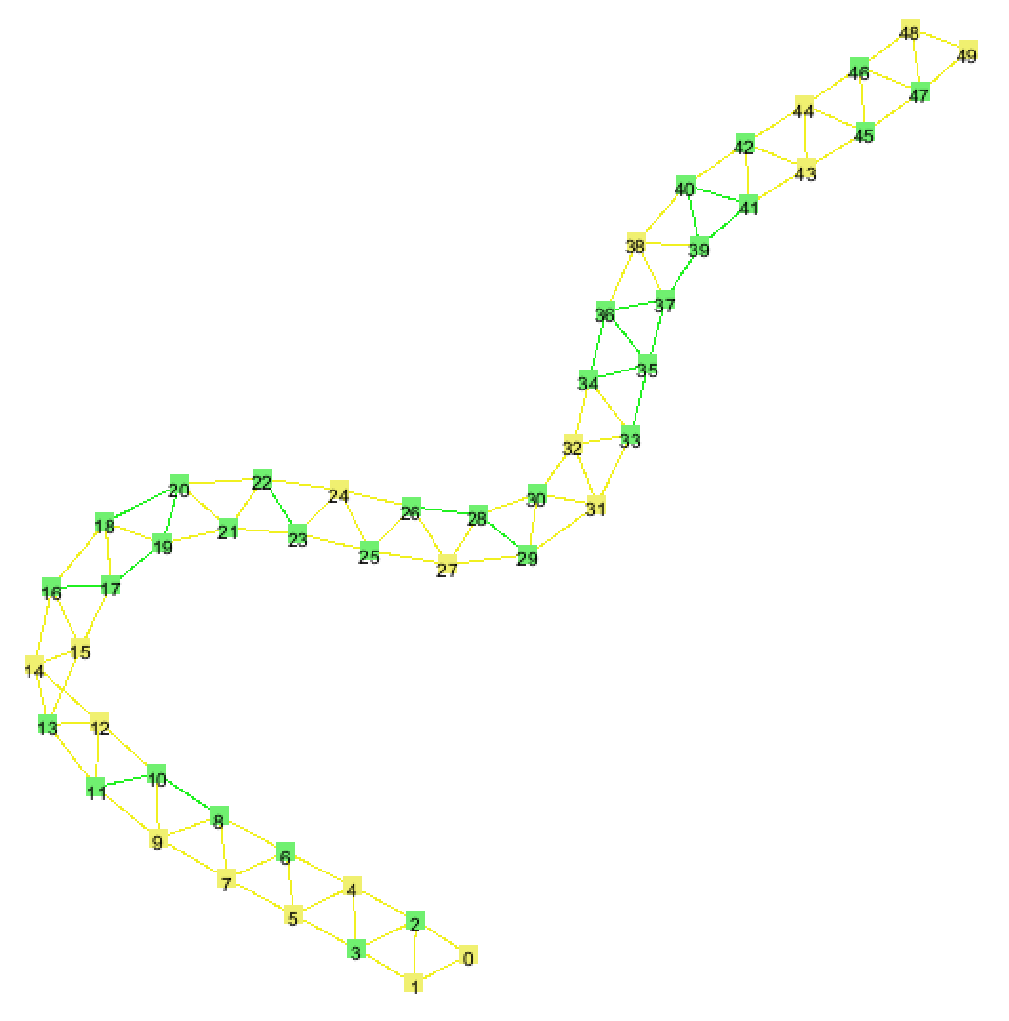
Visualization of Network
With GraphStream 2.0
State of mirrors and links is color coded
Yellow: inactive/starting
Green: active/ready
Red: closed/stopping

Slide 6
Simulation Configuration (sim.conf)
debug=true sim_time=120 num_mirrors=50 num_links_per_mirror=1 startup_time_min=5 startup_time_max=10 ready_time_min=2 ready_time_max=20 stop_time_min=2 stop_time_max=5 link_activation_time_min=2 link_activation_time_max=5

Slide 7
How to describe scenarios?
Write a Simulation Runner (main)
public static void main(String args[]) { TimedRDMSim sim = new TimedRDMSim(„resources/sim.conf“); sim.initialize(new NextNTopologyStrategy()); Effector effector = sim.getEffector(); effector.setMirrors(10, 40); //change mirrors to 10 at timestep 40 effector.setMirrors(30, 70); //change mirrors to 30 at timestep 70 sim.run(); }

Slide 8
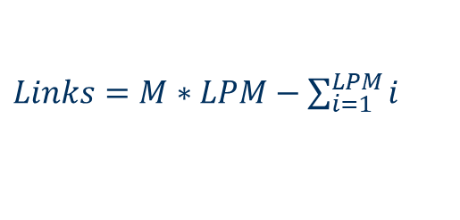
TopologyStrategy: Next N
Each mirror is connected to its next N mirrors
How many links should exist for M mirrors connected to ther next N mirrors?
Example 1: 5 mirrors, N = 2 → 5*2 – 1 – 2 = 7
Example 2: 10 mirrors, N = 4 → 10*4 – 1 – 2 – 3 – 4 = 30
1
2
4
3
5
1
2
6
10
$Links=M∗LPM−\sum_{i=1}^{LPM}{i}$
3
7
4
8
5
9

Slide 9
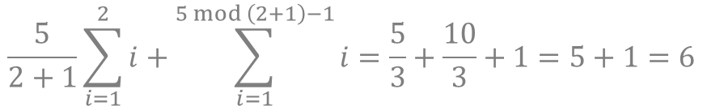
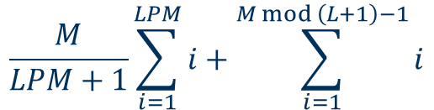
Topology Strategy: Random
Each mirror is connected to exactly N other mirrors
There is a minimum and maximum number of links for the complete graph
Example: 5 Mirrors and 2 Links per Mirror
The number of links depends on the order in which the links are created
Variant A is the result if the links are created in ascending order for each node
The other variants result, if nodes and their partners are randomly choosen
Maximum links: (Mirrors * Links per Mirror) / 2
5 for the example
Minimum links:
1
2
4
1
2
4
A
3
5
B
3
5
1
2
4
1
2
4
C
3
5
D
3
5
$$\frac{M}{LPM+1}\sum_{i=1}^{LPM}{i}+\sum_{i=1}^{M mod \left(L+1\right)−1}{i}$$
$$\frac{5}{2+1}\sum_{i=1}^{2}{i}+\sum_{i=1}^{5 mod \left(2+1\right)−1}{i}=\frac{5}{3}+\frac{10}{3}+1=5+1=6$$

