Slide 1

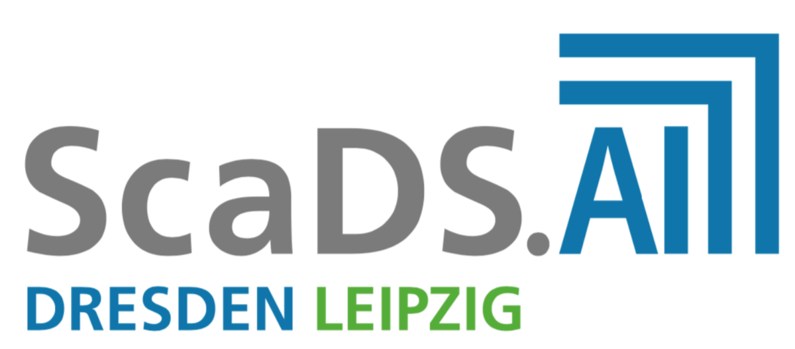
Eigentokens & ComdareDB
Grammar-aware storage as a substrate for deterministic LLM compilation
Profilprojekt Anwendungsforschung (INF-PM-FPA) • TU Dresden, ScaDS.AI
Supervisor: Prof. Dr. Michael Färber • Benjamin-Elias Probst
Interim presentation (30 min)
Notes:
[Sources]
- https://tu-dresden.de/tu-dresden/profil/marke-tud/cd/neues-logo (logo context)
- https://iccl.inf.tu-dresden.de/web/ScaDS.AI/en (ScaDS.AI logo)
[/Sources]

Slide 2
Agenda
Where we are, and what changes with the new architecture extensions
Motivation: determinism + traceability + storage efficiency
Eigentokens: token model and grammar induction
Grammar-aware chunking vs. content-defined chunking (CDC)
RedcomponentDB/Comdare: database substrate and Baugruppen principle
Six-phase BuildSystem + AM: reproducible compilation and benchmarking
LLM compilation path (ELM/CELM): “training as compilation”
Evaluation plan, current status, and next steps
Goal: a storage-driven pipeline that produces deterministic, inspectable model artifacts

Slide 3
Motivation
Why unify storage and model construction?
Pain points in probabilistic LLM pipelines
Eigentokens hypothesis
Opaque weights → hard to audit and debug
Updates often require retraining or fine-tuning
Non-determinism complicates reproducibility
Large corpora contain massive redundancy
Use grammar induction as *deduplication* + *knowledge extraction*
Persist rules as first-class objects (tokens) with hashes
Compile deterministic model artifacts from the grammar cookbook
Make updates incremental: rule edits instead of retraining
Key move: treat redundancy as structure, and structure as a compilation target.

Slide 4
Eigentoken model
A token carries identity, reconstruction program, payload, and references
T = ⟨id, P, D, R⟩
Example: compositional token
id: SHA-512 of token content/definition
P: interpretation program (CELM-lang)
D: optional literal payload (base tokens)
R: references to dependent tokens
id: SHA512("Apfelbaum")
P: CONCAT(tau_1, tau_2)
D: null
R: { SHA512("Apfel"), SHA512("baum") }
Harvard-style separation: P is stored alongside (D, R).
Tokens form a DAG / hypergraph; storage becomes a grammar index.

Slide 5
Grammar-aware chunking
From CDC seeding to cross-object grammatical productions
CDC (FastCDC)
C1
C2
C3
C4
C5
Boundaries chosen by rolling hash → misses higher-level structure across objects.
Eigentokens grammar induction
Base tokens (seeded by CDC)
Higher-level tokens (rules) across objects
Key idea: replace repeated *sequences* by reusable productions, not just identical chunks.
Targets: +25–40% higher dedup effectiveness vs FastCDC on cross-object corpora
Stable under inserts/shifts/renames; rules converge into a “grammar cookbook”
Enables seekable access via Range mapping (HTTP Range semantics)
CDC is a seeding strategy; grammar induction is the compression + knowledge layer.
Notes:
[Sources]
- https://www.usenix.org/conference/atc16/technical-sessions/presentation/xia (FastCDC paper page)
- https://www.rfc-editor.org/rfc/rfc9110.html (HTTP Range semantics)
[/Sources]

Slide 6
Pipelines and phases
Two views: internal storage pipeline vs. BuildSystem six phases
Storage pipeline (A3)
Stage 1
Immediate ingestion
Stage 2
Background induction
Stage 3
Consolidation
CDC seeding + provisional tokens
pattern mining → new rules
index optimization + compaction
BuildSystem six phases (P0–P5)
P0
P1
P2
P3
P4
P5
P0–P2 bootstrap toolchain • P3 interpreter + plugins • P4 accelerators + scheduling • P5 benchmarking + delivery
Both layers are deterministic: storage state is fully reconstructible from tokens and logs
BuildSystem defines “done” by markers, reports, and digests (direct/managed/server modes)
ActiveMachinery groups machines (AM) and layers AD-style user identity on top
We use the same contracts: manifests, digests, and capability probing.

Slide 7
RedcomponentDB / Comdare substrate
Why a database-first core matters for grammar learning
User-facing systems
SQL / TSDB / S3 facades, query layer
Eigentokens grammar layer
token DAG + cookbook + range maps
Comdare DB platform
hypergraph + object store + append-only logs
Binary substrate
files/segments, checksums, optional io_uring on Linux
Design goals: deterministic updates, composability, and efficient partial reads/writes.
Comdare provides the persistence primitives; Eigentokens provides structure and deduplication semantics.
Notes:
[Sources]
- https://kernel.dk/io_uring.pdf (io_uring background, Linux)
[/Sources]

Slide 8
Baugruppen principle
Composable modules, committed via hashes
Idea: a system state is a DAG of small, immutable modules (“Baugruppen”).
Root
Token A
Token B
Token C
Payload
Rule
Index
Each Baugruppe has a SHA-512 identity; duplicates collapse automatically
Small changes only create new nodes along the modified path
CRDT-style merge remains deterministic when rules are designed to converge
This mirrors git-style immutability, but for binary storage + grammars.
Notes:
[Sources]
- https://www.lip6.fr/Marc.Shapiro/papers/2011/CRDTs_SSS-2011.pdf (CRDT convergence principles)
[/Sources]

Slide 9
Indirection as a database primitive
Merge / append / store / reference
Operations on the token graph
Why SHA-512 everywhere?
append: add new leaves + references
store: persist payloads and metadata
reference: reuse existing nodes by hash
merge: reconcile competing updates via convergent rules
Content-addressable identity
Deduplication via key match
Stable references for manifests and caches
Risk management for enormous artifact counts
Performance levers
Large integer ops inside manifests
→ fast multiplication can matter
• locality-aware layout
• async I/O (io_uring)
• modular hashing
Example: Karatsuba reduces multiplications
from O(n²) to ~O(n^{1.58}).
The DB language is about *structural reuse*, not just storage bytes.
Notes:
[Sources]
- https://mathworld.wolfram.com/KaratsubaMultiplication.html (Karatsuba overview & citation)
- https://kernel.dk/io_uring.pdf (io_uring overview)
[/Sources]

Slide 10
LLM compilation path (ELM/CELM)
Training as compilation from a grammar cookbook
Dataset
(objects, logs, code)
Grammar induction
(global cookbook)
Module graph
(tokens as components)
Deterministic model
ELM artifact
What “compiled” means here
Weights and connections are derived from explicit productions (no SGD training loop)
Every parameter can be traced back to rule IDs and the original data spans
Incremental updates become rule edits and re-compilation of affected modules
Deterministic behavior is enforced by construction (same inputs → same outputs)
Open research: output quality vs. generalization; hybrid designs (compiled + lightly fine-tuned).
Eigentokens is a storage kernel and a compiler frontend for model artifacts.

Slide 11
Seekable access over compressed grammars
HTTP Range requests and token-aligned maps
Client
GET /object
Range: bytes=…
Server
Token map →
reconstruct span
Implementation notes
Range map: logical byte offsets → list of tokens + intra-token offsets
Cache hot token spans; preserve locality in B+-forest layout
Optional Linux fast-path: io_uring for async reads/writes
The goal is compression without giving up random-access semantics.
Notes:
[Sources]
- https://www.rfc-editor.org/rfc/rfc9110.html (HTTP Semantics / Range requests)
- https://kernel.dk/io_uring.pdf (io_uring background)
[/Sources]

Slide 12
Evaluation targets
What we want to prove in the Profilprojekt
Quantitative goals
Dedup effectiveness: +25–40% vs FastCDC on realistic cross-object corpora
Tail latency: P95 reads within +15% vs uncompressed baseline
Write amplification: −30% vs LSM-tree style storage (target)
Determinism: same inputs → bit-identical outputs (storage and model artifacts)
Baselines
FastCDC + zstd
fixed-size blocks + seekable compression (e.g., BGZF-like)
RocksDB (LSM) baseline
Success is not just compression—it's reproducible performance and inspectability.

Slide 13
Current project status
What is “done” vs what is still open
Implemented / stabilized
Open engineering gates
Docs: RBMM, ICDs, run layout, schemas
Six-phase validation contract
XML templating baseline (CMake)
Cluster + ServiceRegistry schema updates
Cross-compile toolchain/runner modeled in schema
Phase 3: C++ interpreter + plugin loader pipeline
Digest-verified tool/product stores + manifests
Phase orchestrator parity (sh/bat/cmake)
ServiceRegistry behavior + AM stats endpoints
Recursion tests (BuildSystem → SITL → Steuerrater)
Near-term focus: Phase 3 interpreter + recursion test harness.

Slide 14
Risks / limitations
What could break the plan
Grammar induction cost (worst-case O(n³)) → needs heuristics and batching
Metadata growth for low-redundancy datasets → adaptive fallback to raw/seekable compression
Compiled-model quality is an open research question (vs trained neural LLMs)
Cross-platform compiler/toolchain variance → strong contracts + validation gates required
Security: interpretation VM and manifests must be fail-closed with strict digest checks
We mitigate by phasing: correctness first, performance next, automation last.

Slide 15
Roadmap (next 6–10 weeks)
Concrete deliverables for the next checkpoint
Phase 3: interpreter skeleton (C++), plugin ABI + loader, manifest verification
Phase 3: minimal end-to-end run layout (status.json, markers, ndjson logs)
SITL/Steuerrater recursion harness: one “golden path” build and validation
ServiceRegistry: machine_stats payload + AM group resolution
First benchmark profile ingestion and writeback into AM DB
After this: Phase 4 accelerator planning and scheduler integration.

Slide 16
Questions?
Thank you.
Contact: [your email] • Repo: BenniProbst/CELM

