Slide 1
Radio Frequency Integrated Circuits and Systems Laboratory
-RFICS Lab-
Internship – OPAMP
Student: Nguyễn Thanh Trúc
HCM City, Oct 4th 2024

Slide 2
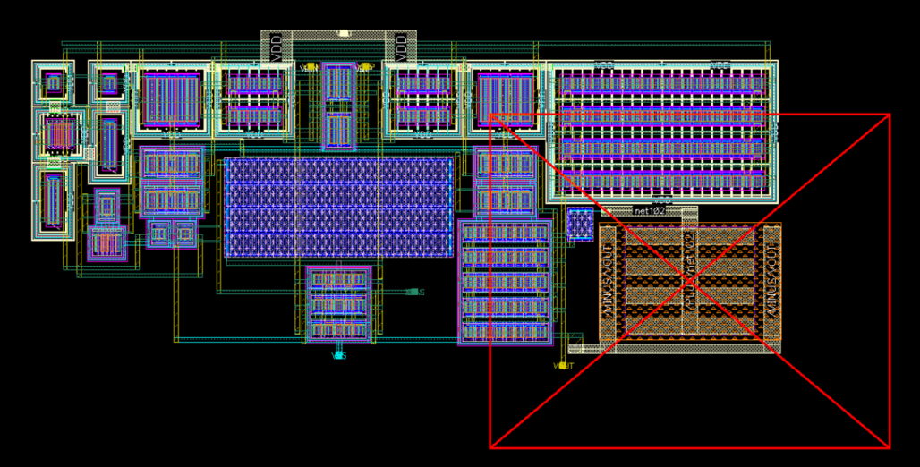
LAYOUT_VERSION1

Slide 3
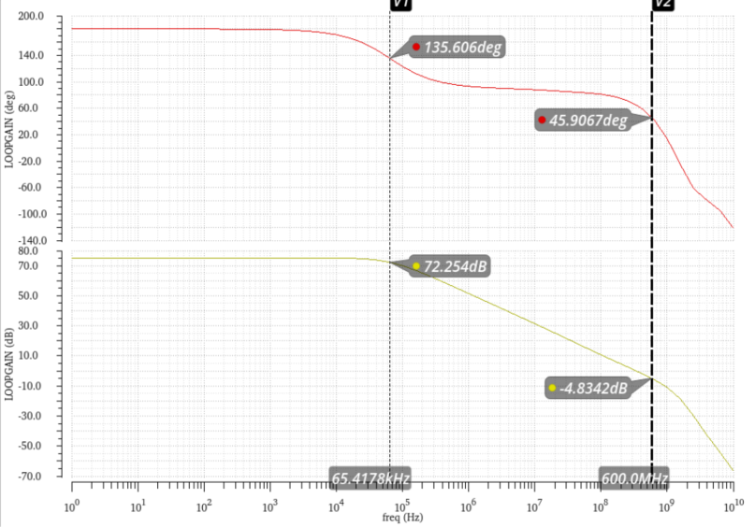
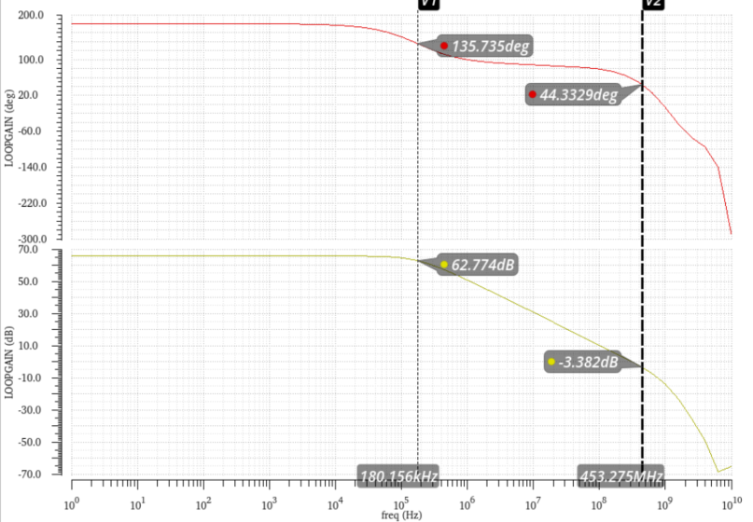
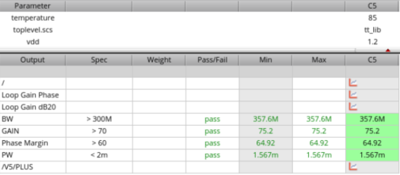
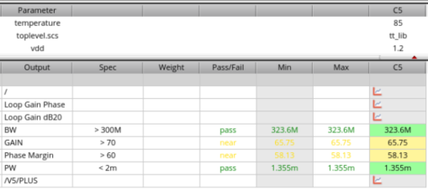
LAYOUT_VERSION1

Slide 4
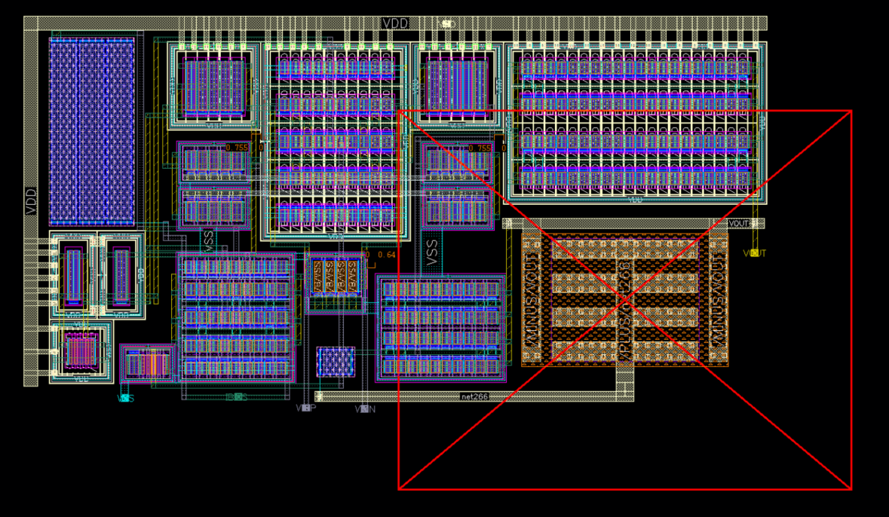
LAYOUT_VERSION2

Slide 5
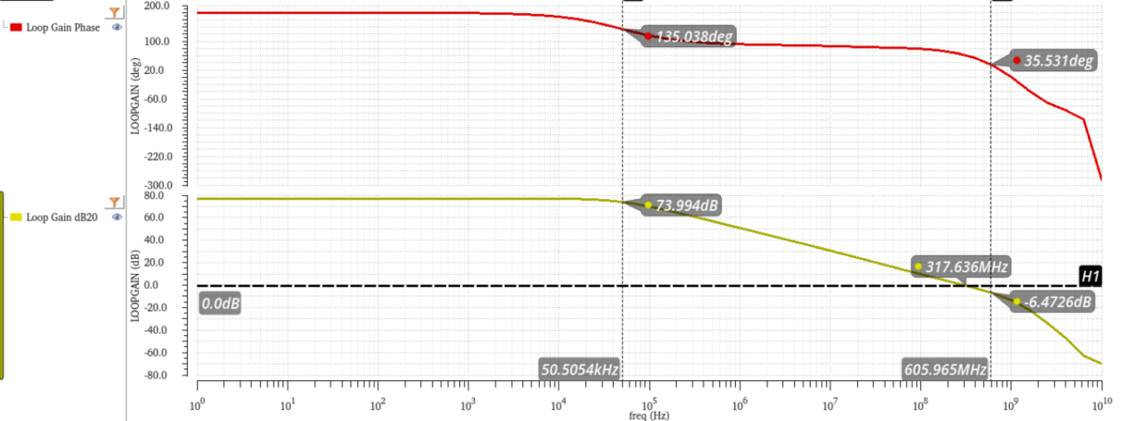
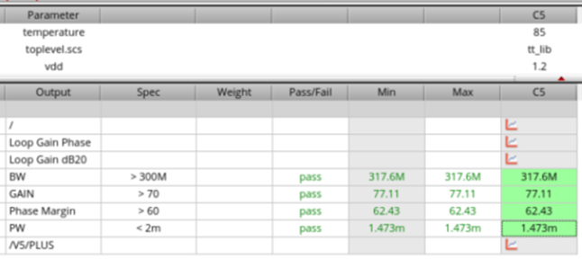
LAYOUT_VERSION2

