Slide 1

Evaluation of the Cell Allocation Mechanism in 6TiSCH Minimal Scheduling Function for Wireless Sensor Networks - Kickoff
Benjamin Ko
Supervisor: Yevhenii Shudrenko
First Examiner: Prof. Timm-Giel

Slide 2
Agenda:
Introduction
Motivation
Research question
Schedule

Slide 3
1. Introduction

Slide 4

1. Introduction - Internet of Things (IoT)
Effort to digitalize the environment by outfitting objects with digital capability and connecting them
Gain control and insight into the physical environment
Many (sensor) nodes that need to be connected
⇒ Wireless networks most suitable for that
Figure 1. IoT network [2]
© [2]

Slide 5
1. Introduction - Wireless networks for IoT
Wireless network needed for IoT
Cheap
Dynamic
Scalable
Easy to maintain
Energy efficient
Low-power and Lossy Networks (LLN)
6TiSCH as a protocol stack for these networks
Figure 1. IoT network [2]
© [2]

Slide 6
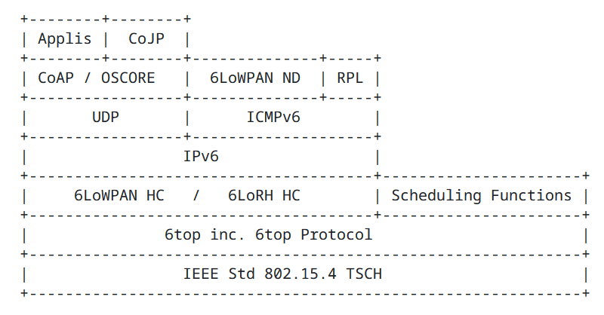
1. Introduction - 6TiSCH
Enables IPv6 for LLN networks using IEEE 802.15.4
6TiSCH stands for IPv6 over TSCH
Convergence of Operational Technology (OT) and Information Technology (IT)[8]
Using 6LoWPAN standard for e.g. header compression and neighbour discovery
Figure 2. Protocol stack of 6TiSCH [1]
© [1]

Slide 7
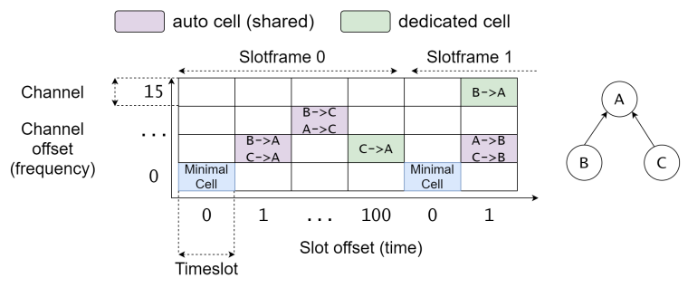
1. Introduction - 6TiSCH
TSCH used as MAC protocol
Mix of TDM/FDM creating a matrix of cells for transmission
6top Protocol (6P) used as communication [3]
Scheduling function (SF) handles schedule
Figure 3. TSCH TDM/FDM schedule [7]
© [1]

Slide 8
1. Introduction - Scheduling Function
The scheduling functions tasks for a node are: [1]
When and how many to cells add/delete
Which cells to include in CellList of the 6P ADD request
The only scheduling function that has a official RFC by the IETF is the Minimal Scheduling function
Figure 3. TSCH TDM/FDM schedule [7]
© Bildnachweis oder andere Copyright Links

Slide 9
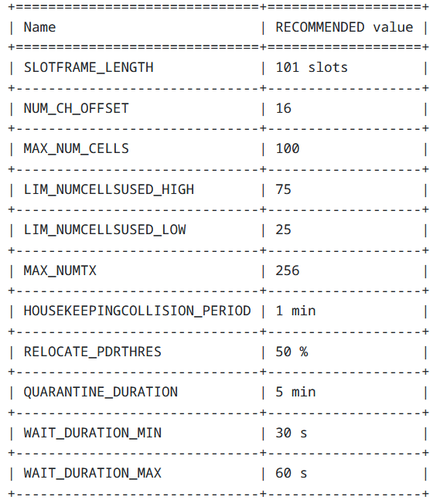
1. Introduction - Minimal Scheduling Function (MSF)
Has mechanisms to decide when to add/delete cells
CellList is chosen randomly and uniformly
Example: Relocation of a cell
PDR_{cellmax} − PDR_{i} > RELOCATE_PDRTHRES
⇒ If true MSF will relocate the cell
PDR = Packet delivery ratio
Figure 4. MSF recommended values [4]
© Bildnachweis oder andere Copyright Links

Slide 10
2. Motivation

Slide 11
2. Motivation - Pre-existing evaluations of MSF
Minimal scheduling function has been studied analytically and with simulations in regards to:
Convergence in the MSF adaptation period [5]
Performance in constant and varying traffic [6]
Influence of 6TiSCH MSF parameters on network KPIs, such as PDR, delay, duty cycle and cell utilisation [7]
© Bildnachweis oder andere Copyright Links

Slide 12
2. Motivation - Need for study in depth
6 TiSCH is an important protocol stack for standardizing the development of IoT
MSF as the only 6TiSCH SF having an official RFC standard [4]
More in depth evaluation and understanding valuable
Cell allocation mechanism not studied in detail yet
Many simulations but little experimental validation
© Bildnachweis oder andere Copyright Links

Slide 13
3. Research question

Slide 14
3. Research question - Headline
Evaluation of the Cell Allocation Mechanism in 6TiSCH Minimal Scheduling Function for Wireless Sensor Networks
© Bildnachweis oder andere Copyright Links

Slide 15
3. Research question - Evaluation
Evaluation of cell allocation duration dependent on:
Node density
Amount of traffic
MSF parameters
Cell allocation mechanisms (optional)
© Bildnachweis oder andere Copyright Links

Slide 16
3. Research question - Cell allocation mechanisms
Different cell allocation mechanisms to evaluate:
Random uniform selection of free cells (default)
Keeping a list of candidates in which the node listens and if traffic is detected then it will be exchanged with another cell
Stated as possibility in RFC for MSF [4]
© Bildnachweis oder andere Copyright Links

Slide 17
3. Research question - How?
1. Analytical modeling
2. Experimental validation
© Bildnachweis oder andere Copyright Links

Slide 18
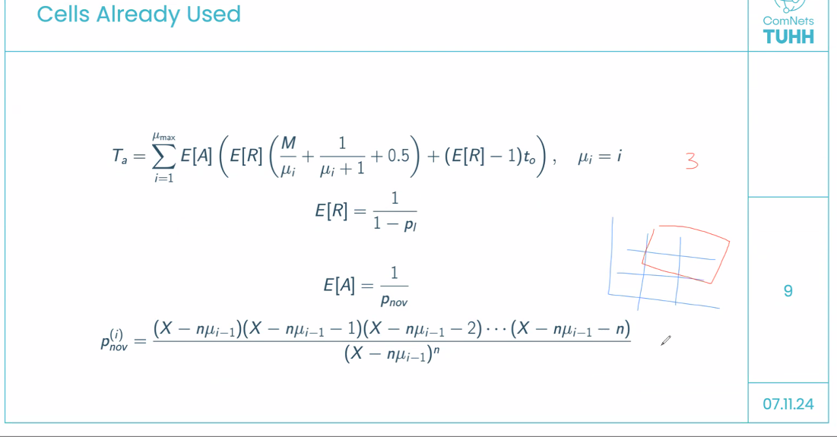
3. Research question - Analytical modeling
Adapt pre-existing statistical models to the situation
Figure 5. Pre-existing statistical model for adaptation time
© Bildnachweis oder andere Copyright Links

Slide 19
3. Research question - Analytical modeling
Figure 6. Base formula for calculating probability of all cell allocation to be without interference
Figure 7. Further specified formula based on the one above
© Bildnachweis oder andere Copyright Links

Slide 20
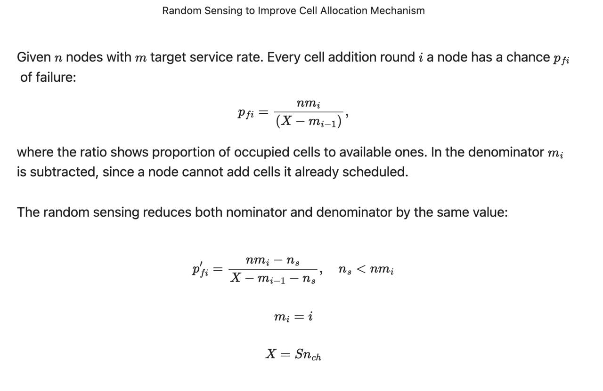
3. Research question - Analytical modeling
© Bildnachweis oder andere Copyright Links

Slide 21
3. Research question - Experimental validation
Using 3 OpenMote B boards running the Contiki-NG operating system
Simple 2 node configuration as parent (sink) and child
A third board will serve as emulator for different network conditions
Network emulator
Parent (sink)
Child
© Bildnachweis oder andere Copyright Links

Slide 22
4. Schedule

Slide 23
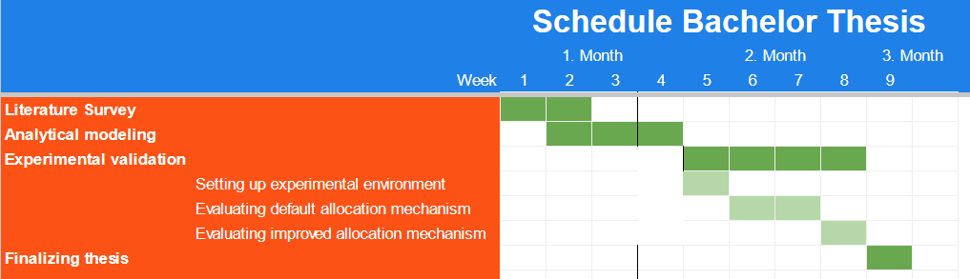
4. Schedule
© Bildnachweis oder andere Copyright Links

Slide 24
References
[1] Pascal Thubert . ‘An Architecture for IPv6 over the Time-Slotted Channel Hopping Mode of IEEE 802.15.4 (6TiSCH)’ . RFC 9030 . May 2021 . url: https://datatracker.ietf.org/doc/html/rfc9030.
[2] https://pixabay.com/images/search/iot%20network/ . Pixabay . last visited 27.11.2024
[3]Qin Wang , Xavier Vilajosana , Thomas Watteyne . 6TiSCH Operation Sublayer (6top) Protocol (6P) . RFC 8480 . November 2018 . https://datatracker.ietf.org/doc/rfc8480/ .
[4] T. Chang, Ed., M. Vučinić, Inria, X. Vilajosana, . ‘6TiSCH Minimal Scheduling Function (MSF)’ . RFC 9033. May 2021. doi: 10.17487/RFC9033. url: https://datatracker.ietf.org/doc/rfc9033/ .
[5] David Hauweele, Remous-Aris Koutsiamanis, Bruno Quoitin et al. ‘Pushing 6TiSCH Minimal Scheduling Function (MSF) to the Limits’. In: 2020 IEEE Symposium on Computers and Communications (ISCC). 2020, pp. 1–7. doi: 10.1109/ISCC50000.
2020.9219692.
[6] David Hauweele, Remous-Aris Koutsiamanis, Bruno Quoitin et al. ‘Thorough Performance Evaluation & Analysis of the 6TiSCH Minimal Scheduling Function (MSF)’. In: Journal of Signal Processing Systems 93 (6 June 2021). doi: 10.1007/
S11265-021-01668-w.
[7] Lukas Borutta. 'Evaluation of the Minimal Scheduling Function for 6TiSCH-based Wireless Sensor Networks' . (16 September 2021)
[8] Pascal Thubert . ‘IPv6 over the TSCH mode of IEEE 802.15.4e’ . https://datatracker.ietf.org/wg/6tisch/about/ . last visited 15.12.2024.
© Bildnachweis oder andere Copyright Links

Slide 25
Thank you!
Technische Universität Hamburg (TUHH)
Ko Benjamin

