Slide 1

Evaluation of the Cell Allocation Mechanism in 6TiSCH Minimal Scheduling Function for Wireless Sensor Networks - Midterm
Benjamin Ko
Supervisor: Yevhenii Shudrenko
First Examiner: Prof. Timm-Giel

Slide 2
Agenda:
Introduction
Current state
Problems
Schedule

Slide 3
1. Introduction

Slide 4
1. Introduction
Evaluation of the Cell Allocation Mechanism in 6TiSCH Minimal Scheduling Function for Wireless Sensor Networks
© Bildnachweis oder andere Copyright Links

Slide 5
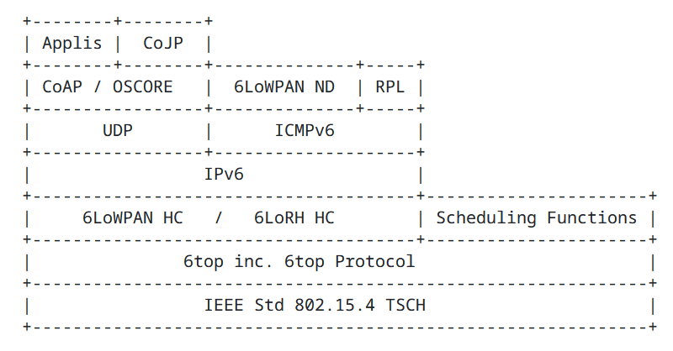
1. Introduction - 6TiSCH
Enables IPv6 for LLN networks using IEEE 802.15.4
6TiSCH stands for IPv6 over TSCH
Convergence of Operational Technology (OT) and Information Technology (IT)[8]
Using 6LoWPAN standard for e.g. header compression and neighbour discovery
Figure 2. Protocol stack of 6TiSCH [1]
© [1]

Slide 6
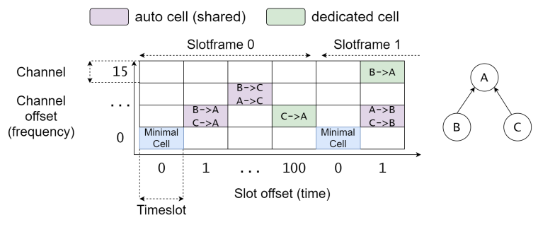
1. Introduction - 6TiSCH
TSCH used as MAC protocol
Mix of TDM/FDM creating a matrix of cells for transmission
6top Protocol (6P) used as communication [3]
Scheduling function (SF) handles schedule
Figure 3. TSCH TDM/FDM schedule [7]
© [1]

Slide 7
1. Introduction - Scheduling Function
The scheduling functions tasks for a node are: [1]
When and how many to cells add/delete
Which cells to include in CellList of the 6P ADD request
The only scheduling function that has a official RFC by the IETF is the Minimal Scheduling function
Figure 3. TSCH TDM/FDM schedule [7]
© Bildnachweis oder andere Copyright Links

Slide 8
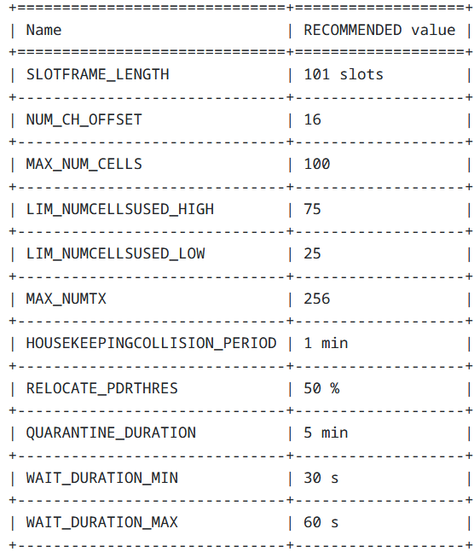
1. Introduction - Minimal Scheduling Function (MSF)
Has mechanisms to decide when to add/delete cells
CellList is chosen randomly and uniformly
Example: Relocation of a cell
PDR_{cellmax} − PDR_{i} > RELOCATE_PDRTHRES
⇒ If true MSF will relocate the cell
PDR = Packet delivery ratio
Figure 4. MSF recommended values [4]
© Bildnachweis oder andere Copyright Links

Slide 9
1. Introduction - Cell allocation mechanisms
Different cell allocation mechanisms to evaluate:
Random uniform selection of free cells (default)
Keeping a list of candidates in which the node listens and if traffic is detected then it will be exchanged with another cell
Stated as possibility in RFC for MSF [4]
© Bildnachweis oder andere Copyright Links

Slide 10
2. Current state

Slide 11
2. Current state - Thesis
Section of Thesis | Progress
Introduction | 95%
Background | 95%
Related work | 95%
Analytical model | 50%
Experimental validation | 30%
Conclusion | 0%
© Bildnachweis oder andere Copyright Links

Slide 12
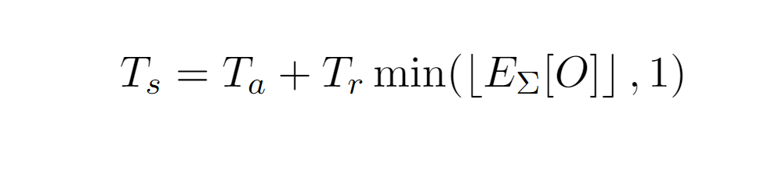
2. Current state - Analytical model
© Bildnachweis oder andere Copyright Links

Slide 13
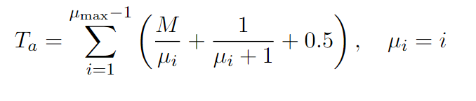
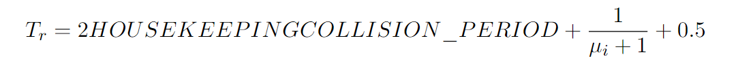
2. Current state - Analytical model
© Bildnachweis oder andere Copyright Links

Slide 14
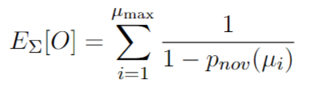
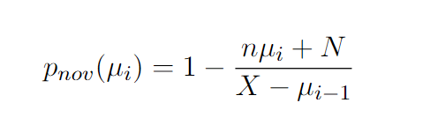
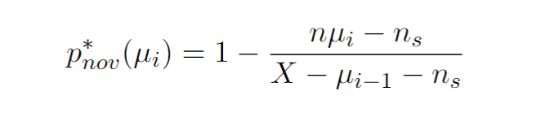
2. Current state - Analytical model
© Bildnachweis oder andere Copyright Links

Slide 15
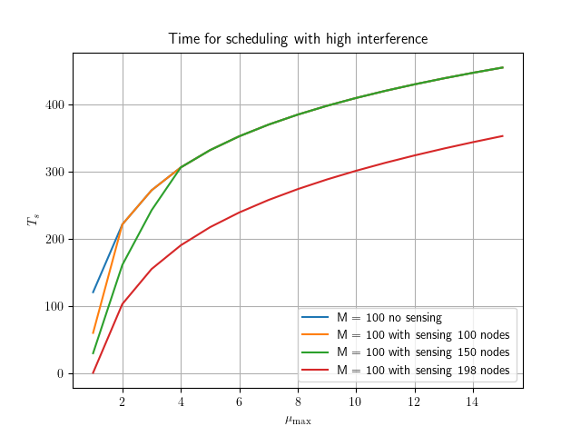
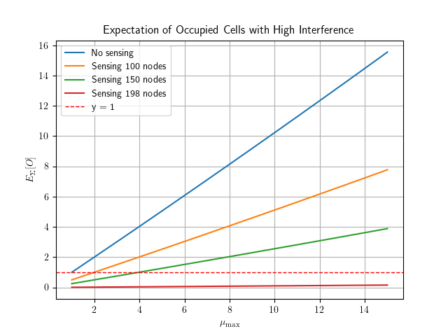
2. Current state - Analytical model
© Bildnachweis oder andere Copyright Links

Slide 16
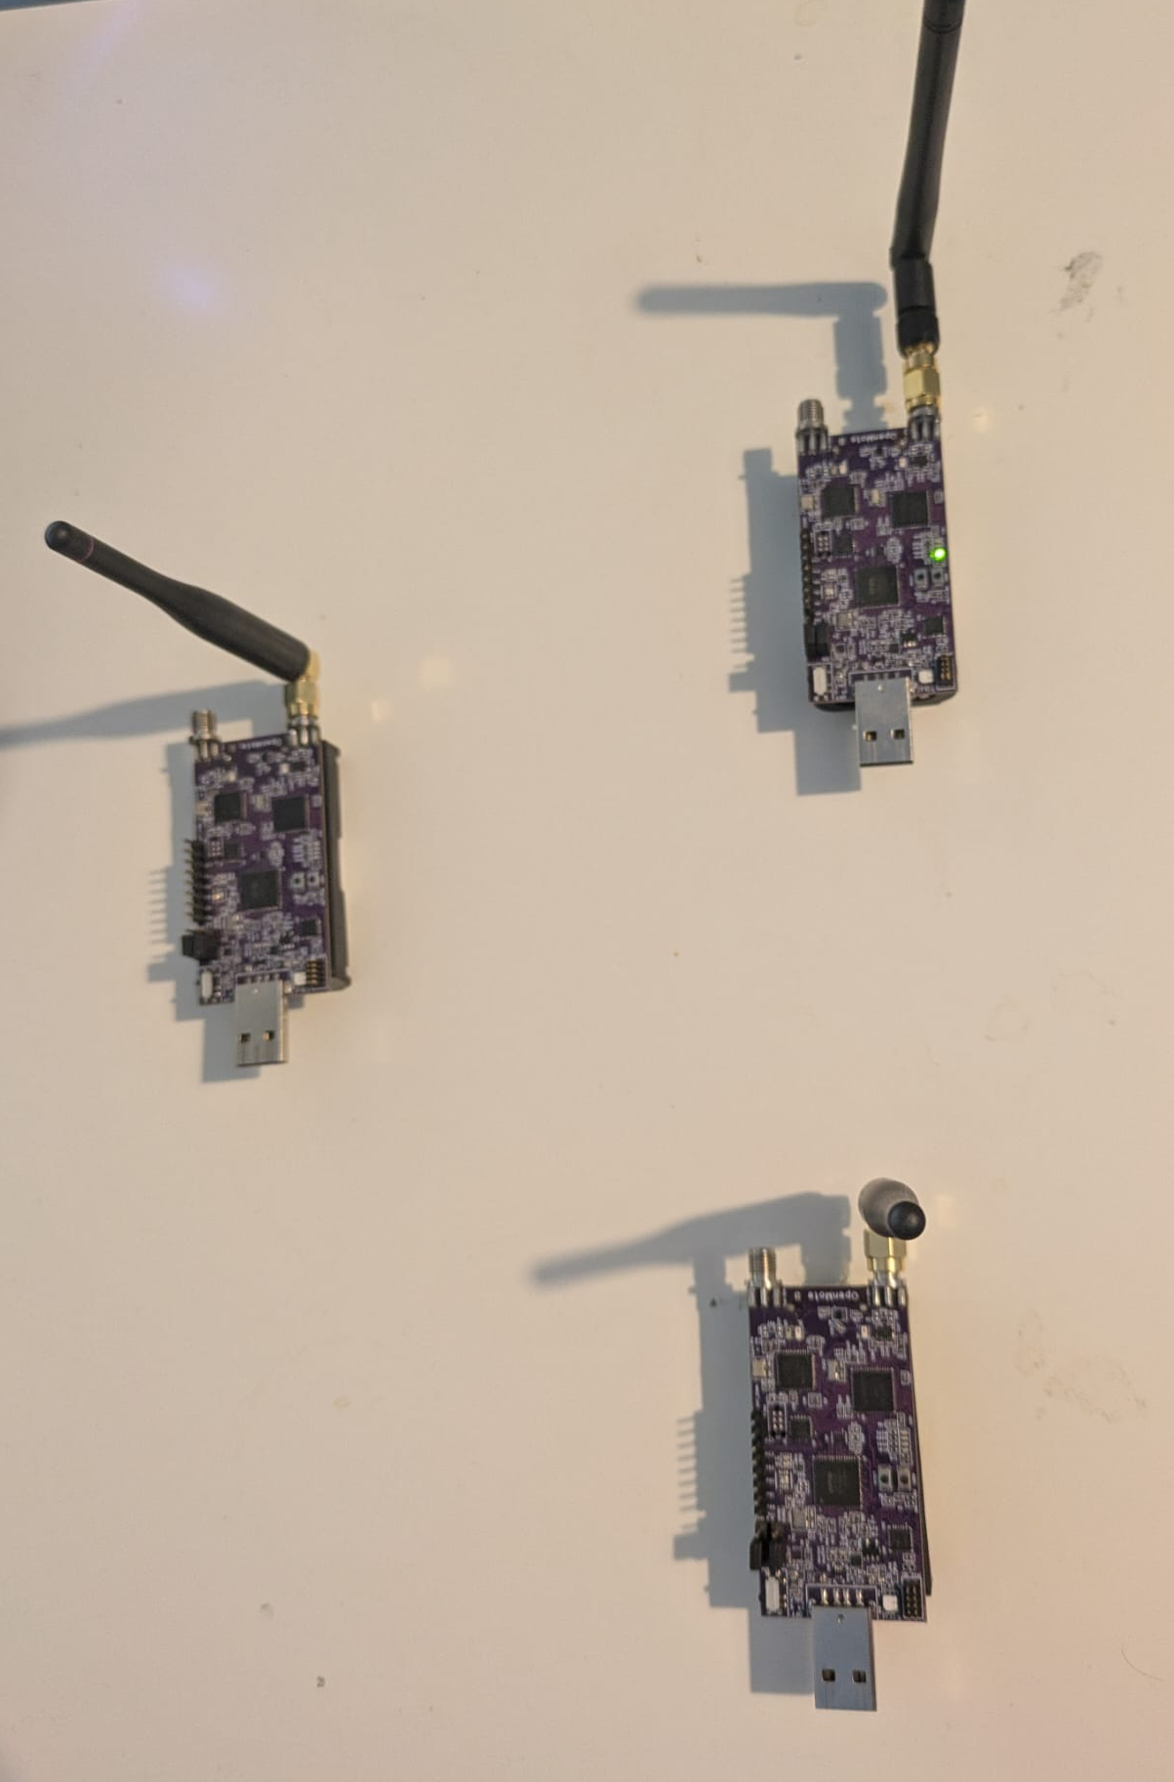
2. Current state - Experimental setup
3 Openmote-B nodes:
Parent (TSCH-coordinator, RPL-root)
Network emulator
Child
Additional implementation added in Contiki-NG code:
Setting up of autonomous cells
Relocation mechanism
Interferer mechanism of broadcasting
Sensing approach
© Bildnachweis oder andere Copyright Links

Slide 17
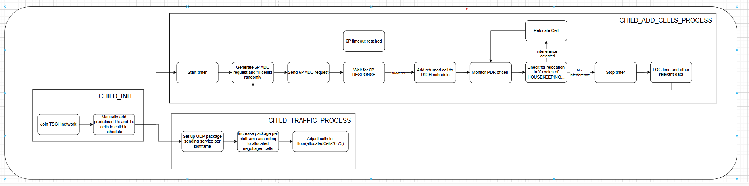
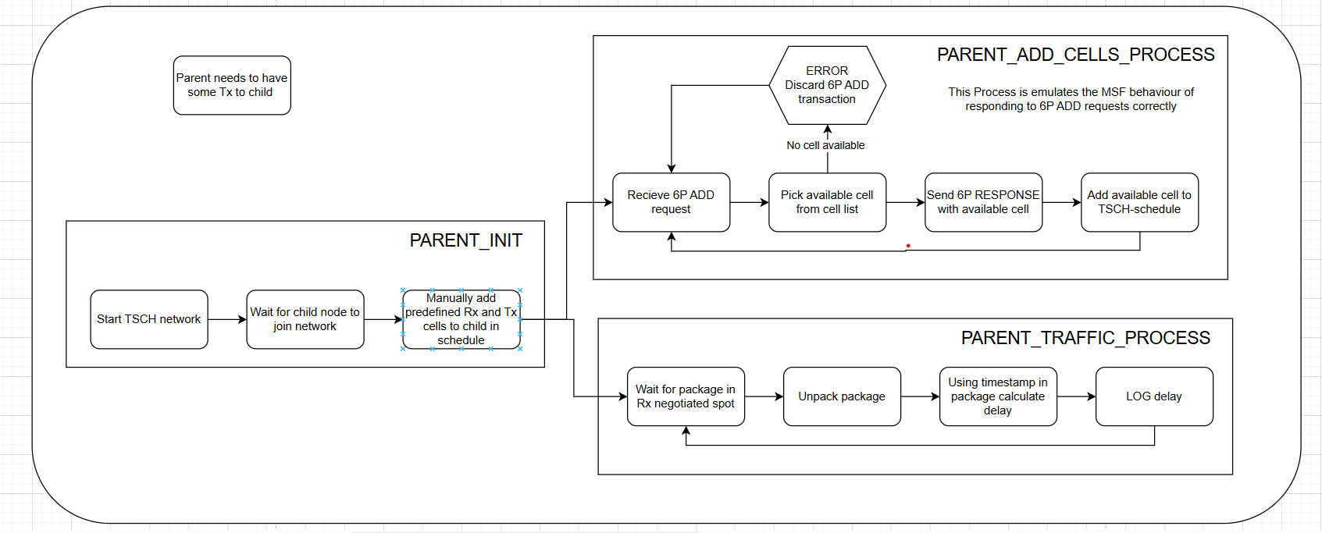
2. Current state - Experimental setup
© Bildnachweis oder andere Copyright Links

Slide 18
2. Current state - Experimental setup
3 Openmote-B nodes:
Parent (TSCH-coordinator, RPL-root)
Network emulator
Child
Additional implementation added in Contiki-NG code:
Setting up of autonomous cells
Relocation mechanism
Interferer mechanism of broadcasting
Sensing approach
© Bildnachweis oder andere Copyright Links

Slide 19
3. Challenges

Slide 20
3. Challenges
Analytical:
Difficulties of unifying a general and abstract model with detailed experimental setup
Especially for sensing allocation approach
Experimental:
Boards get bricked and can only be fixed with debugger
At times unpredictable behaviour due to parallel processes
© Bildnachweis oder andere Copyright Links

Slide 21
4. Schedule

Slide 22
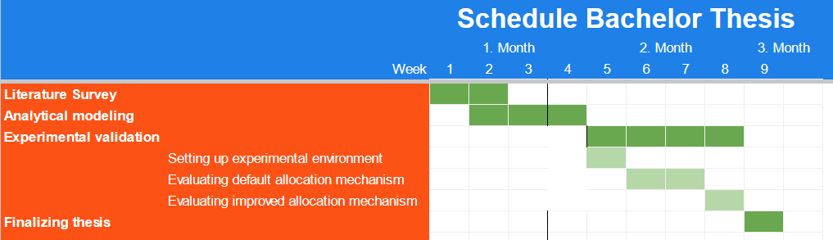
4. Schedule
© Bildnachweis oder andere Copyright Links

Slide 23
References
[1] Pascal Thubert . ‘An Architecture for IPv6 over the Time-Slotted Channel Hopping Mode of IEEE 802.15.4 (6TiSCH)’ . RFC 9030 . May 2021 . url: https://datatracker.ietf.org/doc/html/rfc9030.
[2] https://pixabay.com/images/search/iot%20network/ . Pixabay . last visited 27.11.2024
[3]Qin Wang , Xavier Vilajosana , Thomas Watteyne . 6TiSCH Operation Sublayer (6top) Protocol (6P) . RFC 8480 . November 2018 . https://datatracker.ietf.org/doc/rfc8480/ .
[4] T. Chang, Ed., M. Vučinić, Inria, X. Vilajosana, . ‘6TiSCH Minimal Scheduling Function (MSF)’ . RFC 9033. May 2021. doi: 10.17487/RFC9033. url: https://datatracker.ietf.org/doc/rfc9033/ .
[5] David Hauweele, Remous-Aris Koutsiamanis, Bruno Quoitin et al. ‘Pushing 6TiSCH Minimal Scheduling Function (MSF) to the Limits’. In: 2020 IEEE Symposium on Computers and Communications (ISCC). 2020, pp. 1–7. doi: 10.1109/ISCC50000.
2020.9219692.
[6] David Hauweele, Remous-Aris Koutsiamanis, Bruno Quoitin et al. ‘Thorough Performance Evaluation & Analysis of the 6TiSCH Minimal Scheduling Function (MSF)’. In: Journal of Signal Processing Systems 93 (6 June 2021). doi: 10.1007/
S11265-021-01668-w.
[7] Lukas Borutta. 'Evaluation of the Minimal Scheduling Function for 6TiSCH-based Wireless Sensor Networks' . (16 September 2021)
[8] Pascal Thubert . ‘IPv6 over the TSCH mode of IEEE 802.15.4e’ . https://datatracker.ietf.org/wg/6tisch/about/ . last visited 15.12.2024.
© Bildnachweis oder andere Copyright Links

Slide 24
Thank you!
Technische Universität Hamburg (TUHH)
Ko Benjamin

