Slide 1

Evaluation of the Cell Allocation Mechanism in 6TiSCH Minimal Scheduling Function for Wireless Sensor Networks
Benjamin Ko
Supervisor: Yevhenii Shudrenko
First Examiner: Prof. Timm-Giel

Slide 2
Agenda:
Introduction
Motivation
Analytical Model
Experimental validation
Results
Conclusion

Slide 3
1. Introduction

Slide 4
1. Introduction
Evaluation of the Cell Allocation Mechanism in 6TiSCH Minimal Scheduling Function for Wireless Sensor Networks

Slide 5
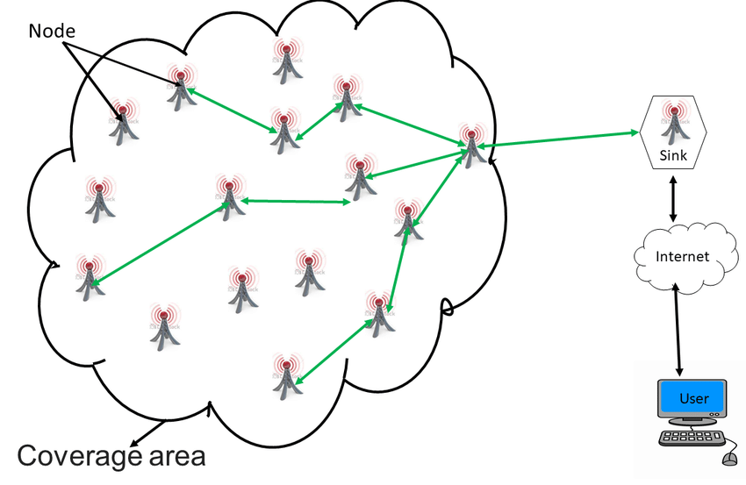
1. Introduction - Wireless sensor networks
Wireless sensor networks (WSN) as used in industrial settings
Enables the collection of environmental data
Characteristics:
Cheap and easy to operate
Scalable
Energy efficient
Figure 1. General architecture of a WSN. [1]

Slide 6
1. Introduction
Evaluation of the Cell Allocation Mechanism in 6TiSCH Minimal Scheduling Function for Wireless Sensor Networks

Slide 7
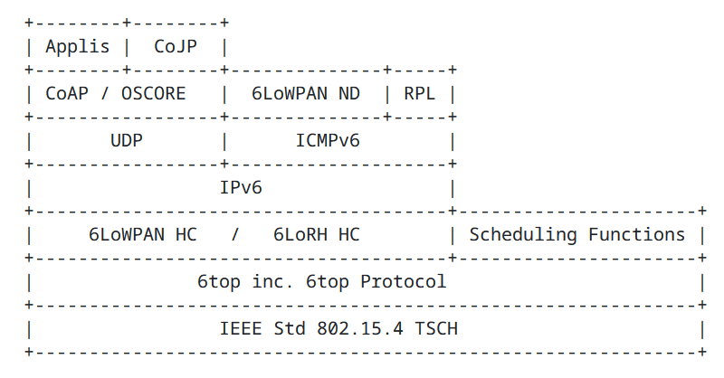
1. Introduction - 6TiSCH
IPv6 over the TSCH mode of IEEE 802.15.4
Utilizes 6LoWPAN for e.g. header compression
Defines 6top sublayer
Defines the tasks of scheduling functions
Figure 2. Protocol stack of 6TiSCH [2]

Slide 8
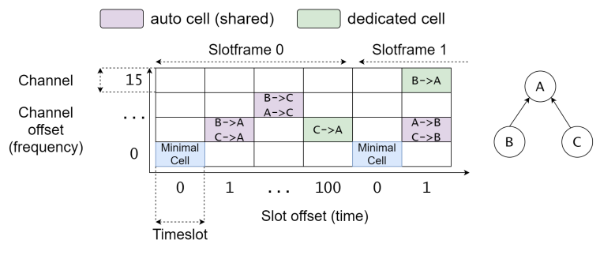
1. Introduction - 6TiSCH
TSCH used as MAC protocol
Mix of TDMA/FDMA creating a matrix of cells for communication
6top Protocol (6P) used for cell negotiation[3]
⇒ Scheduling function handles the schedule
Figure 3. TSCH TDM/FDM schedule [4]

Slide 9
1. Introduction - Scheduling Function
Tasks of the scheduling function[5]:
When and how many cells to add/delete
Which cells to include in CellList of the 6P ADD request
The only scheduling function defined by a RFC is the Minimal Scheduling Function (MSF)
Figure 3. TSCH TDM/FDM schedule [4]

Slide 10
1. Introduction
Evaluation of the Cell Allocation Mechanism in 6TiSCH Minimal Scheduling Function for Wireless Sensor Networks

Slide 11
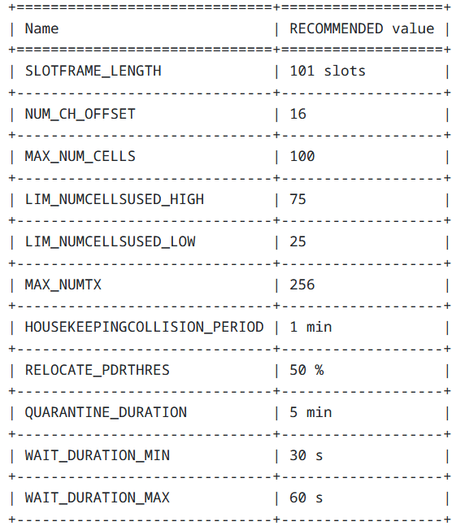
1. Introduction - Minimal Scheduling Function (MSF)
Has mechanisms to decide when to add/delete/relocate cells
Example: Relocation of a cell
Wait 1 min
Evaluate PDR of each cell for relocation
Relocate cells
PDR = Packet delivery ratio
Figure 4. MSF recommended values [2]

Slide 12
1. Introduction
Evaluation of the Cell Allocation Mechanism in 6TiSCH Minimal Scheduling Function for Wireless Sensor Networks

Slide 13
1. Introduction - Cell allocation mechanism
A
B
6P ADD Request
NumCells = 1
CellList = [(2, 1), (1 , 2), (3 , 1), (2 , 2)]
Node A schedule
Node B schedule
ACK
f2
f1
f2
f1
t1 t2 t3
6P ADD Response
CellList = [(3 , 1)]
t1 t2 t3
ACK

Slide 14

1. Introduction - Cell allocation mechanism
1. Default cell allocation mechanism
MSF randomly uniformly selects cells
All free cells
CellList
© Dice taken from [11]

Slide 15

1. Introduction - Cell allocation mechanism
2. Sensing cell allocation mechanism as proposed by RFC 9033 [4]
A candidate cell list is maintained where MSF senses for traffic
When traffic detected cell is dropped
All free cells
Candidate cell list
CellList
© Dice taken from [11], Trash bin taken from [11]

Slide 16
2. Motivation

Slide 17
2. Motivation - Previous work
Previous work on MSF has focused on:
Analytical and Simulation based evaluation of MSF parameters by Tangfei Chang et al. [6] and David Hauweele et al. [7] [8]
Proposing improved version of MSF by for instance varying the number of cells allocated Tangfei Chang et al [6] and Manas Khatua Karnish et al. [9]
Experimental evaluation of 6P and MSF by Francesca Righetti et al. [10]
⇒ Lacking research of cell allocation mechanism and experimental validation

Slide 18
2. Motivation - This work
Evaluate the default and sensing cell allocation mechanism for MSF
Using the KPI:
T_{s}: Time it takes to allocate μ_{max} cells and the network to stabilize
Stabilize: No more relocations necessary
p_{ov}: Probability of overlap
f2
f1
t1 t2 t3
⇒ Using an analytical model and experimental validation

Slide 19
3. Analytical Model

Slide 20
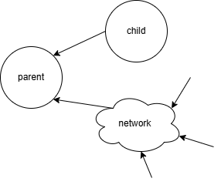
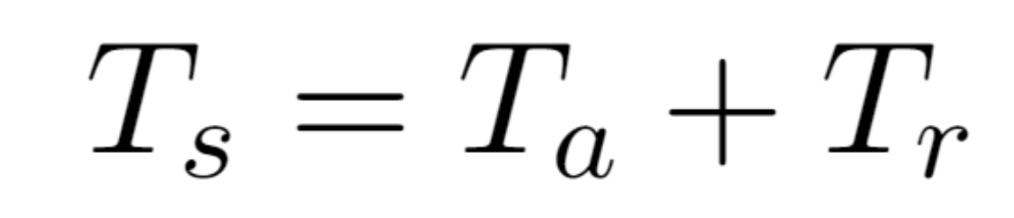

3. Analytical model
Calculate the T_{s} for μ_{max} cells to be allocated:
Figure 5. Network topology of analytical model

Slide 21
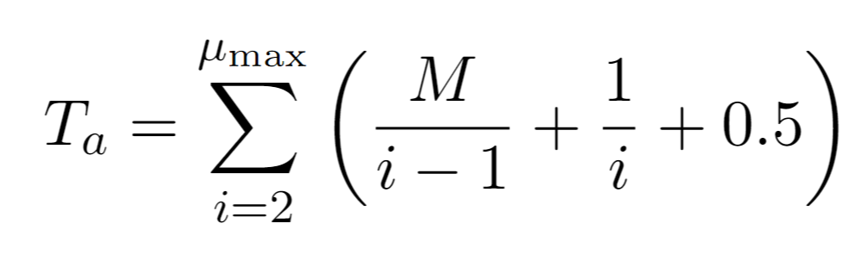
3. Analytical model - Cell allocation time
6P ADD response
Time to next cell allocation
6P ADD request

Slide 22
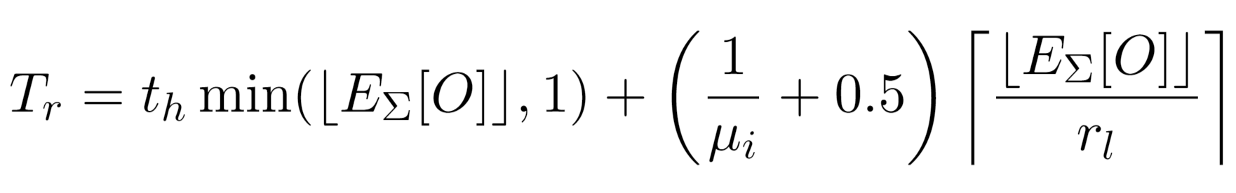
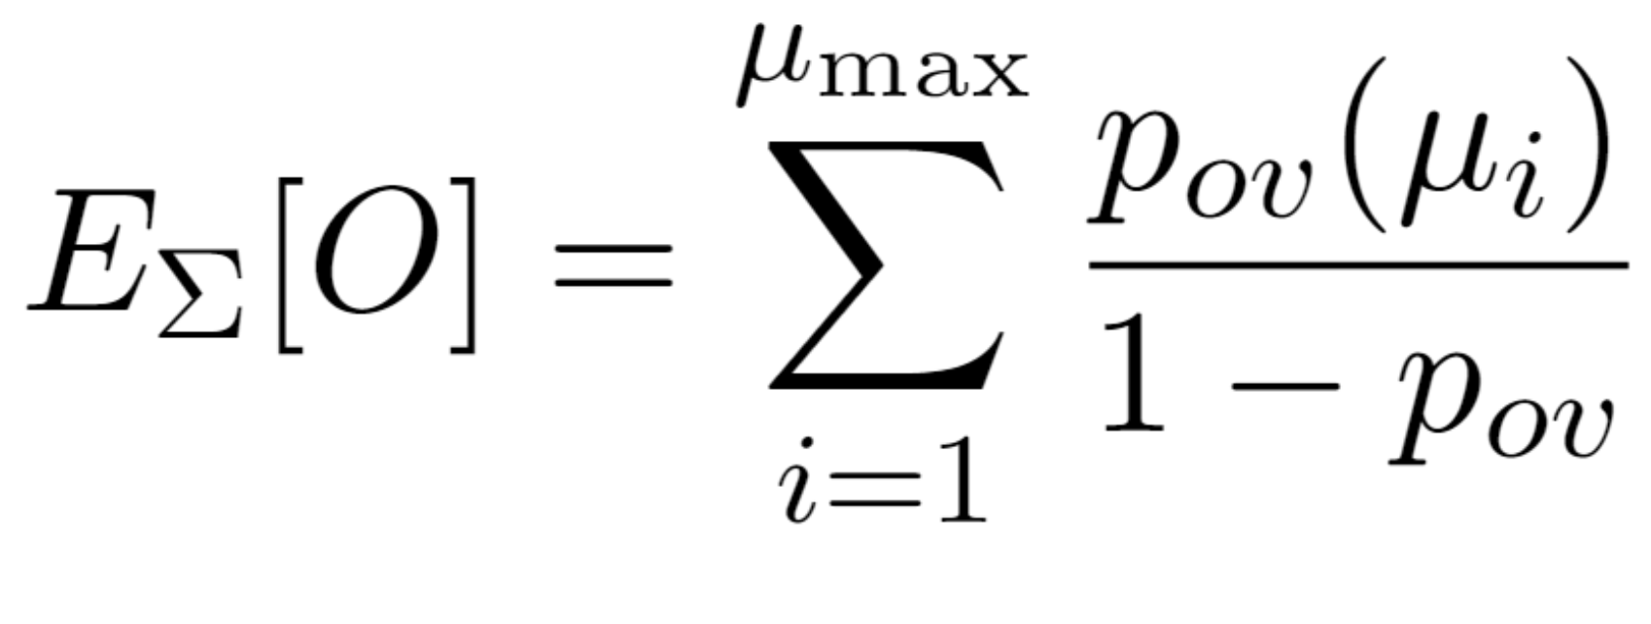
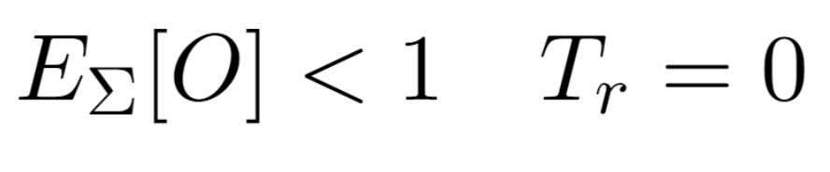
3. Analytical model - Relocation time
Time until all cells
are evaluated
Maximum cells per relocation
Example:

Slide 23
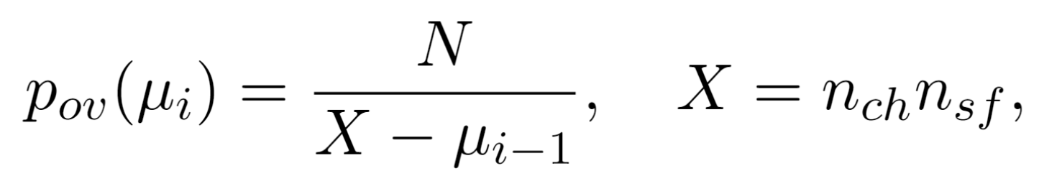
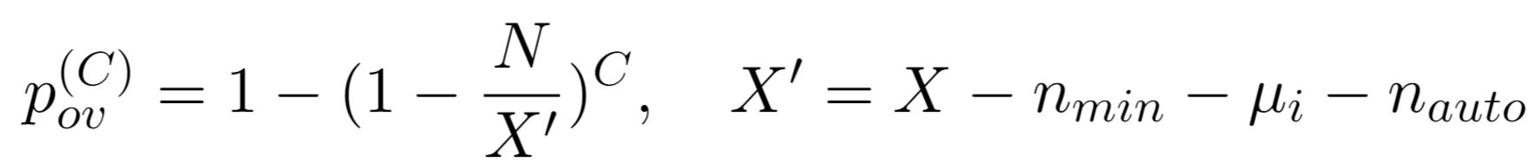
3. Analytical model - Probability of overlap
1. Default cell allocation mechanism:
2. Sensing cell allocation mechanism:
The time it takes for allocating a cell allows for the candidate cell list to become non overlapped (its relatively fast)

Slide 24
4. Experimental validation

Slide 25
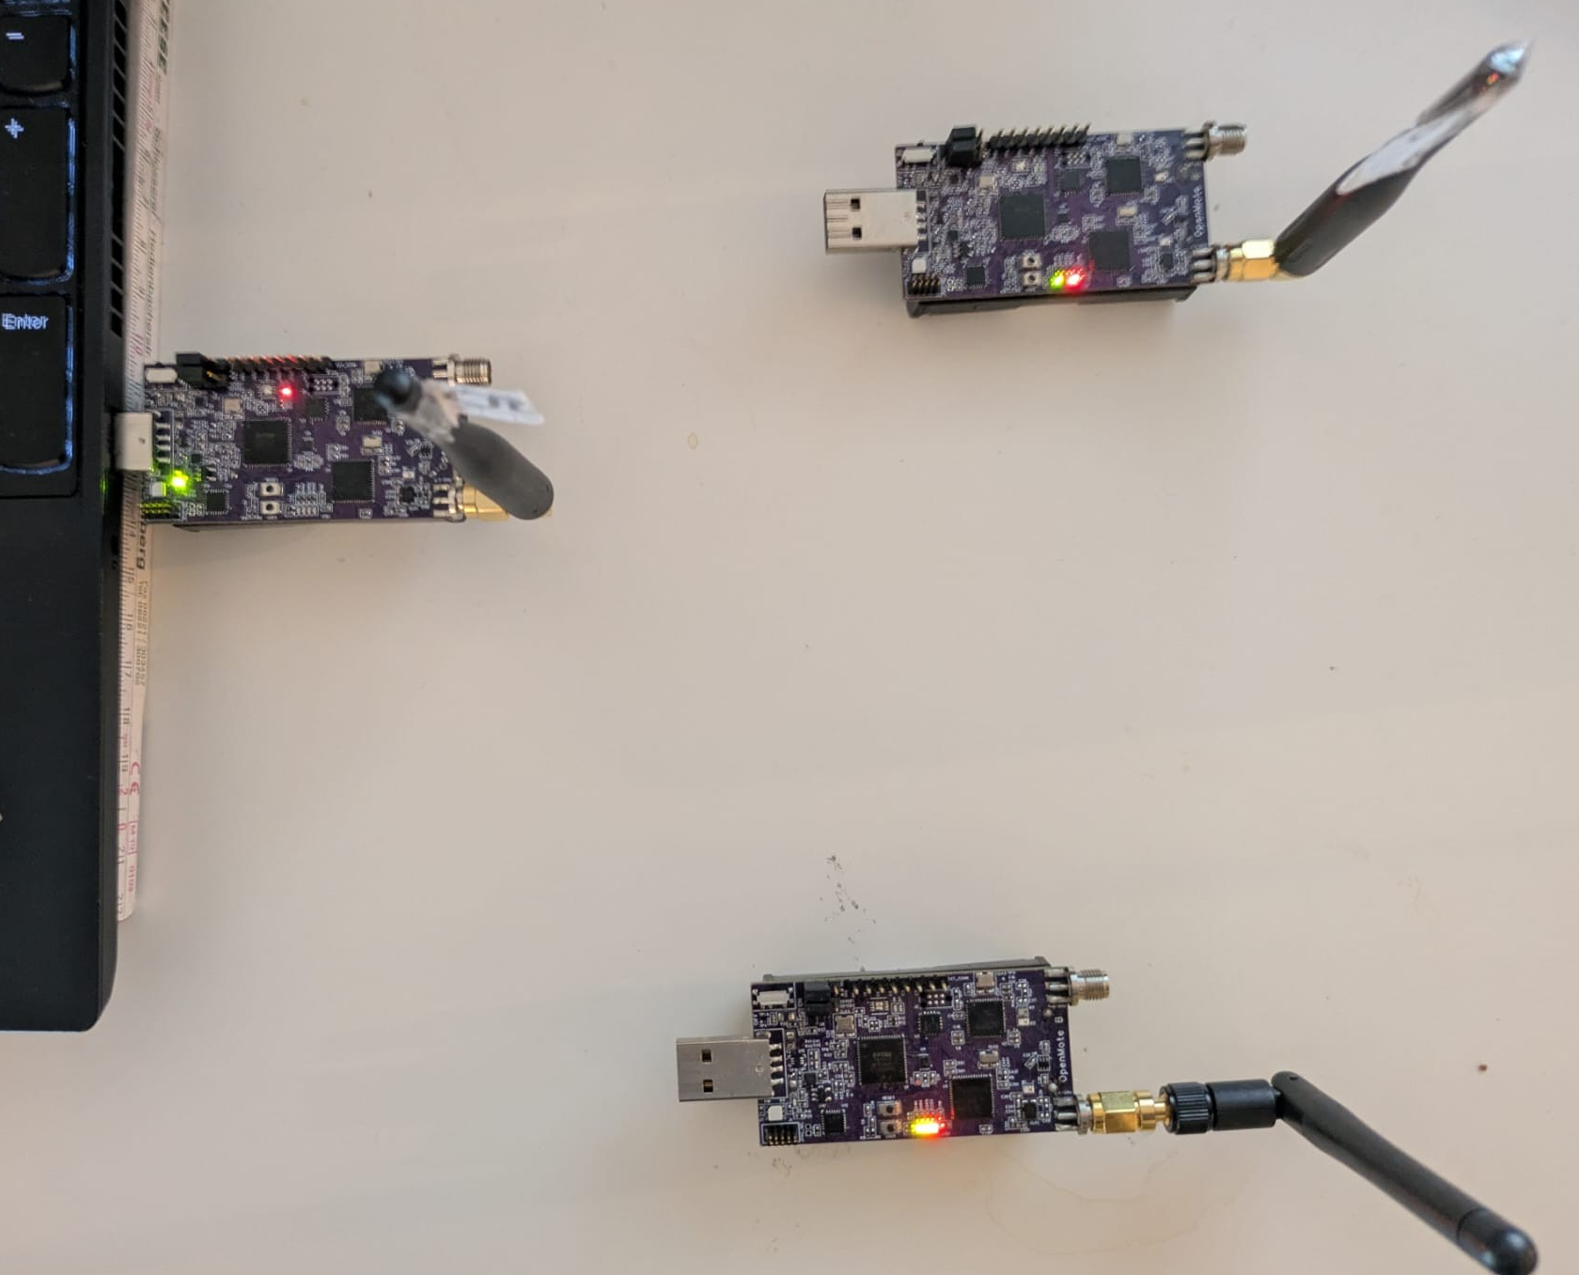
4. Experimental validation
Testbed consisting of Openmote-B boards running Contiki-NG
3 Openmote-B nodes:
Parent (TSCH-coordinator, RPL-root)
Network emulator
Child
Parent
Child
Network emulator
Figure 6. Experimental setup

Slide 26
4. Experimental validation
Parent
Child
Network
Schedule 𝞵_{max} amount of cells
Broadcast messages to emulate traffic

Slide 27
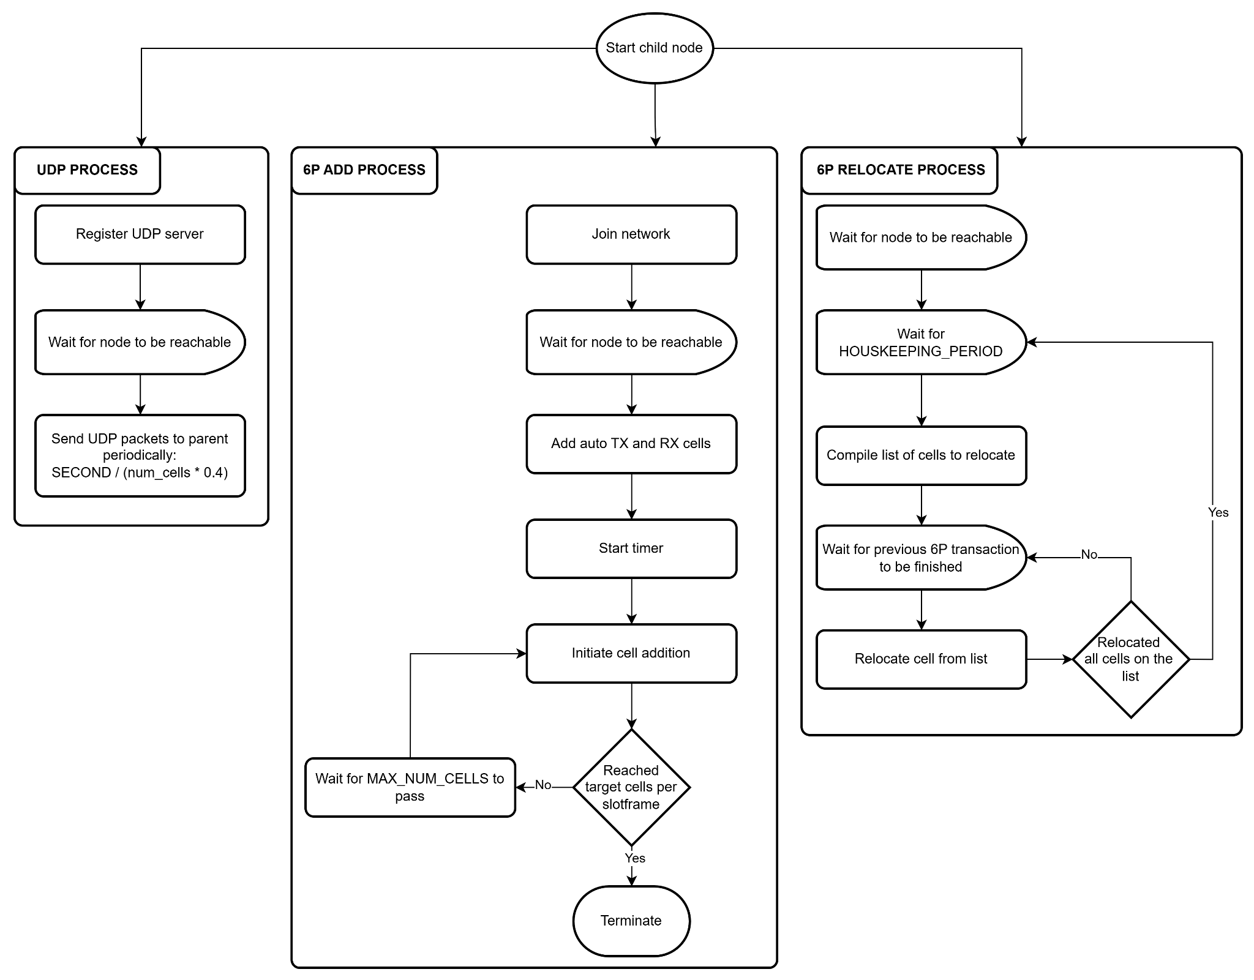
4. Experimental validation
Figure 7. Child node implementation.

Slide 28
4. Experimental validation - Parameters
Parameters | Values
Test runs per setup | 10
MAX_NUM_CELLS | 100 , 50
Network interference | 20% , 10%
HOUSEKEEPINGCOLLISION_PERIOD | 60s
Channels | 4
MAX_NUMTX | 32
Slotframe length | 100

Slide 29
5. Results

Slide 30
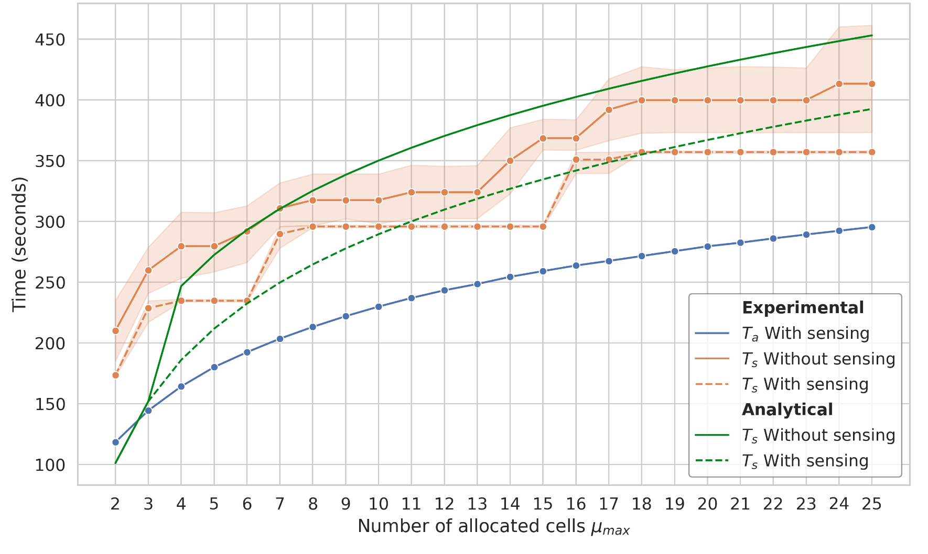
5. Results - Scheduling time
Figure 8. Experimental and analytical results with 20% interference.

Slide 31
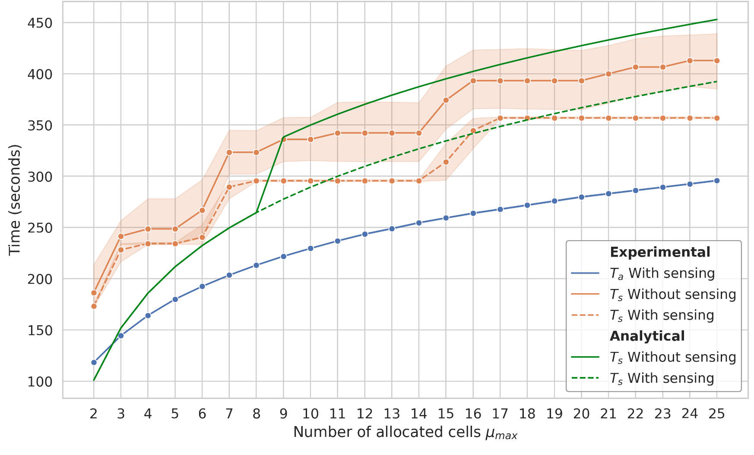
5. Results - Scheduling time
Figure 9. Experimental and analytical results with 10% interference.

Slide 32
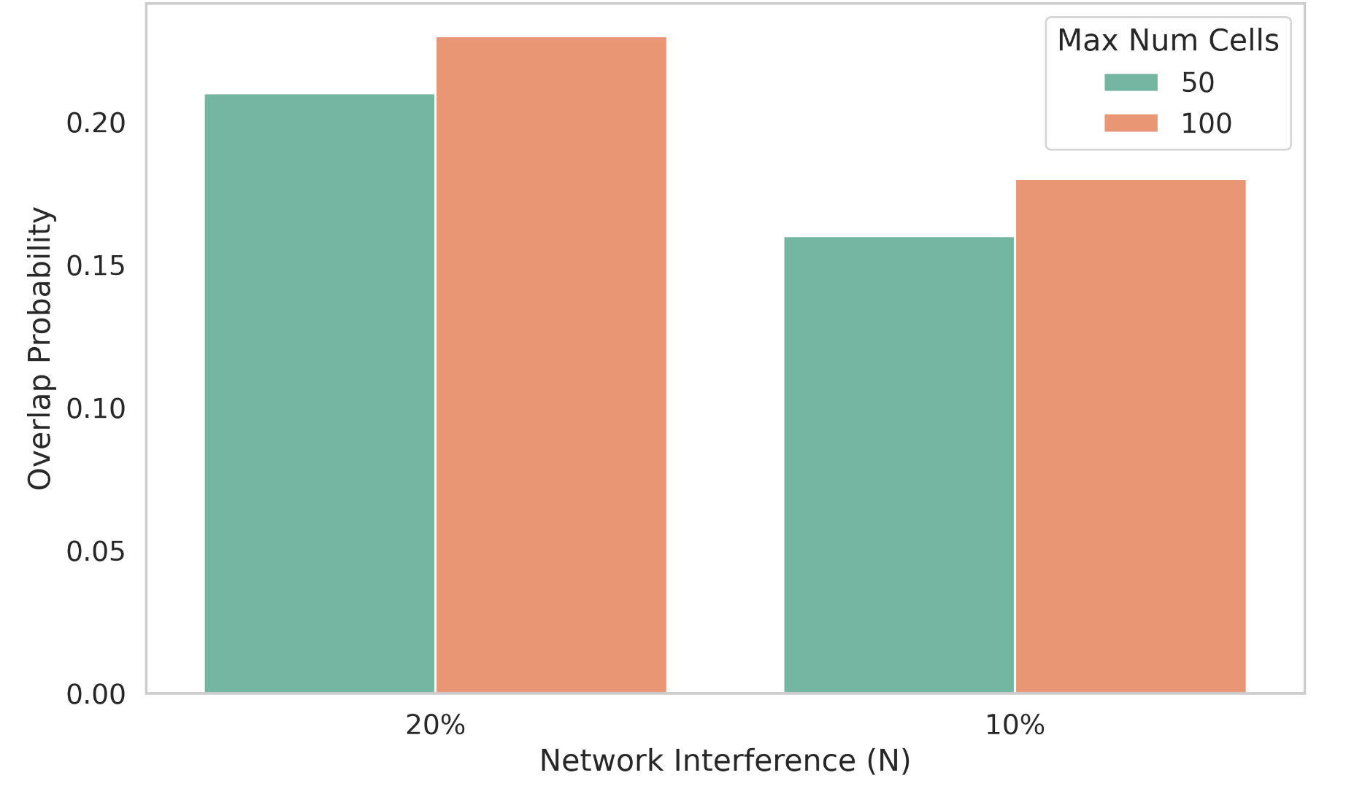
5. Results - Probability of overlap
Probability of overlap higher with higher network interference
Probability of overlap for sensing mechanism is 0
Experimental data confirms analytical predictions
Figure 10. Probability of overlap without sensing.

Slide 33
6. Conclusion

Slide 34
6. Conclusion
Sensing mechanism reduces cell overlaps and allocation time, avoiding relocations
Network interference impacts allocation time across all mechanisms
Lower MAX_NUM_CELLS reduces the allocation time but has insignificant effect on probability of overlap
Experimental results confirm the model’s accuracy
Future work: Full experimental implementation of sensing mechanism
& refined model considering multiple relocations and 6P timeouts

Slide 35
References
[1] Big Data Collection in Large-Scale Wireless Sensor Networks - Scientific Figure on ResearchGate. Available from: https://www.researchgate.net/figure/General-architecture-of-a-wireless-sensor-network-WSN_fig1_329012374 [accessed 14 Apr 2025]
[2] Tengfei Chang, Mališa Vučinić, Xavier Vilajosana et al. 6TiSCH Minimal Scheduling Function (MSF). RFC 9033. May 2021. doi: 10 . 17487 / RFC9033. url: https : //www.rfc-editor.org/info/rfc9033.
[3] Qin Wang, Xavier Vilajosana and Thomas Watteyne. 6TiSCH Operation Sublayer (6top) Protocol (6P). RFC 8480. November 2018. doi: 10.17487/RFC8480. Url: https://www.rfc-editor.org/info/rfc8480.
[4] Lukas Borutta. 'Evaluation of the Minimal Scheduling Function for 6TiSCH-based Wireless Sensor Networks' . (16 September 2021)
[5]Pascal Thubert . ‘An Architecture for IPv6 over the Time-Slotted Channel Hopping Mode of IEEE 802.15.4 (6TiSCH)’ . RFC 9030 . May 2021 . url: https://datatracker.ietf.org/doc/html/rfc9030.
[6] Tengfei Chang, Mališa Vučinić, Xavier V. Guillén et al. ‘6TiSCH Minimal Scheduling Function: Performance Evaluation’. In: Internet Technology Letters 3 (June 2020). Visited on 12th March 2021. doi: 10.1002/itl2.170.
[7] David Hauweele, Remous-Aris Koutsiamanis, Bruno Quoitin et al. ‘Pushing 6TiSCH Minimal Scheduling Function (MSF) to the Limits’. In: HAL (Le Centre pour la Communication Scientifique Directe) (July 2020). Visited on 16th October 2023. doi: 10.1109/iscc50000.2020.9219692.
[8] David Hauweele, Remous-Aris Koutsiamanis, Bruno Quoitin et al. ‘Thorough Performance Evaluation and Analysis of the 6TiSCH Minimal Scheduling Function (MSF)’. In: Journal of Signal Processing Systems 94 (January 2022). doi: 10.1007/
s11265-021-01668-w.
[9] Manas Khatua Karnish and Venkatesh Tamarapalli. ‘IMSF: Improved Minimal Scheduling Function for Link Scheduling in 6TiSCH Networks’. In: Proceedings of the International Conference on Distributed Computing and Networking (ICDCN).
January 2022. doi: 10.1145/3491003.3491027.
[10] Francesca Righetti, Carlo Vallati and Sajal K. Das et al. ‘An Experimental Evaluation of the 6top Protocol for Industrial IoT Applications’. In: 2019 IEEE Symposium on Computers and Communications (ISCC). 2019, pp. 1–6. doi: 10.1109/ISCC47284.2019.8969590.
[11]Freepik. (n.d.). Free graphic resources for everyone. https://www.freepik.com/. Visited on 14th April 2025

Slide 36
Thank you!
Technische Universität Hamburg (TUHH)
Ko Benjamin

Slide 37
1. Introduction - Cell relocation
A
B
6P RELOCATE Request
NumCells = 1
RelCells = [(2, 2)]
CandCells = [(1 , 1), (3 , 2), (3 , 1), (2 , 2)]
Node A schedule
Node B schedule
ACK
f2
f1
f2
f1
t1 t2 t3
6P ADD Response
CellList = [(3 , 2)]
t1 t2 t3
ACK
© Bildnachweis oder andere Copyright Links

Slide 38
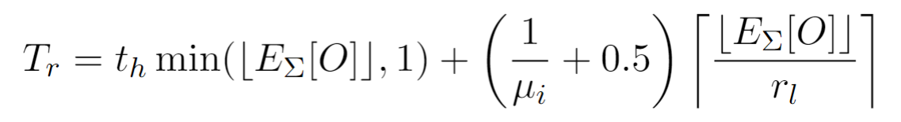
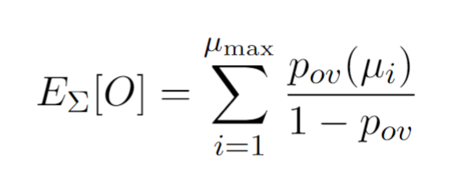
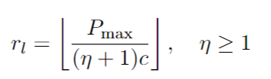
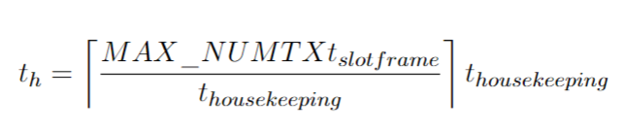
3. Analytical model
© Bildnachweis oder andere Copyright Links

Slide 39
4. Experimental validation
3 Openmote-B nodes:
Parent (TSCH-coordinator, RPL-root)
Network emulator
Child
Additional implementation added in Contiki-NG code:
Setting up of autonomous cells
Relocation mechanism
Interferer mechanism of broadcasting
Sensing approach
© Bildnachweis oder andere Copyright Links

Slide 40

3. Analytical model - Sensing approach
Initially upon selection of the cells the probability of overlap is
Probability of no overlap at all
The time it takes for allocating a cell allows for the candidate cell list to become non overlapped (its relatively fast)
© Bildnachweis oder andere Copyright Links

