Slide 1

Design Recommendation- OP 2
Team 1 - Subsystem E - ECE 295
Eric Liu, Mao Fan, Binjian Yu

Slide 2
Final Reflection
Seeing negative experiences as a positive one.
延迟符号

Slide 3
Requirements
Power
Frequency
THD
Input

Slide 4
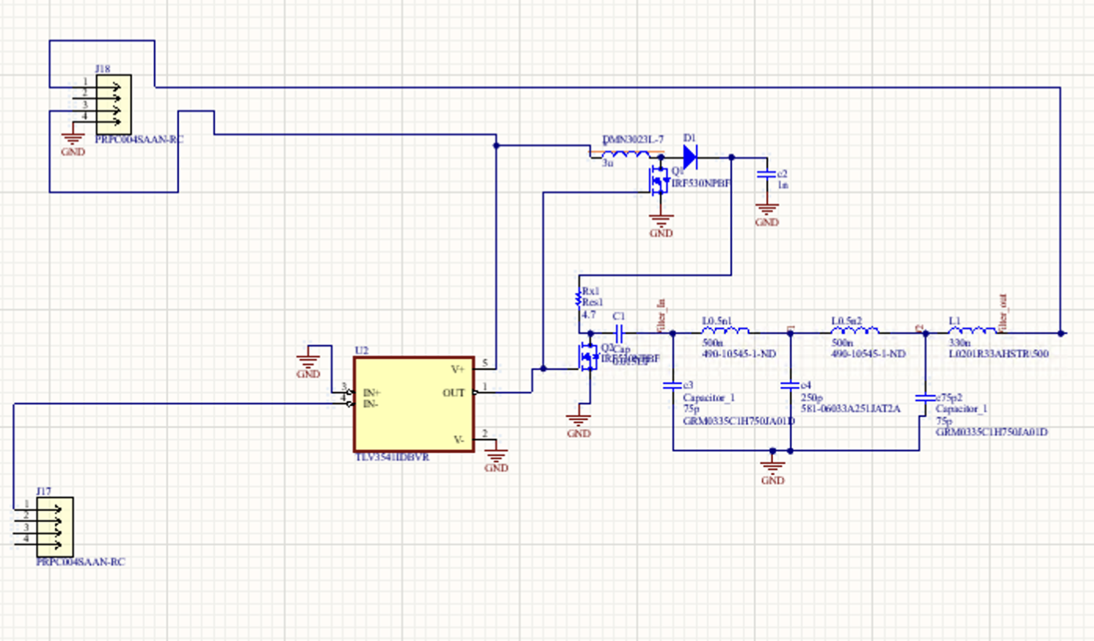
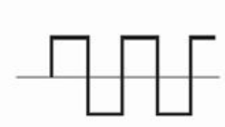
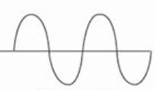
Circuit Overview
Voltage booster
Driver
D-amp
Lowpass

Slide 5
Which Parts Worked
Driver
Signal Amplifier
Stage 1-a
Stage 1-b
Stage 2
Stage 3
Voltage
Booster
Lowpass
Filter

Slide 6
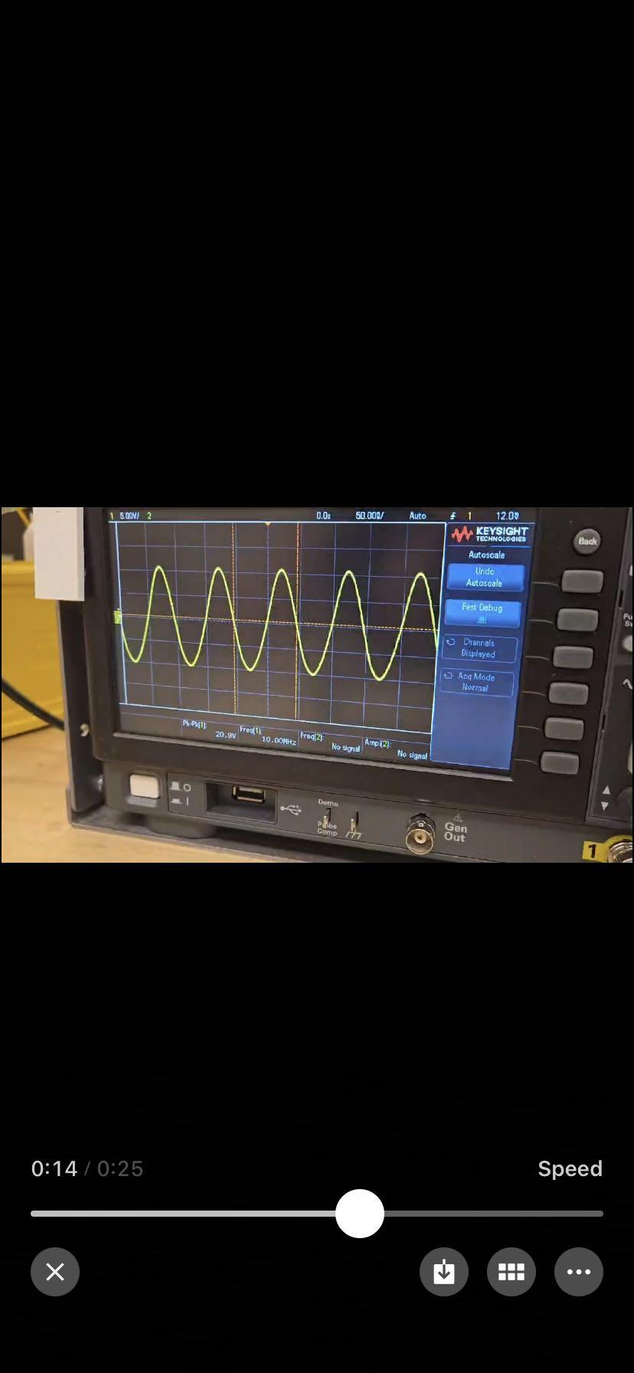
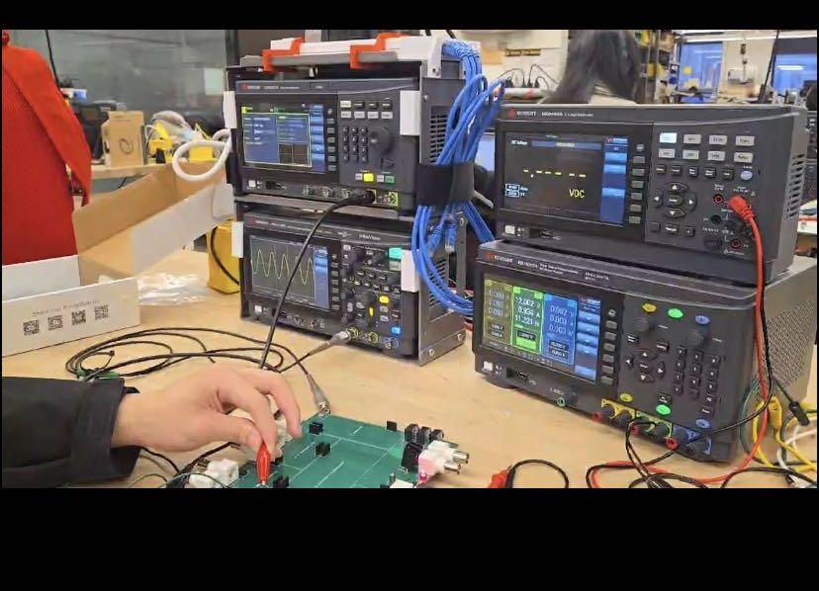

Slide 7
What went wrong?
01
02
03
04
Initial design
PCB
Opamp
CS amplifier
Too low voltage from ineffective switching.
Vin-, Vin+ are misplaced.
Oscillation from power supply.
Sudden shut off at 2 MHZ.
Mosfet burnt
1 to 6 volts

Slide 8
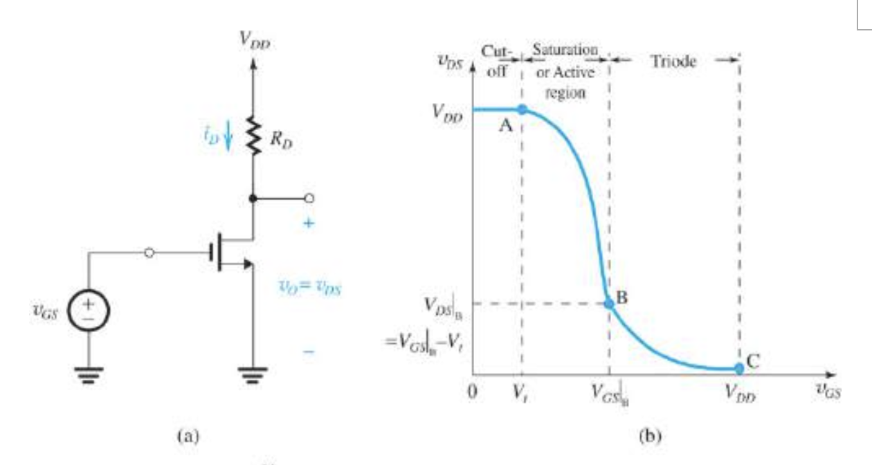
01 Initial design

Slide 9
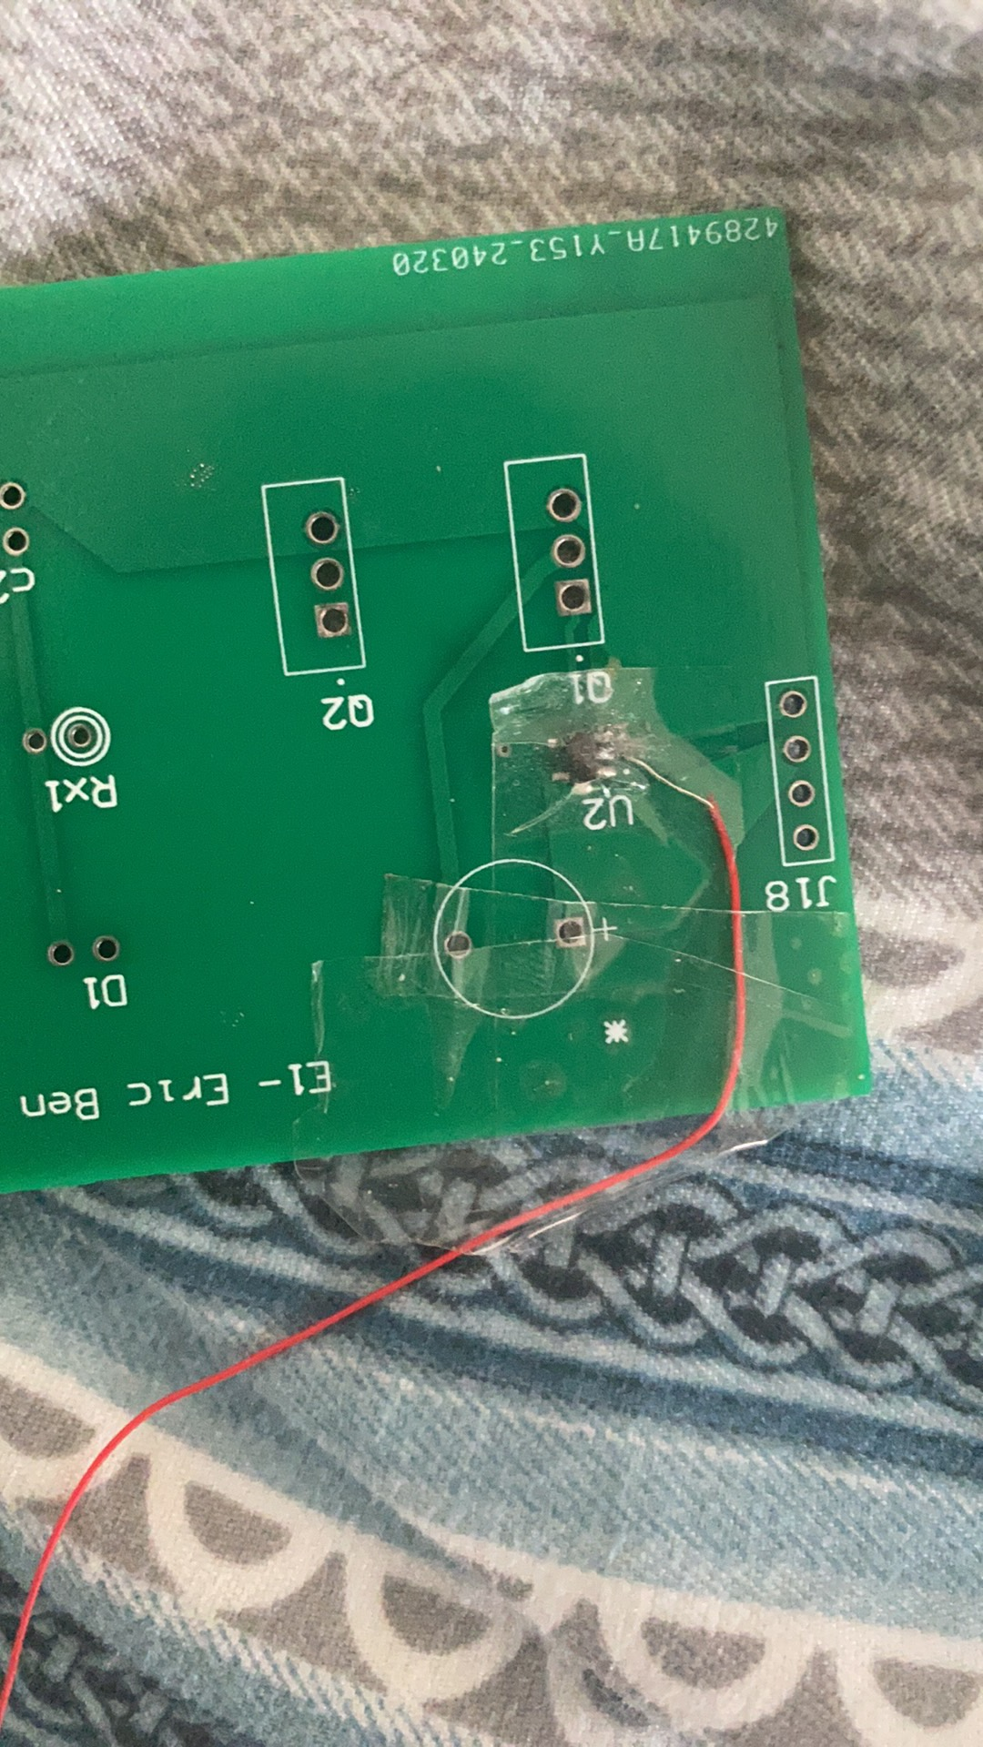
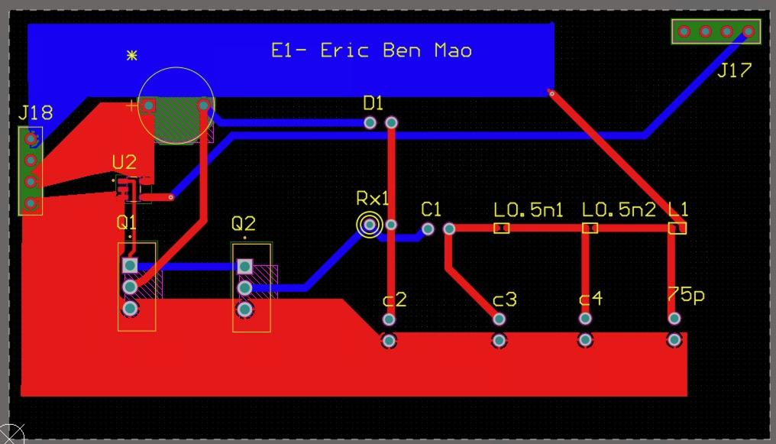
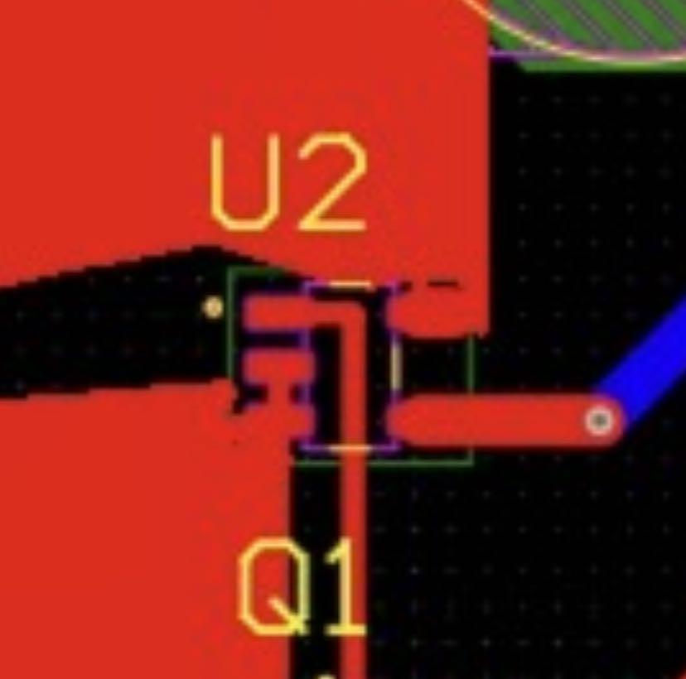
02 PCB

Slide 10
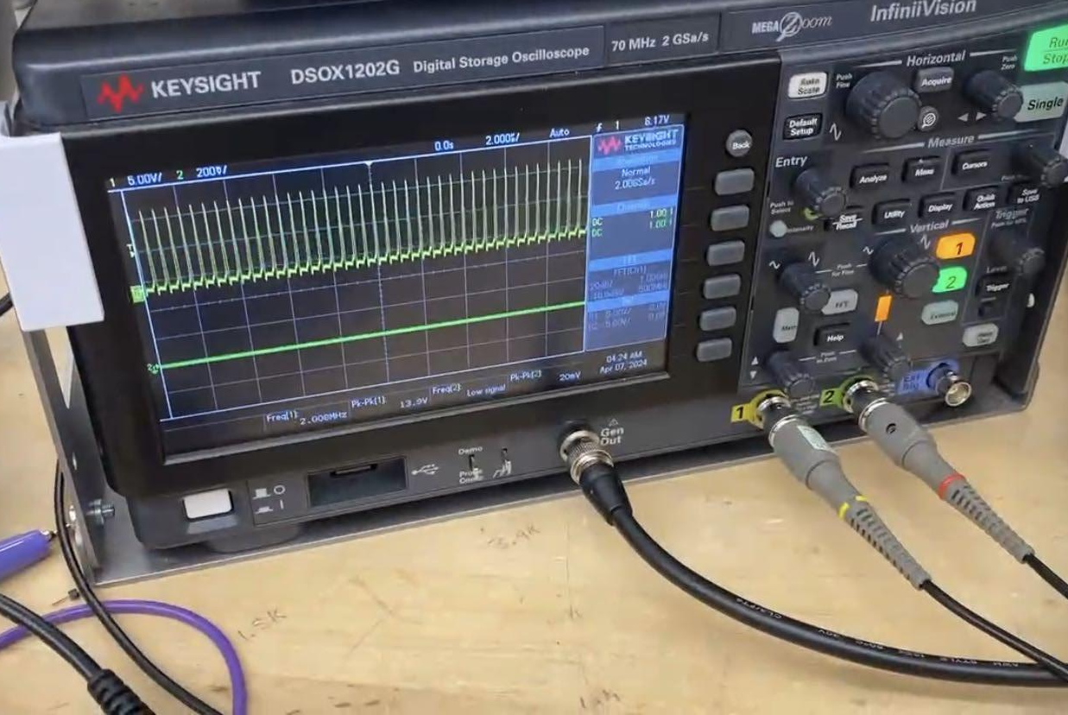
03 OPAMP

Slide 11
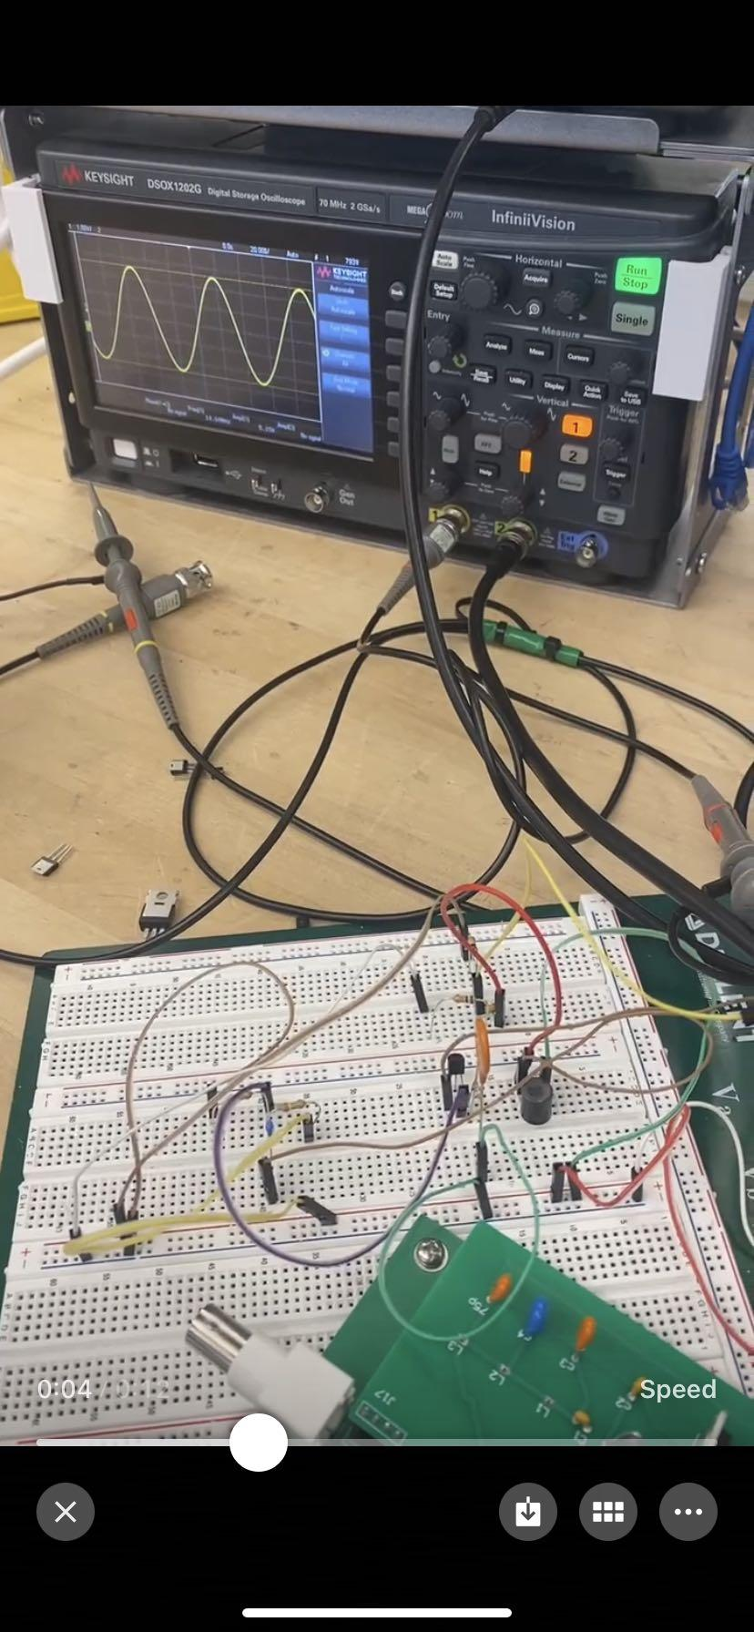
04 Common Source

Slide 12
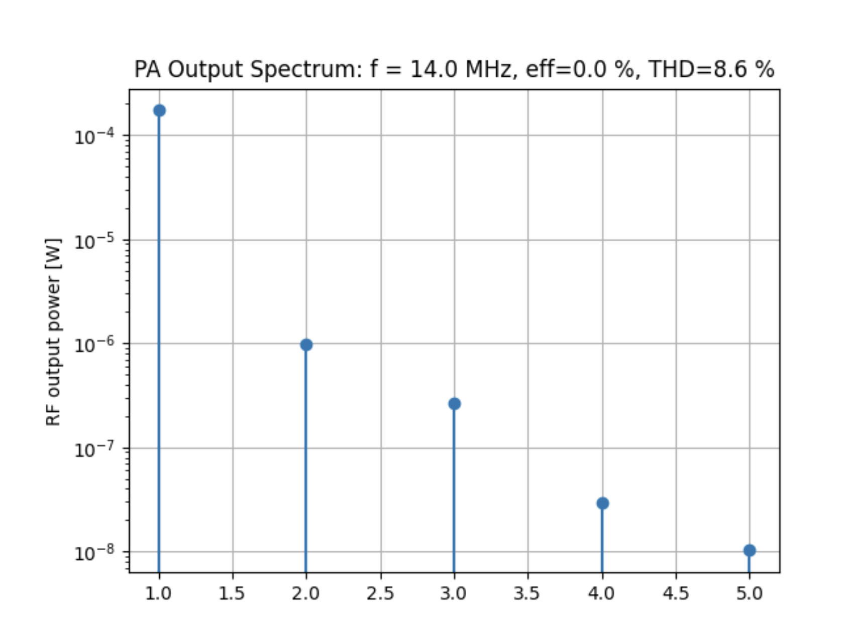
Test Results

Slide 13
Root Causes of Mistakes
Agile vs Waterfall
Course restrictions on how fast can we iterate. VS. How we should iterate from a practical perspective.
Technical
Tools
LTspice, Altium, bread-boarding, soldering.
Fault proofing
How can we plan a head in a project?
Soft Skills
Communication / teamwork
When an issue arising how should we tackle it?
延迟符号

Slide 14
Agile vs Waterfall

Slide 15
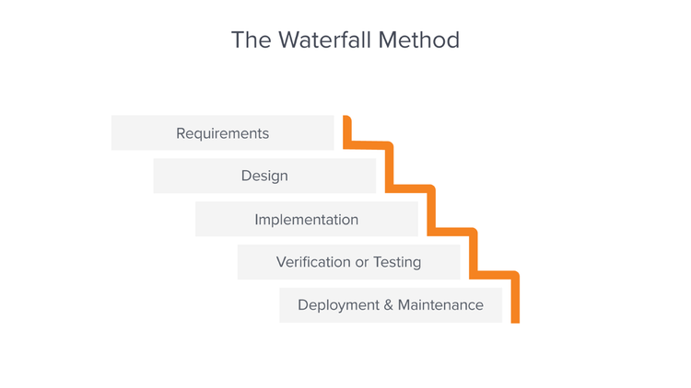
Waterfall
Following the “Waterfall” style
Distinct phases & boundaries
Can’t fix past mistakes

Slide 16
The Valuable Lesson
Waterfall style lacks flexibility and iteration
1
Agile is probably a better methodology
2
Having alternative designs that actually works for backup
Purchasing new op amp or board if find a potential error.
延迟符号

Slide 17
Unfamiliarity with tools

Slide 18

Wasted Efforts
Did not know we need a driver at the beginning
Mosfets were used incorrectly
Incorrect LTspice model used

Slide 19
The Valuable Lesson
Explore the tools more before we use them
1
延迟符号

Slide 20
Fault Proofing

Slide 21
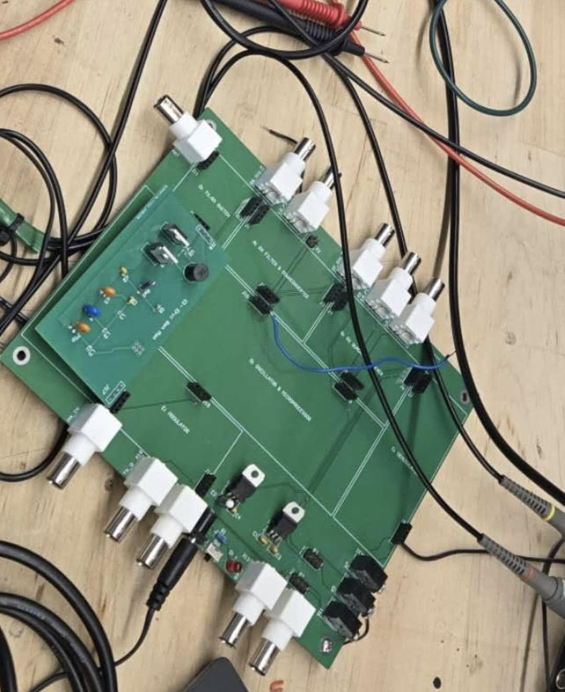
One shot and one chance
Things often might not work
Debugging takes time and spirit
Not enough chances to fix the design

Slide 22

Having all our eggs in one basket
Had only one design
Bought only one type of opamp
Could have put a switch on board
Could have bought different op amps of same size

Slide 23
The Valuable Lesson
Flexibility and contingency planning
1
Thorough testing and troubleshooting
2
延迟符号

Slide 24
Communication/ Team work

Slide 25
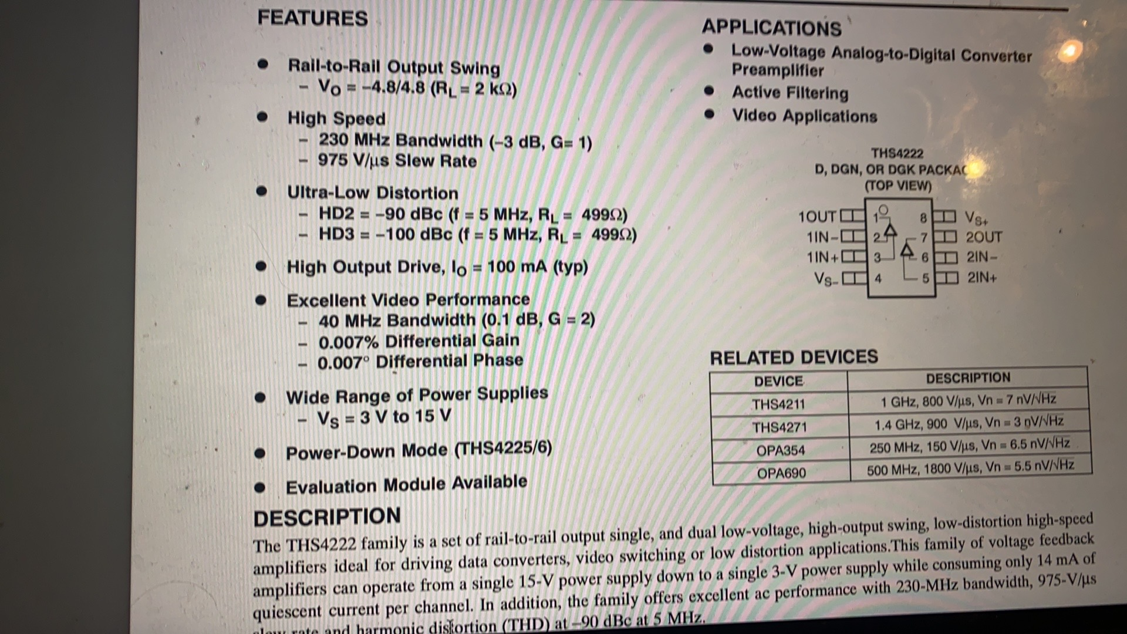
Communication in the troubleshooting process
Communication mistakes in the team
Communication with the TA

Slide 26
The valuable lesson
Proactive and timely action of teamwork
1
Active communication with the TA
2
延迟符号

Slide 27
Next Steps
Production
Fixing the OPAMP
Fixing the PCB
Learning from mistakes
延迟符号

Slide 28
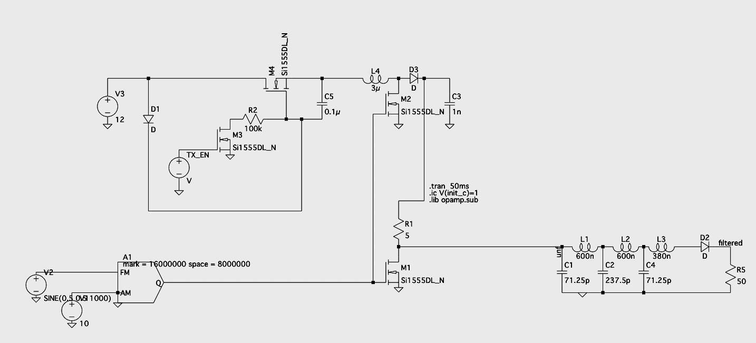
See you later and have a great summer!!!!
Team 1 - Subsystem E - ECE 295

