Slide 1
Paperless Scholarship Disbursement System for PMSSS
PIP4004 Capstone Project
Review-4
Batch Number:175
Under the Supervision of,
Dr. Vijaya Kumar AV
Professor
School of Computer Science and Engineering
Presidency University
Roll Number | Student Name
20211CSE0538 | Aparoop Bennur
20211CSE0457 | Vaishnavi S
20211CSE0404 | Samarth BD
Name of the Program: B.Tech
Name of the HoD: Dr. Asif Mohammad H
Name of the Program Project Coordinator: Dr. Sampath A K
Name of the School Project Coordinators: Dr. Sampath A K / Mr. Md Ziaur Rahman

Slide 2
Content
Problem Statement
Abstract
Github Link
Analysis of Problem Statement
Objectives
Existing Methods-Drawbacks
Proposed Methodology
Architecture Diagram
Timeline of the Project
Literature Survey
Conclusion
References

Slide 3
Problem Statement Number: PSCS_429
Organization: Miscellaneous
Category (Hardware / Software / Both) : Software
Problem Description: The project aims to develop a fully digital system for the submission, verification, and disbursement of scholarships under the Prime Minister's Special Scholarship Scheme (PMSSS). It will enable students to upload their documents securely through an online portal, eliminating the need for physical copies. The system will automate the verification process by the SAG Bureau and facilitate seamless forwarding of approved documents to the Finance Bureau for payment processing. Key features include secure authentication, real-time tracking, automated workflow, and compliance with data privacy standards, ensuring efficiency, transparency, and reduced processing time.
Difficulty Level: Simple

Slide 4
Abstract
The Paperless Scholarship Disbursement System is a modern, digital solution designed to streamline the scholarship management process for the Prime Minister’s Special Scholarship Scheme (PMSSS). This system replaces traditional paper-based workflows with a fully automated, secure, and efficient platform, enabling students to submit documents digitally, track their application status in real-time, and receive timely disbursements. Key features include digital document submission, automated verification, and real-time tracking, all integrated into a user-friendly interface. Built using React.js for the front-end, Node.js and Express.js for the back-end, and MongoDB for data storage, the system is containerized using Docker for easy deployment and scalability. By eliminating manual processes and reducing paperwork, this system not only improves operational efficiency but also contributes to environmental sustainability. The project aims to enhance transparency, reduce errors, and ensure timely financial support for students, making the scholarship disbursement process more accessible and reliable.

Slide 5
Github Link
https://github.com/Bennur07/PMSSS

Slide 6
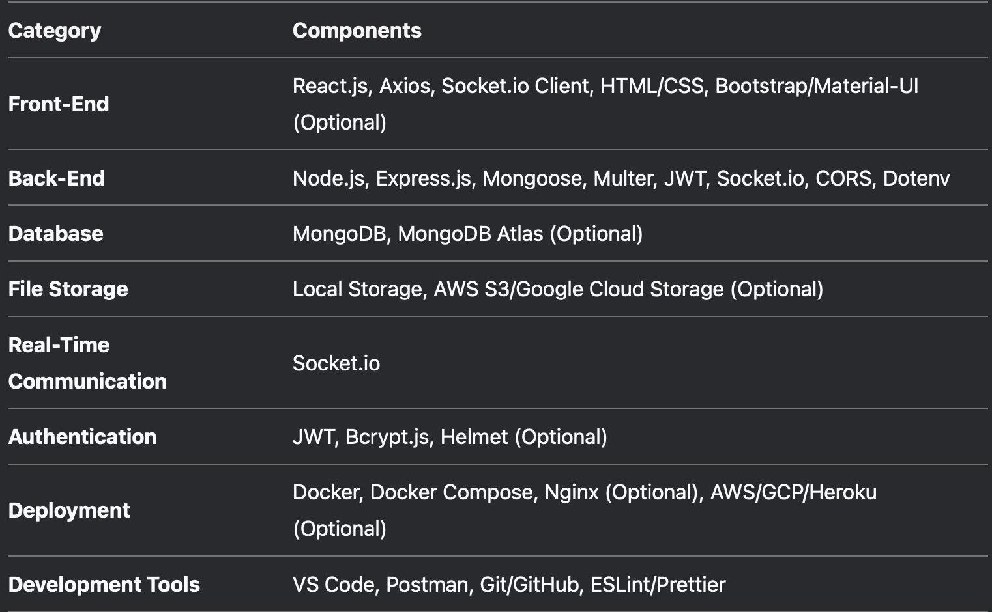
Analysis of Problem Statement
Technology Stack Components:

Slide 7
Analysis of Problem Statement
1. Front-End (Client-Side)
The front-end is responsible for the user interface (UI) and user experience (UX). It interacts with the back-end via APIs.
Components
React.js: A JavaScript library for building dynamic and responsive user interfaces.
Axios: A promise-based HTTP client for making API requests to the back-end.
Socket.io Client: Enables real-time communication with the back-end for status updates.
HTML/CSS: For structuring and styling the UI.
Bootstrap/Material-UI (Optional): For pre-built UI components and responsive design.
2. Back-End (Server-Side)
The back-end handles business logic, database interactions, and API endpoints.
Components
Node.js: A JavaScript runtime for building scalable server-side applications.
Express.js: A web framework for Node.js to create RESTful APIs.
Mongoose: An ODM (Object Data Modeling) library for MongoDB.
Multer: Middleware for handling file uploads.
JSON Web Tokens (JWT): For secure user authentication (if implemented).
Socket.io: Enables real-time, bidirectional communication between the client and server.
CORS (Cross-Origin Resource Sharing): Middleware to allow cross-origin requests from the front-end.
Dotenv: For loading environment variables from a .env file.

Slide 8
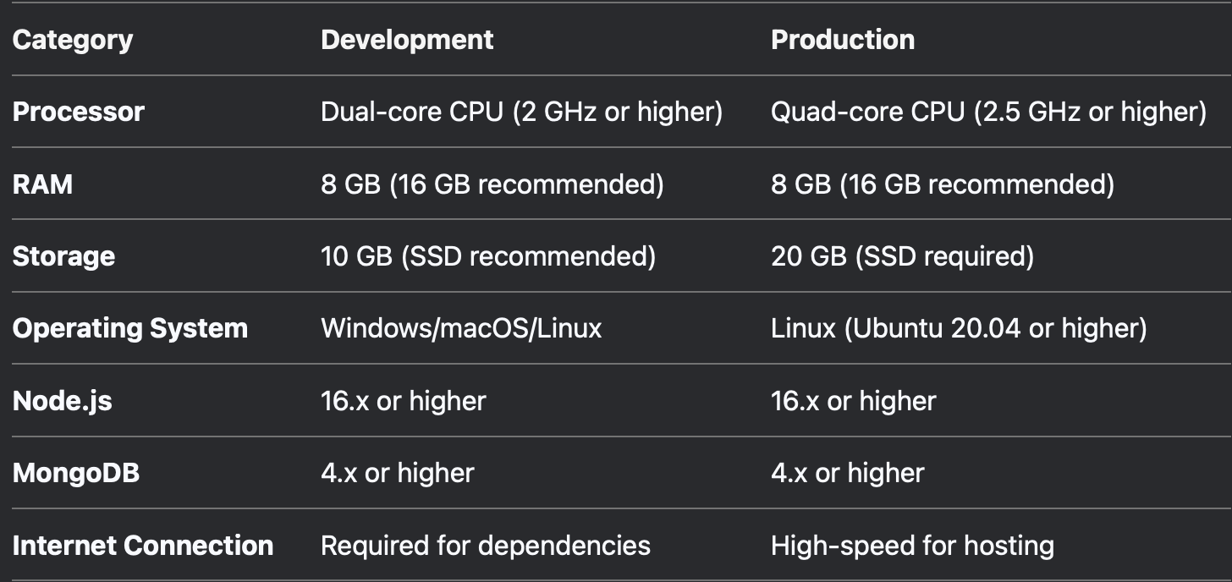
Analysis of Problem Statement (contd...)
Software and Hardware Requirements:

Slide 9
Analysis of Problem Statement (contd...)
1. Understanding the Core Issue
The current scholarship disbursement process under the Prime Minister’s Special Scholarship Scheme (PMSSS)involves significant paperwork, leading to inefficiencies such as delays, administrative burden, and risk of document loss or misplacement. The SAG Bureau aims to address these inefficiencies by transitioning to a fully digital system that will automate document submission, verification, and approval.
2. Key Challenges Identified
Manual and Paper-Based Process: The existing process relies on physical document submission, increasing administrative workload and delays.
Verification Bottlenecks: Manual verification of documents can be slow and prone to errors.
Lack of Real-Time Tracking
This project understands the core issues and the key challenges identified, creating a software to solve the same efficiently. It uses multiple languages, libraries and domains that communicate internally to achieve a common goal.

Slide 10
Objectives
1. To digitize the Scholarship Application Process
Objective: Replace paper-based applications with a fully digital system.
Outcome: Students can submit their scholarship applications and required documents online, reducing manual paperwork and errors.
2. To automate Document Verification
Objective: Implement an automated system for verifying student documents.
Outcome: Reduce manual intervention, minimize errors, and speed up the verification process.
3. To ensure Real-Time Status Tracking
Objective: Provide students and administrators with real-time updates on the status of applications and disbursements.
Outcome: Improve transparency and communication between stakeholders.
5. To reduce Environmental Impact
Objective: Eliminate the need for paper-based processes.
Outcome: Contribute to environmental sustainability by reducing paper usage.

Slide 11
Existing Methods-Drawbacks
1. Waterfall Methodology
Drawbacks:
Inflexible: Changes in requirements are difficult to accommodate once the project has moved to the next phase.
Late Testing: Testing occurs only after the development phase, which can lead to the discovery of critical issues late in the project.
Not Iterative: Does not allow for incremental delivery of features, making it unsuitable for a dynamic project like this one.
2. Spiral Model
Drawbacks:
Complexity: Requires significant effort in risk analysis and planning, which can be overkill for a project of this scale.
Cost and Time: The iterative nature and risk analysis can increase project duration and cost.
Not Suitable for Small Teams: Best suited for large, complex projects with high risks.

Slide 12
Existing Methods-Drawbacks
3. V-Model (Verification and Validation Model)
Drawbacks:
Rigid Structure: Like Waterfall, it is inflexible to changes in requirements.
Late Testing: Testing is still performed late in the development cycle, which can lead to delays.
Not Iterative: Does not support incremental delivery or continuous feedback.
4. Prototyping Model
Drawbacks:
Scope Creep: Continuous refinement of the prototype can lead to scope creep and delays.
Incomplete Solutions: The focus on prototyping may result in an incomplete or unstable final product.
Resource Intensive: Requires significant time and resources to develop and refine prototypes.

Slide 13
Proposed Methodology
Agile with Scrum Framework.
Agile is a software development methodology that focuses on iterative development, where requirements and solutions evolve through collaboration between cross-functional teams. It emphasizes flexibility, customer feedback, and rapid delivery of small, functional increments rather than a single big release.
Scrum is an Agile framework used for managing complex projects, primarily in software development. It organizes work into small, manageable units called Sprints (typically 1-4 weeks long), allowing teams to deliver incremental improvements frequently.
A Sprint is a time-boxed iteration in the Scrum framework, typically lasting 1 to 4 weeks, where a development team works on a set of prioritized tasks to deliver a working product increment.

Slide 14
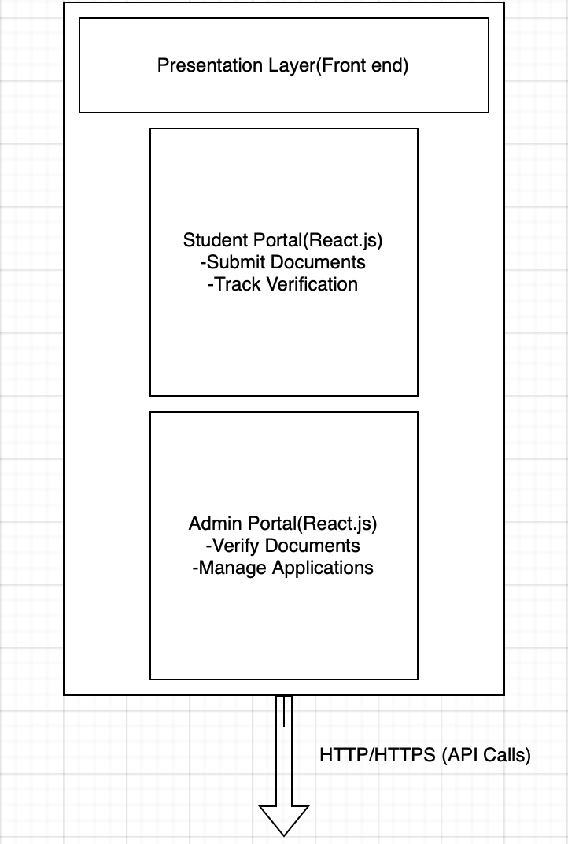
Architecture Diagram

Slide 15
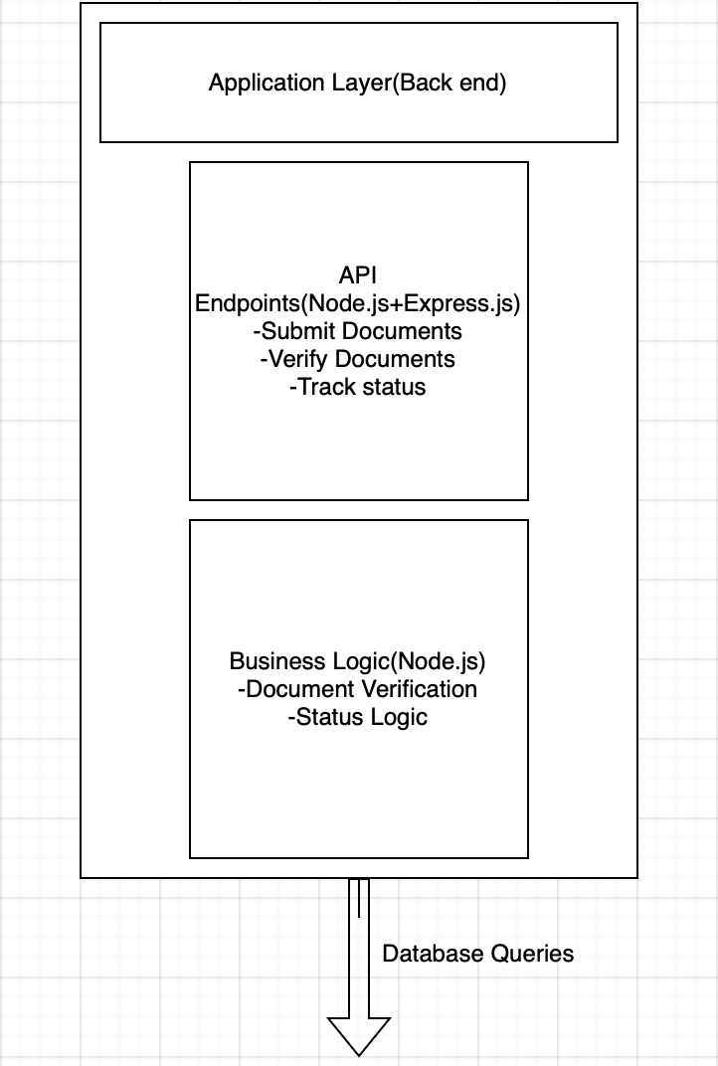
Architecture Diagram

Slide 16
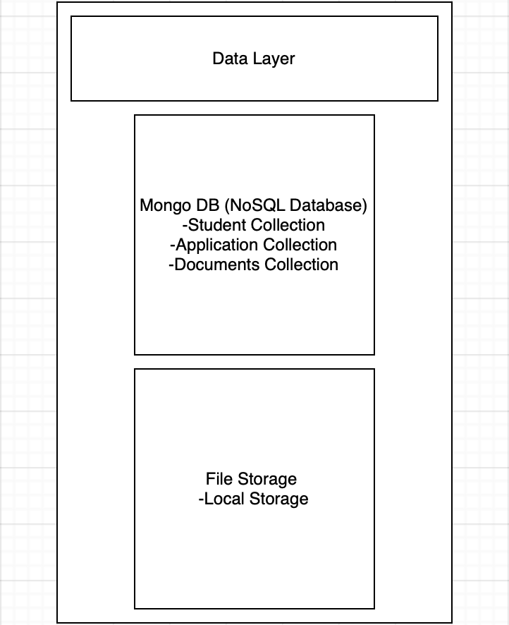
Architecture Diagram

Slide 17
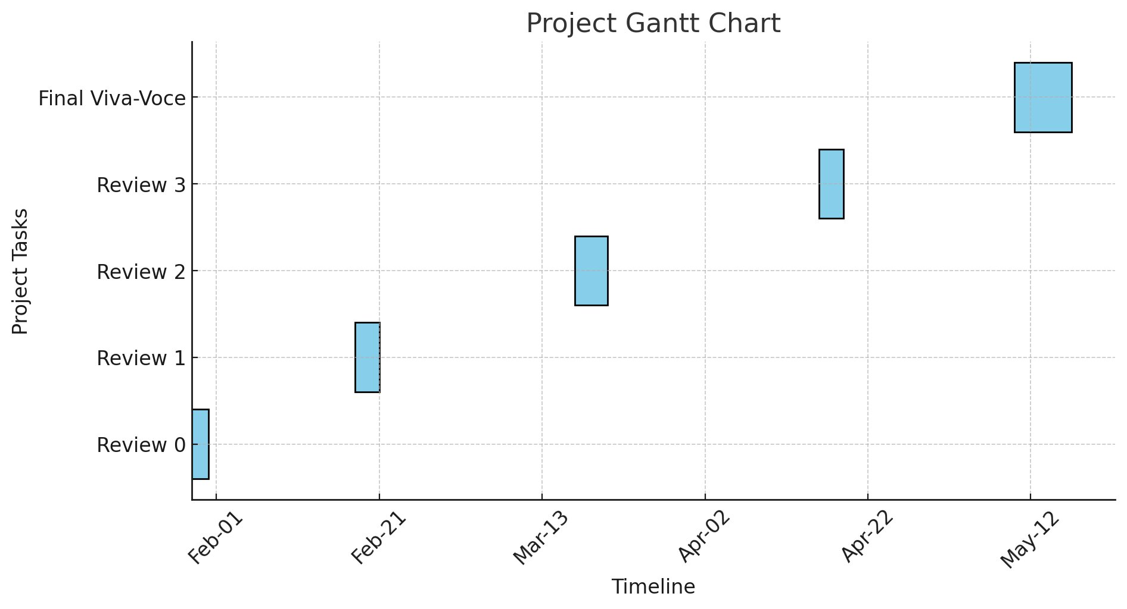
Timeline of the Project (Gantt Chart)

Slide 18
Literature Survey
1. Challenges in Traditional Scholarship Disbursement
- Scholarship disbursement traditionally relies on manual processes, leading to delays, errors, and inefficiencies.
- The need for physical document verification slows down processing times and increases administrative workload.
- Lack of transparency and tracking often results in student dissatisfaction.[1][2]
2. Emerging Technologies in Scholarship Automation
- Blockchain-based solutions improve security, transparency, and automation in scholarship disbursement.
- AI-powered document verification speeds up the process by detecting fraud and ensuring accuracy.
- Cloud-based platforms provide real-time tracking and reduce administrative overhead. [3] [4] [5]
3. Research Gaps & Future Directions
- Integration of AI for automated eligibility checks is still limited.
- Blockchain-based scholarship tracking is under-explored in real-world implementation.
- Real-time monitoring & fraud detection mechanisms need further enhancement.[6][7]

Slide 19
Literature Survey
4. Potential Solutions:
- A fully digital, AI-enhanced system to verify documents and automate fund disbursement.
- Blockchain for secure, transparent fund tracking.
- Student-friendly, mobile-accessible platforms for real-time updates. [8][9]

Slide 20
Conclusion
The Paperless Scholarship Disbursement System for PMSSS was developed in response to persistent challenges faced in the manual distribution of scholarships under the Prime Minister's Special Scholarship Scheme.
This project demonstrates how a digital-first approach can reimagine and optimize public welfare distribution mechanisms. Through the implementation of key technologies such as AI-powered document verification, automated workflow management, cloud-based architecture, the system ensures a secure, transparent, and efficient mechanism for managing scholarship applications and disbursements.
Testing and performance evaluations revealed a drastic reduction in turnaround timefrom several weeks to just a few days—while also achieving high accuracy in document verification and fraud detection.

Slide 21
References (IEEE Paper format)
[1] Bryson, T., Posner, M., St. Pierre, A., & Varner, S. (2011). Digital Humanities (No. 326).
SPEC Kit (p. 192). Association of Research Libraries.
[2] Vinopal, J. (2012). Project Portfolio Management for Academic Libraries: A Gentle
Introduction. College & Research Libraries, 73(4), 379-389.
[3] Walters, T., & Skinner, K. (2011). New Roles for New Times: Digital Curation for Preservation.
Washington, D.C.: Association of Research Libraries.
[4] Bedi P, Gole P, Dhiman S, Gupta N. "Smart Contract based Central Sector Scheme of
Scholarship for College and University Students." Procedia Computer Science 171 (2020)
790-799.
[5] Osman A, Mahmoud A. An Automated Web-Based System for Follow up on the Scholarships
of Faculty Members:
A Case Study Based on Shaqra University [Internet]. researchgate.net. 2019 [cited 2023 Sep 10].

Slide 22
References (IEEE Paper format)
[6] Lifna, C.S., Pawar, M.: Intelligent scholarship disbursement module for National Scholarship
Portal (NSP). Paper presented at the national conference on emerging trends: innovations and
challenges in IT, Bharati Vidyapeeth's Institute of Management and Information Technology, Navi Mumbai, June 2017
[7] Tukgec, U., Adalier, A., Kurktan, Y.: ScholarChain: the scholarship management platform with
blockchain and smart contracts technology. Eurasia Proc. Educ. Soc. Sci. 18, 86-91 2020
[8] A. Satybaldy, A. Subedi, and M. Nowostawski, "A framework for online document verification
using self-sovereign identity technology," Sensors, vol. 22, no. 21, p. 8408, Nov. 2022.
[9] R. Hegde and S. Madival, "A review on data mining and machine learning methods for student
scholarship prediction," in Proc. Sth Int. Conf. Comput. Metodologies Commun. (ICCMC), Арr.
2021, рр. 923-927.

Slide 23


