Slide 1
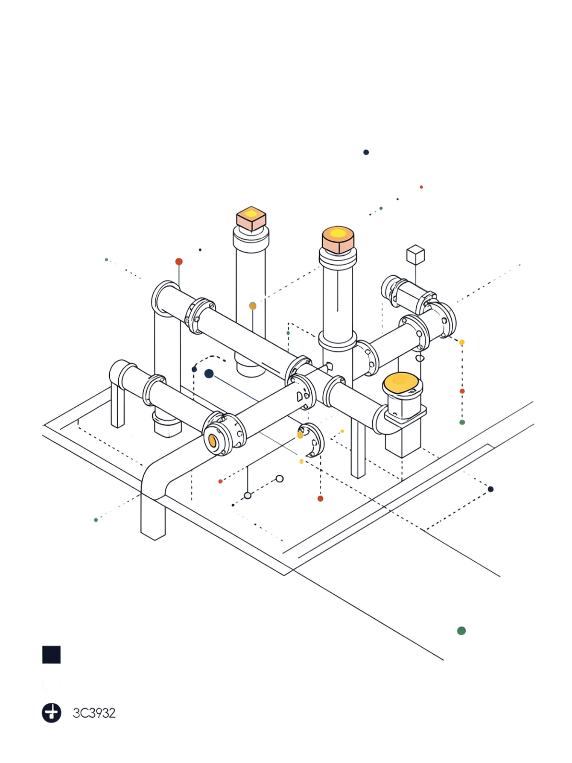
IoT-Based Gas Leakage Detection and Emergency Alert System
Residential and Industrial Safety
GAJJARAPU BENNY HIN
323129520054

Slide 2
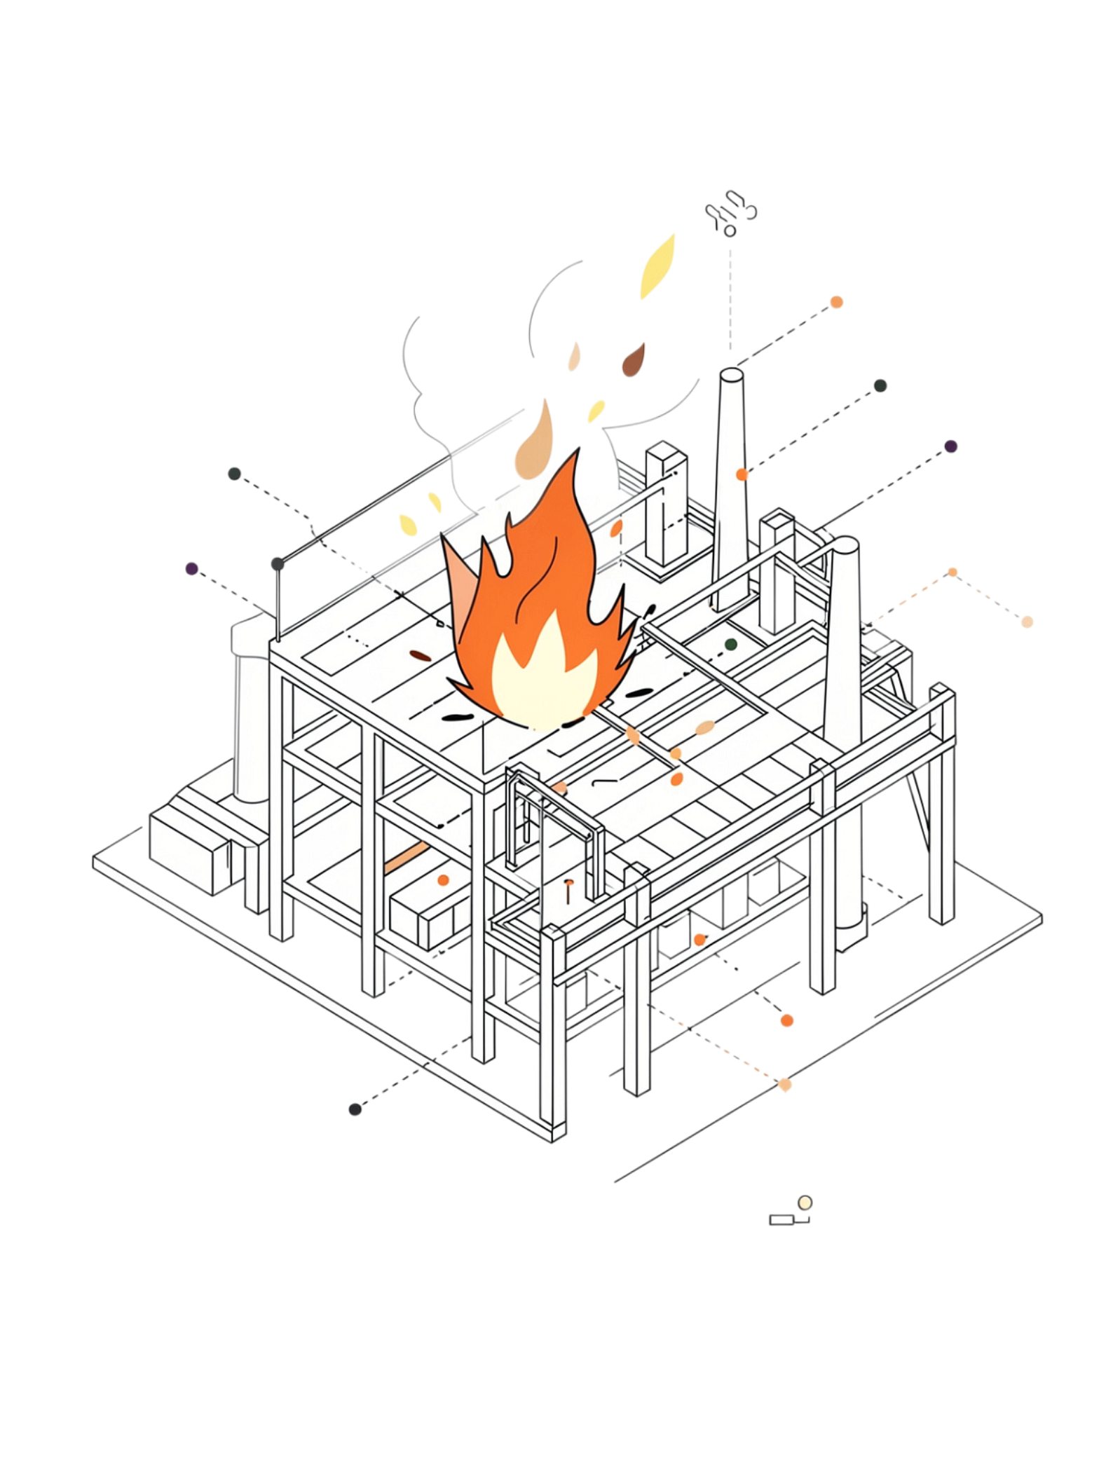
Problem Statement
Hazardous Consequences
Gas leaks in homes, laboratories, and industrial facilities can cause fires, explosions, health hazards, and property damage.
Delayed Detection
Gas leaks may not be detected promptly, and traditional systems often depend on local alarms that fail to notify absent occupants.
Critical Gap
There is a pressing need for continuous gas monitoring and immediate emergency alerts to improve safety and reduce accident risks.

Slide 3
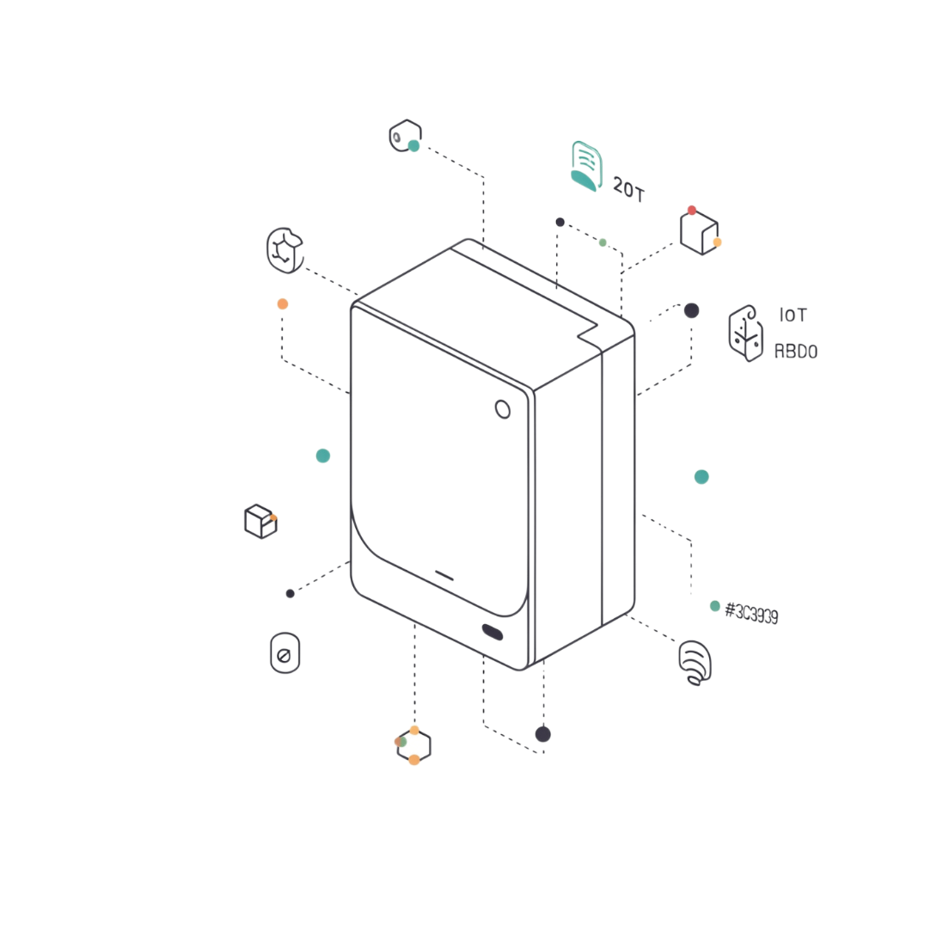
Proposed Solution
IoT-Based Gas Leakage Detection and Emergency Alert System
Continuously monitor gas concentrations using IoT-enabled gas sensors
Detect hazardous gas concentrations in real time
Send immediate emergency notifications when gas levels exceed predefined safety limits
Provide centralized monitoring through a secure and user-friendly interface
Support automated warning alarms and safety mechanisms

Slide 4
Objectives
Continuous Monitoring
Real-Time Alerts
Monitor gas concentration levels and detect leakage at an early stage.
Provide real-time emergency notifications and activate warning alarms automatically.
Centralized Control
Improved Safety
Enable centralized monitoring of connected gas sensors across all facilities.
Improve residential and industrial safety and reduce accident risks with reliable emergency response.

Slide 5

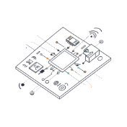
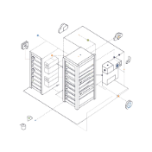

System Components
MQ-Series Gas Sensors
IoT Communication Modules
Cloud Connectivity
Warning Alarms & Safety Mechanisms
Core detection hardware for identifying hazardous gas concentrations in the environment.
Enables remote monitoring, data management, and centralized system oversight from anywhere.
Transmit sensor data wirelessly to the cloud platform for processing and monitoring.
Local emergency notification and automated safety response when dangerous levels are detected.

Slide 6
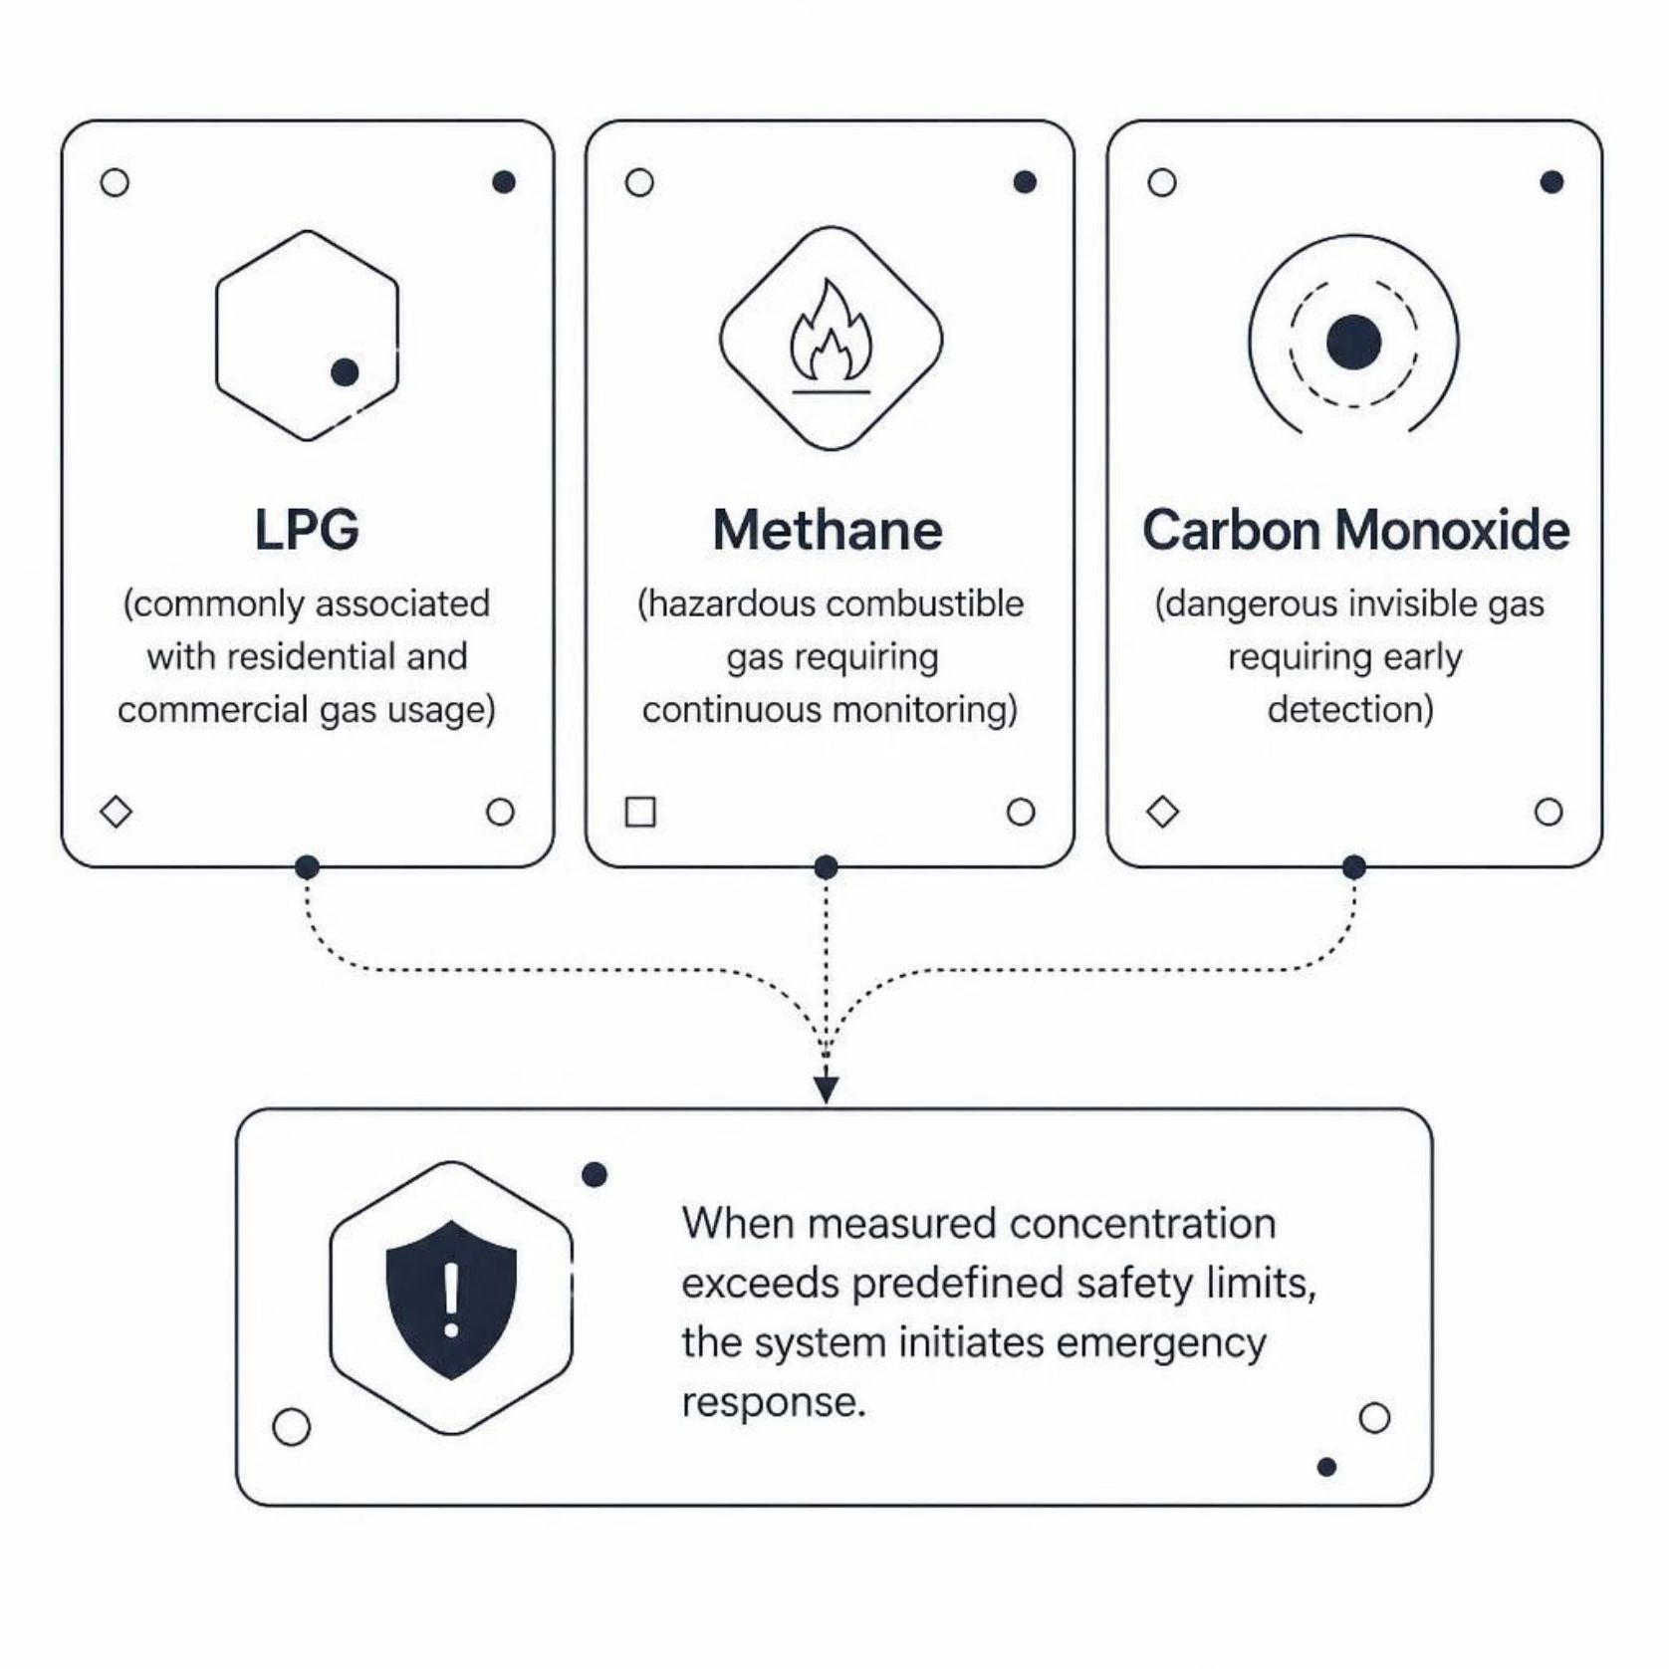

Types of Gas Detection
Multi-Gas Detection Capability
The system is designed to identify three critical categories of hazardous gases, each posing distinct risks to occupants and infrastructure.
LPG: Commonly associated with residential and commercial gas usage — highly flammable and explosive.
Methane: A hazardous combustible gas requiring continuous monitoring in industrial and laboratory settings.
Carbon Monoxide: An odorless, invisible gas that demands early detection to prevent poisoning.
When measured concentration exceeds predefined safety limits, the system immediately initiates emergency response protocols.

Slide 7

System Working Process
Sensing
Transmission
Gas sensors monitor environment
Modules send readings to IoT system
Detection
Processing
MQ-series detect concentrations
Platform processes and compares limits
The system operates as a fully automated pipeline — from continuous environmental sensing through MQ-series hardware, to cloud-based processing, threshold comparison, and immediate multi-channel emergency notification — ensuring no hazardous event goes undetected or unaddressed.

Slide 8
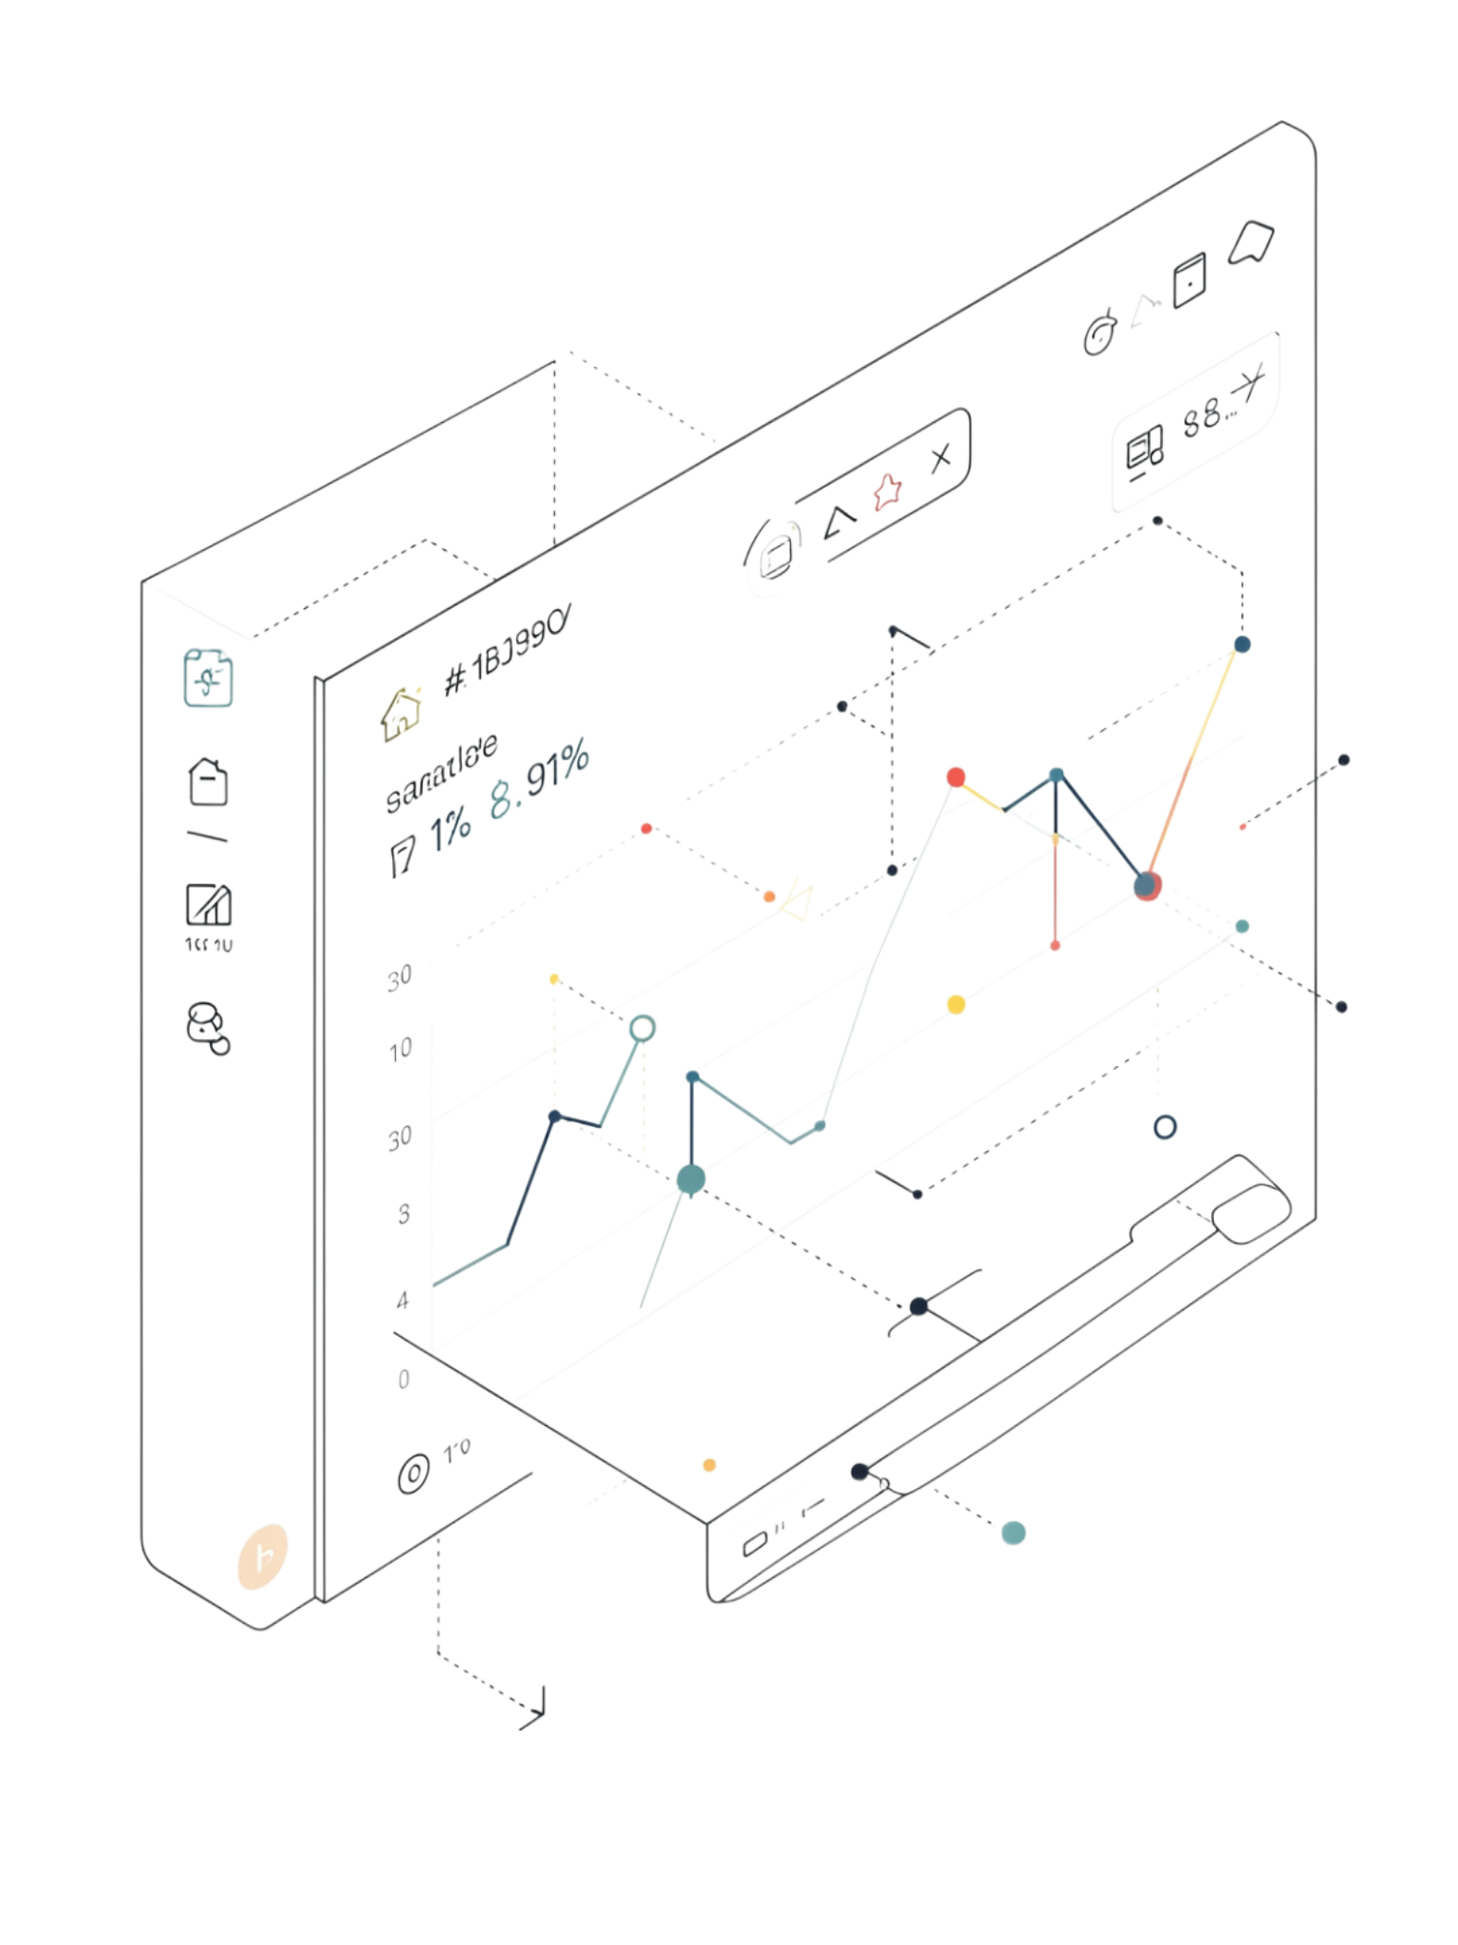
Real-Time Monitoring and Emergency Alerts
Monitoring Capabilities
Live gas concentration monitoring
Real-time sensor status
Alert history and environmental conditions
Overall system health visibility
Emergency Response
Immediate notifications to users and emergency personnel
Warning alarms activated during hazardous conditions
Automated safety response when predefined limits are exceeded

Slide 9





Applications and Benefits
Where It Can Be Deployed
Key Benefits
Residential Buildings
Early gas leakage detection
Faster emergency notification
Improved public and industrial safety
Reduced accident risks
Continuous safety monitoring
Remote monitoring through IoT and cloud connectivity
Secure and centralized system management
Scalable solution for different types of facilities
Industrial Facilities
Laboratories
Restaurants & Warehouses
Commercial Facilities

Slide 10
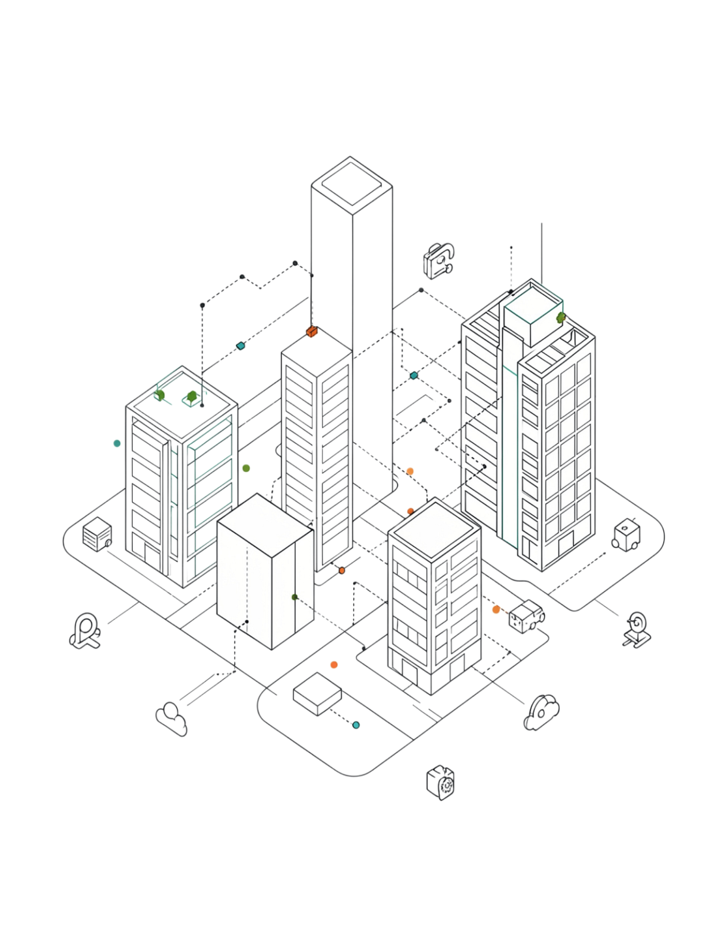
Conclusion and Future Impact
Intelligent Detection
Continuous IoT-based monitoring enables early identification of hazardous gas concentrations, providing an intelligent approach to leakage detection and emergency response.
Rapid Response
Real-time alerts help users and emergency personnel respond quickly, while automated warning alarms and safety mechanisms improve protection during emergencies.
Scalable & Secure
The system is secure, scalable, and applicable across residential, industrial, laboratory, restaurant, warehouse, and commercial environments — supporting safer facilities and reliable emergency response.

