Slide 1
Suricata安裝
410570267 游立宇

Slide 2
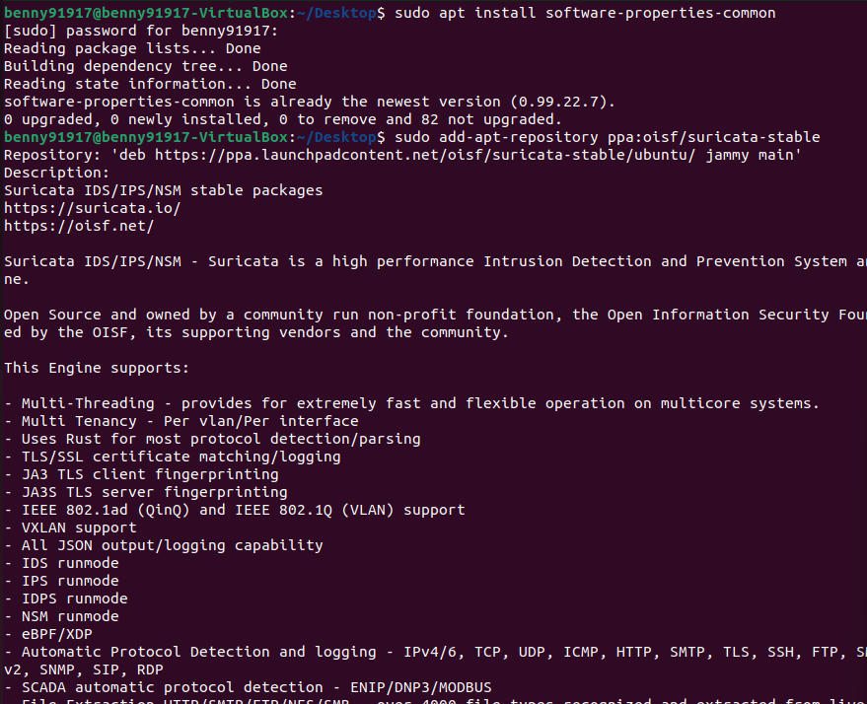
sudo apt install software- properties-commo

Slide 3
sudo add-apt-repository ppa:oisf/suricata-stable

Slide 4
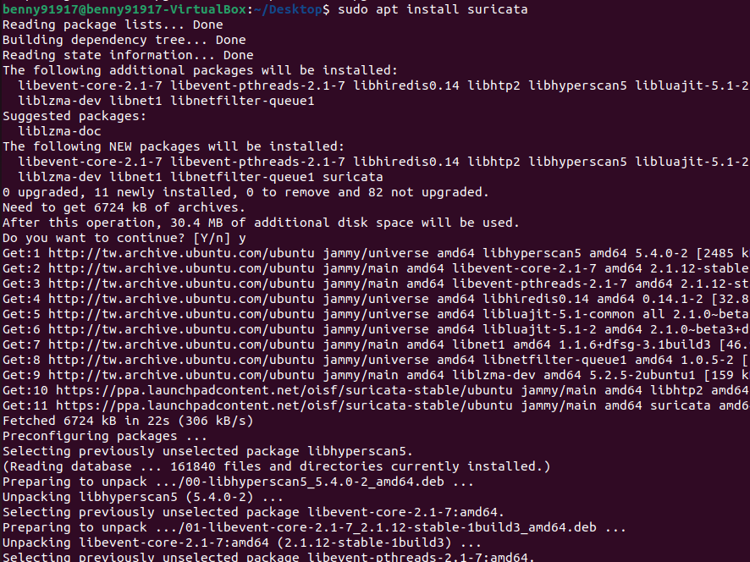
# 安裝 Suricata $ sudo apt install suricata

Slide 5
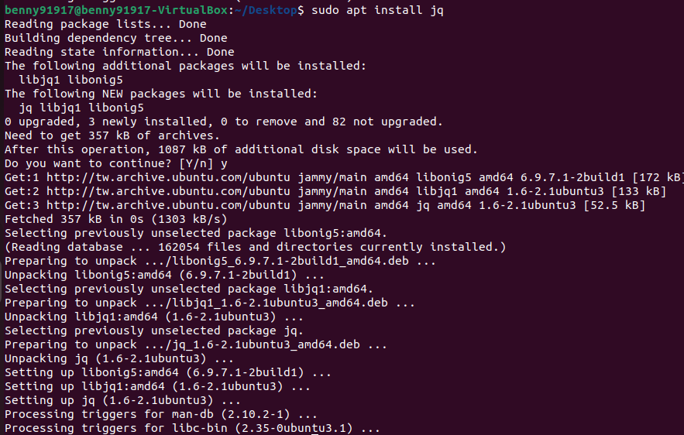
# 安裝 json 解析工具 $ sudo apt install jq

Slide 6
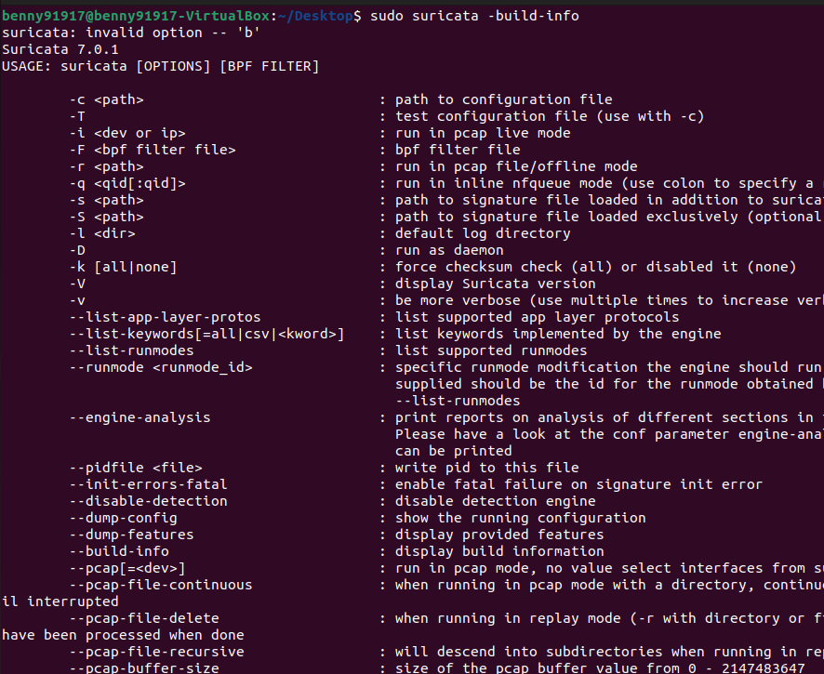
# 檢查 Suricata 安裝結果 $ sudo suricata –build-info

Slide 7
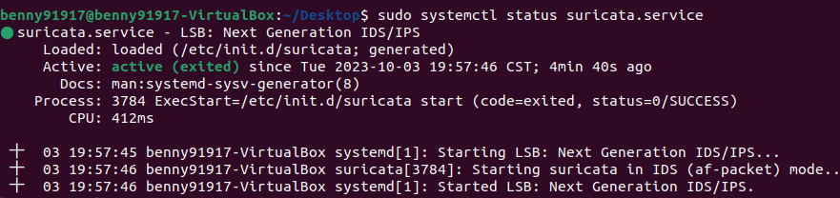
# 檢視 Suricata 服務狀態 $ sudo systemctl status suricata.service

Slide 8
$ cd /var/log/suricata/ $ ls

Slide 9

$ cd /etc/suricata/rules $ ls

Slide 10
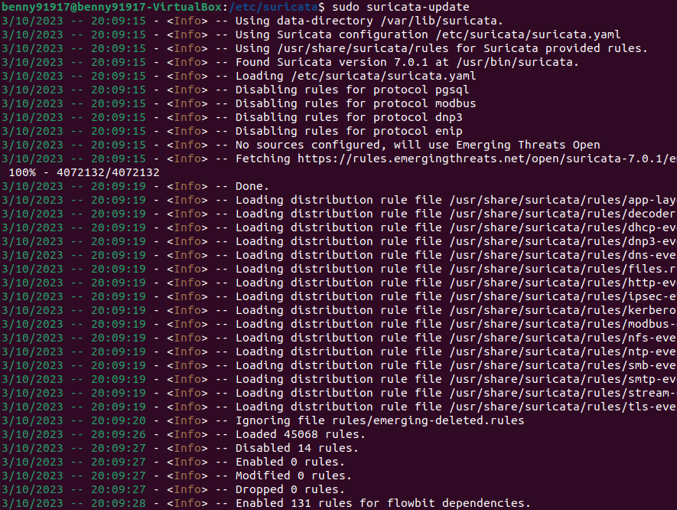
$ sudo suricata-update

Slide 11
$ sudo suricata-update update-sources

Slide 12
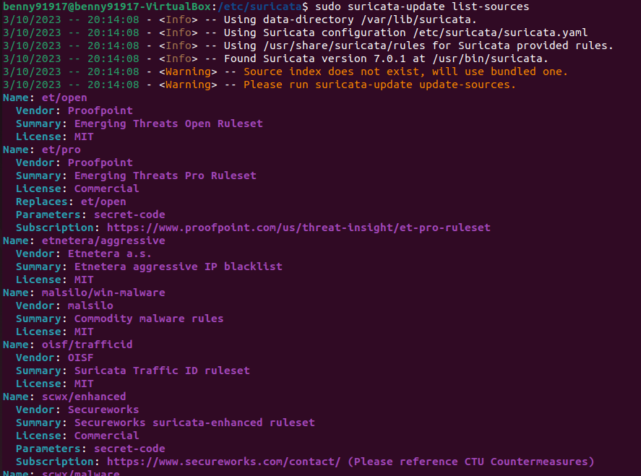
$ sudo suricata-update list-sources

Slide 13
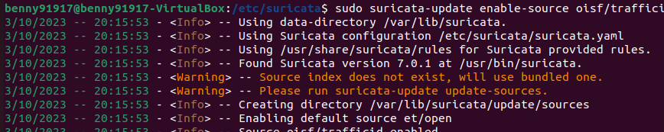
$ sudo suricata-update enable-source oisf/trafficid

Slide 14
$ sudo systemctl restart suricata.service

Slide 15
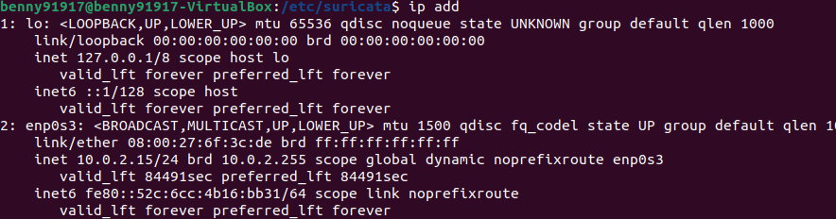
$ ip addr

Slide 16
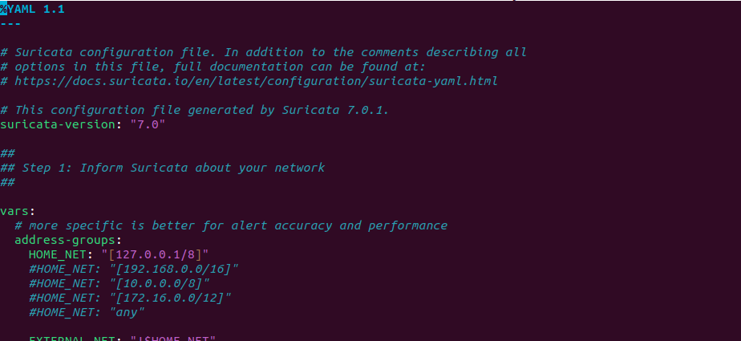
$ sudo nano suricata.yaml 換id、ip

Slide 17
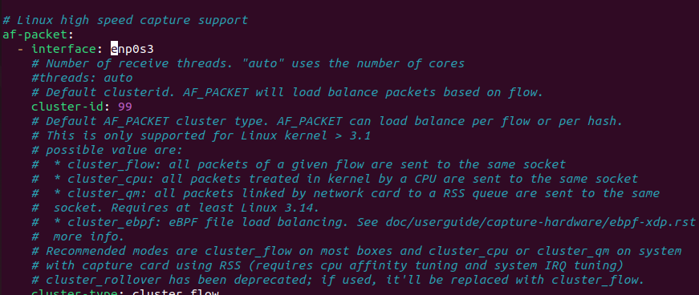

Slide 18
$ sudo nano rule-學 號.rules

Slide 19
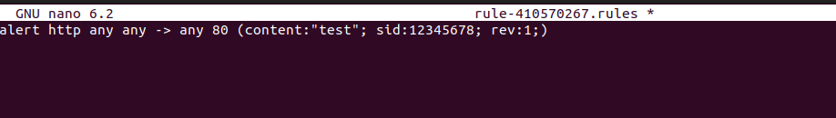
alert http any any -> any 80 (content: "test"; sid: 12345678; rev:1;)

Slide 20
$ sudo suricatasc -c reload-rules

Slide 21
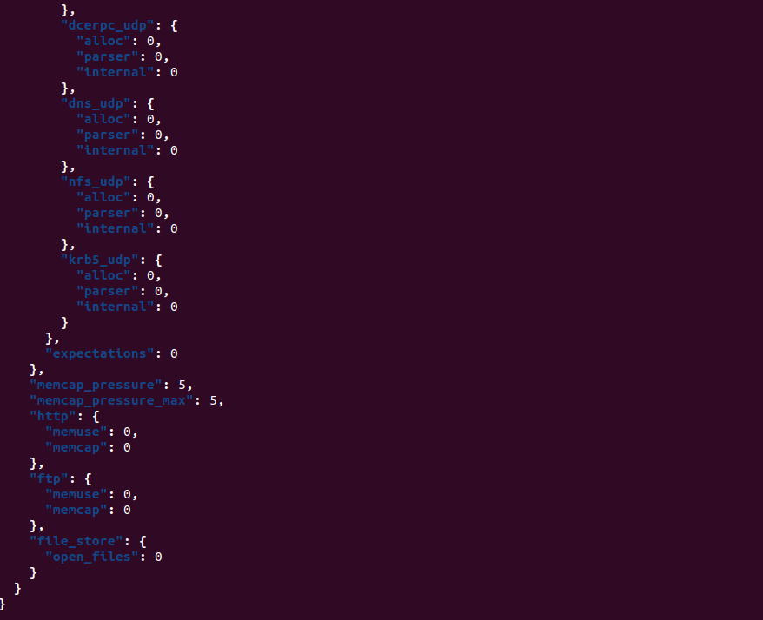
$ tail -f /var/log/suricata/eve.json | jq "."

Slide 22
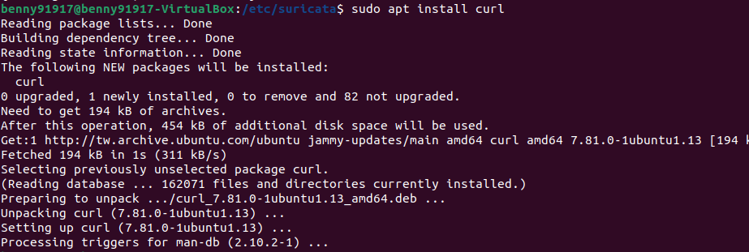
$sudo apt install curl

Slide 23
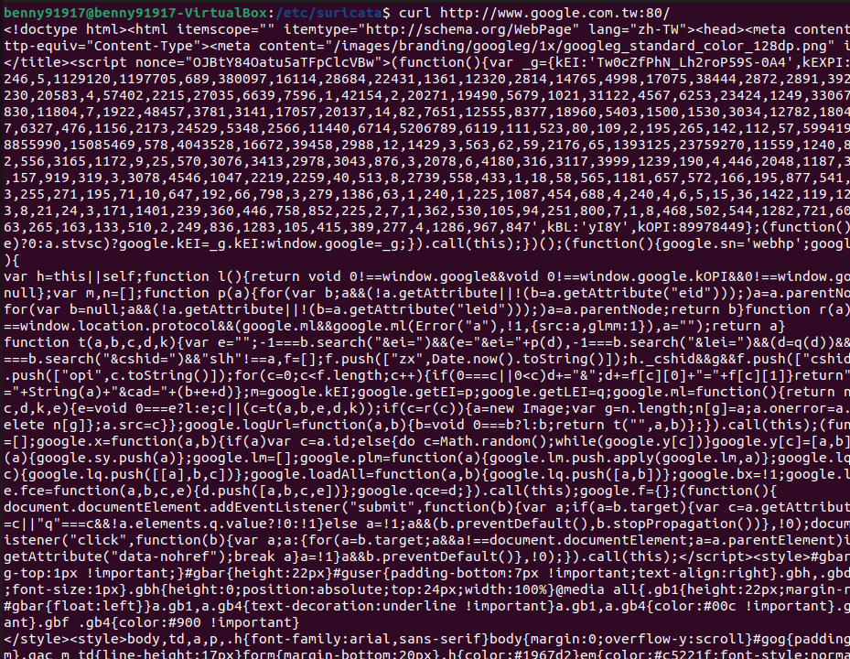
curl http://www.google.com.tw:80/

Slide 24
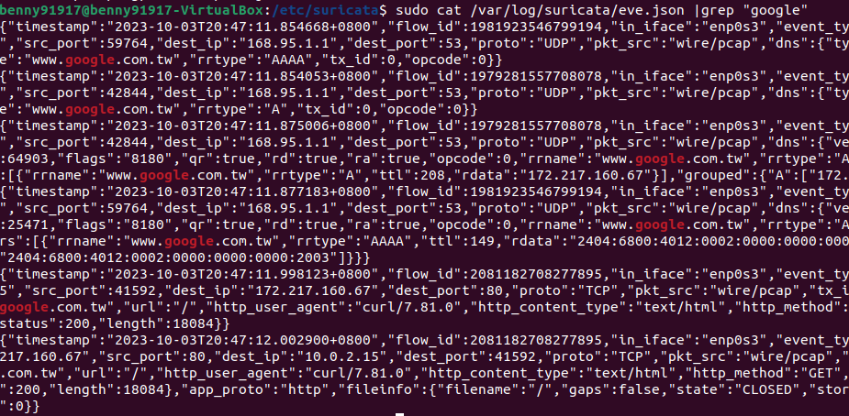
sudo cat /var/log/suricata/eve.json | grep “google”

