Slide 1
Cuff-less Blood Pressure Estimation Using Pulse Transit Time
Speaker : 顏伯任、陳瑋泰
ID：P86071244、P86071058

Slide 2
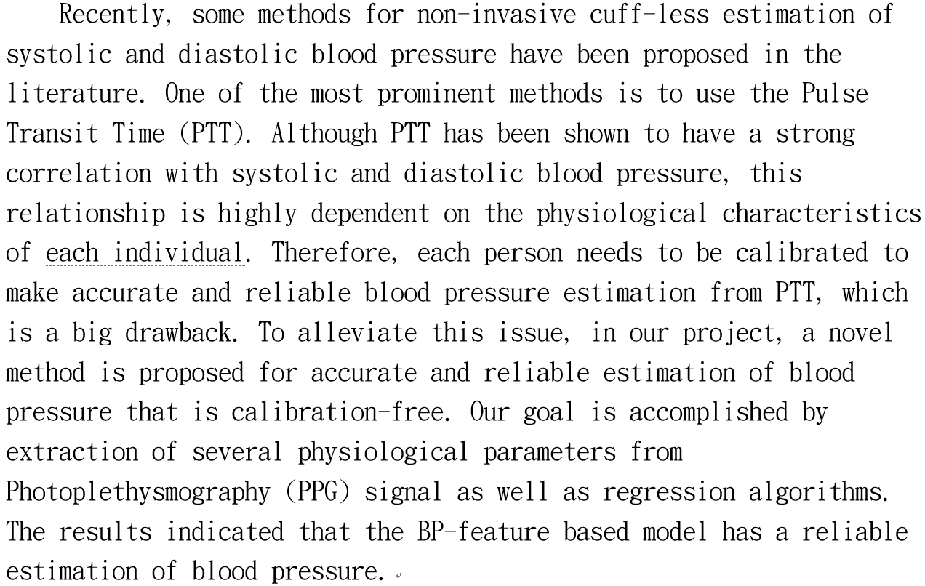
Abstract
Notes:
This is our abstract.

Slide 3
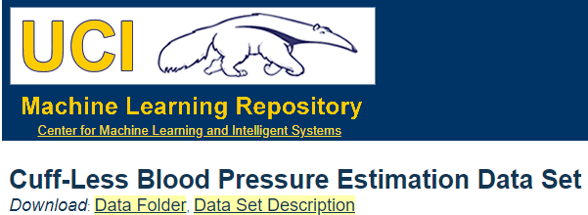
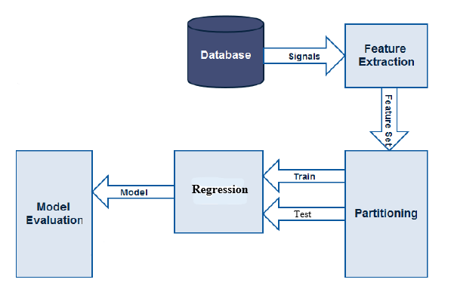
Introduction
Fig. 1. Cuff-less BP estimator block diagram.
Notes:
We get this idea from paper “Cuff-less high-accuracy calibration-free blood pressure estimation using pulse transit time.”
And trace the steps from the paper.
This is our block diagram.
First, we acquire our data from UCI database.
This Data set provides preprocessed and cleaned vital signals which can be used in designing algorithms for cuff-less estimation of the blood pressure.
Then, we extract feature of ECG and PPG as our parameters.
Finally, we use 50% set as training sample, and 50% set as testing.

Slide 4
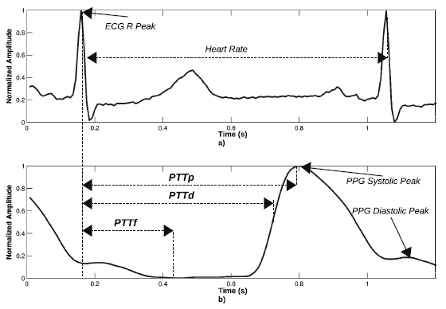
Feature Extraction
Fig. 2. Calculation of PTT from the time taken for the heart beat pulse to
arrive in the finger PPG signal. a) ECG signal. b) PPG signal
Notes:
In feature extraction block.
We extract several physiological parameters from ECG and Photoplethysmography (PPG) signal as shown in the figure. 2.

Slide 5
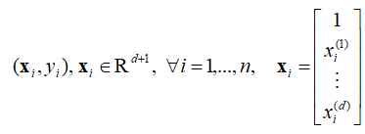

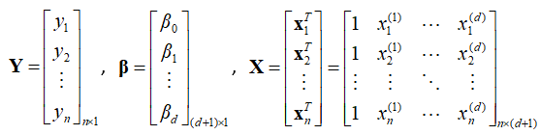
Regression
Multiple linear regression
(1)
(2)
(3)
Notes:
Then, we’ll introduce you how we derive regression model from multiple linear regression.
The independent variables ‘Xi’ are physiological parameters in one matrix shown as equation 1.
And the equation show the dependent variable ‘Y’ is a matrix, which is multiplied by the regression coefficient matrix B shown as equation 2 and 3.

Slide 6
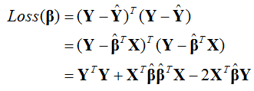
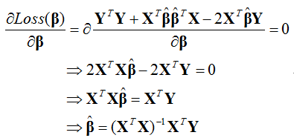
Regression (cont.)
Loss function
(4)
(5)
Notes:
Next, in this slide, we will talk about the loss function.
Why we use the loss function?
Because we want to find out the minimum error in regression.
And in calculus, the local minimum will occur in the slope value equal to 0.
The loss function is used to derive the regression coefficient B.
By doing transpose the ‘Y’ in equation 4
and partial differential the loss function of B in equation 5,
We derive the regression coefficient B finally.

Slide 7
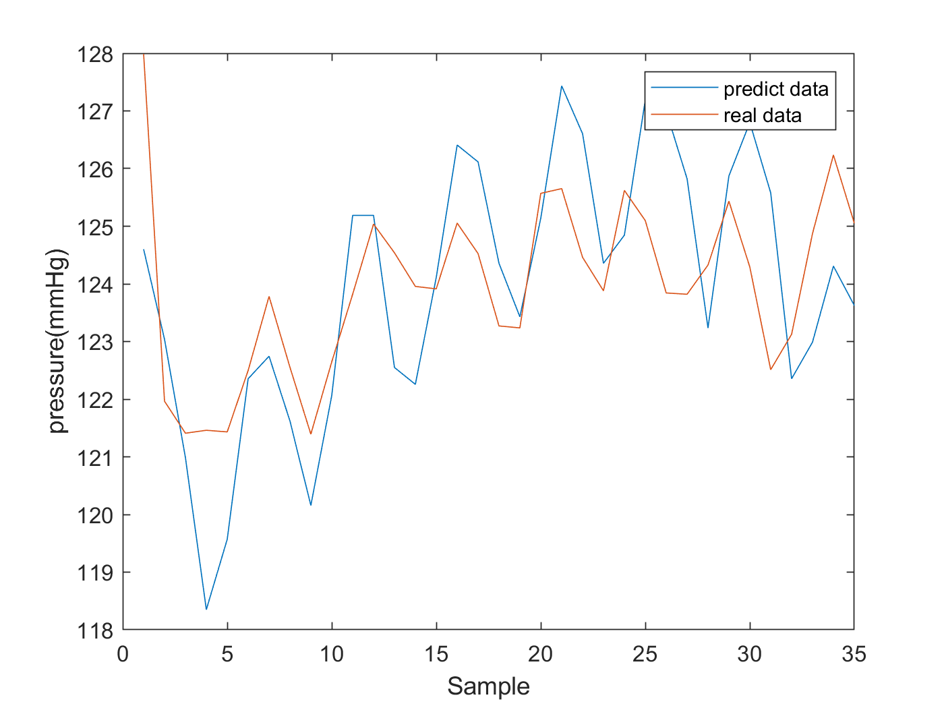
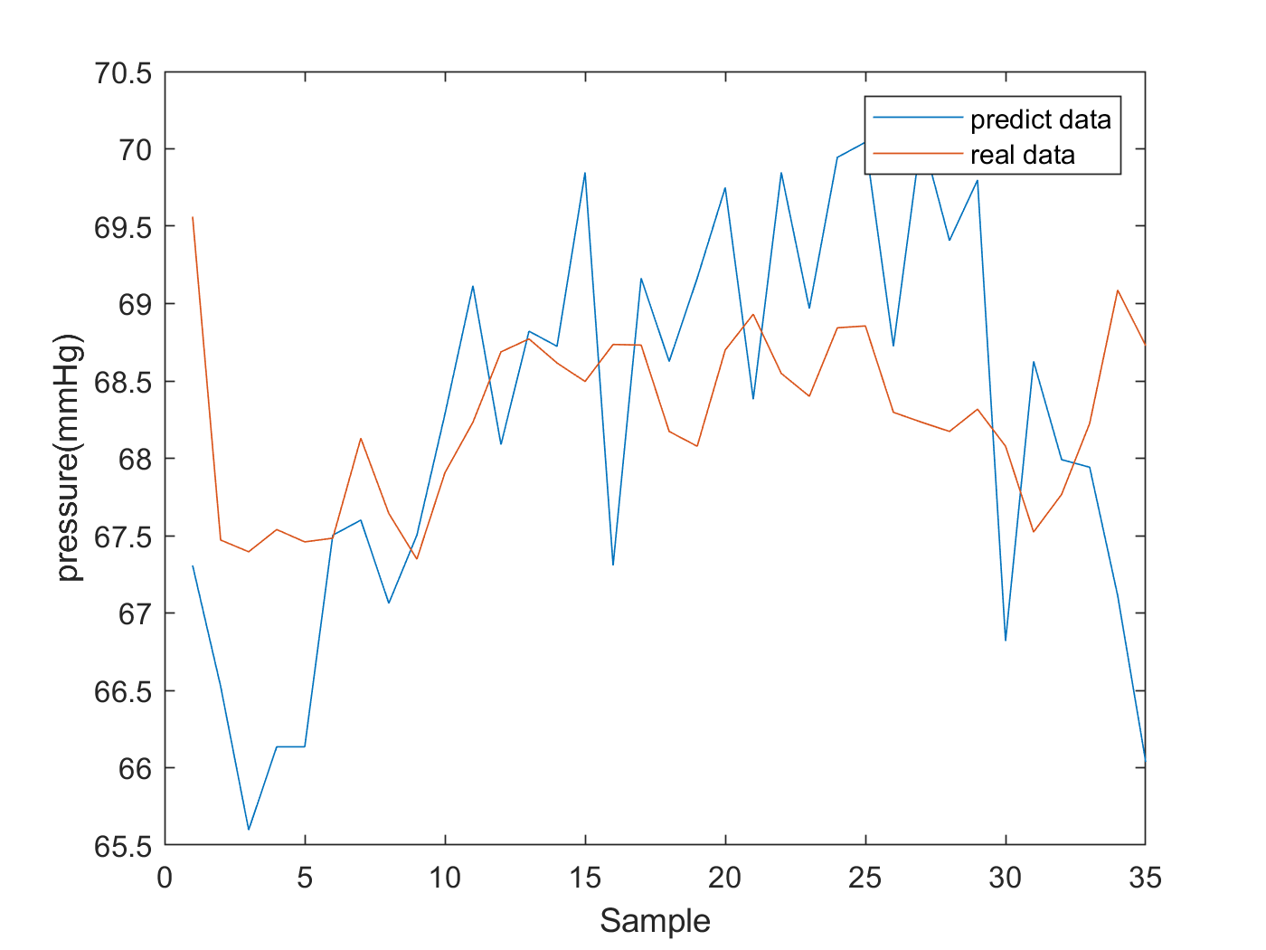
Results
Fig. 3. Training results. a) Systolic blood pressure; b) Diastolic blood pressure
Notes:
In the result part, predicting data shown in this figure. 3 is very similar to the real data,
and this indicates that ECG and PPG parameter have a strong correlation with blood pressure.
A is systolic blood pressure, and b is diastolic blood pressure.
So it could be possible that we can measure blood pressure without using cuff.
In the future, we still need to add more physiological parameters
Or try another different regression model to estimate BP.
As long as we do something like that, we may get the more ideal results.

Slide 8
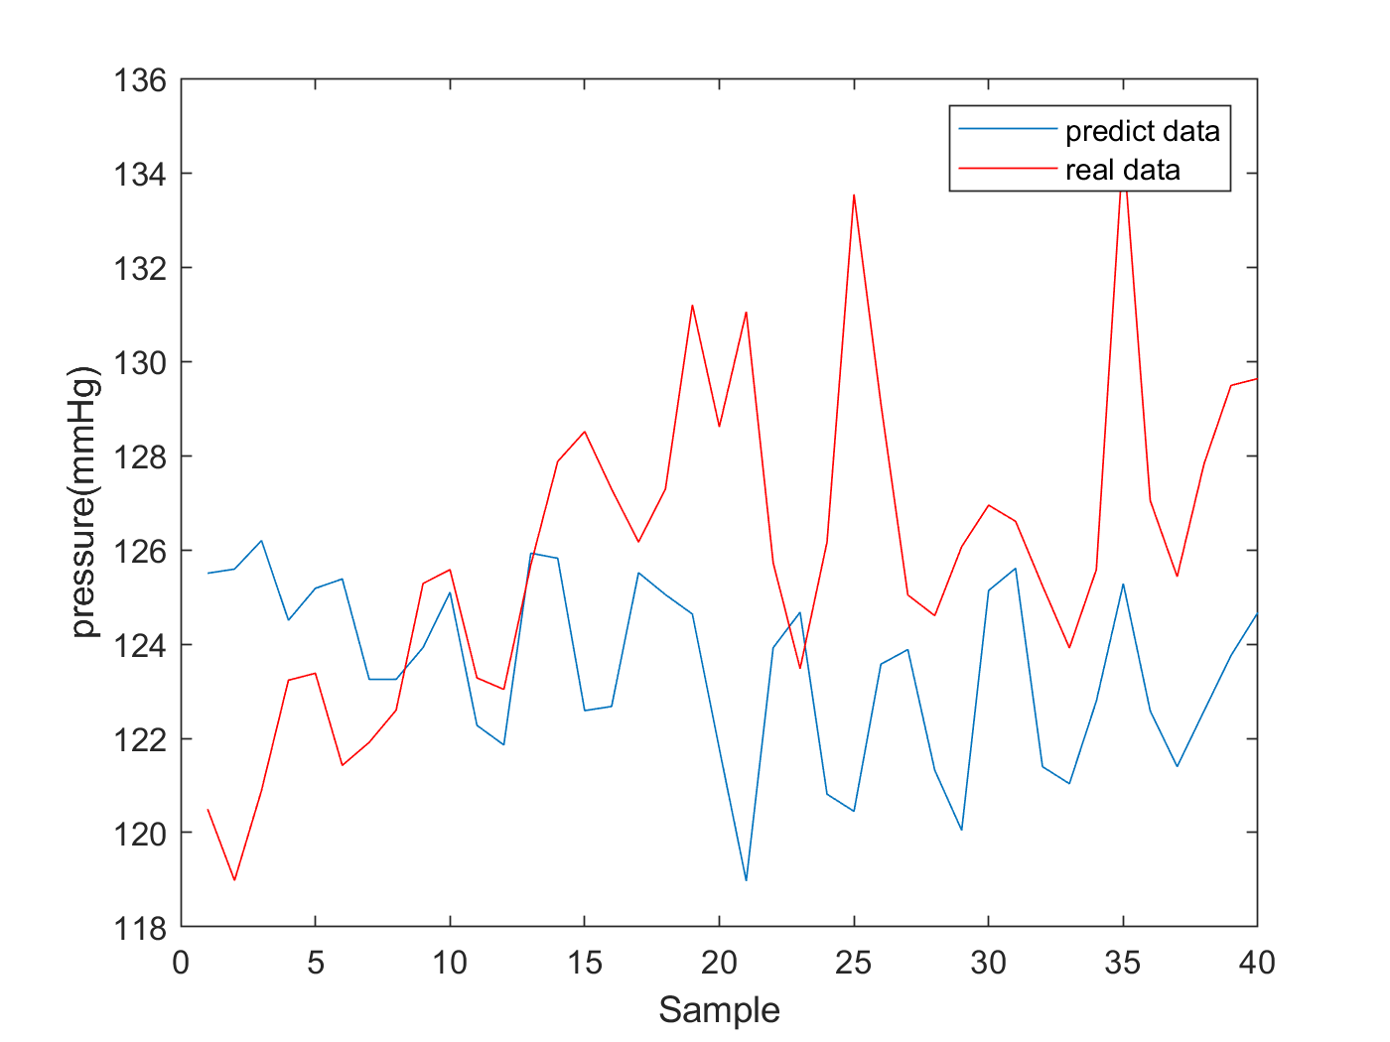
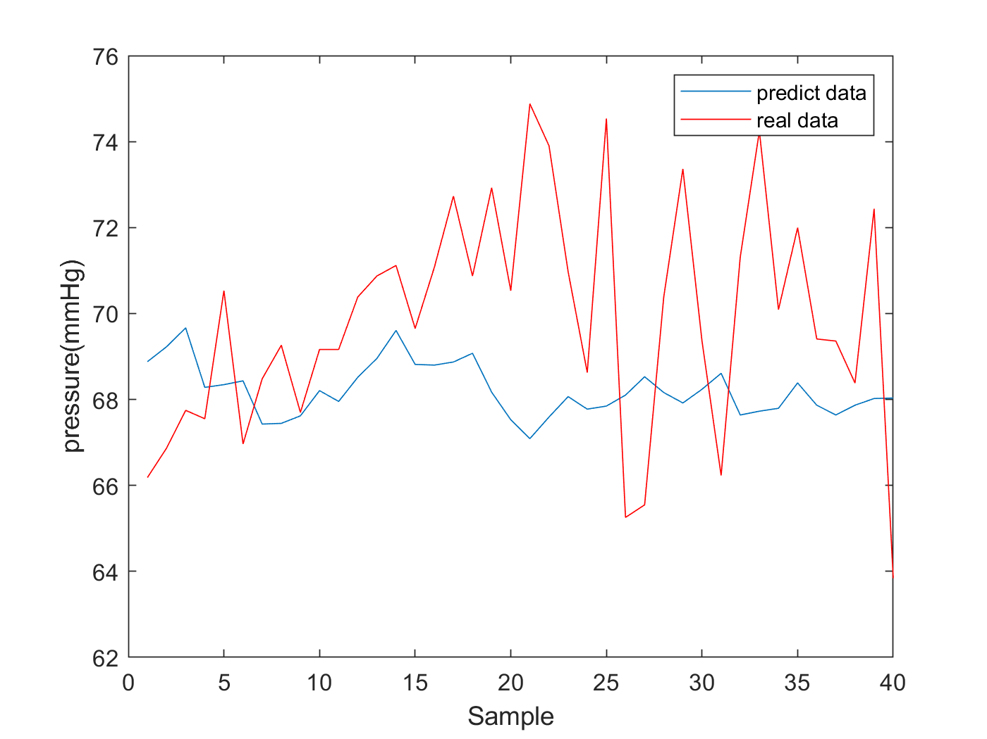
Results (cont.)
Fig. 4. Testing results. a) Systolic blood pressure test; b) Diastolic blood pressure test
Notes:
Continuously, we want to know whether the regression model works appropriately even we use unknown data.
As shown in this figure, you can see that predicting data is very similar to the real data.
In the future, we still need to add more physiological parameters to estimate BP.
As long as we do something like that, we may get the ideal results.

Slide 9
References
1. Linear regression
2. Single linear regression
3. Cuff-Less High-Accuracy Calibration-Free Blood Pressure Estimation Using Pulse Transit Time

Slide 10
Thank you! GitHub

