Slide 1
CodingForFun
By:Benny Li, Jeff Guan, Kenneth Byun, Carson Mooc

Slide 2
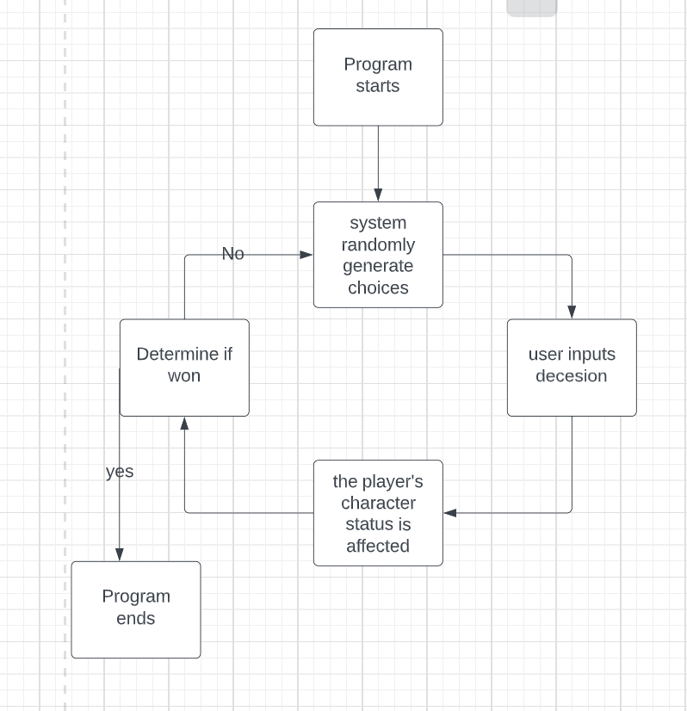
Main system
The uml diagram depicts the gameplay loop of the game, which loops indefinitely until the user has won the game based off the status.

Slide 3
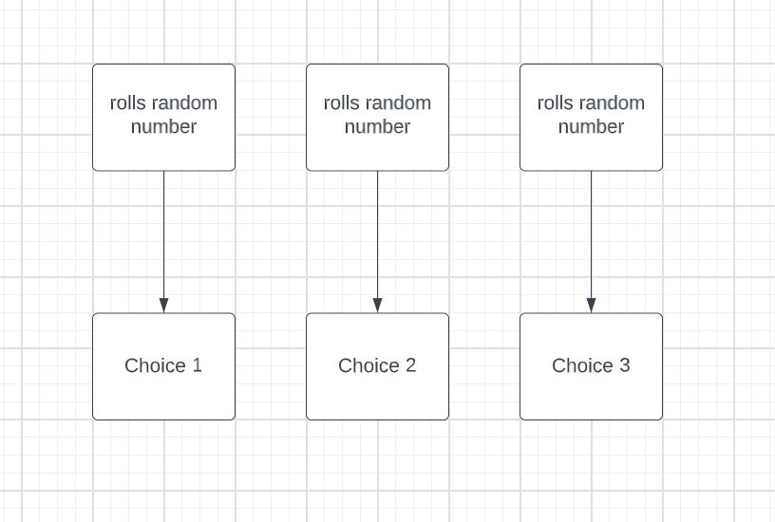
System random generated choices
Using a randomly generated system, it changes the options that the user is able to choose in game.

Slide 4
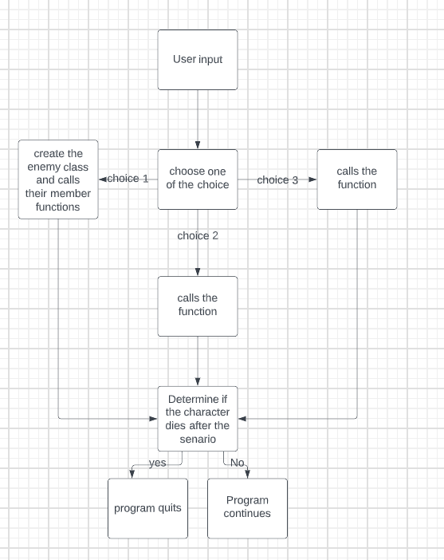
User input decisions
When the user is prompted to input their decision, based on the input the function associated with the input is called and then checked whether or not the user can continue playing the game or not.

Slide 5
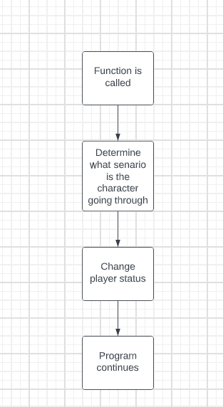
Functions (All)
Once a choice has been made, the respective function is called which then analyzes the user’s situation at the current state of the game. It then changes the player’s status according to the function being called, and the game continues.

Slide 6
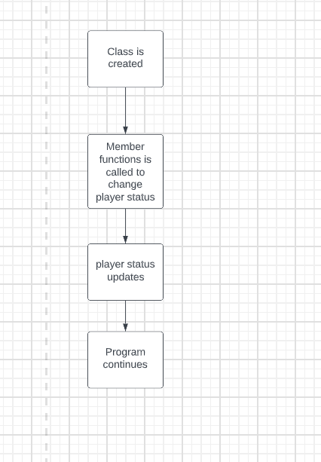
Class initialized
If the called function based on the user’s input confronts an enemy, the enemy class is initialized so that the user is able attack/flee. When either of the two options are chosen, the player status is updated to reflect the current state of the game and continue thereon.

Slide 7
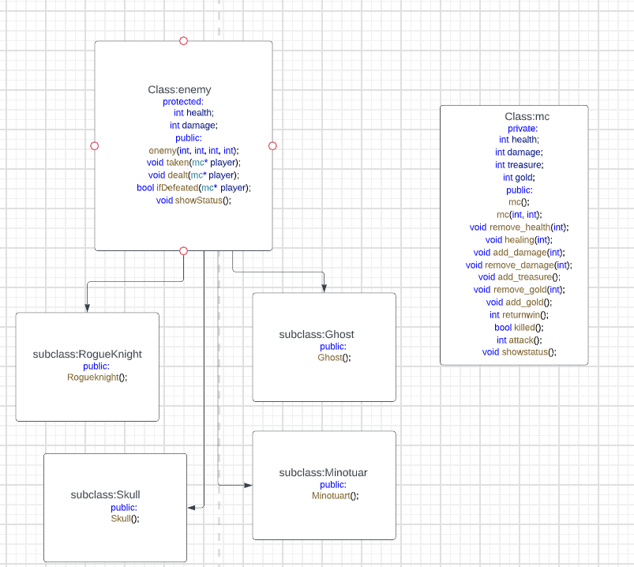
Classes
This outlines all the classes (and subclasses) used in the program with all private, protected, and public members of each class.

