Slide 1
CNN
2024/05/06

Slide 2
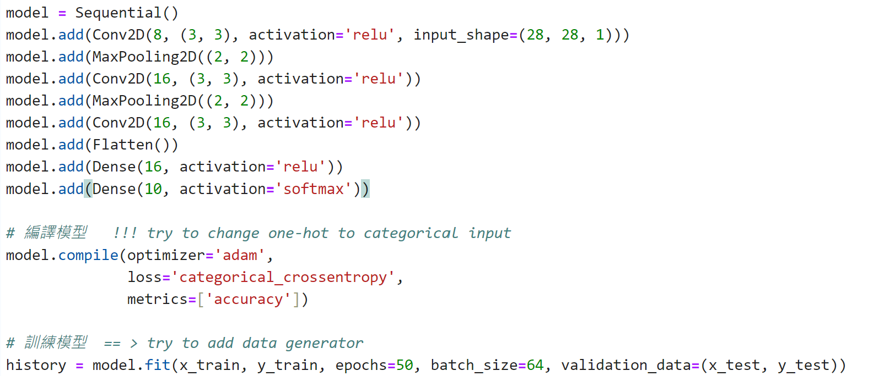
Example of CNN

Slide 3
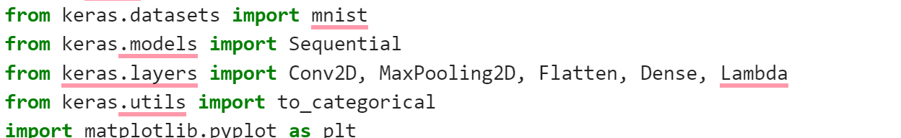
Example of CNN

Slide 4
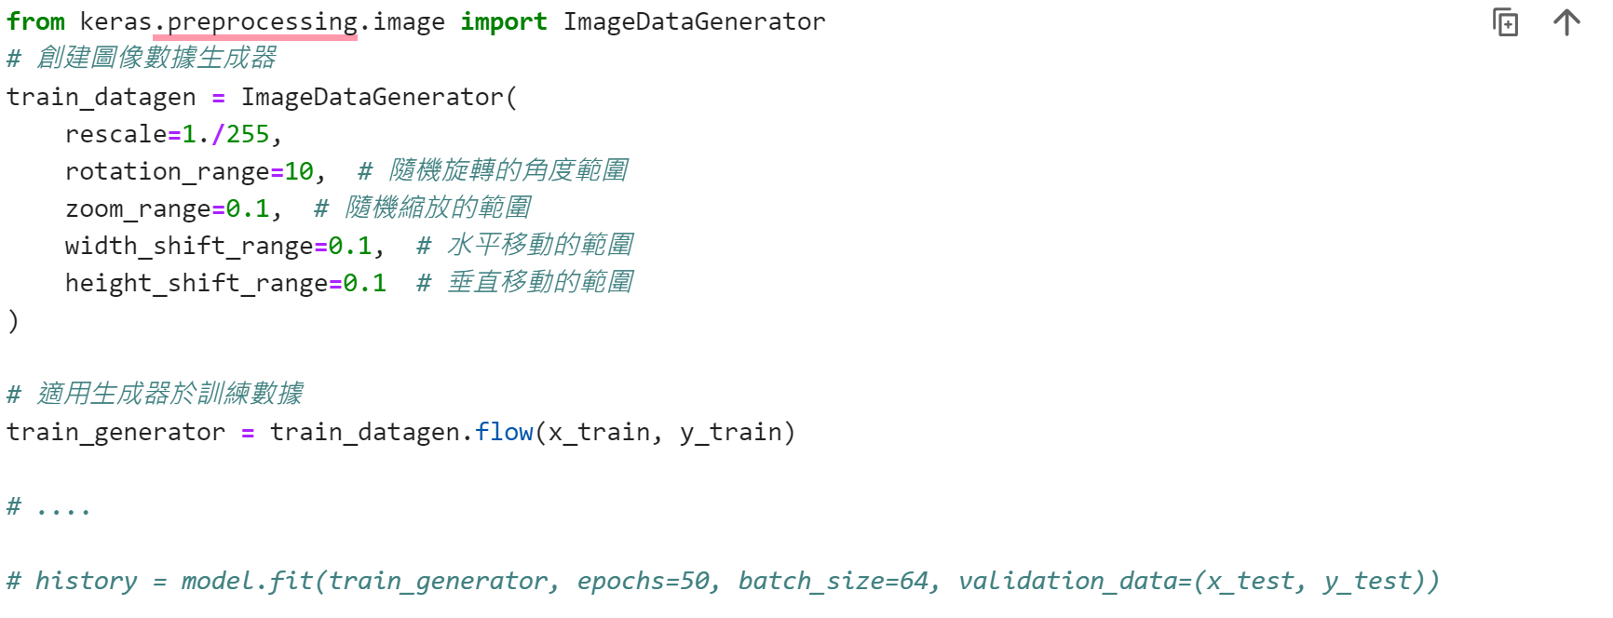
ImageDataGenerator

