Slide 1

機器學習於材料資訊的應用
----第五組期中報告
109613004 余秉叡
109613036 鄒秉翰

Slide 2
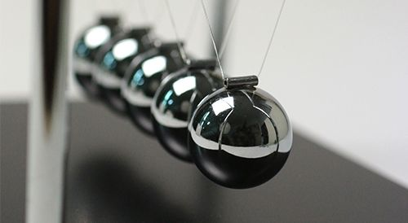
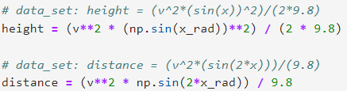
期中報告主題
簡單拋射問題

Slide 3
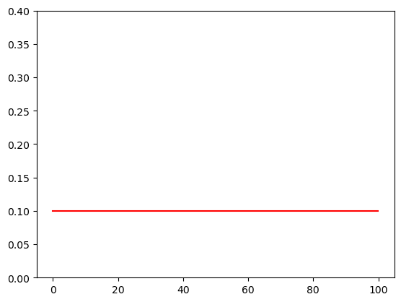
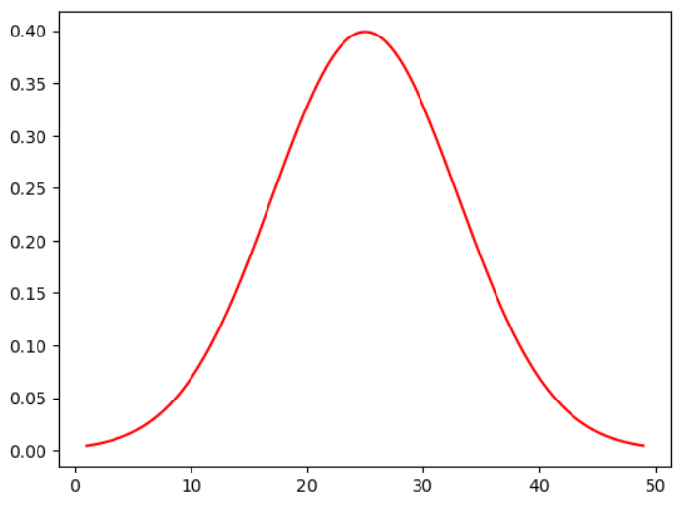
均值分布的訓練資料 (1890筆)
常態分佈的訓練資料 (2000筆)
(a)
(b)
Figure 1. Data set for training machine in different ways. Real data set generated from (a) uniform distribution (b) normal distribution

Slide 4
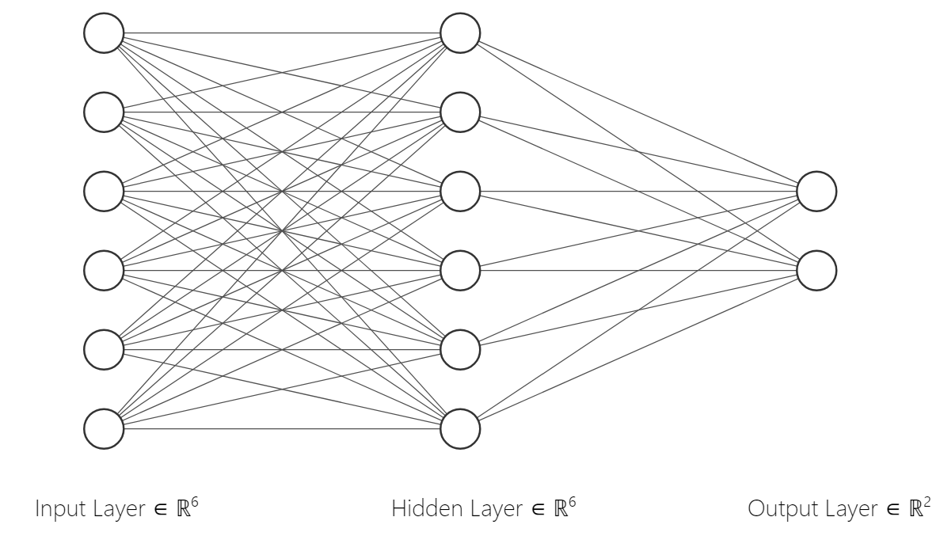
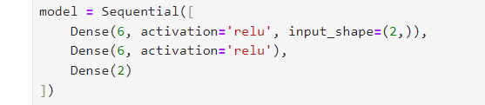
Model_1 (6,6,2)
(a)
(b)
Figure 2. Schematic diagrams and portion of code for the structure of neuromorphic computing. (a) and (b) have shown that Model_1 has 6-6-2 neurons in each layer (c) and (d) also have shown that Model_2 has 2-4-8-8-2 neurons in each layer.

Slide 5
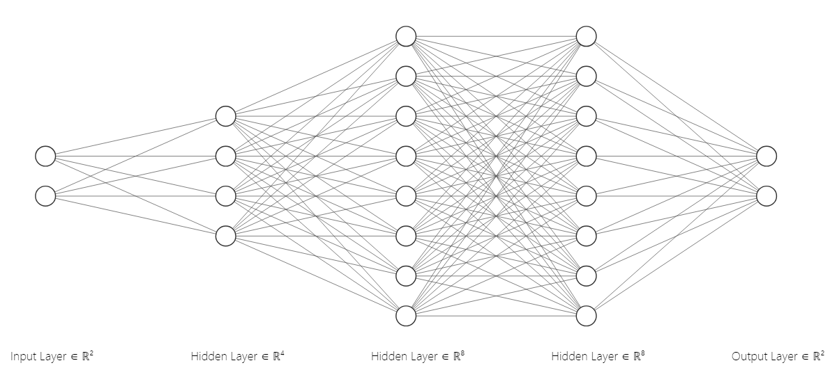
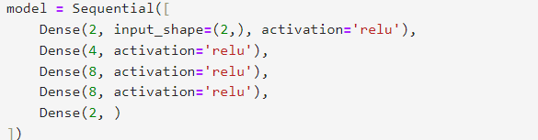
Model_2 (2,4,8,8,2):
(c)
(d)
Figure 2. Schematic diagrams and portion of code for the structure of neuromorphic computing. (a) and (b) have shown that Model_1 has 6-6-2 neurons in each layer (c) and (d) also have shown that Model_2 has 2-4-8-8-2 neurons in each layer.

Slide 6
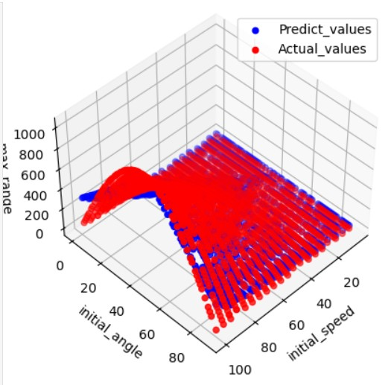
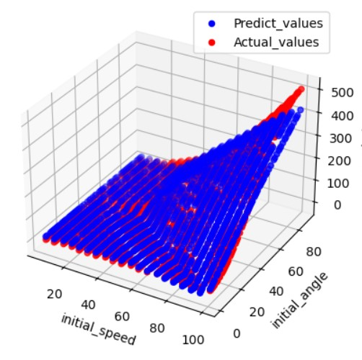
均值分布 (1890筆)
with
Model_1
(a)
(b)
Maximum range
Maximum height
Figure 3. The distribution of consequences after training procedure, displaying the calculating (a) maximum range and (b) height with uniform distribution and Model_1

Slide 7
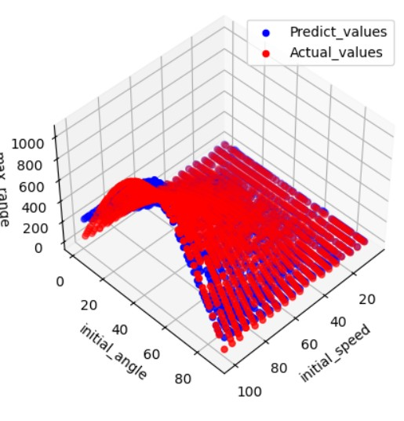
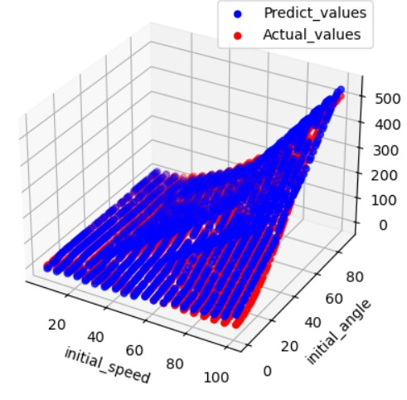
均值分布 (1890筆)
with
Model_2
(a)
(b)
Maximum range
Maximum height
Figure 4. The distribution of consequences after training procedure, displaying the calculating (a) maximum range and (b) height with uniform distribution and Model_2

Slide 8
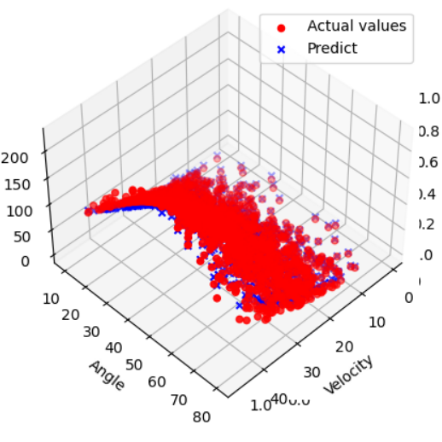
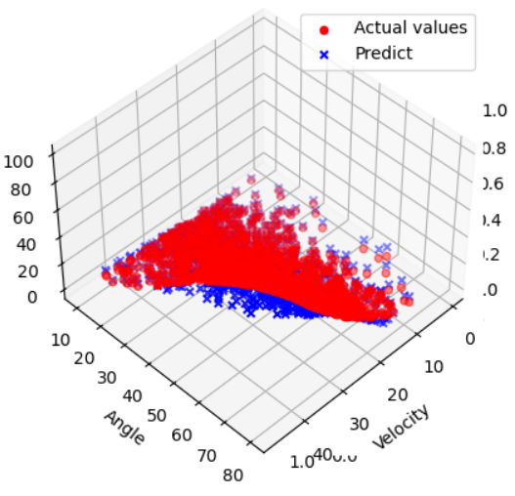
常態分佈 (2000筆)
with
Model_1
(a)
(b)
Maximum range
Maximum height
Figure 5. The distribution of consequences after training procedure, displaying the calculating (a) maximum range and (b) height with normal distribution and Model_1

Slide 9
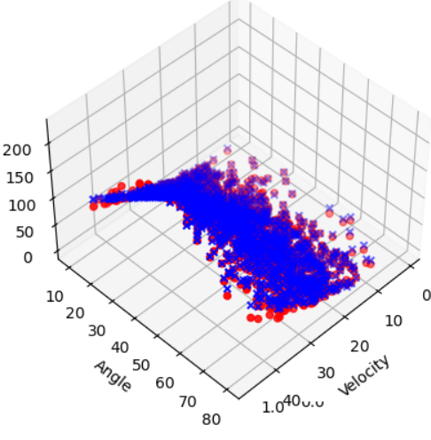
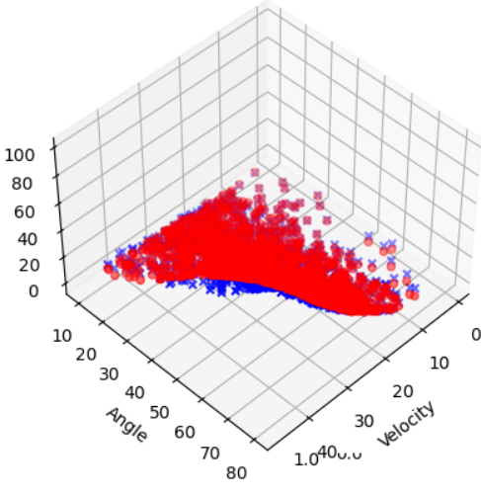
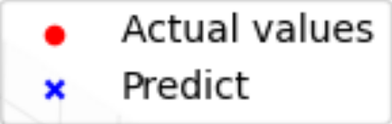
常態分佈 (2000筆)
with
Model_2
(c)
(d)
Maximum range
Maximum height
Figure 6. The distribution of consequences after training procedure, displaying the calculating (a) maximum range and (b) height with normal distribution and Model_2

Slide 10
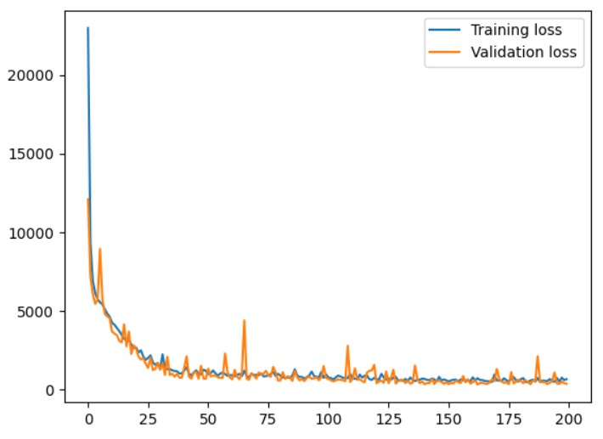
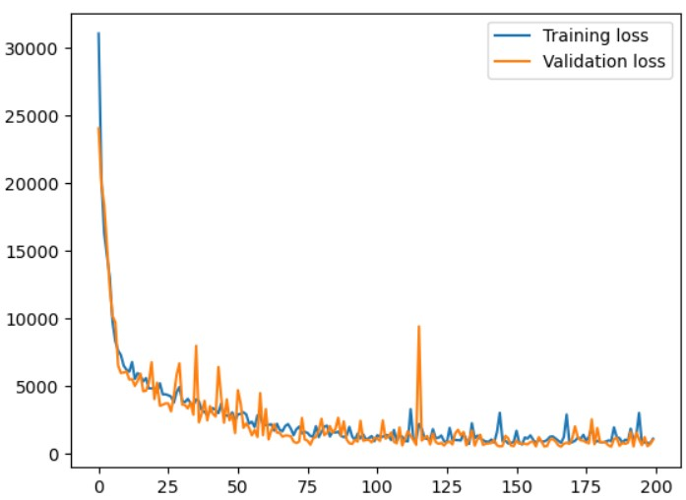
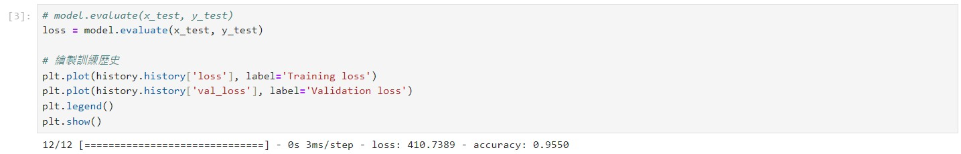

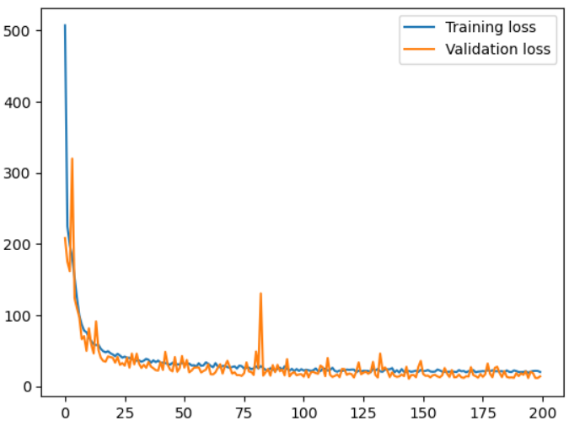
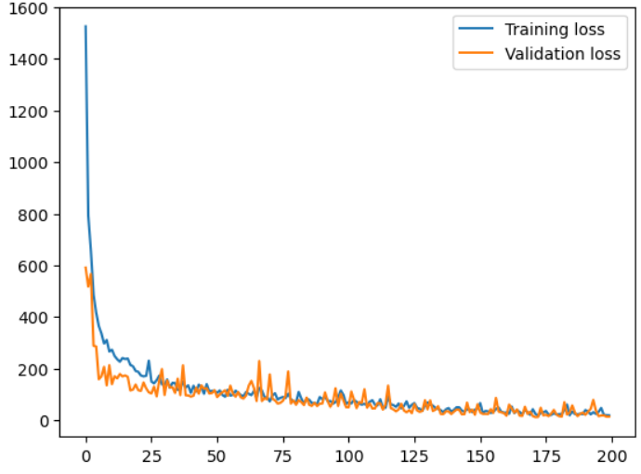
loss & accuracy
Model_1
Model_2
(a)
(b)
均值分布 (1890筆)
(c)
(d)
常態分佈 (2000筆)
Figure 7. Diagrams for recording the training and validation residual (loss) and the average accuracy during the entire training history. Record for (a) uniform distribution with Model_1 (b) uniform distribution with Model_2 (c) normal distribution with Model_1 (d) normal distribution with Model_2

Slide 11
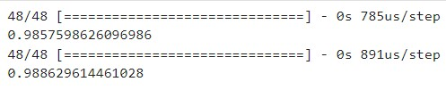
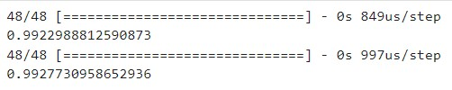


Pearson correlation of distance and height
Model_1
Model_2
Maximum distance:
Maximum distance:
均值分布 (1890筆)
Maximum height:
Maximum height:
Maximum distance:
Maximum distance:
常態分佈 (2000筆)
Maximum height:
Maximum height:
Table 1. Pearson correlation coefficient with respect to uniform distribution (normal distribution) with Model_1 (Model_2) compare to the loss (residual) and accuracy.

Slide 12
結論:
就此題簡單斜拋運動
1. Model_2 (2,4,8,8,2) 比起 Model_1 (6,6,2) 有著更好的表現，適當模型複雜度的增加有助於提升準確度。
2.常態分佈比起均值分布的訓練資料有著更好的表現，給定集中範圍的資料也有助於提升準確度。
3. Loss (Residual) 的絕對值不能一個模型的表現好壞，只能由相對值看出訓練是否完善。
4. Accuracy 及 Pearson correlation 有著完全的相依性，兩者皆能夠作為訓練好壞指標。
5. 將速度及角度分開對距離及高度作圖毫無意義，兩者皆預設在範圍內隨機生成，若要進行單一變數分別對
距離及高度比較，需要將分別固定另外一個變數為定值再進行比較，3D圖更能直接看出趨勢。

