Slide 1

Hackathon 2017
December 2017

Slide 2
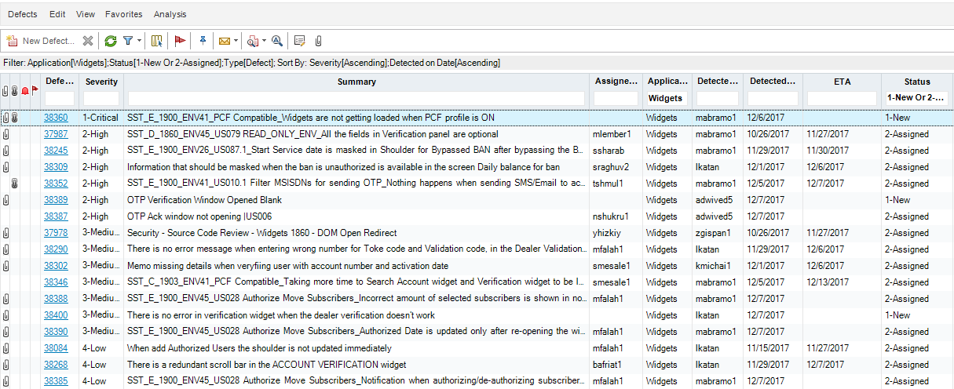


WIFM
We Have The Best Solution For You !
Too Many Defects ???

Slide 3
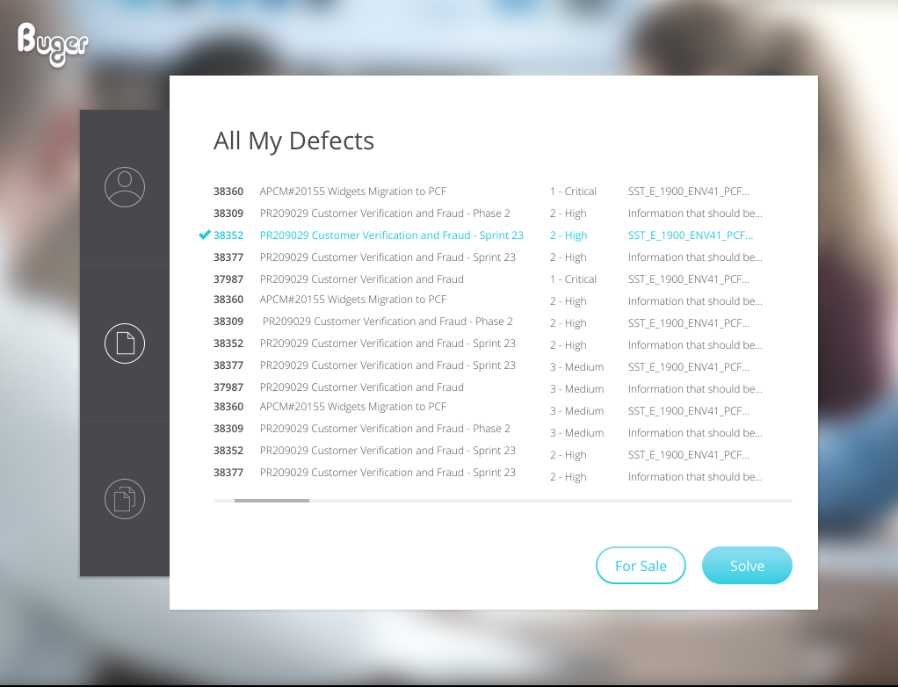
Our Product Provides:
Manage your defects
Trade your defects in a dedicated marketplace
Keep high productivity

Slide 4
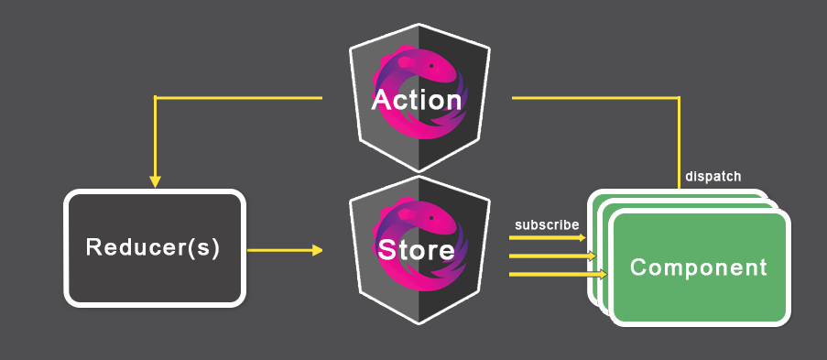




Technologies We Used
Front-End – JS Angular 2 (using Components)
Back-End – NodeJS (JSON-server)
Design-Pattern – Redux using ngrx library for Angular

