Slide 1

Buger Hackathon 2017
December 2017

Slide 2
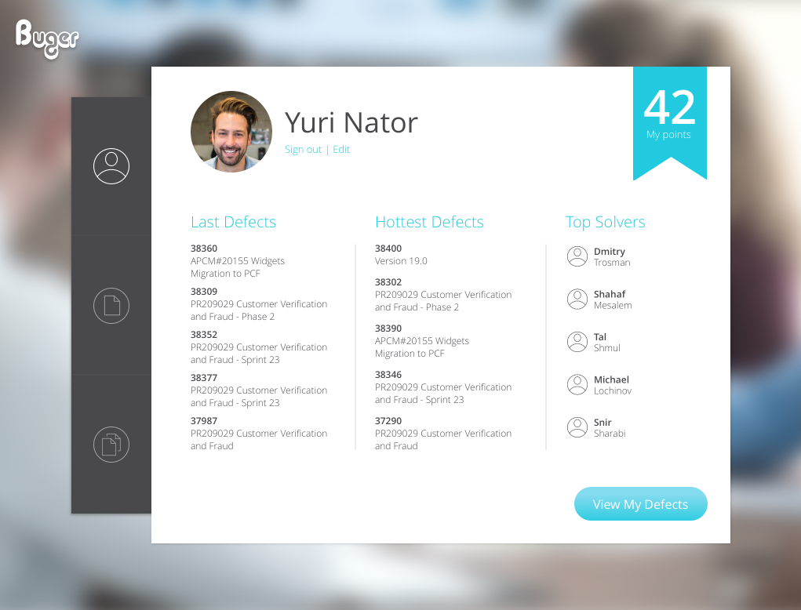
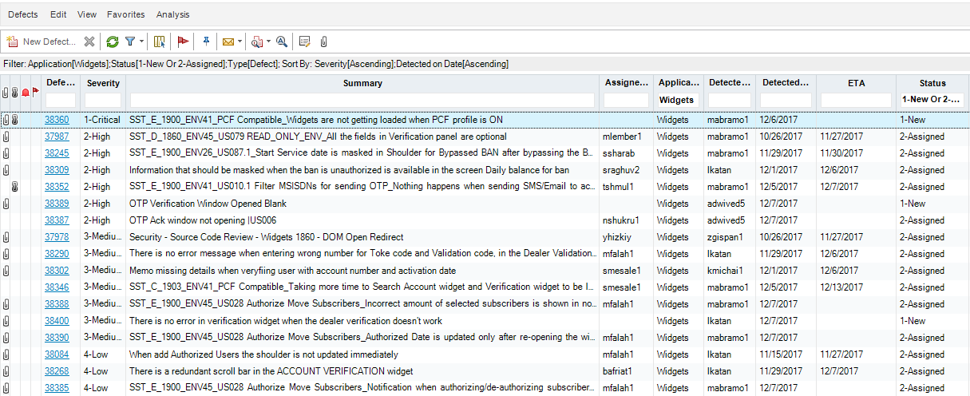
WIFM
We Have The Best Solution For You !
Too Many Defects ???

Slide 3
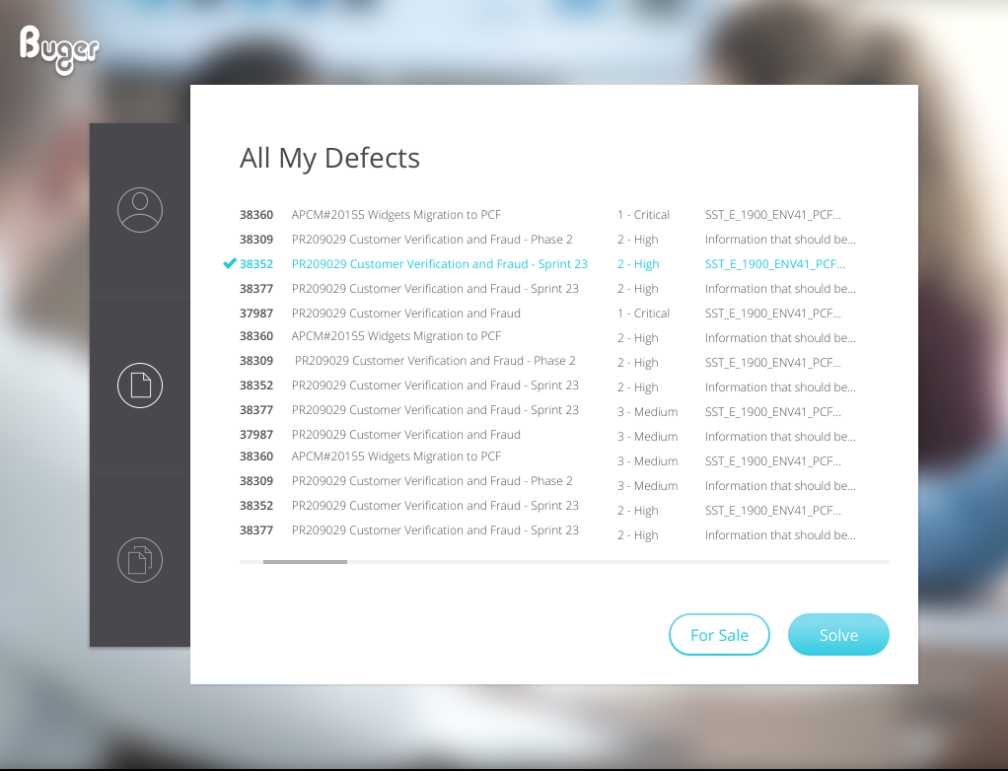
Our Product provides:
Managing your defects
Option to buy/sell defect in order to save time
Keeping high productivity
Notes:
Amdocs, a global company with revenue of US$3.6b in fiscal year 2015, has more than 24,000 professionals serving more than 300 customers in over 90 countries. Our comprehensive understanding of our customers’ business and the relationships we develop enable us to offer greater value by providing them with best practices, insights and solutions gathered from across the communications industry and different geographies. Evidence to the value we provide to our customers is in the industry-leading project success rate and the awards and recognition received from leading analysts, industry leaders and associations across the globe.
Demonstrated Leaderships
Amdocs was recognized by Leading Lights for its innovative service-centric approach to commercializing virtualized and hybrid services, ensuring a seamless, agile experience that hides complexity from the end customers
Amdocs ranked in top 3 IT services for telecoms by Ovum
Amdocs Managed Services wins Pipeline Innovation award for innovations in Managed Services.
Gartner recognizes Amdocs as a leader in integrated revenue and customer management
A comprehensive list of our awards can be found on Amdocs.com @ http://www.amdocs.com/About/Pages/amdocs-awards.aspx

Slide 4



What technologies did we use?
Front-End – JS Angular 2 (using Components)
Design-Pattern – Redux using ngrx library for Angular
Back-End – NodeJS
Notes:
Amdocs, a global company with revenue of US$3.6b in fiscal year 2015, has more than 24,000 professionals serving more than 300 customers in over 90 countries. Our comprehensive understanding of our customers’ business and the relationships we develop enable us to offer greater value by providing them with best practices, insights and solutions gathered from across the communications industry and different geographies. Evidence to the value we provide to our customers is in the industry-leading project success rate and the awards and recognition received from leading analysts, industry leaders and associations across the globe.
Demonstrated Leaderships
Amdocs was recognized by Leading Lights for its innovative service-centric approach to commercializing virtualized and hybrid services, ensuring a seamless, agile experience that hides complexity from the end customers
Amdocs ranked in top 3 IT services for telecoms by Ovum
Amdocs Managed Services wins Pipeline Innovation award for innovations in Managed Services.
Gartner recognizes Amdocs as a leader in integrated revenue and customer management
A comprehensive list of our awards can be found on Amdocs.com @ http://www.amdocs.com/About/Pages/amdocs-awards.aspx

