Slide 1

Horror Movie Trends
Trends over the Last Decade
Ben, Danielle, Joe, rothana

Slide 2
Motivation and Interest
With Halloween just passing while picking our projects our group thought it would be interesting to see how horror movie interest and ratings have trended over the past few years. The first data set we found had horror movies ranging from 2012-2017 but we wanted to expand upon this time frame. This led us to include a Netflix data set allowing us to expand our analysis using the streaming services. Not only was the theme of interest but these data sets were a good introduction for cleaning data sets.
Questions addressed in this analysis
Release Date Analysis (Roth):
What is the change in average ratings between 2012 and 2017?
Which release month is the most popular for each country in the data set?
Country Analysis (Ben):
What country spends the most on average per movie?
What is the relationship between rating average and country?
Rating Analysis (Danielle):
What is the correlation between rating and movie duration?
What is the correlation between rating and location setting?
Netflix Analysis (Joe):
Number of horror movie release vs total release per county per year?
Was the number of releases effected by the pandemic?

Slide 3
Rating Analysis: Source Material
Used IMDB Horror movie Data set from Kaggle.
Limitation of the data set include
Missing data that was filtered out
Unknown number of reviews
Geoapify API was used
Geocode to get place id
Places to get location type
Dependent on data entered to be correct

Slide 4
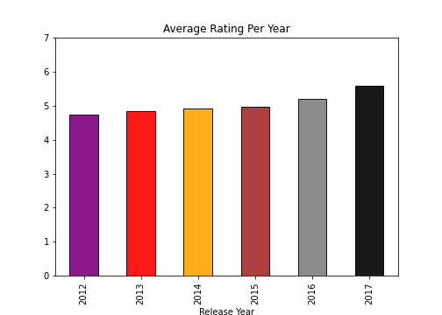
Release Date Analysis: Question 1
What is the change in average ratings between 2012 and 2017?
Based on the dataset, the average rating is between 4 and 6.
As the years went on, the ratings for horror films did increase revealing popularity among the genre.
Notes:
Problems with this chart:
The number of films in each year differs, some years could have more movies than the others.
The number of reviews for each film differs, some films may have received 1, while another 1000s.

Slide 5
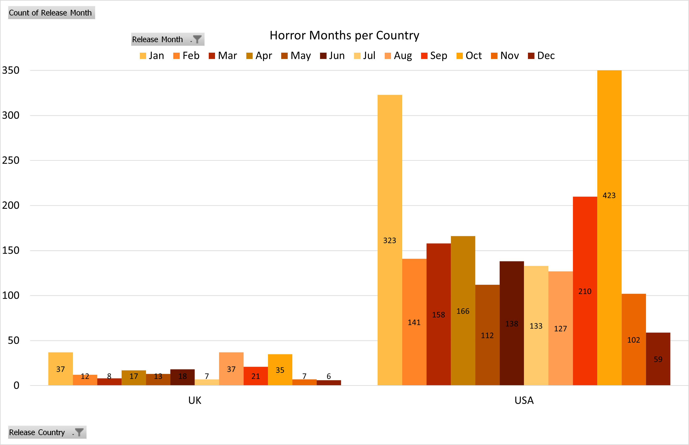
Release Date Analysis: Question 2
Which release month is the most popular for each country in the data set.
We can assume October would be a popular release month, but also find January being no far from that group.
Looking at months outside of fall, horror films release dates are more in the spring and summer seasons.

Slide 6
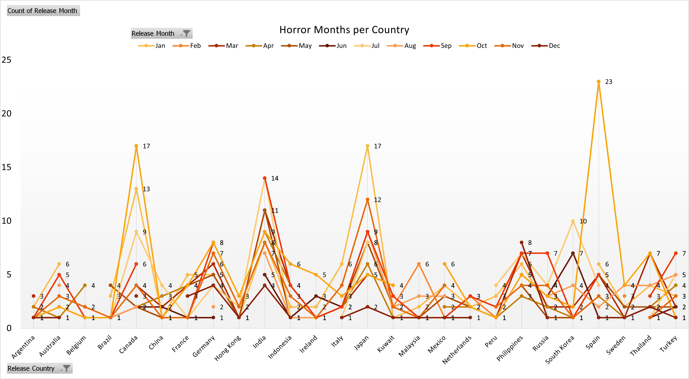
Release Date Analysis: Question 2

Slide 7
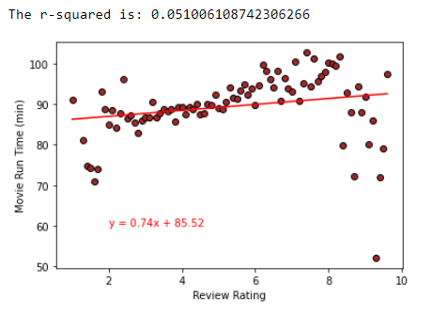
Rating Analysis: Question 1
What is the coloration between review rating and run time?
There is a weak coloration between review rating and movie run time.
From the r2 value we can also see the data does not fit the line well.
From the data given we can note the movie run time drops off with a rating above 8.

Slide 8
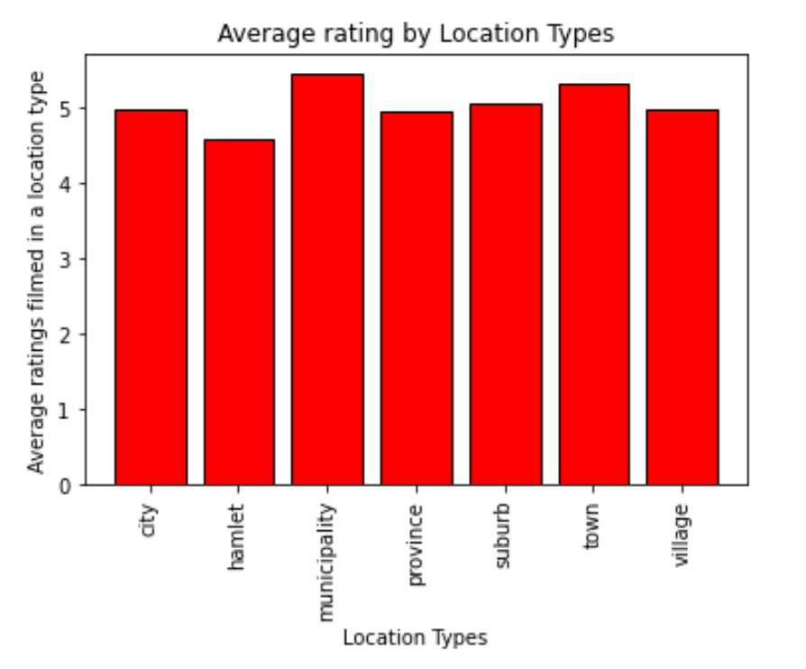
Rating Analysis: Question 2
Is there a significant difference between review ratings based on the location setting?
From this chart we can determine municipalities and towns tend to have higher ratings but are not significantly ahead.
Hamlets on the other hand are not the best setting for horror movies

Slide 9
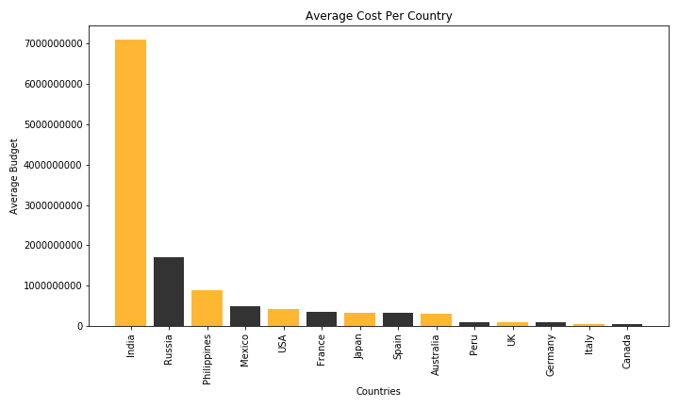
Country Analysis: Question 1
What country spends the most on average per movie?
There were over 70 countries in the data set, but not all the movies had budget data
The data was cleaned to only include countries with 10 or more movies and only include movies with a US currency budget amount

Slide 10
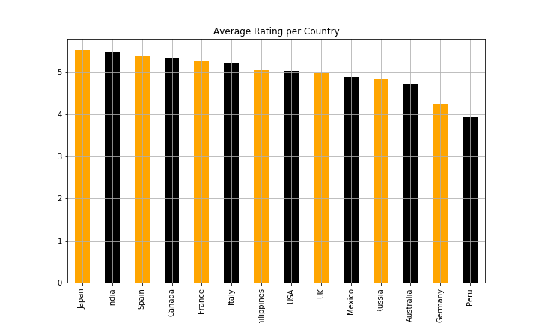
Country Analysis: Question 2
What is the relationship between rating average and country?
Looking at the ratings and the budget, Horror movies seem to be a popular genre
Japan only made 11 movies, the average rating was the highest amount the countries

Slide 11
Country Analysis Facts 2012-2017
Country Movie Count vs. Budget
14 countries out 70+ were included in the analysis
There were large majority of countries with less than 10 movies
India’s average budget is roughly $67 million more per movie than the United States
UK made the second most movies with a more moderate budget per movie
Release Country | Movie Count | Average Budget
India | 32 | $71,049,162.50
Russia | 18 | $16,993,718.06
Philippines | 14 | $8,795,928.57
Mexico | 10 | $5,028,200.00
USA | 834 | $4,257,310.12
France | 12 | $3,508,227.17
Japan | 11 | $3,385,727.27
Spain | 15 | $3,183,413.33
Australia | 14 | $3,142,000.00
Peru | 11 | $1,041,000.00
UK | 86 | $1,022,959.80
Germany | 21 | $927,872.10
Italy | 12 | $560,791.67
Canada | 23 | $529,631.78

