Slide 1

Horror Movie Trends
Trends over the Last Decade
Ben, Danielle, Joe, rothana

Slide 2
Motivation and Interest
With Halloween passing behind us, it would be interesting to look at the horror genre and its popularity within the data set. Today we are seeing a rise in remakes and sequels that may or may not be cutting it for the viewers and would like to see how previous horror films did with the ratings.
Questions addressed in this analysis
Release Date Analysis (Roth):
What is the change in average ratings between 2012 and 2017?
Which release month is the most popular for each country in the data set?
Country Analysis (Ben):
What country spends the most on average per movie?
What is the relationship between rating average and country?
Rating Analysis (Danielle):
What is the correlation between rating and movie duration?
What is the correlation between rating and location setting?
Netflix Analysis (Joe):
Number of horror movie release vs total release per county per year?
Was the number of releases effected by the pandemic?

Slide 3
Rating Analysis
Used IMDB Horror movie Data set from Kaggle.
Limitation of the data set include
Missing data that was filtered out
Unknown number of reviews
Geoapify API was used
Geocode to get place id
Places to get location type
Dependent on data entered to be correct

Slide 4
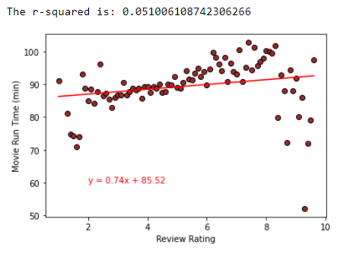
Rating Analysis: Question 1
What is the coloration between review rating and run time?

Slide 5
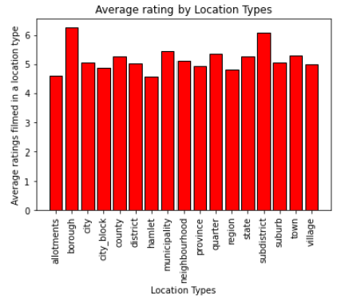
Rating Analysis: Question 2
Is there a significant difference between review ratings based on the location setting?

Slide 6
Question 1
Question 1

Slide 7
Question 1
Question 1

