Slide 1
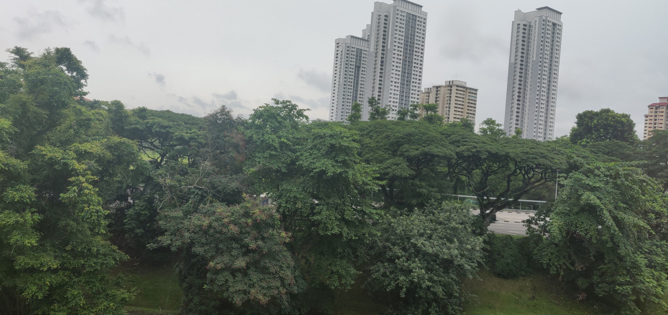

Computer Vision – Identification of Animate Objects with Python

