Slide 1
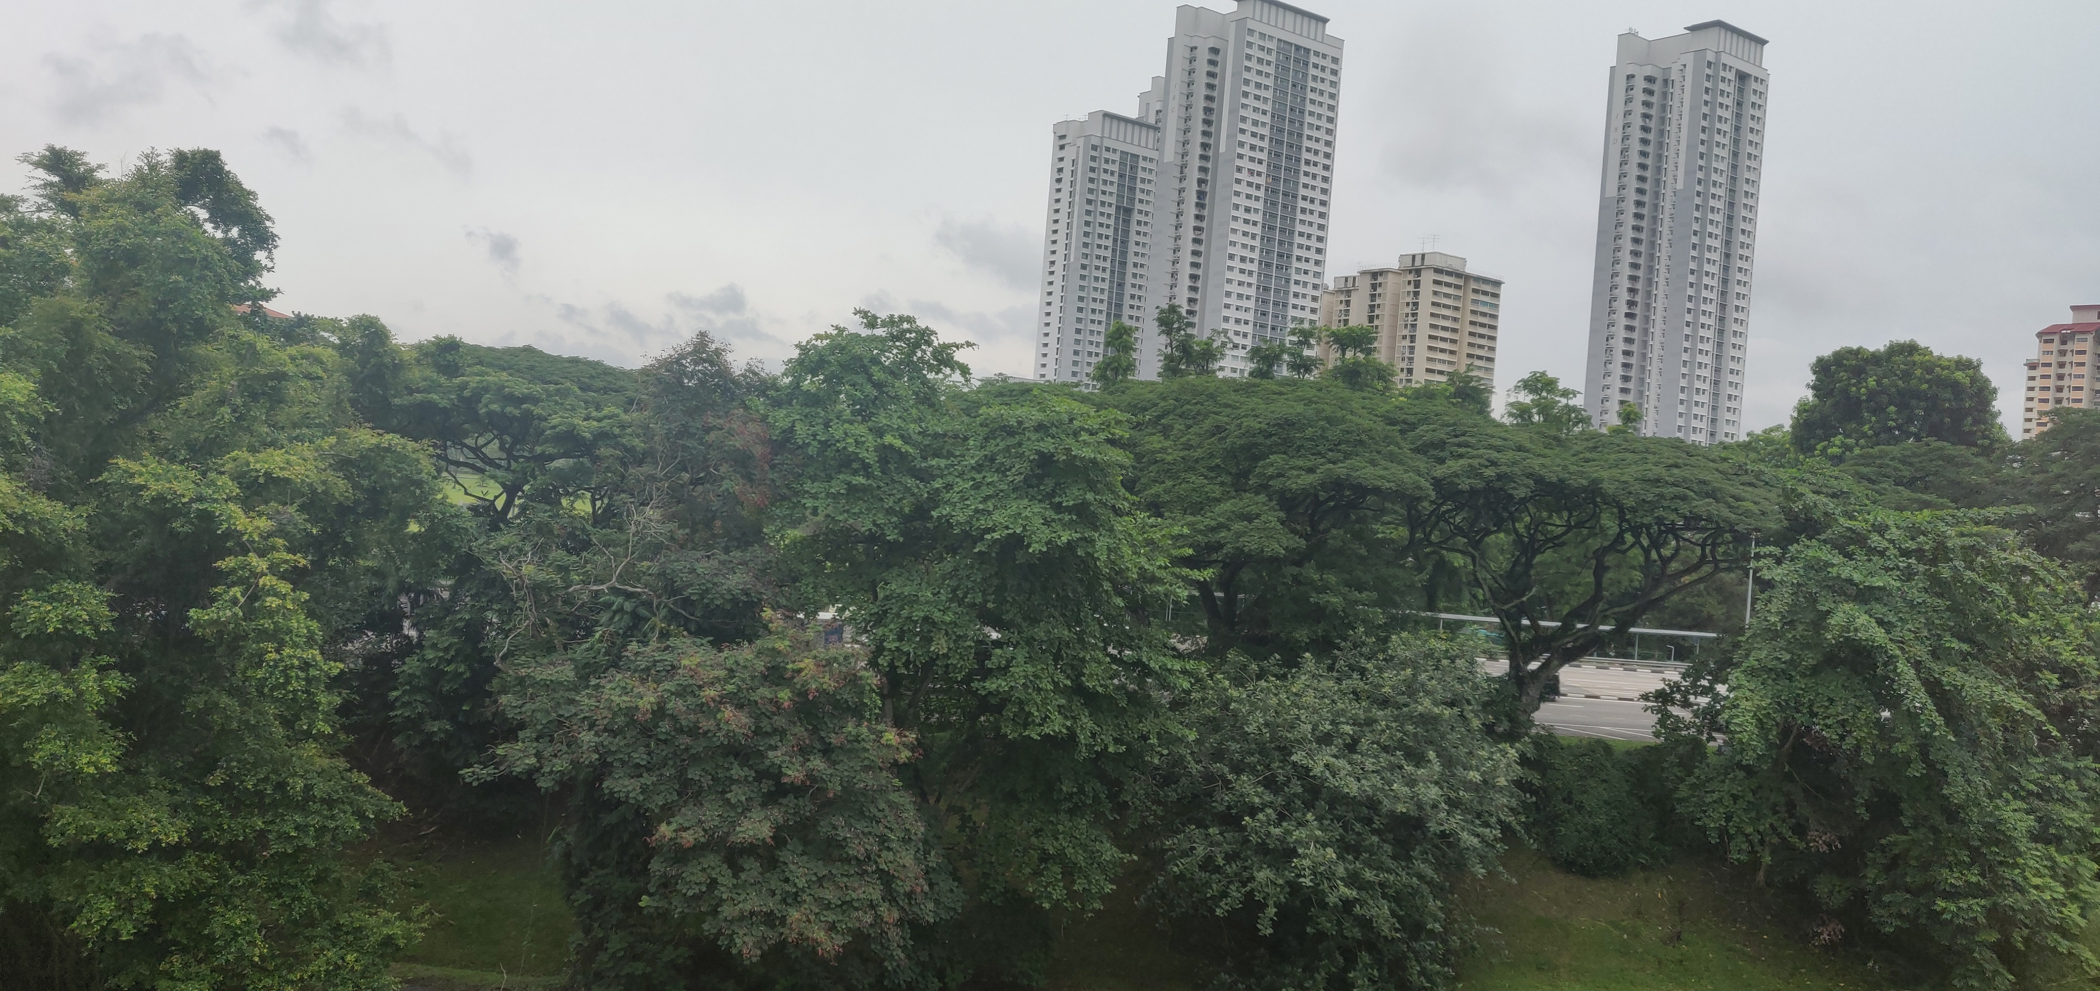

Computer Vision – Identification of Animate Objects with Python

Slide 2

Project Scope
The scope of the project is currently limited to the following:
Identify and classify objects (Animate / Inanimate).
Enable a camera to identify objects process the input
Perform an action once identification is performed.
The scope of the project may evolve in the future according to our proceedings

Slide 3
Process Overview
Teach Machine to recognize objects
Train & Test Machine
Connect Camera to Machine
Process Input from Camera and make Decisions
Perform Actions according to Decisions
Currently not in scope: Connect machine to Alexa/Speaker and identify people visiting a residence. Announce the name of the person through a speaker.

Slide 4
Step 1: Basic Code to Identify an object (03-03-2021)

Slide 5
GitHub Repository Details & Instructions
Please refer to the GitHub repository furnished below.
All changes once made in the local repository should be committed to the develop branch.
Subsequently a Pull Request is to be created by the developer so that the owner of the Repository can validate the code in the develop branch before merging it into the master branch.
GitHub Repository: https://github.com/Tech-Knight-Danny/Proof-of-Concepts/tree/main/Computer_Vision
Directory: Computer Vision

