Slide 1
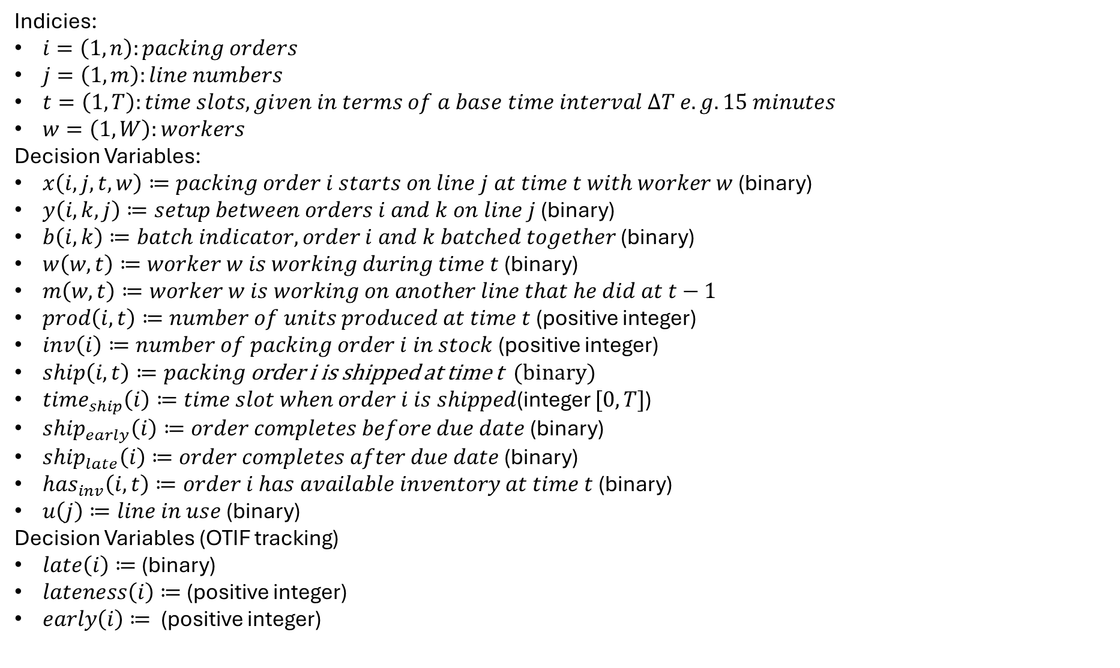
Indicies:
$i=\left(1,n\right):packing orders$
$j=\left(1,m\right):line numbers$
$t=\left(1,T\right):time slots, given in terms of a base time interval ΔT e.g. 15 minutes$
$w=\left(1,W\right):workers$
Decision Variables:
$x\left(i,j,t, w\right)≔packing order i starts on line j at time t with worker w$ (binary)
$y\left(i,k, j\right)≔setup between orders i and k on line j$ (binary)
$b\left(i,k\right)≔batch indicator, order i and k batched together$ (binary)
$w\left(w, t\right)≔worker w is working during time t$ (binary)
$m\left(w,t\right)≔worker w is working on another line that he did at t−1$
$prod\left(i,t\right)≔number of units produced at time t$ (positive integer)
$inv\left(i\right)≔number of packing order i in stock$ (positive integer)
$ship\left(i, t\right)≔packing$ order i is shipped at time t (binary)
$time_{ship}\left(i\right)≔time slot when order i is shipped$(integer $[0,T]$)
$ship_{early}\left(i\right)≔order completes before due date$ (binary)
$ship_{late}\left(i\right)≔order completes after due date$ (binary)
$has_{inv}\left(i,t\right)≔order i has available inventory at time t$ (binary)
$u\left(j\right)≔line in use$ (binary)
Decision Variables (OTIF tracking)
$late\left(i\right)≔$ (binary)
$lateness\left(i\right)≔$ (positive integer)
$early\left(i\right)≔$ (positive integer)

Slide 2
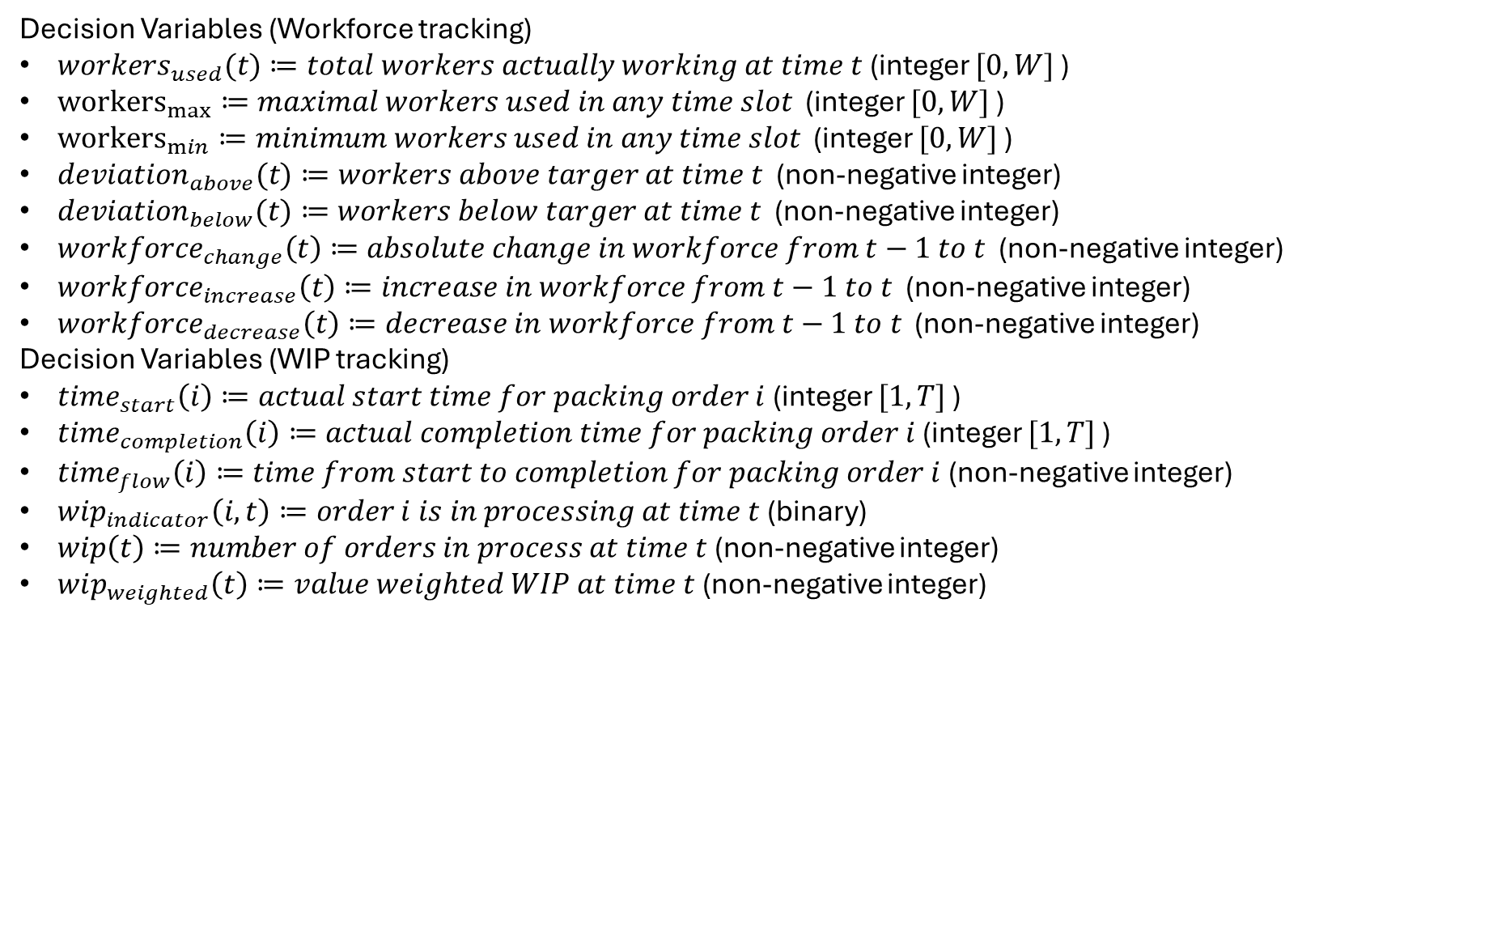
Decision Variables (Workforce tracking)
$workers_{used}(t)≔total workers actually working at time t$ (integer $[0,W]$ )
${workers}_{max}≔maximal workers used in any time slot$ (integer $[0,W]$ )
${workers}_{min}≔minimum workers used in any time slot$ (integer $[0,W]$ )
${deviation}_{above}(t)≔workers above targer at time t$ (non-negative integer)
${deviation}_{below}(t)≔workers below targer at time t$ (non-negative integer)
${workforce}_{change}\left(t\right)≔absolute change in workforce from t−1 to t$ (non-negative integer)
${workforce}_{increase}\left(t\right)≔increase in workforce from t−1 to t$ (non-negative integer)
${workforce}_{decrease}\left(t\right)≔decrease in workforce from t−1 to t$ (non-negative integer)
Decision Variables (WIP tracking)
$time_{start}\left(i\right)≔actual start time for packing order i$ (integer $[1,T]$ )
$time_{completion}\left(i\right)≔actual completion time for packing order i$ (integer $[1,T]$ )
$time_{flow}\left(i\right)≔time from start to completion for packing order i$ (non-negative integer)
${wip}_{indicator}\left(i,t\right)≔order i is in processing at time t$ (binary)
$wip\left(t\right)≔number of orders in process at time t$ (non-negative integer)
$wip_{weighted}\left(t\right)≔value weighted WIP at time t$ (non-negative integer)

Slide 3
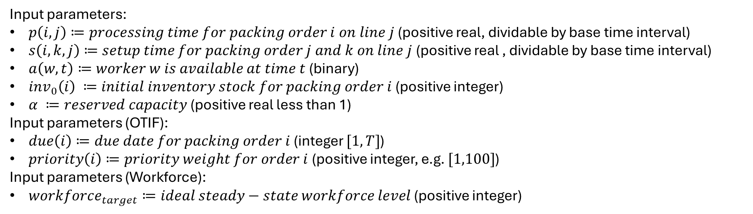
Input parameters:
$p\left(i,j\right)≔processing time for packing order i on line j$ (positive real, dividable by base time interval)
$s\left(i,k,j\right)≔setup time for packing order j and k on line j$ (positive real , dividable by base time interval)
$a\left(w,t\right)≔worker w is available at time t$ (binary)
$inv_{0}\left(i\right) ≔initial inventory stock for packing order i$ (positive integer)
$α ≔reserved capacity$ (positive real less than 1)
Input parameters (OTIF):
$due\left(i\right)≔due date for packing order i$ (integer $[1,T]$)
$priority\left(i\right)≔priority weight for order i$ (positive integer, e.g. $[1,100]$)
Input parameters (Workforce):
$workforce_{target}≔ideal steady−state workforce level$ (positive integer)

Slide 4
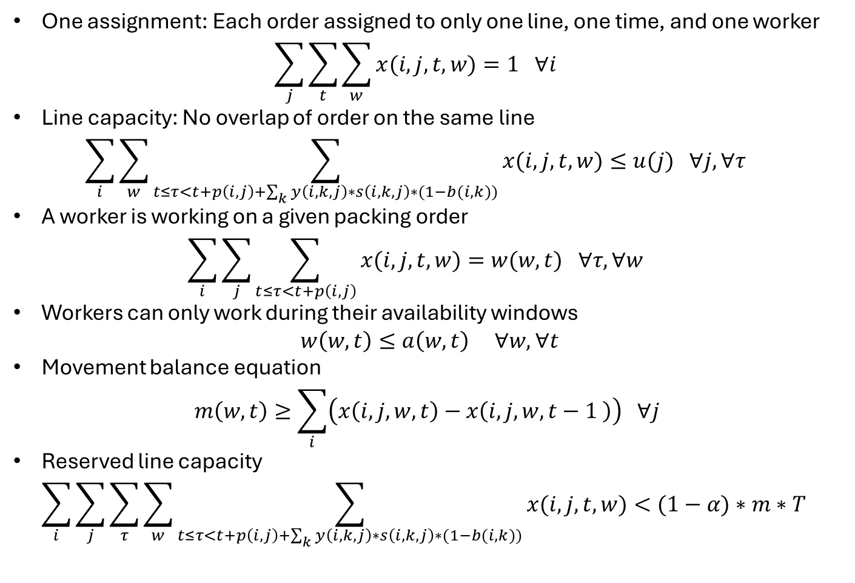
Constraints
One assignment: Each order assigned to only one line, one time, and one worker
$\sum_{j}{\sum_{t}{\sum_{w}{x(i,j,t, w)}}}=1 ∀i$
Line capacity: No overlap of order on the same line
$\sum_{i}{\sum_{w}{\sum_{t≤τ<t+p\left(i,j\right)+\sum_{k}{y\left(i,k,j\right)∗s\left(i,k,j\right)∗(1−b(i,k))}}{x(i,j,t, w)}}}≤u(j) ∀j, ∀τ$
A worker is working on a given packing order
$\sum_{i}{\sum_{j}{\sum_{t≤τ<t+p\left(i,j\right)}{x(i,j,t, w)}}}=w(w,t) ∀τ, ∀w$
Workers can only work during their availability windows
$w\left(w,t\right)≤a\left(w,t\right) ∀w, ∀t$
Movement balance equation
$m\left(w,t\right)≥\sum_{i}{\left(x\left(i,j,w,t\right)−x\left(i,j,w,t−1 \right)\right) ∀j }$
Reserved line capacity
$\sum_{i}{\sum_{j}{\sum_{τ}{\sum_{w}{\sum_{t≤τ<t+p\left(i,j\right)+\sum_{k}{y\left(i,k,j\right)∗s\left(i,k,j\right)∗(1−b(i,k))}}{x(i,j,t, w)}}}}}<(1−α)∗m∗T$

Slide 5
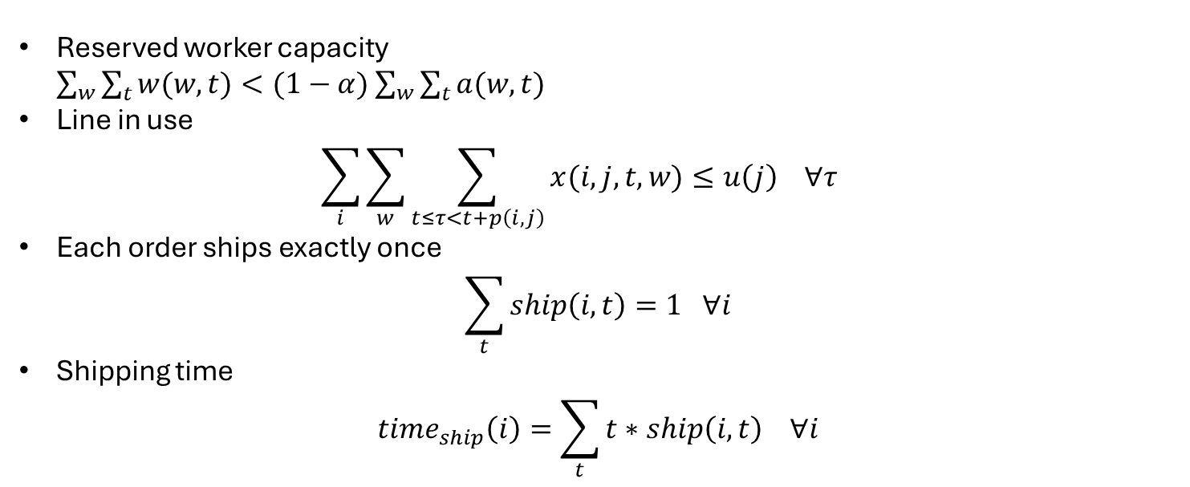
Constraints
Reserved worker capacity
$\sum_{w}{\sum_{t}{w(w,t)}}<(1−α)$ $\sum_{w}{\sum_{t}{a(w,t)}}$
Line in use
$\sum_{i}{\sum_{w}{\sum_{t≤τ<t+p\left(i,j\right)}{x(i,j,t, w)}}}≤u\left(j\right) ∀τ$
Each order ships exactly once
$\sum_{t}{ship\left(i,t\right)=1 ∀i}$
Shipping time
$time_{ship}\left(i\right)=\sum_{t}{t∗ship\left(i,t\right) ∀i}$

Slide 6
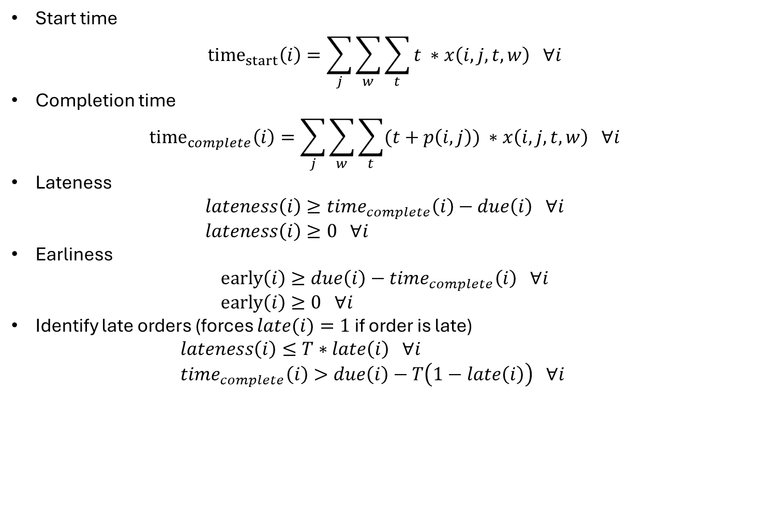
Constraints (OTIF)
Start time
${time}_{start}\left(i\right)=\sum_{j}{\sum_{w}{\sum_{t}{t ∗x\left(i,j,t,w\right) ∀i}}}$
Completion time
${time}_{complete}\left(i\right)=\sum_{j}{\sum_{w}{\sum_{t}{(t+p\left(i,j\right)) ∗x\left(i,j,t,w\right) ∀i}}}$
Lateness
$lateness\left(i\right)≥time_{complete}\left(i\right)−due\left(i\right) ∀i$
$lateness\left(i\right)≥0 ∀i$
Earliness
$early\left(i\right)≥due\left(i\right)−time_{complete}\left(i\right) ∀i$
$early\left(i\right)≥0 ∀i$
Identify late orders (forces $late(i)=1$ if order is late)
$lateness\left(i\right)≤T∗late\left(i\right) ∀i$
$time_{complete}\left(i\right)>due\left(i\right)−T\left(1−late\left(i\right)\right) ∀i$

Slide 7
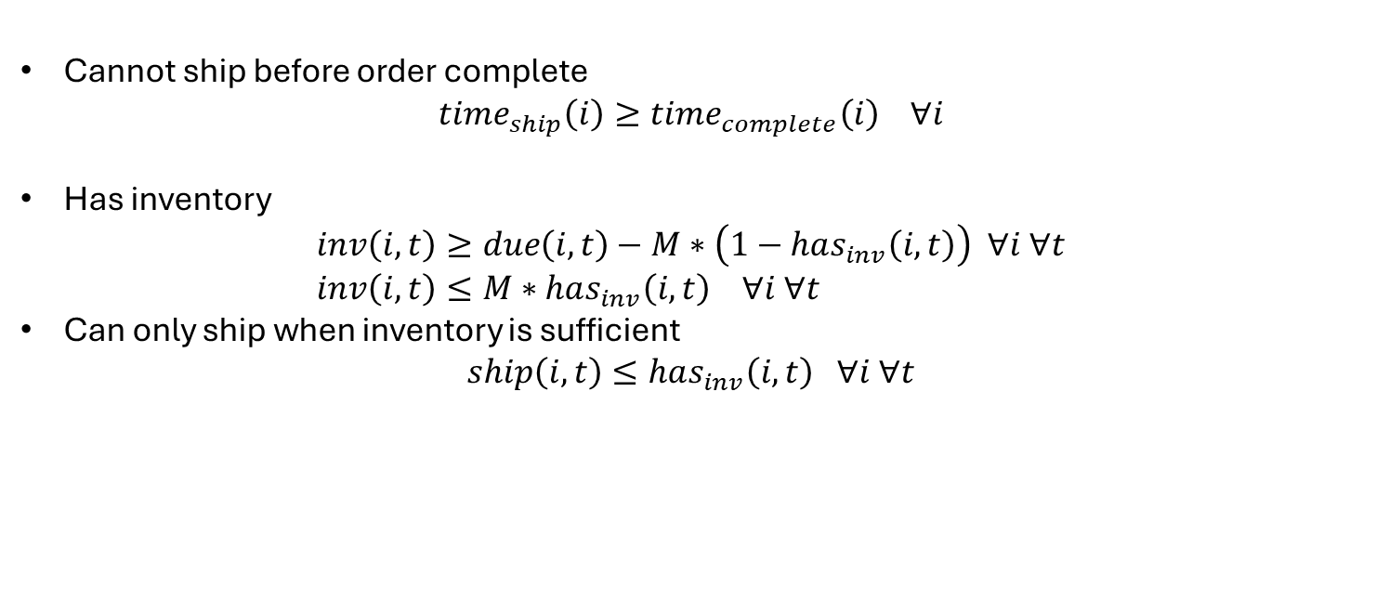
Constraints (Shipping)
Cannot ship before order complete
$time_{ship}\left(i\right)≥time_{complete}\left(i\right) ∀i$
Has inventory
$inv\left(i,t\right)≥due\left(i, t\right)−M∗\left(1−has_{inv}\left(i,t\right)\right) ∀i ∀t$
$inv\left(i,t\right)≤M∗has_{inv}\left(i,t\right) ∀i ∀t$
Can only ship when inventory is sufficient
$ship\left(i,t\right)≤has_{inv}\left(i,t\right) ∀i ∀t$

Slide 8
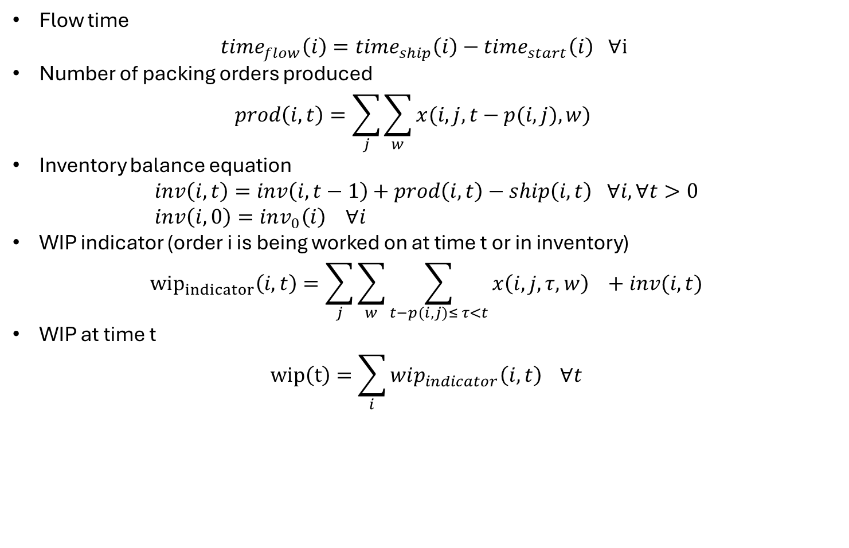
Constraints (WIP)
Flow time
$time_{flow}\left(i\right)=time_{ship}\left(i\right)−time_{start}\left(i\right) ∀i$
Number of packing orders produced
$prod\left(i,t\right)=\sum_{j}{\sum_{w}{x(i,j,t−p(i,j),w)}}$
Inventory balance equation
$inv\left(i,t\right)=inv\left(i,t−1\right)+prod\left(i,t\right)−ship\left(i,t\right) ∀i, ∀t>0$
$inv\left(i,0\right)=inv_{0}\left(i\right) ∀i$
WIP indicator (order i is being worked on at time t or in inventory)
${wip}_{indicator}\left(i,t\right)=\sum_{j}{\sum_{w}{\sum_{t−p(i,j)≤ τ<t}{x\left(i,j,τ,w\right) +inv(i,t)}}}$
WIP at time t
$wip\left(t\right)=\sum_{i}{wip_{indicator}\left(i,t\right)} ∀t$

Slide 9
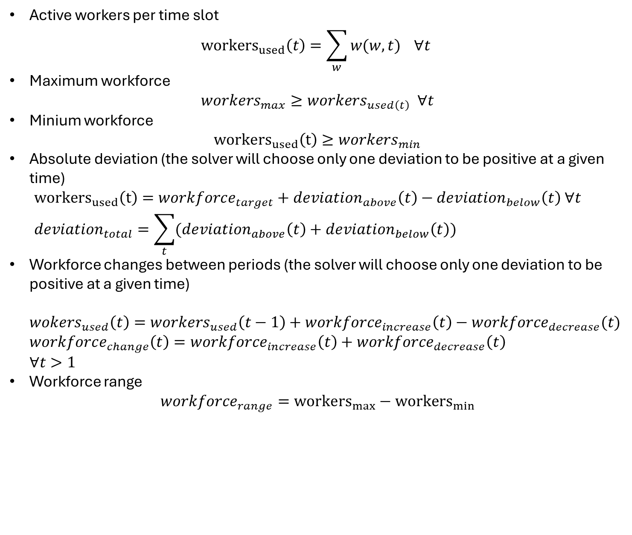
Constraints (Workforce)
Active workers per time slot
${workers}_{used}\left(t\right)=\sum_{w}{w(w,t)} ∀t$
Maximum workforce
$workers_{max}≥workers_{used\left(t\right)} ∀t$
Minium workforce
${workers}_{used}\left(t\right)≥workers_{min}$
Absolute deviation (the solver will choose only one deviation to be positive at a given time)
${workers}_{used}\left(t\right)=workforce_{target}+deviation_{above}\left(t\right)−deviation_{below}\left(t\right) ∀t$
$deviation_{total}=\sum_{t}{(deviation_{above}\left(t\right)+deviation_{below}\left(t\right))}$
Workforce changes between periods (the solver will choose only one deviation to be positive at a given time)
$wokers_{used}\left(t\right)=workers_{used}\left(t−1\right)+workforce_{increase}\left(t\right)−workforce_{decrease}(t)$
$workforce_{change}\left(t\right)=workforce_{increase}\left(t\right)+workforce_{decrease}\left(t\right)$
$∀t>1$
Workforce range
$workforce_{range}={workers}_{max}−{workers}_{min}$

Slide 10
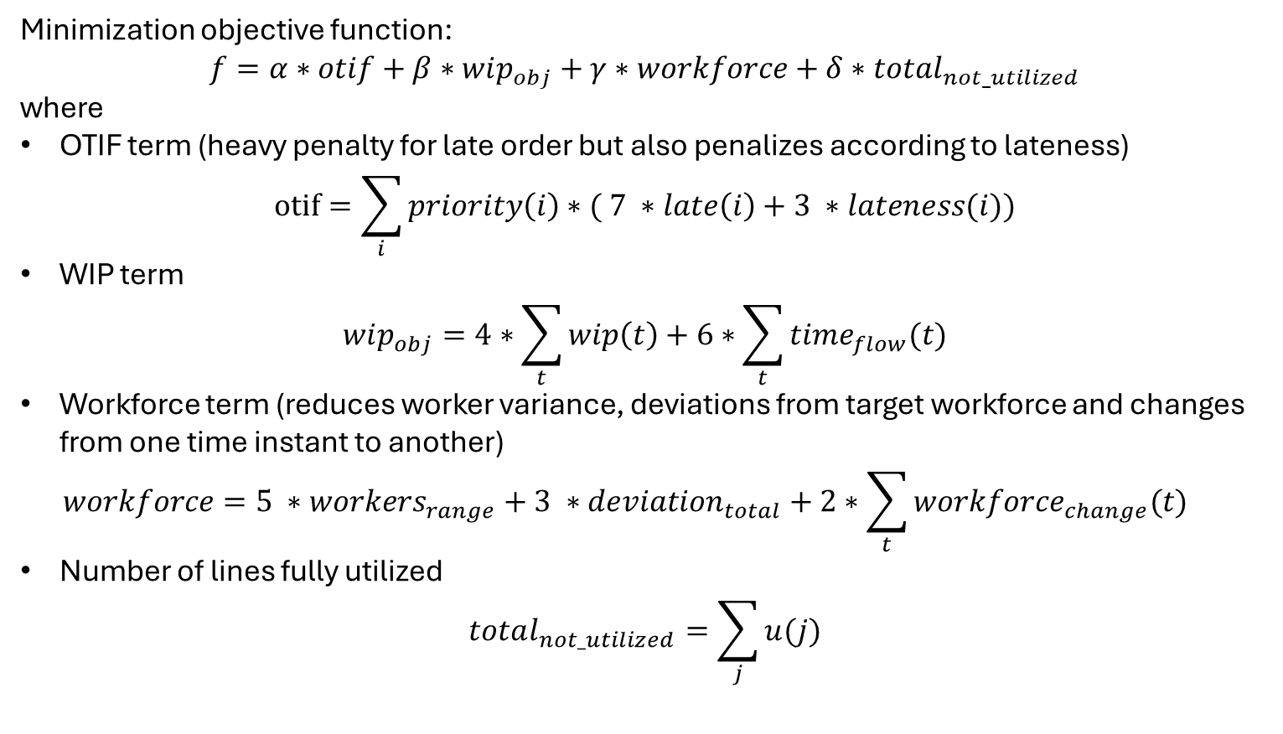
Objective function
Minimization objective function:
$$f=α∗otif+β∗wip_{obj}+γ∗workforce+δ∗total_{not_utilized}$$
where
OTIF term (heavy penalty for late order but also penalizes according to lateness)
$otif=\sum_{i}{priority\left(i\right)∗( 7 ∗late\left(i\right)+3 ∗lateness(i))}$
WIP term
$wip_{obj}=4∗\sum_{t}{wip\left(t\right)}+6∗\sum_{t}{time_{flow}(t)}$
Workforce term (reduces worker variance, deviations from target workforce and changes from one time instant to another)
$workforce=5 ∗workers_{range}+3 ∗deviation_{total}+2∗\sum_{t}{workforce_{change}(t)}$
Number of lines fully utilized
$total_{not_utilized}=\sum_{j}{u(j)}$

