Slide 1
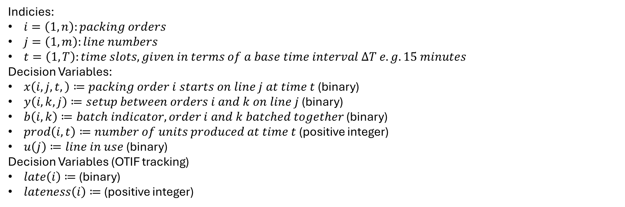
Indicies:
$i=\left(1,n\right):packing orders$
$j=\left(1,m\right):line numbers$
$t=\left(1,T\right):time slots, given in terms of a base time interval ΔT e.g. 15 minutes$
Decision Variables:
$x\left(i,j,t,\right)≔packing order i starts on line j at time t$ (binary)
$y\left(i,k, j\right)≔setup between orders i and k on line j$ (binary)
$b\left(i,k\right)≔batch indicator, order i and k batched together$ (binary)
$prod\left(i,t\right)≔number of units produced at time t$ (positive integer)
$u\left(j\right)≔line in use$ (binary)
Decision Variables (OTIF tracking)
$late\left(i\right)≔$ (binary)
$lateness\left(i\right)≔$ (positive integer)

Slide 2
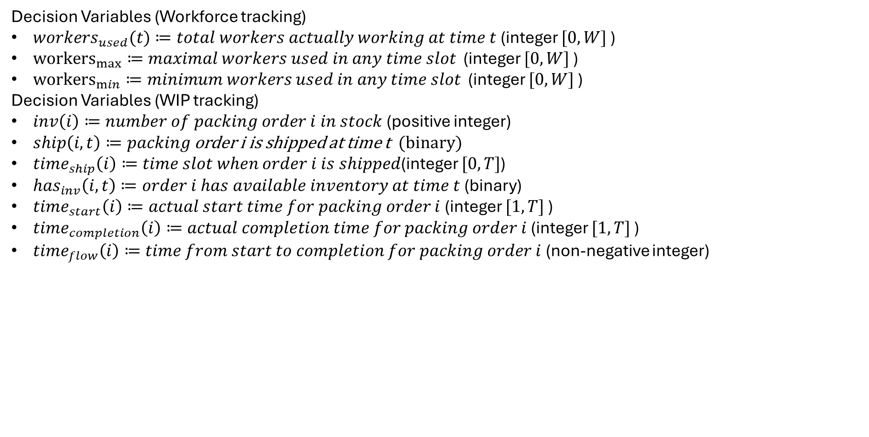
Decision Variables (Workforce tracking)
$workers_{used}(t)≔total workers actually working at time t$ (integer $[0,W]$ )
${workers}_{max}≔maximal workers used in any time slot$ (integer $[0,W]$ )
${workers}_{min}≔minimum workers used in any time slot$ (integer $[0,W]$ )
Decision Variables (WIP tracking)
$inv\left(i\right)≔number of packing order i in stock$ (positive integer)
$ship\left(i, t\right)≔packing$ order i is shipped at time t (binary)
$time_{ship}\left(i\right)≔time slot when order i is shipped$(integer $[0,T]$)
$has_{inv}\left(i,t\right)≔order i has available inventory at time t$ (binary)
$time_{start}\left(i\right)≔actual start time for packing order i$ (integer $[1,T]$ )
$time_{completion}\left(i\right)≔actual completion time for packing order i$ (integer $[1,T]$ )
$time_{flow}\left(i\right)≔time from start to completion for packing order i$ (non-negative integer)

Slide 3
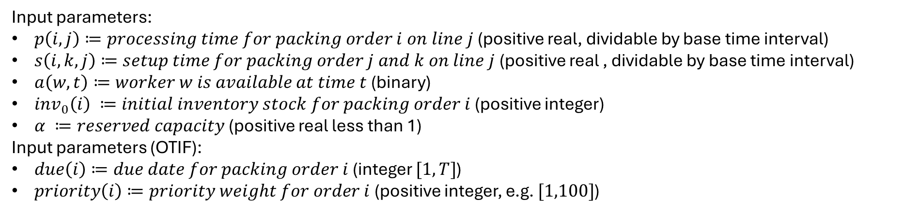
Input parameters:
$p\left(i,j\right)≔processing time for packing order i on line j$ (positive real, dividable by base time interval)
$s\left(i,k,j\right)≔setup time for packing order j and k on line j$ (positive real , dividable by base time interval)
$a\left(w,t\right)≔worker w is available at time t$ (binary)
$inv_{0}\left(i\right) ≔initial inventory stock for packing order i$ (positive integer)
$α ≔reserved capacity$ (positive real less than 1)
Input parameters (OTIF):
$due\left(i\right)≔due date for packing order i$ (integer $[1,T]$)
$priority\left(i\right)≔priority weight for order i$ (positive integer, e.g. $[1,100]$)

Slide 4
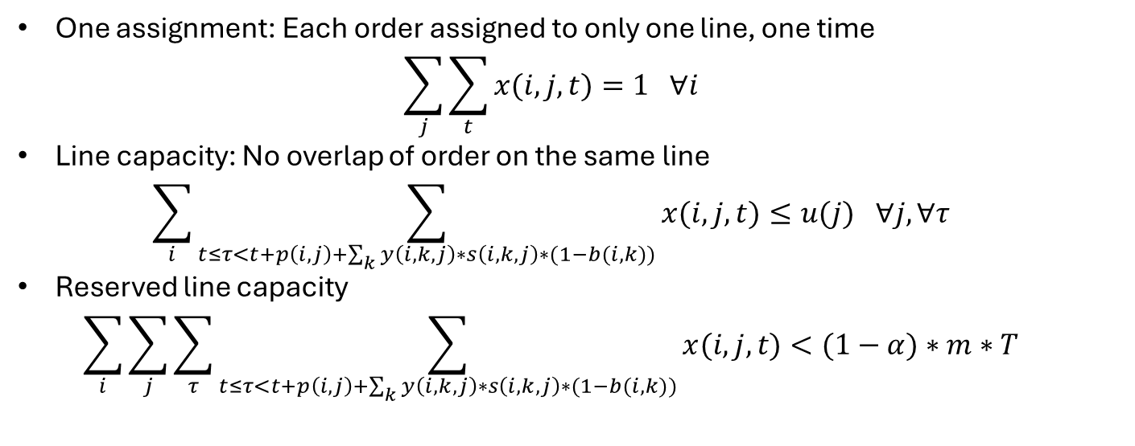
Constraints
One assignment: Each order assigned to only one line, one time
$\sum_{j}{\sum_{t}{x(i,j,t)}}=1 ∀i$
Line capacity: No overlap of order on the same line
$\sum_{i}{\sum_{t≤τ<t+p\left(i,j\right)+\sum_{k}{y\left(i,k,j\right)∗s\left(i,k,j\right)∗(1−b(i,k))}}{x(i,j,t)}}≤u(j) ∀j, ∀τ$
Reserved line capacity
$\sum_{i}{\sum_{j}{\sum_{τ}{\sum_{t≤τ<t+p\left(i,j\right)+\sum_{k}{y\left(i,k,j\right)∗s\left(i,k,j\right)∗(1−b(i,k))}}{x(i,j,t)}}}}<(1−α)∗m∗T$

Slide 5
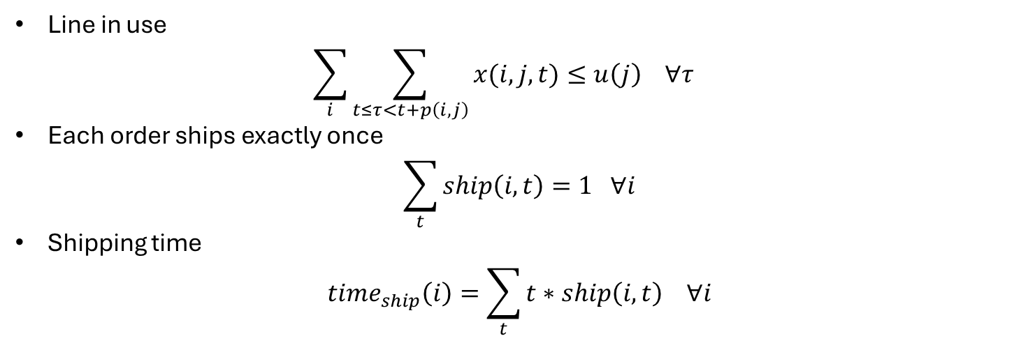
Constraints
Line in use
$\sum_{i}{\sum_{t≤τ<t+p\left(i,j\right)}{x(i,j,t)}}≤u\left(j\right) ∀τ$
Each order ships exactly once
$\sum_{t}{ship\left(i,t\right)=1 ∀i}$
Shipping time
$time_{ship}\left(i\right)=\sum_{t}{t∗ship\left(i,t\right) ∀i}$

Slide 6
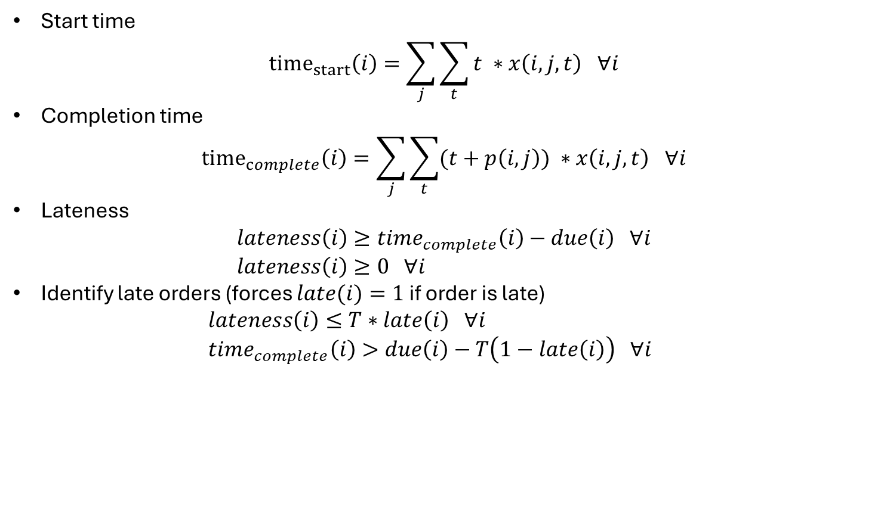
Constraints (OTIF)
Start time
${time}_{start}\left(i\right)=\sum_{j}{\sum_{t}{t ∗x\left(i,j,t\right) ∀i}}$
Completion time
${time}_{complete}\left(i\right)=\sum_{j}{\sum_{t}{(t+p\left(i,j\right)) ∗x\left(i,j,t\right) ∀i}}$
Lateness
$lateness\left(i\right)≥time_{complete}\left(i\right)−due\left(i\right) ∀i$
$lateness\left(i\right)≥0 ∀i$
Identify late orders (forces $late(i)=1$ if order is late)
$lateness\left(i\right)≤T∗late\left(i\right) ∀i$
$time_{complete}\left(i\right)>due\left(i\right)−T\left(1−late\left(i\right)\right) ∀i$

Slide 7
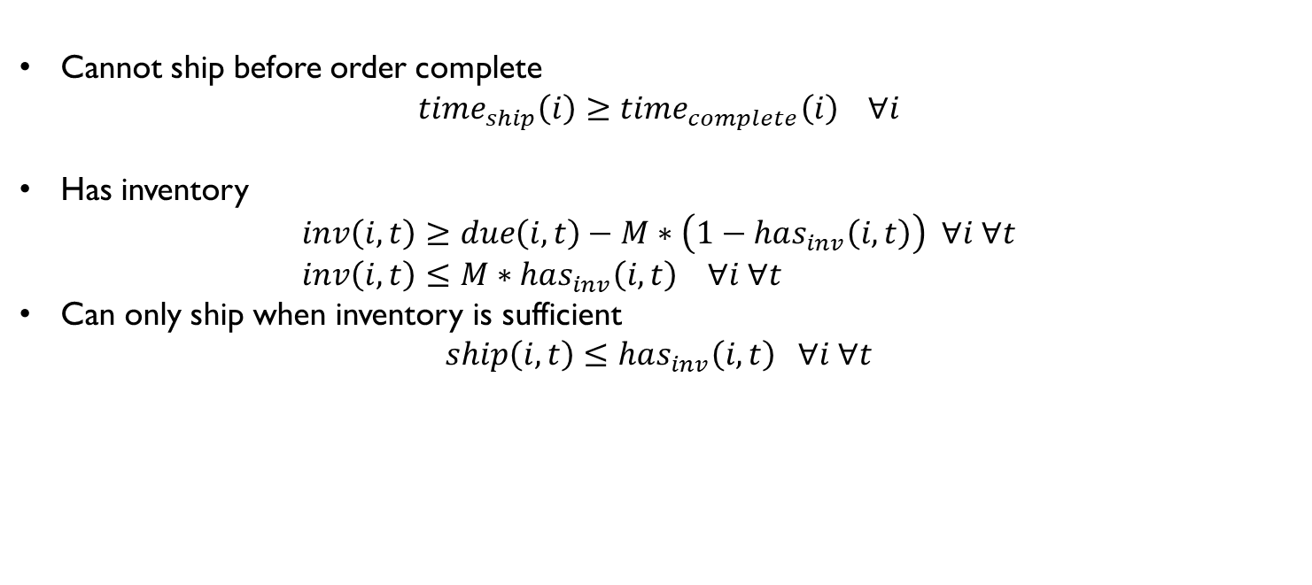
Constraints (Shipping)
Cannot ship before order complete
$time_{ship}\left(i\right)≥time_{complete}\left(i\right) ∀i$
Has inventory
$inv\left(i,t\right)≥due\left(i, t\right)−M∗\left(1−has_{inv}\left(i,t\right)\right) ∀i ∀t$
$inv\left(i,t\right)≤M∗has_{inv}\left(i,t\right) ∀i ∀t$
Can only ship when inventory is sufficient
$ship\left(i,t\right)≤has_{inv}\left(i,t\right) ∀i ∀t$

Slide 8
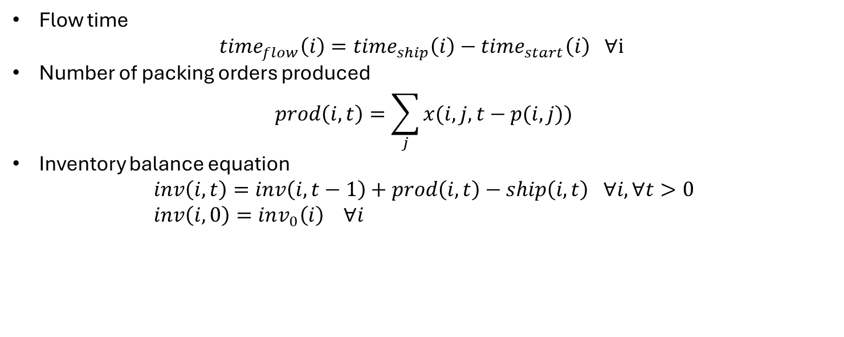
Constraints (WIP)
Flow time
$time_{flow}\left(i\right)=time_{ship}\left(i\right)−time_{start}\left(i\right) ∀i$
Number of packing orders produced
$prod\left(i,t\right)=\sum_{j}{x(i,j,t−p(i,j))}$
Inventory balance equation
$inv\left(i,t\right)=inv\left(i,t−1\right)+prod\left(i,t\right)−ship\left(i,t\right) ∀i, ∀t>0$
$inv\left(i,0\right)=inv_{0}\left(i\right) ∀i$

Slide 9
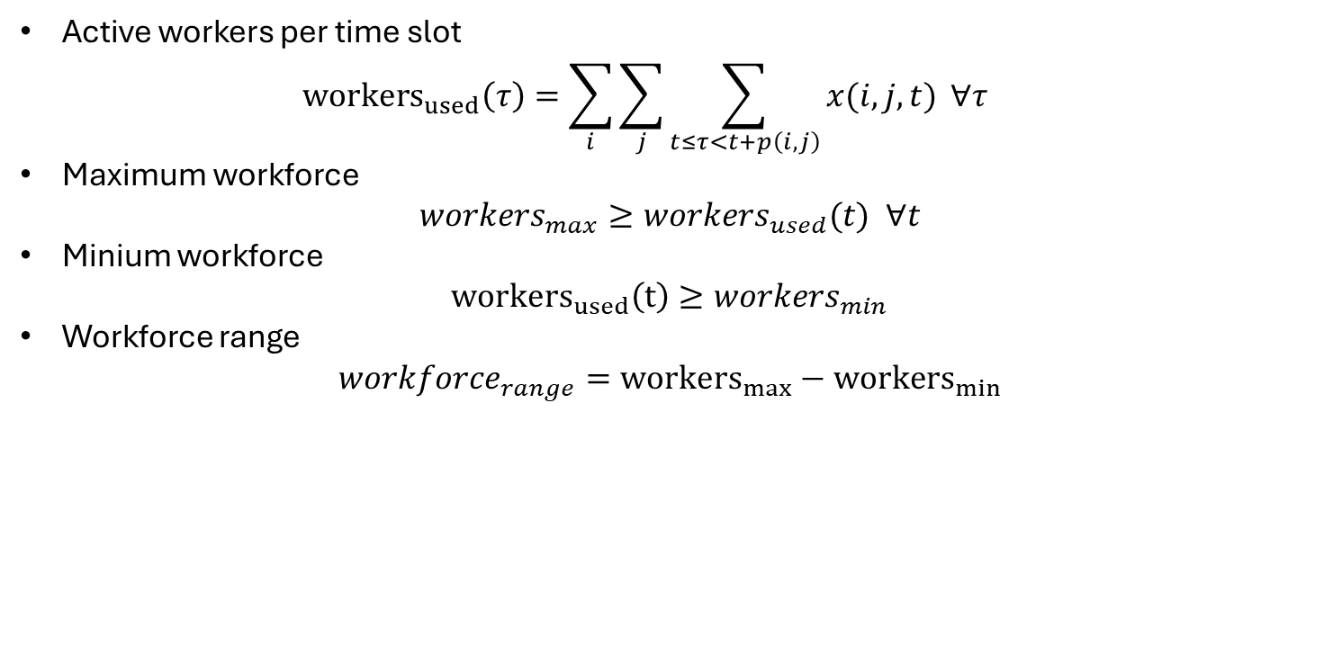
Constraints (Workforce)
Active workers per time slot
${workers}_{used}\left(τ\right)=\sum_{i}{\sum_{j}{\sum_{t≤τ<t+p\left(i,j\right)}{x(i,j,t)}}} ∀τ$
Maximum workforce
$workers_{max}≥workers_{used}(t) ∀t$
Minium workforce
${workers}_{used}\left(t\right)≥workers_{min}$
Workforce range
$workforce_{range}={workers}_{max}−{workers}_{min}$

Slide 10
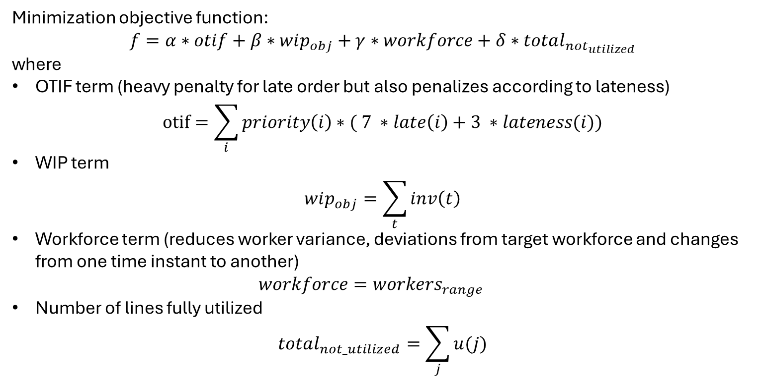
Objective function
Minimization objective function:
$$f=α∗otif+β∗wip_{obj}+γ∗workforce+δ∗total_{not_{utilized}}$$
where
OTIF term (heavy penalty for late order but also penalizes according to lateness)
$otif=\sum_{i}{priority\left(i\right)∗( 7 ∗late\left(i\right)+3 ∗lateness(i))}$
WIP term
$wip_{obj}=\sum_{t}{inv\left(t\right)}$
Workforce term (reduces worker variance, deviations from target workforce and changes from one time instant to another)
$workforce=workers_{range}$
Number of lines fully utilized
$total_{not_utilized}=\sum_{j}{u(j)}$

