Slide 1
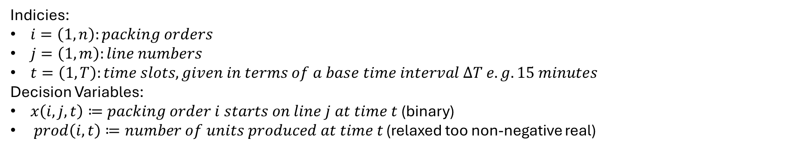
Indicies:
$i=\left(1,n\right):packing orders$
$j=\left(1,m\right):line numbers$
$t=\left(1,T\right):time slots, given in terms of a base time interval ΔT e.g. 15 minutes$
Decision Variables:
$x\left(i,j,t\right)≔packing order i starts on line j at time t$ (binary)
$prod\left(i,t\right)≔number of units produced at time t$ (relaxed too non-negative real)

Slide 2

Decision Variables (Workforce tracking)
$workers_{used}(t)≔total workers actually working at time t$ (relaxed too real $[0,W]$ )
${workers}_{max}≔maximal workers used in any time slot$ (relaxed too real $[0,W]$ )
${workers}_{min}≔minimum workers used in any time slot$ (relaxed too real $[0,W]$ )
Decision Variables (WIP tracking)
$inv\left(i\right)≔number of packing order i in stock$ (relaxed too non-negative real)
$ship\left(i, t\right)≔packing$ order i is shipped at time t (binary)

Slide 3
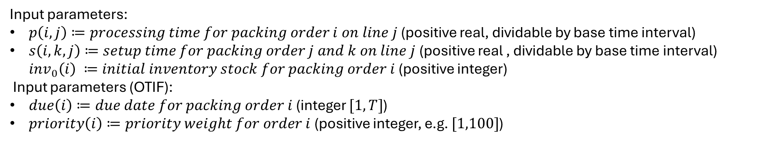
Input parameters:
$p\left(i,j\right)≔processing time for packing order i on line j$ (positive real, dividable by base time interval)
$s\left(i,k,j\right)≔setup time for packing order j and k on line j$ (positive real , dividable by base time interval) $inv_{0}\left(i\right) ≔initial inventory stock for packing order i$ (positive integer)
Input parameters (OTIF):
$due\left(i\right)≔due date for packing order i$ (integer $[1,T]$)
$priority\left(i\right)≔priority weight for order i$ (positive integer, e.g. $[1,100]$)

Slide 4
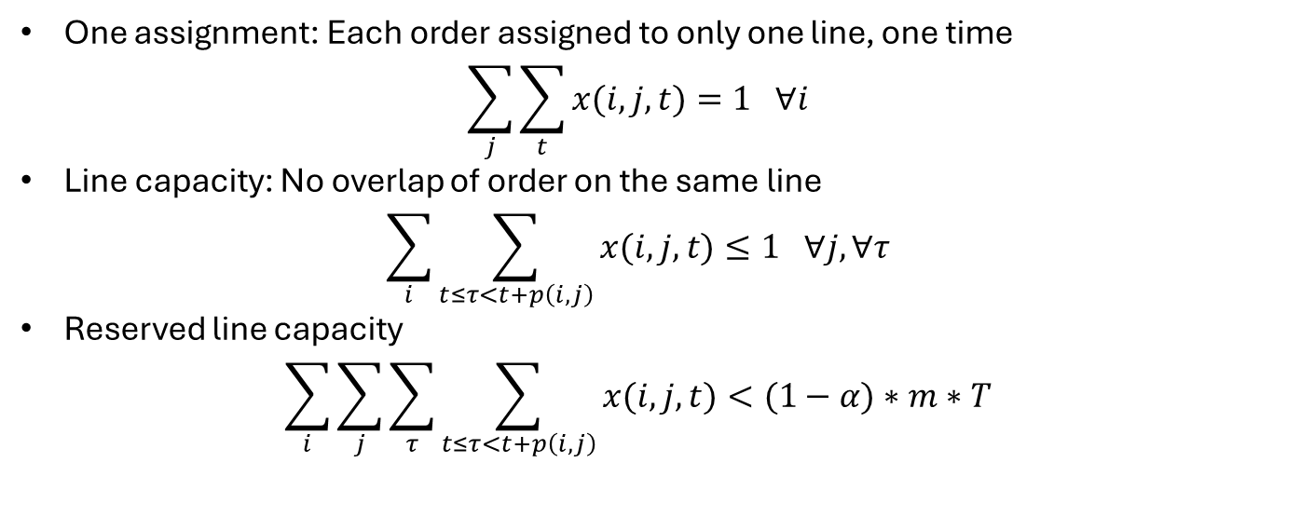
Constraints
One assignment: Each order assigned to only one line, one time
$\sum_{j}{\sum_{t}{x(i,j,t)}}=1 ∀i$
Line capacity: No overlap of order on the same line
$\sum_{i}{\sum_{t≤τ<t+p\left(i,j\right)}{x(i,j,t)}}≤1 ∀j, ∀τ$
Reserved line capacity
$\sum_{i}{\sum_{j}{\sum_{τ}{\sum_{t≤τ<t+p\left(i,j\right)}{x(i,j,t)}}}}<(1−α)∗m∗T$

Slide 5
Constraints

Slide 6
Constraints (OTIF)

Slide 7

Constraints (Shipping)
Each order ships exactly once
$\sum_{t}{ship\left(i,t\right)=1 ∀i}$
Ship no earlier than due time
$\sum_{t}{t∗ship(i,t)}≥due(i)$

Slide 8
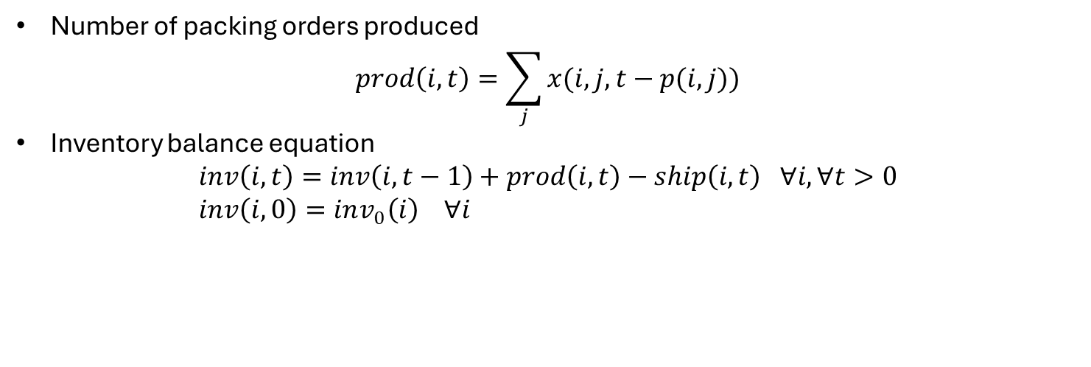
Constraints (WIP)
Number of packing orders produced
$prod\left(i,t\right)=\sum_{j}{x(i,j,t−p(i,j))}$
Inventory balance equation
$inv\left(i,t\right)=inv\left(i,t−1\right)+prod\left(i,t\right)−ship\left(i,t\right) ∀i, ∀t>0$
$inv\left(i,0\right)=inv_{0}\left(i\right) ∀i$

Slide 9
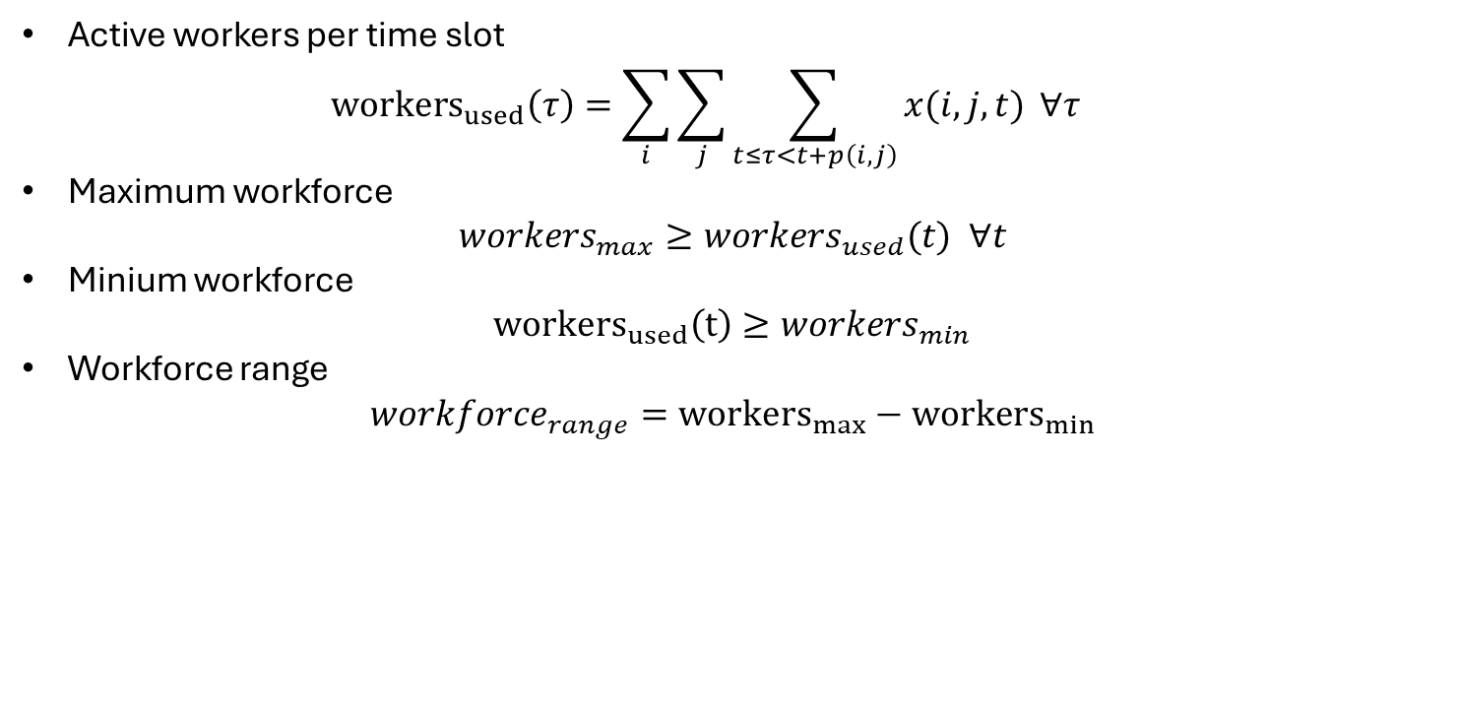
Constraints (Workforce)
Active workers per time slot
${workers}_{used}\left(τ\right)=\sum_{i}{\sum_{j}{\sum_{t≤τ<t+p\left(i,j\right)}{x(i,j,t)}}} ∀τ$
Maximum workforce
$workers_{max}≥workers_{used}(t) ∀t$
Minium workforce
${workers}_{used}\left(t\right)≥workers_{min}$
Workforce range
$workforce_{range}={workers}_{max}−{workers}_{min}$

Slide 10
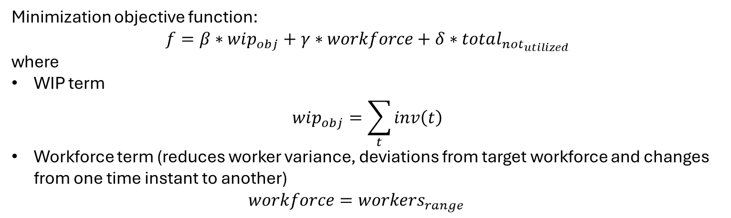
Objective function
Minimization objective function:
$$f=β∗wip_{obj}+γ∗workforce+δ∗total_{not_{utilized}}$$
where
WIP term
$wip_{obj}=\sum_{t}{inv\left(t\right)}$
Workforce term (reduces worker variance, deviations from target workforce and changes from one time instant to another)
$workforce=workers_{range}$

