Slide 1
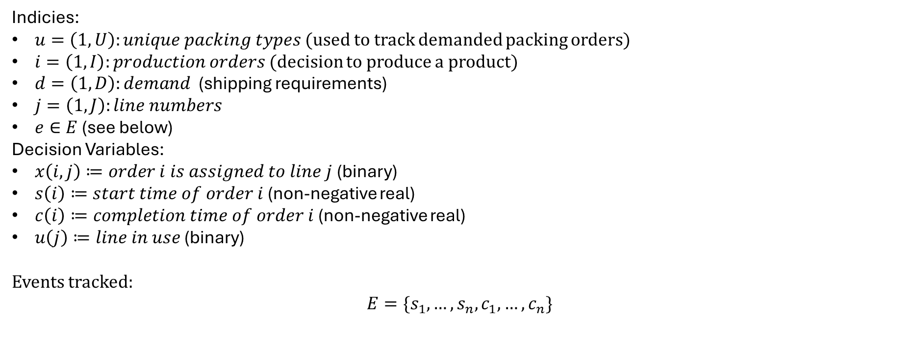
Indicies:
$u=\left(1,U\right):unique packing types$ (used to track demanded packing orders)
$i=\left(1,I\right):production orders$ (decision to produce a product)
$d=\left(1,D\right):demand$ (shipping requirements)
$j=\left(1,J\right):line numbers$
$e∈E$ (see below)
Decision Variables:
$x\left(i,j\right)≔order i is assigned to line j$ (binary)
$s\left(i\right)≔start time of order i$ (non-negative real)
$c\left(i\right)≔completion time of order i$ (non-negative real)
$u\left(j\right)≔line in use\text{ (}\text{binary}\text{)}$
Events tracked:
$$E=\{s_{1}, …,s_{n}, c_{1}, …,c_{n}\}$$

Slide 2
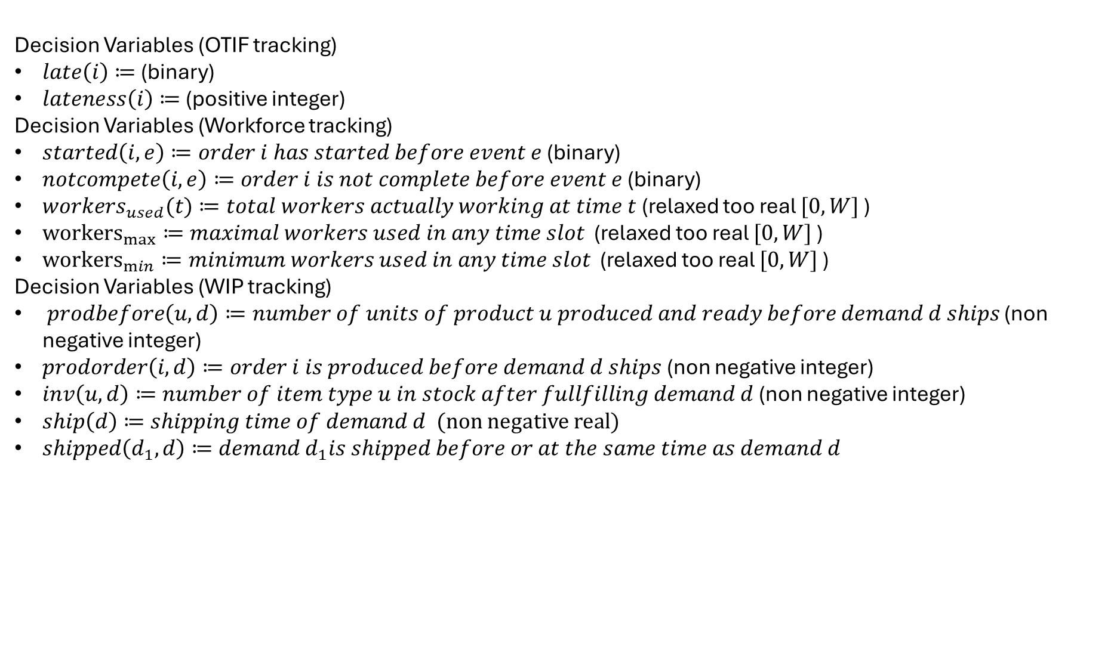
Decision Variables (OTIF tracking)
$late\left(i\right)≔$ (binary)
$lateness\left(i\right)≔$ (positive integer)
Decision Variables (Workforce tracking)
$started\left(i,e\right)≔order i has started before event e$ (binary)
$notcompete\left(i,e\right)≔order i is not complete before event e$ (binary)
$workers_{used}(t)≔total workers actually working at time t$ (relaxed too real $[0,W]$ )
${workers}_{max}≔maximal workers used in any time slot$ (relaxed too real $[0,W]$ )
${workers}_{min}≔minimum workers used in any time slot$ (relaxed too real $[0,W]$ )
Decision Variables (WIP tracking)
$prodbefore\left(u,d\right)≔number of units of product u produced and ready before demand d ships$ (non negative integer)
$prodorder\left(i,d\right)≔order i is produced before demand d ships$ (non negative integer)
$inv\left(u,d\right)≔number of item type u in stock after fullfilling demand d$ (non negative integer)
$ship\left(d\right)≔shipping time of demand d$ (non negative real)
$shipped\left(d_{1},d\right)≔demand d_{1}is shipped before or at the same time as demand d$

Slide 3
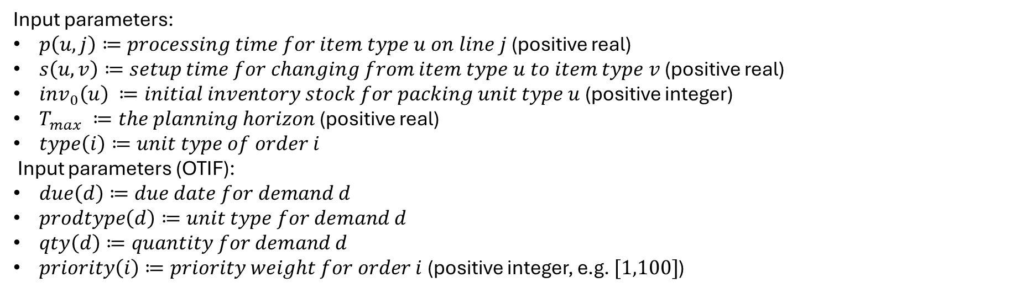
Input parameters:
$p\left(u,j\right)≔processing time for item type u on line j$ (positive real)
$s\left(u,v\right)≔setup time for changing from item type u to item type v$ (positive real)
$inv_{0}\left(u\right) ≔initial inventory stock for packing unit type u$ (positive integer)
$T_{max} ≔the planning horizon$ (positive real)
$type\left(i\right)≔unit type of order i$
Input parameters (OTIF):
$due\left(d\right)≔due date for demand d$
$prodtype\left(d\right)≔unit type for demand d$
$qty\left(d\right)≔quantity for demand d$
$priority\left(i\right)≔priority weight for order i$ (positive integer, e.g. $[1,100]$)

Slide 4
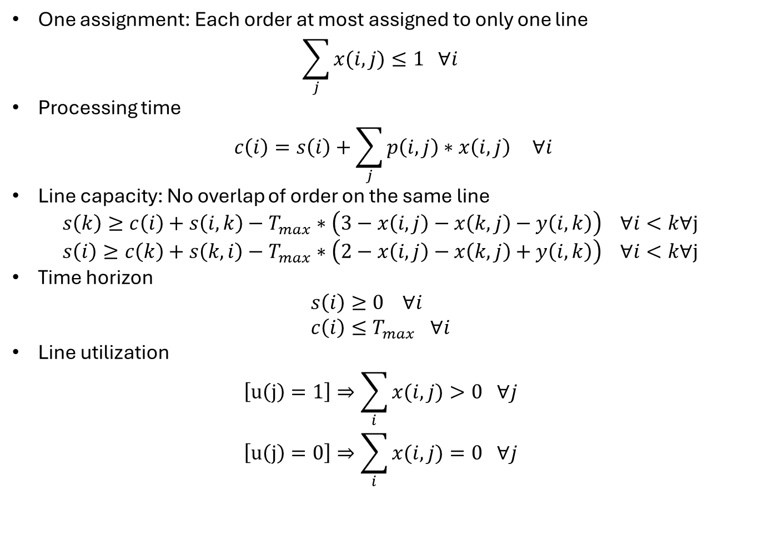
Constraints
One assignment: Each order at most assigned to only one line
$\sum_{j}{x(i,j)}≤1 ∀i$
Processing time
$c\left(i\right)=s\left(i\right)+\sum_{j}{p\left(i,j\right)∗x\left(i,j\right)} ∀i$
Line capacity: No overlap of order on the same line
$s\left(k\right)≥c\left(i\right)+s\left(i,k\right)−T_{max}∗\left(3−x\left(i,j\right)−x\left(k,j\right)−y\left(i,k\right)\right) ∀i<k∀j$
$s\left(i\right)≥c\left(k\right)+s\left(k,i\right)−T_{max}∗\left(2−x\left(i,j\right)−x\left(k,j\right)+y\left(i,k\right)\right) ∀i<k∀j$
Time horizon
$s\left(i\right)≥0 ∀i$
$c\left(i\right)≤T_{max} ∀i$
Line utilization
$\left[u\left(j\right)=1\right]⇒\sum_{i}{x(i,j)}>0 ∀j$
$\left[u\left(j\right)=0\right]⇒\sum_{i}{x(i,j)}=0 ∀j$

Slide 5
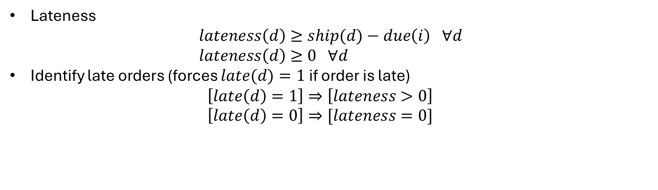
Constraints (OTIF)
Lateness
$lateness\left(d\right)≥ship(d)−due\left(i\right) ∀d$
$lateness\left(d\right)≥0 ∀d$
Identify late orders (forces $late(d)=1$ if order is late)
$\left[late\left(d\right)=1\right]⇒\left[lateness>0\right]$
$\left[late\left(d\right)=0\right]⇒[lateness=0]$

Slide 6
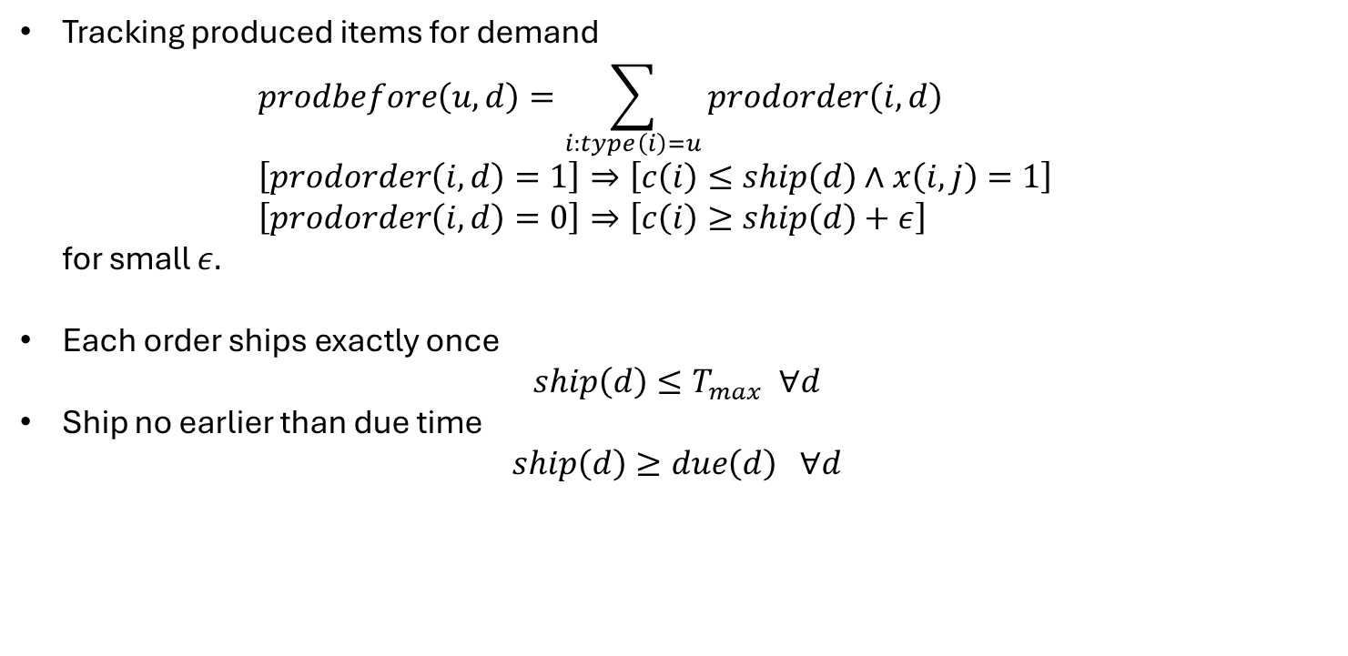
Constraints (Demand)
Tracking produced items for demand
$prodbefore\left(u,d\right)=\sum_{i:type\left(i\right)=u}{prodorder\left(i,d\right)}$
$\left[prodorder\left(i,d\right)=1\right]⇒\left[c\left(i\right)≤ship\left(d\right)∧x\left(i,j\right)=1\right]$
$\left[prodorder\left(i,d\right)=0\right]⇒\left[c\left(i\right)≥ship\left(d\right)+ε\right]$
for small $ε.$
Each order ships exactly once
$ship\left(d\right)≤T_{max} ∀d$
Ship no earlier than due time
$ship\left(d\right)≥due\left(d\right) ∀d$

Slide 7
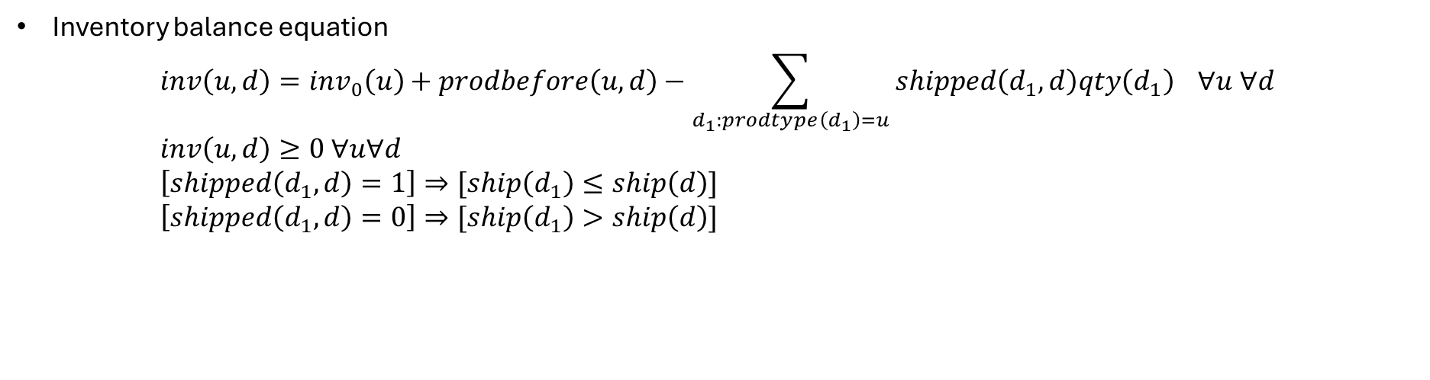
Constraints (WIP)
Inventory balance equation
$inv\left(u,d\right)=inv_{0}\left(u\right)+prodbefore\left(u,d\right)−\sum_{d_{1}:prodtype\left(d_{1}\right)=u}{shipped\left(d_{1}, d\right)qty\left(d_{1}\right)} ∀u ∀d$
$inv\left(u,d\right)≥0 ∀u∀d$
$\left[shipped\left(d_{1},d\right)=1\right]⇒[ship\left(d_{1}\right)≤ship\left(d\right)]$
$\left[shipped\left(d_{1},d\right)=0\right]⇒[ship\left(d_{1}\right)>ship\left(d\right)]$

Slide 8
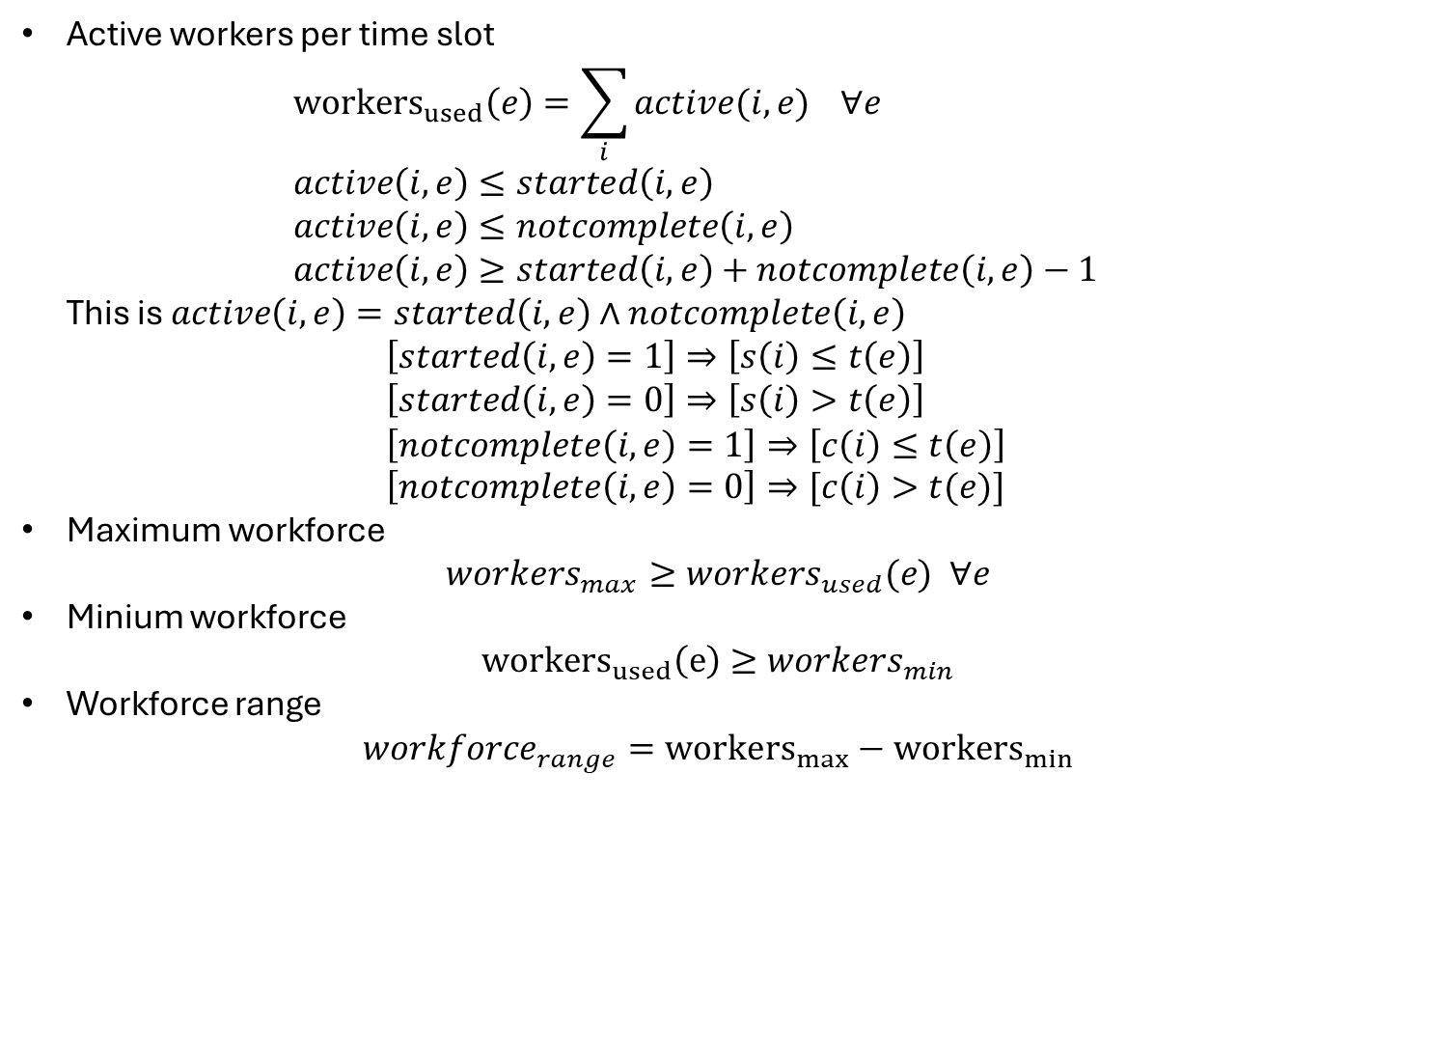
Constraints (Workforce)
Active workers per time slot
${workers}_{used}\left(e\right)=\sum_{i}{active(i,e)} ∀e$
$active\left(i,e\right)≤started\left(i,e\right)$
$active\left(i,e\right)≤notcomplete\left(i,e\right)$
$active\left(i,e\right)≥started\left(i,e\right)+notcomplete\left(i,e\right)−1$
This is $active\left(i,e\right)=started\left(i,e\right)∧notcomplete\left(i,e\right)$
$\left[started\left(i,e\right)=1\right]⇒\left[s\left(i\right)≤t\left(e\right)\right]$
$\left[started\left(i,e\right)=0\right]⇒\left[s\left(i\right)>t\left(e\right)\right]$
$\left[notcomplete\left(i,e\right)=1\right]⇒\left[c\left(i\right)≤t\left(e\right)\right]$
$\left[notcomplete\left(i,e\right)=0\right]⇒[c\left(i\right)>t(e)]$
Maximum workforce
$workers_{max}≥workers_{used}(e) ∀e$
Minium workforce
${workers}_{used}\left(e\right)≥workers_{min}$
Workforce range
$workforce_{range}={workers}_{max}−{workers}_{min}$

Slide 9
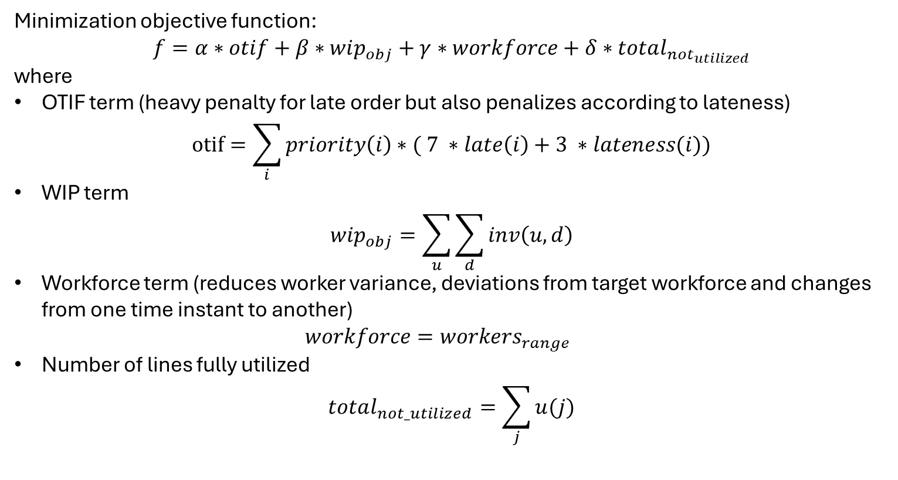
Objective function
Minimization objective function:
$$f=α∗otif+β∗wip_{obj}+γ∗workforce+δ∗total_{not_{utilized}}$$
where
OTIF term (heavy penalty for late order but also penalizes according to lateness)
$otif=\sum_{i}{priority\left(i\right)∗( 7 ∗late\left(i\right)+3 ∗lateness(i))}$
WIP term
$wip_{obj}=\sum_{u}{\sum_{d}{inv\left(u,d\right)}}$
Workforce term (reduces worker variance, deviations from target workforce and changes from one time instant to another)
$workforce=workers_{range}$
Number of lines fully utilized
$total_{not_utilized}=\sum_{j}{u(j)}$

