Slide 1
Financial Customer Analyses and Campaign Development FOR BANK ABC
potential cross-sell target
Presenter: Benny
Notes:
Today, we are going to talk about financial customer analyses and campaign development for bank ABC.
Our goal is to find out the current customers who do not have Thrive account and suggest Thrive accounts to them based on the current customers who have Thrive account.

Slide 2
DATA integration
Customers’
Region
Age
Product type
Balance
Notes:
First thing first, we will do the data integration to see the overview of our customers in the data set. We would introduce our customers region, age, product that they have with the bank, and the balance they have in each account.

Slide 3
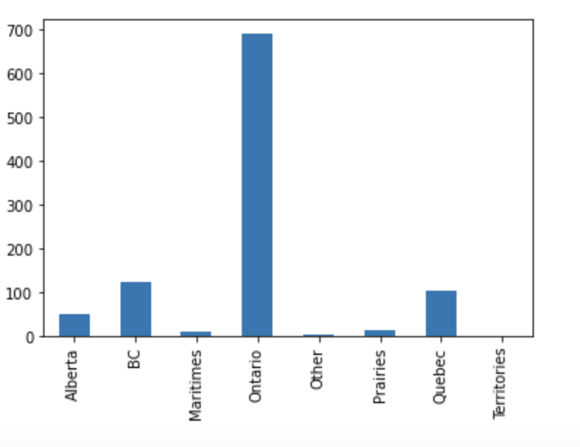
General distribution of financial customers
There are 997 unique accounts in the dataset
Notes:
There are 997 customers in our data. Most of the customers are from Ontario, then BC, Quebec, and Alberta.

Slide 4
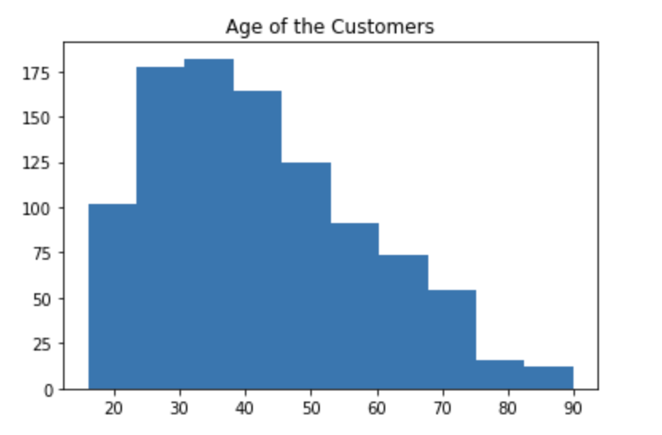
General distribution of financial customers
Most customers are around 25 to 45 years old.
Notes:
By the histogram, it is seen that the majority of the customers in our data are around 25-45 years old.

Slide 5
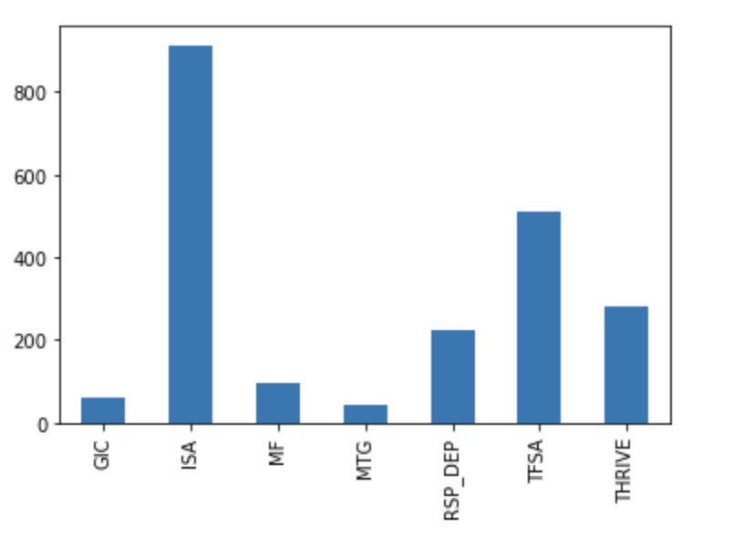
General distribution of financial customers
ISA & TFSA are the two most popular product type
Notes:
Here we are going to see the number of product type that all customers having. ISA is the Savings Account, and over 800 customers have this account. The second most popular account is TFSA account, around 500 customers have it. The following are RSP Deposit Account and THRIVE account, about 250 and 300 customers have it respectively.

Slide 6
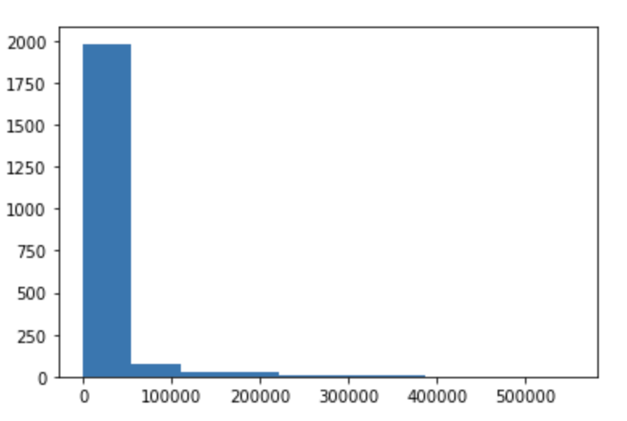
General distribution of financial customers
Notes:
This is a histogram for the balance in each account that the customers have put in. We see that the right scale plot, and the majority falls between 0 to 50000.

Slide 7
DATA insight
Goal
customers without chequing account customers
→ customers with chequing account customers
Notes:
For this project, our goal is to increase the number of chequing account with the bank. In other words, we want to make more customers who do not have Chequing product be interested in Chequing accounts.

Slide 8
DATA insight
Customer with THRIVE: VS Customer without THRIVE:
Age Age
Region Region
Notes:
We are going to compare the ages and regions between the customer who have chequing account and who do not have chequing account.

Slide 9
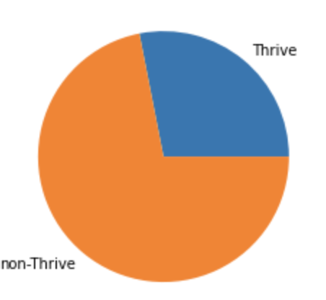
Cross Sell Campaign Insights
Notes:
From this pie chart, we see that around 3 quarter of the customers do not have chequing accounts whereas a quarter of the customers have the chequing accounts.
So we would use a quarter data to find the insight and understand which kind of customers have a greater opportunity to create a chequing account.

Slide 10
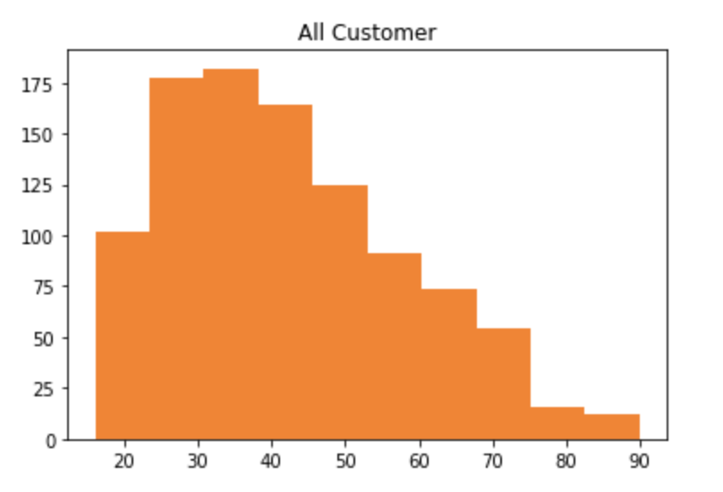
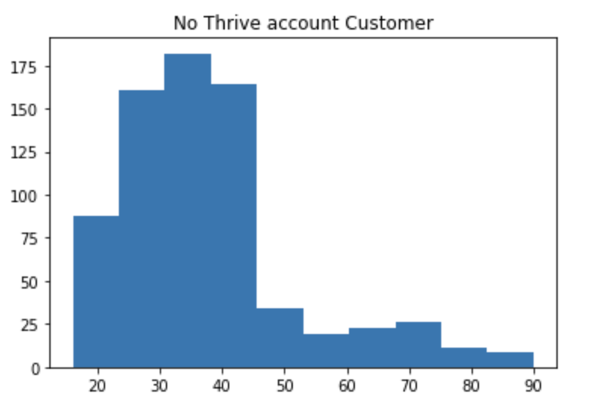
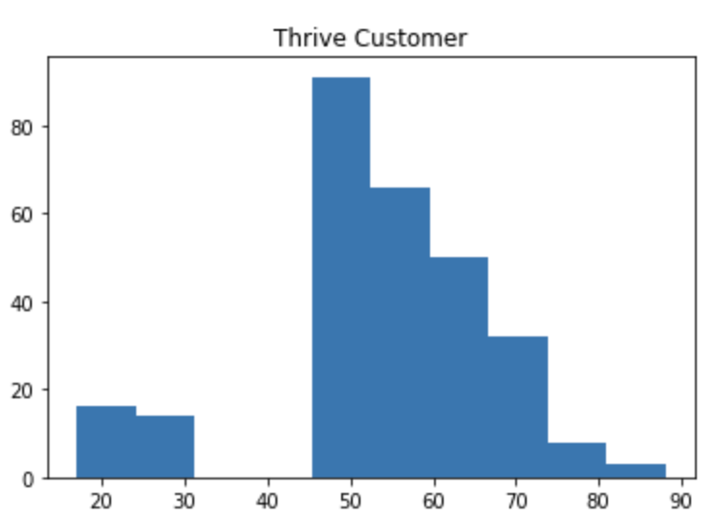
Cross Sell Campaign Insights
Notes:
The left graph shows counts of all customers ages, middle shows the count of customers’s ages who do not have chequing account only. The right graph shows the opposite of the middle graph.
From the right graph, most customers are from 45 to 75 years old. In this age ranges, there is not much customers in the middle graph compared to 25 to 45 years old.

Slide 11
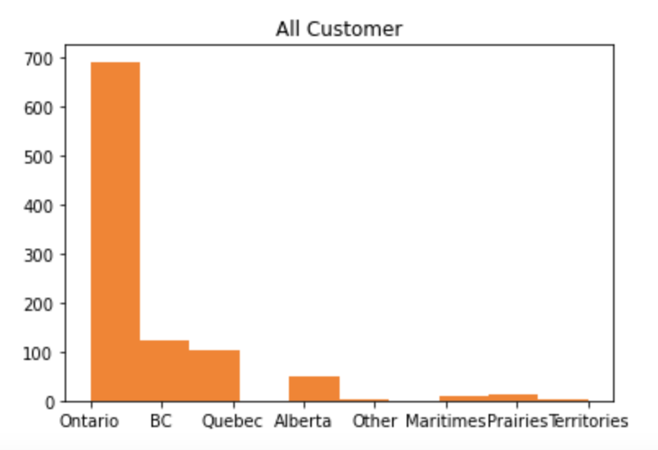
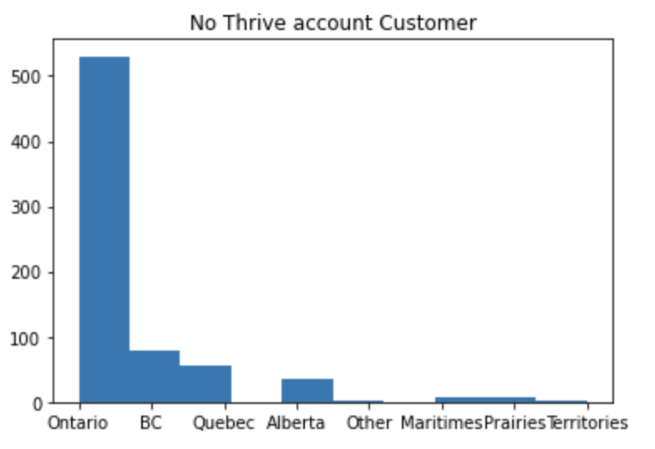
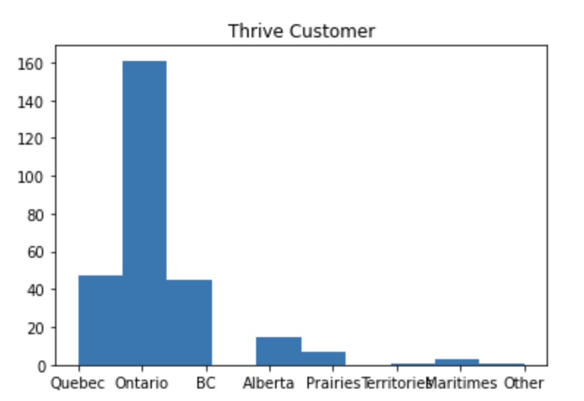
Cross Sell Campaign Insights
Notes:
Now we have the plots for the customers’ regions. Same as last slide, all customers from the left graph, customers with no thrive account from the middle, and customers with thrive account from the right graph.
Both middle and right graph shares in common because most customers with and without thrive account are likely from Ontario, bc, Quebec and alberta. And very little amount of customers are from other regions.

Slide 12
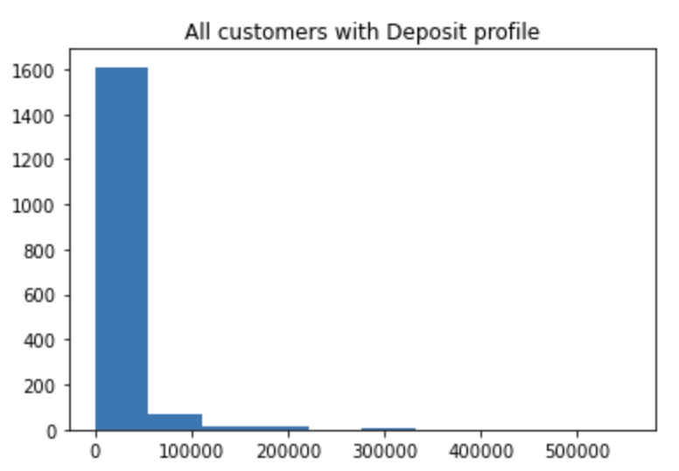
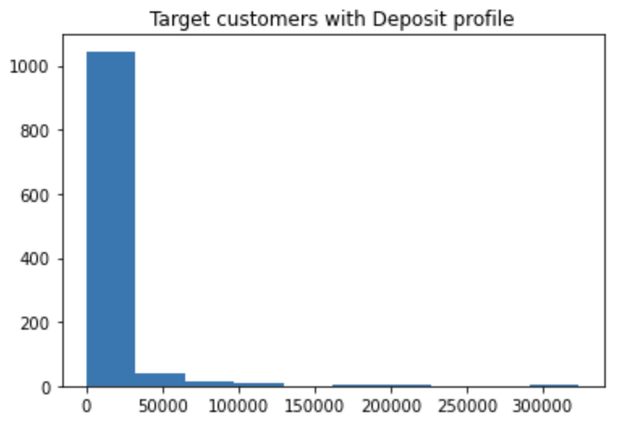
Cross Sell Campaign Insights
Notes:
Here is the Deposit Balance Distribution. Customer base versus Potential target group. Based on the graph, there is no much difference, the only difference is the amount of each balance count.

Slide 13

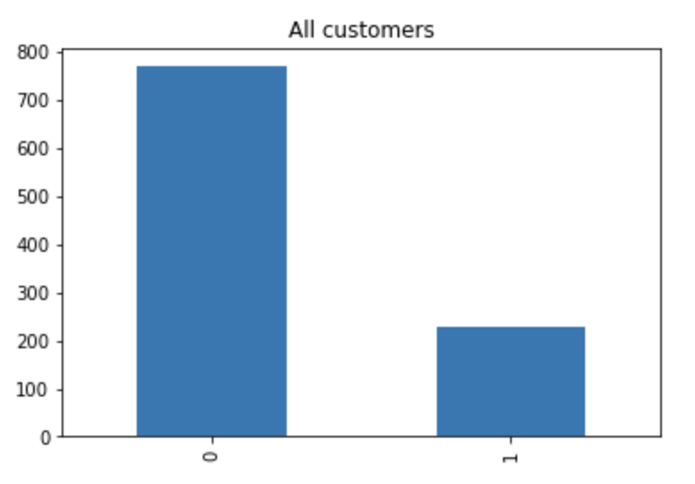
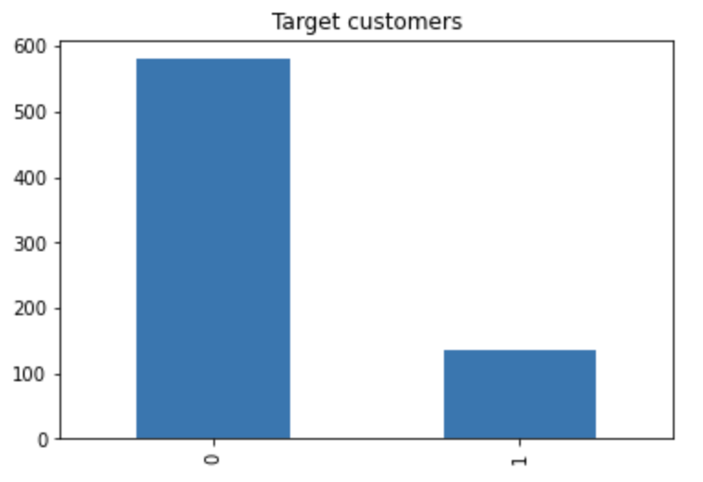
Cross Sell Campaign Insights
Notes:
Now we want to determine whether the customers have high or low Deposit balance. We would like to use the mean of the balance as a standard to identify high or low deposit balance. Larger than the mean would refer to high balance. In reverse, smaller than the mean refers to low balance.
From our Customer base graph, we see that 770 customers are below the mean, and the rest are above. Similar to our targeting customers.

Slide 14
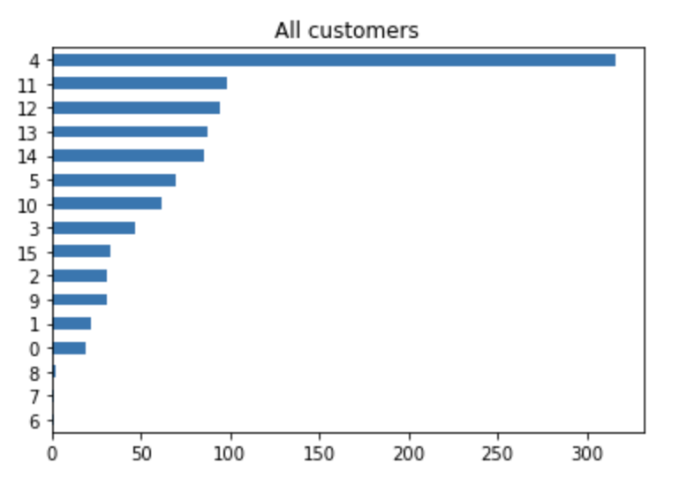
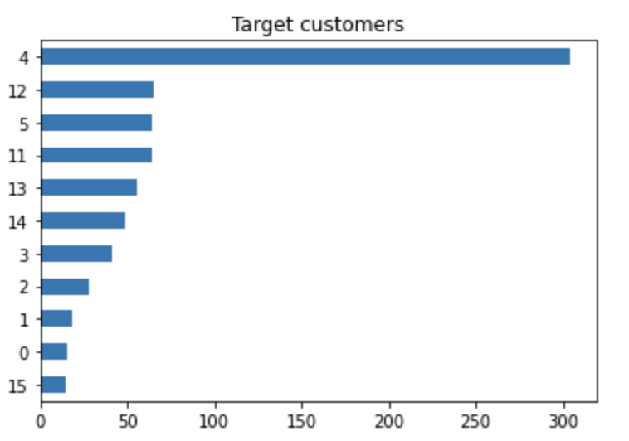
Cross Sell Campaign Insights
Notes:
Here is two graphs of showing how long have the customers be with the bank. Both graphs shows that most customers have been with the bank for 4 years. Followed by 11 – 14 years.

Slide 15
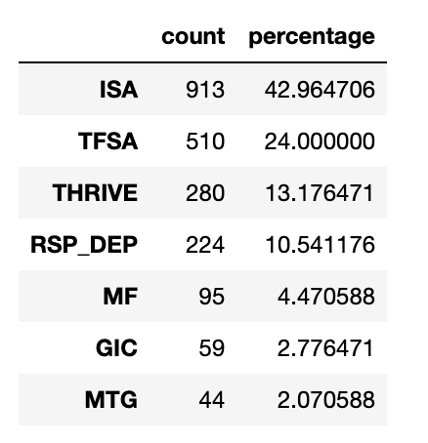
Cross Sell Campaign Insights
On average, each customer has 2.13 accounts with the bank.
Notes:
Each customer have different accounts with the bank. And we are interested in how many products do they have on average. So this table shows the count of each product type and the percentage of them.
Most customers have ISA and TFSA accounts. Only 280 customers have Thrive accounts.
After the calculation, we find out that each customer has 2 accounts on average.

Slide 16
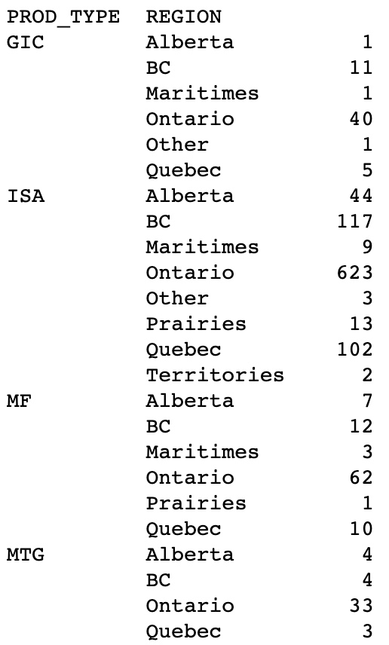
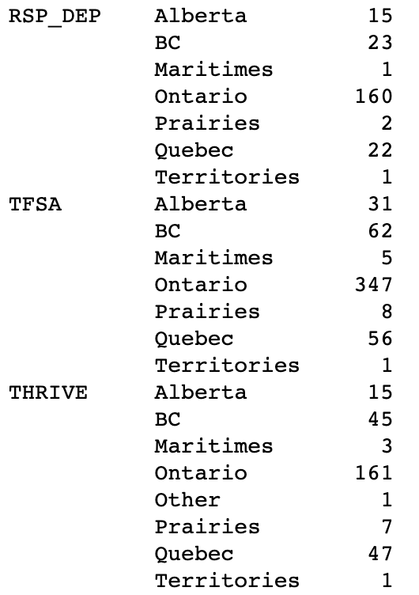
Cross Sell Campaign Insights
Notes:
Here is a table to see the count of the specific product type based on different region. For Thrive accounts, many customers are from BC, Ontario, and Quebec.

Slide 17
Cross Sell Campaign Insights
There are 555 targeted customers who would accept email notification. The cost is 27.75 dollars.
There are 140 targeted customers who would accept mail notification. The cost is 245.0 dollars.
272.75 < 1000 .Therefore, we have enough budget.
$ 272.75
Notes:
Now we want to promote the thrive accounts, and we got 1000 dollars budget of sending email and mail. We have 555 targeted customers accept email, and 140 targeted customers only accept mail. The cost of sending out the email and mail are around 270. And we have way too much budget left.
So we would like to send multiple email and mail to our customers, and each customer may have receive more than 1 email or mail in this promotion.

Slide 18
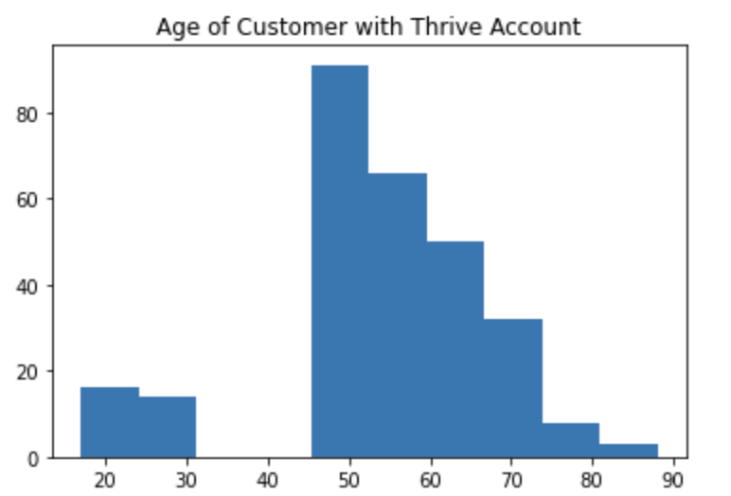
Cross Sell Campaign Insights
There are 542 customers who would accept email notification. The cost is 27.1 dollars.
There are 135 customers who would accept mail notification. The cost is 236.25 dollars.
$ 536
Notes:
Now we see that customer with thrive account are most likely from 45 to 75 years old. So we would like to send email and mail to our targeted customer in the age ranges. Our cost now is around 500.

Slide 19
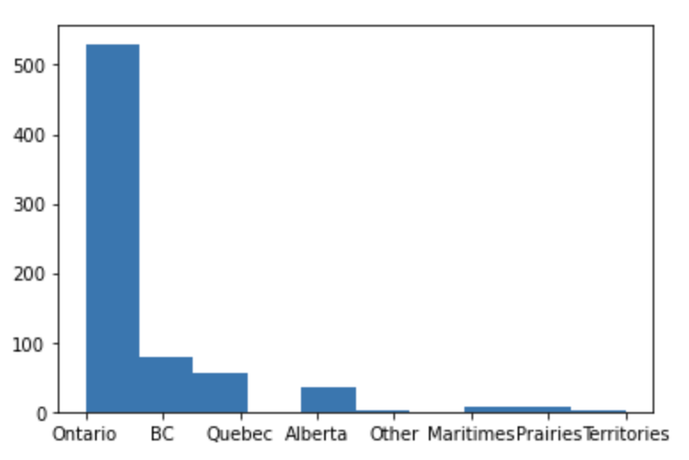
Cross Sell Campaign Insights
There are 544 customers who would accept mail notification. The cost is 27 dollars.
There are 137 customers who would accept mail notification. The cost is 240 dollars.
$ 803
Notes:
Now we see that customer with thrive account are ['Ontario','BC','Quebec','Alberta’]. After sending, our cost now is around 800. we still have 200 dollars to spend on. So we decided to send based on Number of times client login the bank website. We want more active customers to receive the mailing instead of the customers that do not use the bank very often.

Slide 20
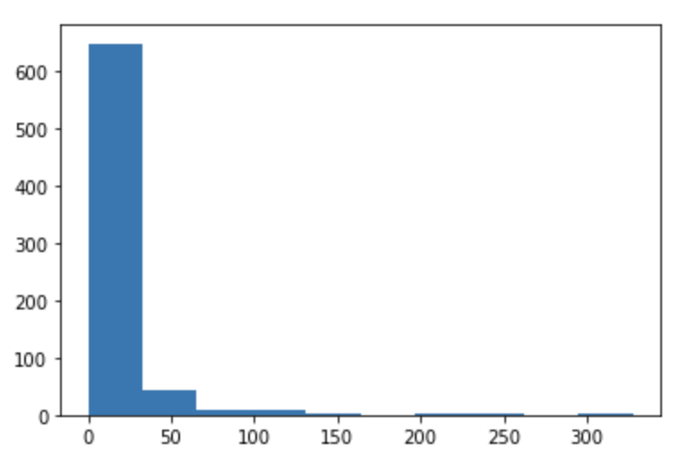
Cross Sell Campaign Insights
There are 143 customers who would accept mail notification. The cost is 7 dollars.
There are 39 customers who would accept mail notification. The cost is 68 dollars.
$ 878
Notes:
However, based on the graph, the majority of the customer login the bank website with 0 to 10 times. So, we would like to send to the customers who login the website 10 times.
Now our cost goes up to nearly 900.

Slide 21
THE END

