Slide 1
Customer Distribution and
Deactivation Analyses
Telecommunication Project
Presenter: Son Kit Leong
Notes:
Today, I am going to discuss about CRM data of a wireless company. Our goal is to see the customer distribution and do deactivation analyses.

Slide 2
Purpose
1. Introduce the data
2. Investigate the customer distribution and business behaviors
3. Relationship between variables
Notes:
First things first, before we get started the analysis, I want to introduce the data.

Slide 3
Data introduction
Variable:
  Acctno: account number.
  Actdt: account activation date
  Deactdt: account deactivation date
  DeactReason: reason for deactivation.
  GoodCredit: customer’s credit is good or not.
  RatePlan: rate plan for the customer.
  DealerType: dealer type.
  Sales: the amount of sales to a customer.
  Age: customer age.
  Province: province.
Notes:
In this data, we have 10 variables to look at. We can calculate the tenure date by using account activation date and account deactivation date to see how many days the customers are with the wireless company. We could also see what the most reason for deactivation in the data. Customer’s credit, rate plan and dealer type for the customer, and the sales of each customer have paid for the company.

Slide 4
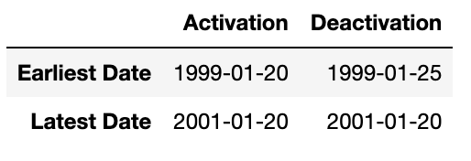
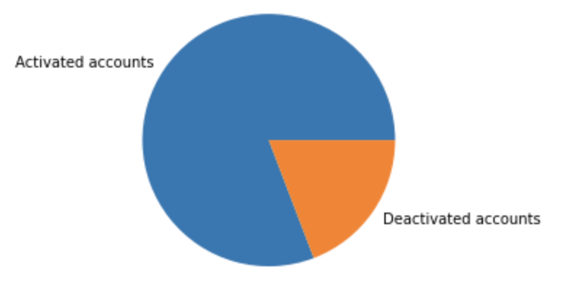
Data introduction
There are 82620 activated accounts
There are 19635 deactivated accounts
Notes:
In the data, there are 80 thousand activated accounts, and 19 thousand deactivated accounts. The majority of customers are still activated in 20th of January 2001.

Slide 5
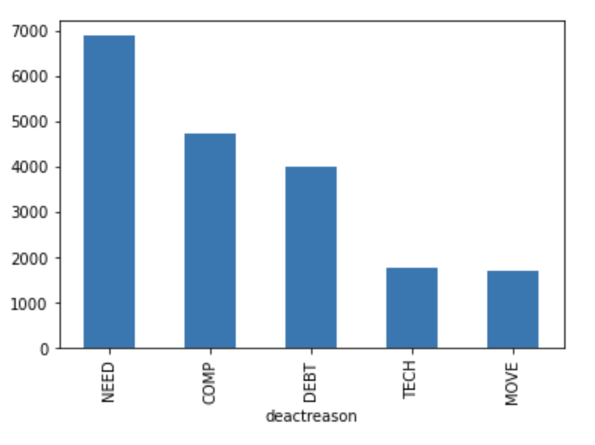
Data introduction
The most reason of deactivating accounts is NEED, followed by COMP and DEBT.
  NEED 6888
  COMP 4722
  DEBT 4020
  TECH 1767
  MOVE 1696
Notes:
For the deactivated accounts, the most reason of deactivating accounts is NEED, followed by COMP and DEBT.

Slide 6
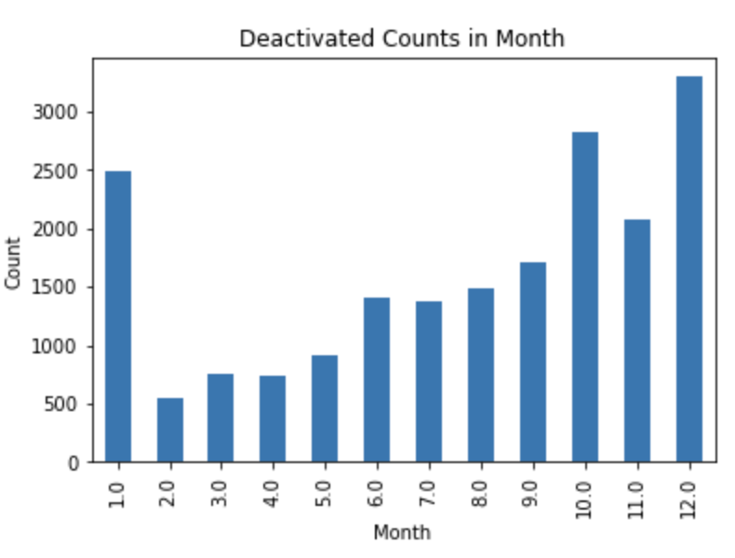
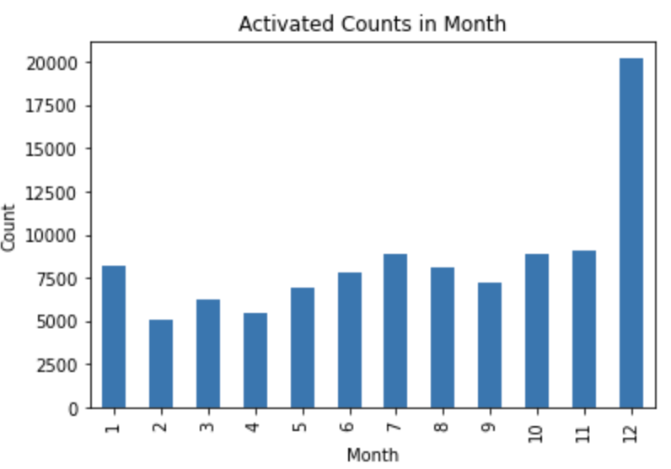
Data introduction
Notes:
These two bar charts demonstrate how many customers are deactivated and activated each month between 1999 to 2001.
In the left plot, it shows the deactivated counts, and we see that there are some outstanding counts in January, September and December.
In the right plot, it shows the activated counts, and we see that the most outstanding counts is in December.
Overall, December is the month which people become the customers in the company the most and also people are not using their company the most.

Slide 7
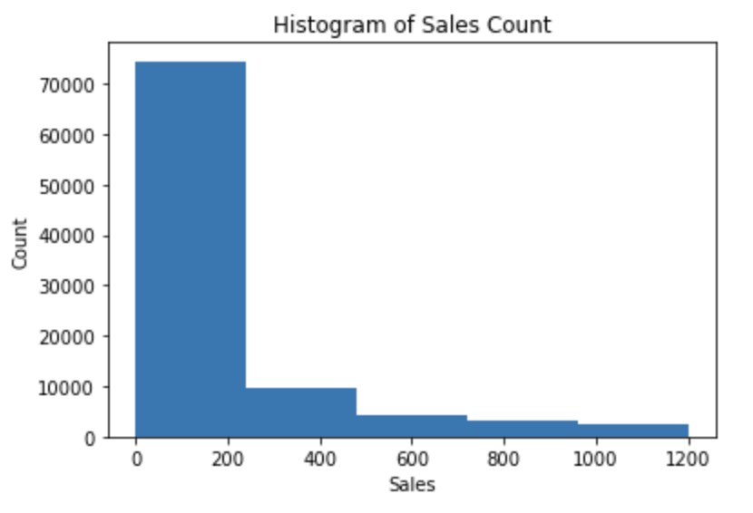
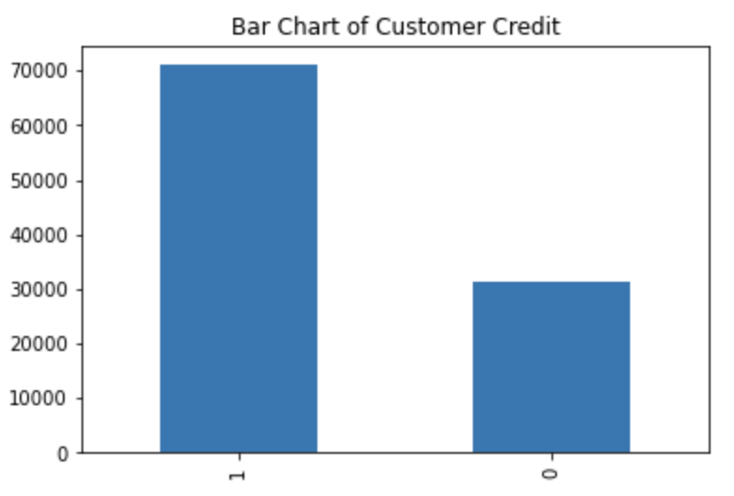
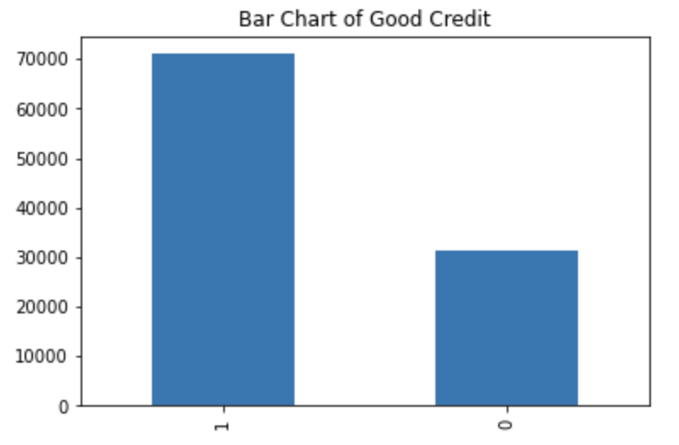
Data introduction
Notes:
The left graph is a histogram of sales count. We see that most customers spent about 0 to 200 to the company, and a few customers spent over 200 and even fewer as the amounts go up.
The right graph is a bar chart of customer credit. 1 represents customers with good credit and 0 represents customers with bad credit. The graph shows us that around 70 thousands customers are noted as good credit, and 30 thousand customers are bad credit.

Slide 8
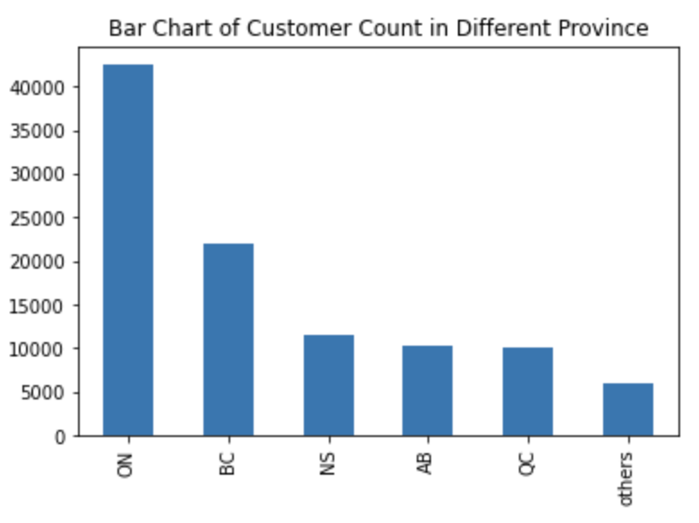
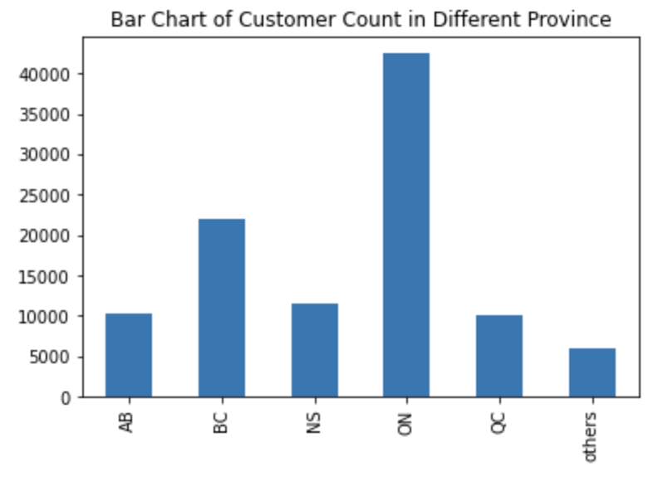
Data introduction
Notes:
This is a bar chart showing which province has the most customers in the company. Customers from ON province are over 40 thousand and it is way more customers than other provinces.
The second highest customer counts is BC province with around 25 thousands.

Slide 9
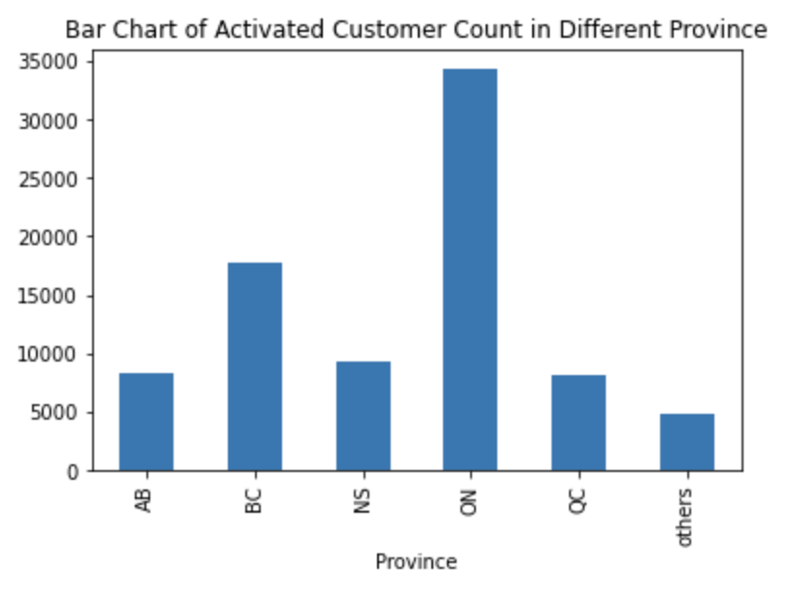
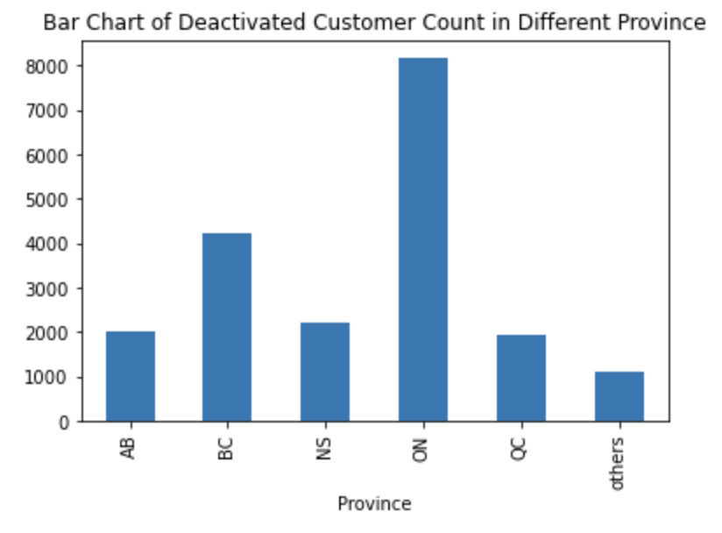
Data introduction
Notes:
These two graphs are also the bar chart of customers counts in each province. But the left graph is about activated customers whereas the right graph is about the deactivated customers.
Compared to the count of activated customers and deactivated customers, the trends are similar. ON has the most customers, followed by BC.

Slide 10
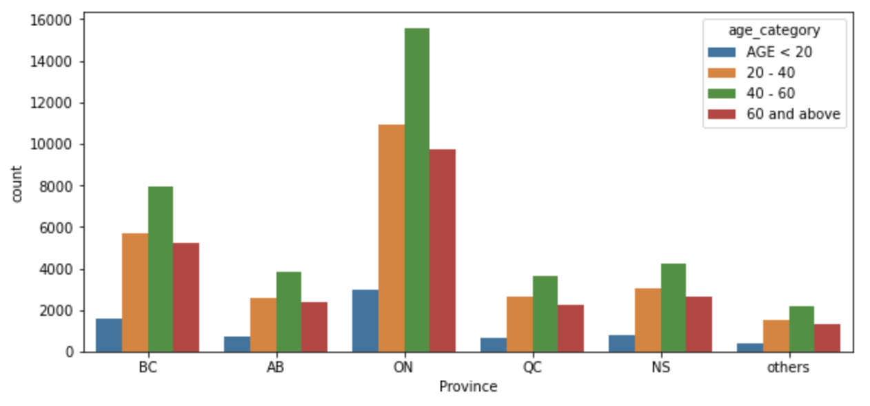
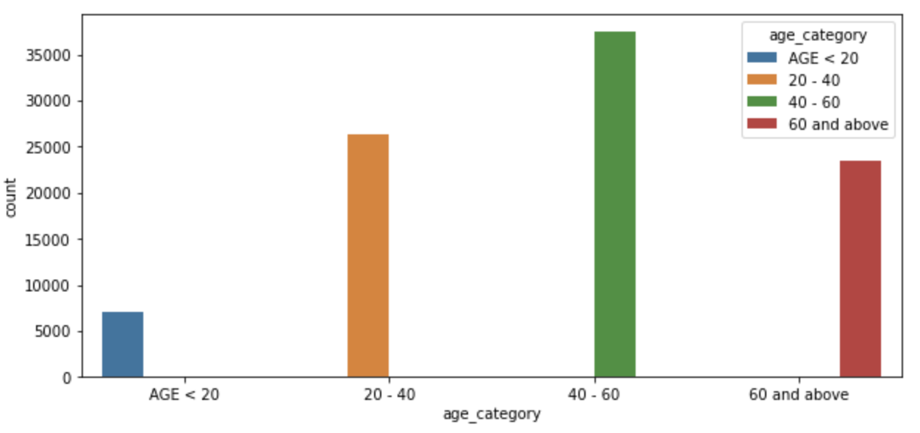
Data introduction
Notes:
The plot on the top is a bar chart showing the customers counts in each province according to the age group. As required, we separate the customers into 4 groups, age under 20, 20-40, 40-60, and over 60 years old. The graph on the bottom is a total customers counts based on the age group.
We see that over 35 thousand customers are between 40 to 60 years old. And around 16 thousand customers are from ON. Around 25 thousands customers are between 20-40 years old, and 11 thousands are from ON. Compared to ON and BC, ON is twice of BC among each age group approximately.

Slide 11
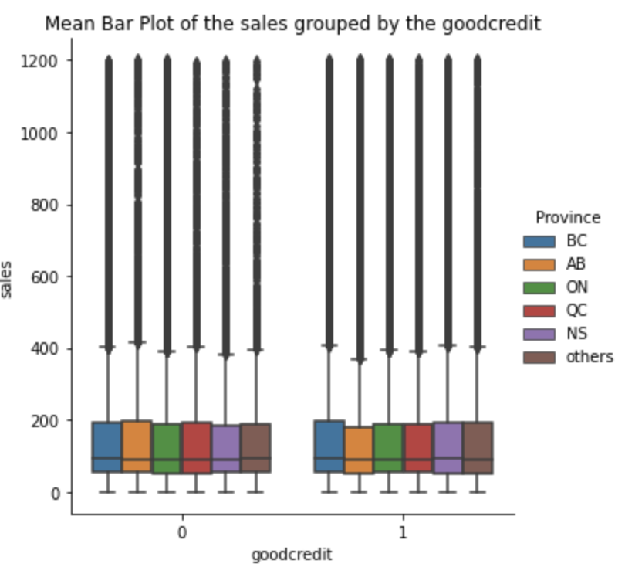
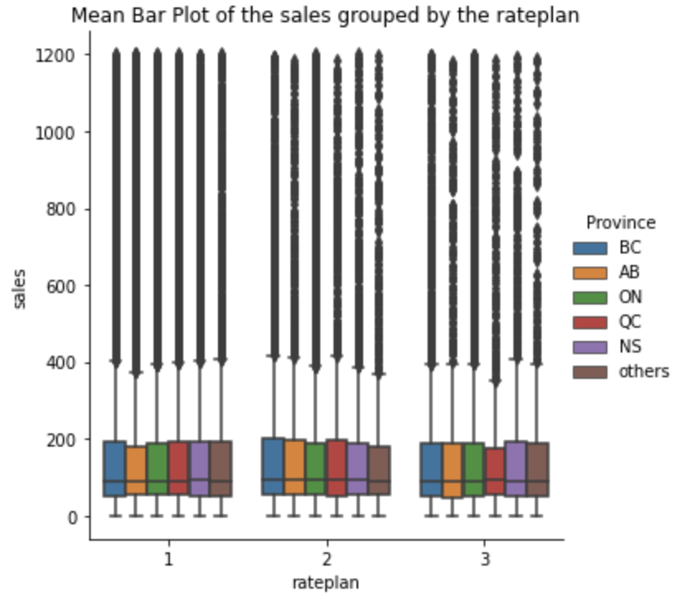
Data introduction
Notes:
These two plots are the mean bar plot of sales for each province according to customers credit and customers rate plan.
For the left plot, it shows that sales from the customers with good credit and bad credit in each province. It looks like the mean of the sale amount is similar for each province according to different customer credit, and it is about 100 sales on average.
For the right plot, it shows that sales from the customers with different rate plan in each province. The mean of the sale amount is also similar for each province according to different customer rateplan, and it is about 100 sales on average.

Slide 12
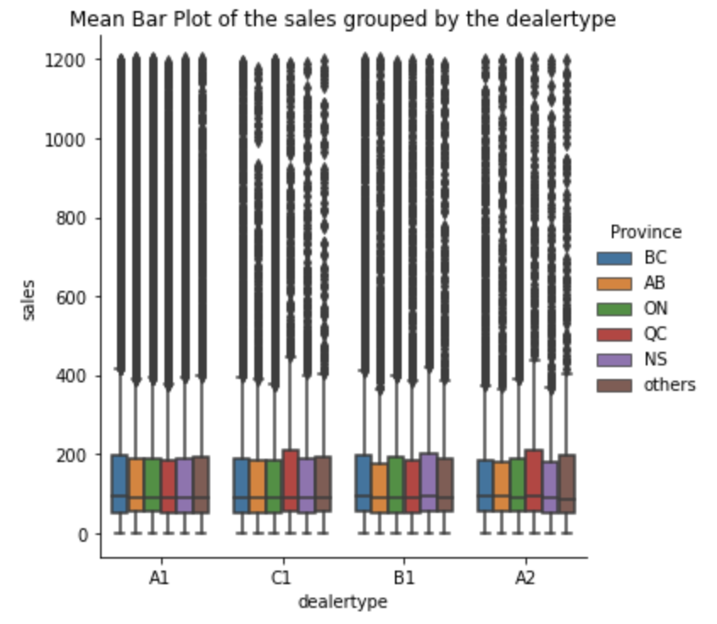
Data introduction
Notes:
This plot shows that sales from the customers with different dealertype in each province. The mean of the sale amount is also similar for each province according to different customer dealertype, and it is about 100 sales on average.

Slide 13
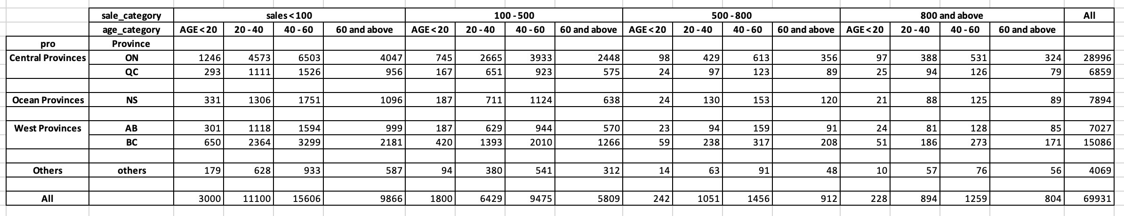
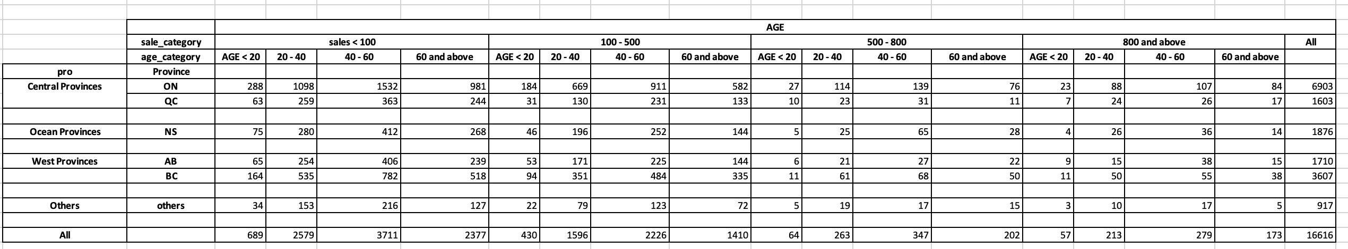
Data introduction
Activated Customers
Deactivated Customers
Notes:
These are the tables for the counts of activated customers and deactivated customers in each province based on different age and sale segments.
We see that about 15 thousands and 11 thousands activated customers who paid less than 100 are 40-60 and 20-40 years old respectively. Sales that are less than 100 are from teen and adult customers in ON and BC province.
For the deactivated customers, it is similar that most customers from the age of 20-60 paid less than 100 in telecommunication.
Overall, if you interested in more detail between age segments and sale segments in each province, you could get more insight from these two tables.

Slide 14
Purpose
1. Introduce the data
2. Investigate the customer distribution and business behaviors
3. Relationship between variables
Notes:
Now let move to data analysis part. We would investigate which month has the most customer deactivated their accounts. How many days would customers use the services? And the association between variables and the sale.

Slide 15
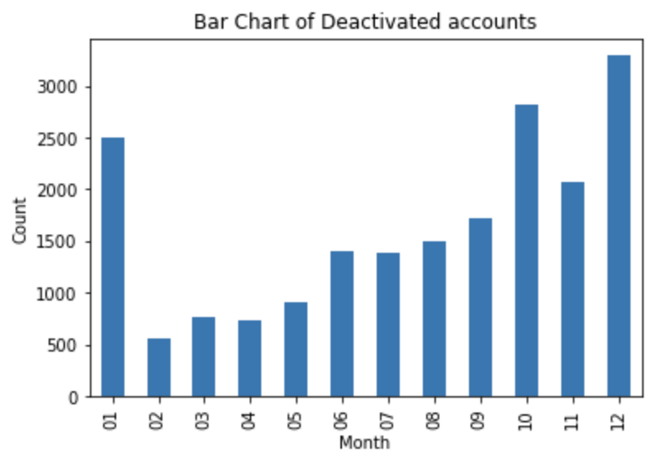
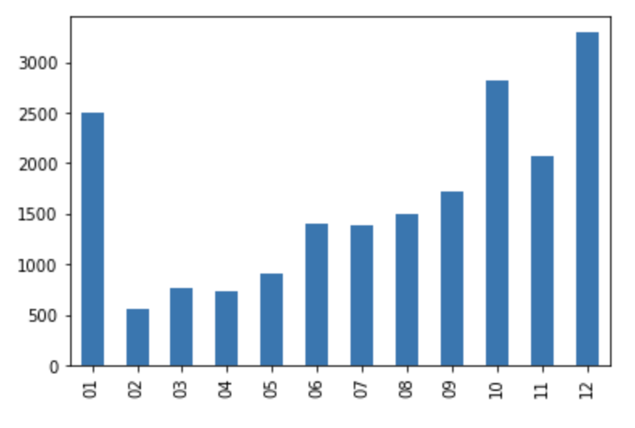
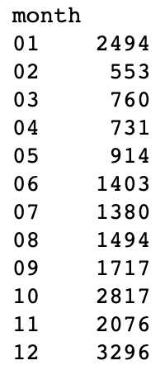
Data Integration
Notes:
In the data introduction part, we have talked about December is the popular month that customer deactivated their accounts.
There are many reasons for that. It might be the new year event, where other telecommunications have better deals compared to the current telecommunication.
Therefore, in order to decrease the amount of deactivated customers in December, the company may need to make some changes with their initial plans.
It is also suggested that January and September need improvement as well.

Slide 16
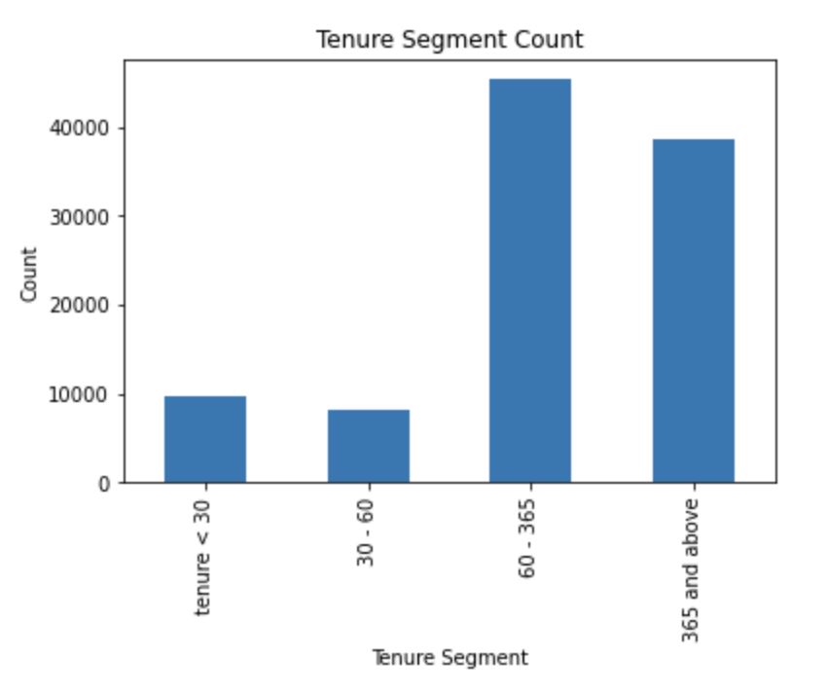
Data Integration
Notes:
This is a bar chart of customers’ tenure segment. Over 40 thousands customers used the telecommunication between 60 days (about 2 months) and a year. Another majority of tenure segment is a year and above. Tenure less than 30 and tenure between 30 days and 60 days are around 10 thousand.

Slide 17
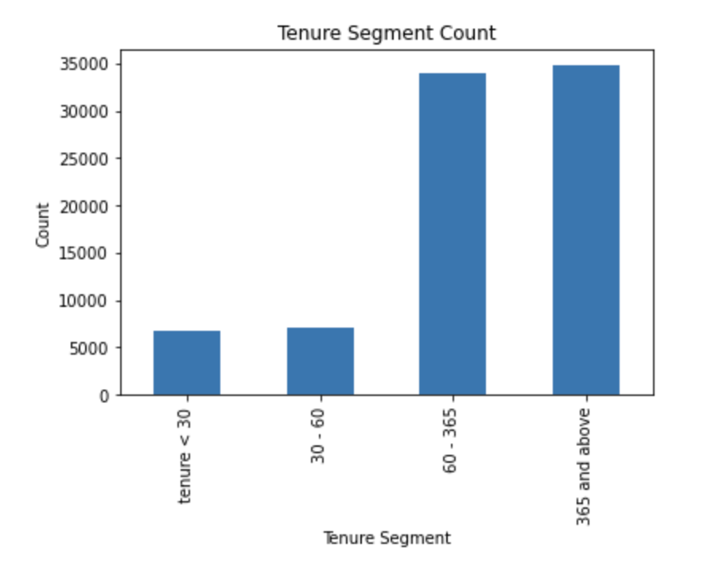
Data Integration
Activated accounts
Notes:
Here we have a tenure segment plot for the activated accounts. About 35 thousands customers used the telecommunication for a year and more, and around the same number for 2 months to a year. It is good news that many customers used the telecommunication for 60 days and more.

Slide 18
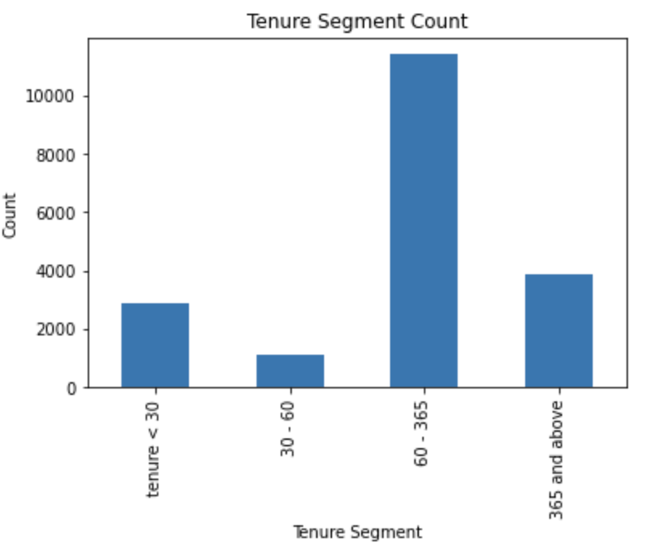
Data Integration
Deactivated accounts
Activated
Notes:
Here we have the plot for deactivated accounts. Over 10 thousands customers stop using the telecommunication after 60 days or a year after creating accounts. And approximately three thousand customers left in less than 30 days or after 1 year. In order to decrease the count of the group 60-365, the company needs to make changes to keep the customers using their services.

Slide 19
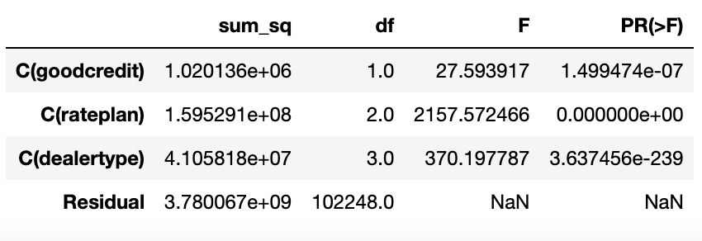
Data Integration
Notes:
Now we are going to discover the association between tenure segments and “Good Credit” “RatePlan ” and “DealerType.
This anova table shows that there is association between tenure and C(goodcredit)+C(rateplan)+C(dealertype).
It suggests that the rating of customers credit, rateplan, dealertype may have a significant influence on customer tenure duration

Slide 20
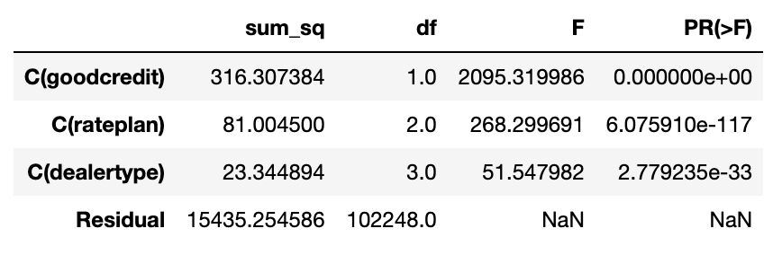
Data Integration
Notes:
This table discovers the association between account status and “Good Credit” “RatePlan ” and “DealerType.
This table shows that there is association between account status and C(goodcredit)+C(rateplan)+C(dealertype).
It suggests that the rating of customers credit, rateplan, dealertype may have a significant influence on customer tenure duration

Slide 21
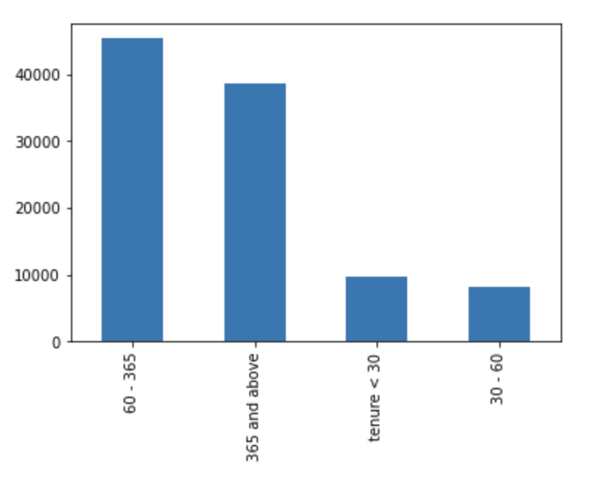
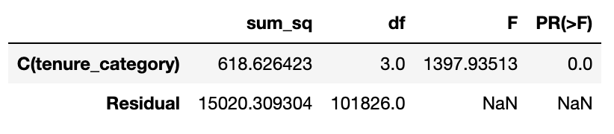
Data Integration
Notes:
The table on the left is to find whether there is association between the account status and the tenure segments. The p-value shows that association exists between them.
The bar chart on the right is to see how many counts in each tenure segments. We want to find a better tenure segmentation strategy that is more associated
with the account status, so I tried to change the tenure segment to have an equally distributed bar.

Slide 22
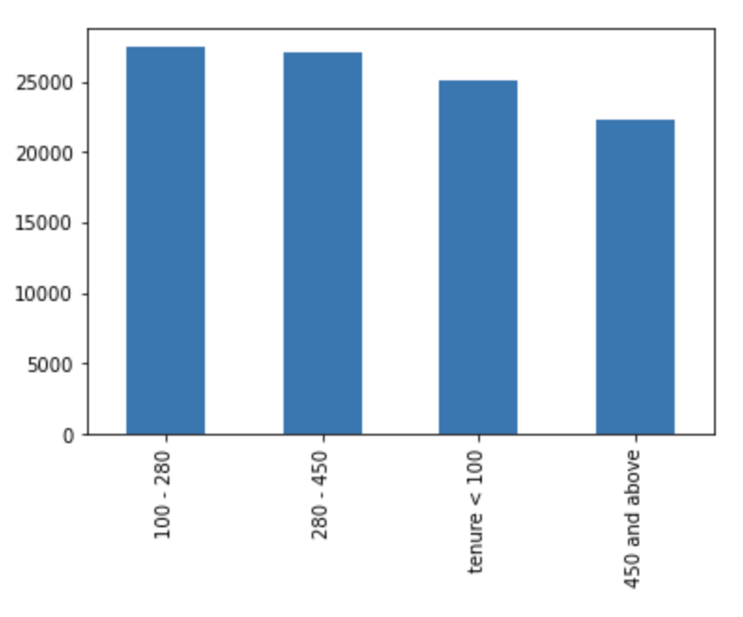
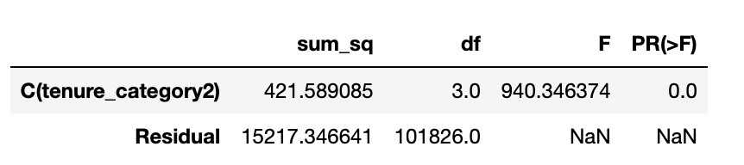
Data Integration
Notes:
Now the tenure segment changed to less than 100, 100-280, 280-450, and 450 and above. We see the p-value from the left table, and it shows there is association between the account status and the new tenure segments.

Slide 23
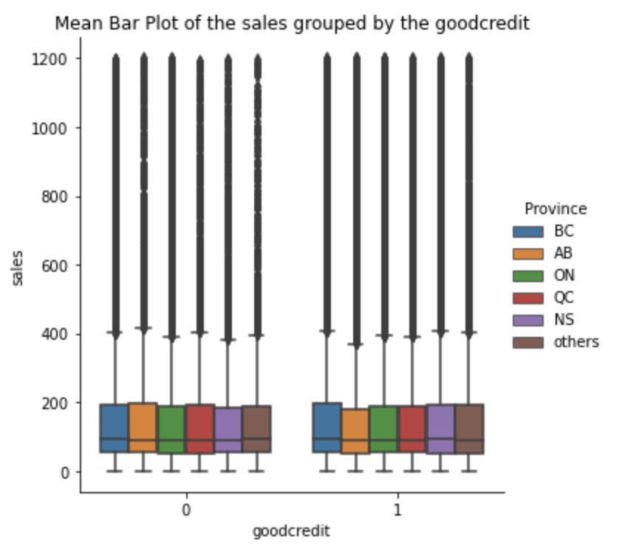
Data Integration
Notes:
In this section, we want to see whether Sales amount differ among different GoodCredit, account status and customer age segments.
We bring back the mean bar again, and the mean of sales are similar for different customer credits.

Slide 24
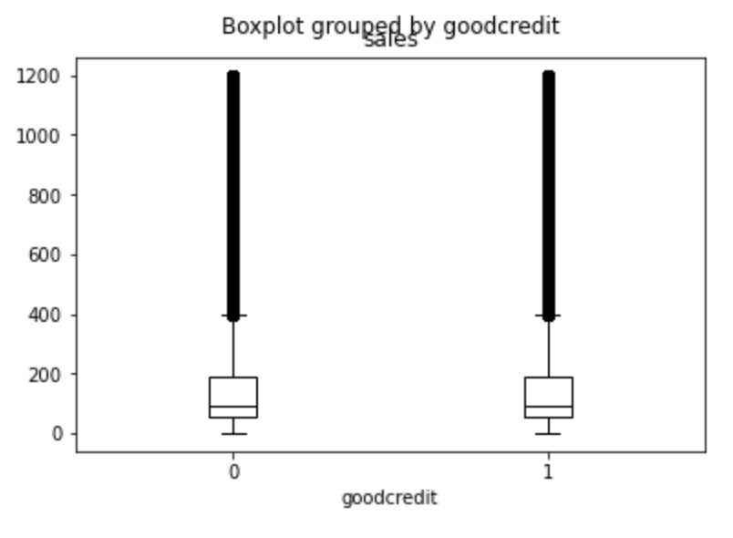
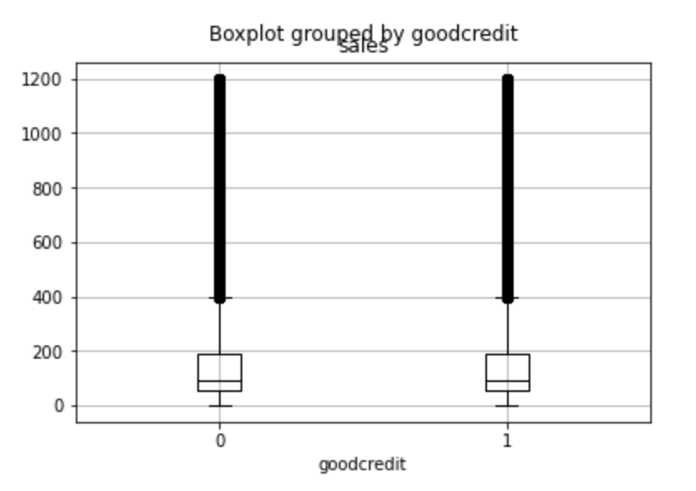
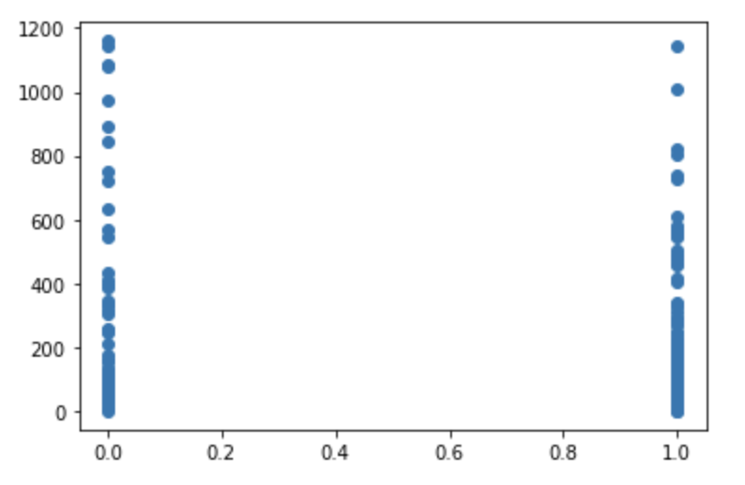
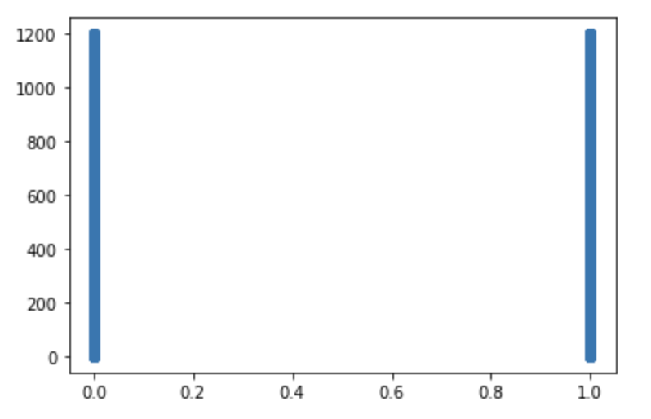
Data Integration
Notes:
Goodcredit
The boxplot shows that the mean of the sales for different customers credit is about the same at sales of 100. The maximum and minimum amount of sales are close in different credit too.
So there is no big difference in sales among the variable of GoodCredit

Slide 25
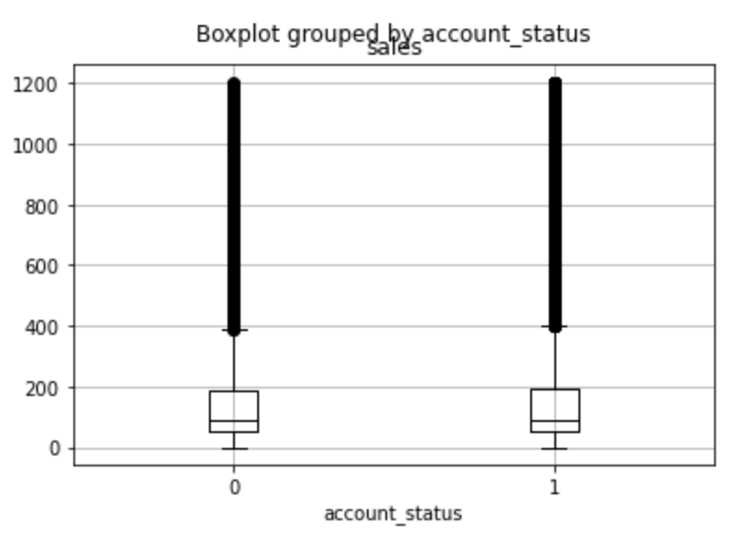
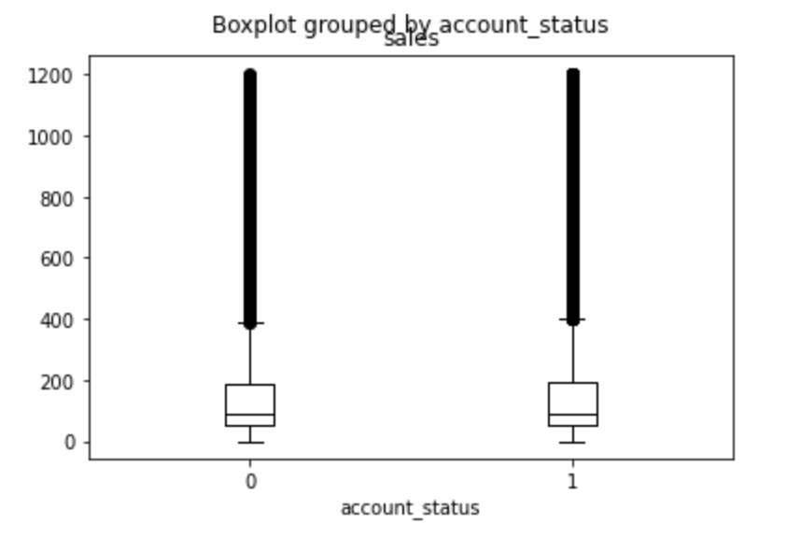
Data Integration
Notes:
The boxplot here shows that there is a slightly difference in 75th percentile and maximum. According to the boxplot, Activated accounts have higher sale amount in both 75th percentile and maximum, and they are at 200 and 400 sales respectively. However, deactivated account have made just below 200 and 400 in sales. Therefore, there is no big difference in sales.

Slide 26
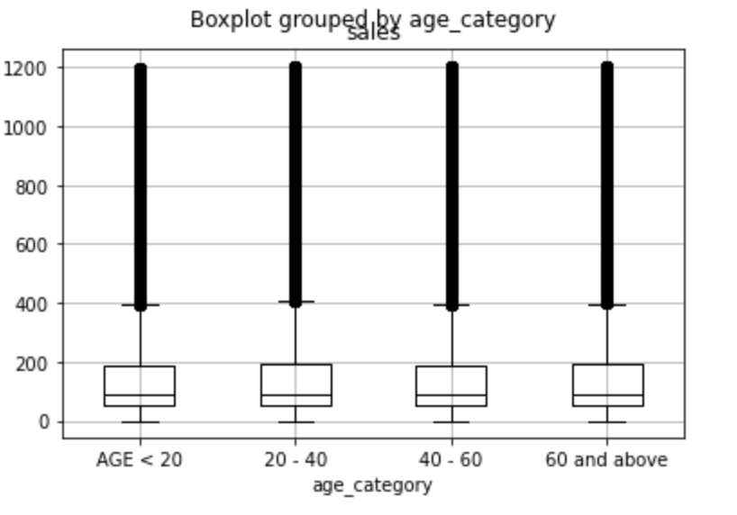
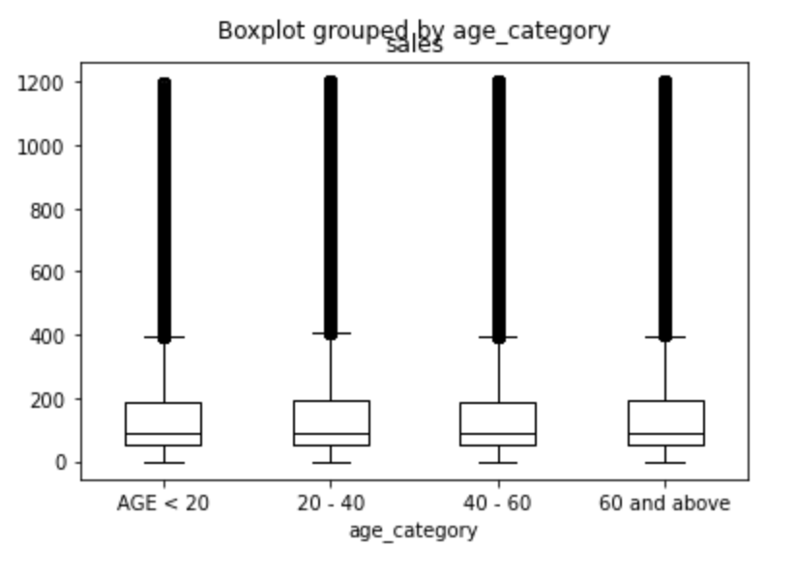
Data Integration
Notes:
Here we are going to see the age_category and sales difference. Sales are a bit higher in 20-40 group in 75th percentile and maximum compared to other three groups. Age<20 and 40-60 are about the same, and the maximum is below 400 and 75th percertile is below 200. There is a slight sale difference in different age group but it is not obvious as well.

Slide 27
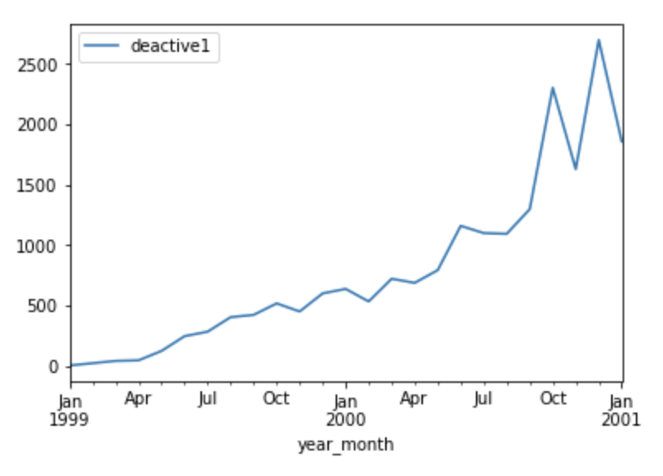
Data Integration
Notes:
Last but not least, forecast the deactivation trends for the next 6 months. This is a plot of deactivation counts of each month in 1999 to 2001. We see that there is an upward trend, and the number was increasing as the time passed.

Slide 28
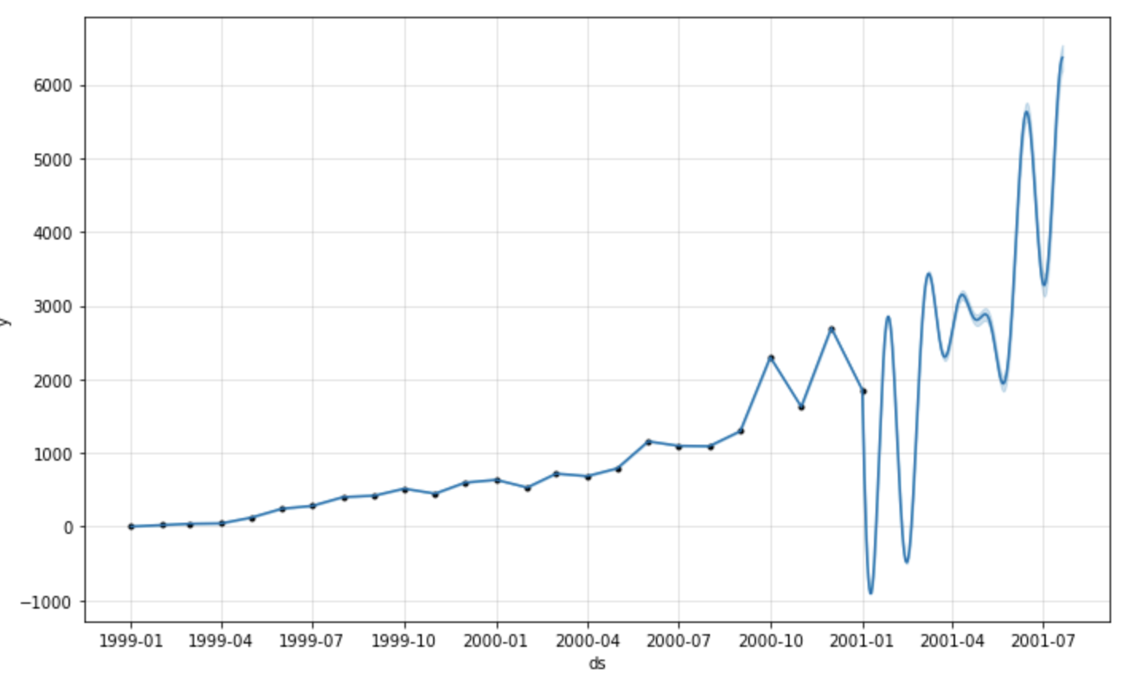
Data Integration
Notes:
So we forecast a plot to see the predicted trend

Slide 29
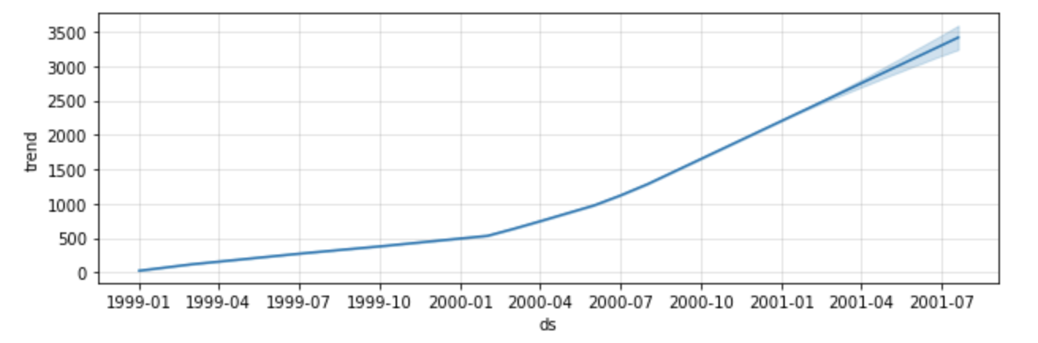
Data Integration

Slide 30
The end
Telecommunication Project
Notes:
Today, I would discuss about CRM data of a wireless company. Our goal is to see the customer distribution and deactivation analyses.

