Slide 1
Basic Signal Procesing
Pablo Irarrazaval

Slide 2
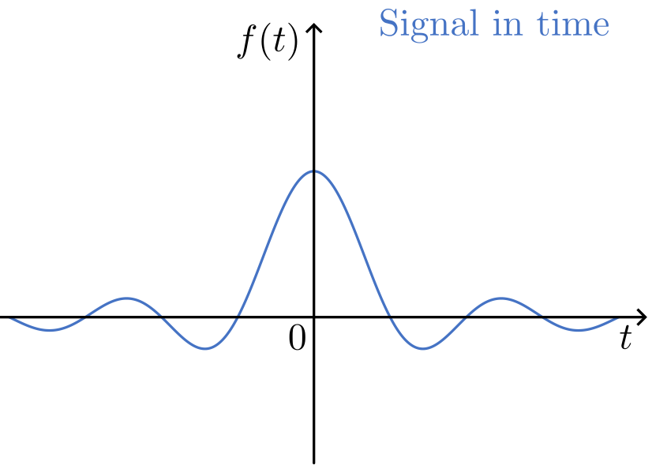
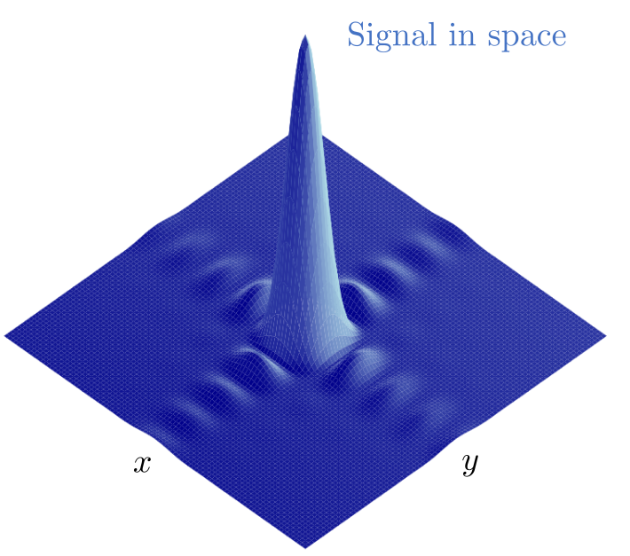
Signals
A signal is a variable or detectable physical quantity by which information can be transmitted. This can be measured in time, space or in another domain.

Slide 3
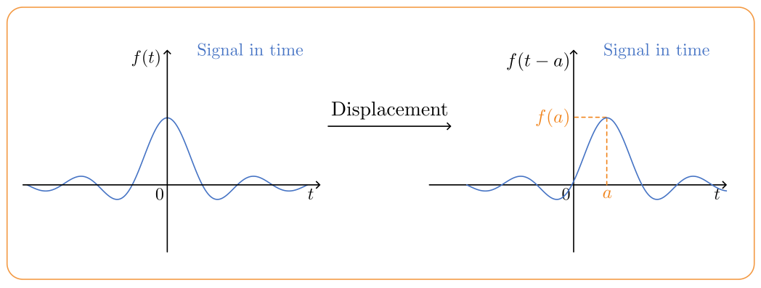
Signal operations

Slide 4
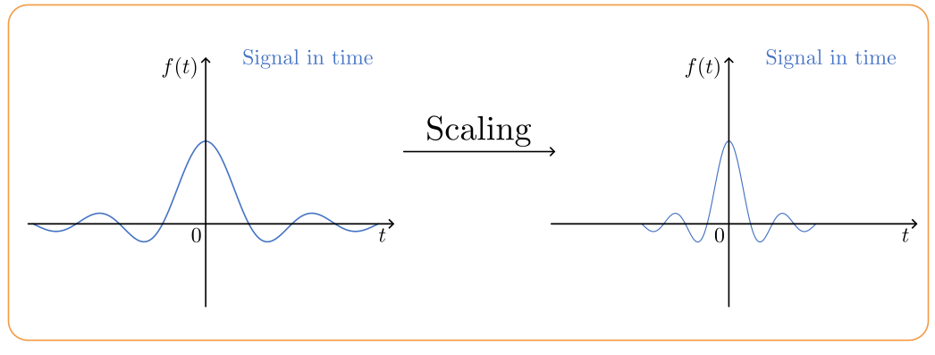
Signal operations

Slide 5
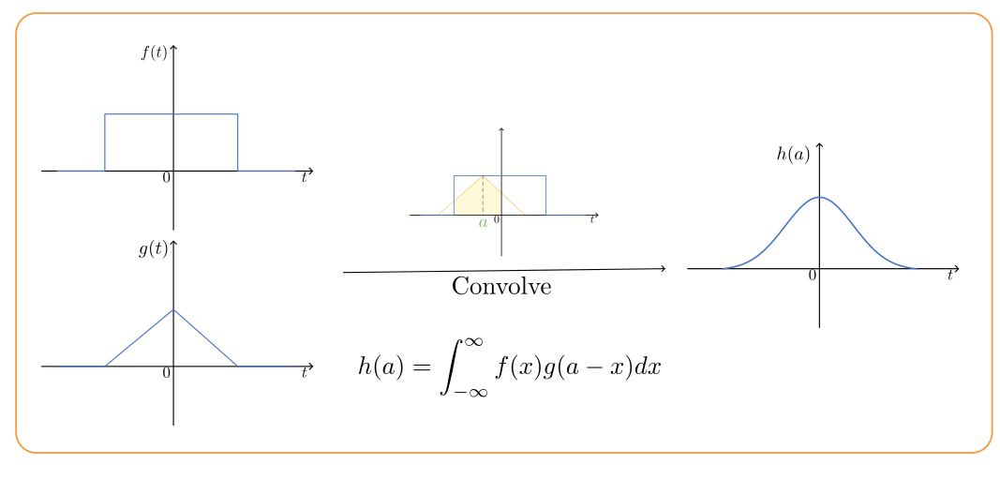
Signal operations

Slide 6
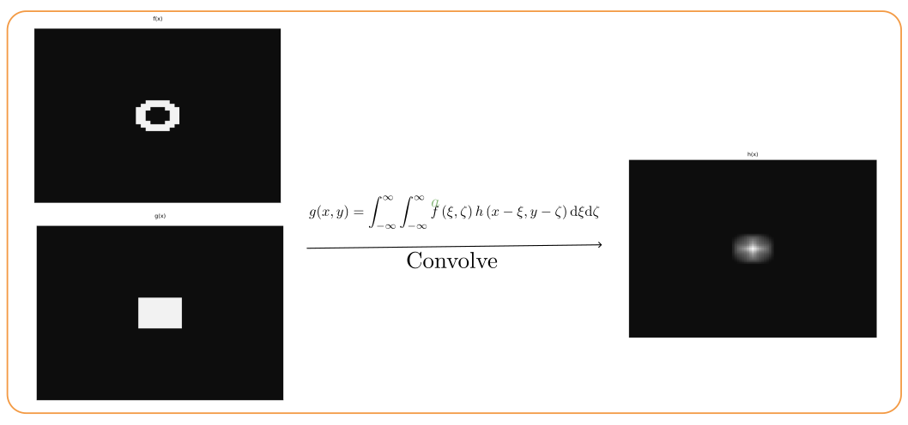
Signal operations

Slide 7
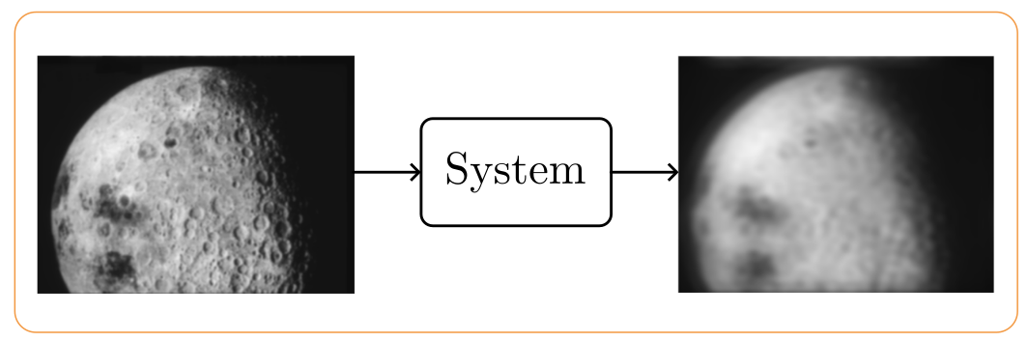
Systems
A system transforms signals into another signal

Slide 8
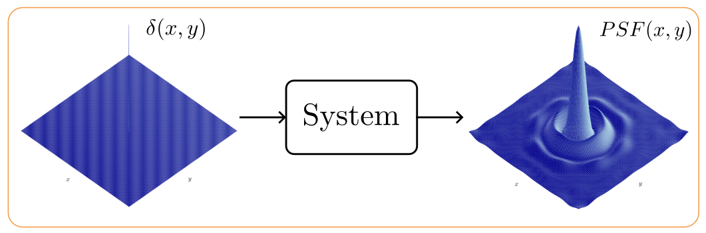
PSF
In a system the impulse response is the output of the system when the input is a dirac delta

Slide 9
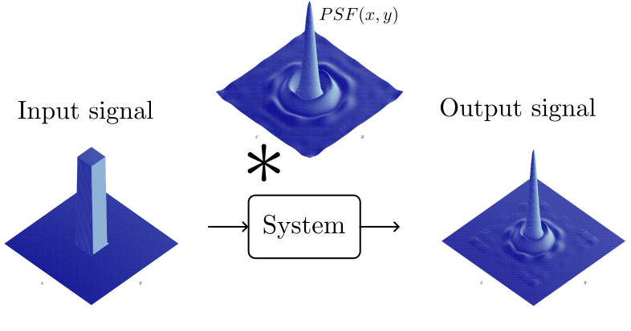
Systems
In a linear and invariant system the output of the system is the convolution between the input and the impulse response of the system (PSF)

Slide 10
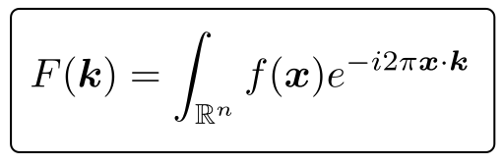
The Fourier Transform
The Fourier transform is a mathematical operation that allows signals from the time or space domain to the temporal or spatial frequency domain respectively.

Slide 11
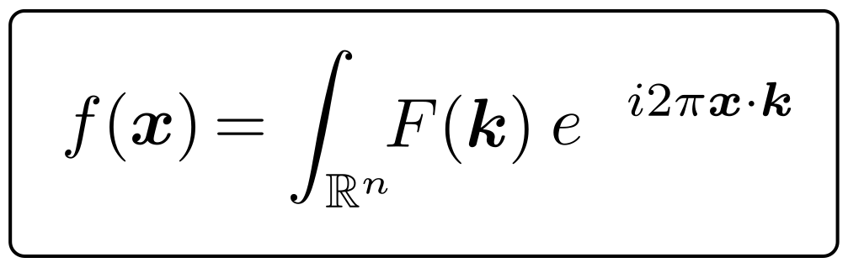
The Inverse Fourier Transform
The Inverse Fourier transform is a mathematical operation that allows signals from the frecuncy domain to the time domain respectively.

Slide 12
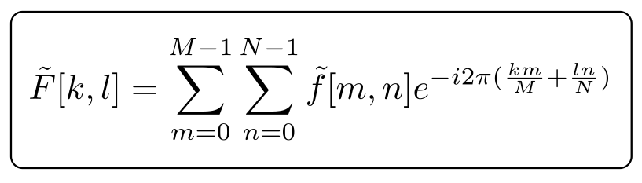
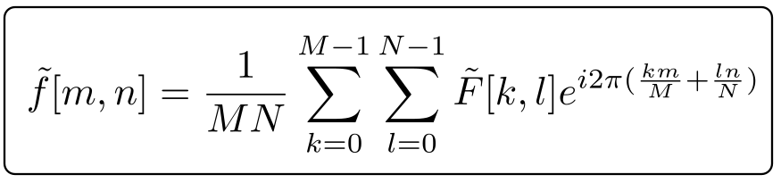
2D Discrete Fourier Transform
Inverse D Discrete Fourier Transform

Slide 13
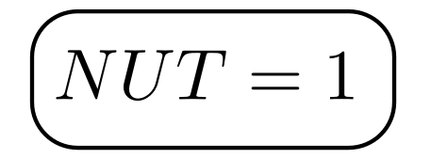
2D Discrete Fourier Transform
2D Discrete Fourier transform is for discrete and periodic signals. The number of samples (N), the sample period on time(T) and the sample period on frecuency are related by:

Slide 14
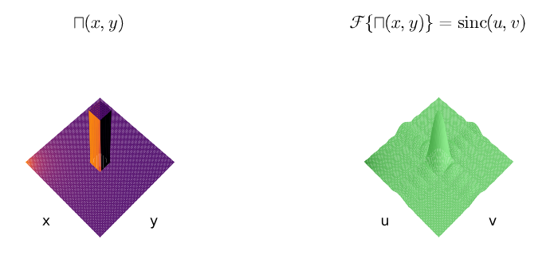
Example Fourier Transform

Slide 15
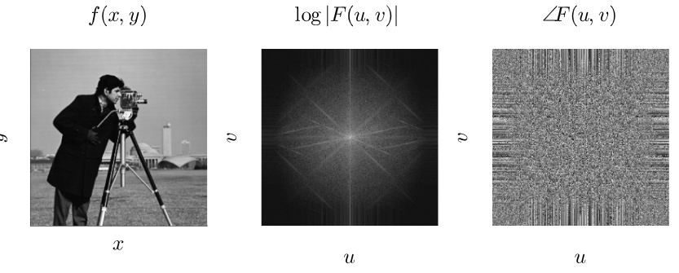
Example Fourier Transform

Slide 16
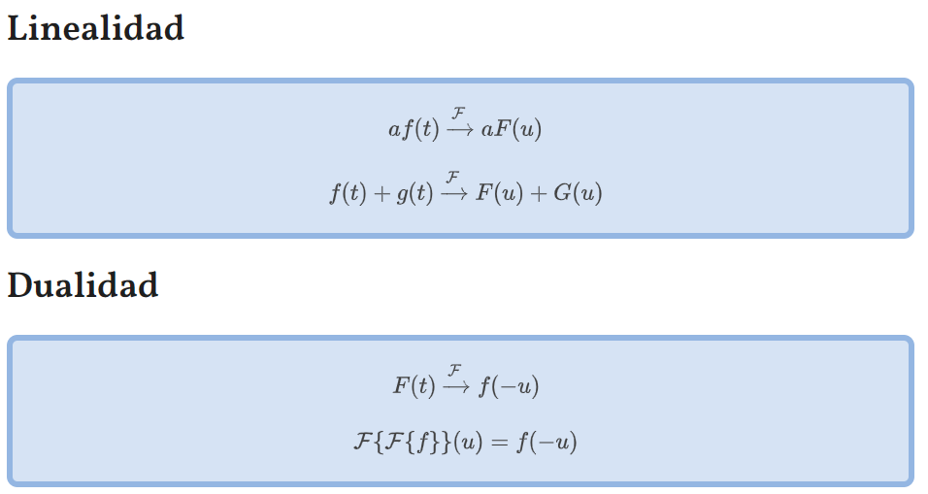
Propiedades transformada de Fourier

Slide 17
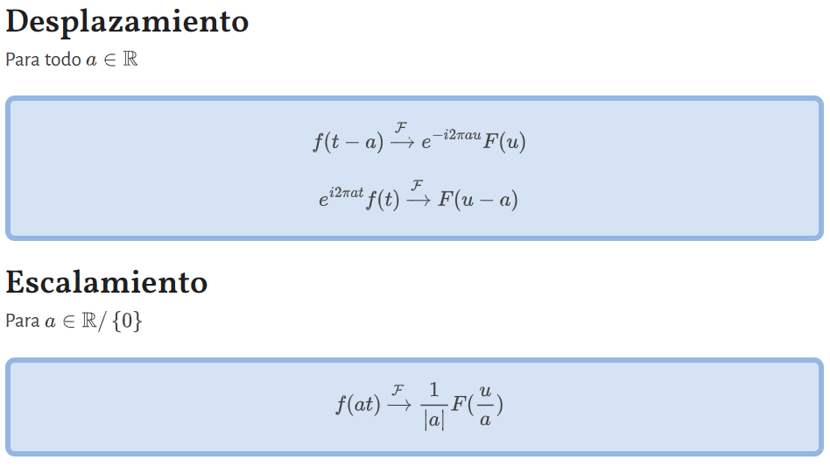
Propiedades transformada de Fourier

Slide 18
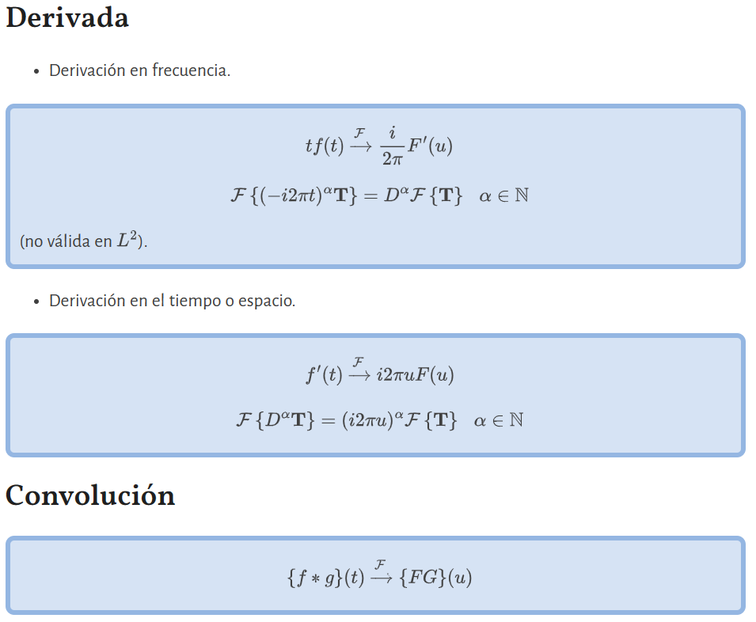
Propiedades transformada de Fourier

Slide 19
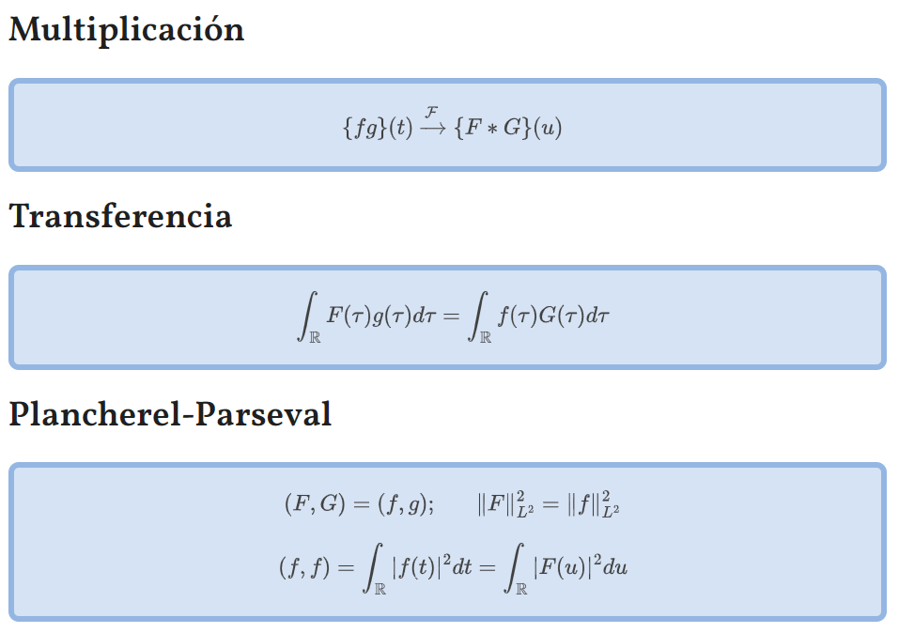
Propiedades transformada de Fourier

Slide 20
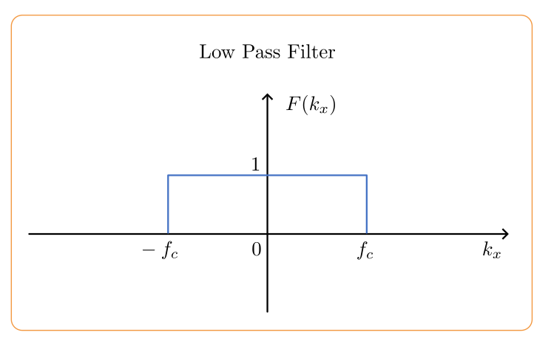
Low pass filter: attenuate frequencies that are greater than a specified cutoff frequency

Slide 21
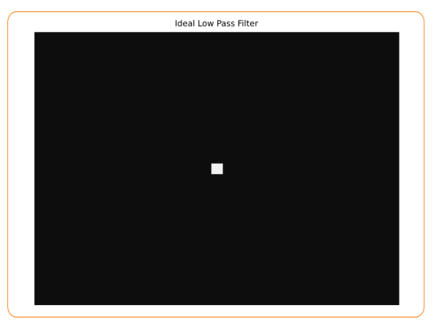
2D low pass filters: they work analogously to 1D filters. It is possible to have a different cutoff frequency for each spatial frequency

Slide 22
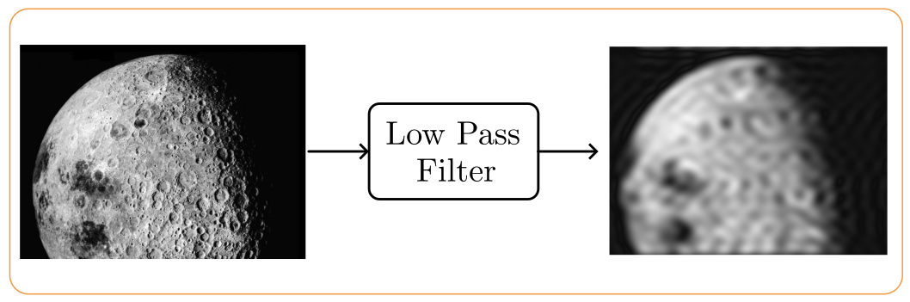
2D low pass filter example

Slide 23
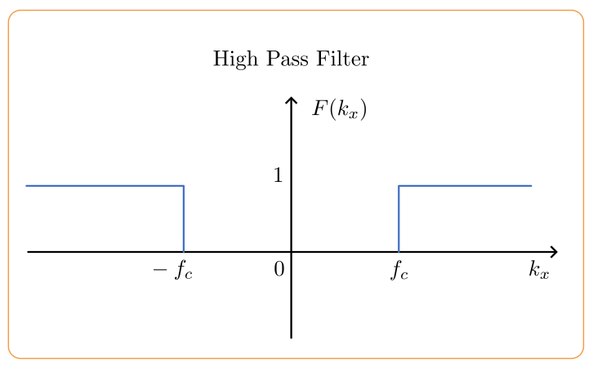
High pass filters: attenuate frequencies that are lower than a specified cutoff frequency

Slide 24
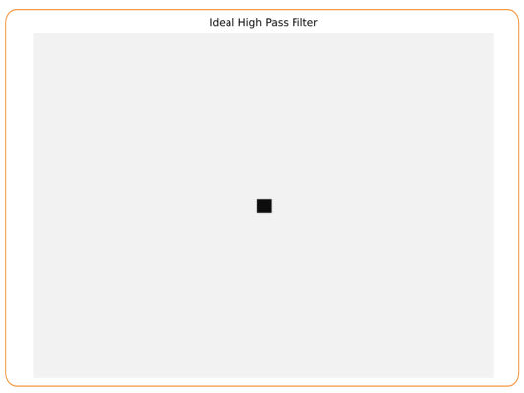
2D High pass filters

Slide 25
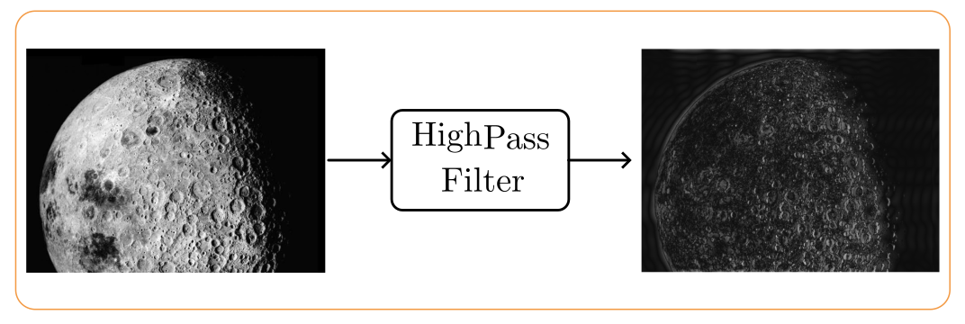
2D High pass filters

Slide 26
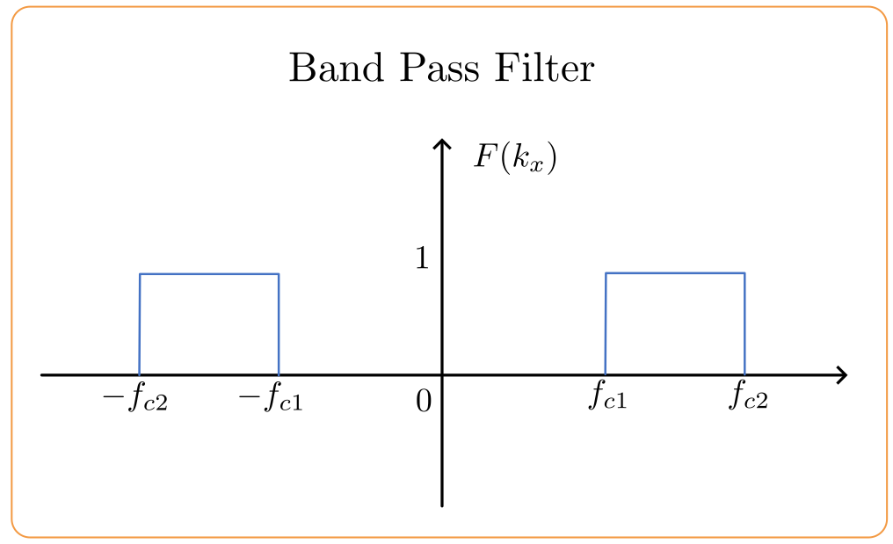
Band-pass filter

Slide 27
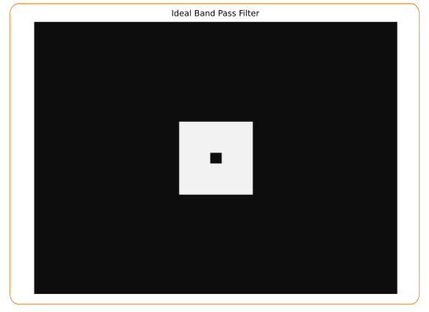
Band-pass filter

Slide 28
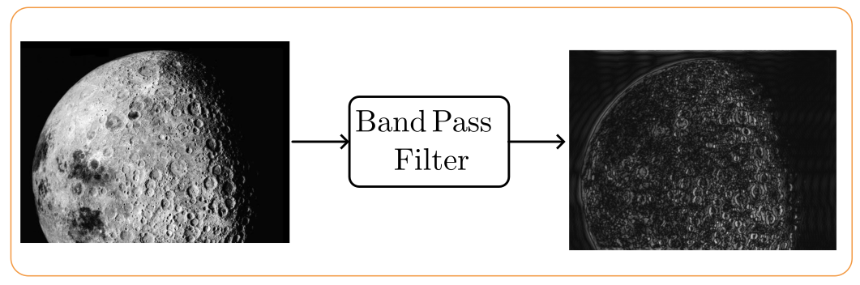
Band-pass filter

Slide 29
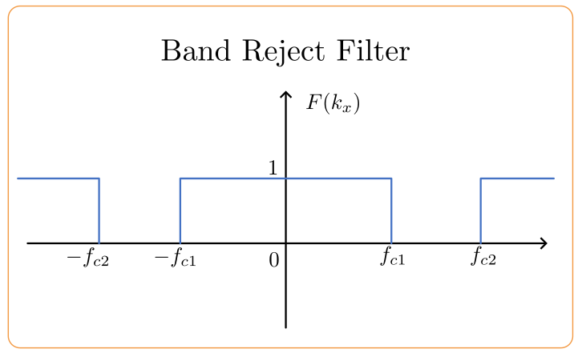
Band reject filter

Slide 30
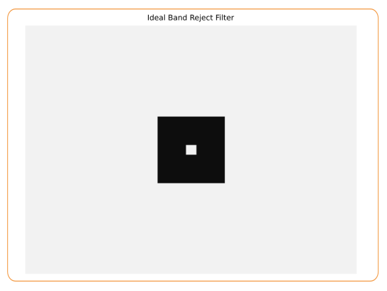
Band reject filter

Slide 31
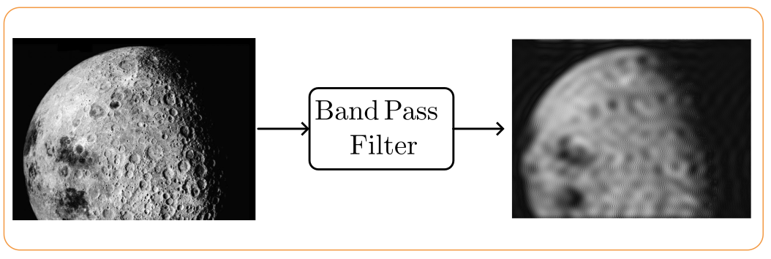
Band reject filter

Slide 32
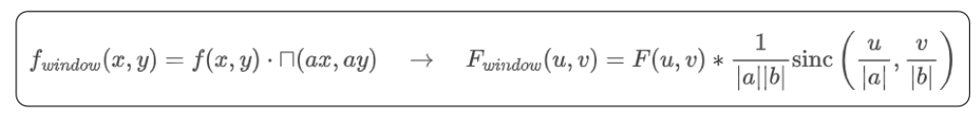
Ventaneo
Se dice que una señal es ventaneada cuando solo se selecciona una porción de la señal. Esto se puede interpretar como multiplicar la señal a ventanear por una señal que es de soporte compacto. Como bien sabemos, todas las señales de soporte compacto tienen una transformada de Fourier que es de ancho de banda ilimitado. Esto significa que al ventanear una función su espectro se convoluciona con una función infinita. El caso típico es el de la ventana rectangular, cuya transformada de Fourier es el sinc. De esta forma al ventanear:

