Slide 1
Chapter 4
File and File Systems
File Systems

Slide 2
Outline
File and File System
Properties of files
Basic File System Operations
File Naming
File Structure
Directories
Access Methods of File
File Protection

Slide 3

File and File System
File is a logical collection of information stored on secondary storage such as hard disk. It is a collection of records.
File system is the one of the most important parts of the OS to a user.
  It is used to control how data is stored and retrieved.
  It provide a means to store data organized as file as well as a collection of function that can be performed on file.
  It Maintain a set of attributes associated with the file.
  Without a file system, information placed in a storage area would be one large body of data with no way to tell where one piece of information stops and the next begins.
  There are many different kinds of file systems. Each one has different structure and logic, properties of speed, flexibility, security, size and more.
File Systems

Slide 4
Properties of files
Long-term existence
  Files or stored on disk or other storage and do not disappear when a user logs off.
  Sharable between processes
  Files have names and can have associated access permission that permit controlled sharing
  Structure
  Files can be organized into hierarchical or more complex structure to reflect the relationships among files.
File Systems

Slide 5
Basic File System Operations
  Several operations on files can be controlled. Operation include:-
  read - read a file
  write - write a file
  execute - load and execute a file
  append - append information at the end of a file
  delete - free the space allocated to a file
  update – modifying, deleting and adding to a file
  copy- copy the contents of a file
  list- listing the name of the file
File Systems

Slide 6
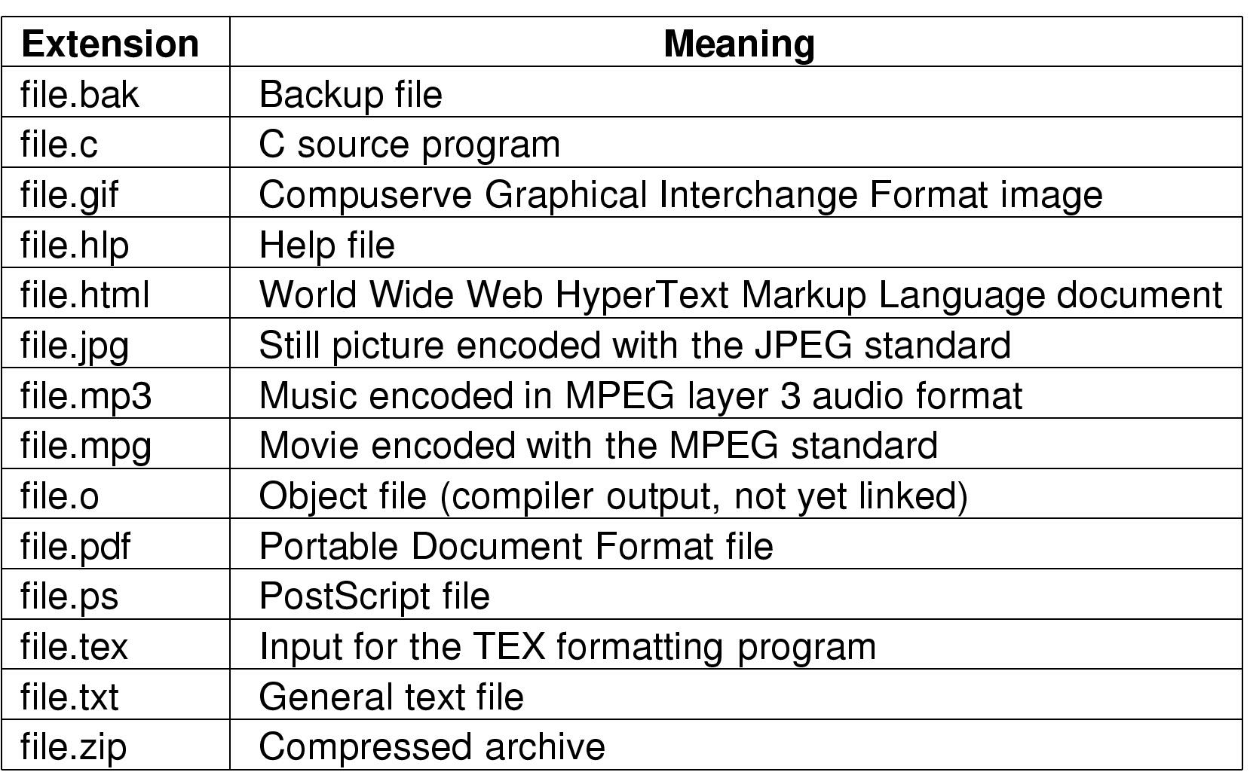
File Naming
Typical file extensions.
File Systems

Slide 7
The following terms are commonly used when discussing Files
Field
  It is a basic element of data. It contains a single value. It is fixed or variable length.
  Database
  Collection of related data. Relationships among elements of data are explicit.
  Files
  Files is the collection of similar records. It is treated as a single entity. May be referenced by name.
  Record
  Record is a collection of related fields that can be treated as a unit by some application programme. The one field is the key (a unique identifier).
File Systems

Slide 8
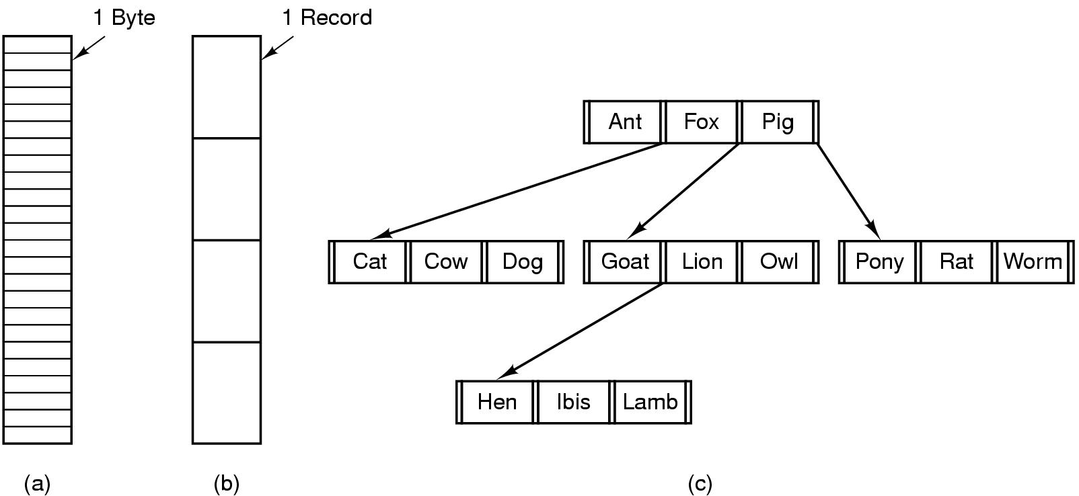
File Structure
Files can be structured as a sequence of bytes or as a collection of records or as a complex structures, e.g. tree
File Systems

Slide 9
Directories
Directory is a symbol table of files that stores all the related
information about the file it hold with the contents.
Directory is a list of files.
Each entry of a directory define a file information like a file name, type, its version number, size, owner of file, access rights, date of creation and date of last backup.
Usually are themselves files
File Systems

Slide 10
How to structure the directory to optimize all of the following ?
Search a file
Create a file
Delete a file
List directory
Rename a file
Traversing the FS
Directory
Files
F 1
F 2
F 3
F 4
F n
File Systems

Slide 11
Solution ➔ Logical Structure Of Directory
The directories can be structured in the following ways:-
  Single level directory
  Two level directory
  Tree structured directory
  Acyclic graph directory
  General graph directory
File Systems

Slide 12

1. Single-level Directory
One directory for all files in the volume
Called root directory
- Used in early PCs (single-user OS's), even the first supercomputer CDC 6600
Pros : simplicity, ability to quickly locate files
Cons : inconvenient naming (uniqueness, remembering all)
File Systems

Slide 13

2. Two-level Directory
Each user has a separate directory
Solves name collision, but what if user has lots of files
May not allow a user to access other users’ files
File Systems

Slide 14

3. Tree-structured Directory
Directory is now a tree of arbitrary height
Directory contains files and subdirectories
A bit in directory entry differentiates files from subdirectories
File Systems

Slide 15
Path Names
To access a file, the user should either:
  Go to the directory where file resides, or
  Specify the path where the file is
Path names are either absolute or relative
  Absolute : path of file from the root directory
  Relative : path from the current working directory
Most Operating Systems have two special entries in each directory:
  “.” for current directory and “..” for parent
File Systems

Slide 16

4. Acyclic Graph Directories
Share subdirectories or files
File Systems

Slide 17
Acyclic Graph Directories (cont’d)
How to implement shared files and subdirectories:
  Why not copy the file?
  New directory entry, called Link (used in UNIX)
    Link is a pointer to another file or subdirectory
    Links are ignored when traversing FS
    ln in UNIX, fsutil in Windows for hard links
    ln –s in UNIX, shortcuts in Windows for soft links
Issues?
  Two different names (aliasing)
  If dict deletes count ⇒ dangling pointer
    Keep back pointers of links for each file
    Leave the link, and delete only when accessed later
    Keep reference count of each file
File Systems

Slide 18
5. General graph directory
It is formed by adding links into an existing tree structure.
It overcomes the problem of acyclic graph by allows the cycles in a directory.
Thus it avoids the searching of a component twice in a subdirectory.
File Systems

Slide 19
Access Methods of File
Files are used to store data.
The information present in the file can be accessed by various methods.
Thus, the way of retrieving data from a file is known as access methods.
Different systems use different access methods. The various access methods used are:
  1. Sequential access - file is accessed in the order it is stored in the file one record after the other.
  2. Direct access - it is possible to access the records of a file in any order.
  3. Indexed access - an index is created for the file. This index contains pointer for various blocks of a file, just like an index in the back of the book.
File Systems

Slide 20
File Protection
One of the major functions of the file system is to protect this information against unauthorized access and physical damage.
Physical damage may occur because of hardware problems, power failure, head crashes, dirt and extreme temperatures.
  ➔ In order to prevent such damage some systems performs backup at regular intervals.
Protection is achieved by limiting the type of file access which can be made.
Files use different access rights such as:
  Access Control
  Password Protection
  File Naming.
File Systems

Slide 21

Questions

