Slide 1


Parcours OpenClassRooms
Data Scientist
PX Intitulé
Développé sur un Notebook Jupyter Colaboratory
Benoît DELORME
Création :
Mise à jour :

Slide 2
Sommaire
I. Partie_1
II. Partie_2
III. Partie_3
IV. Partie_4
V. Partie_5

Slide 3
I. Partie_1
1. Sous-partie_1
frame_name
frame_name
frame_name
frame_name

Slide 4
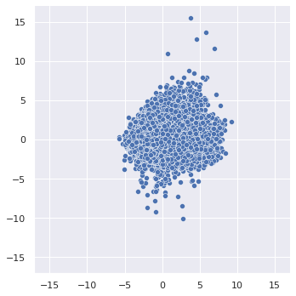
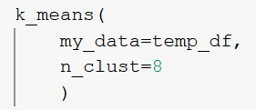
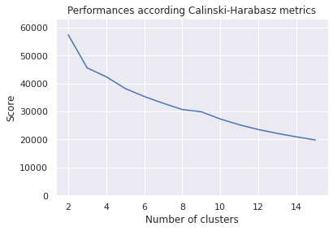
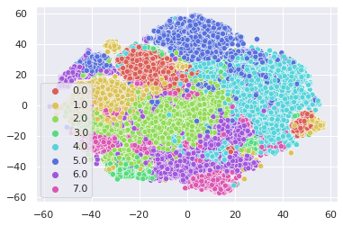
I. Partie_1
1. Sous-partie_1
Visualiser
Modéliser
Optimiser
Représenter
Analyser

Slide 5
Bilan et perspectives
Sujet | Commentaire

Slide 6
Améliorations
Andrew Ng
Why it matters: Organizations increasingly rely on algorithms to help make decisions that impact peoples’ lives, including who gets a bank loan, a job, or jail time. Public backlash has led to proposals like the Algorithmic Accountability Act, which would require the U.S. government to develop rules that mitigate algorithmic bias and provide ways for citizens to appeal automated decisions.
We’re thinking: All algorithms are prone to some degree of error. At a company the size of Amazon, even a tiny error can have a large impact. Every effort should be made to audit such systems for fairness, make sure the tradeoffs between flexibility and efficiency are transparent, and treat individuals with compassion and respect.
Source
Newsletter 22/07/2021

Slide 7
Fin de la présentation
Merci pour votre attention

