Slide 1
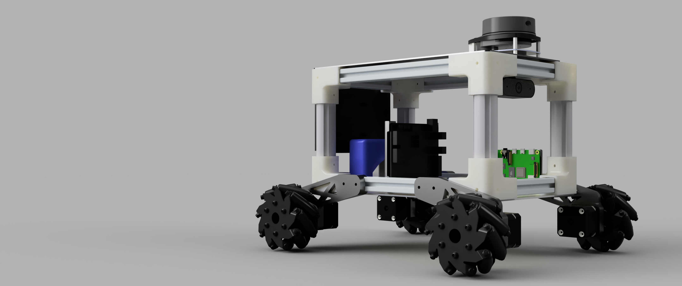
Mobile Robot Platform

