Slide 1

▌ UNCLASSIFIED ▐
WarriorFit
Digitizing Military Physical Fitness Testing
Benoit Goethals · May 2026
Shiny for Python · PostgreSQL · Async SQLAlchemy · Docker · Flet · FastAPI
WarriorFit · Benoit Goethals · May 2026
01 / 20

Slide 2
▌ UNCLASSIFIED ▐
Project Description
What WarriorFit is, and why it exists
WarriorFit is a comprehensive fitness and military management application designed to track physical performance, manage personnel data, and generate analytical reports. The system integrates data collection, statistical analysis, and reporting capabilities tailored for military fitness standards.
Each unit within Defence has a physical training cell aimed at preparing soldiers physically for operational deployment.
Annually, every soldier must complete the PHEF (Physical Fitness Evaluation Defence). In addition, combat units carry out functional and combat tests, while paracommandos must endure additional combat evaluations.
Currently, much of this process is manual, leading to inefficiency, errors, and administrative delays.
WarriorFit replaces paper, spreadsheets, and email with a single auditable platform.
WarriorFit · Benoit Goethals · May 2026
02 / 20

Slide 3
▌ UNCLASSIFIED ▐
The Problem
How military fitness testing works today — without WarriorFit
PTIs conduct annual fitness tests manually — paper forms, no central system
Results entered into spreadsheets, forwarded to HR by hand — error-prone and slow
Five different test types with different scoring rules managed completely separately
No centralized view: no unit dashboard, no trend analysis, no historical data
HR synchronization is fully manual — delays mean compliance gaps
No GDPR-compliant consent or data management process in place
Cross-country timing done on paper or basic apps — no integration with HR or analytics
WarriorFit · Benoit Goethals · May 2026
03 / 20

Slide 4
▌ UNCLASSIFIED ▐
The Solution
What the WarriorFit ecosystem delivers
ECOSYSTEM
WarriorFit (Shiny)
Web platform: test sessions, scoring, dashboards, reports, GDPR
Shiny Web
24 pages · RBAC
Mobile/desktop app for on-site race timing — syncs to shared DB
Flet Cross Client
Mailpit
SMTP trap
Flet Cross
Field timing
FastAPI Backend
REST API bridge between Flet and the shared PostgreSQL
WarriorFit
PostgreSQL
HR Simulator
FastAPI stub simulating BEMIL HRM — validates broker integration
Mailpit
SMTP trap for local dev — catches all outgoing email notifications
HR Simulator
BEMIL stub
FastAPI
REST + JWT
Live: https://test.warriorfit.bensoft.be/ · Cross client: https://clientcross.bensoft.be/ · Mail: https://mailstub.bensoft.be/
WarriorFit · Benoit Goethals · May 2026
04 / 20

Slide 5
▌ UNCLASSIFIED ▐
Who Uses It?
6 roles — RBAC enforced at every page route
Role
Who
What they can do
Admin
IT / Command staff
Full access: users, settings, audit logs, system health
PTI
Physical Training Instructor
Conduct tests, unit dashboard, generate PDF reports
APTI
Assistant PTI
Same as PTI — assist with sessions and reporting
Planner
Planning staff
Manage test session scheduling only
Guest
Unit officers
Read-only: unit overview, individual test history
User
Serviceman
Own history, PHEF chart, privacy self-service controls
WarriorFit · Benoit Goethals · May 2026
05 / 20

Slide 6
▌ UNCLASSIFIED ▐
Fitness Test Types
Five test categories — one unified platform
1
PHEF
2400 m run + side bridge (L & R) · scored by age/gender table · personal trend chart
2
Functional
Push-ups · sit-ups · pull-ups — scored by rep count with age/gender categories
3
Combat
Paratrooper: running time + obstacle course + rope events
4
March
Long-distance endurance (configurable km, default 30) · pass/fail + grade
5
Cross/Run
Full event lifecycle · Chronos XML bulk import · Flet field timer integration
WarriorFit · Benoit Goethals · May 2026
06 / 20

Slide 7
▌ UNCLASSIFIED ▐
Agile Methodology
User-story driven development — 20 epics, 80 stories, 231 story points
Story Point Scale
#
Epic
Pts
#
Epic
Pts
1 pt = 2–4 hours
1
User Management
18
11
Unit Dashboard
12
2 pts = 4–8 hours
2
Test Session Planning
15
12
Calendar Events
5
3 pts = 1–2 days
3
PHEF Test Input
18
13
Room Reservations
8
5 pts = 2–3 days
4
Combat Test Input
10
14
Audit Logs
5
5
Swimming Test Input
7
15
Welcome Dashboard
5
8 pts = 3–5 days
6
Functional Test Input
12
16
Application Settings
8
7
March Registration
13
17
Status Monitoring
5
8
Cross & Runs
28
18
Reports & Export
8
9
BEMIL Personnel Lookup
5
19
Security & Auth
7
10
Individual History
15
20
GDPR / Privacy
15
Total: 20 epics · 80 stories · 231 story points
All stories delivered — Sep 2025 → May 2026
WarriorFit · Benoit Goethals · May 2026
07 / 20

Slide 8
▌ UNCLASSIFIED ▐
User Story Example
Epic 3 · Story 3.1 — PHEF Test Entry [5 points]
Story Format
Linked Test Cases
As a
PTI
[x] Form shows all required fields (serial, SB-R, SB-L, run time)
I want to
enter a PHEF test result for a serviceman
[x] Invalid time format → error shown before submit
So that
the result is stored, scored, and forwarded to HR automatically
[x] Unknown serial → 'Confirm Serial' blocks Add button
Acceptance Criteria
[x] Score displayed live as values change
[x] Pass/fail calculated correctly for all age/gender groups
Serial number confirmed against BEMIL before entry
[x] DB row created with correct foreign keys after Add
Side bridge L/R and 2400 m run time fields required
[x] Broker message enqueued (mock HR call verified)
Live score shown per component during entry
[x] Audit log entry present after save
Pass: side-bridge total ≥ 20 pts AND run ≥ 10 pts
[ ] Email notification received in Mailpit
Audit log created on save
Email notification sent to PTI
HR message queued in broker (async, non-blocking)
WarriorFit · Benoit Goethals · May 2026
08 / 20

Slide 9
▌ UNCLASSIFIED ▐
Test Cases & Quality
1 500+ lines of test code · unit + integration coverage
Test File
Cases
Type
What is tested
test_phef_calculator.py
14
Unit
Age/gender scoring tables — side bridge + run time
test_Functional_calculator.py
~20
Unit
Pull-ups, push-ups, sit-ups scoring by age category
test_broker_unit.py
30+
Unit
Async queue, exponential backoff, dead-letter logic
test_application_config.py
25+
Unit
YAML config loading, DB URL, SMTP settings
test_read_xml_chronos_and_save.py
15+
Integration
Chronos XML import: XSD validation + DB persistence
0 mypy errors
Ruff compliant
black formatted
CI on every commit
Pre-commit hooks
Test strategy: calculators fully unit-tested · broker mocked (no DB) · XML import uses real async session
WarriorFit · Benoit Goethals · May 2026
09 / 20

Slide 10
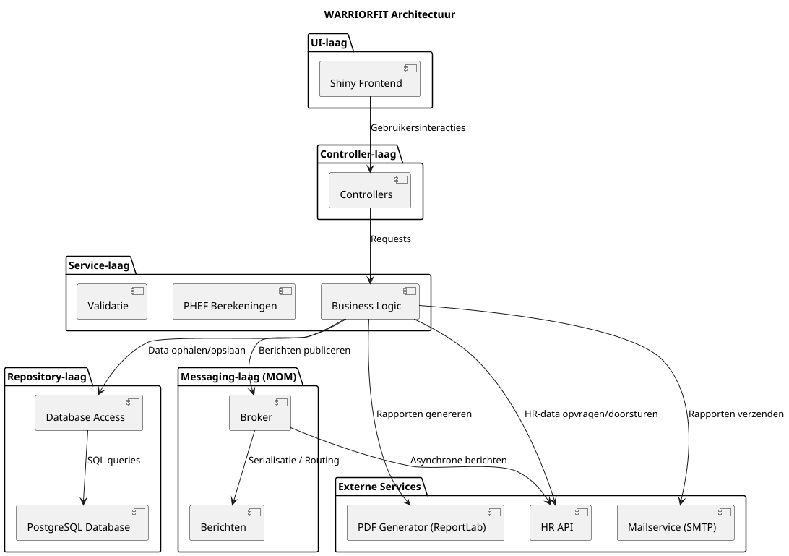
▌ UNCLASSIFIED ▐
Architecture Overview
Layered unidirectional dependency flow
WarriorFit · Benoit Goethals · May 2026
10 / 20

Slide 11
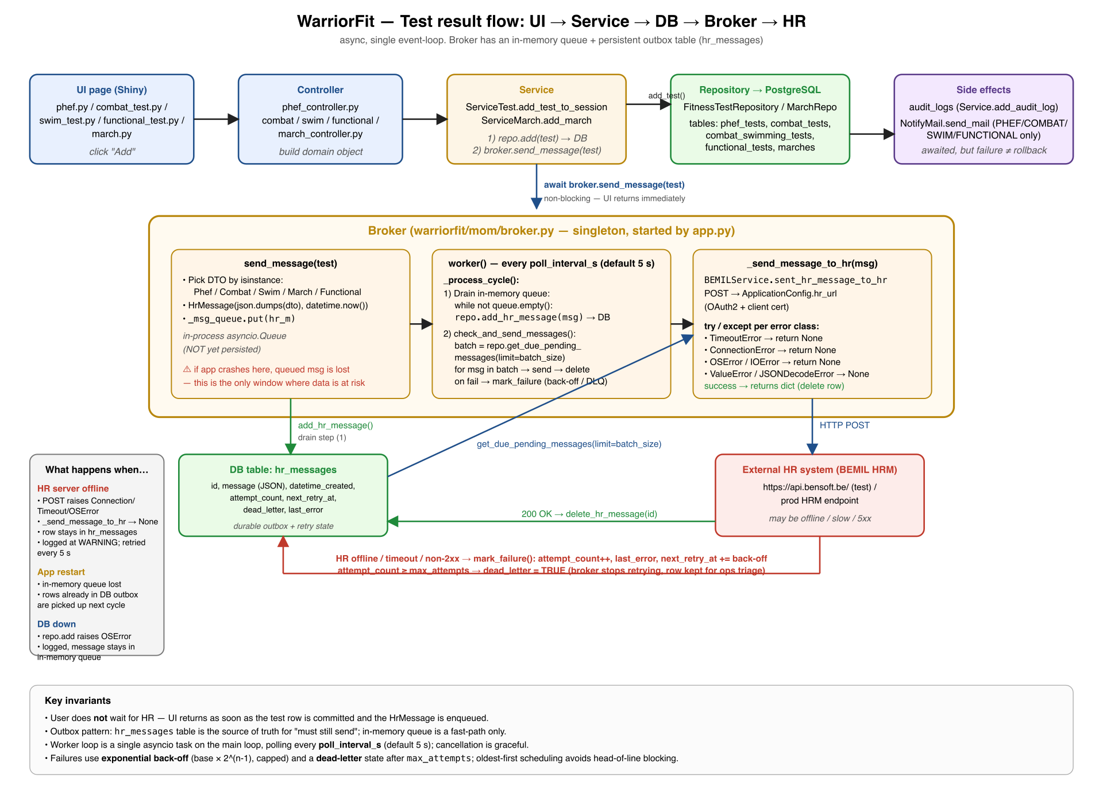
▌ UNCLASSIFIED ▐
PHEF Test Data Flow
From PTI form entry → DB → async Broker → HR system
WarriorFit · Benoit Goethals · May 2026
11 / 20

Slide 12
▌ UNCLASSIFIED ▐
PHEF Flow — Step by Step
Two parallel paths: synchronous save + async HR forwarding
1. PTI enters form
4. Broker (background)
Serial confirmed via BEMIL API
Writes to hr_messages table (durable outbox)
Live score calculated while typing
POSTs JSON to HR API every 5 seconds
Add button disabled until session + serial validated
Exponential backoff on failure (5 s → 10 min)
Dead-letter after 10 failed attempts
2. Controller layer
Validates time format (mm:ss)
Key invariants
Builds PhefTest domain object with scores
User never waits for HR — immediate feedback
Outbox survives app crash / HR outage
3. Service layer
Persists test to PostgreSQL (awaited)
HR offline → retried indefinitely
Hands DTO to Broker (non-blocking)
All steps logged in audit trail
Creates audit log + sends email
WarriorFit · Benoit Goethals · May 2026
12 / 20

Slide 13
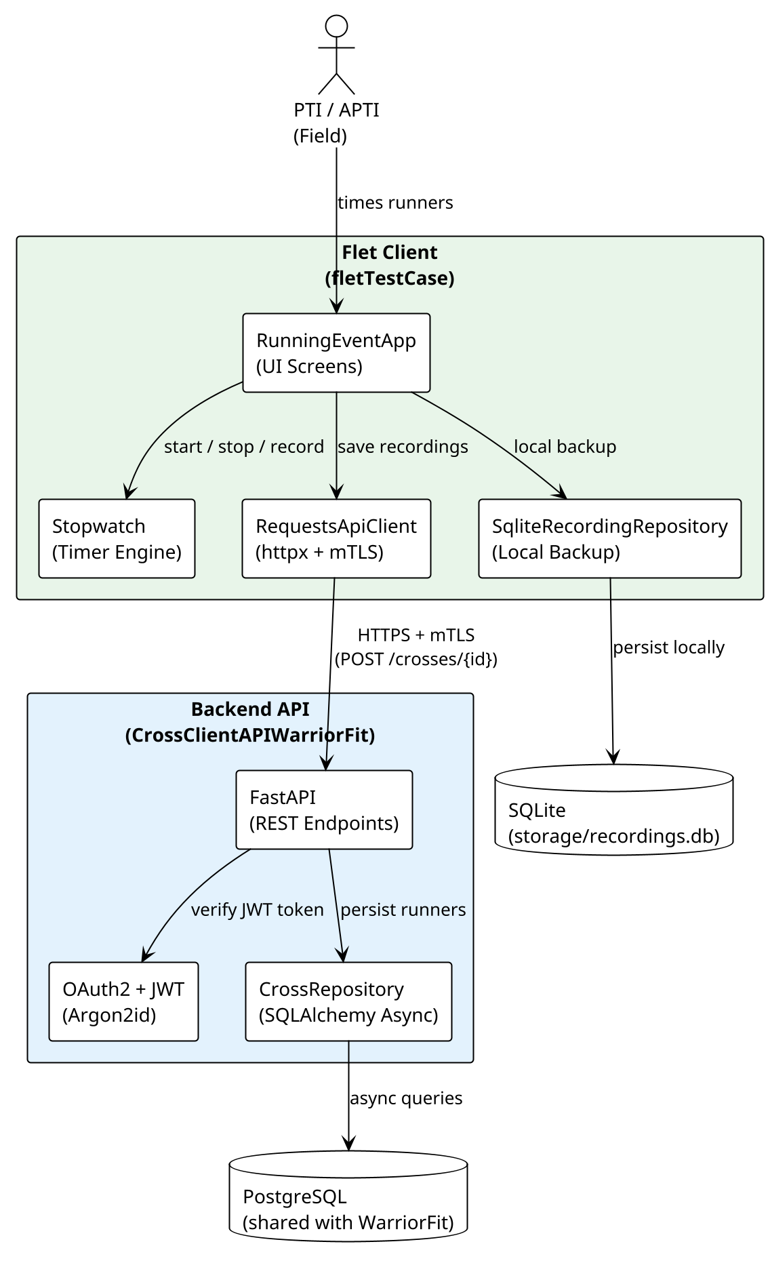
▌ UNCLASSIFIED ▐
Flet Cross Application
Three-component architecture for on-site race timing
Three Components
WarriorFit (Shiny)
Planning, cross session management, statistics dashboard
FastAPI Backend
REST API: JWT auth, runner CRUD, shared PostgreSQL
Flet Client
Mobile/desktop timer app — PTIs use it on the sports field
Field workflow
PTI creates session in WarriorFit (Cross Planning page)
PTI opens Flet app on tablet — selects session (JWT auth)
For each finisher: enter serial + time → POST /api/runners/
WarriorFit auto-shows updated results from shared PostgreSQL
PTI views top-10 + demographics in Cross Statistics page
clientcross.bensoft.be
WarriorFit · Benoit Goethals · May 2026
13 / 20

Slide 14
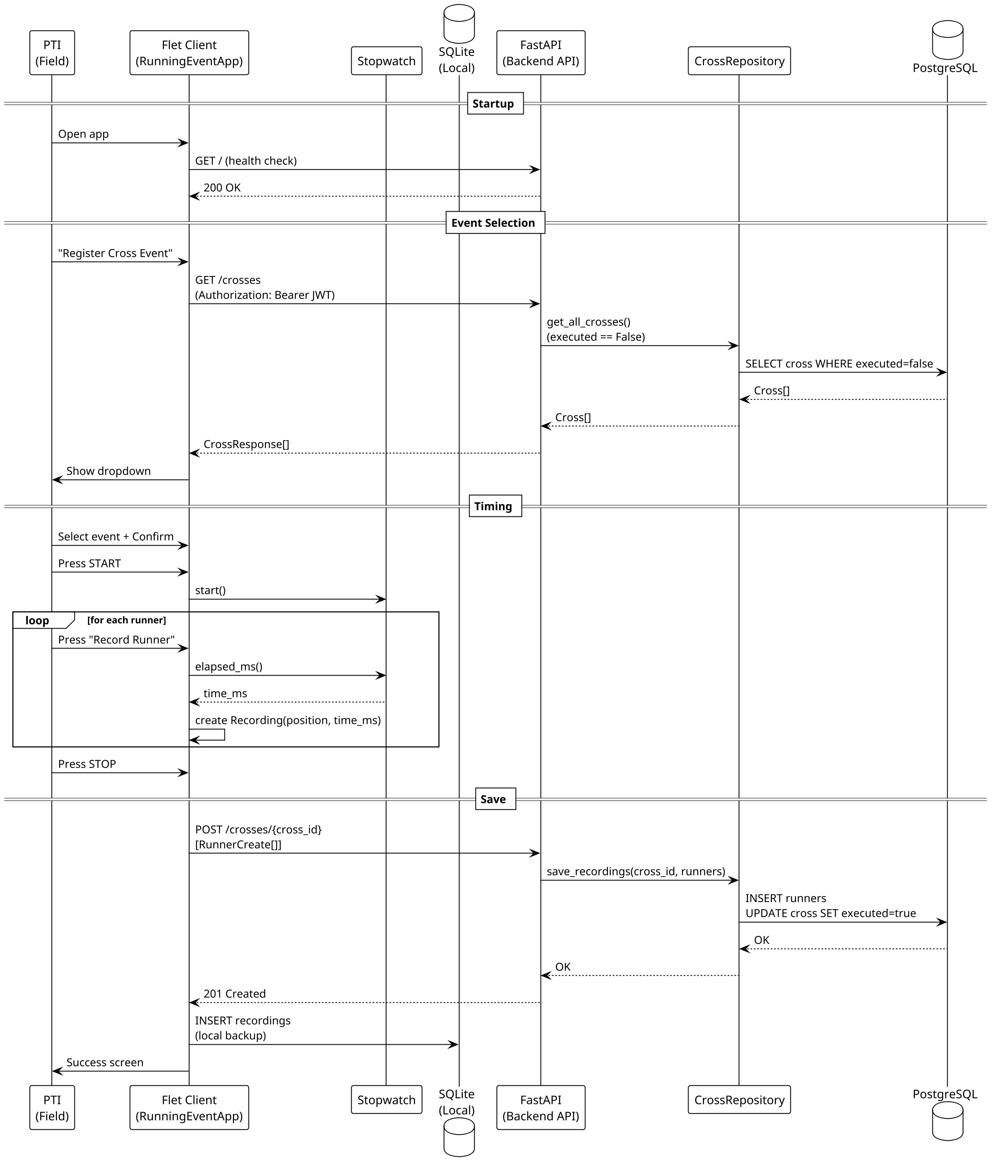
▌ UNCLASSIFIED ▐
Flet Client — Sequence Diagram
PTI flow: login → select event → time runners → save results
WarriorFit · Benoit Goethals · May 2026
14 / 20

Slide 15
▌ UNCLASSIFIED ▐
HR Simulator & Mailpit
Development infrastructure — test without touching real systems
HR Simulator (hr_fatapi_dummy.py)
Mailpit (SMTP trap for development)
FastAPI application mimicking the BEMIL HRM REST API
SMTP server on port 1025 at 192.168.0.30 — catches all emails
Web UI at https://mailstub.bensoft.be/ — inspect every message
Accepts POST /api/v1/phef/test with PhefTestDto JSON
No emails reach real recipients during development
Returns { success: true, ack: 'Message enqueued' }
Tests all WarriorFit notification types without sending real mail:
CORS configured for localhost:8005
PHEF / Combat / Swim / Functional test added
Validates broker → HR message pipeline end-to-end
March registration confirmation
In production: replace base URL in config.yml → real HR endpoint
Room reservation created or cancelled
{ "serial_number": "12345678", "running_time": 720.0, "sideBridge_r": 65.0, "sideBridge_l": 58.0, "timestamp": "2026-05-01T09:15:00" }
Test session created by PTI
WarriorFit config (dev): mail.host: 192.168.0.30 · port: 1025 · use_ssl: false
WarriorFit · Benoit Goethals · May 2026
15 / 20

Slide 16
▌ UNCLASSIFIED ▐
Tech Stack
Modern, async-first, production-hardened
Layer
Technology
Details
Language
Python 3.13+
Async-first · mypy strict · 21 800 lines
Web Framework
Shiny for Python
Reactive UI · 24 pages · DataGrids · modals
ORM
SQLAlchemy 2.0 async
AsyncSession · polymorphic STI · Alembic migrations
Database
PostgreSQL + asyncpg
Pool: size=20, max_overflow=30 · TLS in prod
Charts
Plotly
Interactive dashboards · auto-resize on tab switch
DI
dependency-injector
DeclarativeContainer · 40+ wired singletons
Security
Argon2id
Memory-hard hashing · 10-min session timeout · RBAC
Field App
Flet
Mobile/desktop cross-country timer app
API
FastAPI
REST backend for Flet · JWT auth · Uvicorn
Dev Tools
Mailpit + HR Simulator
SMTP trap + BEMIL API stub for local testing
CI/CD
GitHub Actions + Docker
Ruff · black · mypy · Docker image · Nginx HTTPS
WarriorFit · Benoit Goethals · May 2026
16 / 20

Slide 17
▌ UNCLASSIFIED ▐
Development Journey
Agile — 4 phases, continuous delivery, 946 commits
Sep–Oct 2025
Phase 1: Prototype
Flat structure · god-class DBService · monolithic pages · first test types
Oct–Dec 2025
Phase 2: Feature Growth
Business logic extraction · RBAC · calculators · config management · March/Cross
Dec 2025–Feb 2026
Phase 3: Architecture
DI container · layered design · async sessions · audit logging · Flet cross app
Feb–May 2026
Phase 4: Hardening
CI/CD · Docker · mypy strict · GDPR · security · HR simulator · Mailpit
946 commits
21 800 lines
80 user stories
231 story points
0 mypy errors
All stories done
WarriorFit · Benoit Goethals · May 2026
17 / 20

Slide 18
▌ UNCLASSIFIED ▐
Security Highlights
Defence-grade from day one
✓
Argon2id password hashing
OWASP-recommended memory-hard algorithm, tuned for production hardware
✓
Session auto-logout
10-minute inactivity timeout with server-side session invalidation
✓
RBAC at every route
allowed_roles guard on every PageSpec — no client-side trust
✓
Full audit trail
Login attempts, failures, data access — all logged with IP address
✓
PostgreSQL TLS
sslmode=verify-full in production — certificate validation enforced
✓
No secrets in Docker image
WF_SECRET_KEY and DB credentials injected at runtime via environment
✓
OWASP Top 10 assessment
Completed and documented in SECURITY.md
WarriorFit · Benoit Goethals · May 2026
18 / 20

Slide 19
▌ UNCLASSIFIED ▐
What's Next
Vision beyond the current release
Mobile-responsive layout
Optimized for tablets used on the sports field
Offline mode
Service worker for result capture without connectivity
Notification system
Email alerts for expiring test deadlines and overdue sessions
Multi-unit / battalion view
Aggregated command-level dashboards across units
Live HR integration
Connect broker to real BEMIL HR API endpoint
Extended test types
Additional Belgian Defence-specific evaluations
WarriorFit · Benoit Goethals · May 2026
19 / 20

Slide 20
▌ UNCLASSIFIED ▐
Questions?
Benoit Goethals
benoit.goethals@gmail.com
WarriorFit: https://test.warriorfit.bensoft.be/
Cross client: https://clientcross.bensoft.be/
Mailpit: https://mailstub.bensoft.be/
Demo video: https://youtu.be/wZveSgpKTf8
WarriorFit · Benoit Goethals · May 2026
20 / 20

