Slide 1
WarriorFit
Digitizing Military Physical Fitness Testing
Benoit Goethals · May 2026
Shiny for Python · PostgreSQL · Async SQLAlchemy · Docker · Flet · FastAPI

Slide 2
The Problem
How military fitness testing works today — without WarriorFit
PTIs conduct annual fitness tests manually — paper forms, no central system
Results entered into spreadsheets, forwarded to HR by hand — error-prone and slow
Five different test types with different scoring rules managed completely separately
No centralized view: no unit dashboard, no trend analysis, no historical data
HR synchronization is fully manual — delays mean compliance gaps
No GDPR-compliant consent or data management process in place
Cross-country timing done on paper or basic apps — no integration with HR or analytics

Slide 3
The Solution
What the WarriorFit ecosystem delivers
WarriorFit (Shiny)
Web platform: test sessions, scoring, dashboards, reports, GDPR
Flet Cross Client
Mobile/desktop app for on-site race timing — syncs to shared DB
FastAPI Backend
REST API bridge between Flet and the shared PostgreSQL
HR Simulator
FastAPI stub simulating BEMIL HRM — validates broker integration
Mailpit
SMTP trap for local dev — catches all outgoing email notifications
Live: https://test.warriorfit.bensoft.be/ · Cross client: https://clientcross.bensoft.be/ · Mail: https://mailstub.bensoft.be/

Slide 4
Who Uses It?
6 roles — RBAC enforced at every page route
Role
Who
What they can do
Admin
IT / Command staff
Full access: users, settings, audit logs, system health
PTI
Physical Training Instructor
Conduct tests, unit dashboard, generate PDF reports
APTI
Assistant PTI
Same as PTI — assist with sessions and reporting
Planner
Planning staff
Manage test session scheduling only
Guest
Unit officers
Read-only: unit overview, individual test history
User
Serviceman
Own history, PHEF chart, privacy self-service controls

Slide 5
Fitness Test Types
Five test categories — one unified platform
1
PHEF
2400 m run + side bridge (L & R) · scored by age/gender table · personal trend chart
2
Functional
Push-ups · sit-ups · pull-ups — scored by rep count with age/gender categories
3
Combat
Paratrooper: running time + obstacle course + rope events
4
March
Long-distance endurance (configurable km, default 30) · pass/fail + grade
5
Cross/Run
Full event lifecycle · Chronos XML bulk import · Flet field timer integration

Slide 6
Agile Methodology
User-story driven development — 20 epics, 80 stories, 231 story points
Story Point Scale
#
Epic
Pts
#
Epic
Pts
1 pt = 2–4 hours
1
User Management
18
11
Unit Dashboard
12
2 pts = 4–8 hours
2
Test Session Planning
15
12
Calendar Events
5
3 pts = 1–2 days
3
PHEF Test Input
18
13
Room Reservations
8
5 pts = 2–3 days
4
Combat Test Input
10
14
Audit Logs
5
5
Swimming Test Input
7
15
Welcome Dashboard
5
8 pts = 3–5 days
6
Functional Test Input
12
16
Application Settings
8
7
March Registration
13
17
Status Monitoring
5
8
Cross & Runs
28
18
Reports & Export
8
9
BEMIL Personnel Lookup
5
19
Security & Auth
7
10
Individual History
15
20
GDPR / Privacy
15
Total: 20 epics · 80 stories · 231 story points
All stories delivered — Sep 2025 → May 2026

Slide 7
User Story Example
Epic 3 · Story 3.1 — PHEF Test Entry [5 points]
Story Format
Linked Test Cases
As a
PTI
[x] Form shows all required fields (serial, SB-R, SB-L, run time)
I want to
enter a PHEF test result for a serviceman
[x] Invalid time format → error shown before submit
So that
the result is stored, scored, and forwarded to HR automatically
[x] Unknown serial → 'Confirm Serial' blocks Add button
Acceptance Criteria
[x] Score displayed live as values change
[x] Pass/fail calculated correctly for all age/gender groups
Serial number confirmed against BEMIL before entry
[x] DB row created with correct foreign keys after Add
Side bridge L/R and 2400 m run time fields required
[x] Broker message enqueued (mock HR call verified)
Live score shown per component during entry
[x] Audit log entry present after save
Pass: side-bridge total ≥ 20 pts AND run ≥ 10 pts
[ ] Email notification received in Mailpit
Audit log created on save
Email notification sent to PTI
HR message queued in broker (async, non-blocking)

Slide 8
Test Cases & Quality
1 500+ lines of test code · unit + integration coverage
Test File
Cases
Type
What is tested
test_phef_calculator.py
14
Unit
Age/gender scoring tables — side bridge + run time
test_Functional_calculator.py
~20
Unit
Pull-ups, push-ups, sit-ups scoring by age category
test_broker_unit.py
30+
Unit
Async queue, exponential backoff, dead-letter logic
test_application_config.py
25+
Unit
YAML config loading, DB URL, SMTP settings
test_read_xml_chronos_and_save.py
15+
Integration
Chronos XML import: XSD validation + DB persistence
0 mypy errors
Ruff compliant
black formatted
CI on every commit
Pre-commit hooks
Test strategy: calculators fully unit-tested · broker mocked (no DB) · XML import uses real async session

Slide 9
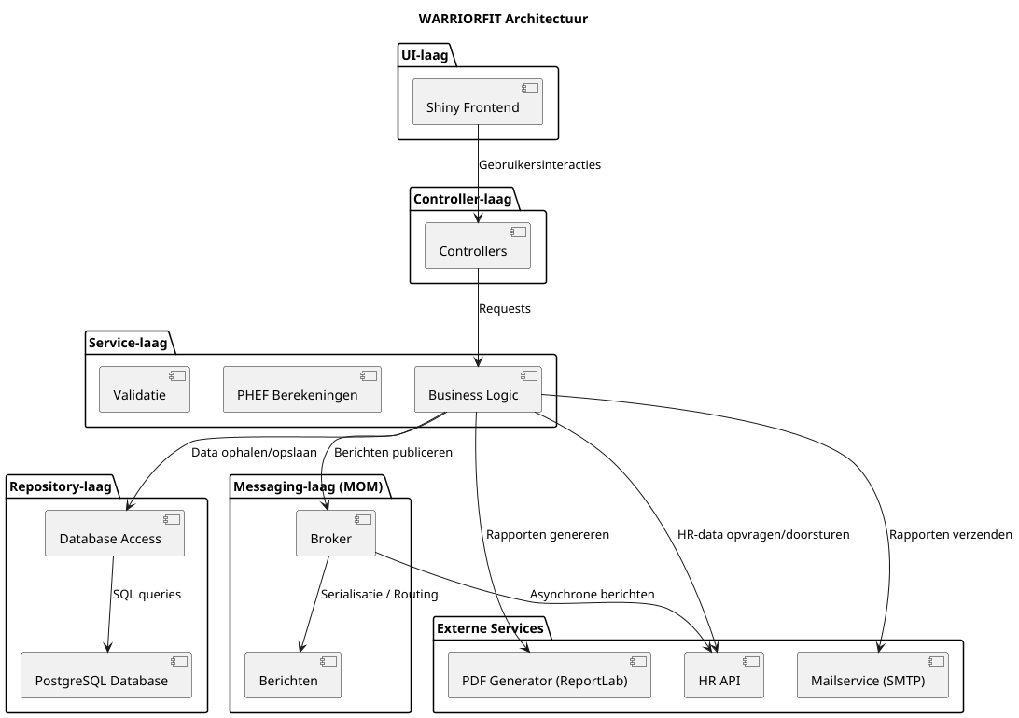
Architecture Overview
Layered unidirectional dependency flow

Slide 10
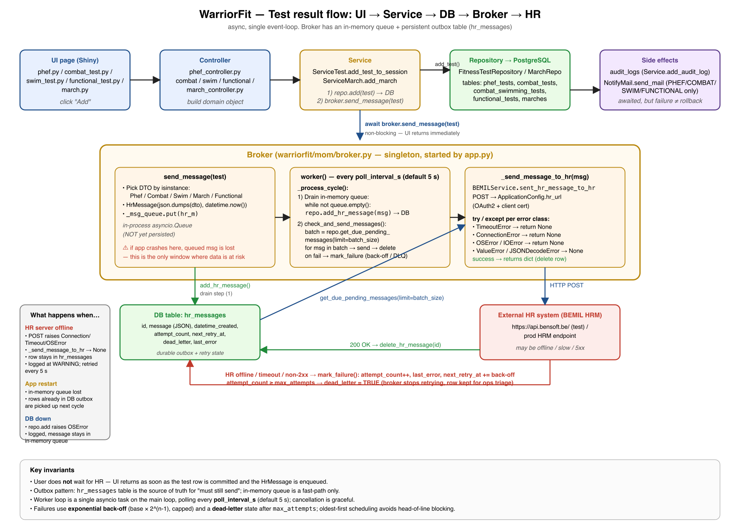
PHEF Test Data Flow
From PTI form entry → DB → async Broker → HR system

Slide 11
PHEF Flow — Step by Step
Two parallel paths: synchronous save + async HR forwarding
1. PTI enters form
4. Broker (background)
Serial confirmed via BEMIL API
Writes to hr_messages table (durable outbox)
Live score calculated while typing
POSTs JSON to HR API every 5 seconds
Add button disabled until session + serial validated
Exponential backoff on failure (5 s → 10 min)
Dead-letter after 10 failed attempts
2. Controller layer
Validates time format (mm:ss)
Key invariants
Builds PhefTest domain object with scores
User never waits for HR — immediate feedback
Outbox survives app crash / HR outage
3. Service layer
Persists test to PostgreSQL (awaited)
HR offline → retried indefinitely
Hands DTO to Broker (non-blocking)
All steps logged in audit trail
Creates audit log + sends email

Slide 12
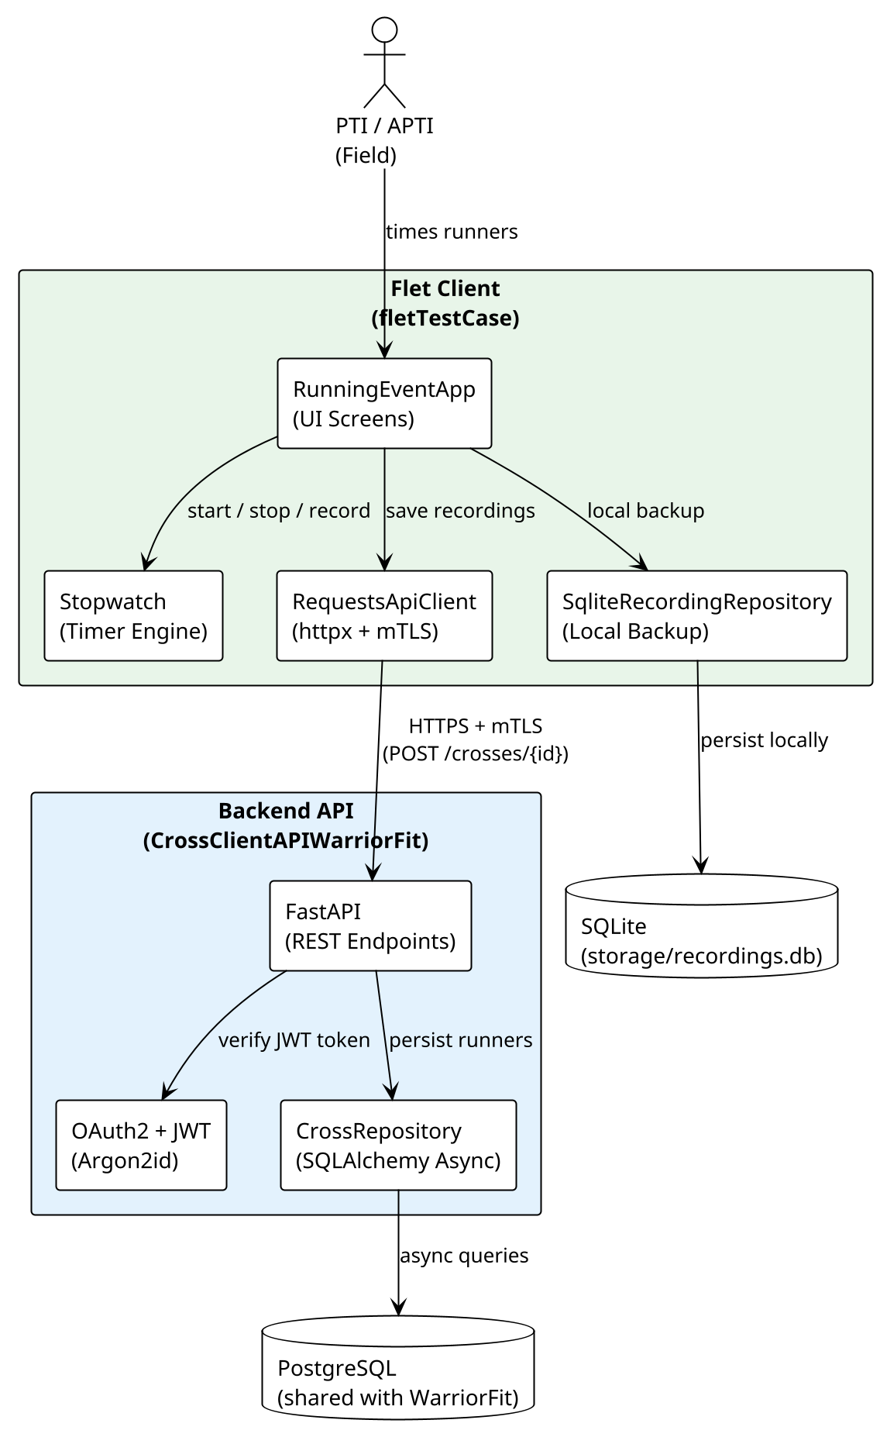
Flet Cross Application
Three-component architecture for on-site race timing
Three Components
WarriorFit (Shiny)
Planning, cross session management, statistics dashboard
FastAPI Backend
REST API: JWT auth, runner CRUD, shared PostgreSQL
Flet Client
Mobile/desktop timer app — PTIs use it on the sports field
Field workflow
PTI creates session in WarriorFit (Cross Planning page)
PTI opens Flet app on tablet — selects session (JWT auth)
For each finisher: enter serial + time → POST /api/runners/
WarriorFit auto-shows updated results from shared PostgreSQL
PTI views top-10 + demographics in Cross Statistics page
clientcross.bensoft.be

Slide 13
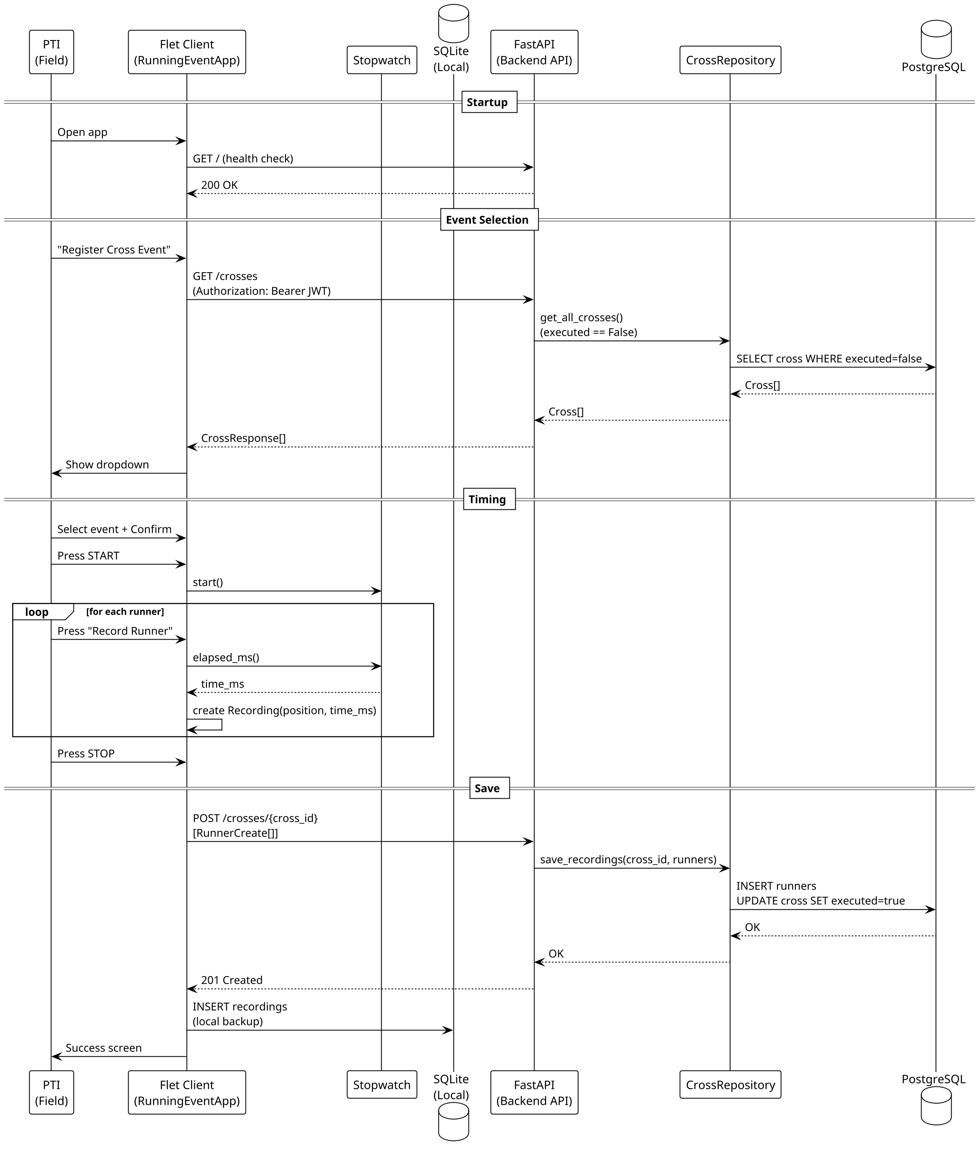
Flet Client — Sequence Diagram
PTI flow: login → select event → time runners → save results

Slide 14
HR Simulator & Mailpit
Development infrastructure — test without touching real systems
HR Simulator (hr_fatapi_dummy.py)
Mailpit (SMTP trap for development)
FastAPI application mimicking the BEMIL HRM REST API
SMTP server on port 1025 at 192.168.0.30 — catches all emails
Web UI at https://mailstub.bensoft.be/ — inspect every message
Accepts POST /api/v1/phef/test with PhefTestDto JSON
No emails reach real recipients during development
Returns { success: true, ack: 'Message enqueued' }
Tests all WarriorFit notification types without sending real mail:
CORS configured for localhost:8005
PHEF / Combat / Swim / Functional test added
Validates broker → HR message pipeline end-to-end
March registration confirmation
In production: replace base URL in config.yml → real HR endpoint
Room reservation created or cancelled
{ "serial_number": "12345678", "running_time": 720.0, "sideBridge_r": 65.0, "sideBridge_l": 58.0, "timestamp": "2026-05-01T09:15:00" }
Test session created by PTI
WarriorFit config (dev): mail.host: 192.168.0.30 · port: 1025 · use_ssl: false

Slide 15
Tech Stack
Modern, async-first, production-hardened
Layer
Technology
Details
Language
Python 3.13+
Async-first · mypy strict · 21 800 lines
Web Framework
Shiny for Python
Reactive UI · 24 pages · DataGrids · modals
ORM
SQLAlchemy 2.0 async
AsyncSession · polymorphic STI · Alembic migrations
Database
PostgreSQL + asyncpg
Pool: size=20, max_overflow=30 · TLS in prod
Charts
Plotly
Interactive dashboards · auto-resize on tab switch
DI
dependency-injector
DeclarativeContainer · 40+ wired singletons
Security
Argon2id
Memory-hard hashing · 10-min session timeout · RBAC
Field App
Flet
Mobile/desktop cross-country timer app
API
FastAPI
REST backend for Flet · JWT auth · Uvicorn
Dev Tools
Mailpit + HR Simulator
SMTP trap + BEMIL API stub for local testing
CI/CD
GitHub Actions + Docker
Ruff · black · mypy · Docker image · Nginx HTTPS

Slide 16
Development Journey
Agile — 4 phases, continuous delivery, 946 commits
Sep–Oct 2025
Phase 1: Prototype
Flat structure · god-class DBService · monolithic pages · first test types
Oct–Dec 2025
Phase 2: Feature Growth
Business logic extraction · RBAC · calculators · config management · March/Cross
Dec 2025–Feb 2026
Phase 3: Architecture
DI container · layered design · async sessions · audit logging · Flet cross app
Feb–May 2026
Phase 4: Hardening
CI/CD · Docker · mypy strict · GDPR · security · HR simulator · Mailpit
946 commits
21 800 lines
80 user stories
231 story points
0 mypy errors
All stories done

Slide 17
Security Highlights
Defence-grade from day one
✓
Argon2id password hashing
OWASP-recommended memory-hard algorithm, tuned for production hardware
✓
Session auto-logout
10-minute inactivity timeout with server-side session invalidation
✓
RBAC at every route
allowed_roles guard on every PageSpec — no client-side trust
✓
Full audit trail
Login attempts, failures, data access — all logged with IP address
✓
PostgreSQL TLS
sslmode=verify-full in production — certificate validation enforced
✓
No secrets in Docker image
WF_SECRET_KEY and DB credentials injected at runtime via environment
✓
OWASP Top 10 assessment
Completed and documented in SECURITY.md

Slide 18
What's Next
Vision beyond the current release
Mobile-responsive layout
Optimized for tablets used on the sports field
Offline mode
Service worker for result capture without connectivity
Notification system
Email alerts for expiring test deadlines and overdue sessions
Multi-unit / battalion view
Aggregated command-level dashboards across units
Live HR integration
Connect broker to real BEMIL HR API endpoint
Extended test types
Additional Belgian Defence-specific evaluations

Slide 19
Questions?
Benoit Goethals
benoit.goethals@gmail.com
WarriorFit: https://test.warriorfit.bensoft.be/
Cross client: https://clientcross.bensoft.be/
Mailpit: https://mailstub.bensoft.be/
Demo video: https://youtu.be/wZveSgpKTf8

