Slide 1
Economic Growth and Inequality in England and Great Britain (1270–1870)
From Plague to Prosperity: Who Benefited?
(Chosen audience: non-technical stakeholders)

Slide 2
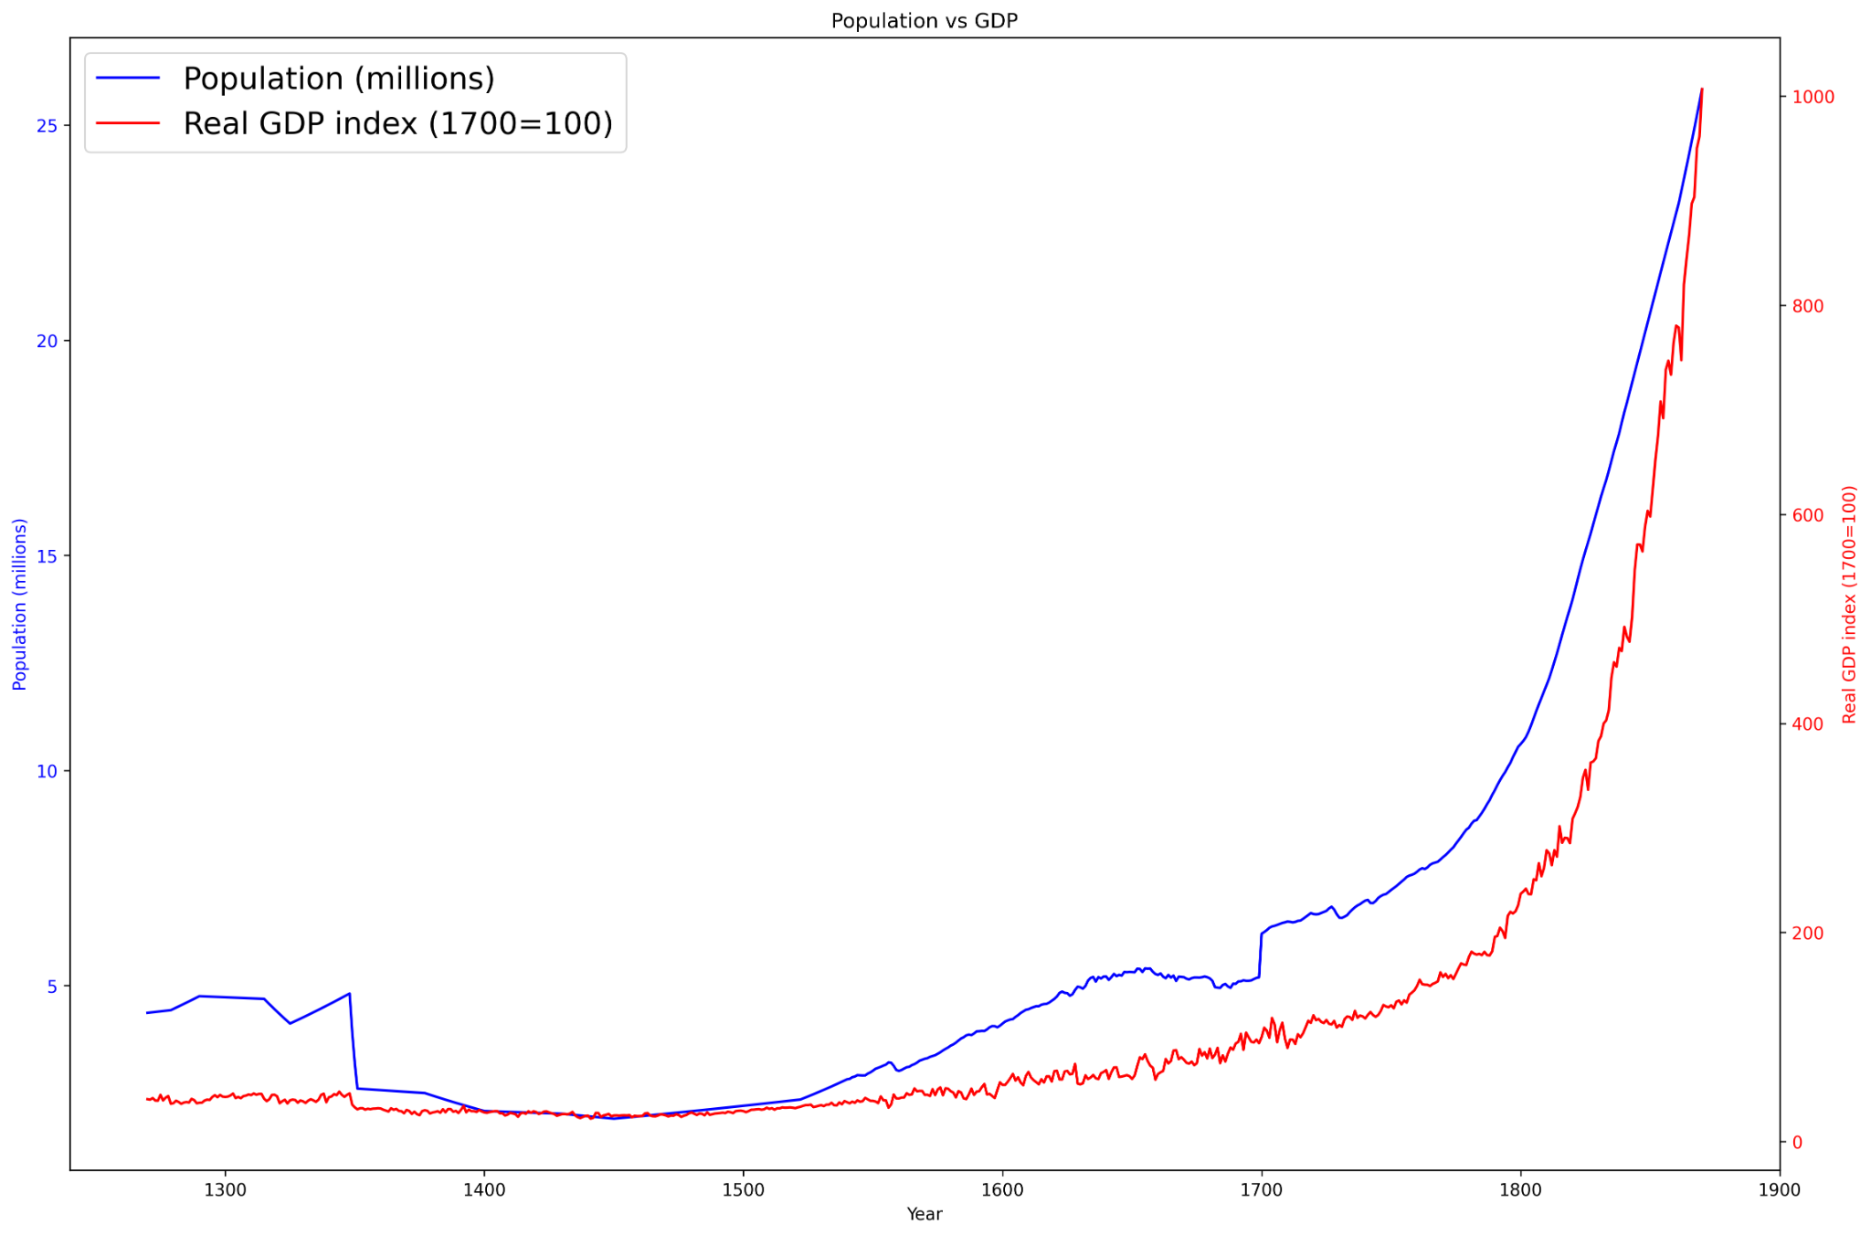
Historical Foundations and Takeoff
After 1700 = exponential growth.
Union Jack and Bank of England.
Unified internal market.
Public confidence.
Greater opportunities.

Slide 3
Extensive Growth Pre-1750
Population and GDP tracked each other closely until 1750.
Early economic growth = fueled by more people.

Slide 4
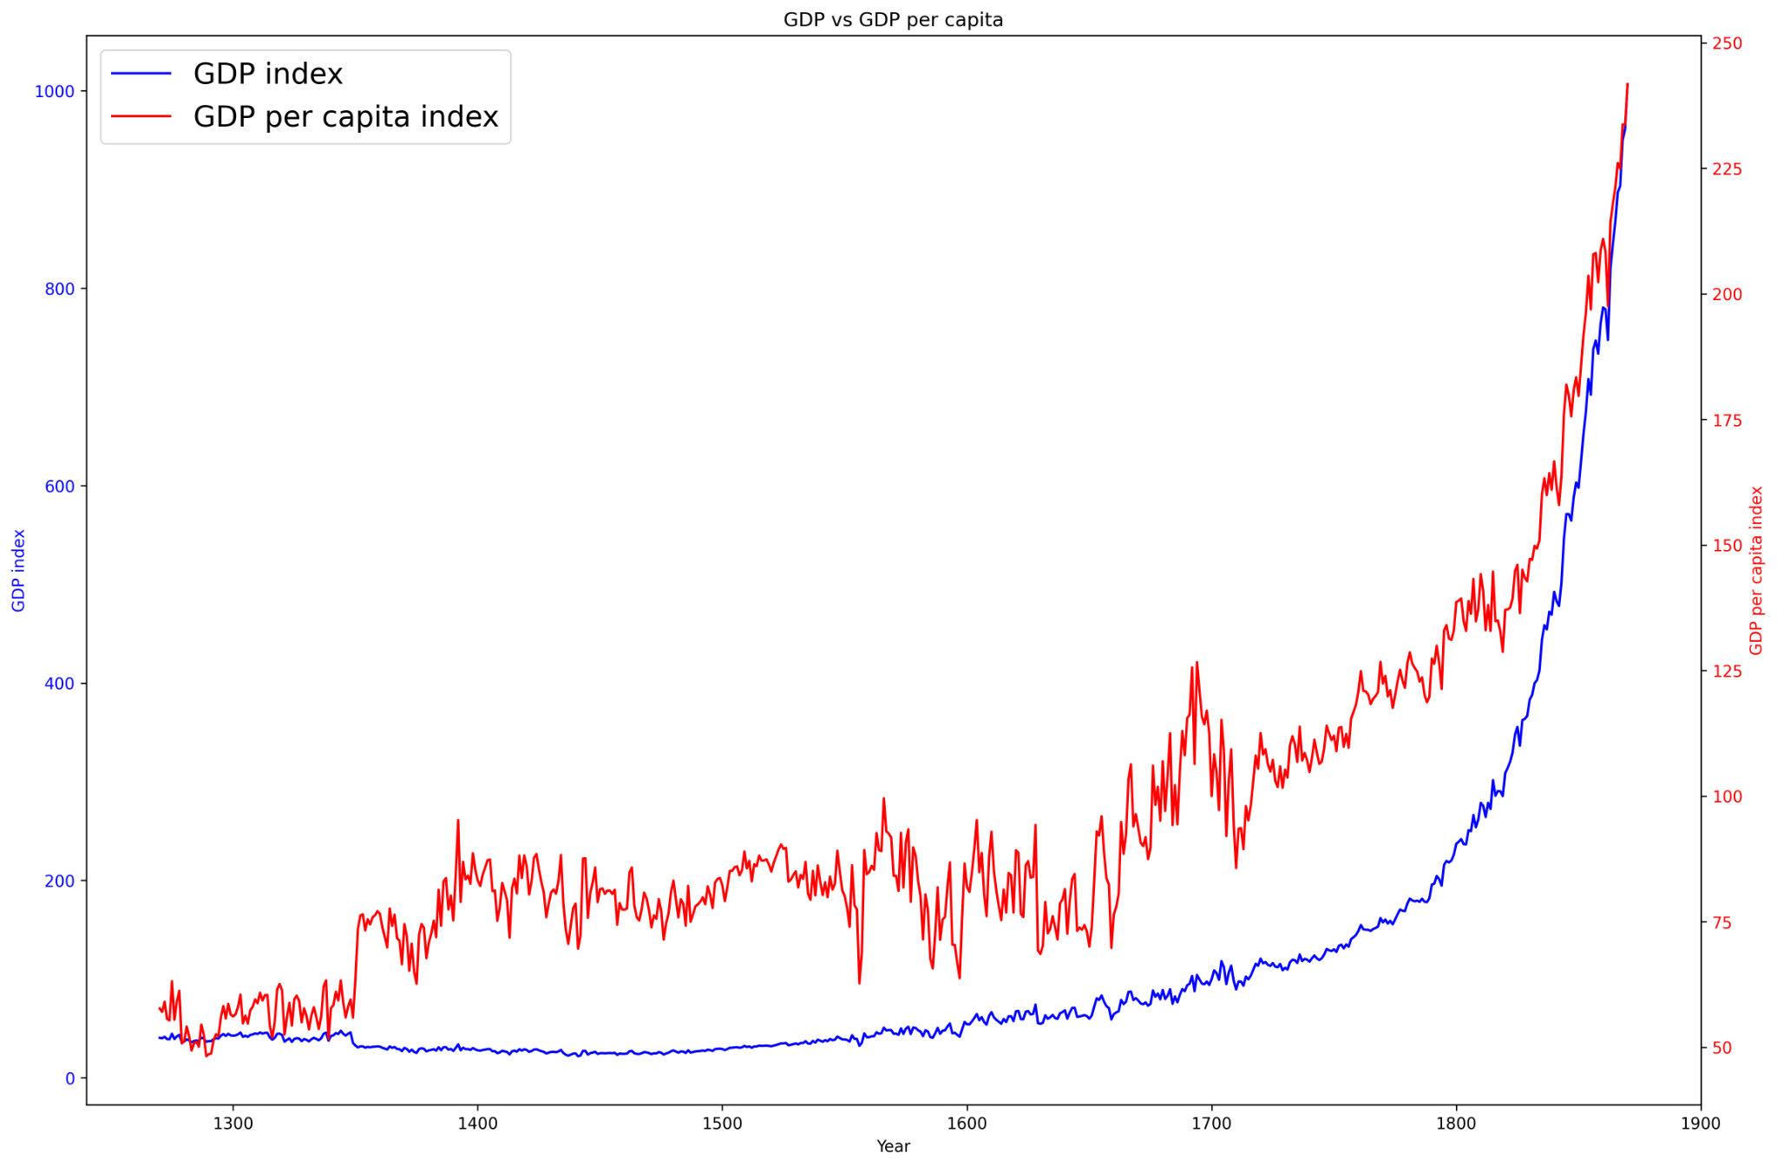
Industrial Revolution and Productivity Surge
1750 = Industrial Revolution.
After 1750, GDP per capita = rise.
Productivity-driven growth.

Slide 5
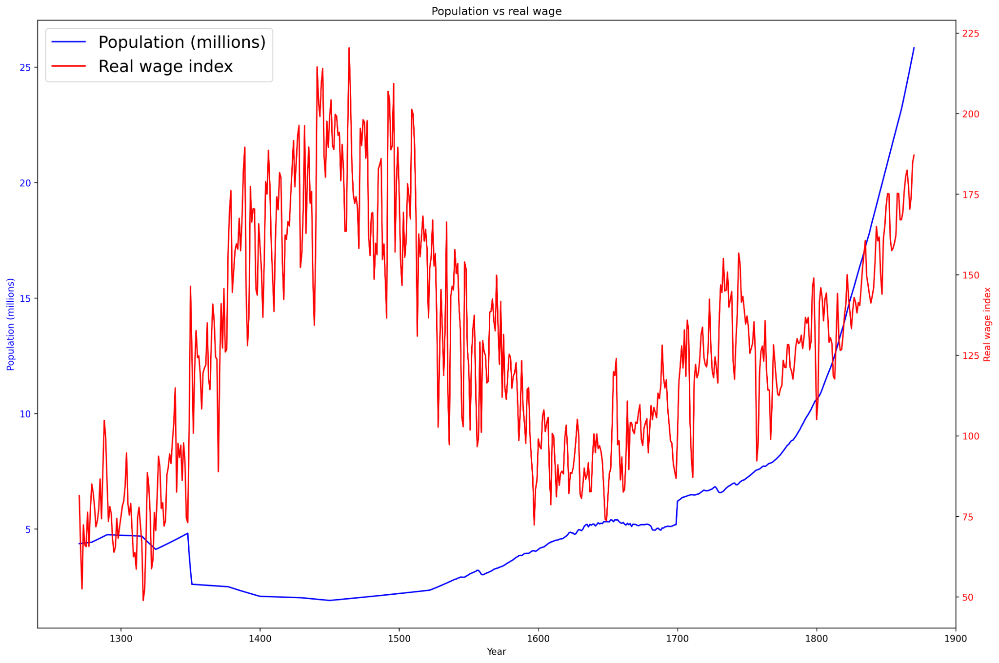
Labor, Plague, and Wages
1350 = Black death.
1450 = Underpopulated.
Fewer workers + more assets = Leverage.
Post-1450: More people, lower wages.
Late 19th century = equivalent real wages.

Slide 6
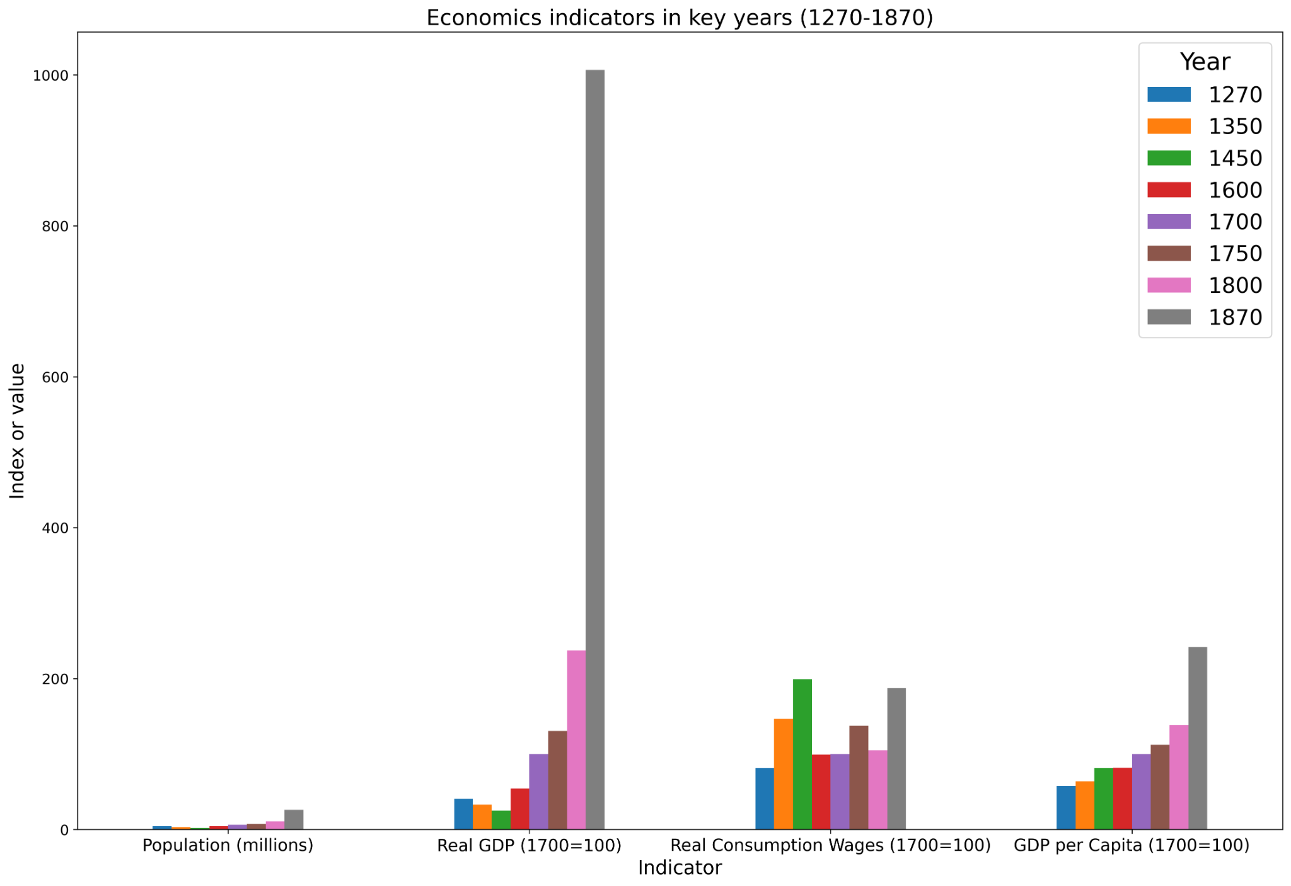
A Disconnect Between Output and Wages
GDP soared 25X.
Wages barely moved.
1450 ≈ 1870 pay.
Wealth ≠ well-being.
Growth without gain.

Slide 7
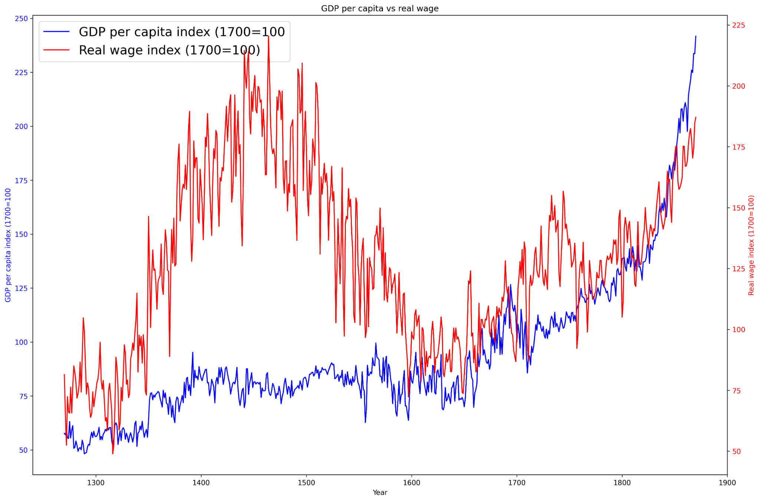
Divergence and Inequality
1750: Wealth split.
GDP rose sharply.
Wages lagged behind.
Inequality increased fast.
Worker gains limited.

Slide 8
Malthus Pressure
1450–1700: Wages fall, population rises.
Post-plague boom: Fewer workers, higher pay.
Recovery era: Labor surplus returns.
1450–1700: Productivity stagnant.
Result: Wages decline

Slide 9
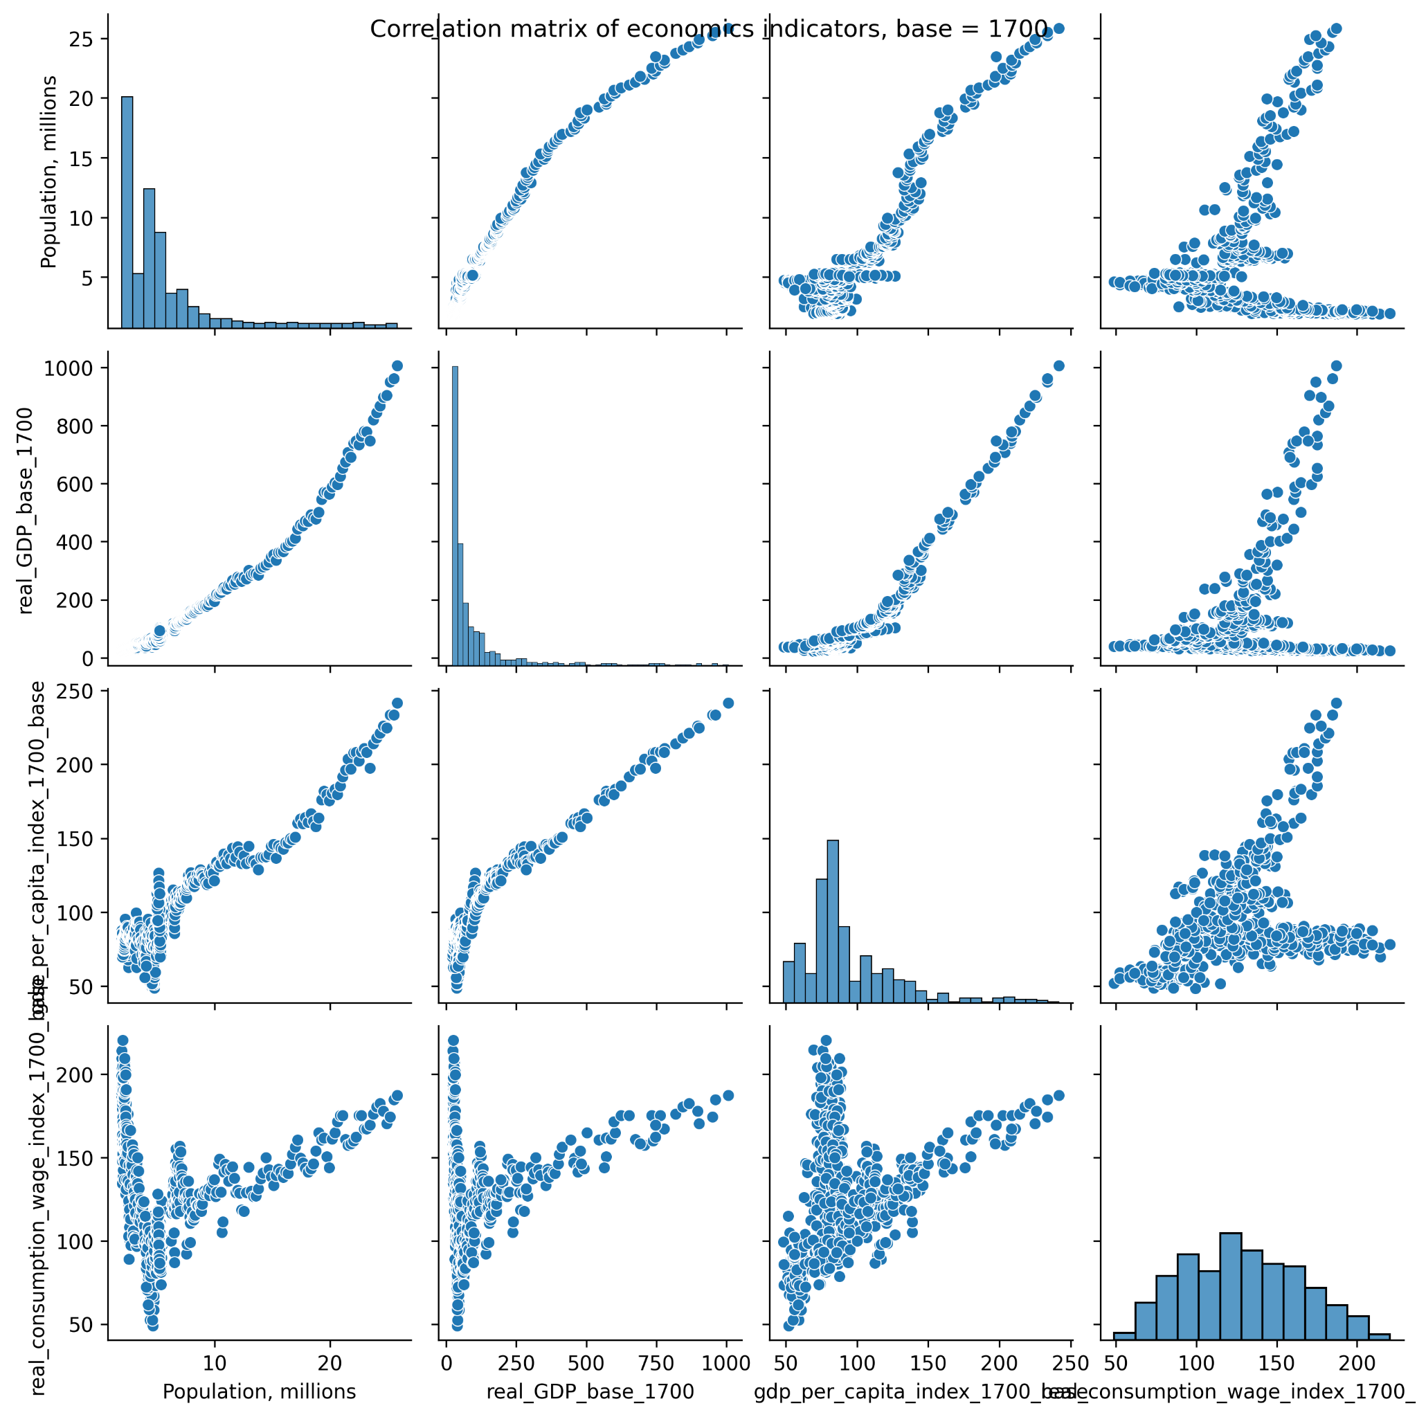
Correlation Analysis
1270-1870: GDP/population correlated.
Post-1750: GDP/capita rises.
Entire period: Wages uncorrelated.
Growth ≠ well-being.
Matrix proves disconnection.

Slide 10
Conclusion – A Disturbing Reality
1450: Gains through death
(Post-plague scarcity raised wages)
1870: Gains through delay & exploitation
(Growth followed long industrial hardship)
Progress ≠ Prosperity
(Living standards rose only under strain)
Wealth via tragedy
(Either mortality or exploitation fueled improvement)
Question remains:
“Did death lift the poor, or did inequality hold them down?”

