Slide 1
Capstone Two Presentation
Can machine learning help cities cut through the red tape of building permits?
Classifying Permit Types from San Francisco Building Permit Data Using Machine Learning
Benoit Loze
18/07/2025

Slide 2
Problem Statement
Goal: Classify SF building permit types using structured features.
Success Criteria: ≥80% accuracy.
Scope: Supervised classification.
Constraints: Missing data, class imbalance, feature engineering.

Slide 3
Data Wrangling
Reviewed dataset (2013–2018), removed high-null columns.
Imputed missing values.
Converted date types and fixed categorical features.
Saved cleaned CSV for next steps.

Slide 4
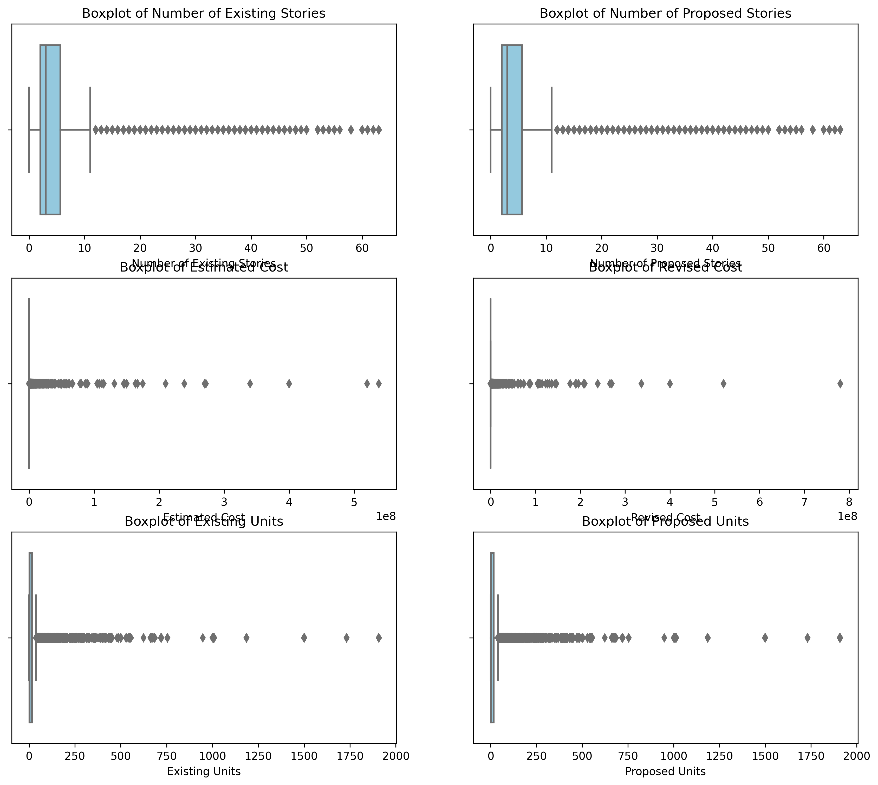
Outliers and Redundancies
Identified outliers in numeric features.
Visualized with boxplots and histograms.
Removed redundant features and logged partial duplicates.

Slide 5
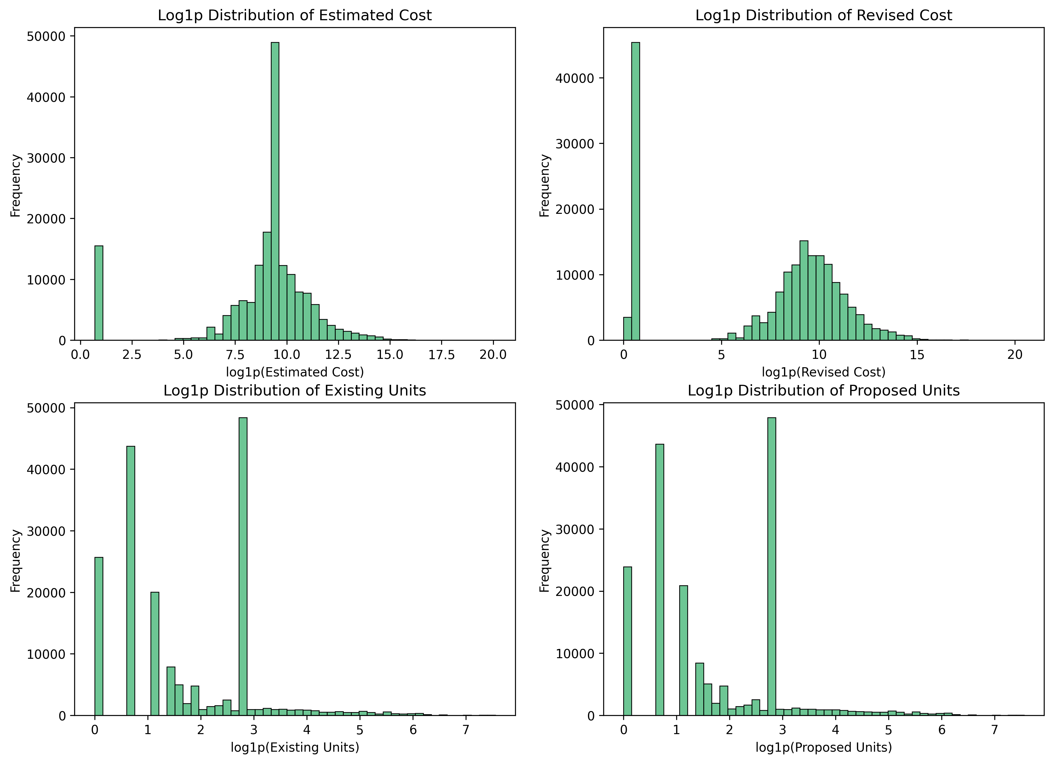
EDA Overview
Normalized skewed variables with log1p.
Split data by high-rise vs low-rise.
Feature significance tested (p<0.05).
Dropped collinear features to improve model reliability.

Slide 6
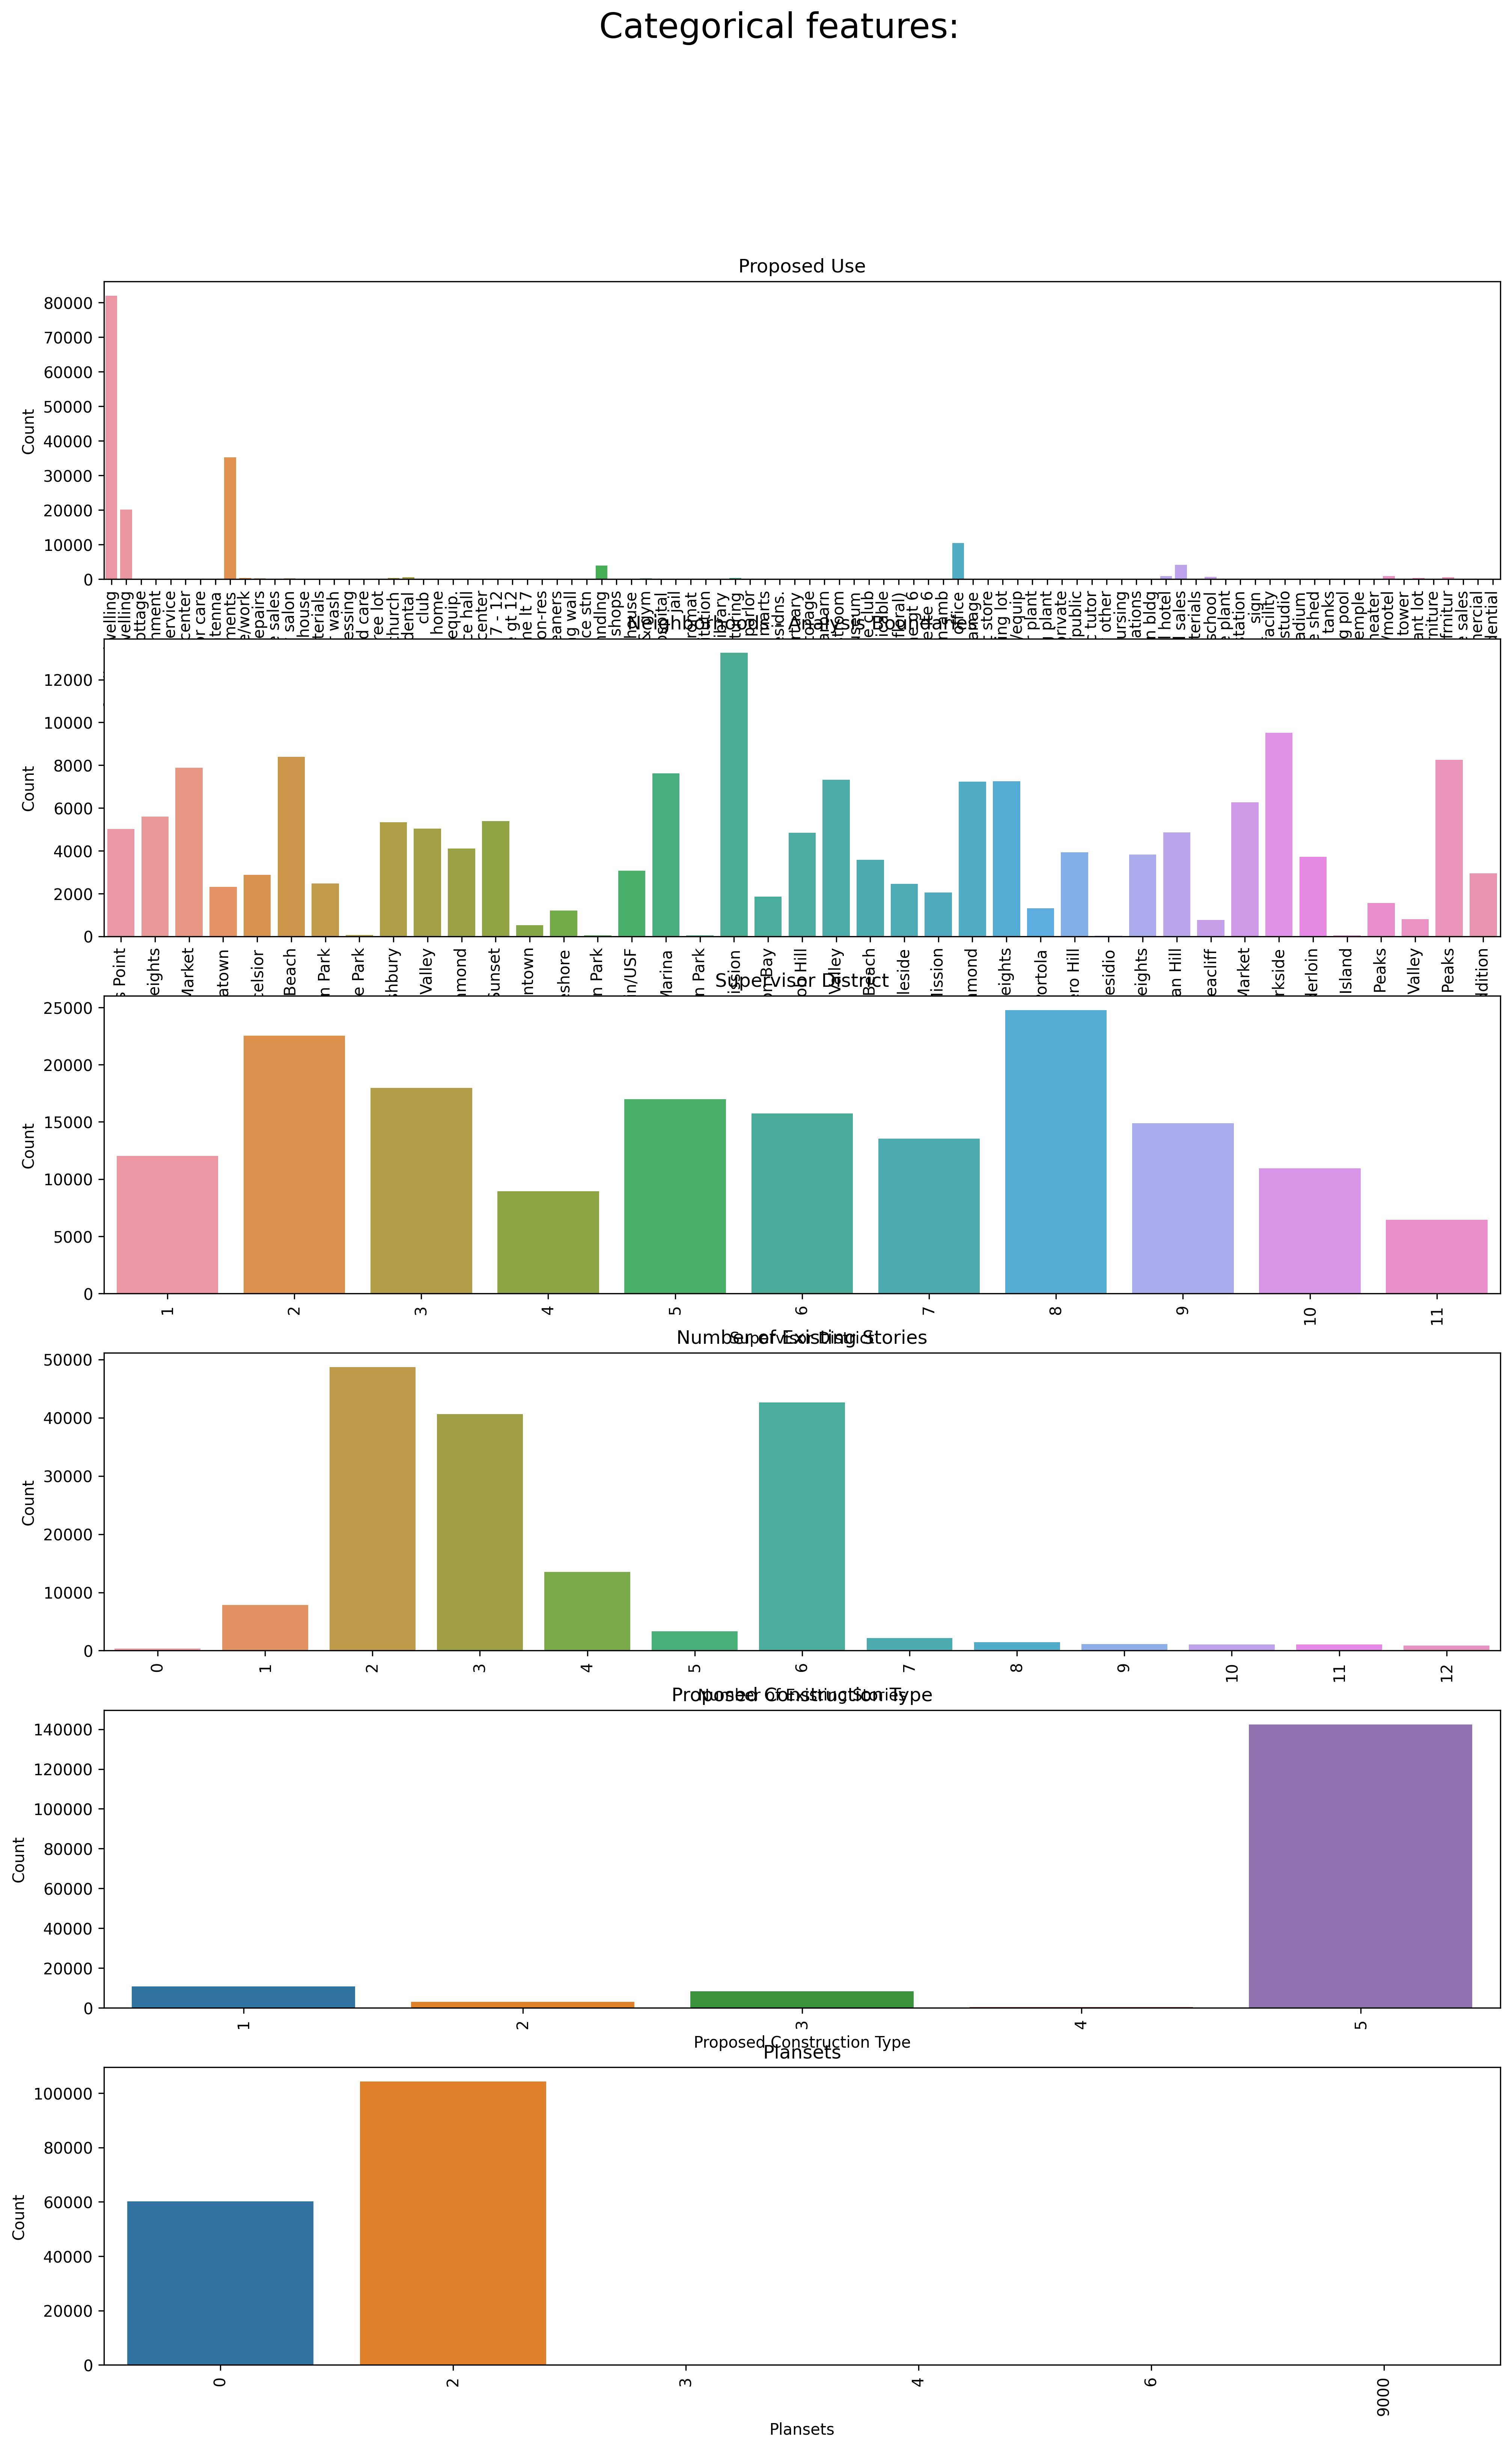
Categorical Analysis
Explored distributions of categorical variables.
Saved for next stages.

Slide 7
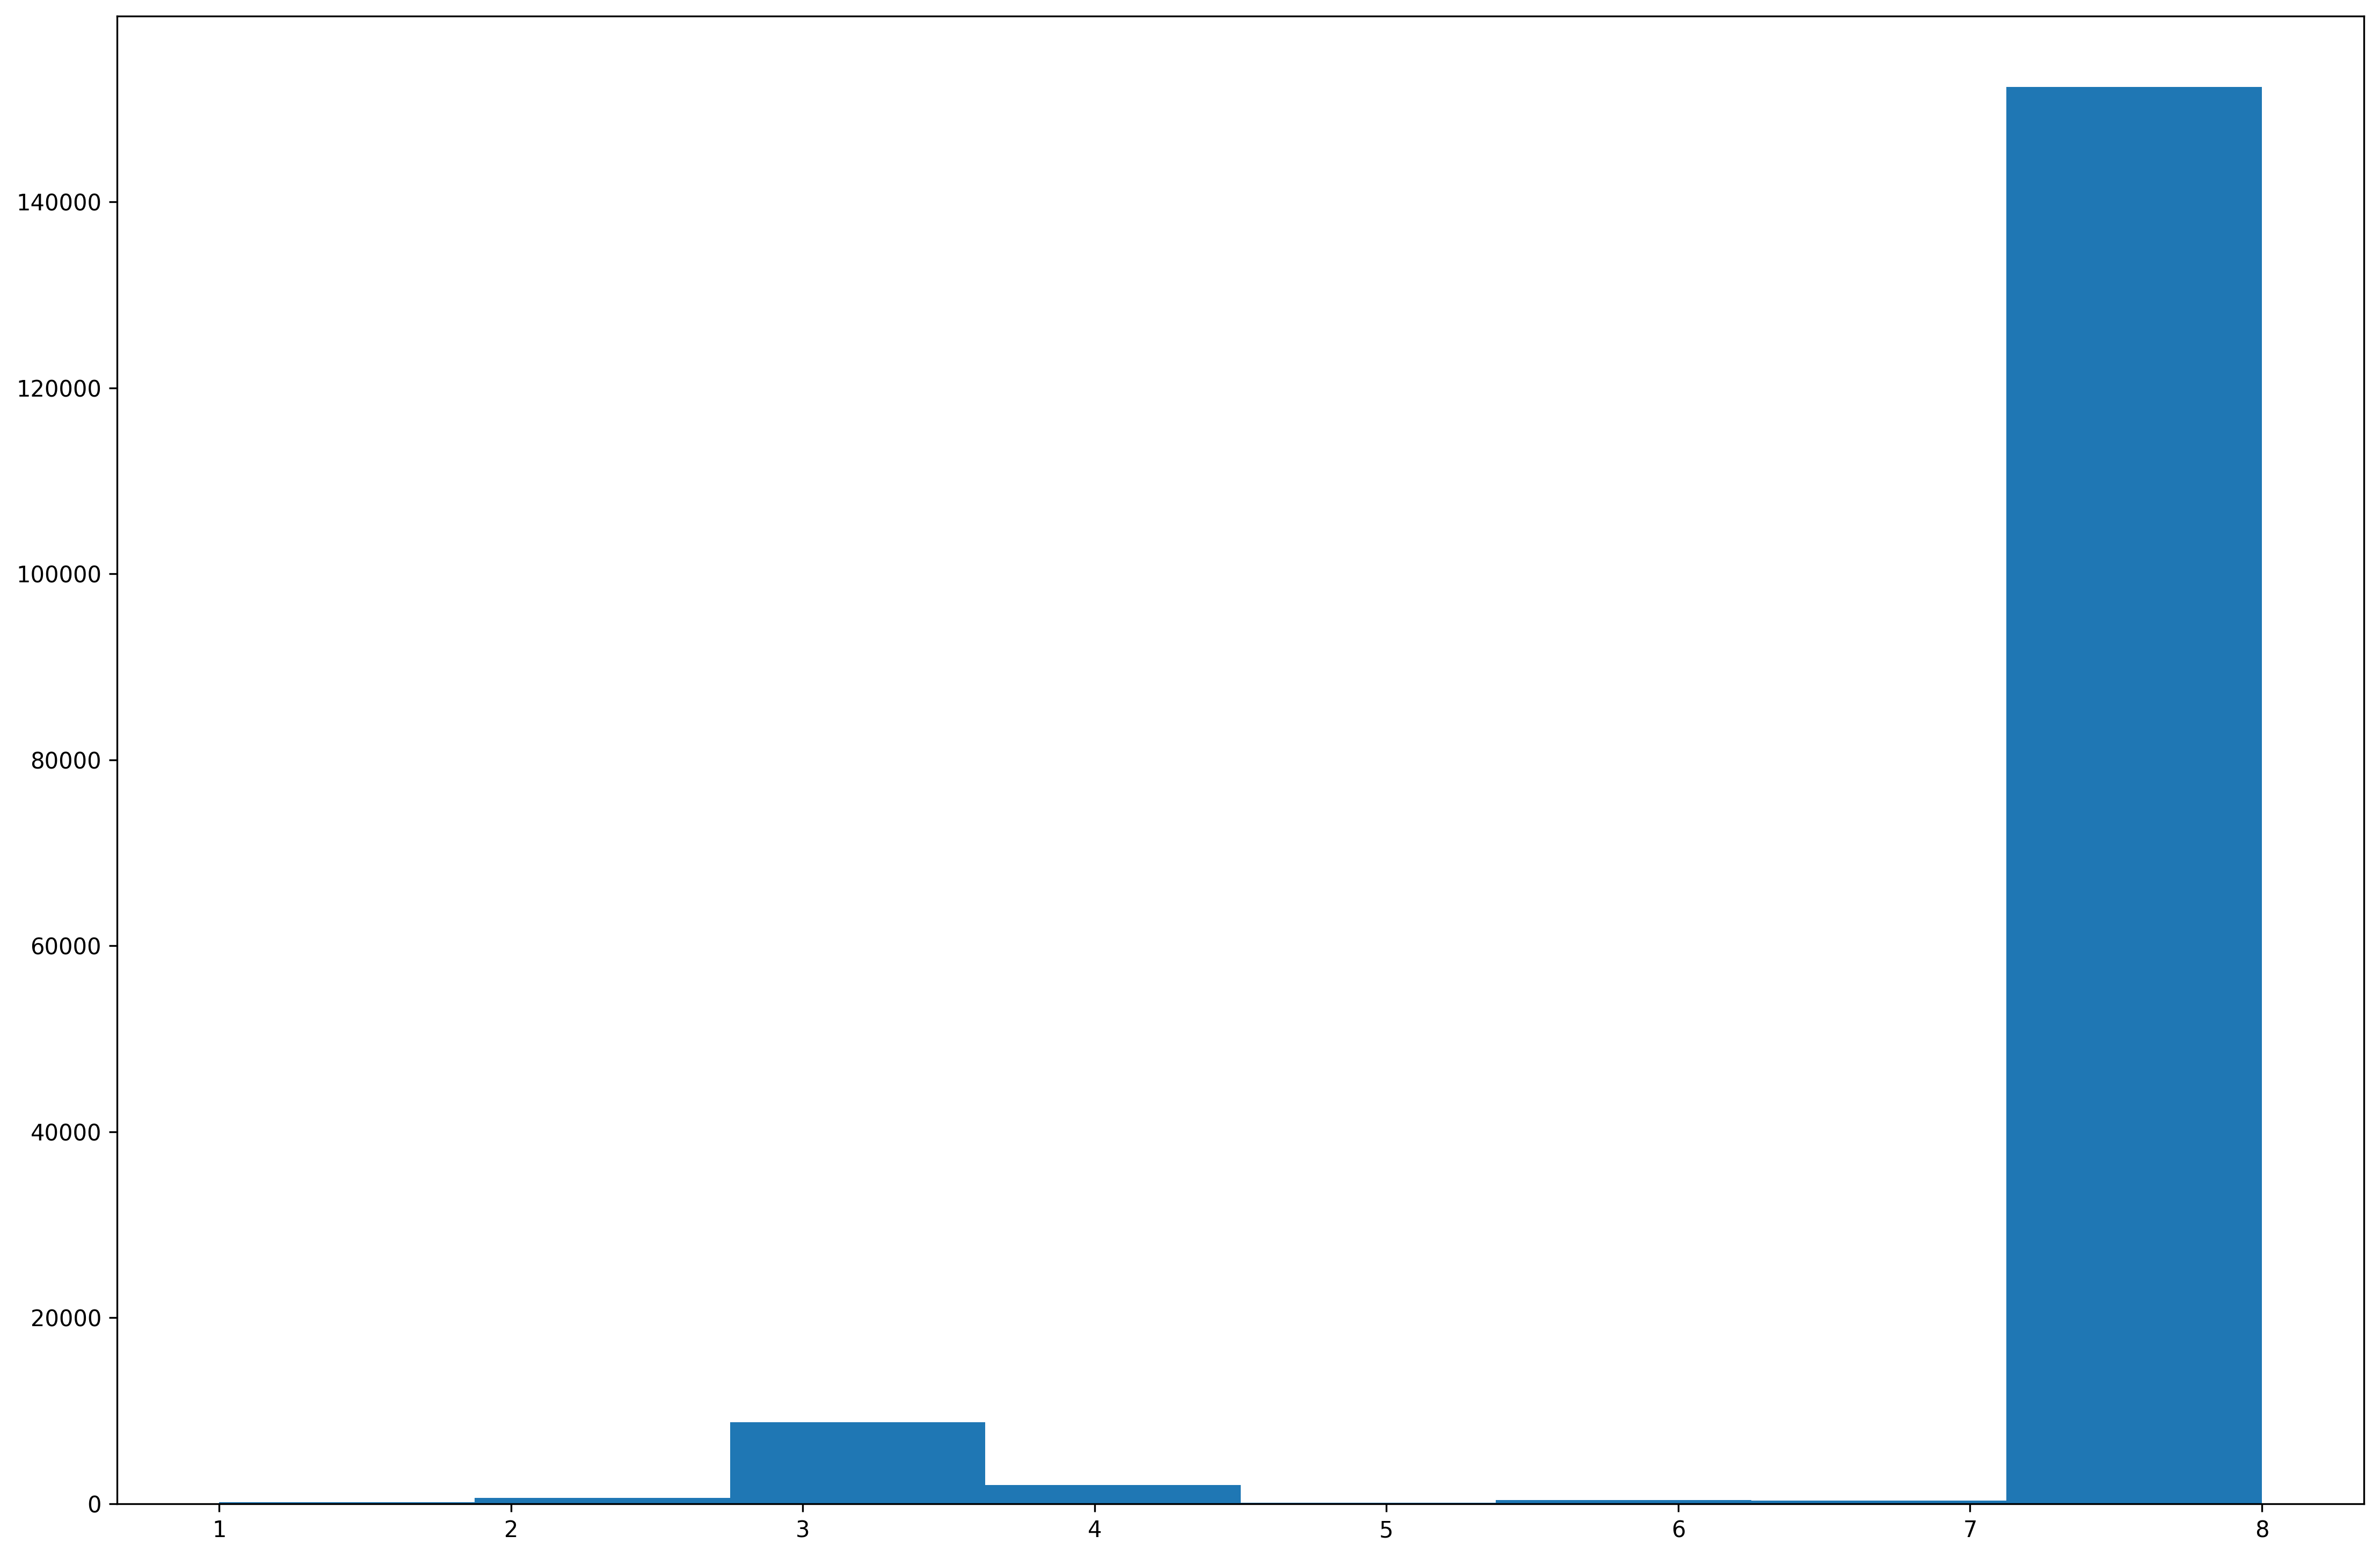
Data Preprocessing
Handled class imbalance
Encoded features per model type.
Scaled data for regression models.
Ensured no data leakage throughout pipeline.

Slide 8
Target Imbalance
Severe imbalance: Class 7 ≈ 90%.
Stratified data split ensured class representation.
Used class_weight for rebalancing during model training.

Slide 9
Modeling Approach
Tested Logistic Regression and Random Forest.
Evaluated via precision, recall, F1 score, confusion matrix.
Avoided misleading accuracy metric.

Slide 10
Logistic Regression
Used multinomial logistic regression.
Bayesian optimization or Random search = same results.
Still misclassified many samples due to class imbalance.

Slide 11
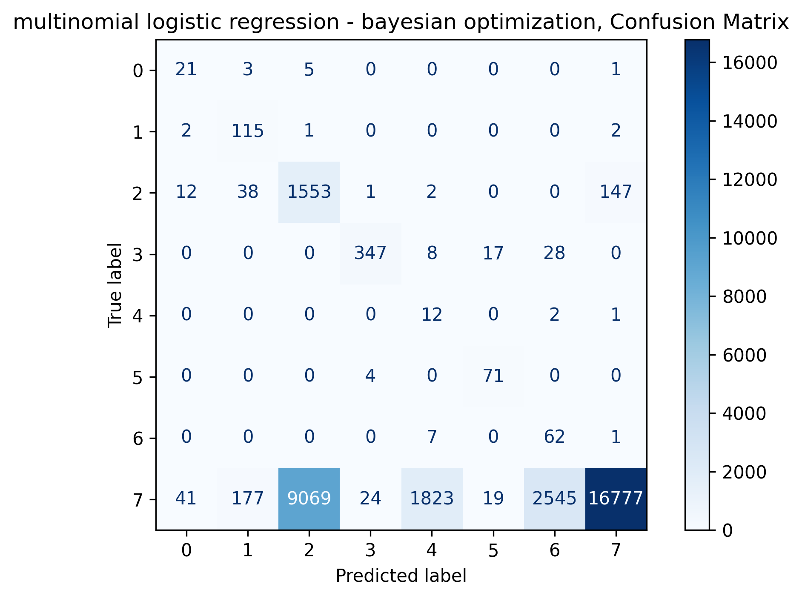
Logistic Regression Confusion Matrix

Slide 12
Random Forest
Random Forest with Bayesian optimization yielded best performance.
Better balanced precision and recall.
Improved Class 7 prediction, fewer misclassifications.

Slide 13
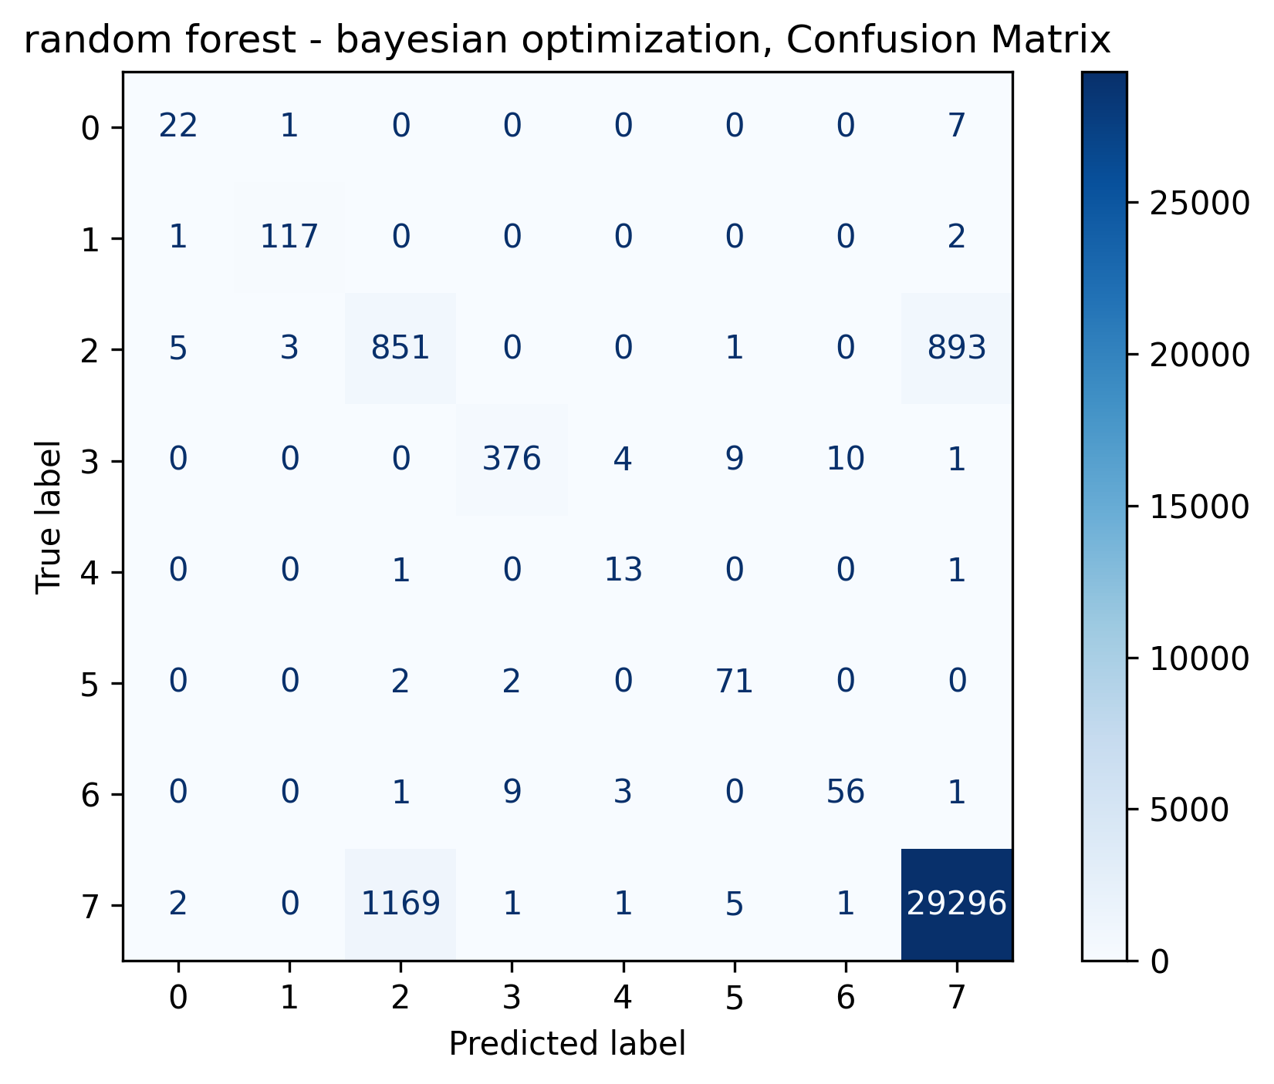
Random Forest Confusion Matrix

Slide 14
Final Model Selection
Random Forest (Bayesian Optimization)
F1: 0.81, Precision: 0.79, Recall: 0.84
Best handling of class imbalance.
Robust across all permit types.

Slide 15
Conclusion
Efficient pipeline designed to prevent leakage.
Models tested and evaluated across real-world constraints.
Outcome: Reliable automation of permit type classification using ML.

