Slide 1
Capstone Three Presentation
Can we classify news articles as fake or real based on their textual content?
Classifying News Types from Using Machine Learning, Deep Learning and Transformer.
Benoit Loze
26/08/2025

Slide 2
Problem Statement
Goal: distinguish between fake news and real news.
Success Criteria: DSM + ≥85% accuracy.
Scope: supervised classification.
Constraints: missing data, class imbalance, feature engineering.

Slide 3

Dataset Description
WELFake_Dataset.csv.
72,134 balanced entries.
Title, text, label features.
Available at: https://www.kaggle.com/datasets/saurabhshahane/fake-news-classification

Slide 4
Data Wrangling
Missing values removal (<5% nulls).
Identification & removal of duplicates.
Text normalization:
Tokenization.
Punctuation, digits and stop words removal.
Final lemmatization & character lowering.

Slide 5
Exploratory Data Analysis – EDA.
Strong discriminators:
POS proper noun/other noun ratio title.
NER ratio title.
Polarity title.
Polarity text.
Subjectivity title.
Subjectivity text.
Readability title.
Readability text.
Weak discriminators:
Length of text.
Vocabulary richness.
Terms frequency.
POS proper noun/other noun ratio text.
NER ratio text.
NER frequency.

Slide 6
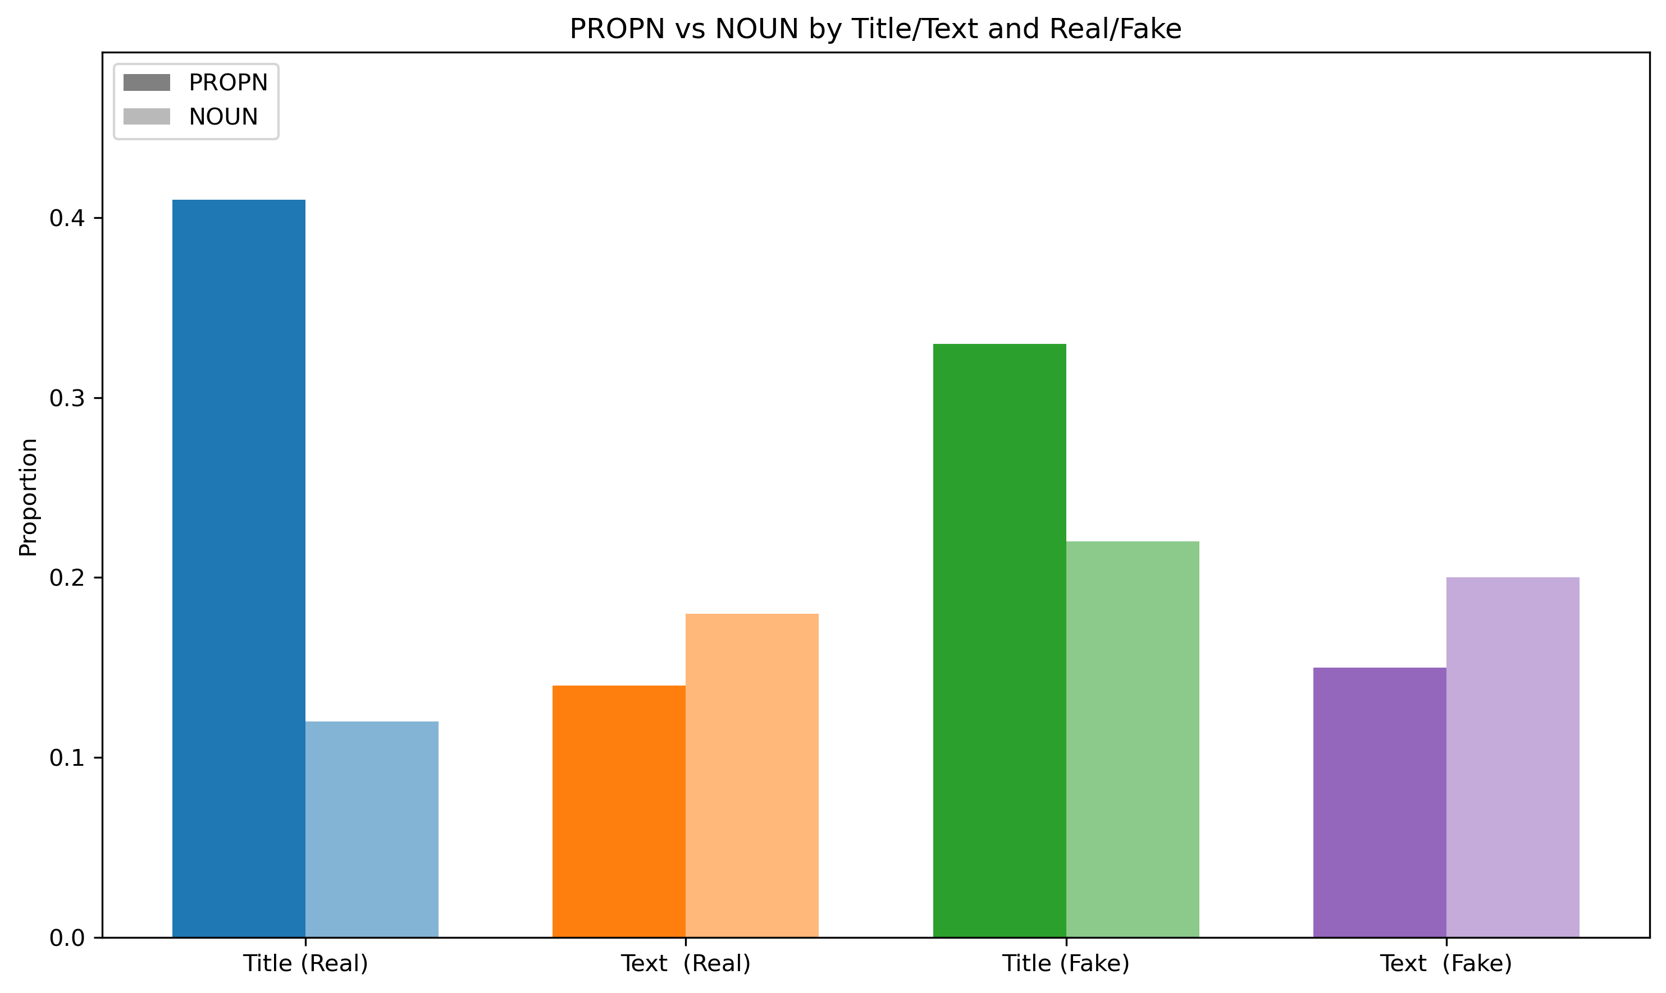
Exploratory Data Analysis – EDA.
POS – proper nouns & other nouns ratio:
Fake news title = generic nouns.
Real news title = proper nouns.

Slide 7
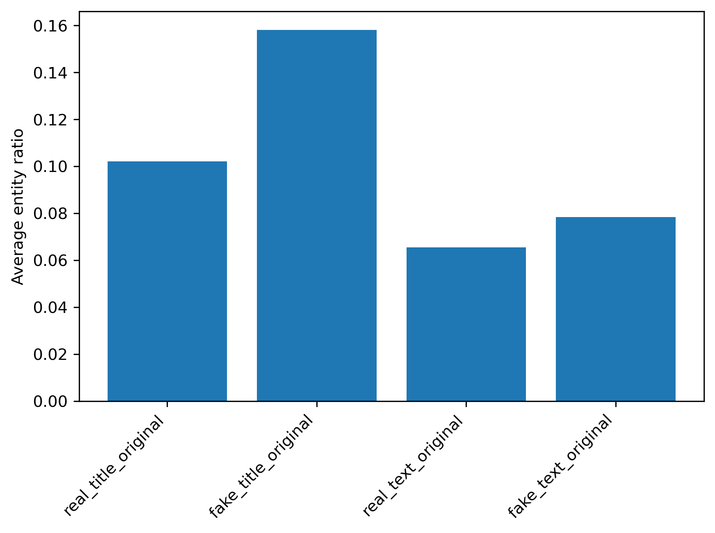
Exploratory Data Analysis – EDA.
NER – Named Entities Recognition:
Fake news title = more named entities.

Slide 8
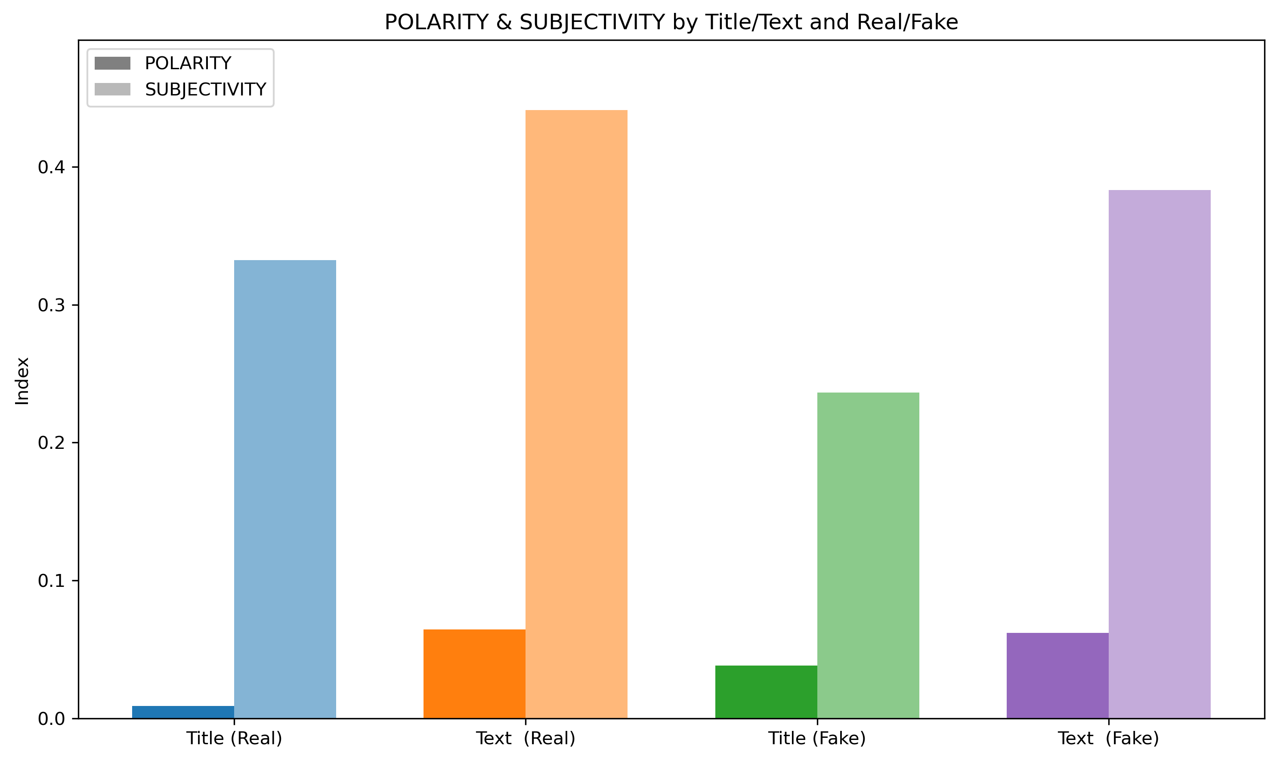
Exploratory Data Analysis – EDA.
Polarity & subjectivity:
Fake news title = more polarity.
Real news title = more subjectivity.
Real news text = more subjectivity.

Slide 9
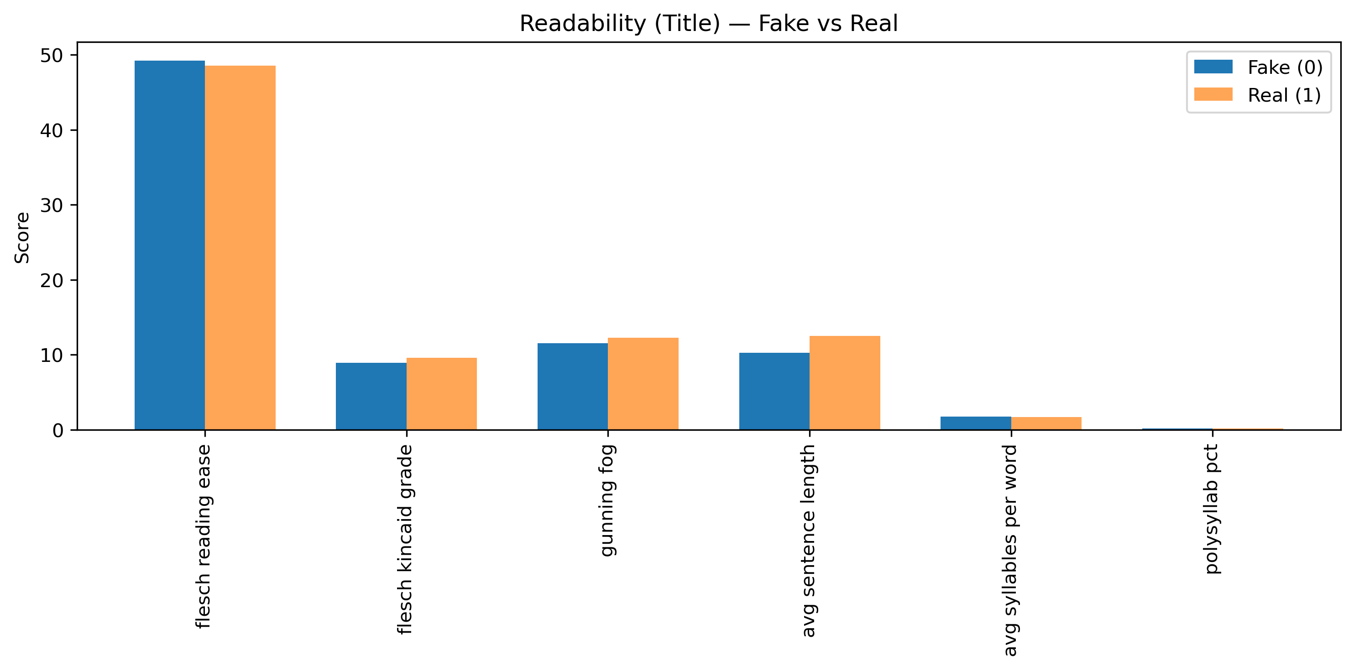
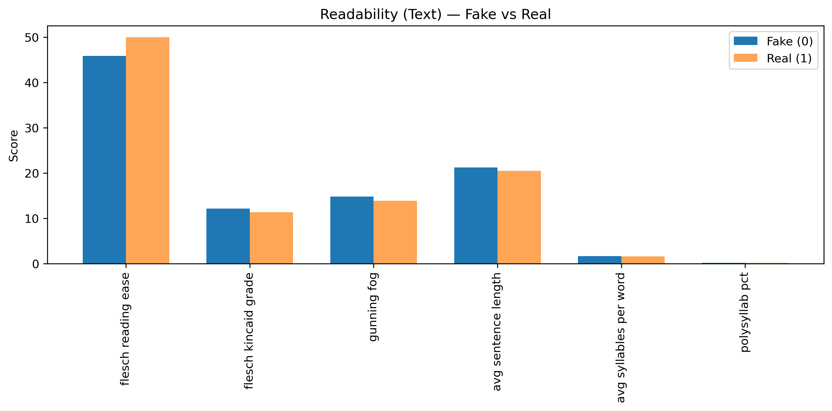
Exploratory Data Analysis – EDA.
Readability:
Fake news title = easier to read.
Real news text = easier to read.

Slide 10
Modeling Approach
Tested Logistic Regression and Random Forest.
Evaluated via precision, recall, F1 score, confusion matrix.
Avoided misleading accuracy metric.

Slide 11
Logistic Regression
Used multinomial logistic regression.
Bayesian optimization or Random search = same results.
Still misclassified many samples due to class imbalance.

Slide 12
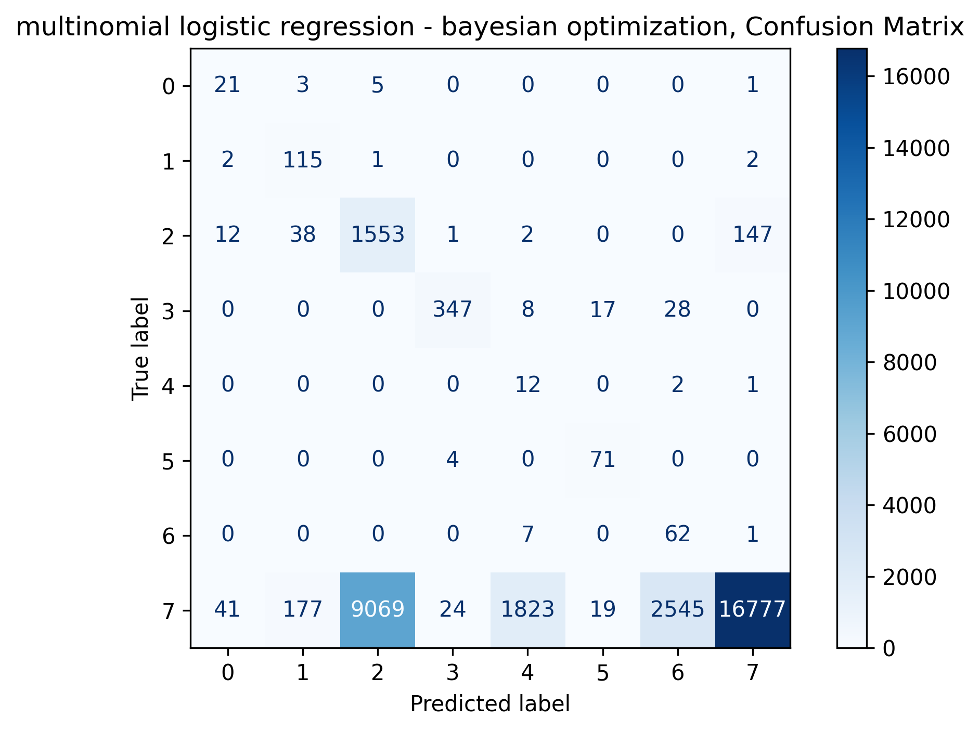
Logistic Regression Confusion Matrix

Slide 13
Random Forest
Random Forest with Bayesian optimization yielded best performance.
Better balanced precision and recall.
Improved Class 7 prediction, fewer misclassifications.

Slide 14
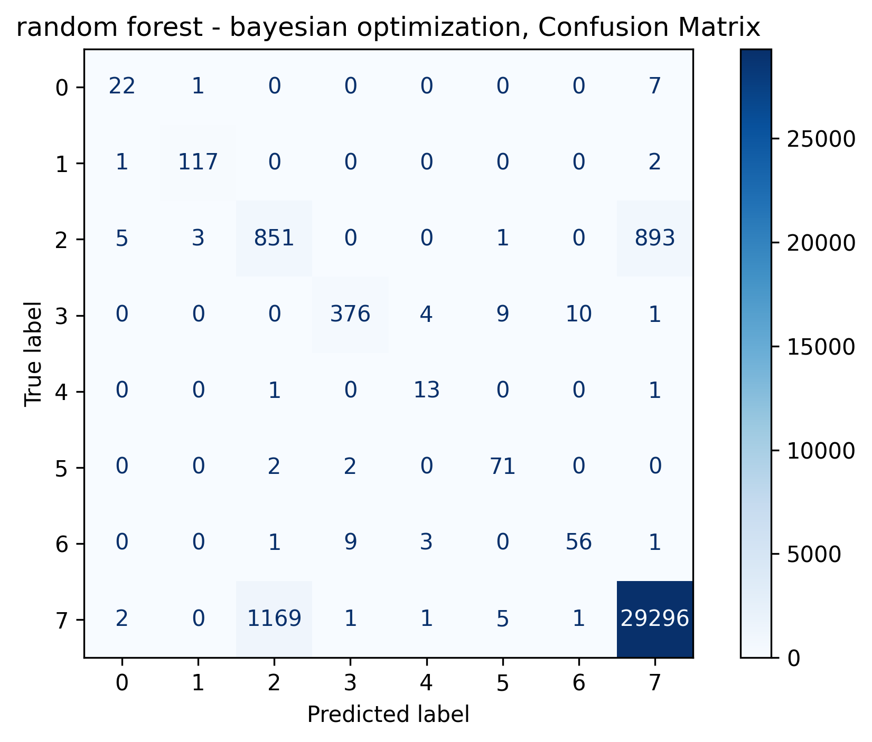
Random Forest Confusion Matrix

Slide 15
Final Model Selection
Random Forest (Bayesian Optimization)
F1: 0.81, Precision: 0.79, Recall: 0.84
Best handling of class imbalance.
Robust across all permit types.

Slide 16
Conclusion
Efficient pipeline designed to prevent leakage.
Models tested and evaluated across real-world constraints.
Outcome: Reliable automation of permit type classification using ML.

