Slide 1
Capstone Three Presentation
Can we classify news articles as fake or real based on their textual content?
Classifying News Types from Using Machine Learning, Deep Learning and Transformer.
Benoit Loze
26/08/2025

Slide 2
Problem Statement
Goal: distinguish between fake news and real news.
Success Criteria: DSM + ≥85% accuracy.
Scope: supervised classification.
Constraints: missing data, class imbalance, feature engineering.

Slide 3

Dataset Description
WELFake_Dataset.csv.
72,134 entries.
Balanced classes.
Title, text, label features.
Available at: https://www.kaggle.com/datasets/saurabhshahane/fake-news-classification

Slide 4
Data Wrangling
Missing values removal (<5% nulls).
Identification & removal of duplicates.
Text normalization:
Tokenization.
Punctuation, digits and stop words removal.
Final lemmatization & character lowering.

Slide 5
Exploratory Data Analysis – EDA.
Strong discriminators:
POS proper noun/other noun ratio title.
NER ratio title.
Polarity title.
Polarity text.
Subjectivity title.
Subjectivity text.
Readability title.
Readability text.
Weak discriminators:
Length of text.
Vocabulary richness.
Terms frequency.
POS proper noun/other noun ratio text.
NER ratio text.
NER frequency.

Slide 6
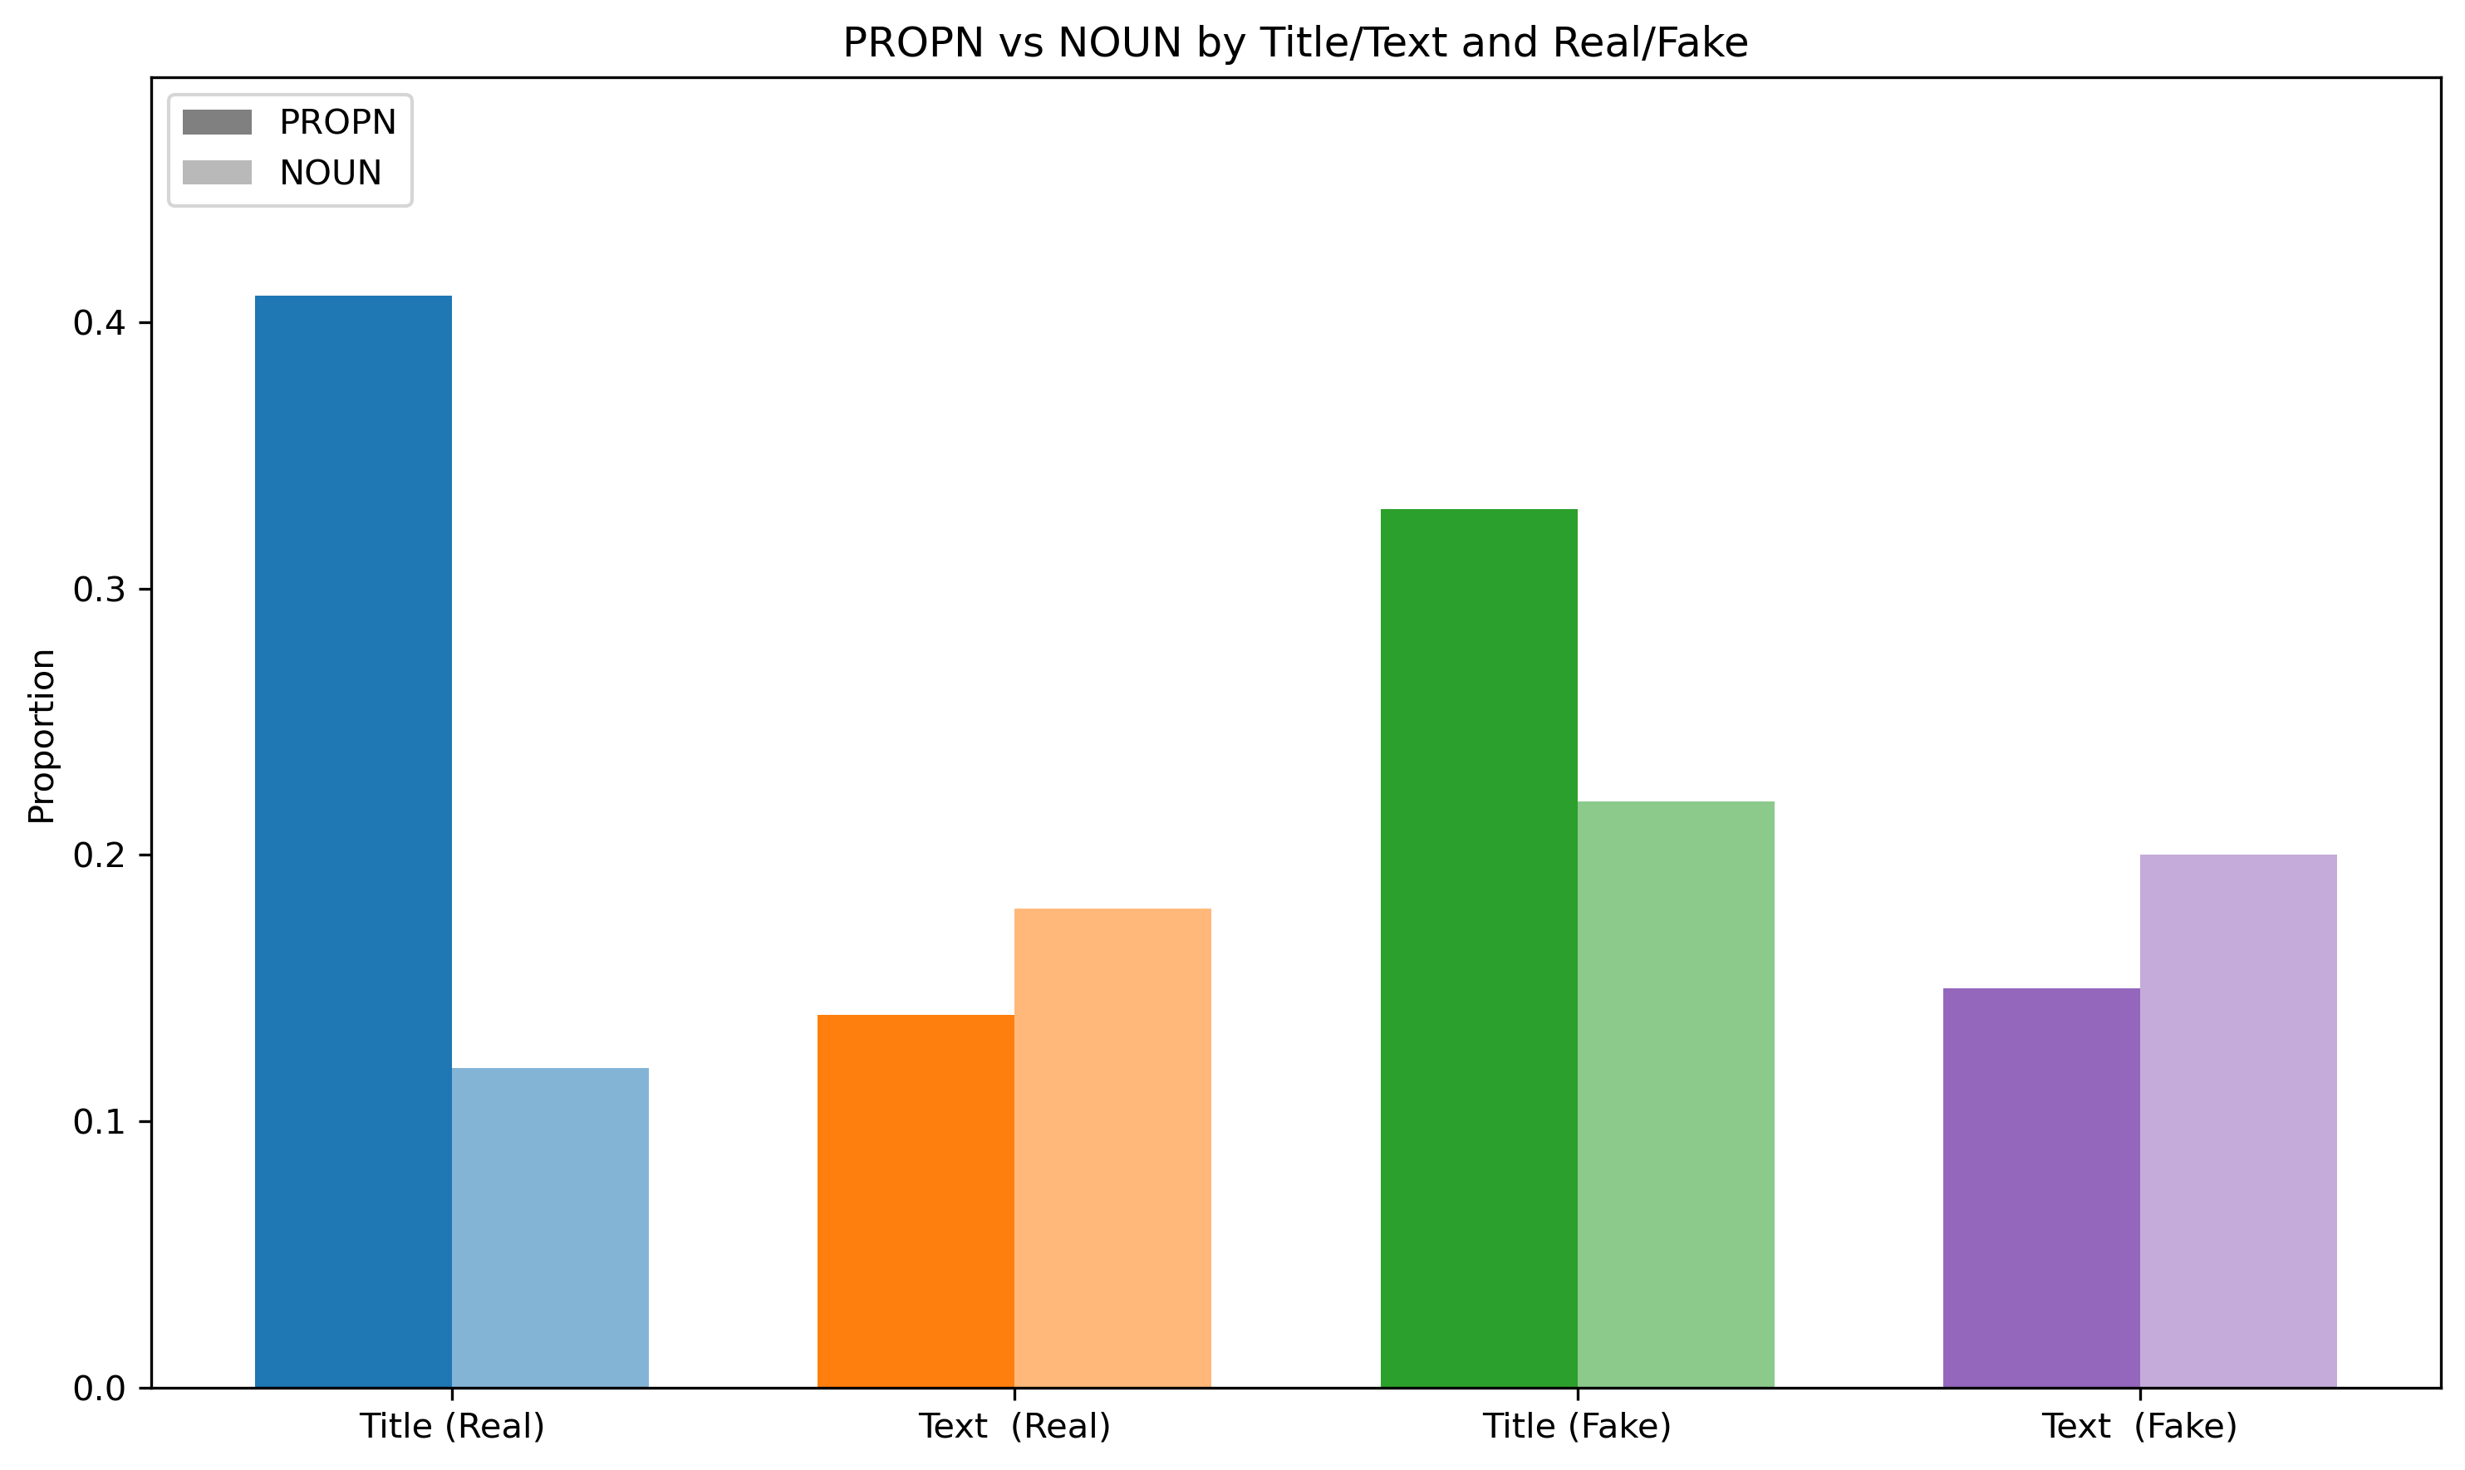
Exploratory Data Analysis – EDA.
POS – proper nouns & other nouns ratio:
Fake news title = generic nouns.
Real news title = proper nouns.

Slide 7
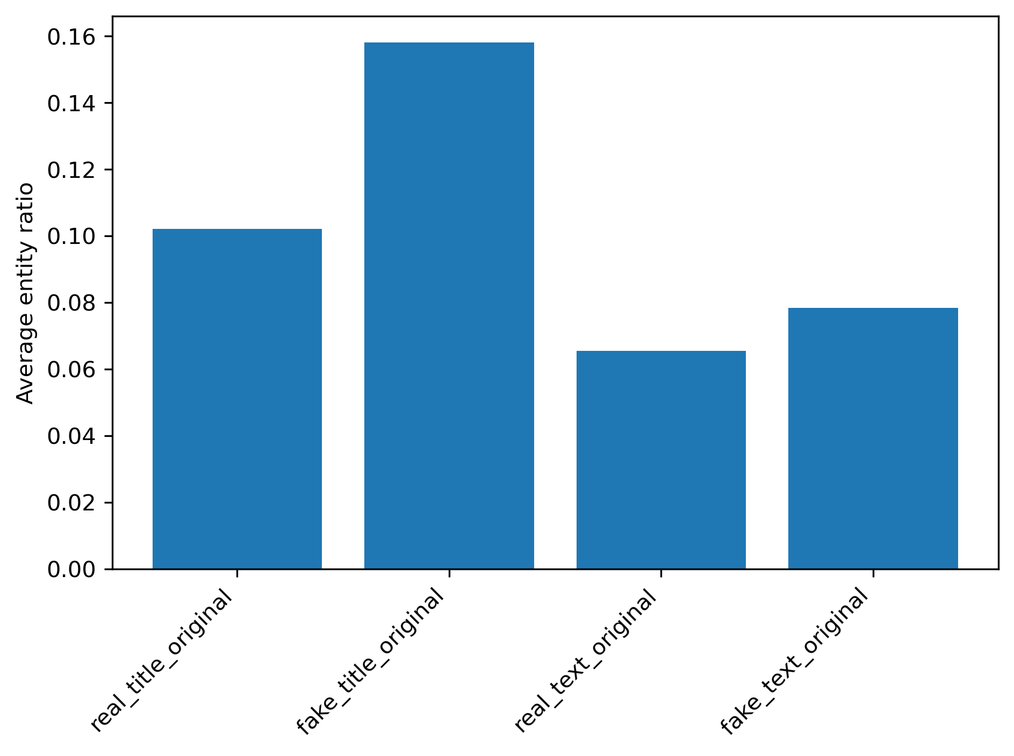
Exploratory Data Analysis – EDA.
NER – Named Entities Recognition:
Fake news title = more named entities.

Slide 8
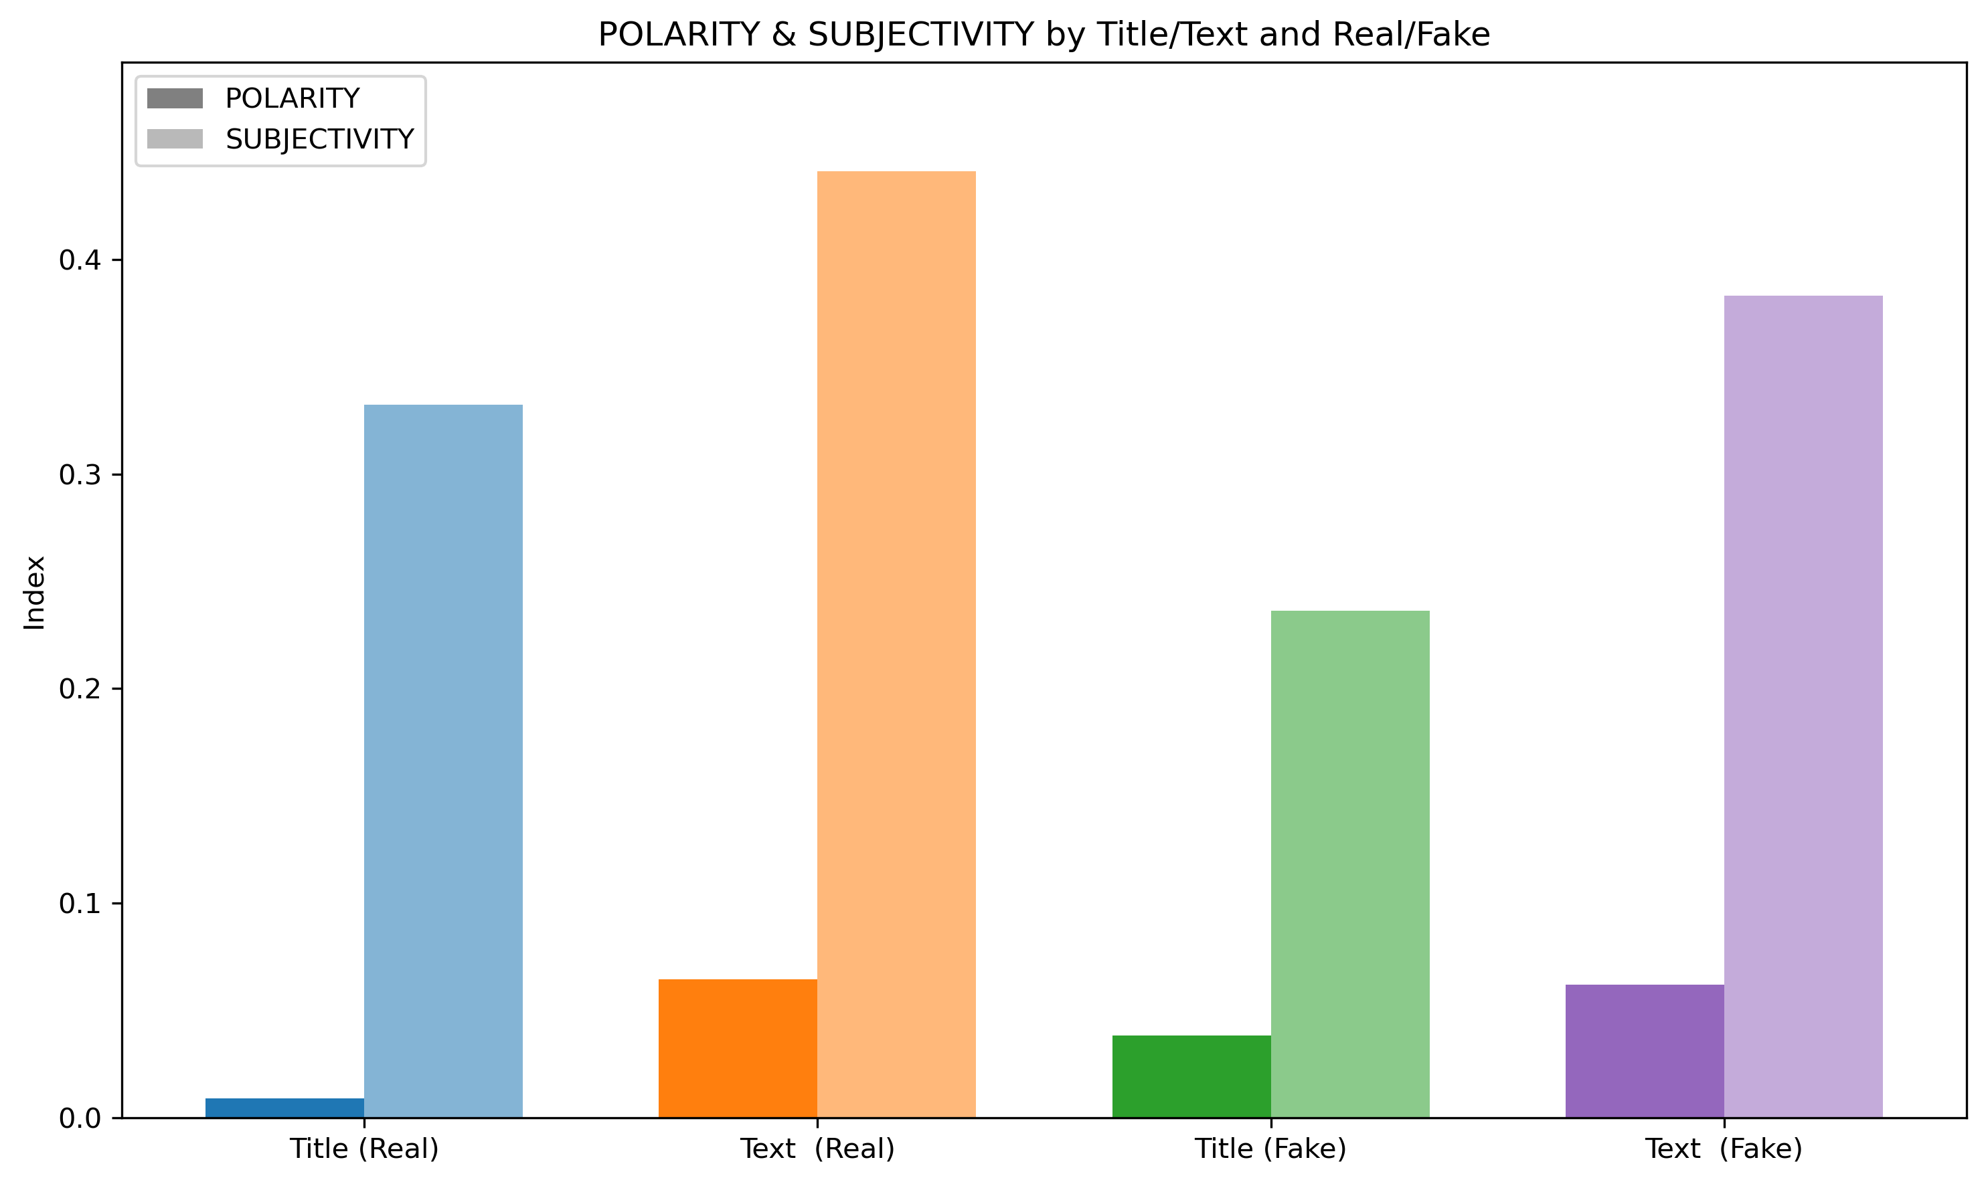
Exploratory Data Analysis – EDA.
Polarity & subjectivity:
Fake news title = more polarity.
Real news title = more subjectivity.
Real news text = more subjectivity.

Slide 9
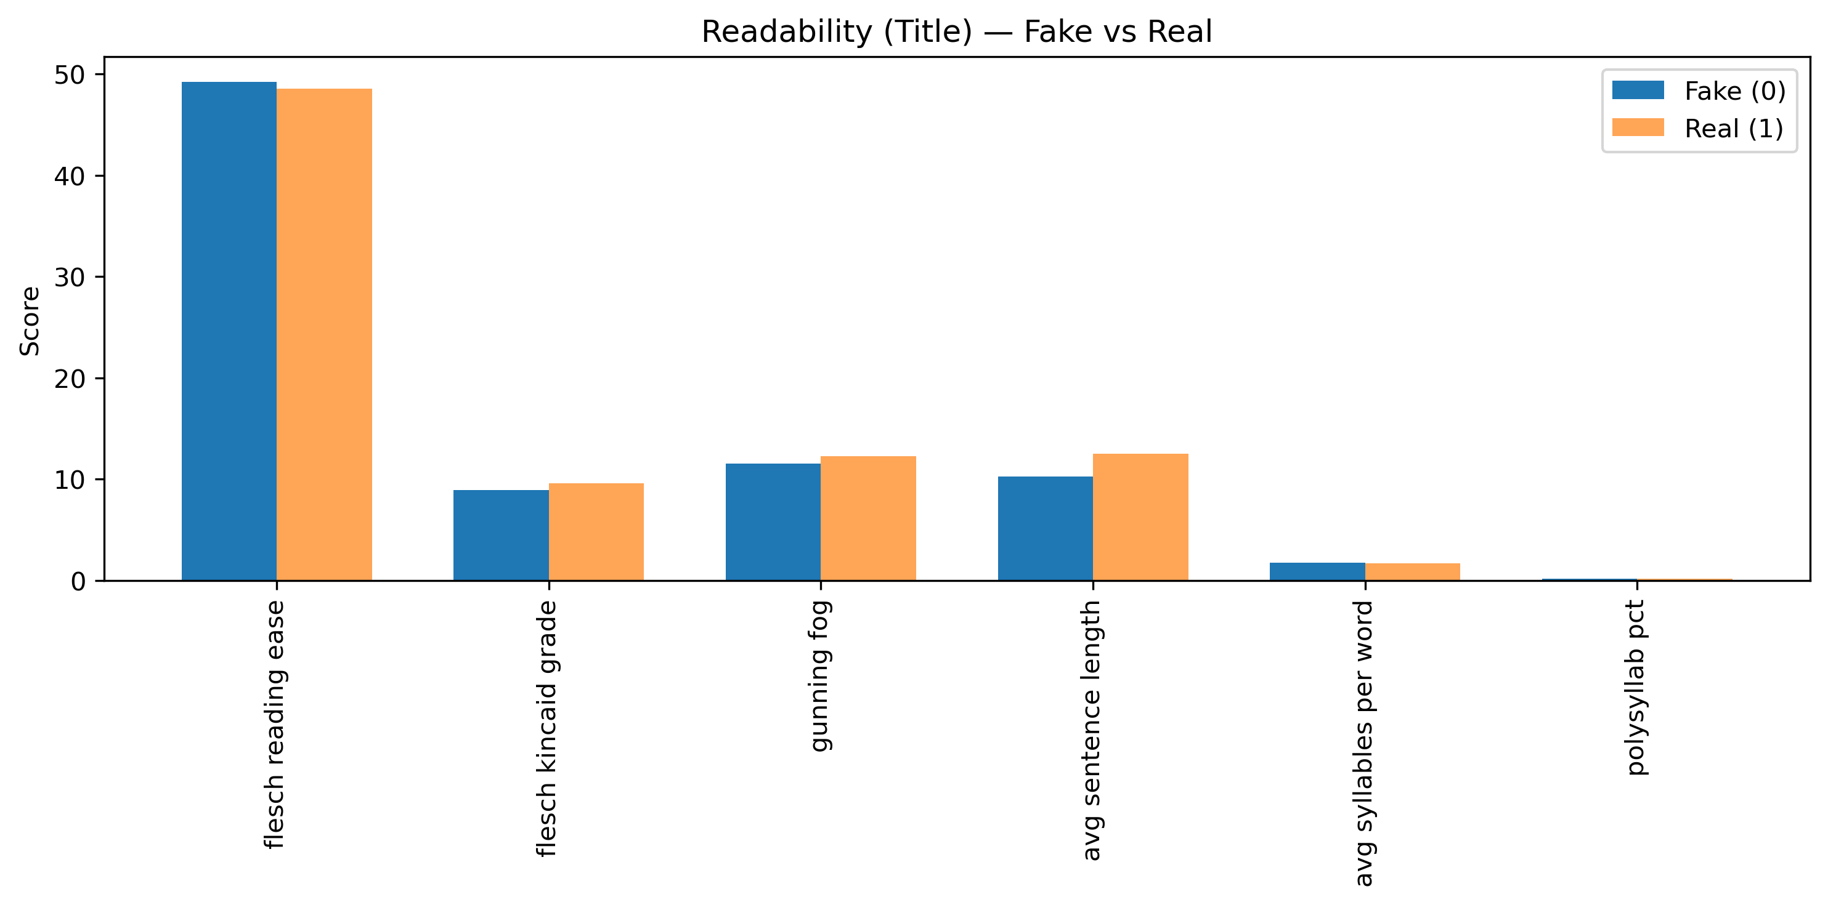
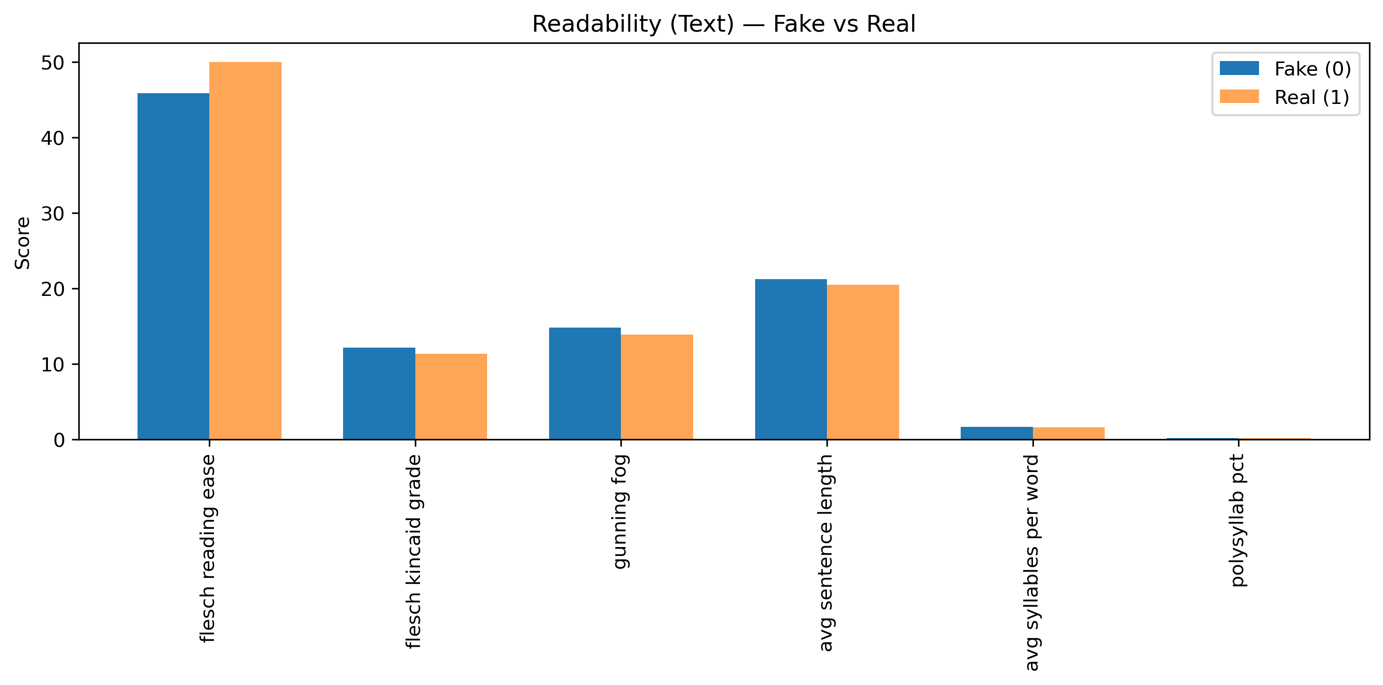
Exploratory Data Analysis – EDA.
Readability:
Fake news title = easier to read.
Real news text = easier to read.

Slide 10
Modeling Approach
4 models:
Machine learning – random forest.
Machine learning – logistic regression.
Deep learning – bi-LSTM.
Transformer – DistilBERT.

Slide 11
Modeling Approach
To avoid data leakage = train/test/split first :
ML models:
TFIDF vectorization.
Bayesian optimization.
Deep learning:
title & text combined.
Learning embedding from scratch.
Overfitting counter measures.
Transformer:
Title & text combined.
Tokenization and encoding.

Slide 12
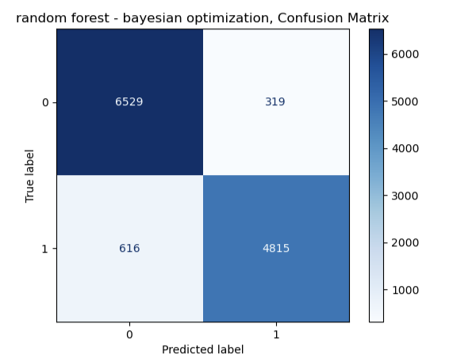
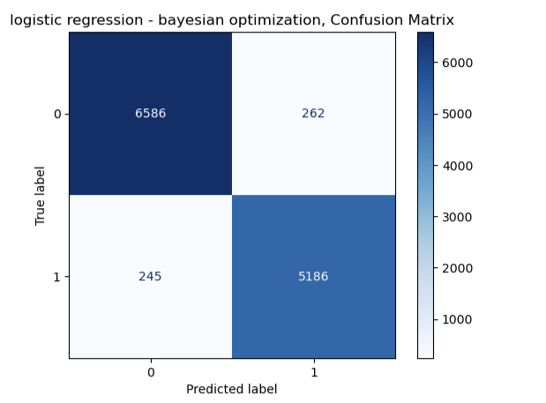
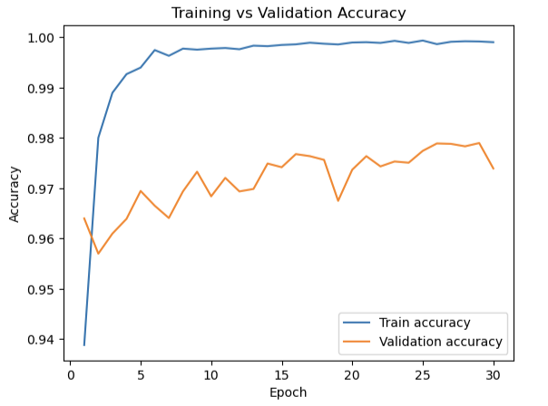
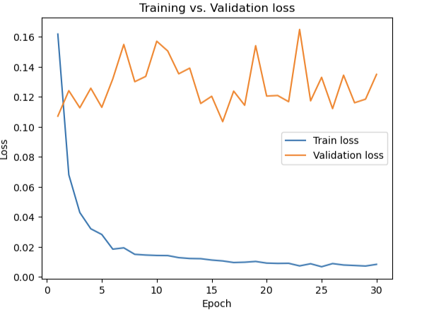
Modeling Approach

Slide 13
Modeling Approach
F1 scores:
Random forest = 92 %.
Logistic regression = 96 %.
Deep learning = 97.40 %.
Transformer = 99.50 % = SELECTED.

Slide 14
Recommendations & Future Work
Model evaluation on additional datasets = robustness.
“Strong discriminators” & additional feature engineering.
Slight target class imbalance & “class_weight” parameter.

