Slide 1

Chapter 2 – Foundation
Prepared by: Shier Nee, SAW
Based on: Probabilistic Machine Learning by Kevin Murphy

Slide 2
Outline
Probability: Univariate Model
Probability: Multivariate Model
Statistic
Notes:
Uni – 45 min, multi – 30min, break (15min), statistic – 1.5hr

Slide 3





Univariate Gaussian Distribution
Univariate
Multivariate
Statistic
The most widely used distribution of real-valued random variables is the Gaussian distribution,
also called the normal distribution.
The following shows the cumulative distribution function of a continuous random variable Y.
The following shows the probability of Y between a and b is given as following.
Cdf of Gaussian is defined as
,
mean
variance

Slide 4
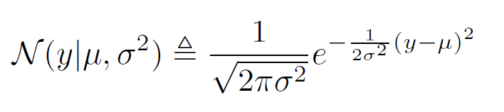
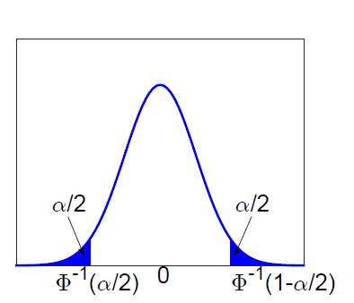
Gaussian Distribution
Univariate
Multivariate
Statistic
The most widely used distribution of real-valued random variables is the Gaussian distribution,
also called the normal distribution.
Probability distribution function of Gaussian is
mean
variance
Normalization – ensure area under curve = 1

Slide 5
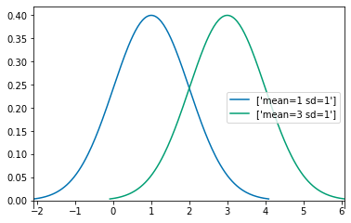
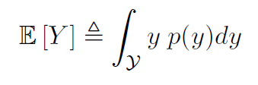
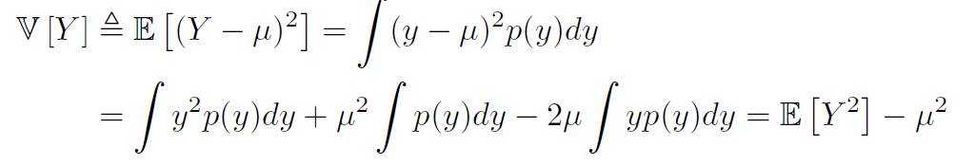
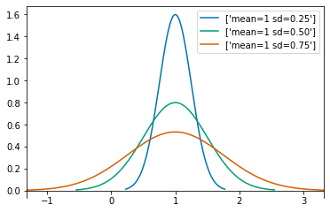

Gaussian Distribution
Univariate
Multivariate
Statistic
Mean of pdf of Gaussian is = 0
Variance of pdf of Gaussian is = Spread

Slide 6
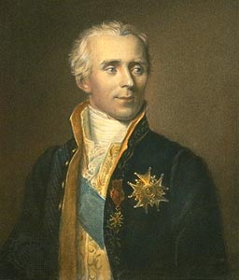
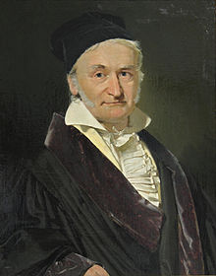
Fun Facts of Gaussian
Univariate
Multivariate
Statistic
The fundamental nature of this distribution and its main properties were noted by Laplace when Gauss was six years old.
Gauss popularized the use of the distribution in the 1800s, and the term “Gaussian” is now widely used in science and engineering
Laplace
Gauss
Image taken from Wikipedia

Slide 7
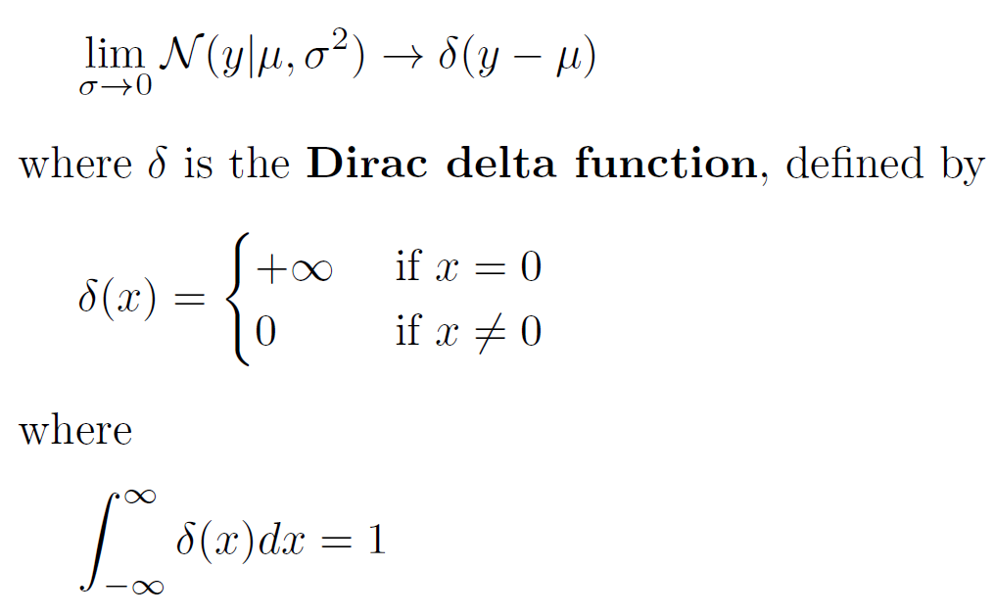
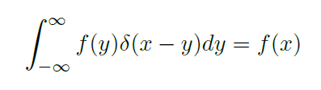
Dirac delta function
Univariate
Multivariate
Statistic
When variance of Gaussian goes to zero, the distribution becomes narrorwer.
Sifting Property

Slide 8
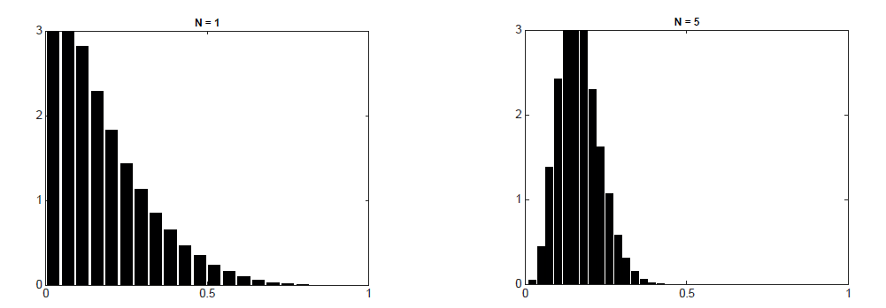
Central Limit Theorem
Univariate
Multivariate
Statistic
When independent random variables are summed up, the distribution converges to a normal distribution even if the original distribution themselves are not normally distributed.
sims = RV(Beta(a=2, b=3)).sim(1000000)
Notes:
This function wants to stretch and shift the probability distribution

Slide 9
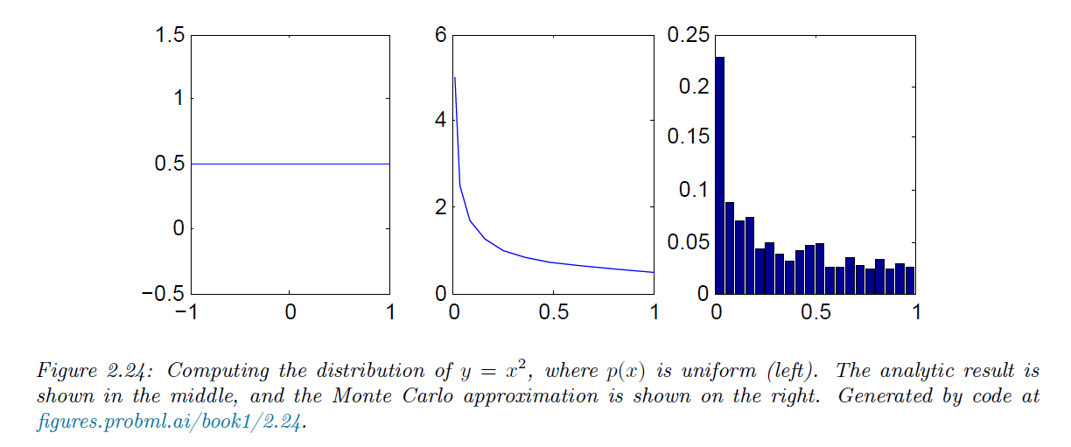
Monte Carlo Approximation
Univariate
Multivariate
Statistic
It is often difficult to compute the induced distribution p(y) analytically.
One simple but powerful alternative is to draw a large number of samples from the x’s distribution, and then to use these samples (instead of the distribution) to approximate p(y).
Notes:
This function wants to stretch and shift the probability distribution

Slide 10
Let’s move to Colab
Univariate
Statistic
Multivariate

Slide 11



Multivariate - Gaussian
Univariate
Multivariate
Statistic
The most widely used joint probability distribution for continuous random variable is the multivariate Gaussian or multivariate normal (MVN).
MVN density is
Mean vector
Covariance matrix
Notes:
This function wants to stretch and shift the probability distribution

Slide 12
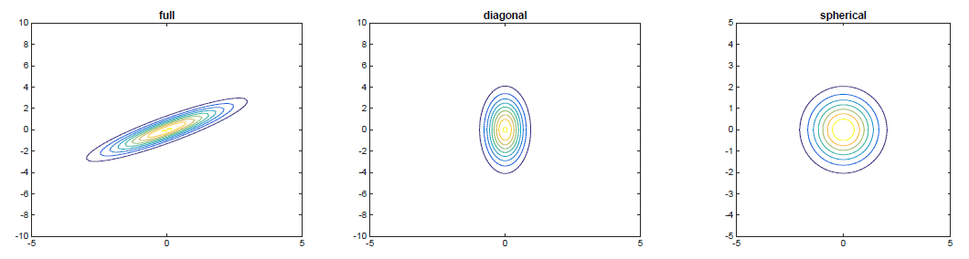
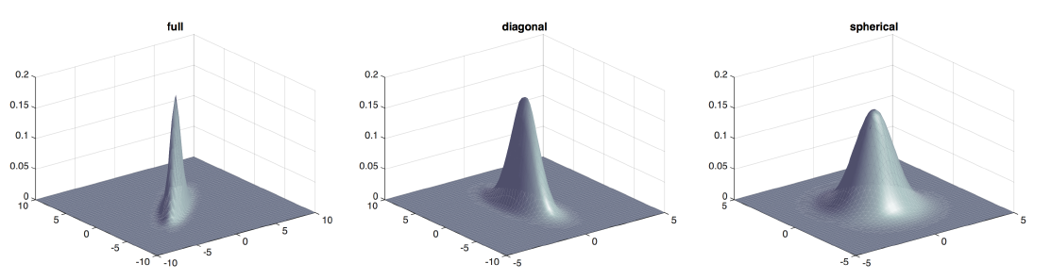
Multivariate - Gaussian
Univariate
Multivariate
Statistic
Notes:
This function wants to stretch and shift the probability distribution

Slide 13
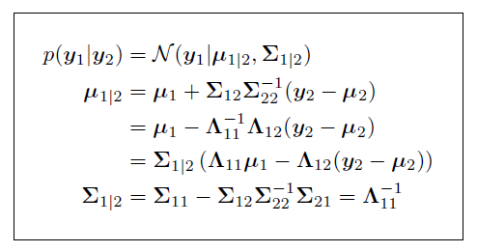
Imputate missing value from Gaussian
Univariate
Multivariate
Statistic
Guess the probability at y₁ = 0, y₂ = -1
p(y₁=0|y₂=-1)
Posterior Conditional Formula
x
x
x
x
x
x
x
x
x
x
x
x
x
x
x
x
x
x
y₁
y₂
Notes:
This function wants to stretch and shift the probability distribution

Slide 14
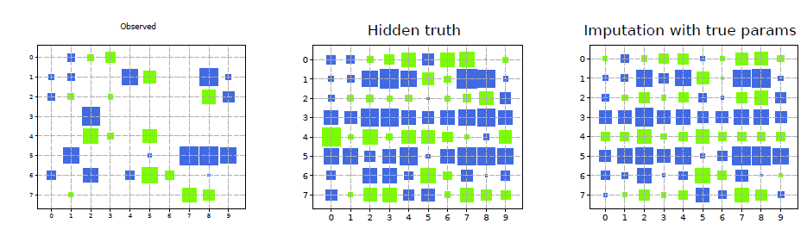
Multivariate - Gaussian
Univariate
Multivariate
Statistic
Notes:
This function wants to stretch and shift the probability distribution

Slide 15
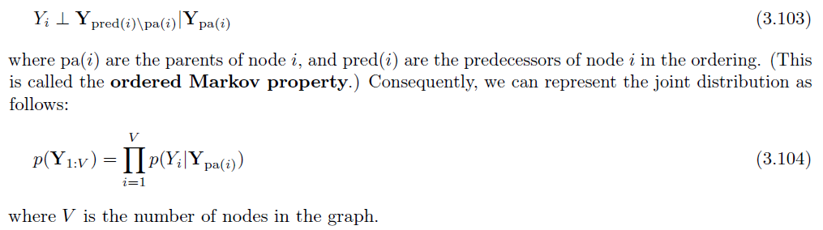
Probabilistic graphical models
Univariate
Multivariate
Statistic
A probabilistic graphical model or PGM is a joint probability distribution that uses a graph
structure to encode conditional independence assumptions.
Node = Random variable
Edge = Direct dependency
Connect them such that each node is conditionally independent of all its predecessors given its parents
Notes:
This function wants to stretch and shift the probability distribution

Slide 16
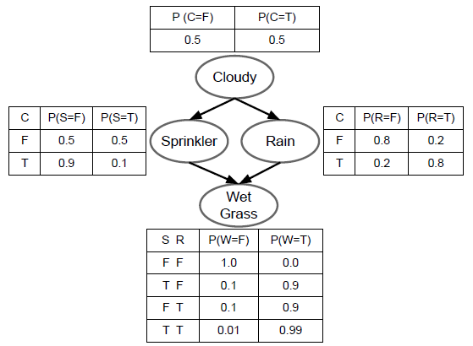
Example PGM: Water sprinkler network
Univariate
Multivariate
Statistic
Suppose we want to model the dependencies between 4 random variables:
C (whether it is cloudy season or not),
R (whether it is raining or not),
S (whether the water sprinkler is on or not), and
W (whether the grass is wet or not).
Joint distribution
Conditional probability distribution (CPD) for node i
Notes:
This function wants to stretch and shift the probability distribution

Slide 17
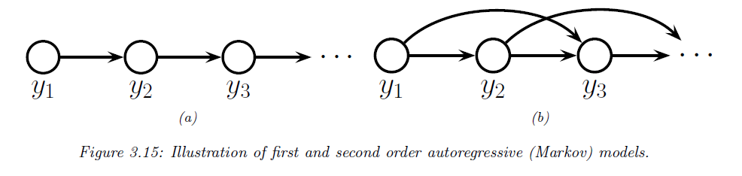


Example PGM: Markov Chain Network
Univariate
Multivariate
Statistic
Suppose we want to create a joint probability distribution over variable-length sequences, p(y1:T ). MC model is a stochastic model describing a sequence of possible events in which the probability of each event depends only on the state attained in the previous event.
First order Markov Model
Mth order Markov Model
Notes:
This function wants to stretch and shift the probability distribution

Slide 18
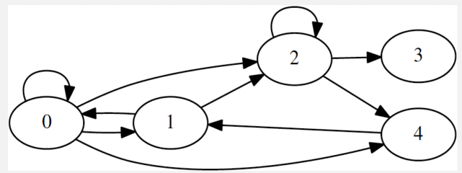
Example
Univariate
Multivariate
Statistic
Given this PGM, the adjacent matrix is
 | 0 | 1 | 2 | 3 | 4
0 | 1 | 1 | 0 | 0 | 0
1 | 1 | 0 | 0 | 0 | 1
2 | 1 | 1 | 1 | 0 | 0
3 | 0 | 0 | 1 | 0 | 0
4 | 1 | 0 | 1 | 0 | 0
Notes:
This function wants to stretch and shift the probability distribution

Slide 19
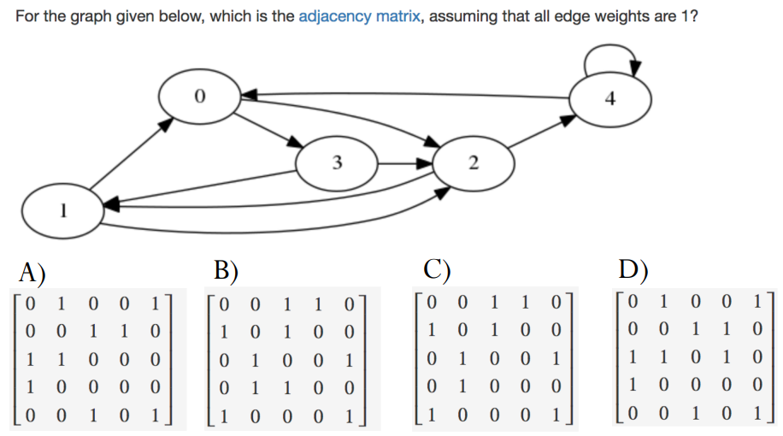
Example
Univariate
Multivariate
Statistic
Notes:
Answer: A

Slide 20
Let’s move to Colab
Univariate
Multivariate
Statistic

Slide 21

Model Fitting / Training
Univariate
Multivariate
Statistic
Loss function / objective function

Slide 22
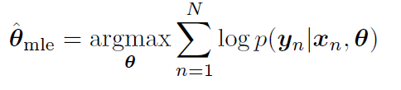

Maximum likelihood estimation
Univariate
Multivariate
Statistic
Estimated Parameter
Probability
Model
Since most optimization algorithms are designed to minimize cost functions, we redefine the objective function to be the (conditional) negative log likelihood or NLL and we minimize NLL

Slide 23
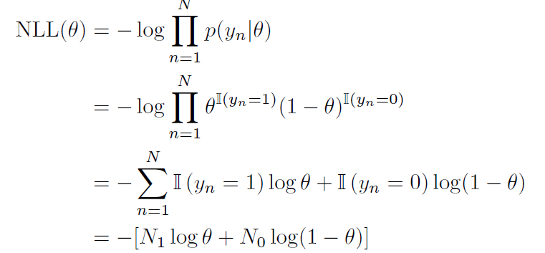
MLE for the Bernoulli distribution
Univariate
Multivariate
Statistic
Suppose Y is a random variable representing a coin toss, where the event Y = 1 corresponds to heads and Y = 0 corresponds to tails.
Let θ = p(Y = 1) be the probability of heads. The probability distribution for this rv is the Bernoulli.
The NLL for the Bernoulli distribution is given by

Slide 24
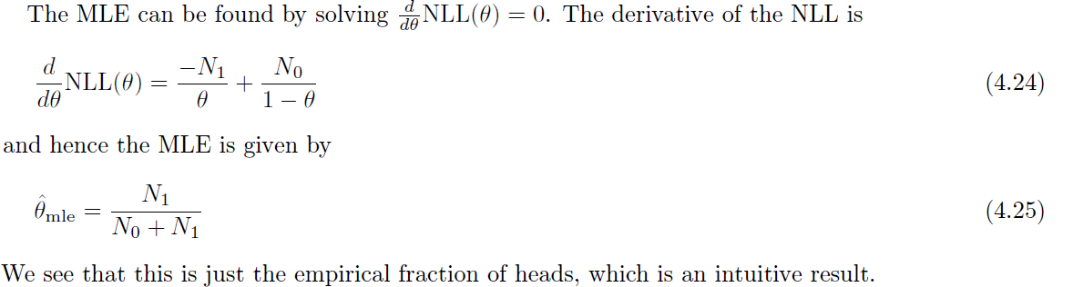
MLE for the Bernoulli distribution
Univariate
Multivariate
Statistic

Slide 25
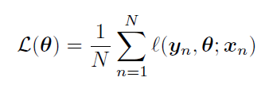
Empirical Risk Minimization
Univariate
Multivariate
Statistic
We can generalize MLE by replacing the (conditional) log loss term, with any other loss function.
This is known as empirical risk minimization or ERM, since it is the expected loss where the
expectation is taken wrt the empirical distribution.
See Decision Theory Section for more details.

Slide 26
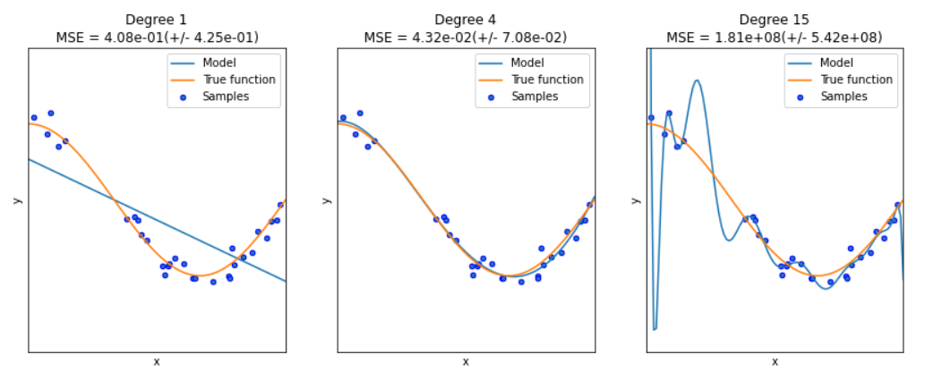
Regularization
Univariate
Multivariate
Statistic
Enough parameters to perfectly fit the training data.
Most of the time, empirical distribution ≠ true distribution
Model unable to predict novel future data → Overfitting

Slide 27
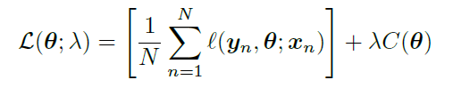
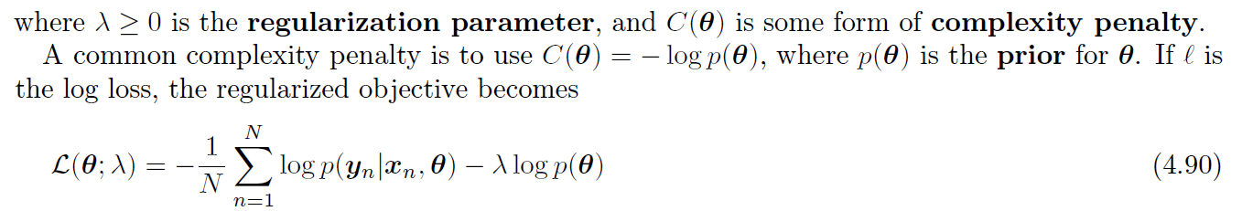
Regularization
Univariate
Multivariate
Statistic
Add penalty term to loss function

Slide 28
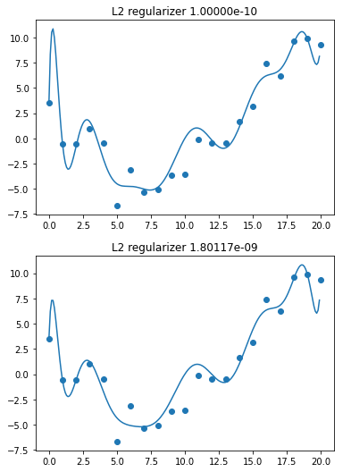
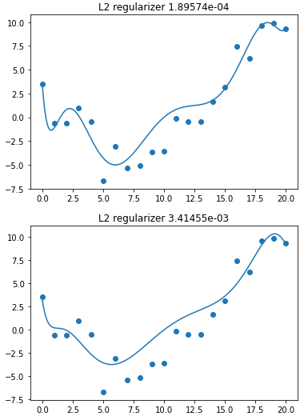
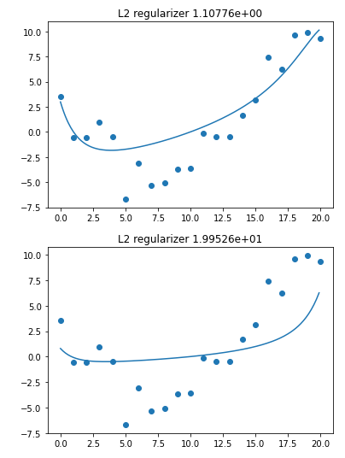
Regularization - How to choose?
Univariate
Multivariate
Statistic
C
E
A
B
D
F

Slide 29
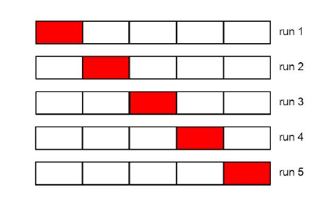





Regularization – Validation Set
Univariate
Multivariate
Statistic
Fit the model on D_{train} (for each setting of λ) with loss function
For each λ, we compute parameter estimate
Then evaluate its performance on D_{valid} using validation data.
We then pick the value of λ that results in the best validation performance.
Fit the model on with D_{train} and D_{valid} using λ*
If training data sample size is very small, will have problem.

Slide 30
Regularization – Validation Set
Univariate
Multivariate
Statistic
For first CV,
Fit the model on D_{train} (for each setting of λ) with loss function
For each λ, we compute parameter estimate, θ
Then evaluate its performance on D_{valid} (red) using validation data.
We then pick the value of λ that results in the best validation performance.
We have λ₁
6. Repeat five times.
We will have
CV1: λ_{1,} Loss₁; CV2: λ_{2,} Loss₂; CV3: λ_{3,} Loss₃ ; CV4: λ_{4,} Loss₄;
CV5: λ_{5,} Loss₅
7. We then pick the value of λ* that results in the best validation performance (lowest loss).
8. Fit the model on with D_{train} and D_{valid} using λ*

Slide 31
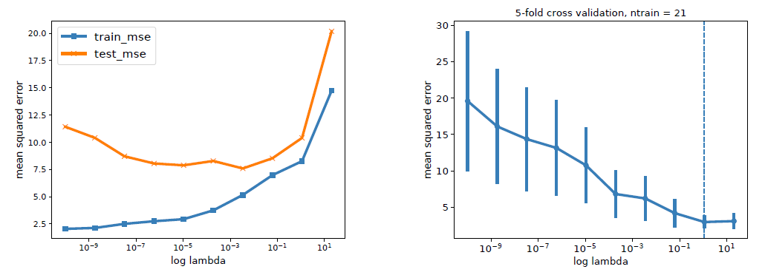
Regularization – Validation Set
Univariate
Multivariate
Statistic
Vertical line is the point chosen by the one standard error rule

Slide 32
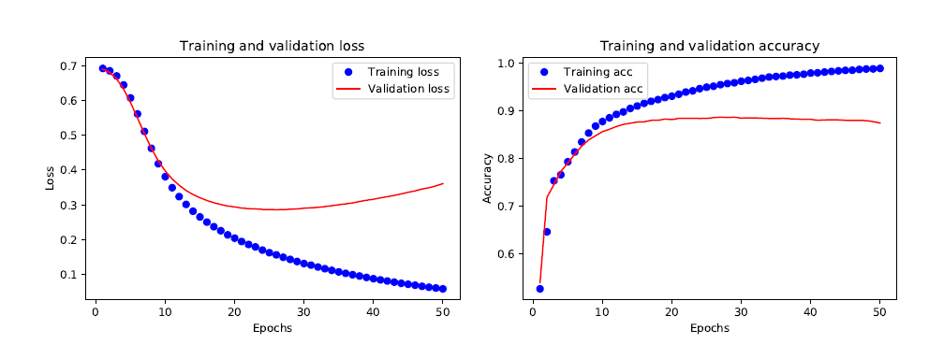
Regularization – Early Stopping
Univariate
Multivariate
Statistic

Slide 33
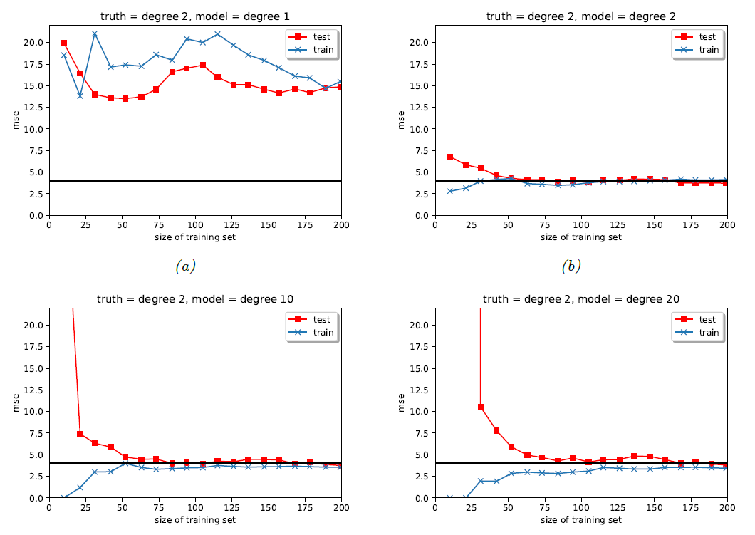
Regularization – More Data
Univariate
Multivariate
Statistic
Simple model → underfitting
Model complexity increases, train and test approaches true error (black line)
Complex model → overfitting (big gap between train and test), but gap reduces as N increases
Optimal model (degree 2) – best → converges fastest

Slide 34
Regularization – More Data
Univariate
Multivariate
Statistic
Simple model → underfitting
Model complexity increases, train and test approaches true error (black line)
Complex model → overfitting (big gap between train and test), but gap reduces as N increases
Optimal model (degree 2) – best → converges fastest

Slide 35
Let’s move to Colab
Univariate
Multivariate
Statistic

