Slide 1

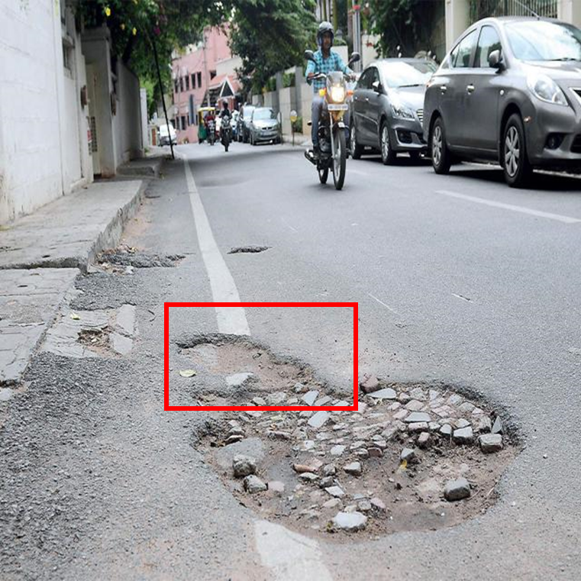
Axis-Aligned Bounding Box (AABB - txt file
class_id coordinates (x_center, y_center) (width) (height)
Oriented Bounding Box (OBB) - txt file
class_id coordinates (x_center, y_center) (width) (height) (Rotation angle (θ))

Slide 3
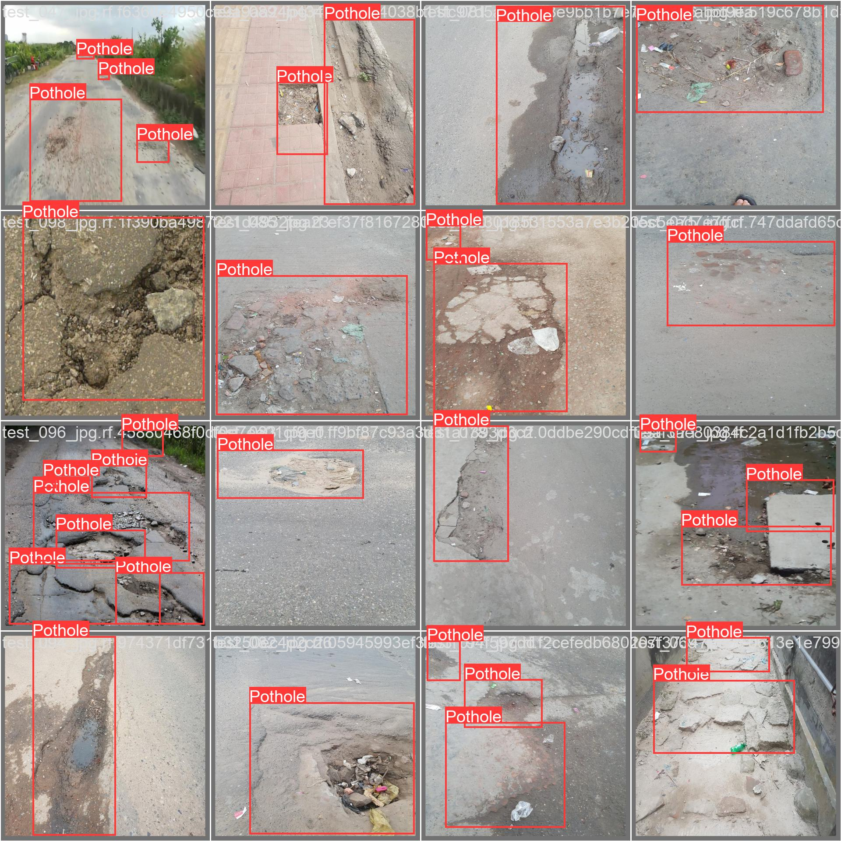

Slide 4

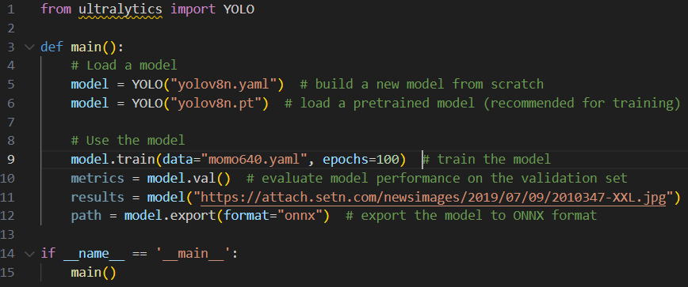
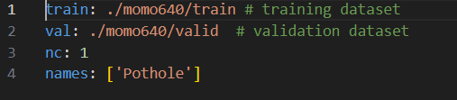

Slide 5
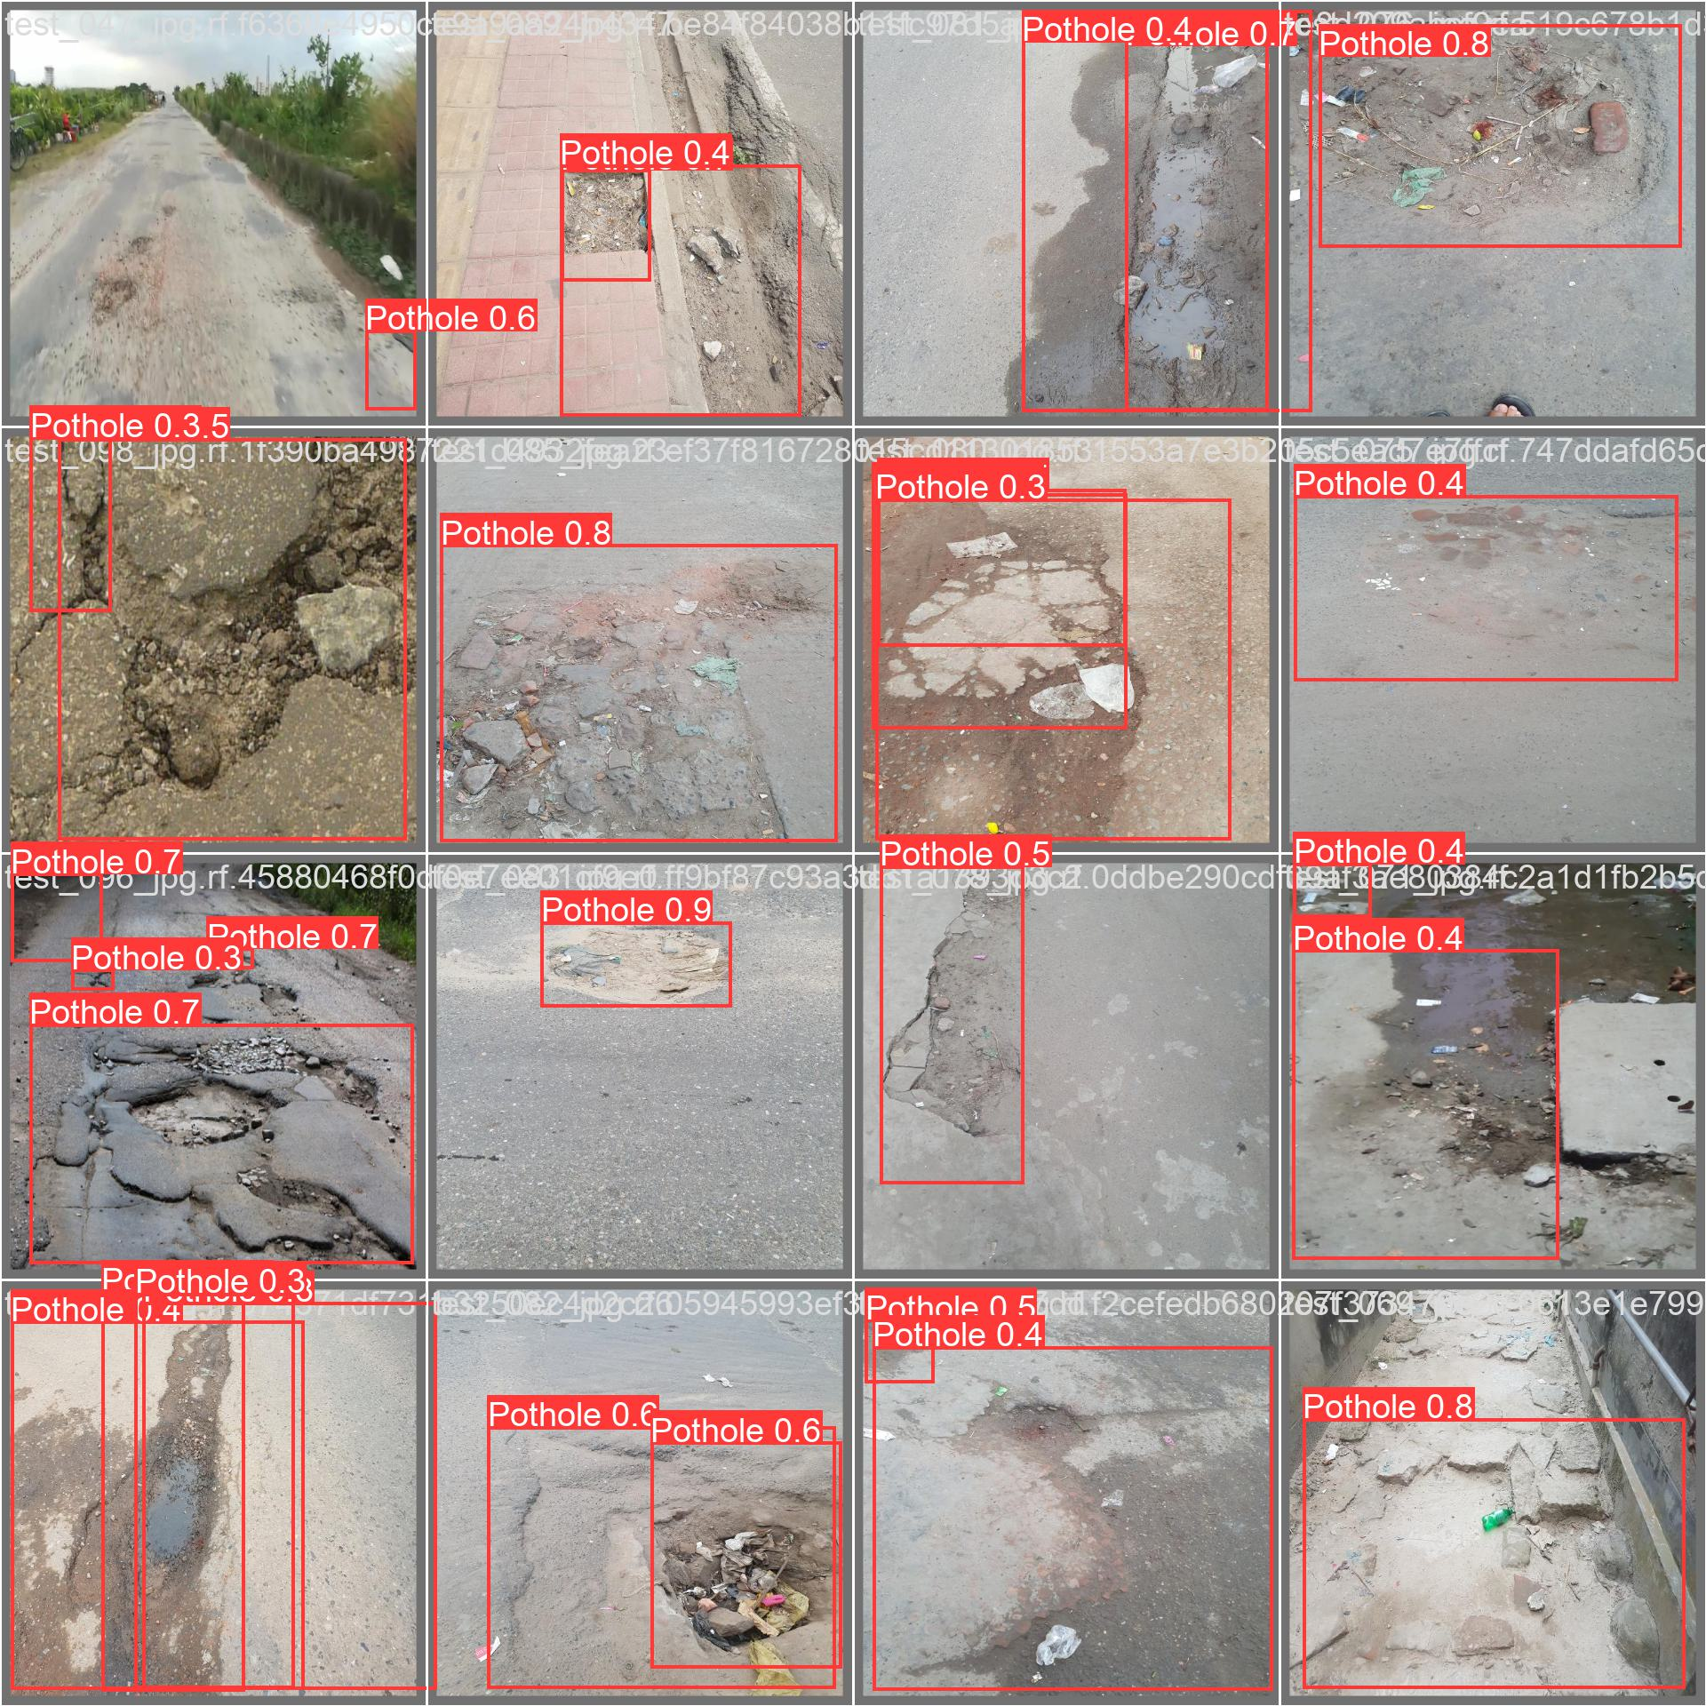

Slide 6
Multi Class
Inhouse training
Customized test program
Download YOLO OFFICIAL/MY DEPLOY CODE

