Slide 1
Best types of films to produce

Slide 2
Business Problem
Business Problem
Microsoft sees all the big companies creating original video content and they want to get in on the fun. They have decided to create a new movie studio, but they don’t know anything about creating movies. You are charged with exploring what types of films are currently doing the best at the box office. You must then translate those findings into actionable insights that the head of Microsoft's new movie studio can use to help decide what type of films to create.
Business Problem

Slide 3
We get to see the most popular movies and the number of people who voted for the movie.
Most movies with high popularity have a high vote count.
The graph below shows how they relate to each other

Slide 4

A graph showing number of votes against popularity

Slide 5
The votes are then put to average and we see the average vote count
We compare the vote average to the popularity of the movie to get a view of how the movies was received by the crowd
Below is a graph to show they relate to each other

Slide 6

A graph showing popularity against vote average

Slide 7
Budgets, profits and losses
Movies with high popularity often make profit and some make losses.
The popularity of the movie does not make it sure to make profits.
Other factors like budget of the movie and how the movie sells contribute a lot to the profit of the movie.
From the data analysed, we find the most common budget is 200million.
Below is a graph to show the budgets used for most movies

Slide 8
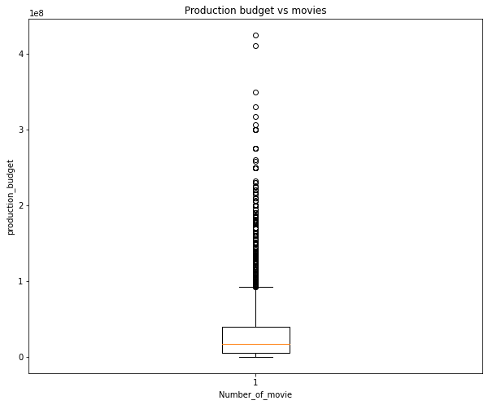
A graph shows the distribution of budgets used to produce movies

Slide 9
In the slide we see that most of the movies had a budget of below 200m but most being around 200m.
From the data analyzed we get to categorize the budgets into three so as to get the profits made in relation to the budget.
We get to see the movies that made profits and how much they made with a budget of 200million.
Below is a graph to show profits made by movies with a budget of 200million

Slide 10
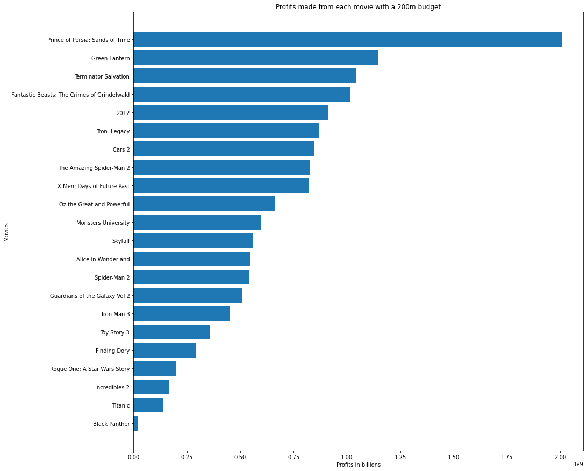
A graph showing profits of movies with a budget of 200m

Slide 11

A graph showing movies with a budget of over200m that made a profit

Slide 12
A graph showing profits movies with a budget of below 200m
From the graph we have seen that most movies with a budget of 200million and above have made profits, the most profitable being Avatar.
Though most movies made profit, some made losses like dark phoenix and lone ranger.
We analysed data and created a graph of all movies that made losses.

Slide 13
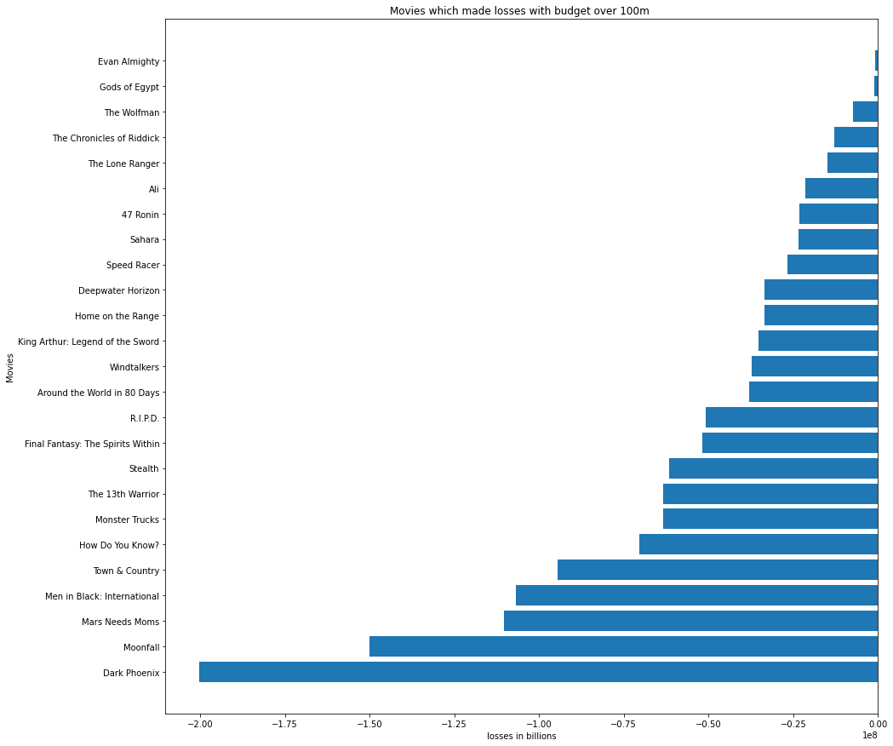
A graph showing movies that made losses with a budget of over 100m

Slide 14
As shown in the diagram, the budget can influence the production of the movie but not necessarily make profit.
To answer the question which types of movies are doing the best and making maximum profits,we will relate genre of movies with the popularity
Below is a graph showing the most popular movie genres

Slide 15
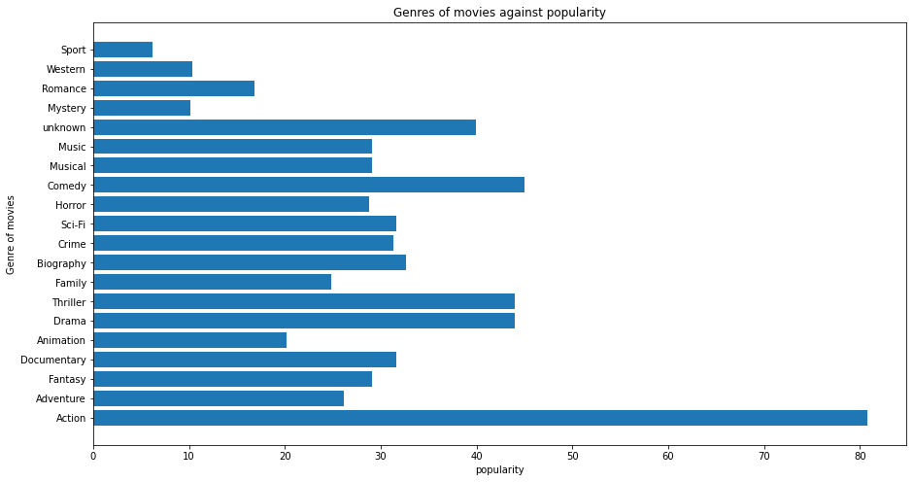
A graph showing the genre of movies against popularity

Slide 16
From the diagram we can see the most popular movie genre is action.
Genre of movies with popularity above 30 is :
Action,comedy,drama, thriller,crime,scifi, documentary and documentary
This shows the most popular genres of movies.
We then show how each genre is doing financially by showing sales made.
Below is a graph showing the genres with the most sales

Slide 17
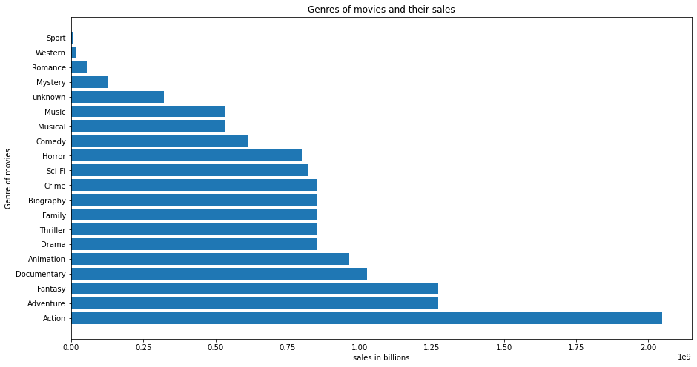
A graph showing the genre of movies against sales

Slide 18
In the graph, action has made most sales again and it was still the most popular
Though movies often tend to mix these genres to create unique movies and get the most profits in their sales.
To answer the question of which types of movies are best I would recommend:
Action;Adventure;Drama;fantasy; animation;thriller;crime;comedy;horror

