Slide 1
Image Recognition
On pretrained MobileNet_V2 model
Peng Luo

Slide 2
Tech selection
Backend Language: Python
framework: Flask
Web server NgiNx
High performance Wsgi server: Gunicorn + gevent
database: MongoDB
API Documentation: swagger
Machine learning model: MobileNet_v2
Deployed on: Aliyun

Slide 3
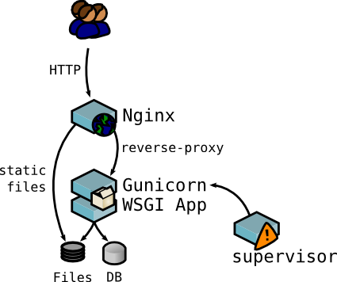
System Structure and data flow
Ideally will be like what image shows

Slide 4
Why nginx?
High performance web server
reverse proxy
Load balancer
Static files
…

Slide 5
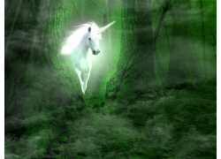
WHY gunicoRn + gevent?
High performance
Multiprocessing support
Http to WSGI
coroutine

Slide 6
Why MongoDB?
Key-value NoSQL : suitable for the scenario
High Performance
Easy to use

Slide 7
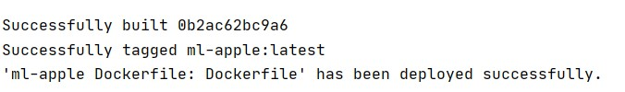
Docker?
Dependency management
Easier for deployment
Improve scalability

Slide 8
demo
History endpoint: GET
PredictION endpoint: POST
http://106.14.46.83/
curl -k -X POST -F "image=@human.jpg" "http://106.14.46.83/predict"

Slide 9
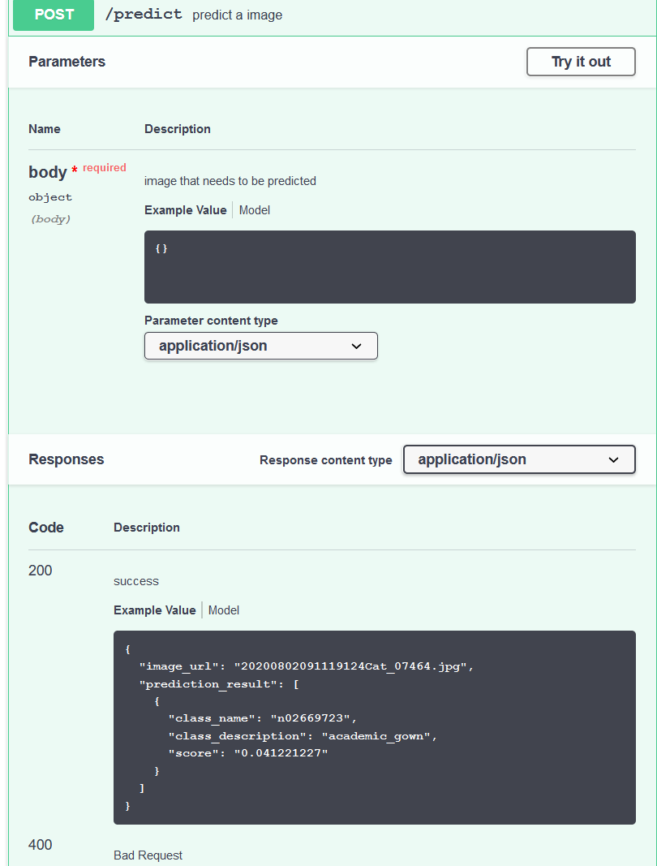
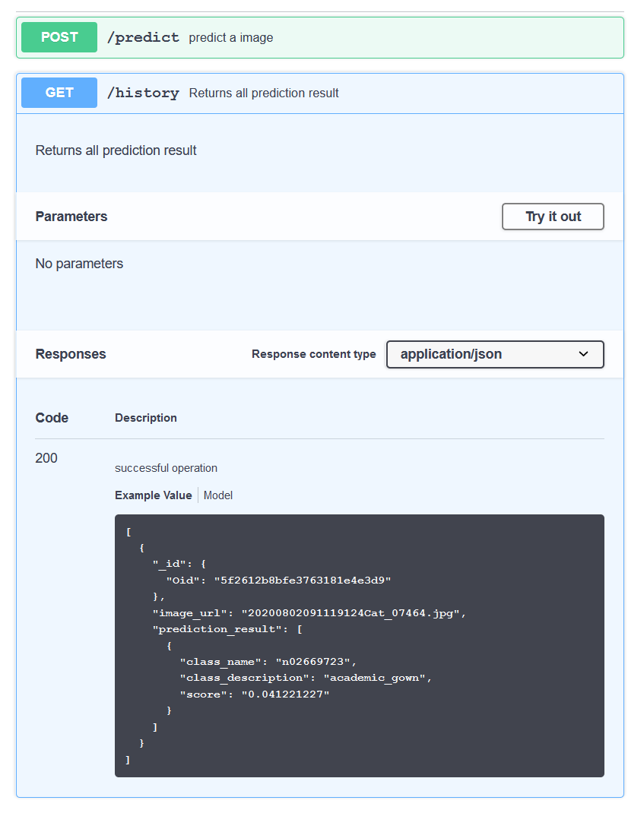
Swagger documentation

Slide 10
Limitations
Security design = none
Performance wont be so good since every image will be stored for displaying on “history” website.
Dealing a single image at a time while keras model can batch images
ALIYUN SERVER IS FREE SO ITS PERFORMANCE IS POOR

Slide 11
How it can be improved
Redis as queue/message broker put in between ML model and prediction requests
Don’t store actual image to reduce disk IO for better performance
Supervisor for better monitoring

Slide 12
Q&A?

Slide 13
Thank u for watching!

