Slide 2
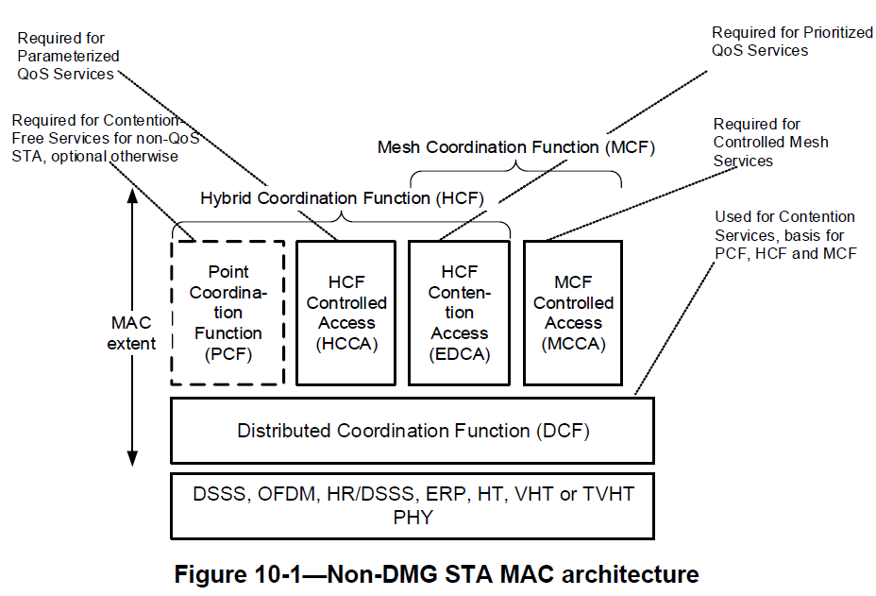
Mac Architecture

Slide 3
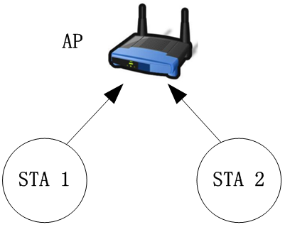
Carrier Sense Multiple Access with Collision Avoidance (CSMA/CA)
To avoid packet collision
Transmitter uses a carrier-sense (CS) mechanism to determine whether another transmission is in progress before initiating a transmission
CS function
Physical
Virtual (NAV)
https://zhuanlan.zhihu.com/p/20721272

Slide 4
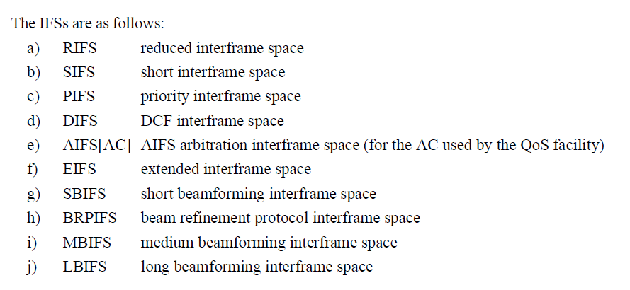
Inter-frame Spacing (IFS)
Time interval between frames
STA shall use CS function to determine whether the WM is idle
Ten different IFSs are defined to provide priority levels

Slide 5
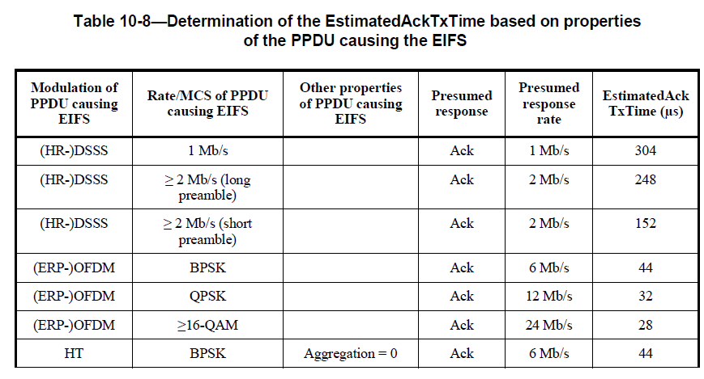
Inter-frame Spacing (IFS)
aSlotTime = aCCATime + aMACProcessingDelay + aRxTxTurnaroundTime + aAirPropagationTime
aSIFSTime = aRxPHYDelay + aMACProcessingDelay + aRxTxTurnaroundTime
PIFS = aSIFSTime + aSlotTime
DIFS = aSIFSTime + 2 * aSlotTime
EIFS = aSIFSTime + AckTxTime + DIFS

Slide 6
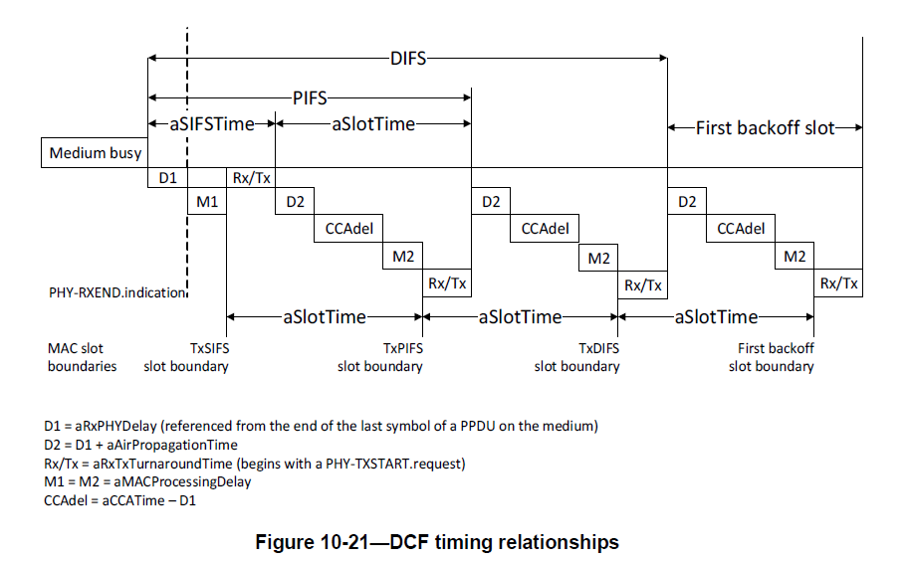
Inter-frame Spacing (IFS)

Slide 7
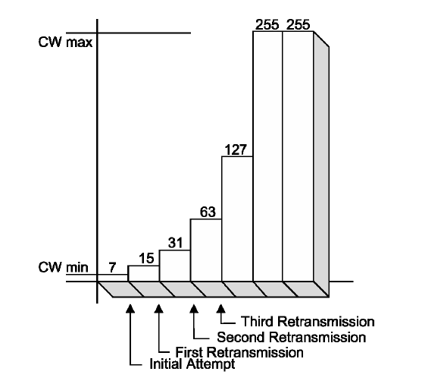
Random Backoff

Slide 8
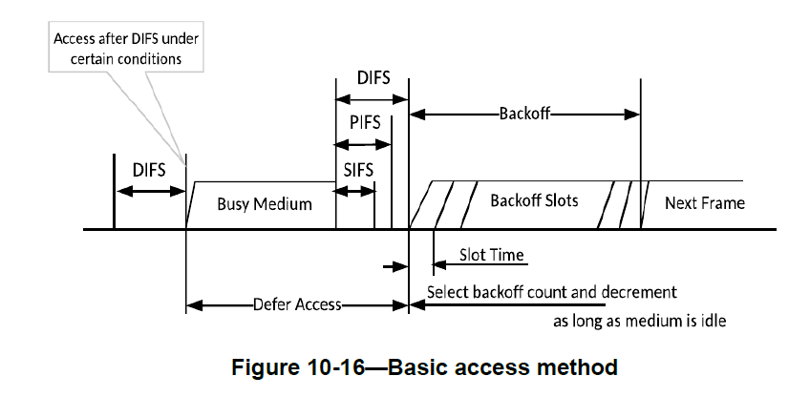
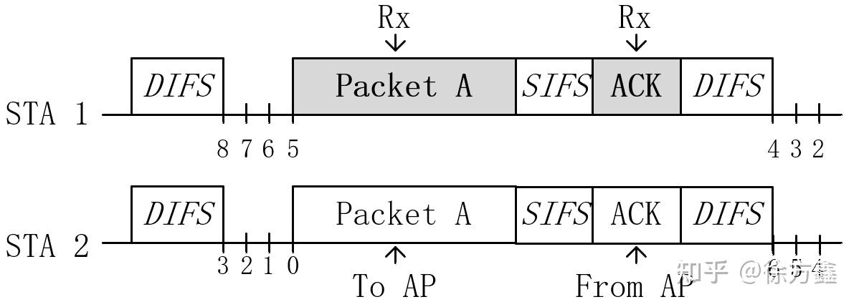
DCF

Slide 9
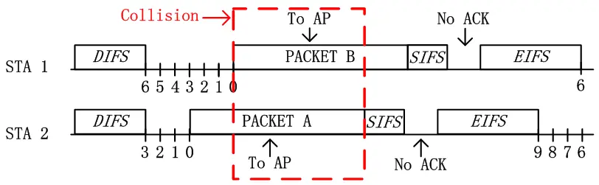
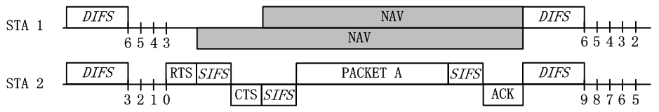
RTS/CTS
To deal with hidden node
RTSThreshold (wasted for small frame)

Slide 10
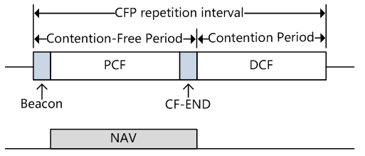
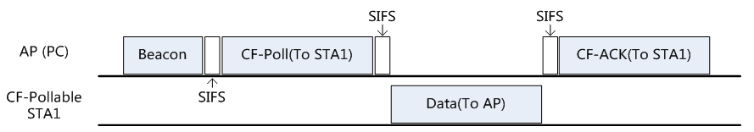
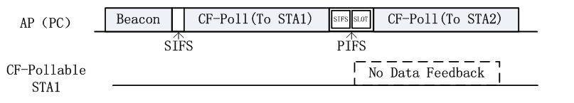
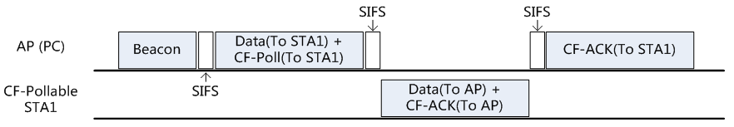
PCF
Based on DCF

Slide 11
TXOP

Slide 12
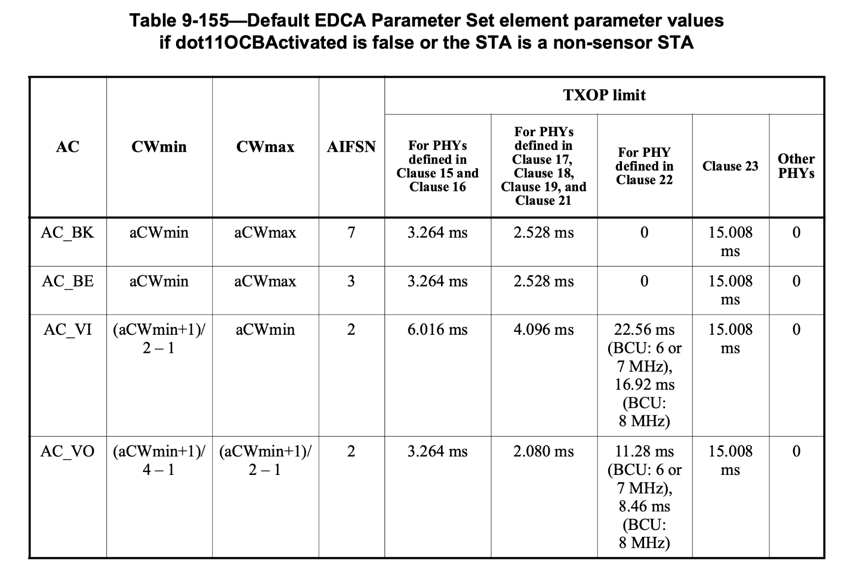
EDCA
DCF + TXOP
CW, AIFS 根據 QoS 調整

Slide 13
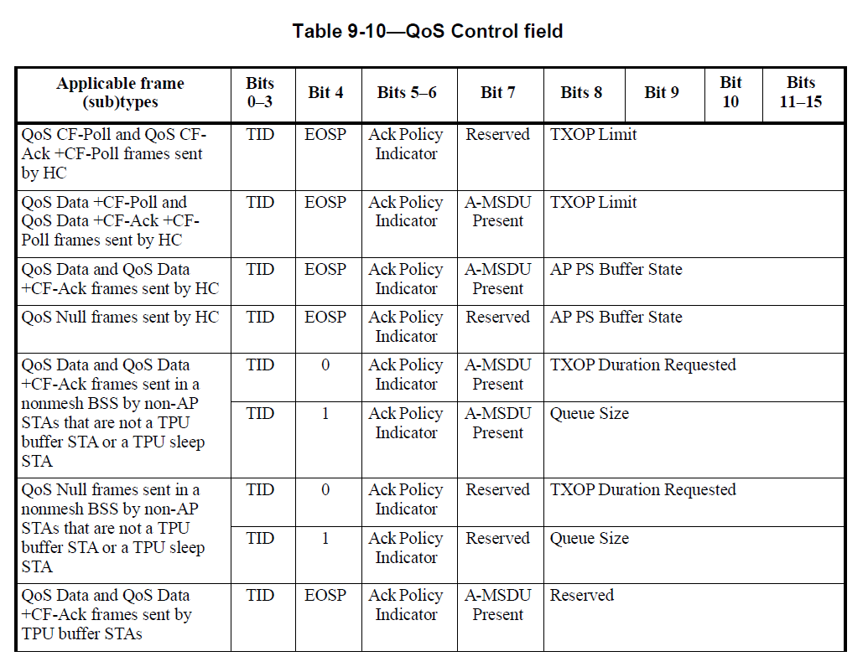
HCCA
PCF + TXOP
不同處是可以在 CFP 內發起 CAP
How to start a CAP
HC 用 duration field 開啟
(RTS/CTS、CTS、QoS-Data)

Slide 14
Frame Format

Slide 15
Fragmentation

Slide 16
Frame Aggregation
A-MSDU
A-MPDU

Slide 17
Management Frame

Slide 18
Scanning

Slide 19
Authentication

Slide 20
Association

Slide 21
Power Saving

Slide 22
Time Syncing

