Slide 1

How did we make it!
Step by step!

Slide 2
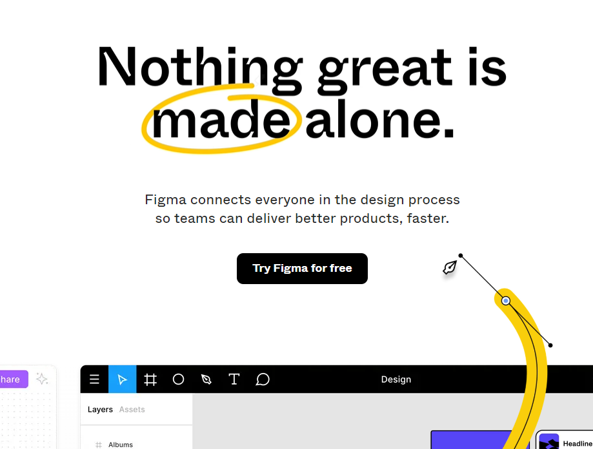
FIGMA
First to make your desing you will need FIGMA, its a website that will help you to make the best desing for your website
After you register you can make a template and then you can start working with figma!
https://www.figma.com/

Slide 3
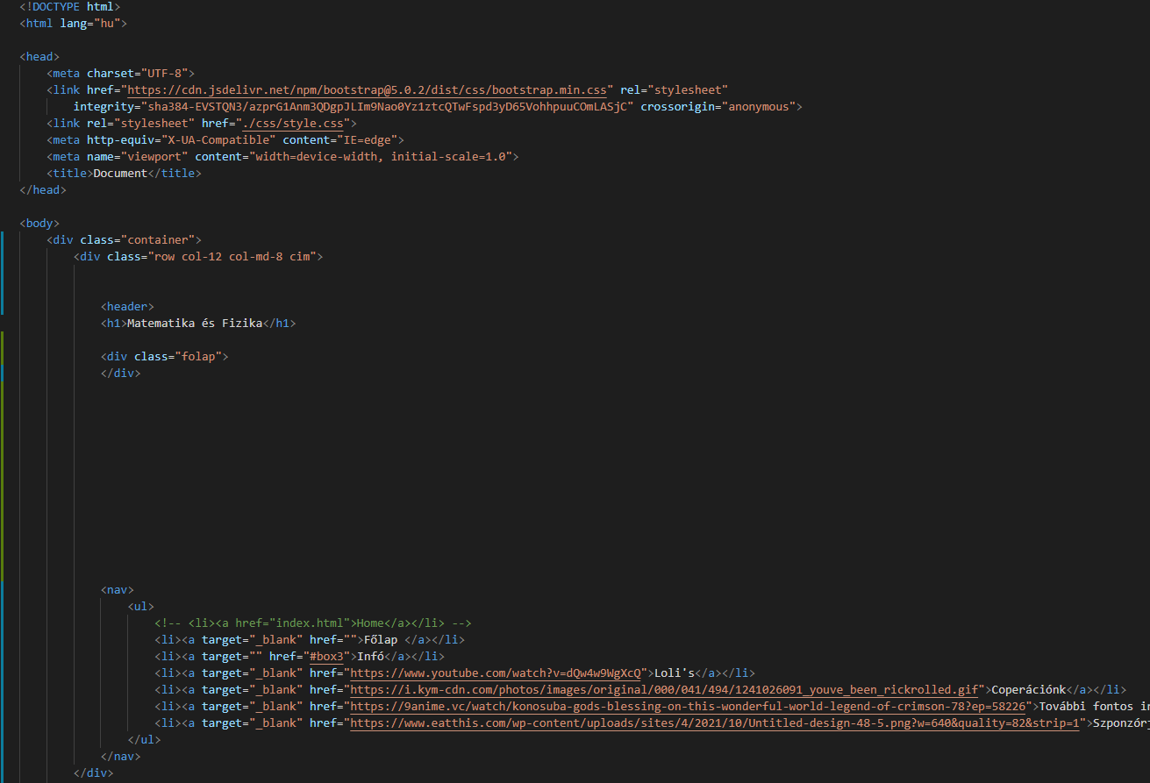
Visual studio code
This is the program we used to code our website! But you can code a lot of other things with it like „pyhton and javascript”
With this you can code your website and its css and bootstrap

Slide 4
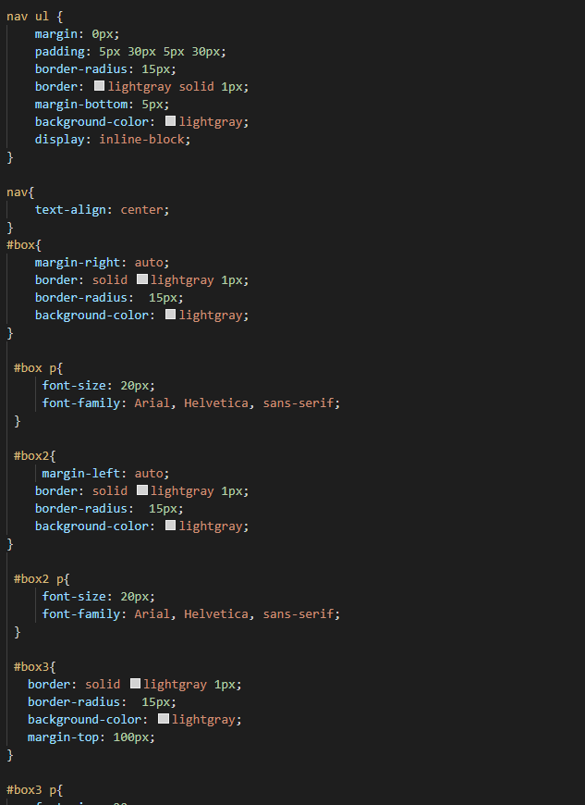
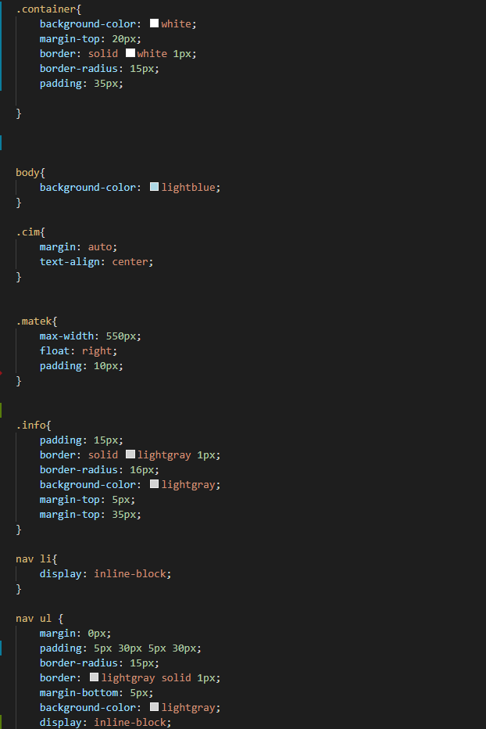
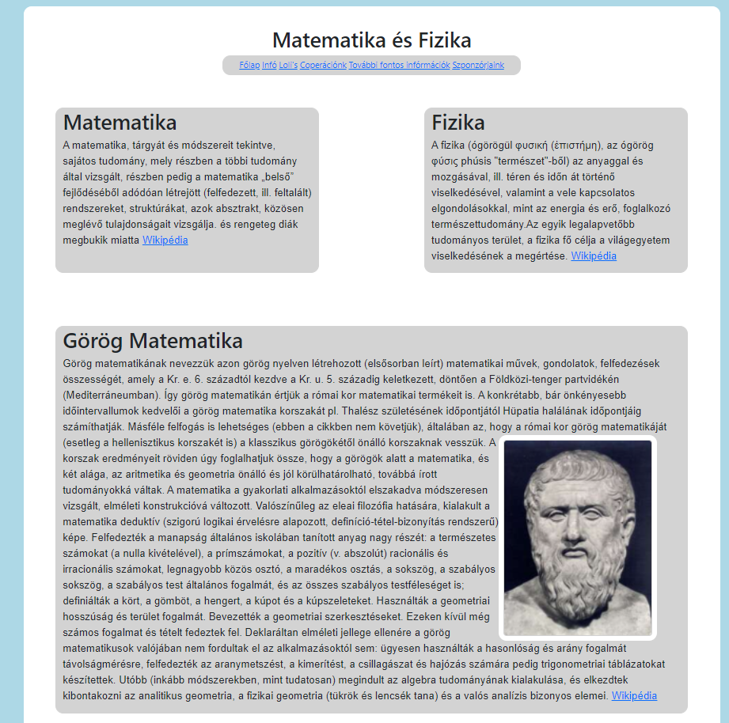
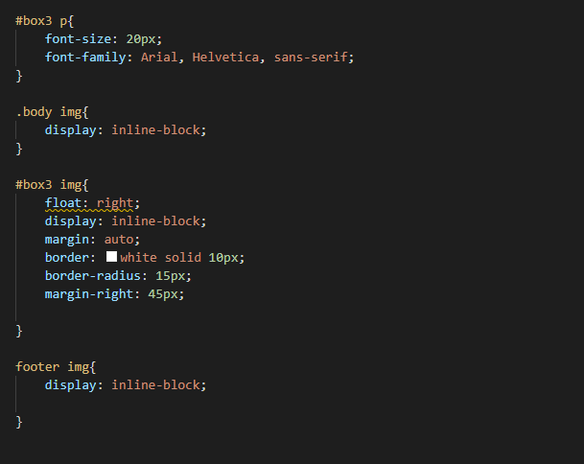
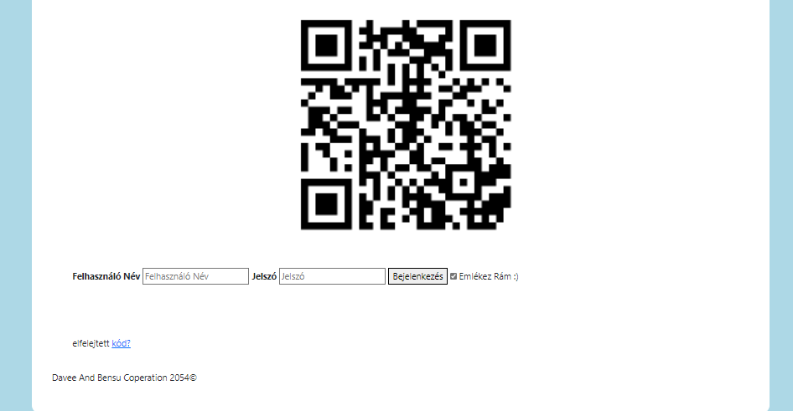
What did we make!
The css coding

