Slide 1
SMART REPAIR
Bensy Benny
Internal GUIDE: Ms. Sona maria sebastian

Slide 2
ABSTRACT
The ‘Online Complaint Service system’ has been developed to anyone can post their complaints by searching for the mechanics that are located nearby their places and solving their complaints at the door step just by one click.
This Project is very useful for everyone who wants any complaint services because now a day’s everyone wants to save time and shot out their problems within time, therefore, the services are very useful for people.

Slide 3
INTRODUCTION
The Online Complaint Service system has been developed to anyone can post their complaints by searching for the mechanics that are located nearby their places and solving their complaints at the door step just by one click. In this Project, public can register complaints for Electrical Works, Plumbing, Carpentry Services, Water purifier, Washing machine, Refrigerator, Car Repair etc. Customers can search the nearby mechanic shop and can register the complaint online. In this project identification and solution for the complaints given by the people, deal with them within the specified time limit is the main concept of the project.

Slide 4
The complaints can be assigned to different mechanics and will be tracked. The Administrator can control all the activities in the system, for creating issues using registration, assign to a mechanic or a service engineer, check the service performance and examines whether the problem is Correct or not within a period. In registration, it should be open and assigned to a mechanic and he can update the status of the complaint. So The Application helps the peoples to find the solution for their problem in an easily manner.

Slide 5
MODULES
Module-1
USER
Login
Register
Post Complaint
View complaint status
Get Admin Contact details
Manage Profile
Search area, city, state and country wise population
Search Plumber, Carpenter, electrician, Ac Maintenance, sweeper, gardener , etc
Feedback

Slide 6
Module-2
OFFICER
Register
Login
View Complaint
Update status
Update proof of work
Module-3
ADMIN
Generate id & password for officer
Can create/delete an account
Can view the accounts
Add Officers
Add business partners
Update Employees

Slide 7
Module-4
BUISNESS PARTNER
Manage Profile
Manage Employee
Assign Duty to Employee
View Booking Service History
Attend and update complaint service
Update Profile
Module-5
EMPLOYEE
Login
Register
Update Profile
View Booking Service History
Attend and update home service.

Slide 8
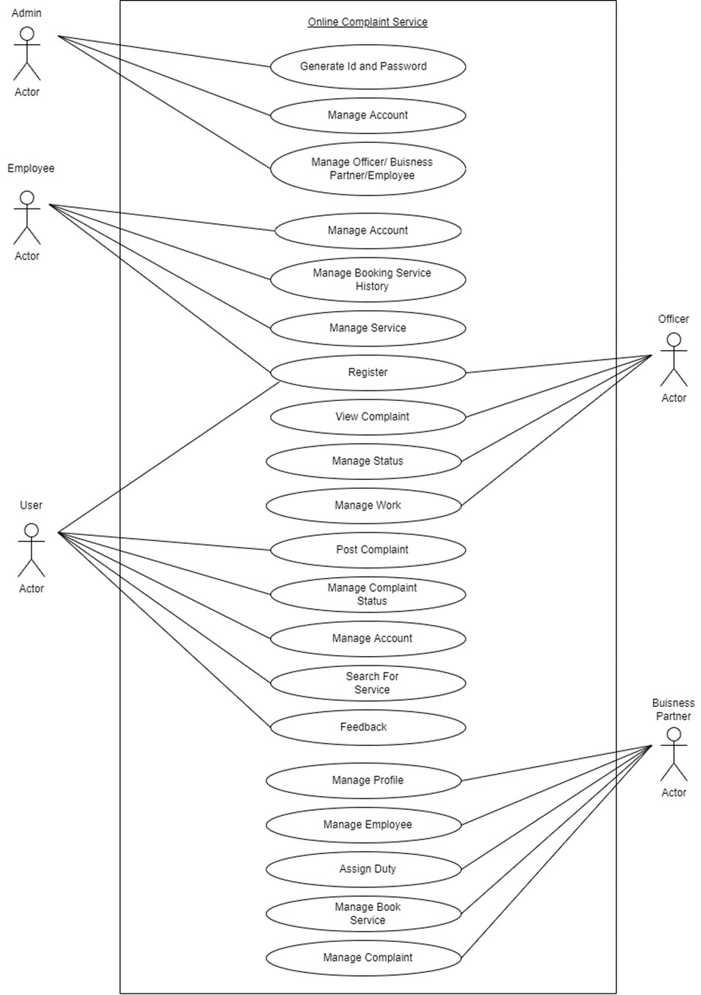
UML DIAGRAM USE CASE DIAGRAM

Slide 9
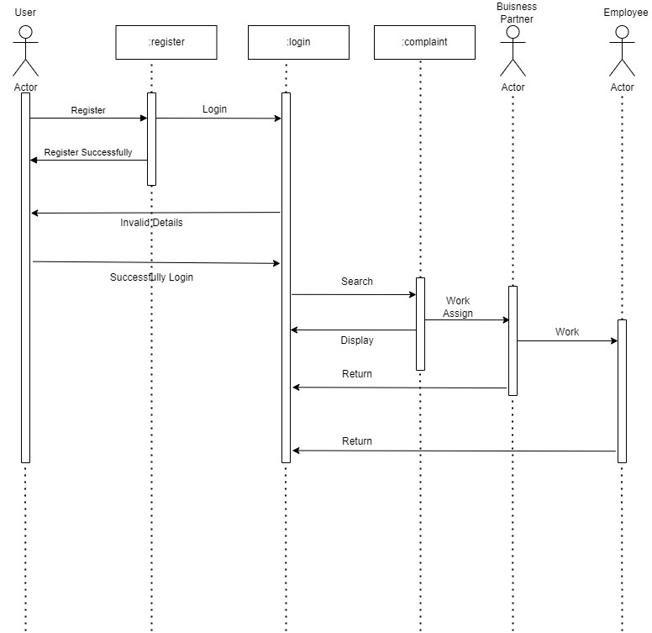
SEQUENCE DIAGRAM

Slide 10
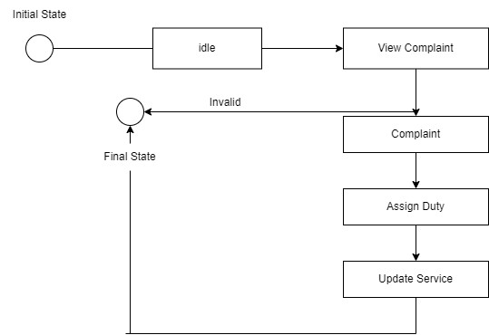
State Chart Diagram

Slide 11
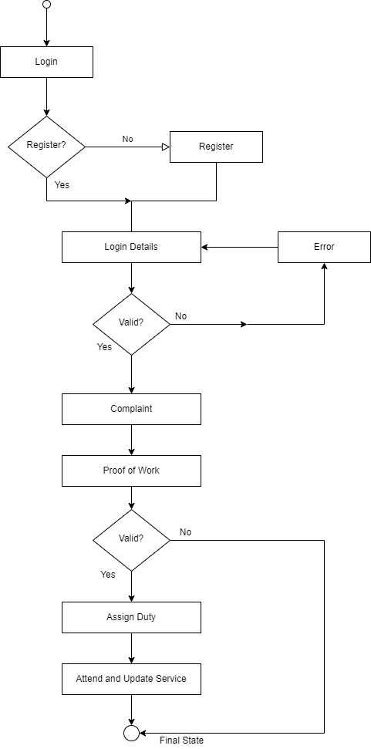
Activity Diagram

Slide 12
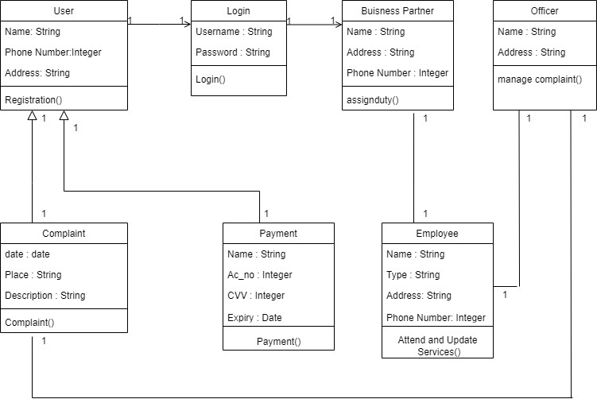
Class Diagram

Slide 13
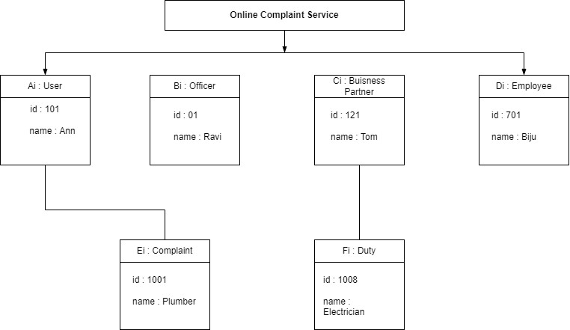
Object Diagram

Slide 14
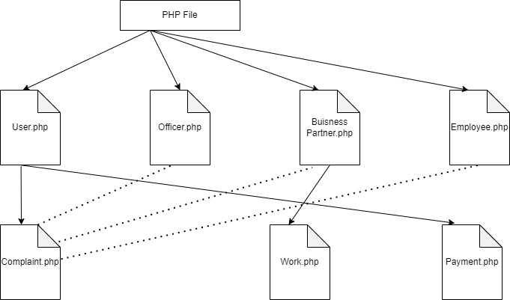
Component Diagram

Slide 15
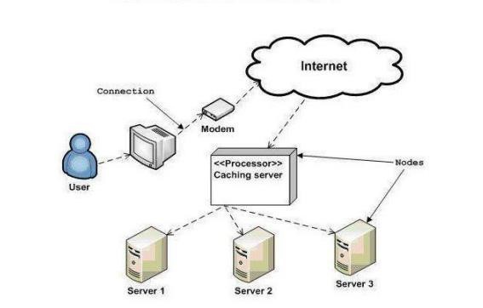
Deployment Diagram

Slide 16
TABLES
Tbl_UserType
Filedname | Datatype | Size | Description
UserType_id | int | 10 | Primary key
Type_name | varchar | 20 | Store user type
Status | Varchar | 50 | Status
Tbl_Registration
Fieldname | Datatype | Size | Description
Reg_id | Varchar | 15 | Primary key
Login_id | Int | 10 | Foreign key
Fname | Varchar | 25 | First name
Lname | Varchar | 25 | Last name
Address | Varchar | 50 | Address
Mobile_no | int | 15 | Moblie number
Aadhaar_No | Int | 20 | Aadhaar
Status | Varchar | 50 | Status

Slide 17
Tbl_Login
Filedname | Datatype | Size | Description
Login_id | int | 10 | Primary key
UserType_id | int | 10 | Foreign key
Username | Varchar | 25 | Username
Password | varchar | 12 | Store password
Status | Varchar | 50 | Status
Tbl_Category_Complaint
Filedname | Datatype | Size | Description
Category_id | int | 20 | Primary key
Category_Type | varchar | 30 | Type of Category
Status | Varchar | 50 | Status

Slide 18
Tbl_Complaint
Fieldname | Datatype | size | Description
Complaint_id | int | 20 | Primary key
Reg_id | int | 20 | Foreign key
Category_id | Int | 20 | Foreign Key of Tbl_Category_Complaint
Date | date |  | Apply Date
Place | Varchar | 30 | Place
Description | varchar | 30 | Description of Complaint
Status | Varchar | 50 | Status

Slide 19
Tbl_Payment
Fieldname | Datatype | Size | Description
Pay_id | int | 15 | Primary key
Reg_id | int | 20 | Foreign key
Amount | int | 12 | Amount
Date | date
Ac_no | int | 15 | Account Number
Ac_Holder_name | Varchar | 20 | Account Holder Name
CVV | int | 10 | Card Verification Value
Expiry Date | date |  | Expiry Date

Slide 20
Tbl_Feedback
Fieldname | Datatype | Size | Description
Feedback_id | int | 12 | Primary key
Reg_id | int | 12 | Foreign Key
Feedback | Varchar | 50 | Not Null
Status | Varchar | 20 | Status

Slide 21
SYSTEM SPECIFICATION
Hardware Specification
Processor - Intel core i3 RAM - 4 GB
Hard disk - 1 TB
Software Specification
Front End - HTML, CSS
Back end - MYSQL
Client on PC - Windows 7 and above.
Technologies used - JS, J Query, PHP

Slide 22
Existing System
The user can locate the mechanic from a nearby place by himself. It takes long time and difficulty to find mechanics and also very Expensive.
DRAWBACKS OF EXISTING SYSTEM
• Human effort is needed.
• It is difficult to find mechanics.
• More manual hours need to process application.
• It is very Expensive

Slide 23
Proposed System
The proposed system is defined to meets all the disadvantages of the existing system. It is necessary to have a system that is more user friendly and user attractive for Smart Repair. In our proposed system, the issues of existing system can be overcome by the proposed system. It makes the process is more easier and It provides complaint services available at anywhere with a fast manner. The User can post a feedback and admin can view and send solution to the user and An Android Application is used to Track the Location of the Customer and Online Payment Service is also provided.
Advantages of Proposed:
Better security
Ensure data accuracy
Better service

Slide 24
THANK YOU

