Slide 1


University Of Luxembourg.
Faculty of Sciences, Technology and Medecine
Département Of Data Science.
THE EVOLUTION OF
CASES OVER TIME IN FRANCE
Carried out by :
Mr. BENTAZIR fadhallah
Prof :
Mr. Roland KRAUSE
2022- 2023

Slide 2

PLAN OF THE PRESENTATION
ABSTRACT.
LIBRARIES.
ANANLYSZING THE DATA.
CONCLUSION.

Slide 3
ABSTRACT
This dataset contains information on confirmed COVID-19 cases, deaths and hospitalizations in France from January 2020. It also contains information on departments and regions of France. With this data, we could create visualizations to show the evolution of COVID-19 cases over time, differences between regions and departments, or trends related to hospitalizations and deaths.

Slide 4
LIBRARIES
Corresponding data for this project are as follows.
The evolution of COVID-19 cases over time in France.
Differences between regions and departments.
Trends related to hospitalizations and deaths.
The link for this Dataset is as follows : https://www.kaggle.com/datasets/hraouak/covid19-in-france

Slide 5
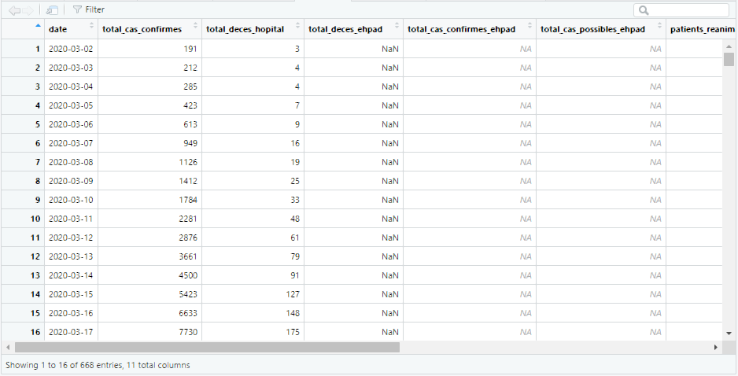
LIBRARIES
Our Dataset continet 668 rows and 11 columns
https://www.kaggle.com/datasets/hraouak/covid19-in-france

Slide 6
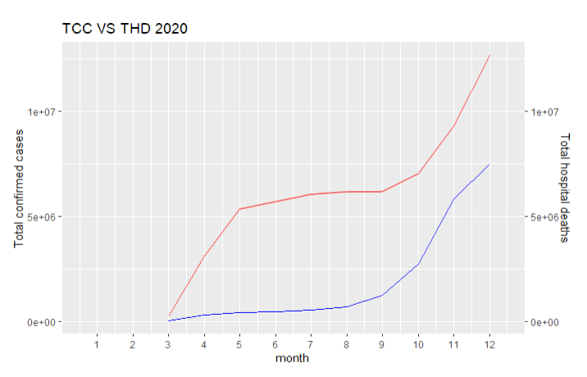
ANANLYSZING THE DATA
The first cases were reported in January this year and since then the number of cases and deaths has increased rapidly.
Despite the efforts that France has made, it has experienced several waves of infections during the year, with peaks in cases in March, April, November and December 2020. As shown in the following graph :
Fig. (1): the evaluation of cases of COVID-19 in France and cases of death in time ”2020”.
TCC : Total Confirmed Cases
THD : Total Hospital Deaths

Slide 7
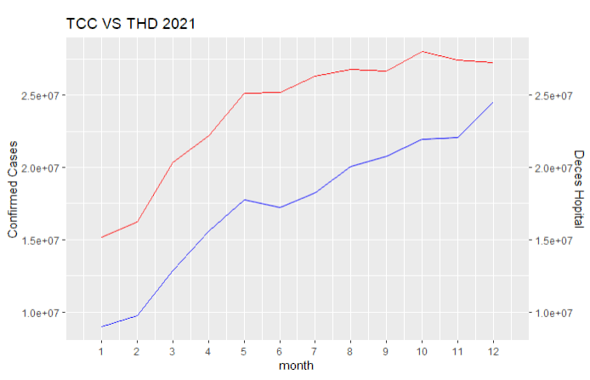
ANANLYSZING THE DATA
In 2021, France began rolling out COVID-19 vaccines, prioritizing those most at risk. The vaccination campaign accelerated during the year and from June 2021, France opened up vaccination to all adults.
Despite these efforts, France still experienced a third wave of the epidemic during the fall and winter of 2021, with record levels of cases and deaths. As shown in the following graph :
Fig. (2): the evaluation of cases of COVID-19 in France and cases of death in time ”2021”.
TCC : Total Confirmed Cases
THD : Total Hospital Deaths

Slide 8
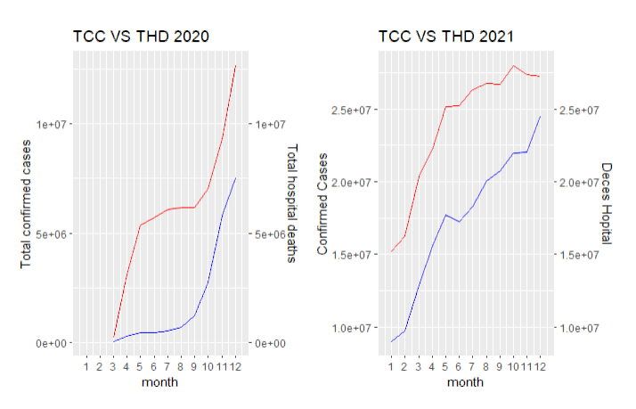
ANANLYSZING THE DATA
As of 2021, France has recorded over 4 million confirmed cases of COVID-19 and over 100,000 deaths related to the disease. Infection rates have increased significantly over the past few months, due to the spread of new variants of the virus.
Fig. (3): The evaluation of cases of COVID-19 in France and cases of death in time ”2020 and 2021”.
TCC : Total Confirmed Cases
THD : Total Hospital Deaths

Slide 9
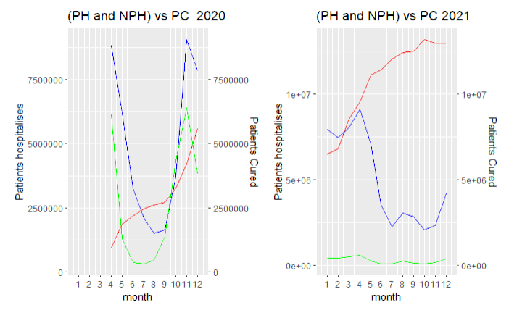
ANANLYSZING THE DATA
Regarding hospitalizations, the number of people hospitalized for COVID-19 in France reached its peak in April 2020, with around 28,000 people hospitalized. Since then, the number of people hospitalized has fluctuated, but increased again at the end of 2021 due to the second wave of the epidemic. Hospital capacity was stretched during the first wave of the outbreak, leading to restrictions on medical care for patients with other conditions.
Fig. (4): The evaluation of deaths and hospitalizations in France from “January 2020”.
PH : Patients Hospitalizes
NPH: New Patients Hospitalizes
PC : Patients Cured

Slide 10
CONCLUSION
In summary, France has been one of the countries most affected by the COVID-19 pandemic, with high levels of cases and deaths. Authorities have taken steps to curb the spread of the virus, but the situation remains difficult due to the highly contagious nature of the virus and the variants that have emerged.
The vaccination campaign is underway and has been accelerated, but it still takes some time to see the effects on the epidemic.

Slide 11

Merci pour votre attention
I’m Deeply grateful to Proffessor Roland KRAUSE ans his assistants for their invaluable guidance throughout my data visualization project

