Slide 1
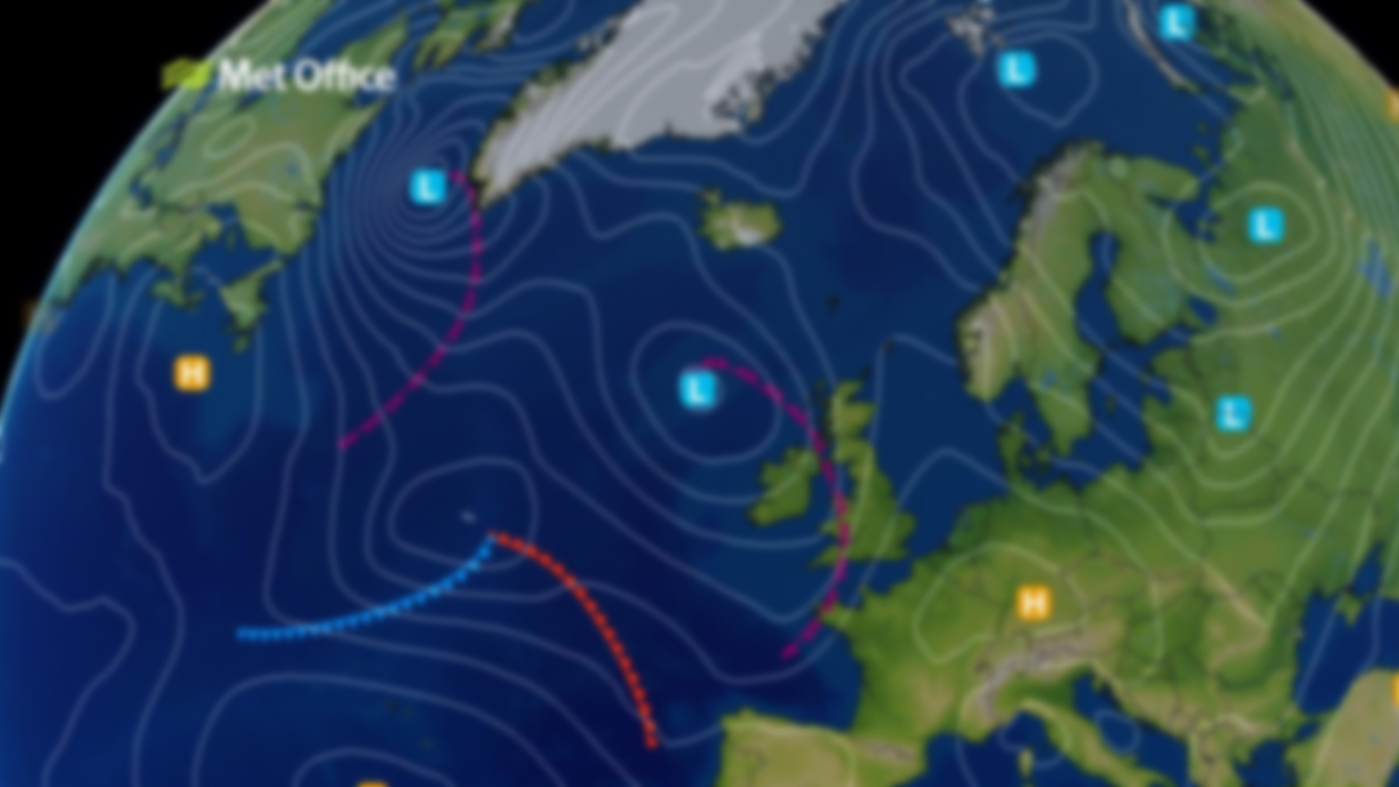
Front Finder
Identification of atmospheric fronts in images

Slide 2
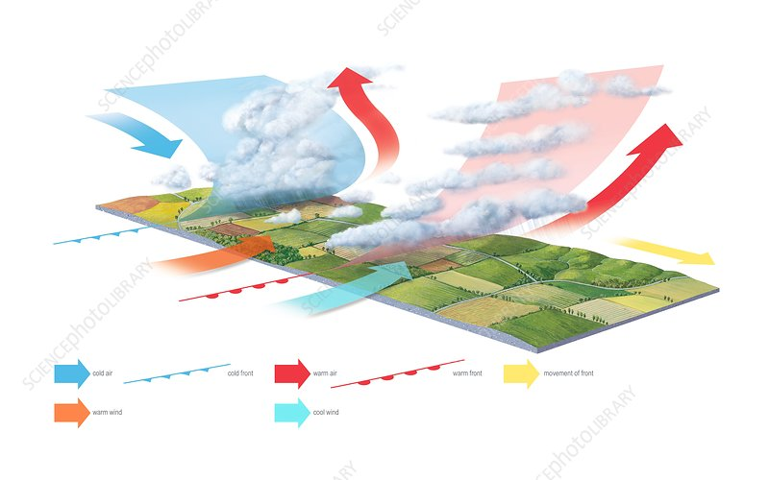
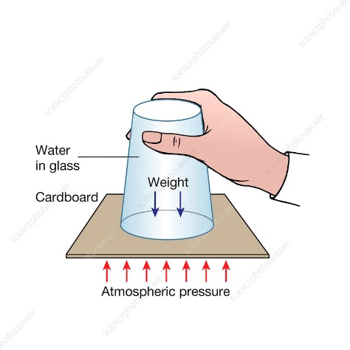
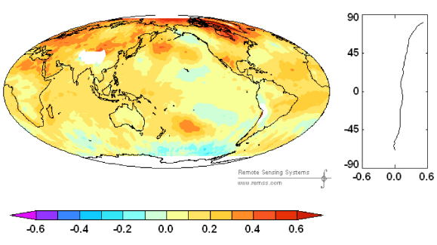
The Purpose
It was found that over time the distribution of vascular accidents by day can be correlated with certain weather factors such as the atmospheric front, pressure, temperature etc.
We will focus on the connection between these accidents and atmospheric fronts.
Therefore, the first step would be to identify these fronts in the "synoptic map" images.

Slide 3
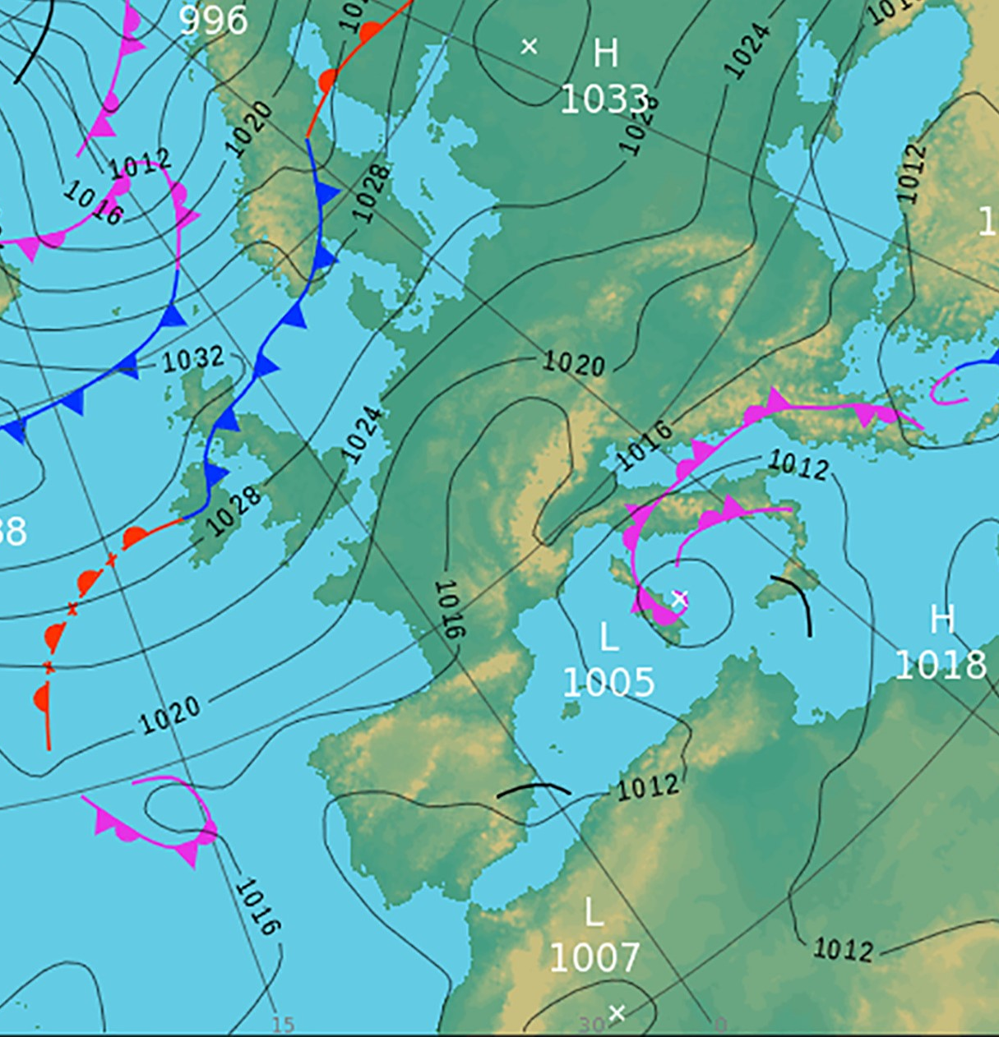
Our contribution
We created an application that receives a color or a black and white image of a synoptic map and finds the types of atmospheric fronts from it.
This is based on an artificial intelligence algorithm and image processing that divides the image into 32x32 pixel segments which it classifies in one of the following classes: cold, warm and occluded. The pieces are highlighted in the resulting image by framing them in correspondingly colored squares.

Slide 4
SWOT Analysis
Front Finder
Strengths
Weakness
Accuracy up to 85%
Works on both color and black & white images
Relatively small inference time
Should be even better trained than it is now
The graphic interface could be improved
S
W
O
T
Not many applications that have the same functionalities
Helps researchers correlate weather information with stroke
Lack of real data that can be used for training
Lack of interest in such an application from the majority of users
Opportunities
Threats

Slide 5
Thank you!
The team consists of:
Mara Gheorghe
Bogdan Bentea
Iulian Bodgan
Stefan Bodea

