Slide 1


Bank of Baroda Hackathon - 2022
Technology Partner
Your Team Name: Skill Prodigies
Your team bio : Darkest Nights Produce Brightest Stars!
Date : 20.09.2022

Slide 2
Problem Statement
Why did you decide to solve this Problem statement
01
We as students, when we approach the bank we can wait for minutes or hours to get our services done.
02
But this time constraints do not apply the same for all.
This would be a great opportunity for us to help the bank in solving this issue and to provide better service for the people, which benefits both the parties.
03
A lot of working people, senior citizens, physically challenged people and pregnant women , waiting for hours together to get their service.
04
Working people, who rarely can apply for leave, have to get half-day permissions to get their services done whenever the service segment at bank faces a rush hour.

Slide 3
User Segment & Pain Points
Which user /advertiser segment would be early adopter of your product & why?
Categorize people who needs special attention
Senior Citizens
Persons with disability
Pregnant Women
Government Staff
The long waiting process causes discomfort.
Need to be assisted immediately for service.
To treat them with care and provide fast service.
To give them priority, as they serve the Nation.

Slide 4
Pre-Requisite
What are the alternatives/competitive products for the problem you are solving?
Our prime aim is to identify and classify the needy to enhance their experience with the bank in a better way, to pursue that the following techniques are required:
Techniques | Azure Video Indexer | Amazon Rekognition
Facial Recognition | Yes | Yes
Face Comparison | No | Yes
Facial Analysis | No | Yes
Explicit Content Detection | Yes | Yes
Object Detection | Yes | Yes
PPE Detection | No | Yes
Emotion identification | Yes | Yes
Observed people tracking | Yes | Yes

Slide 5

Azure tools or resources
Azure tools or resources which are likely to be used by you for the prototype, if your idea gets selected
Face detection: Detects and groups faces appearing in the video.
We will use “Azure Video Indexer” to develop the prototype as it meets the listed requirements:
Labels identification: Identifies visual objects and actions displayed.
Visual content moderation: Detects adult and/or racy visuals.
Observed people tracking: Detects observed people in videos and provides information such as the location of the person in the video frame.
Matched person: Matches people that were observed in the video with the corresponding faces detected.

Slide 6
Any Supporting Functional Documents
Present your solution, talk about methodology, architecture & scalability
Assigning priorities
Face detection and analysis
Faces detected
Video Input
PPE Detection
Count of People
Processed data for classification
Object Detection
Objects Identified
1.Person with disability (objects identified such as wheel chairs, support sticks etc.)
2.Senior citizens
3.Pregnant women
4.Govt staffs- ID Tags, uniforms etc.
5.Known facilitators.
6.Vulnerable objects.
Azure Video Indexer
Sentiment Analysis
Emotions captured

Slide 7
Key Differentiators & Adoption Plan
How is your solution better than alternatives and how do you plan to build adoption?
Better than Alternatives
Build Adoption
Currently, there is no completely developed tool for 'Person Identification and Prioritization'. so our prototype which solves all the needed requirements for the best service , if selected would be better than the alternatives available at the market and will improvise the banking services.
We are planning to implement Custom-made business logics with Microsoft Azure Video Indexer's output to solve the given Problem Statement.

Slide 8
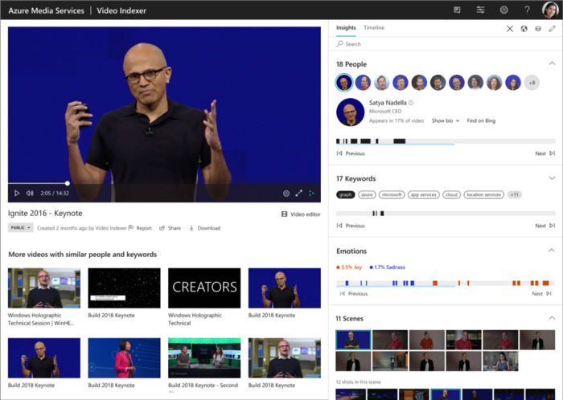
GitHub Repository Link & supporting diagrams, screenshots, if any
How far it can go?
https://github.com/MicrosoftDocs/azure-docs/blob/main/articles/azure-video-indexer/detected-clothing.md
https://github.com/MicrosoftDocs/azure-docs/blob/main/articles/azure-video-indexer/video-indexer-overview.md

Slide 9

Thank You
Team member names:
Naveenkumar G
Mosus Jorden S
Lingeshwaran K
Rajalingam B

