Slide 1
一中 37th 電腦資訊研究社 上學期．社課Ⅱ
條件選擇與迴圈控制

Slide 2

社團網站
https://tcirc.tw
特別感謝「星城數位科技」慷慨的合作性捐贈

Slide 3

幹部陣容
https://www.instagram.com/tcfsh_circ_37th/
趕快追蹤、按愛心喔！

Slide 4

Telegram 討論區
https://t.me/joinchat/KUNytVBKySskb35M4TdOig
Telegram 真理！！

Slide 5
Facebook 社團
https://www.facebook.com/groups/941195249549340/

Slide 6
4. 條件選擇
分支結構的跳轉

Slide 7
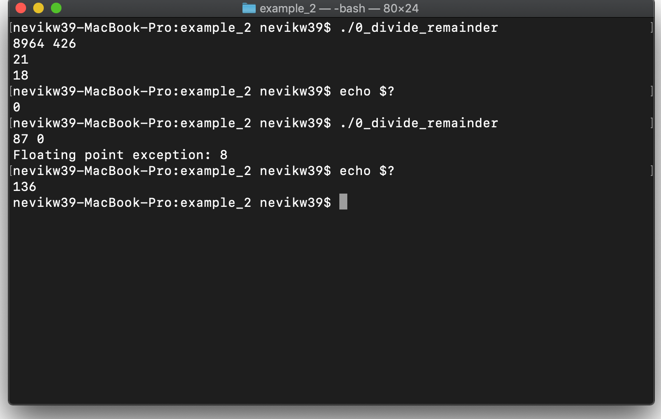
實驗：除以 ０
#include <stdio.h>
int main()
{
int a, b;
scanf("%d%d", &a, &b);
printf("%d\n%d\n", a / b, a % b);
return 0;
}

Slide 8
Exit Code
# | Meaning
0 | Successfully exited.
1 | General errors.
2 | Misuse of shell builtins.
126 | Command invoked cannot execute.
127 | “command not found”
128 | Invalid argument to exit.
128 + n | Fatal error signal "n"
130 | SIGINT: Terminated by Control-C.
134 | SIGABRT: Aborted.
136 | SIGFPE: Floating point exception.
136 | SIGSEGV: Segmentation fault.
255 | Exit status out of range.

Slide 9
SIGFPE: Floating point exception
FPE_INTDIV | 整數除以零
FPE_INTOVF | 整數上溢
FPE_FLTDIV | 浮點除以零
FPE_FLTOVF | 浮點上溢
FPE_FLTUND | 浮點下溢
FPE_FLTRES | 浮點結果不準
FPE_FLTINV | 無效浮點操作
FPE_FLTSUB | 浮點下標越界

Slide 10
if-else
if (condition)
{
statement;
}
else
{
statement;
}

Slide 11
說例：GreenJudge a011 - 及格
#include <stdio.h>
int main()
{
int n;
scanf("%d", &n);
if (n < 60)
puts(”FAIL");
else
puts("PASS");
return 0;
}

Slide 12
說例：GreenJudge a012 - 奇數與偶數
#include <stdio.h>
int main()
{
int n;
scanf("%d", &n);
if (n % 2)
puts("ODD");
else
puts("EVEN");
return 0;
}
#include <stdio.h>
int main()
{
int n;
scanf("%d", &n);
if (n & 1)
puts("ODD");
else
puts("EVEN");
return 0;
}

Slide 13
Logical Operators
P | Q | P && Q | P || Q
0 | 0 | 0 | 0
0 | 1 (n ∀ ℕ ≠ 0) | 0 | 1
1 (n ∀ ℕ ≠ 0) | 1 (n ∀ ℕ ≠ 0) | 1 | 1
P |  | !P
0 |  | 1
1 (n ∀ ℕ ≠ 0) |  | 0
Precedence: ! (Associativity: left) > && > ||

Slide 14
說例：GreenJudge c032 - 1. 學年學分制
#include <stdio.h>
int main()
{
int a, b;
scanf("%d%d", &a, &b);
if (a + b >= 120)
putchar('2');
else if (a >= 60 || b >= 60)
putchar('1');
else
putchar('0');
}
#include <stdio.h>
int main()
{
int a, b;
scanf("%d%d", &a, &b);
if (a + b >= 120)
putchar('2');
else
printf("%d", a >= 60 || b >= 60);
}

Slide 15
if-else-if…
if (condition)
{
statement;
}
if (condition)
{
statement;
}
if (condition)
{
statement;
}
if (condition)
{
statement;
}
else if (condition)
{
statement;
}
else if (condition)
{
statement;
}

Slide 16
說例：GreenJudge c014 - 1. 國道計程收費
#include <stdio.h>
int main()
{
int a, b;
scanf("%d%d", &a, &b);
if (b > a) b -= a;
else b = a - b;
if (b > 200) printf("%d", b * 3);
else if (b > 20) printf("%d", b * 4);
else printf("0");
return 0;
}
#include <stdio.h>
int main()
{
int a, b;
scanf("%d%d", &a, &b);
b = abs(a - b);
printf("%d", max(b - 20, 0) * 4 - max(b - 200, 0));
return 0;
}

Slide 17
Nested if
if (condition)
{
statement;
}
else
{
statement;
}
if (condition)
{
statement;
}
else
{
statement;
}
if (condition)
{
if (condition)
{
statement;
}
else
{
statement;
}
}
else
{
statement;
}

Slide 18
switch-Case
switch (integer)
{
case const_value:
statement;
break;
case const_value:
statement;
break;
default;
statement;
}

Slide 19
switch-Case
C / C++ 只接受整數型態（包含字元、列舉及實作整數轉換之類別）
case 必須是編譯時期常數 (C++11: constexpr)
如果沒有 break 會繼續執行下一個 case 的陳述！！
可以使用 Range Case

Slide 20
說例：GreenJudge c027 - 2. 上課時間
#include <stdio.h>
int main()
{
int h, m;
scanf("%d%d", &h, &m);
switch (h)
{
case 7:
puts(m < 30 ? "XXX" : "YES");
break;
case 8 ... 11:
case 13 ... 16:
puts(m < 10 ? "NO" : "YES");
break;
case 12:
puts(m < 30 ? "NO" : "YES");
break;
default:
puts("XXX");
}
return 0;
}

Slide 21
5. 迴圈控制
重複執行的指令

Slide 22
引子： n 次 hello, world
沒有一行解決不了的輸出，如果有，那就兩行
然而，當 n 很大或在執行時期才確定時，很閒然是行不通
因此，我們有「迴圈」這種控制結構，令程式執行重複的陳述

Slide 23
while
while (condition)
{
statement;
}

Slide 24
範例： n 次 hello, world
#include <stdio.h>
int main()
{
int n;
scanf("%d", &n);
while (n--)
puts("hello, world");
return 0;
}

Slide 25
說例：GreenJudge c046 - 3. 小數點後 N 位
#include <stdio.h>
int main()
{
int a, b, n;
scanf("%d%d%d", &a, &b, &n);
printf("%d.", a / b);
a %= b;
while (n--)
{
a *= 10;
printf("%d", a / b);
a %= b;
}
return 0;
}

Slide 26
說例：GreenJudge c040- 3. 輾轉相除法
#include <stdio.h>
int main()
{
int a, b, m, n;
scanf("%d%d", &a, &b);
m = a;
n = b;
while (a % b)
{
printf("%d%%%d=%d\n", a, b, a % b);
int t = b;
b = a % b;
a = t;
}
printf("%d%%%d=%d\nGCD(%d,%d)=%d", a, b, a % b, m, n, b);
return 0;
}
Notes:
輾轉相除法介紹：http://163.20.9.7/dyna/data/user/math/files/201412081252233.pdf

Slide 27
do-while
do
{
statement;
} while (condition);

Slide 28
說例：GreenJudge a027 - 倒數計時
#include <stdio.h>
int main()
{
int n;
scanf("%d", &n);
do
printf("%d ", n);
while (n--);
return 0;
}

Slide 29
for
for (initial; condition; afterthought)
{
statement;
}

Slide 30
範例： n 次 hello, world
#include <stdio.h>
int main()
{
int n;
scanf("%d", &n);
for (int i = 0; i < n; i++)
puts("hello, world");
return 0;
}

Slide 31
說例：GreenJudge c004 - 4. 檢查碼
#include <stdio.h>
int main()
{
int n = 0;
for (int i = 1; i < 8; i++)
n += (getchar() - '0') * i;
printf("%d", (10 - n % 10) % 10);
return 0;
}

Slide 32
break, continue
break
立刻離開迴圈
continue
立刻開始下一輪迴圈

