Slide 1
一中 37th 電腦資訊研究社 上學期．社課
條件選擇與迴圈控制

Slide 2
串電 OJ
http://judge.tcirc.tw
特別感謝「星城數位科技」慷慨的合作性捐贈

Slide 3

社團網站
https://tcirc.tw
特別感謝「星城數位科技」慷慨的合作性捐贈

Slide 4

幹部陣容
https://www.instagram.com/tcfsh_circ_37th/
趕快追蹤、按愛心喔！

Slide 5

Telegram 討論區
https://t.me/joinchat/KUNytVBKySskb35M4TdOig
Telegram 真理！！

Slide 6
Facebook 社團
https://www.facebook.com/groups/941195249549340/

Slide 7
6. 指標概念
變數的地址

Slide 8
Variable & Pointer
#include <stdio.h>
int main()
{
int n = 87;
int *p = &n;
printf("n = %d, address of n = %p\n", n, &n);
printf("p points to %p, whose value is %d.", p, *p);
return 0;
}

Slide 9
Reference & derefernce
&: “Address of” Operator 取址
*: Indirection Operator 取值

Slide 10
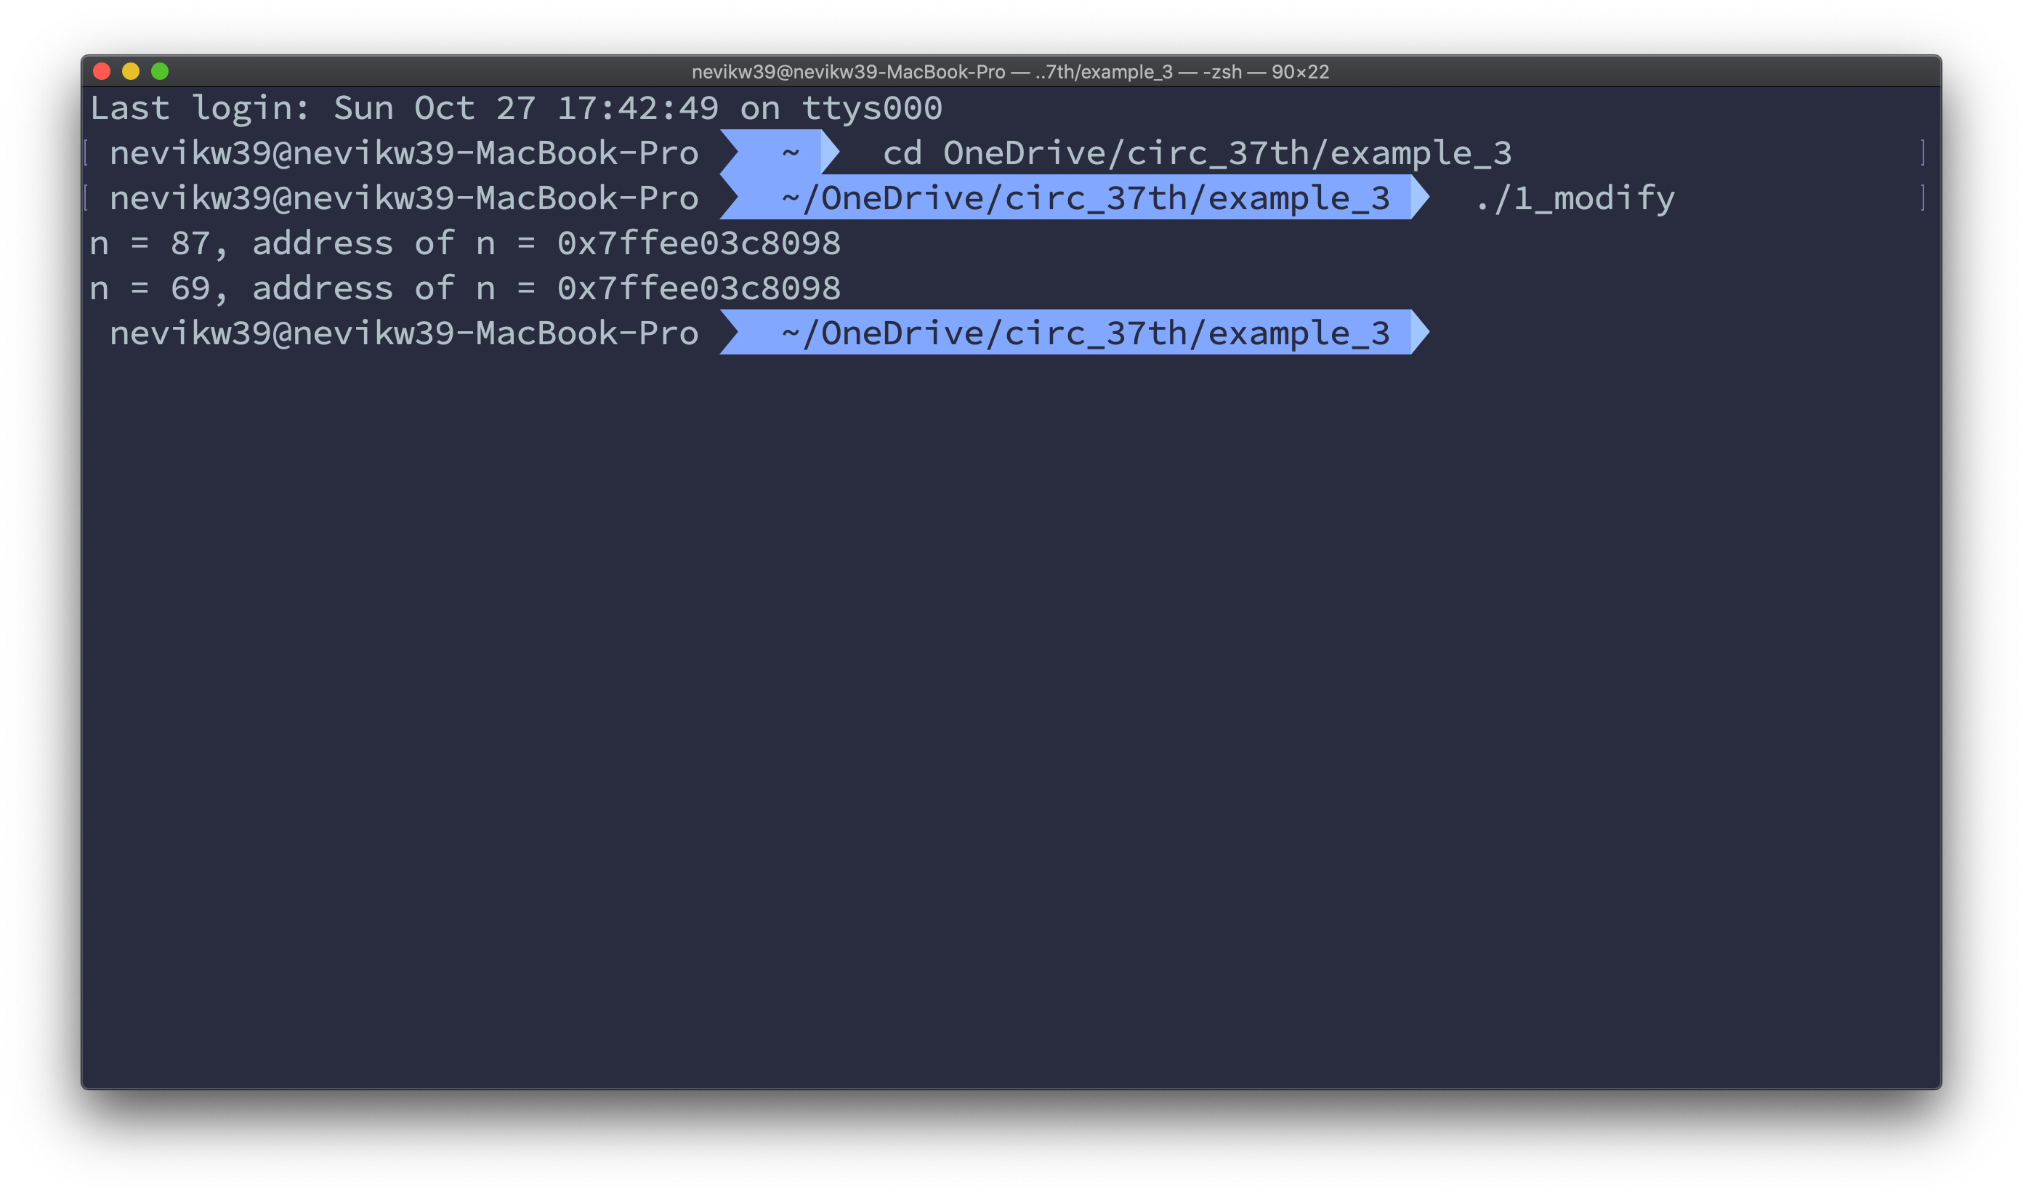
Reference & Dereference
#include <stdio.h>
int main()
{
int n = 87;
int *p = &n;
printf("n = %d, address of n = %p\n", n, &n);
*p = 69;
printf("n = %d, address of n = %p\n", n, &n);
return 0;
}

Slide 11
Arithematic
+-: Offset 偏移
-: Distance 距離

Slide 12
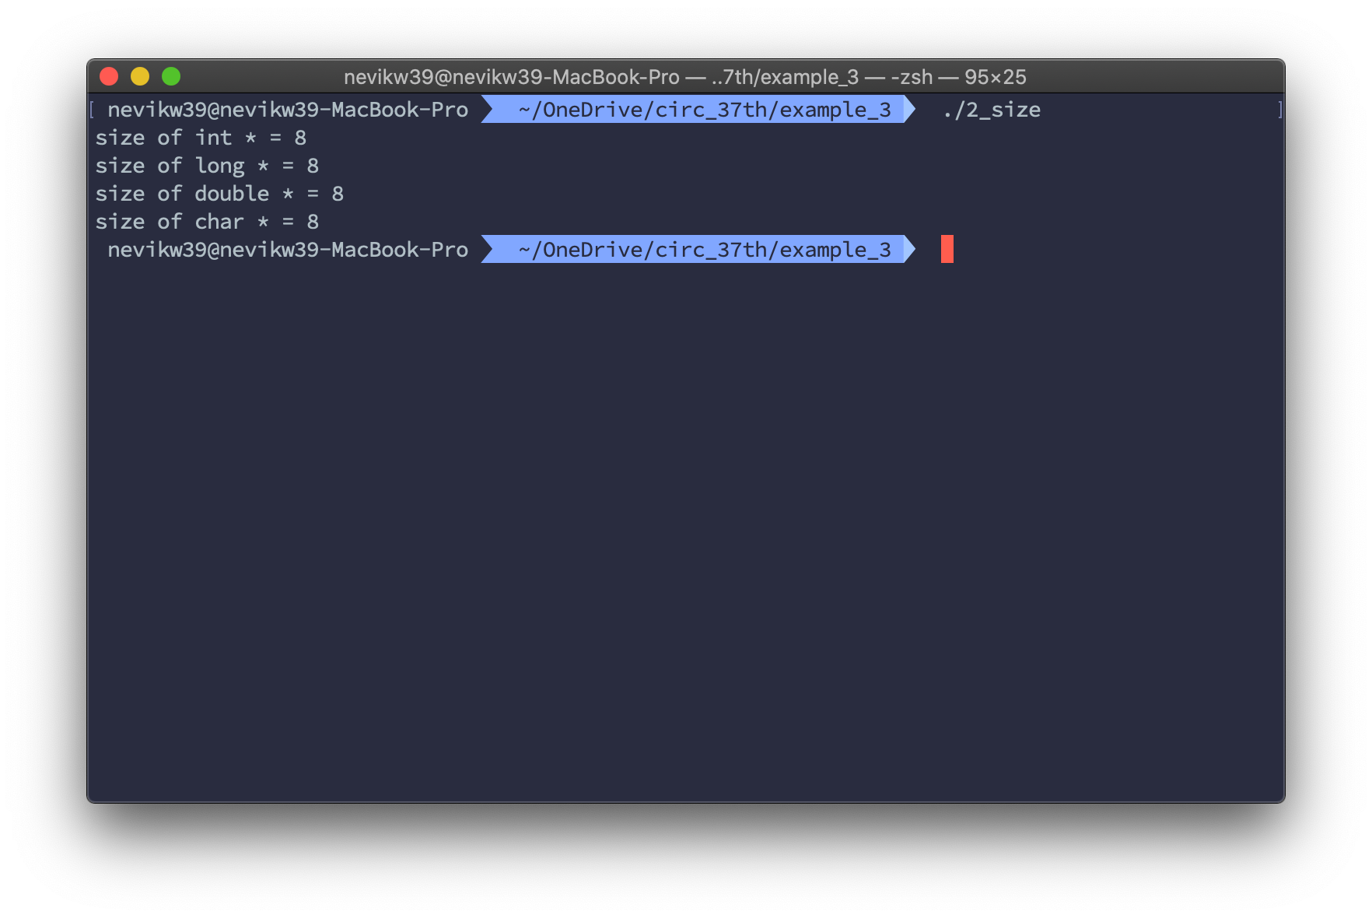
Size
#include <stdio.h>
int main()
{
printf("size of int * = %d\n", sizeof(int *));
printf("size of long * = %d\n", sizeof(long *));
printf("size of double * = %d\n", sizeof(double *));
printf("size of char * = %d\n", sizeof(char *));
return 0;
}

Slide 13
Other
指標指標
常量的指標
常量指標
常量的常量指標
函式指標
…

Slide 14
7. 舊式陣列及字串
就是指標跟連續空間

Slide 15
Array
#include <stdio.h>
int main()
{
int arr[5] = {4, 3, 2, 1, 0};
return 0;
}

Slide 16
Traversal
#include <stdio.h>
int main()
{
int arr[5] = {4, 3, 2, 1, 0};
for (int i = 0; i < sizeof(arr) / sizeof(int); i++)
printf("%d ", arr[i]);
return 0;
}
#include <stdio.h>
int main()
{
int arr[5] = {4, 3, 2, 1, 0};
for (int *i = arr; i < arr + sizeof(arr) / sizeof(int); i++)
printf("%d ", *i);
return 0;
}

Slide 17
Multi-Dimensional Array
嘻嘻

Slide 18
String
一種字元陣列
結尾為 ‘\0’ (0)
格式修飾子為 %s

Slide 19
Traversal
#include <stdio.h>
int main()
{
char *str = "tcirc";
for (int i = 0; i < 6; i++)
printf("%d ", str[i]);
return 0;
}
#include <stdio.h>
int main()
{
char *str = "tcirc";
for (char *i = str; *i; i++)
printf("%d ", *i);
return 0;
}

Slide 20
<string.h>
strlen
strcmp
strchr
strstr
strtok
memset
memcpy

