Slide 1
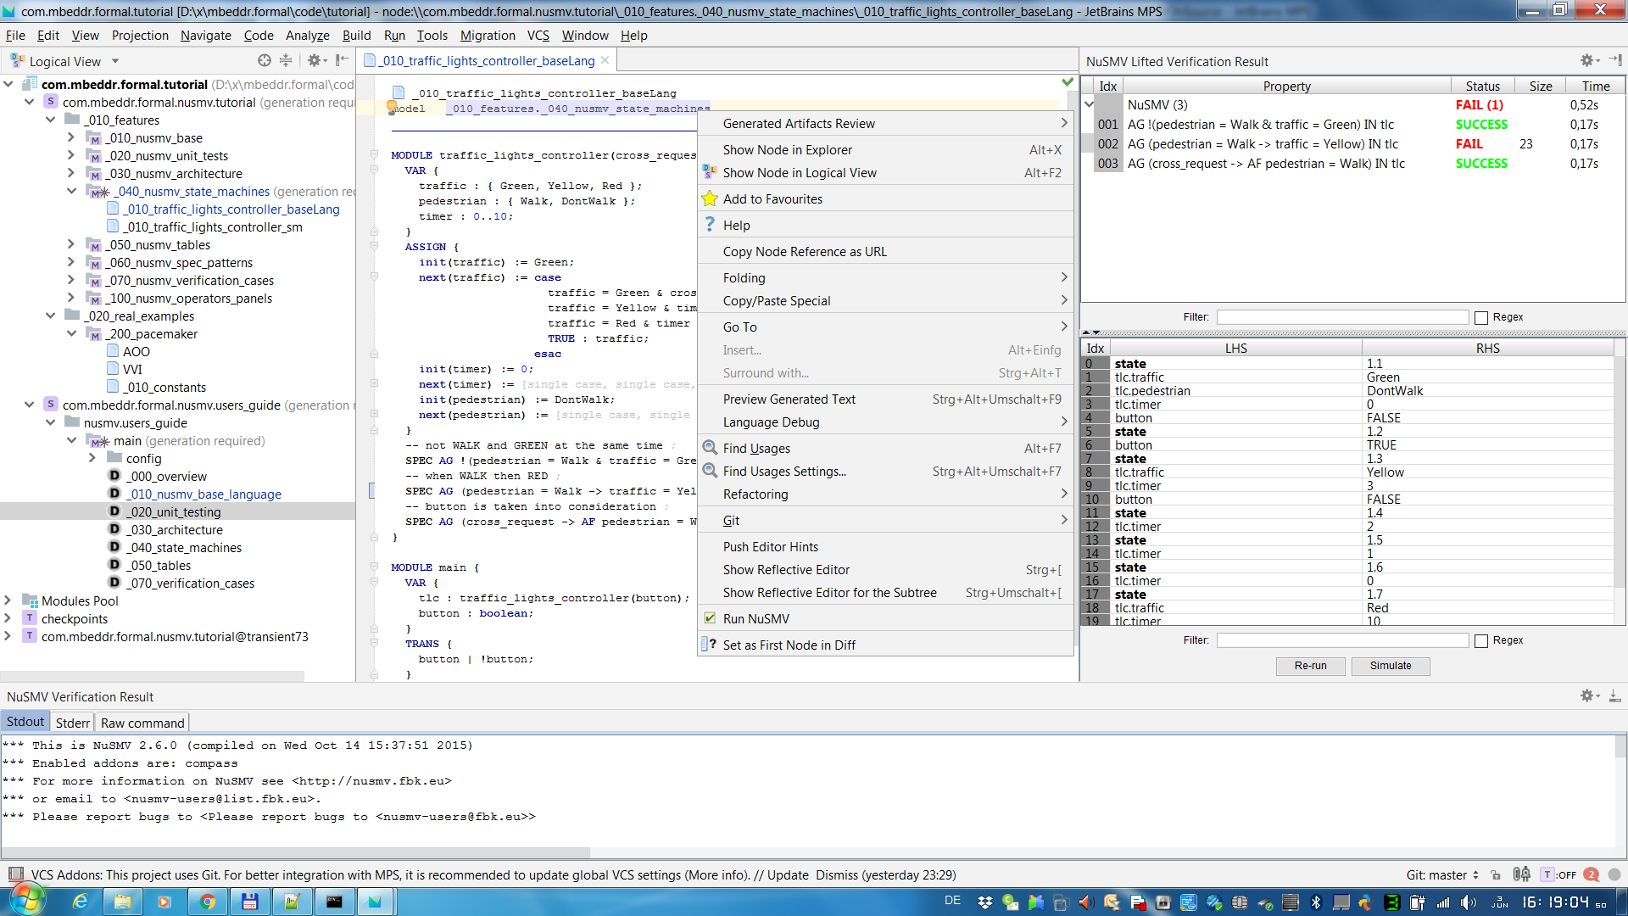
inputs

Slide 2
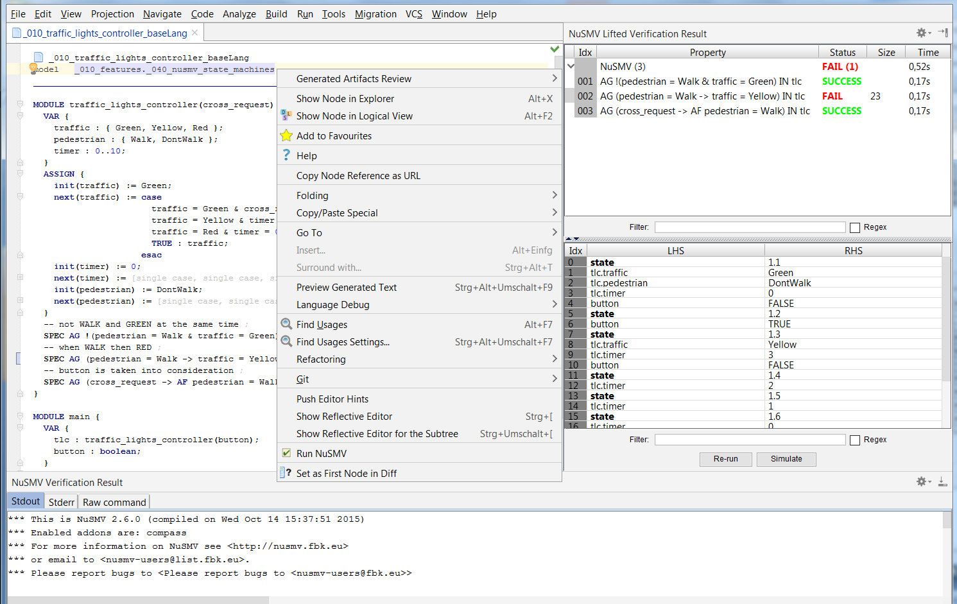
Right-click on a root node
containing a ‘main’ module
Verification results lifted at the DSL level
Counterexample for the selected result
Run NuSMV
Raw output (STDOUT and STDERR) of NuSMV and the command used to run it.

